Slide 1
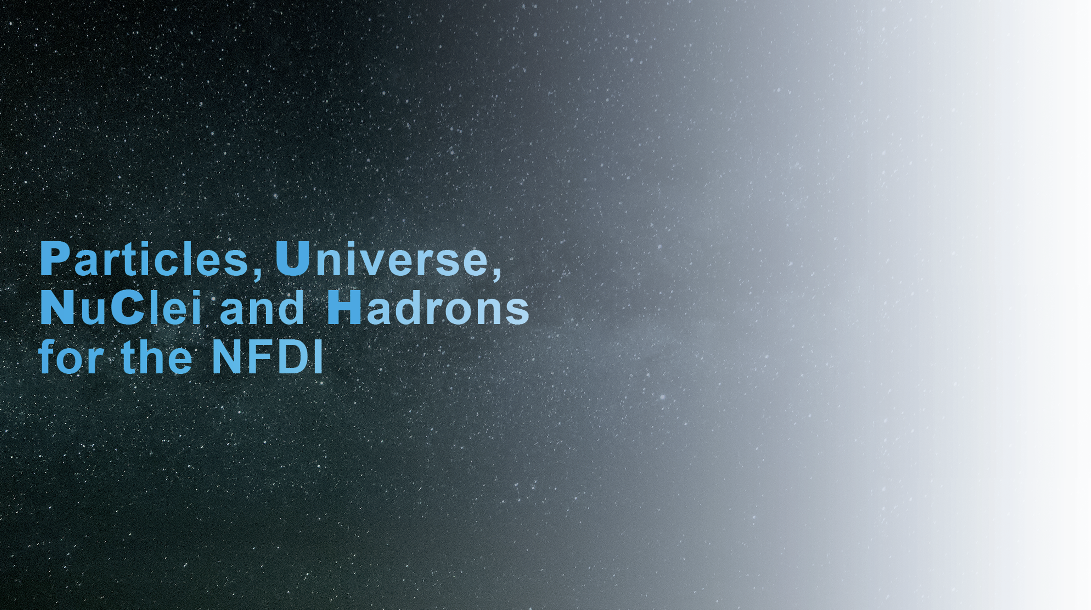
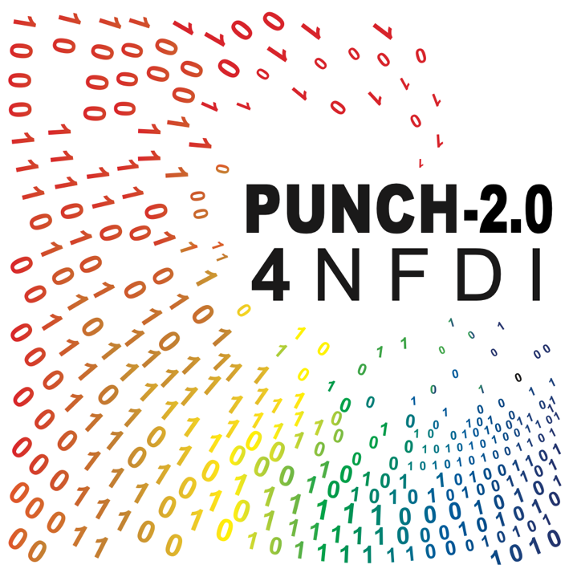
A consortium in the NFDI
Annual Meeting 2025
AIP Potsdam, 19/20 November 2025

Slide 2
Impression from Annual Meeting 2024 (Bonn)

Slide 3
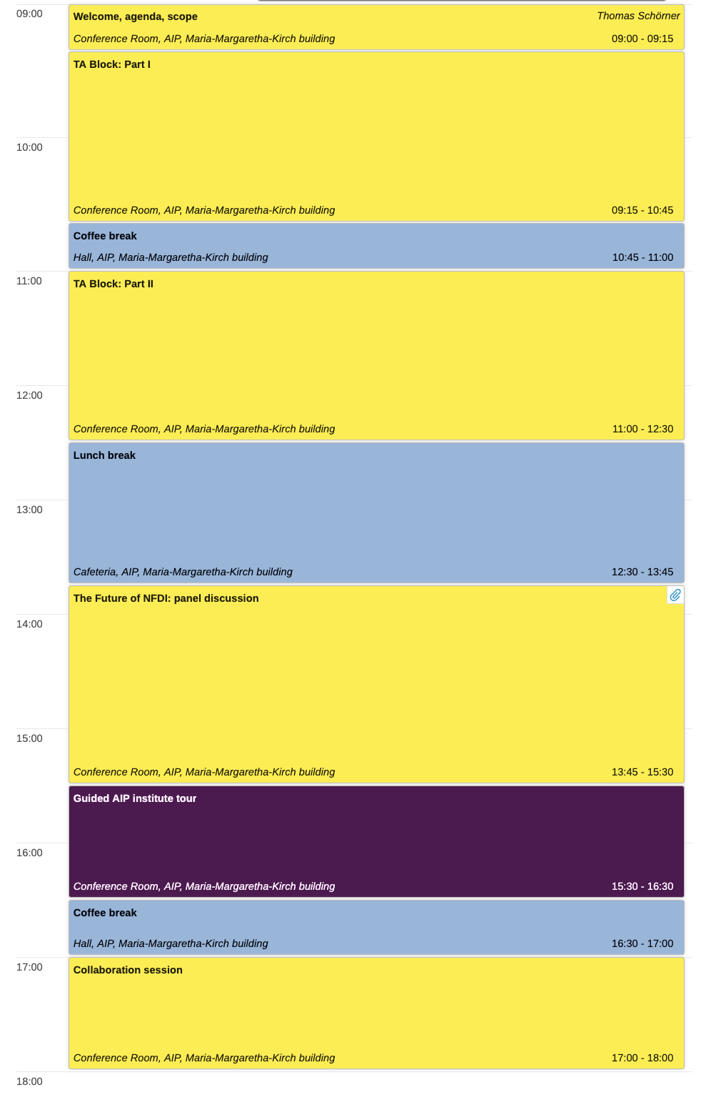
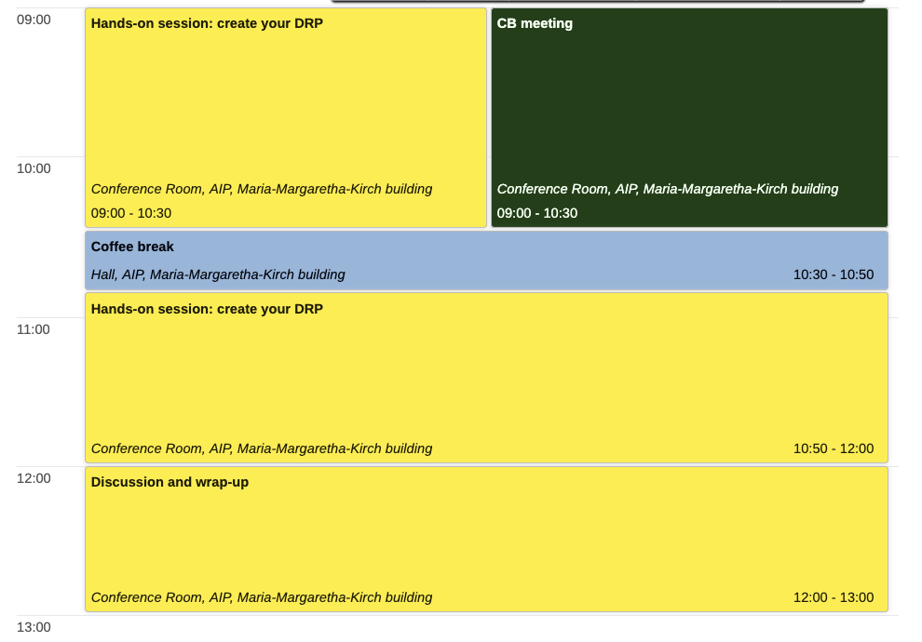
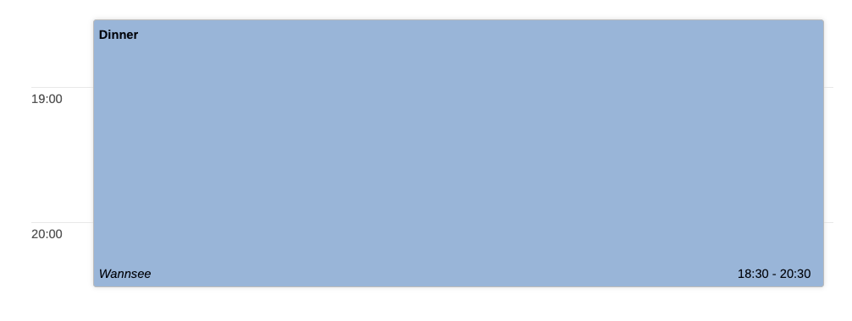
Agenda

Slide 4
Jan ‘26: Reaction to DFG minutes
Mar ‘26:
DFG expert verdict
Jun/Jul ‘26:
Final notification
Timeline
Oct 2021
PUNCH begins
Sep 2024
Report
Feb 2025
Nov 2025
today
Oct 2026
End / begin
Now – spring ’26:
Take stock
Finalise P1 work
Prepare ground for P2
Workshop 03/26 FIAS!
27-29 Nov ‘24 Annual meeting
18 Feb / 4 Mar ‘25 In-person meetings
18 June ‘25 letter of intent
Composition of consortium
13 Oct Evaluation
11 Feb ‘25 Evaluation
April ‘25 Concept fixed
6 Aug ‘25 Proposal deadline
Still some way to go in PUNCH-1.0
PUNCH4NFDI AM 2025 | AIP Potsdam, 19 Nov 2025 | Welcome - TS

Slide 5
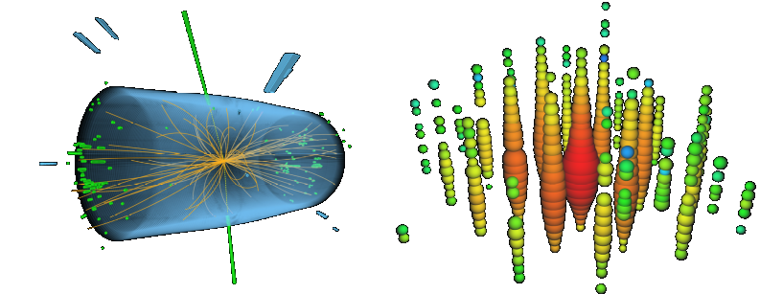
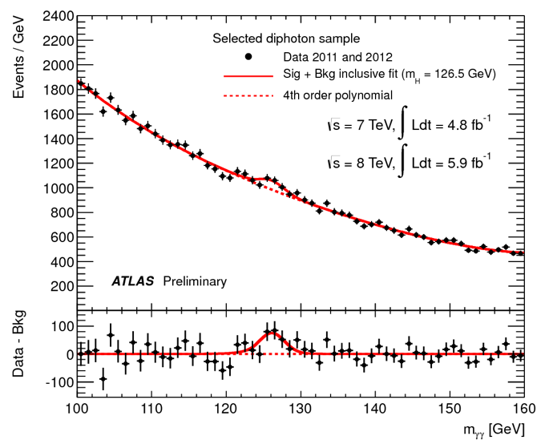
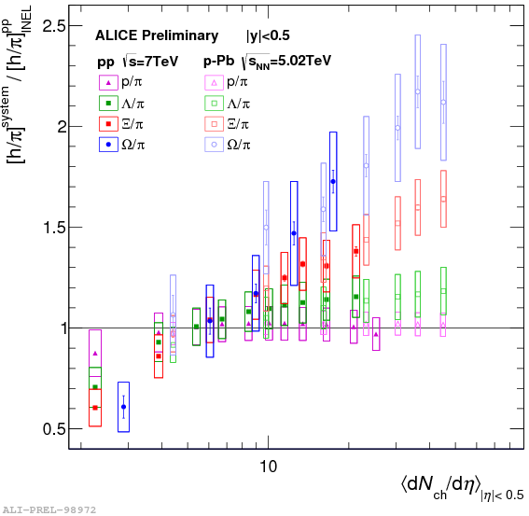
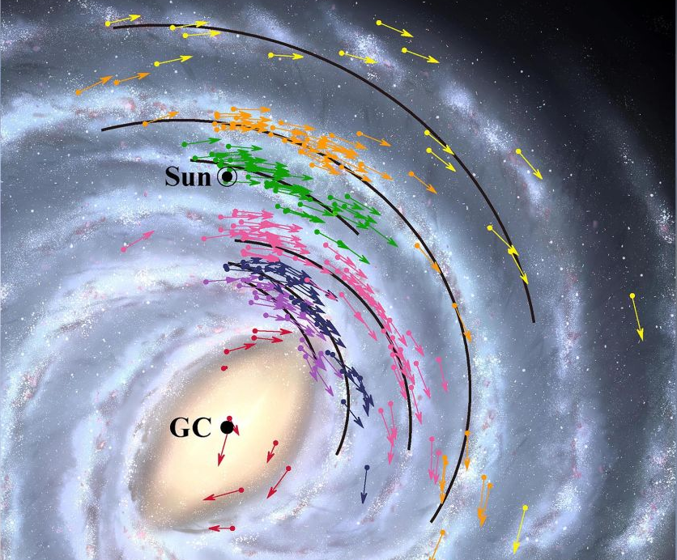
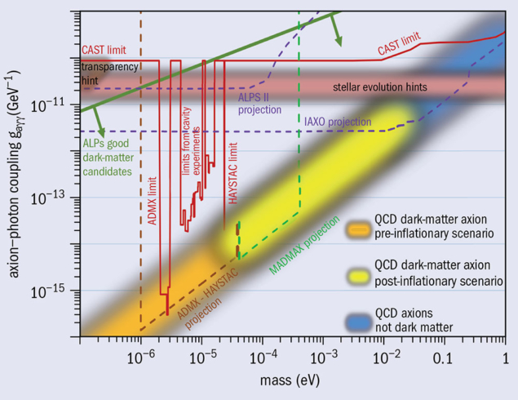
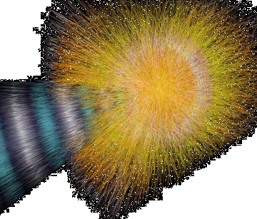
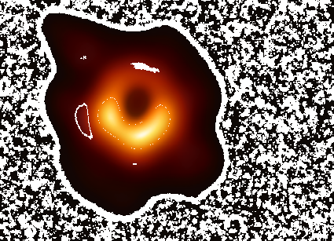
PUNCH* Science and PUNCH4NFDI
*Particles, Universe, NuClei and Hadrons
4 communities, 12+21 institutions
Representing 9000 scientists in Germany
University, Helmholtz, MPG, Leibniz
Strong international embedding
Dark matter
CMS experiment @ CERN: particle physics
IceCube experiment: astroparticle physics
Heavy-ion collision @ ALICE: nuclear & hadron physics
Black hole picture: astronomy
Higgs boson
Quark matter
Black holes

Slide 6
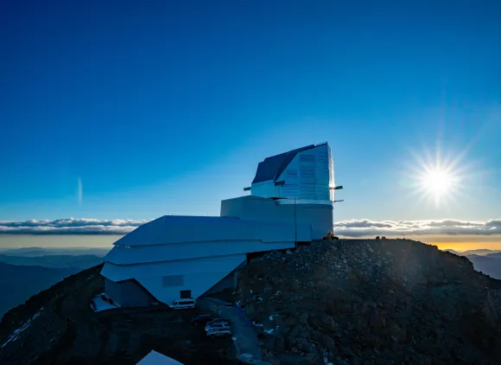


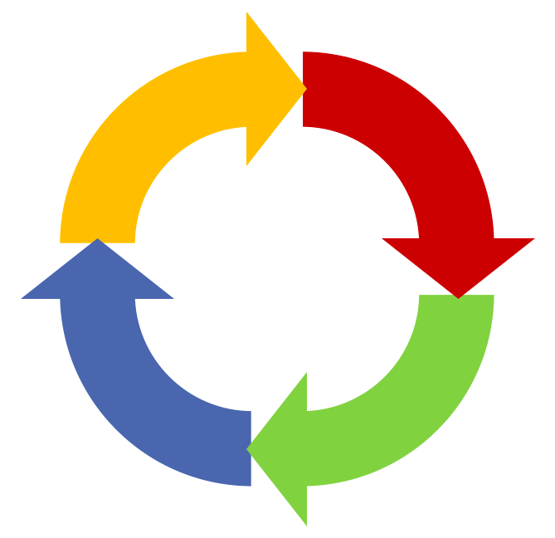

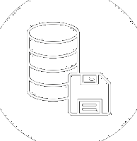

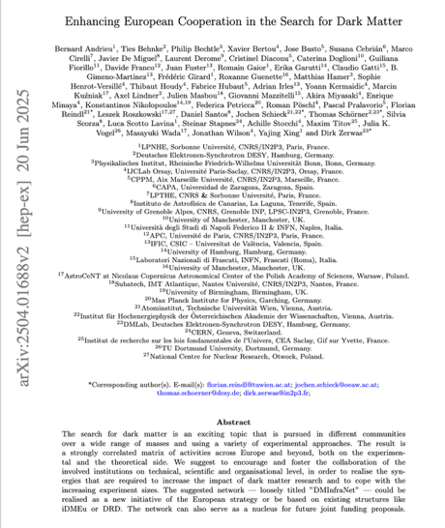
(✓)
UC 2.4/5
Curation Selection, combination
MD catalogues
REANA
Preparation
UC 2.2
(✓)
AAI
Portal
DRPs and registry
RDMO
Retrieval
Analysis
UC 2.3/6/7
Compute/Storage4PUNCH
REANA
Statistical / ML / simulation tools Analysis tools, benchmarks
github & gitlab
Publication Archival
Storage4PUNCH
DRPs and registry
MD catalogues
Portal

Slide 7


The last golden mile of RDM!
Science Data Platform SDP
Preparation
Retrieval
Analysis
Digital Research
Product DRP
Publication Archival

Slide 8
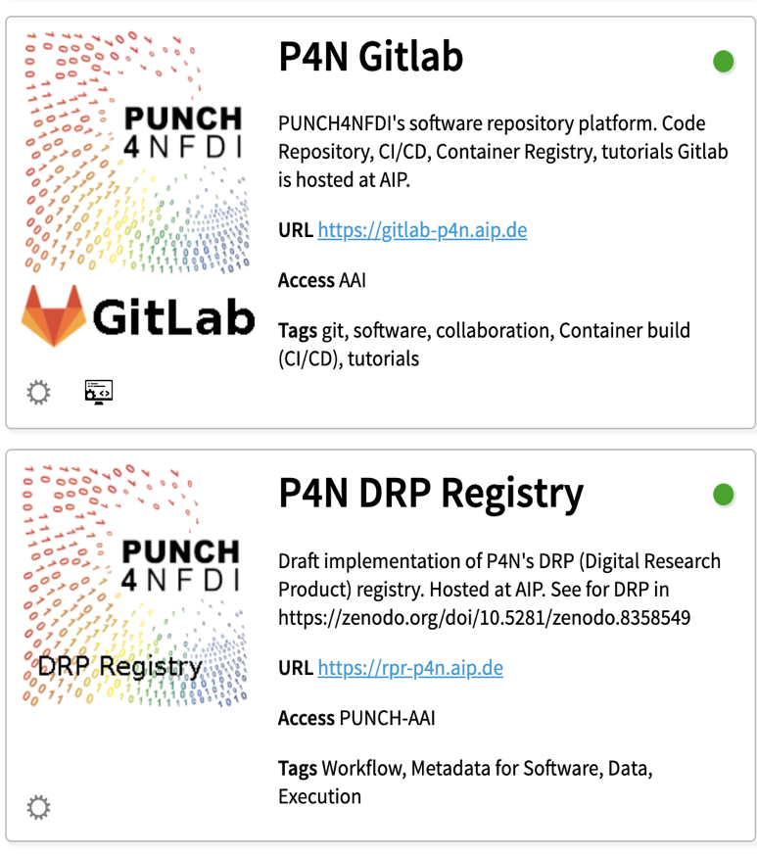
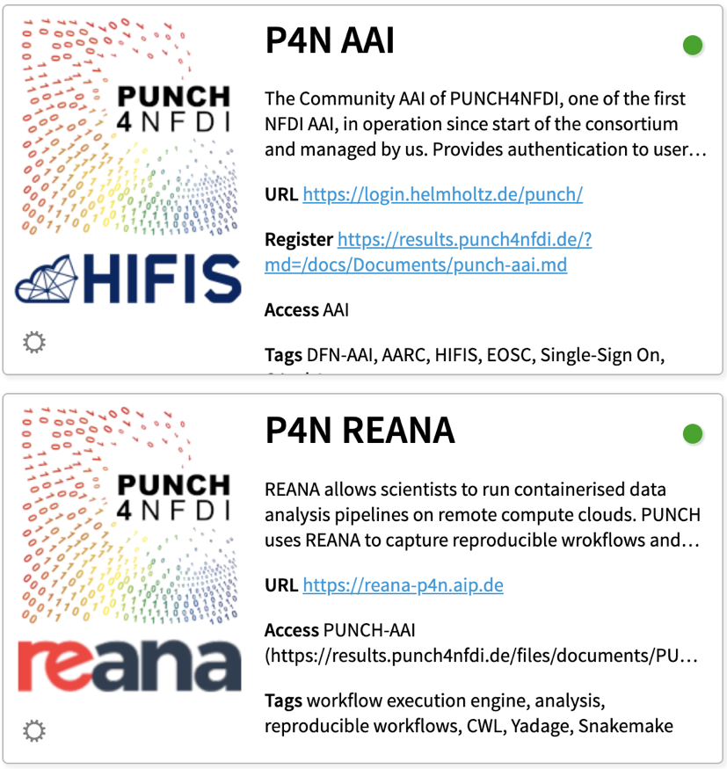
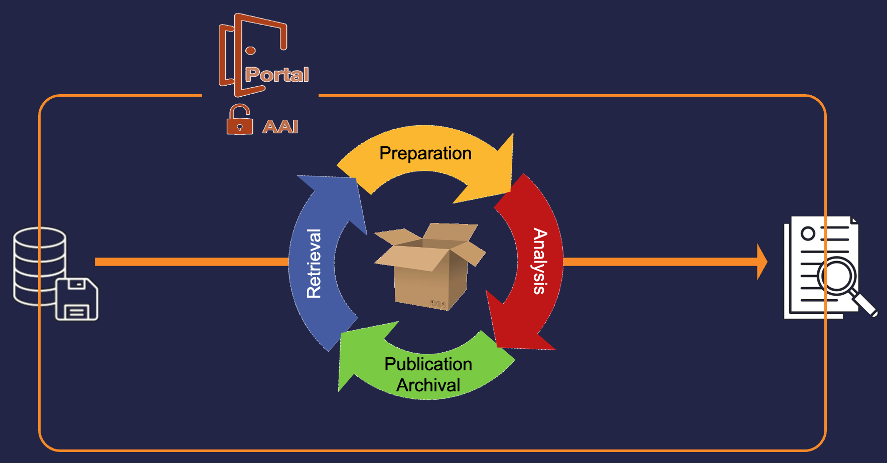



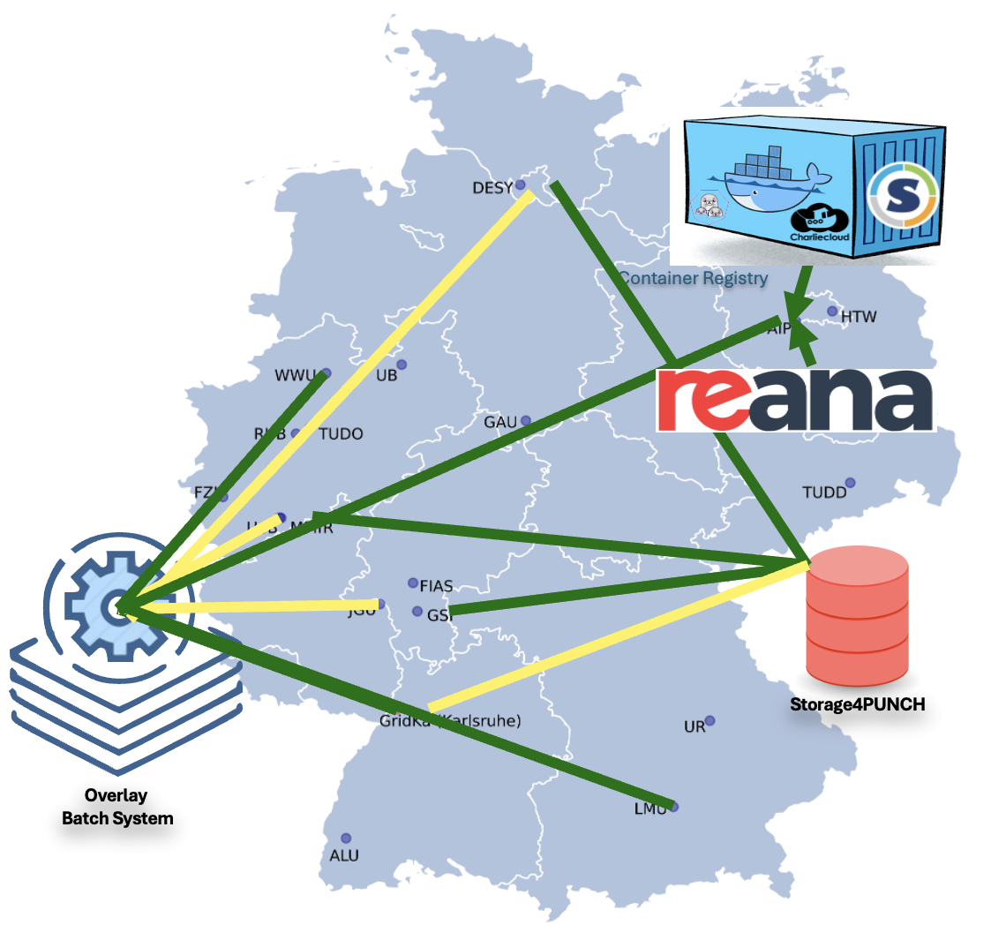
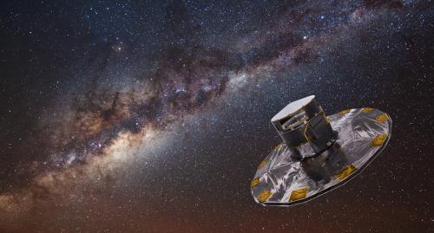

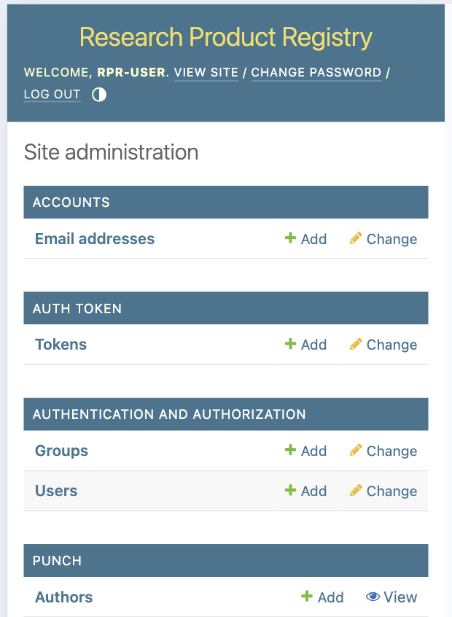
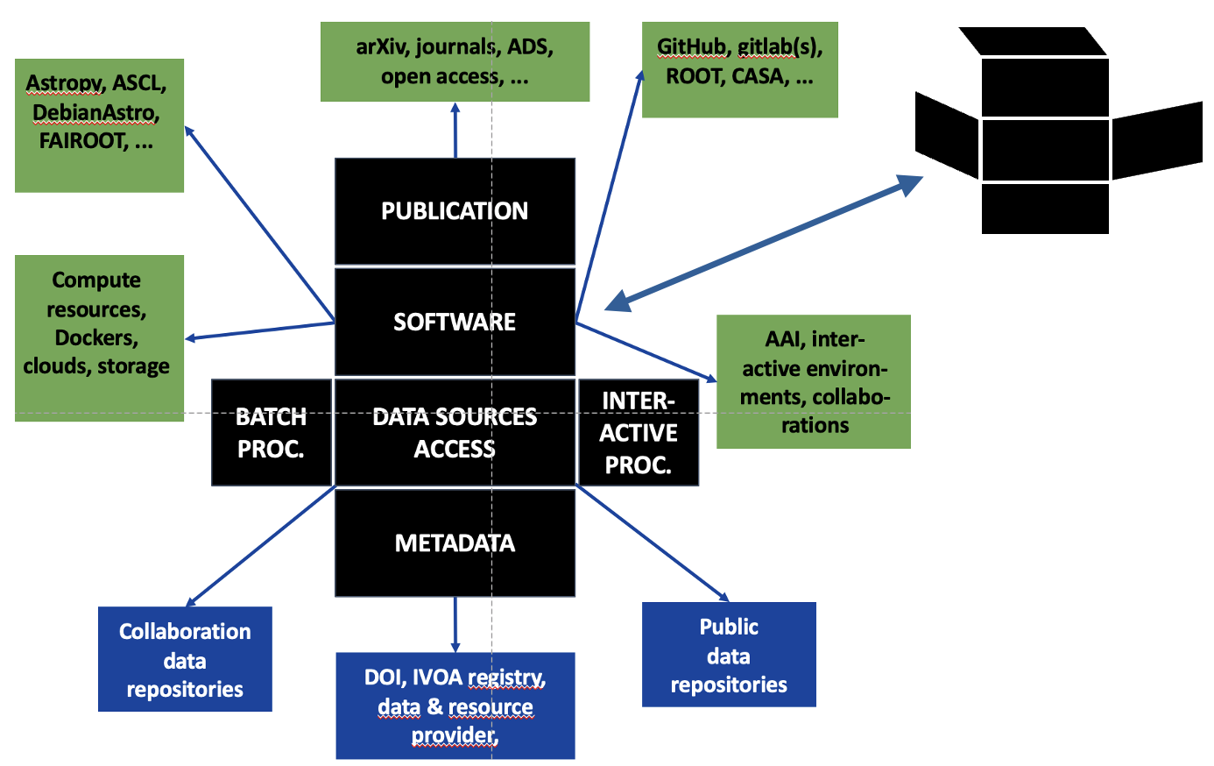
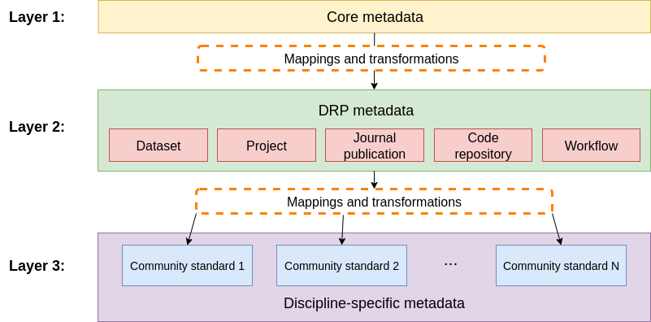
From PUNCH4NFDI …
Services collection
Connection to / use of archives
Federated storage & compute
Metadata schema
Digital Research Product
Registry and catalogues

Slide 9

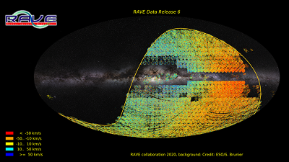
From PUNCH4NFDI …
Services collection
… to PUNCH-2.0
154 publications in Zotero data base
>40 co-developed services in data sheet – from federated infrastructures to REANA, physics.tools
Contributions to four Base4NFDI base services proposals – preparation of more in the pipeline
Successful achievement of work programme and deliverables
But also lessons learned “the hard way” – concentration / re-focusing in PUNCH-2.0 on
proven technical solutions user community building sustainable services
Last 12 months:
Nov ‘26: proposal defense
SDP stress test: GAIA data, 20k jobs!
Aug ‘26: proposal submission
Feb ‘26: mid-term report defense
PUNCH4NFDI helpdesk online
finalized 5 deliverables
40+ publications, 25+ presentations
Several AAI feature requests
Connection to /use of archives
Federated storage & compute
Metadata schema
Digital Research Product
Registry and catalogues

Slide 10
TA 3 Service, Results & Stakeholder Management
Objective 6: NFDI architecture, sustainability, connections
Objective 5: Education and training
Objective 4: Implementation of use cases
TA 4 Project Management & Governance
Objective 3: Science Data Platform as user interface
TA 2 Enabling Science Exploitation
Objective 2: Sustainable services
TA 1 Techn. Foundation
Objective 1: Technological basis; operation models

Slide 11

PUNCH-2.0 TAs, WPs and Use Cases
2.1 Science Data Platform
UC 2.2 Data Management Framework
3.1 Services & Results Management
UC 2.3 Data-Generating Simulations
UC 2.4 Phenomenological Analysis
3.2 Training, Education, Open & FAIR
UC 2.5 Future Observations
UC 2.6 Future Colliders
3.3 Stakeholder Management
UC 2.7 Large Datasets
1.2 Storage Infrastructure
1.4 Software, Containers, Registries, DRP
1.3 Compute Infrastructure
1.1 Technical Coordination
4.1 Overall Project Management
4.2 Financial Management
4.3 Legal Management
4.4 Science Communication

Slide 12
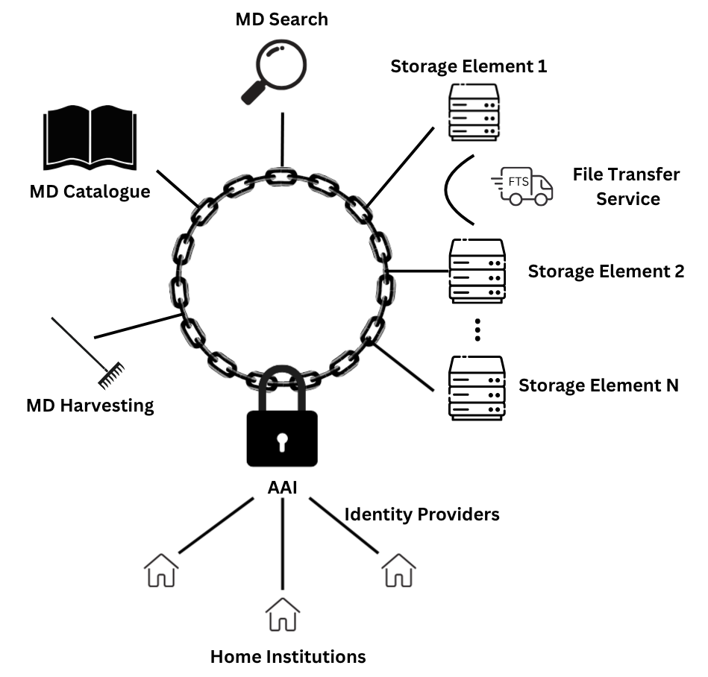
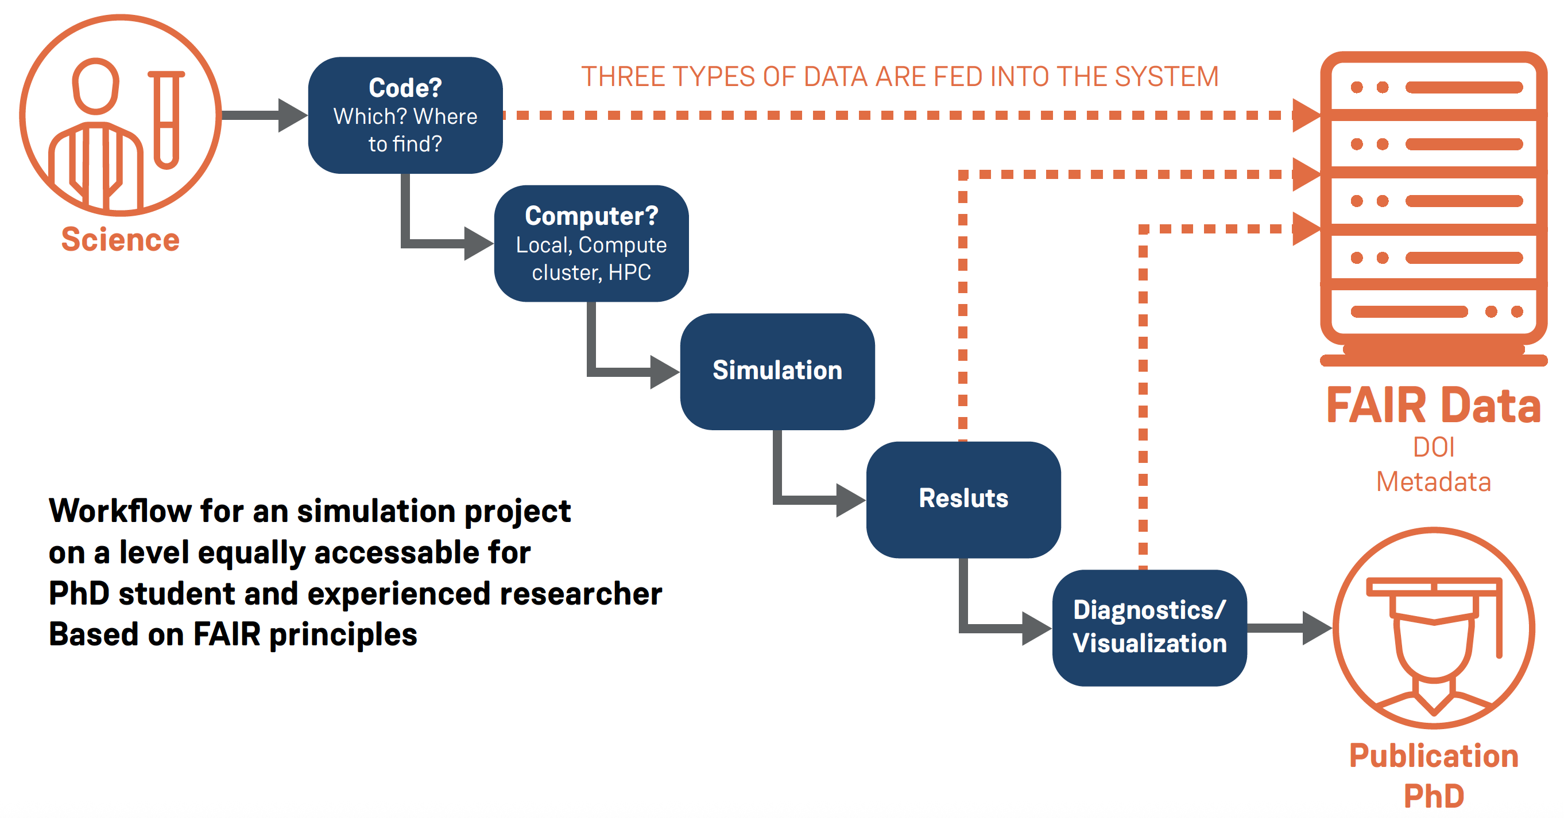
TA 2 Use Cases - Examples
UC 2.2 RDM Framework
UC 2.4 Phenomen. Analysis
EXPLORE - federated access to compute resources
UC 2.3 Data-Gen. Simulations – Unlike the traditional simulation workflow — from idea to publication (where components like code and results are described only in the final paper or thesis), the new FAIR workflow integrates all essential elements into the final data product.
Users & Communities
Federated access to HPC / NHR compute resources
Job submission via OBS
Builds on FAIR- compliant work- flows from LHC Open Data
PUNCH - AAI
EXPLORE Service
Support full simulation lifecycle
Standardized metadata schemas for sim.s
Promote reproducible simulation outputs
Overlay Batch System
HPC / NHR Centers
A unified RDM framework for small / medium data sources with distributed data and complex data access patterns
Based on ILDG MD catalogue
Test cases: ILDG, axion experiments at DESY, nuclear physics, radio astronomy, …
Results & Outreach
Expands to astronomy & cosmology workflows in WP2.4
Enables science, education, and outreach across PUNCH communities
→ target groups: general public, teachers / students, and theorists

Slide 13
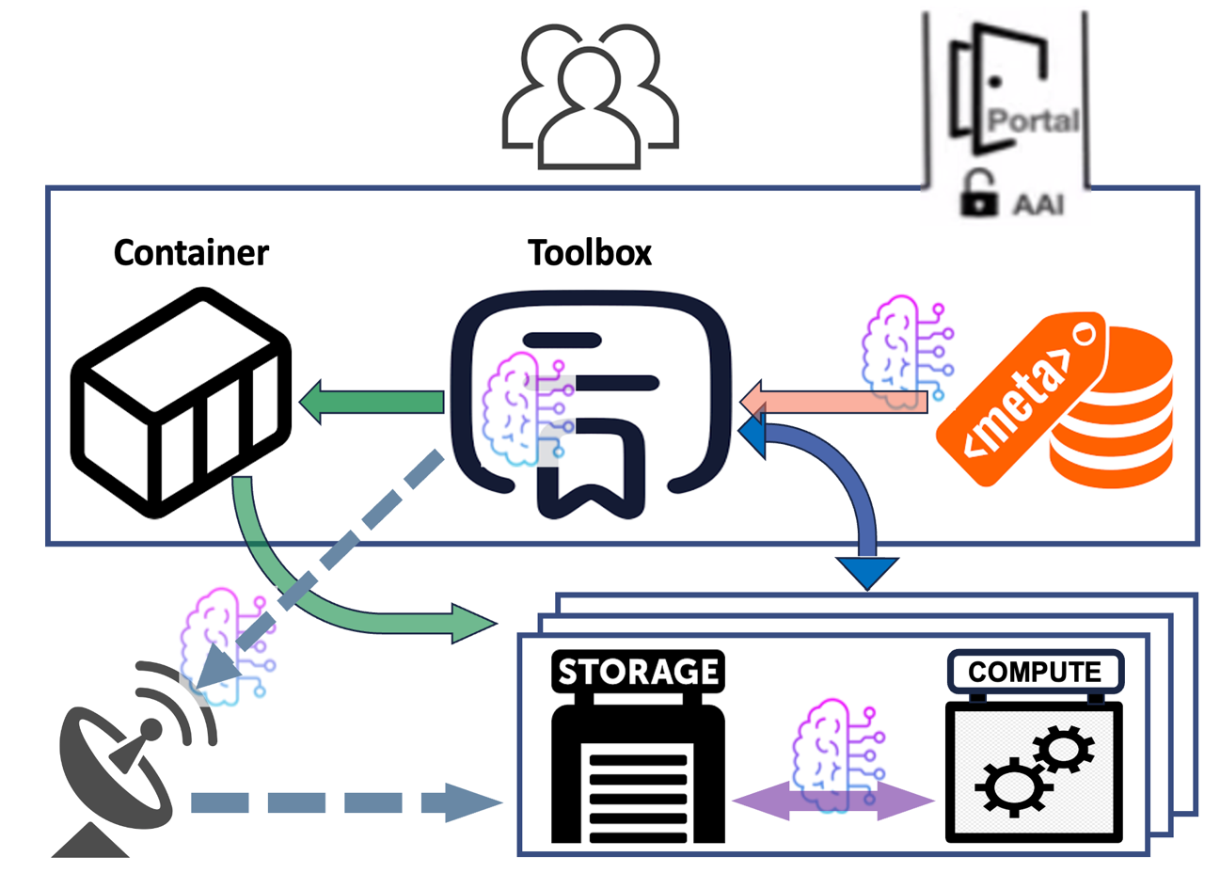
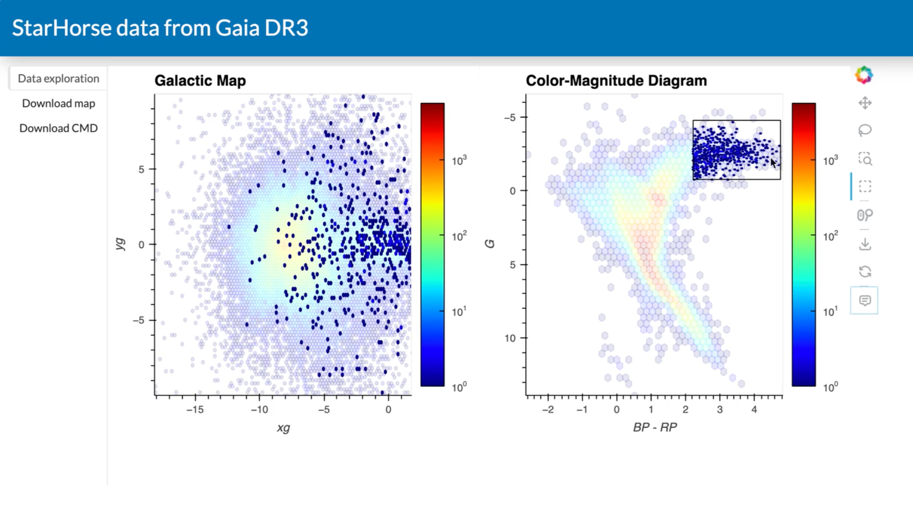
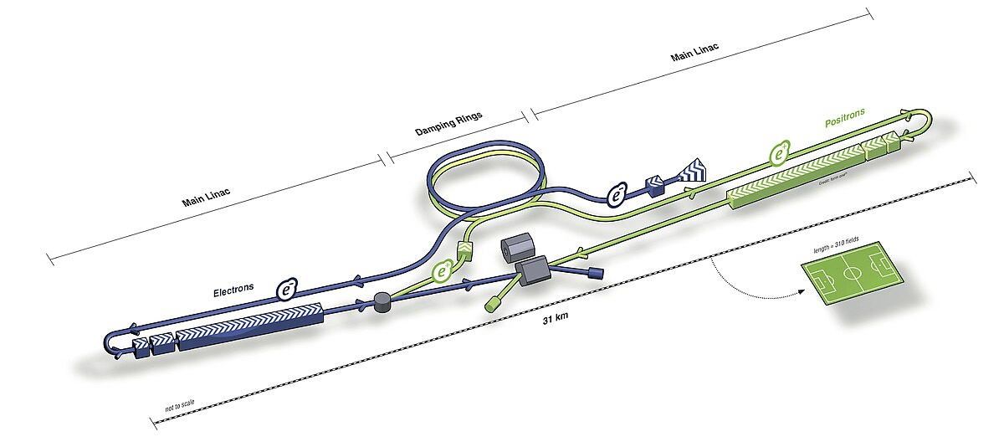
TA 2 Use Cases - Examples
UC 2.5 Future Observations
Real-time, non-storable data
Tools for on-the-fly processing
Optimize algorithms during data acquisition
Ensure FAIR principles even under streaming conditions
UC 2.7 Large Data Sets
(Re) processing and visualization of current or upcoming large telescopes/infrastructures
→ efficient rendering and quick visualization
UC 2.6 Future Colliders
Integrate key4HEP software stack into PUNCH4NFDI
Create workflows for detector concept validation
Testing PUNCH-2.0 components to their limits with very large data volumes
Optimizing data curation and visualization
Target groups: radio astronomy, astronomy in general, simulators
Reproducible design-to-analysis pipelines
Prepare for next-gen. collider experiments

Slide 14
Thanks a lot to our hosts and all organisers & contributors!

Slide 15
Thank you!
The PUNCH4NFDI Consortium
Spokesperson: PD Dr. Thomas Schörner (DESY, thomas.schoerner@desy.de) DESY, Notkestr. 85, D-22607 Hamburg
Contact:
Mail: punch4nfdi@desy.de
Web: www.punch4nfdi.de

