Slide 1









AMBCAT - Digital Amber Catalogue
Funded Project
Presenter: Jörg U. Hammel, Helmholtz-Zentrum Hereon, ORCID 0000-0002-6744-6811
Neele Rahmlow, Deutsches Elektronen-Synchrotron (IT)
Frank Schlünzen, Deutsches Elektronen-Synchrotron (IT)
Implemented by

Slide 2
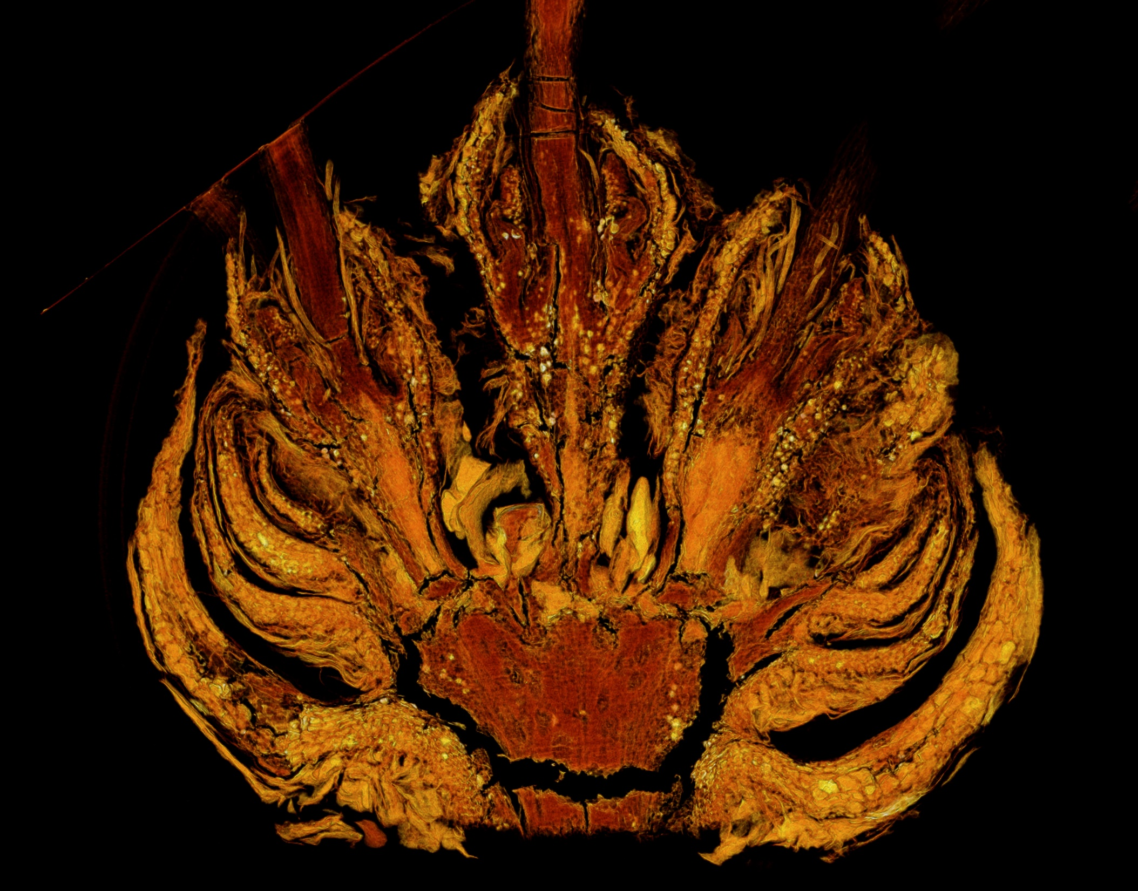
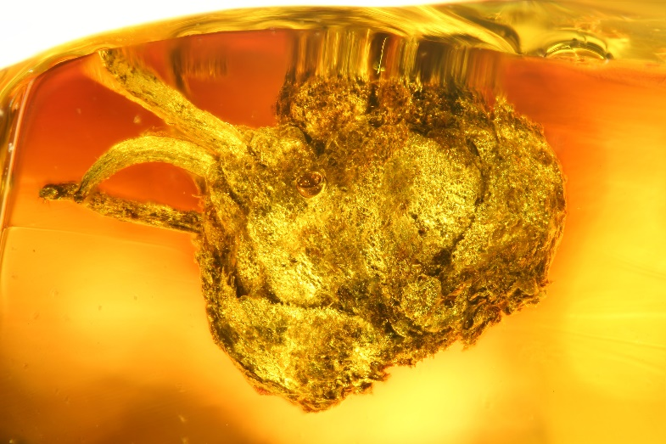
CHALLENGE ADDRESSED
What problem(s) are you going to solve?
Amber fossils are rare and unique objects -> access is limited
Microscopic inspection is limited to externally visible characters
X-ray computed tomography allows to study hidden characters and share data easily
Flowers of Castanopsis kaulii (Fagaceae) from 34-38 million-years-old Baltic amber
Published in:
Sadowski, E.-M., J. U. Hammel, and T. Denk. 2018. Synchrotron X-ray imaging of a dichasium cupule of Castanopsis from Eocene Baltic amber. American Journal of Botany 105(12): 2025–2036.

Slide 3

SOLUTION
What are you planning to do to solve the problem?
More than 1500 unique amber fossils FAIR & OPEN available
          SciCat catalogue
Userfriendly web frontend
Crosslink metadata from related databases e.g. collection data from museum
Interactive online visualization and inspection service included in the web portal

Slide 4
RESULTS
What will be the results and how do you plan to make them available to the broader community?
Webservice providing access to CT data and additional meta data
Online visualization tool implemented in webservice
Free and open accessible as a service to the community and public

Slide 5
RISKS
What risks could limit the success of the project, and how can they be mitigated
All required data already available
Use of established tools to implement the service
Online visualization tools not yet tested – performance?

Slide 6
TEAM
Who is doing it
Dr. Frank Schluenzen (DESY)
Neele Ramlow (DESY)
Dr. Jörg U. Hammel (Hereon)
Consortium Use Case Partners
Dr. Ulrich Kotthoff (LIB) - Germany
Dr. Danilo Harms (LIB) - Germany
Dr. Benjamin Wipfler (LIB) - Germany
Dr. Eva-Maria Sadowski (MfN) - Germany
Dr. Ricardo Pérez-de la Fuente (OUM) - UK
Dr. David Peris (CSIC-CMCNB) - Spain
Dr. Viktor Baranov (CSIC) – Spain
Dr. Brendon Boudinot (SMF) – Germany
Dr. Monica Solorzano-Kraemer (SMF) –Germany)
Dr. Hans Pohl (FSU) – Germany
Dr. Joachim Haug (LMU) - Germany

Slide 7

ROADMAP
What steps are to be taken?
1.) Data curation
- Ingest existing P05 data into SciCat
- Automate continuous ingestion for future experiments
2.) Tools for data maintenance
- Improve data curation with user-friendly tools
- Interface with external sources (e.g. museums or universities)
3.) Implementing AMBCAT
- Create a new Streamlit web application
- Architecture similar to the ‘Human Organ Atlas’
4.) Data visualisation
- Investigate ParaView
- Integrate features into AMBCAT

Slide 8
1.) Data curation
Tasks
- Ingest existing P05 data into SciCat
- Automate continuous ingestion for future experiments

Slide 9
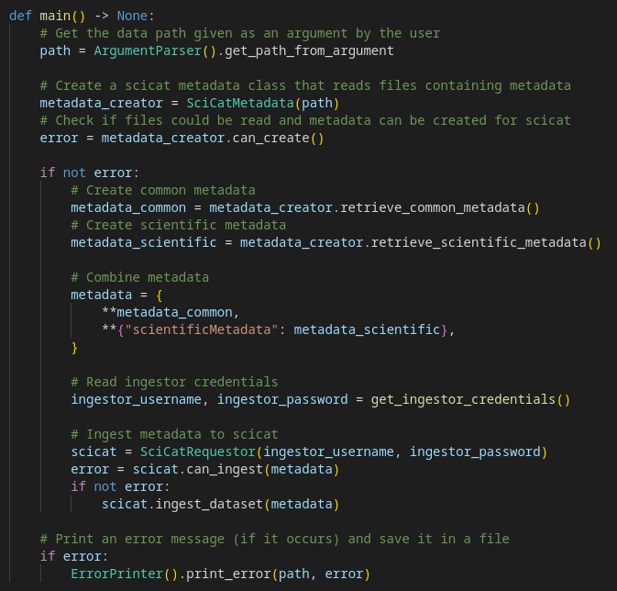
1.) Data curation
1
Python programme (ingestor.py)
1) Takes a data path as an argument
2) Reads HDF5, JSON and log files
for one dataset
3) Creates general and scientific metadata
from these files automatically
4) Uploads the metadata to SciCat, or
updates the data if PID already exists
5) If an error occurs, an error message
is saved
2
3
4
5

Slide 10
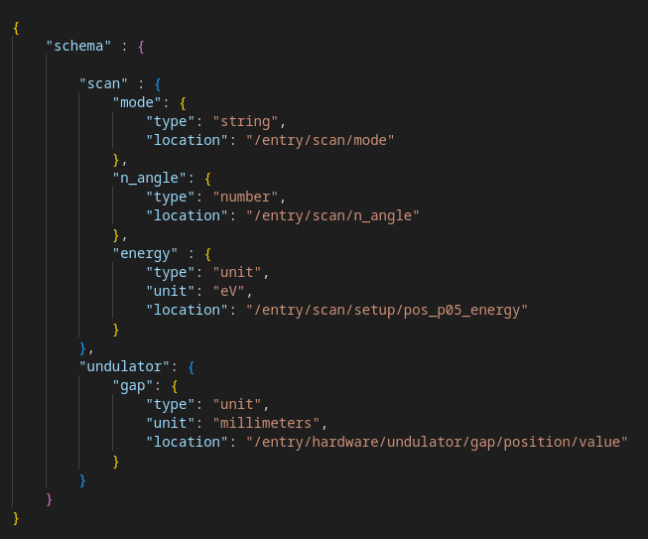









1.) Data curation
Python programme (ingestor.py)
datapath.py
Template
raw / derived
/path/to/data/
ingestor.py
Metadata

Slide 11
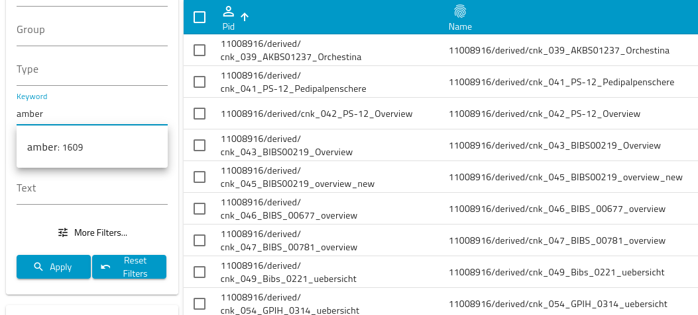
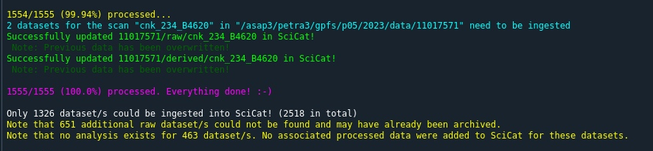
1.) Data curation
Python programme (ingestor.py)
- 762 raw and 847 derived datasets (1,609 in total) already added to SciCat
- Some of the data has already been archived and must be retrieved
- Code and templates can be extended and used for future datasets
- Further metadata will be added, especially attachments
Execution of the script (ingestor.py) last week

Slide 12


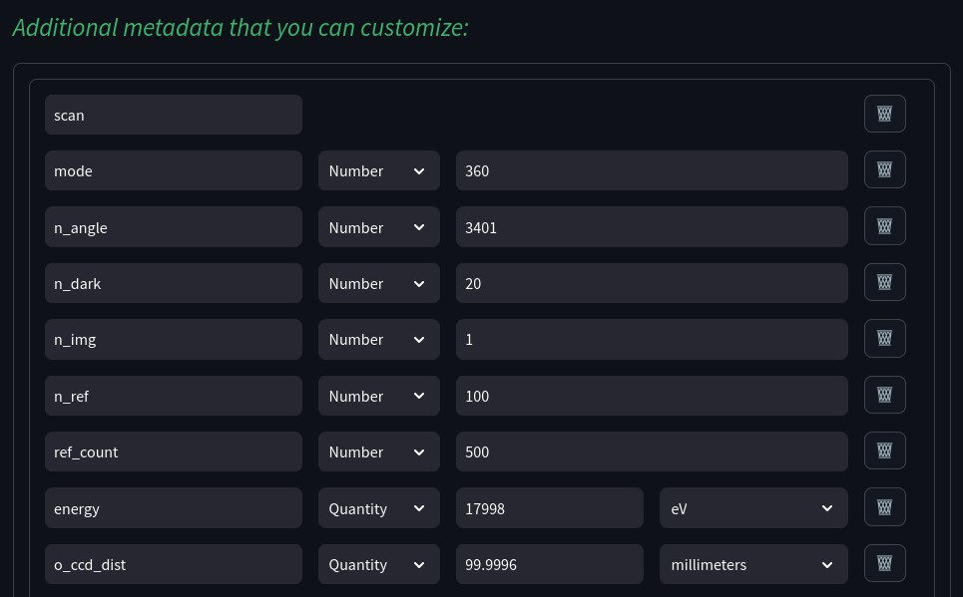




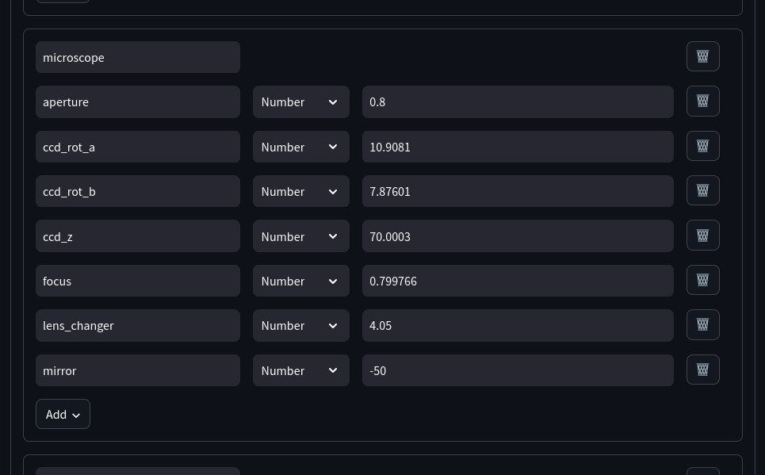
2.) Tools for data maintenance
Tasks
- Improve data curation with user-friendly tools
- Interface with external sources (e.g. museums or universities)
SciCat-Editor
- Web application created with the Streamlit framework
- Allows manual input of scientific metadata for datasets in SciCat
- Structure and validation of metadata can be specified via a template
(e.g. data types, mandatory fields, …)
Curate
Ingest
SciCat database
Template
(JSON-Schema)
SciCat frontend
dataset
„SciCat-Editor“

Slide 13
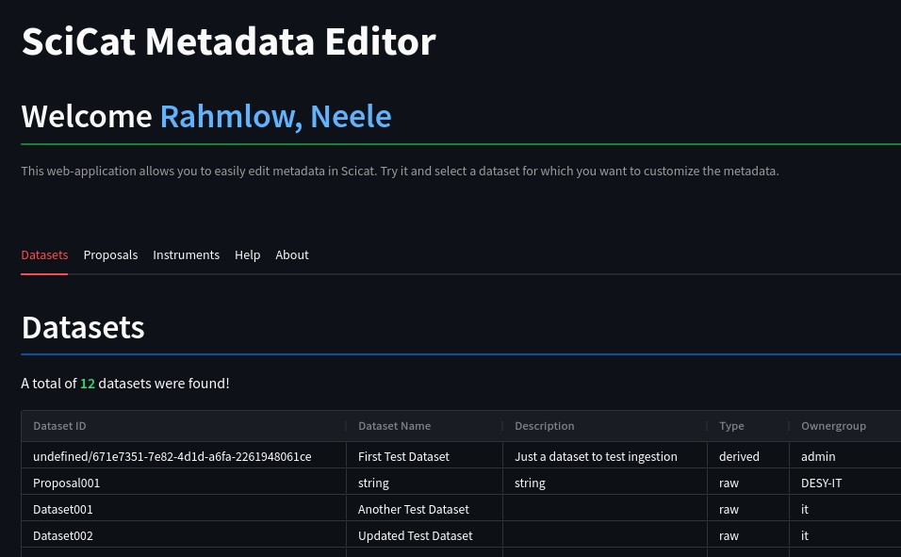
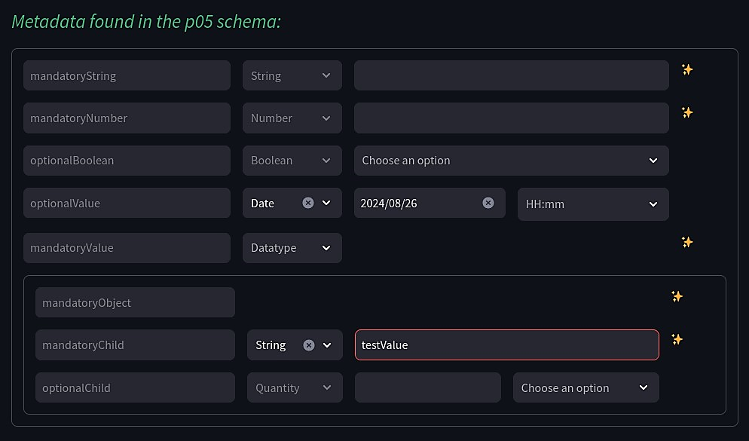
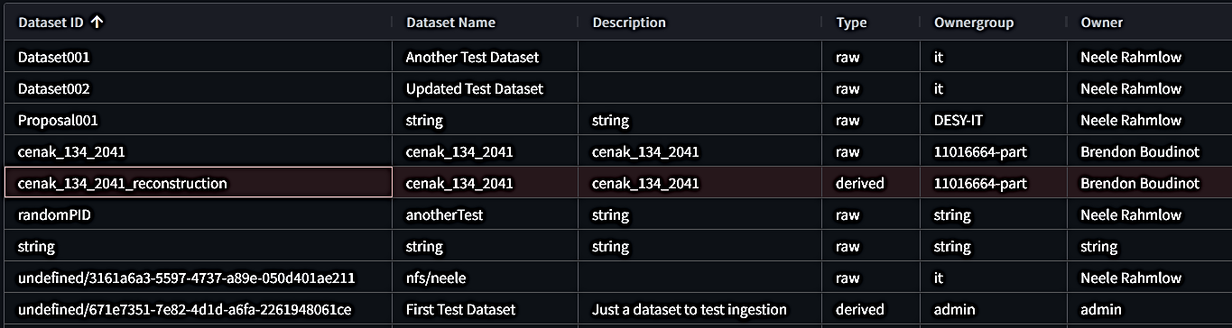
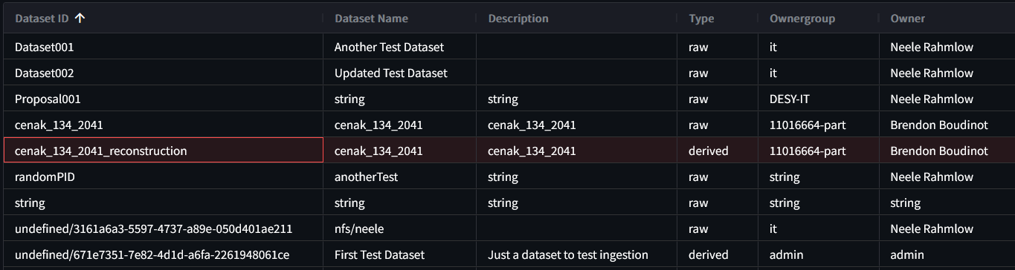

2.) Tools for data maintenance
SciCat-Editor
=> Curation is simplified
=> Control, guidance and validation
Website is currently unavailable, but will be relaunched in the future!

Slide 14
2.) Tools for data maintenance
SciCat-Editor
- Data curation can be improved using the SciCat-Editor
- Further data fields, such as comment, rate or linking data, need to be added
Automated ingestion (via scripts)
- Just as important, and enables metadata to be added quickly in the future too
- Some information is still missing, such as sample information
(code of automated scripts must be extended)
- Curation of amber data beyond P05 data is also planned (e.g. Senckenberg Search)

Slide 15
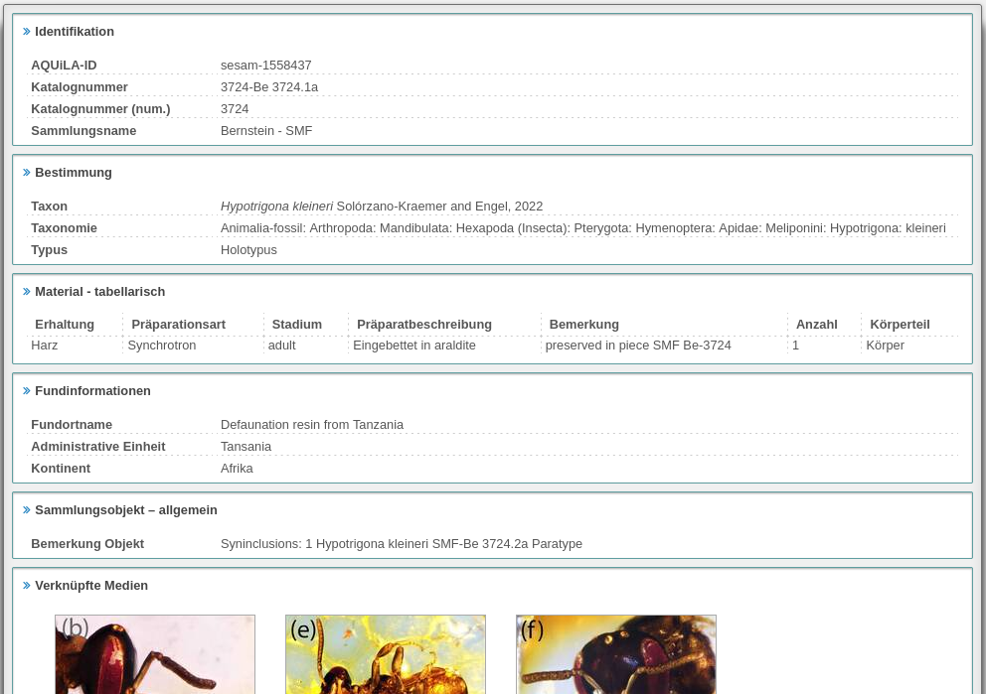
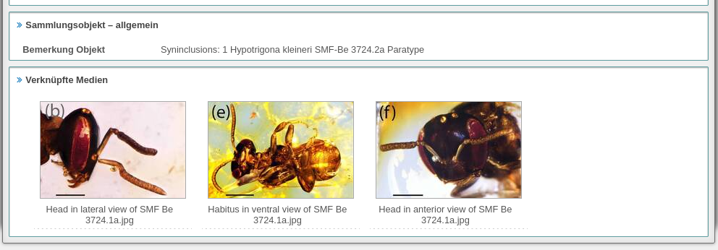
2.) Tools for data maintenance
SciCat-Editor
- Data curation can be improved using the SciCat-Editor
- Further data fields, such as comment, rate or linking data, need to be added
Automated ingestion (via scripts)
- Just as important, and enables metadata to be added quickly in the future too
- Some information is still missing, such as sample information
(code of automated scripts must be extended)
- Curation of amber data beyond P05 data is also planned (e.g. Senckenberg Search)
https://www.senckenberg.de/en/science/research-infrastructure/databases-and-digital-resources/aquila/

Slide 16
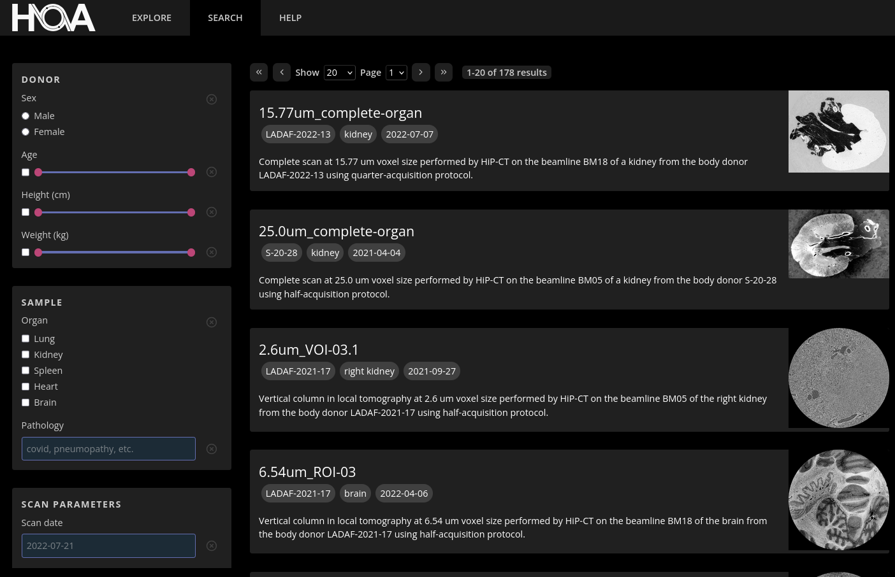
3.) Implementing AMBCAT (Amber Catalogue)
Tasks
- Create a new Streamlit web application
- Architecture similar to the ‘Human Organ Atlas’
Search, Access and Explore
- Amber datasets from DESY and partner
institutions are displayed
- Data is searchable and filterable
- Links provide access to the data
- Data can be viewed using 3D models
The web application “Human Organ Atlas“

Slide 17
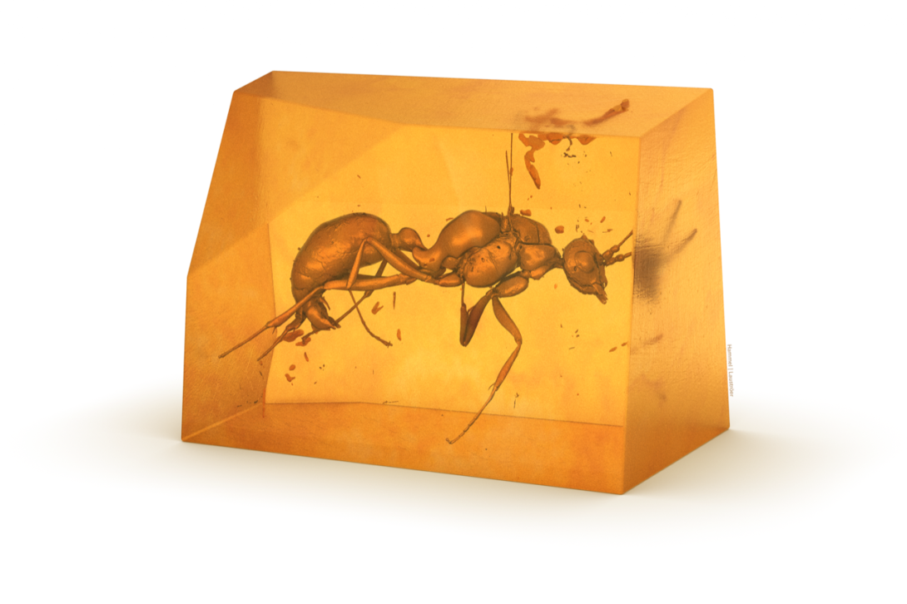
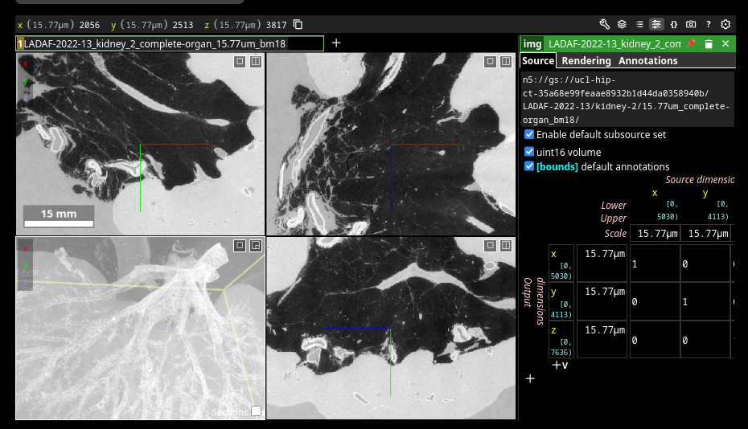
4.) Data visualisation
Tasks
- Investigate ParaView
- Integrate features into AMBCAT
ParaView
- An application for data analysis and
visualisation
- Hopefully, it will enable improved
3D visualisation compared to the
Human Organ Atlas (to be tested)
3D models on the “Human Organ Atlas“ website

Slide 18
SUMMARY
AMBCAT (Amber Catalogue)
- AMBCAT is a Streamlit web application that enables users to search for, access and
explore amber data
- AMBCAT serves as a collection point for amber data, providing a higher-level context
(in terms of temporal/geographical origin, phylogenetics and ecological environment)
- AMBCAT makes a significant contribution to the FAIR data principle
- AMBCAT is accessible to everyone and can raise public ecological awareness

Slide 19
Thank You!

