Slide 1
Muon Collider RF
Simon Albright
With material from:
Heiko Damerau
Christine Vollinger
Eric Montesinos
Frank Gerigk
Michela Neroni

Slide 2
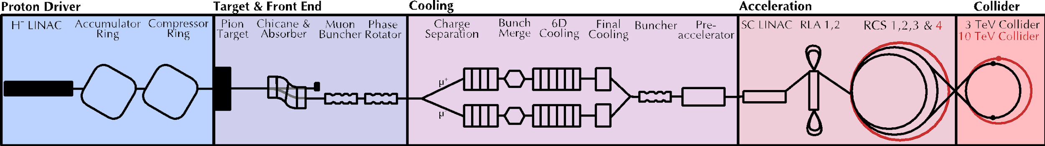
RF is almost everywhere, and directly/indirectly includes many subjects:
High power vacuum electronics
FPGA and DSP development
Analogue signal processing
Beam dynamics
Electromagnetic modelling/design/manufacture
…

Slide 3
Full RF system
Low power Level RF:
The “brain”
mW scale signals
Specifies what the RF should do to control the beam
Magnetic field
Voltage functions
…
LLRF
HLRF
High power Level RF:
Amplifies mW signals to kW/MW scale
Drives RF power into the cavity
Beam Measurement
Cavities
Beam

Slide 4
Contents
Longitudinal Beam Dynamics
RF Cavities
Beam Loading
RF Power Amplification

Slide 5
Longitudinal Beam Dynamics

Slide 6
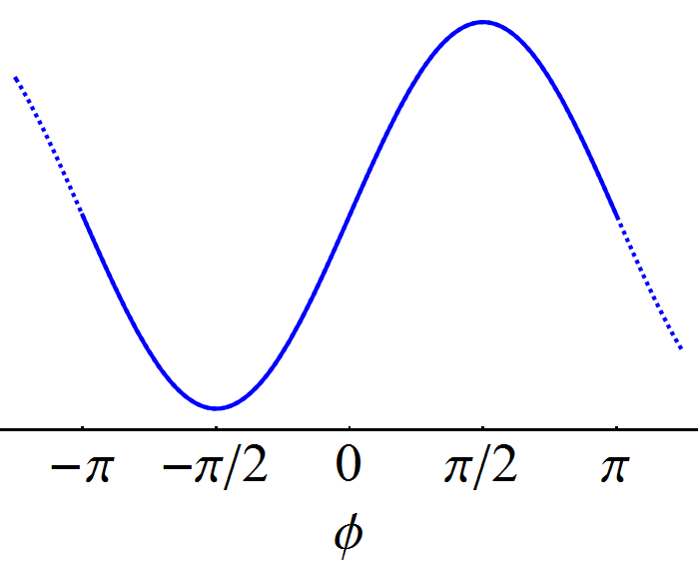
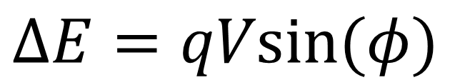
Beam RF Interaction
Individual particles gain (or lose) energy as:
$$ΔE=qVsin⁡(φ)$$
These particles lose energy
These particles gain energy

Slide 7
Acceleration
Accelerating on-crest:
Most efficient use of the voltage
Very little margin of error
Can lead to banana shaped bunches
Frequently used in linacs
Accelerating off-crest:
Allows larger beams beam
Easier to control and mitigate errors
Obligatory in rings

Slide 8
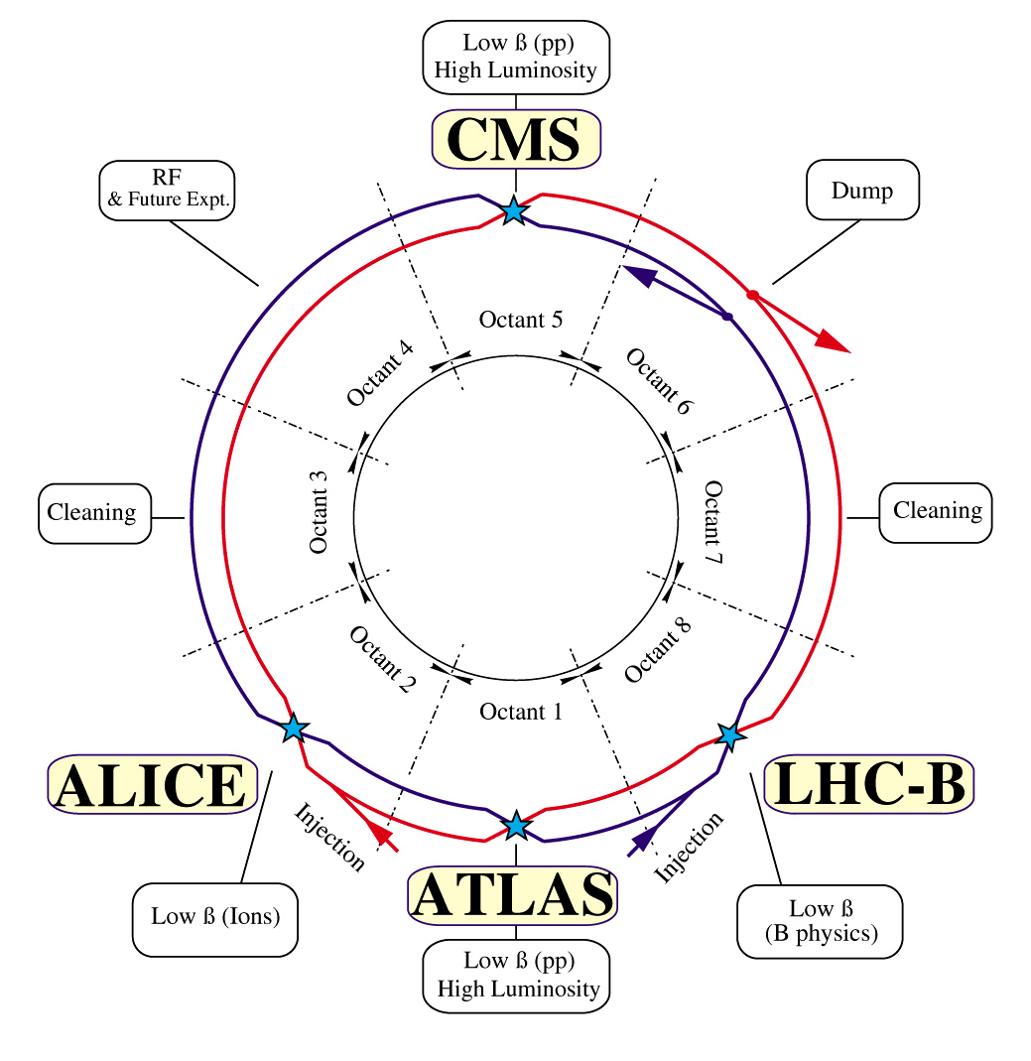
Synchrotron Layout
Not RF
Not RF
RF
Not RF
Not RF
Each beam will see:
16 RF cavities
27 km of other stuff
Not RF
Not RF
Not RF

Slide 9




Synchrotron Motion
$$E$$
$$ΔE$$
$$φ$$
$$ΔE$$

Slide 10


Synchrotron Motion
$$E$$
Not RF
$$Δφ$$
$$φ$$
$$Δφ$$

Slide 11



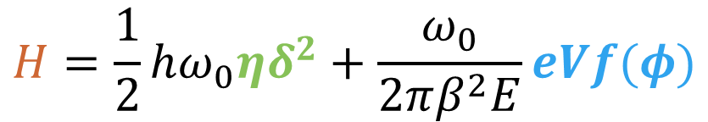
Synchrotron Motion
$$E$$
Given enough time, particles will oscillate from the head to the tail and back again
$$H=\frac{1}{2}hω_{0}ηδ^{2}+\frac{ω_{0}}{2πβ^{2}E}eVf(φ)$$
$$φ$$
Change of phase
(not RF)
Change of energy
(RF)
If the motion is slow enough, discrete steps in energy and phase can be approximated by a continuous function
If not, things can get a little spicy

Slide 12
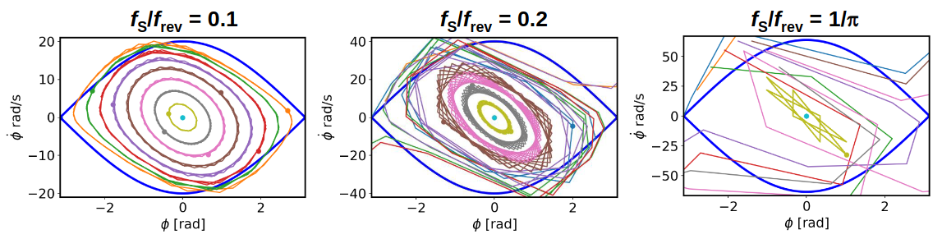

Spicy Synchrotron Motion
Fast Motion
Very Fast Motion
Too Fast Motion
Trajectories become discontinuous
Normal limit of bounded motion
High amplitude particles lost
Elliptical trajectories become distorted

Slide 13
Key Takeaways
RF Is used to change the beam energy
particles at different positions in the bunch will gain/lose different amounts of energy
High and low energy particles drift within the bunch
Motion is discretised, small steps are needed to preserve stable motion

Slide 14
Cavities

Slide 15
Electromagnetic Pendulum
Beam
Cavities are effectively a harmonic oscillator; energy is added by RF power amplifiers and is lost to the cavity walls and extracted by the beam
The electric field is (typically) parallel to the beam direction
The magnetic field is (typically) perpendicular to the beam direction

Slide 16
RLC Circuit
L
R
C
RF power source
V
Cavity gap voltage
Main terms of interest:
R_{Shunt}: Resistive impedance at the resonant frequency
ω₀: Resonant angular frequency, given by L and C
Q: Quality factor, energy loss per RF period

Slide 17
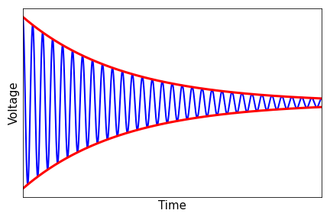
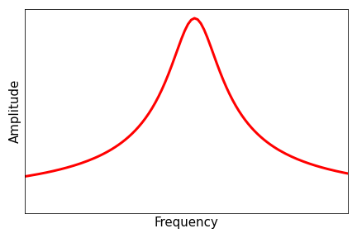
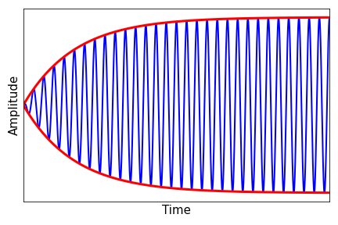
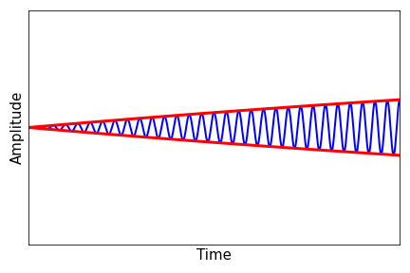
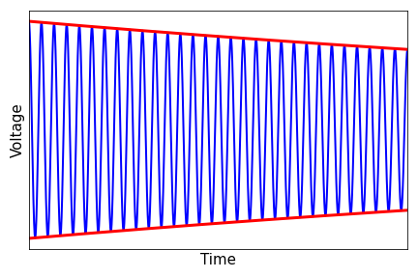
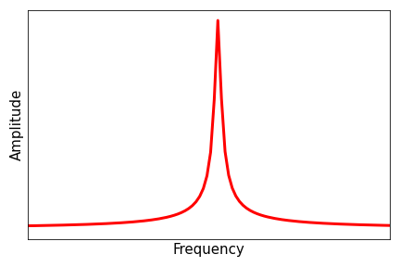
Quality Factor
Low Q:
High bandwidth
Fast decay
Fast filling
High Q:
Low bandwidth
Slow decay
Slow filling

Slide 18
Key Parameters
Peak Voltage: Scales with frequency (weakly), risk of sparking if too high
Frequency: Scales with size, high is good for V/m, low is good for large beams
Q: Influences frequency range and rate of energy loss/gain
R/Q: Defined by geometry, defines how easy it is to add voltage
Cu
Steel
Nb
(4K)
Moderate Q
Moderate R_{Shunt}
Low Q
Low R_{Shunt}
Enormous Q
Enormous R_{Shunt}

Slide 19
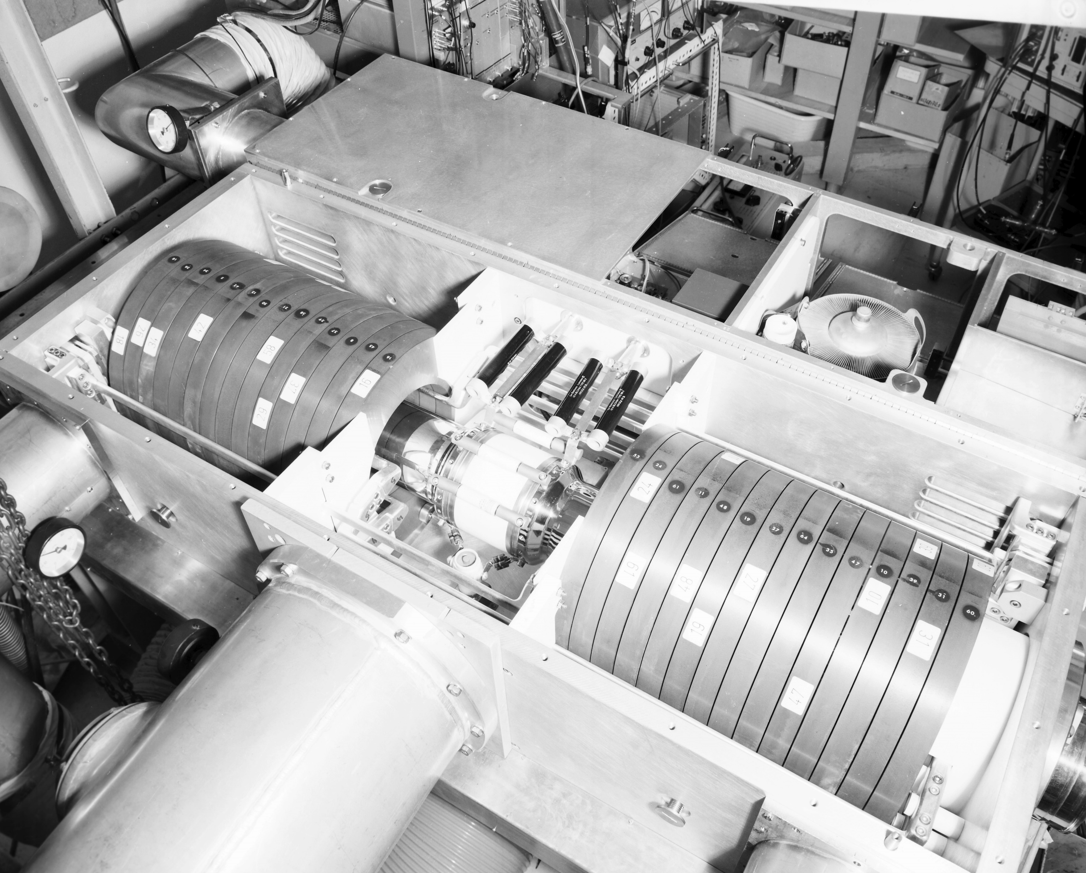
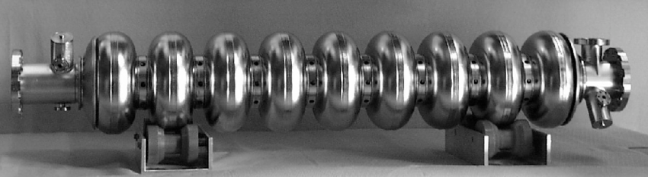
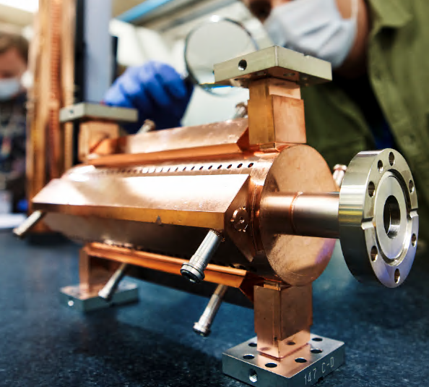
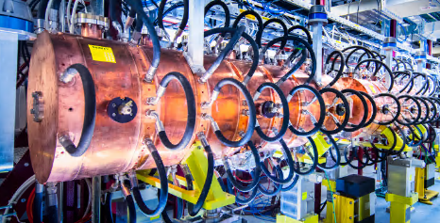
Types of Cavity
(Old) PSB: 3-8 MHz
TESLA: 1.3 GHz
Linac4: ~300 MHz
CLIC prototype: ~10 GHz

Slide 20
Key Takeaways
Cavities are resonators that store RF energy
Cavity geometry defines R/Q, independent of material
High-Q cavities lose and gain energy very slowly
Many designs of cavities exist, all optimised for different conditions

Slide 21
Beam Loading

Slide 22
RLC Circuit
L
R
C
RF power source
V
Cavity gap voltage
Beam current

Slide 23
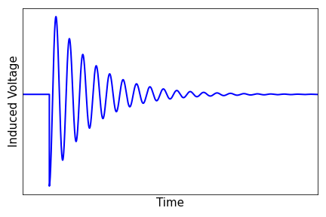
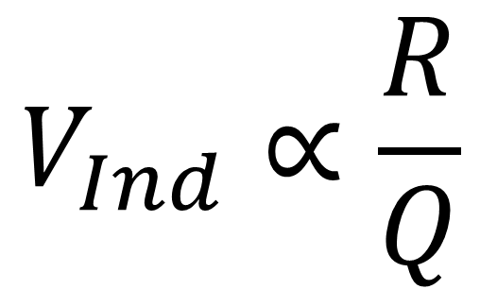
Beam Induced Voltage
$$V_{Ind}∝\frac{R}{Q}$$

Slide 24
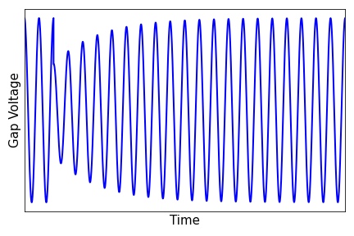
Beam Induced Voltage
Drop in voltage due to beam passage
Proportional to R/Q and beam current
Cavity refilling (Q)

Slide 25
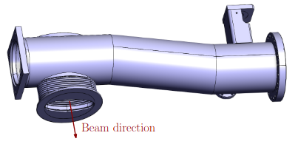
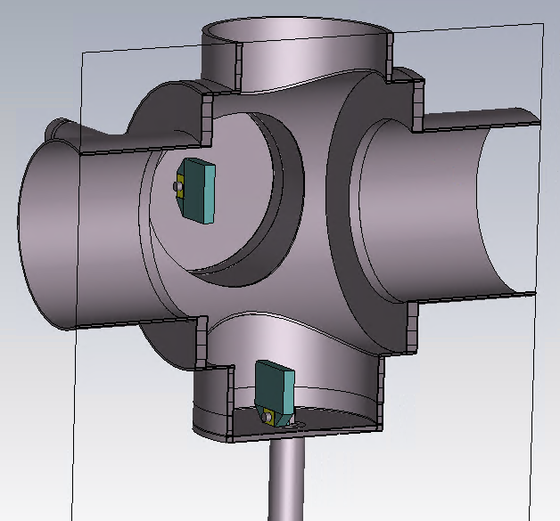
Cavities that aren’t Cavities
Vacuum pumping manifold of the CERN Proton Synchrotron
Multiple resonant frequencies in the 1 – 1.5 GHz range
Suspected of causing beam instabilities
Proposed beam scraper for the CERN SPS
Strong modes predicted at 0.9 and 1.3 GHz
Design modified to suppress them

Slide 26
Key Takeaways
The beam acts as an additional current source in the cavity
Beam induced voltage counteracts RF voltage and acts back on the beam
Almost anything exposed to the beam acts as a cavity and careful design choices are needed to avoid negative effects

Slide 27
Power Amplification

Slide 28
Vacuum Tubes
Vacuum tubes:
High electron current generated by a cathode
Low power signals applied to screen modulate the current
High AC-current electron beam on the anode provides high power signal
Limited in frequency and power
Very durable and reliable

Slide 29
Solid State
DC
Solid state:
Pairs of transistors, one to amplify the positive side, the other to amplify the negative side
Low power but modular
Modularity gives reliability, one broken transistor does not bring down the entire RF system
Gradually replacing vacuum tubes in many contexts

Slide 30
Klystrons
Klystron:
High current electron beam passes through an RF cavity
Lower power input RF energy modulates the beam
Bunches form as the beam travels along the klystron
Electron bunches deposit energy in the second cavity (beam loading) producing high power output RF
Very high power and available at a lot of frequencies (small tuning range)

Slide 31
Key Takeaways
Variety of options for Power amplification, best solution depends on the application:
  Vacuum tubes: Durable, Radiation tolerant, can absorb power transients
  Solid-State: Reliability through modularity
  Klystrons: Highest power
Like cavities, no one-size fits-all solution

Slide 32
What matters where?

Slide 33
High proton beam power calls for high RF power
Very short and intense muon bunches lead to significant beam loading
Strong magnets next to cavities increase risk of sparking
Need very high voltage for fast acceleration
Fast synchrotron motion in the RCS needs care

