Slide 1


EuXFEL Operator Training
Injector beam optics measurements
Matthias Scholz
March 18, 2025

Slide 2
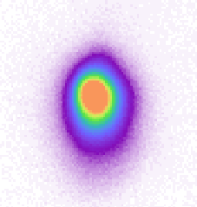
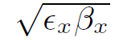
First things first
The width of the beam (in horizontal or vertical plane) at a certain position in the beamline depends on two things: The so-called beta function at the position and the emittance.
A screenshot from the camera OTRC.59.I1in the XFEL injector

Slide 3
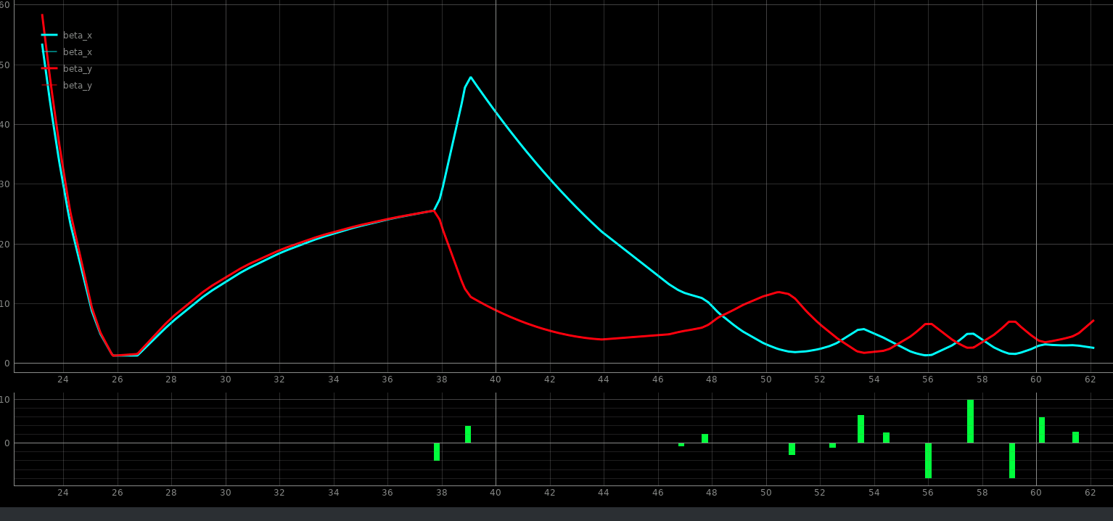
First things first
Matching means, that the actual electron beam parameters fit to the design optics of the lattice (given by the position and strength of magnets). In other words, the beam’s size at different positions in the accelerator is as designed.
The lattice is designed such that the electron beam’s quality in the undulator beamlines is as good as possible for lasing.
Beta functions (“beam sizes’) in the EuXFEL injector
Position of the cathode
Strengths of quads
I1 matching section

Slide 4
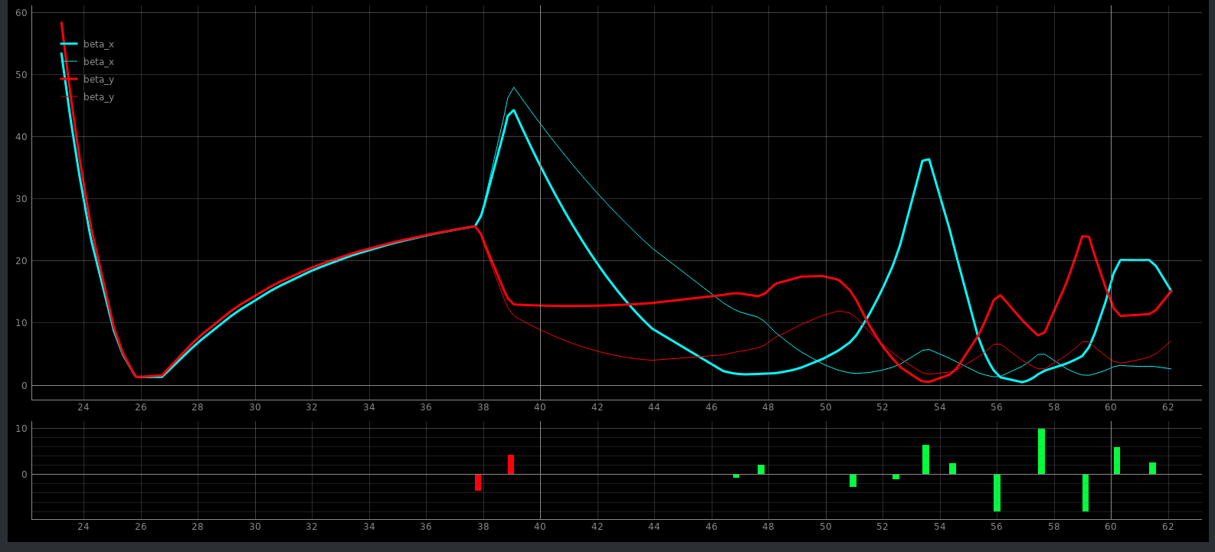
First things first
Matched and mismatched beams in I1
The beam sizes are different from what we need for successful operation
Changed the strengths of two quads in A1 and AH1

Slide 5


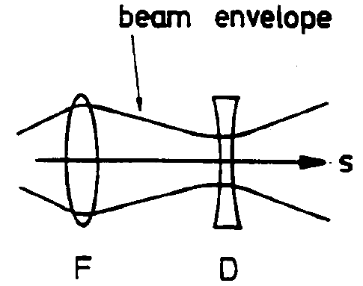
Emittance and Twiss-parameters
The beam orientation is described with the Twiss-parameters .
The “slope” of the ellipses are a signature of convergent or divergent beams.
A beam which does not have the same orientations (with respect to design optics) is called “mismatched” even if the emittance is the same.
This, can actually be measured (transverse beam sizes) e.g. with a screen or wire!

Slide 6
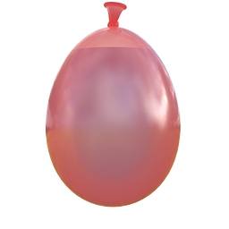
Emittance
Area covered by particles in phase space is
called emittance
We can assume an elliptical distribution
Emittance is conserved in linear optics
(Liouville’s theorem)
=> beam behaves like an incompressible liquid
=> focusing the beam will increase its
divergence
Small beams with little divergence as required
for SASE lead to small emittance requirements.

Slide 7
Emittance and Twiss-parameters
The beam orientation is described with the Twiss-parameters
The “slope” of the ellipses are a signature of convergent or divergent beams.
A beam which does not have the same orientations (with respect to design optics) is called “mismatched” even if the emittance is the same
same emittance with mismatch
smaller emittance and no mismatch

Slide 8
Emittance and beam size measurements
momentum
position
beam size

Slide 9
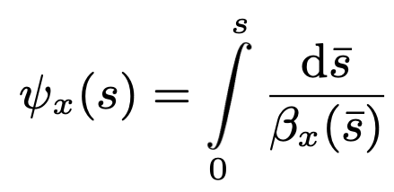
Emittance and beam size measurements
momentum
Δ phase advance *
momentum
* This is only true in the so called normalized phase space, but for simplicity's sake, let's keep it that way.
beam size
beam size
position

Slide 10
Emittance and beam size measurements
momentum

Slide 11
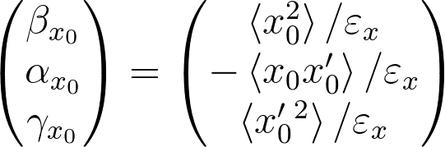

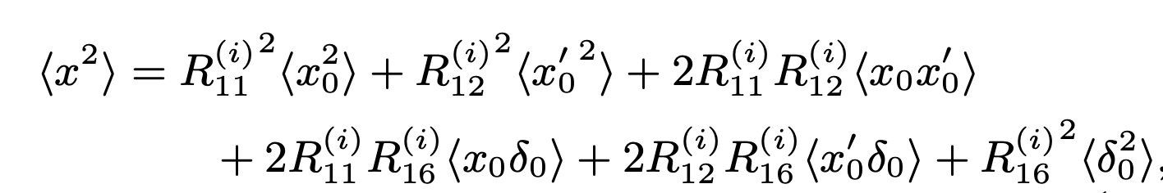
How to determine emittance and Twiss parameters
The definition of the emittance and the Twiss parameters at position 0 using the second beam moments.
and
We can only measure <X²>, the squared rms beam size 𝝈².
-> not enough…
However, we know how <X²> is transformed from 0 to 𝓲 using the transfer matrix elements R_{kl}
𝓲
We do the measurements in section with no bending magnets and assume that the transfer matrix elements R₁₆ and R₂₆ are zero.

Slide 12
How to determine emittance and Twiss parameters
The definition of the emittance and the Twiss parameters at position 0 using the second beam moments.
and
We can only measure <X²>, the squared rms beam size 𝝈².
-> not enough…
However, we know how <X²> is transformed from 0 to 𝓲 using the transfer matrix elements R_{kl}
𝓲
can be measured
three unknowns
Transfer matrix elements -> well known

Slide 13
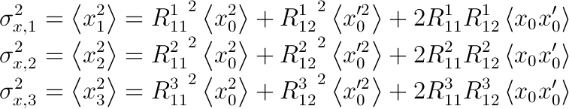
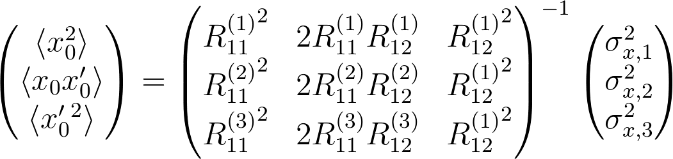
Calculation of beam moments
Lets make 3 measurements with different transfer matrices!
can be measured
Transfer matrix elements -> well known
three unknowns
and 3 equations
Done. All 3 required beam moments can be calculated.

Slide 14
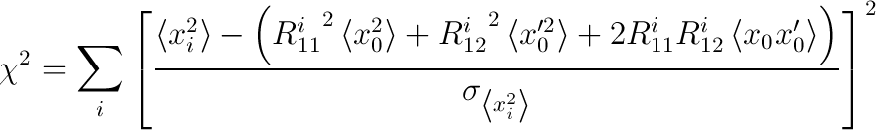

Fit of beam moments
Calculating the beam moments with 3 measurements does not result in any error estimations!
-> Preferably more than 3 measurements should be made.
The beam moments can be determined by a least square fit:
known
fit parameters
minimize
and

Slide 15
Measurement methods
How to make at least 3 different measurements with different transfer matrices between a reference position and the measurement position.
4 screen method
quad scan
reference
position
reference
position
screens
screen
quads
quads
S
S
R ⁽¹⁾
R ^{(𝓲)}
Different transfer matrix due to 𝓲 = 1,…,N quad settings

Slide 16
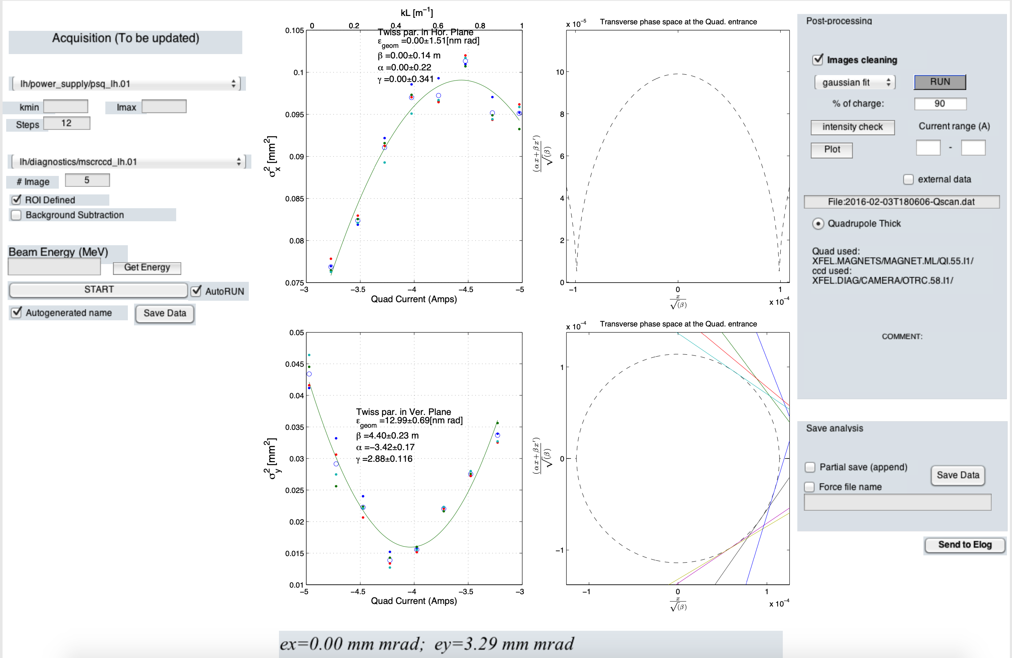
Single quad scan
Depending on the beam optics it is often not possible to scan both planes at the same time.
A very small beam size in the injector can lead to a beam blow up due to space charge.

Slide 17
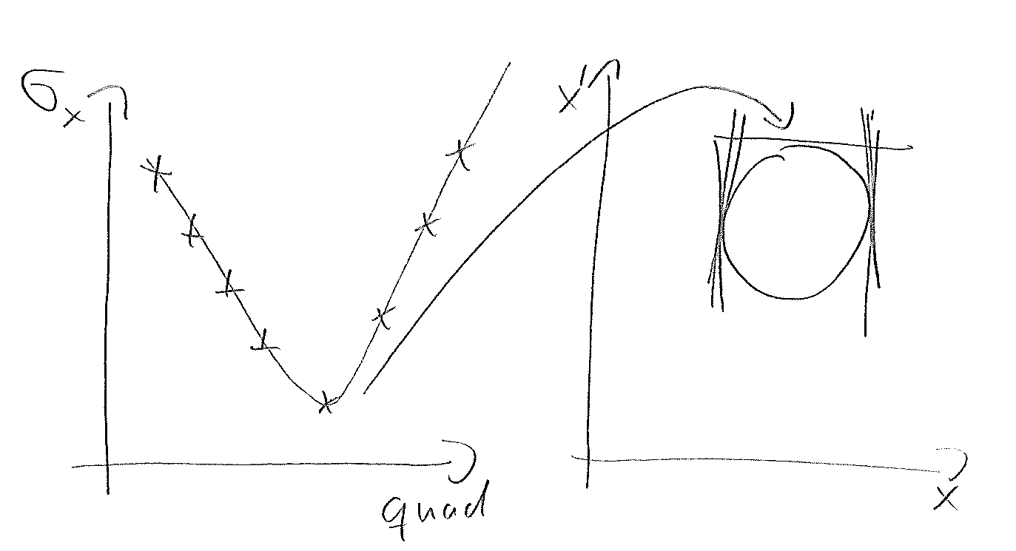
Single quad scan and scan step sizes
If equally large steps are selected for the magnetic strength, this can potentially lead to doubtful measurement results.
The measurement result of the emittance in the example on the right hand side is absolutely dominated the one measurement taken in the beam waist.
Many thanks to Bolko for the nice and explanatory drawing ☺

Slide 18
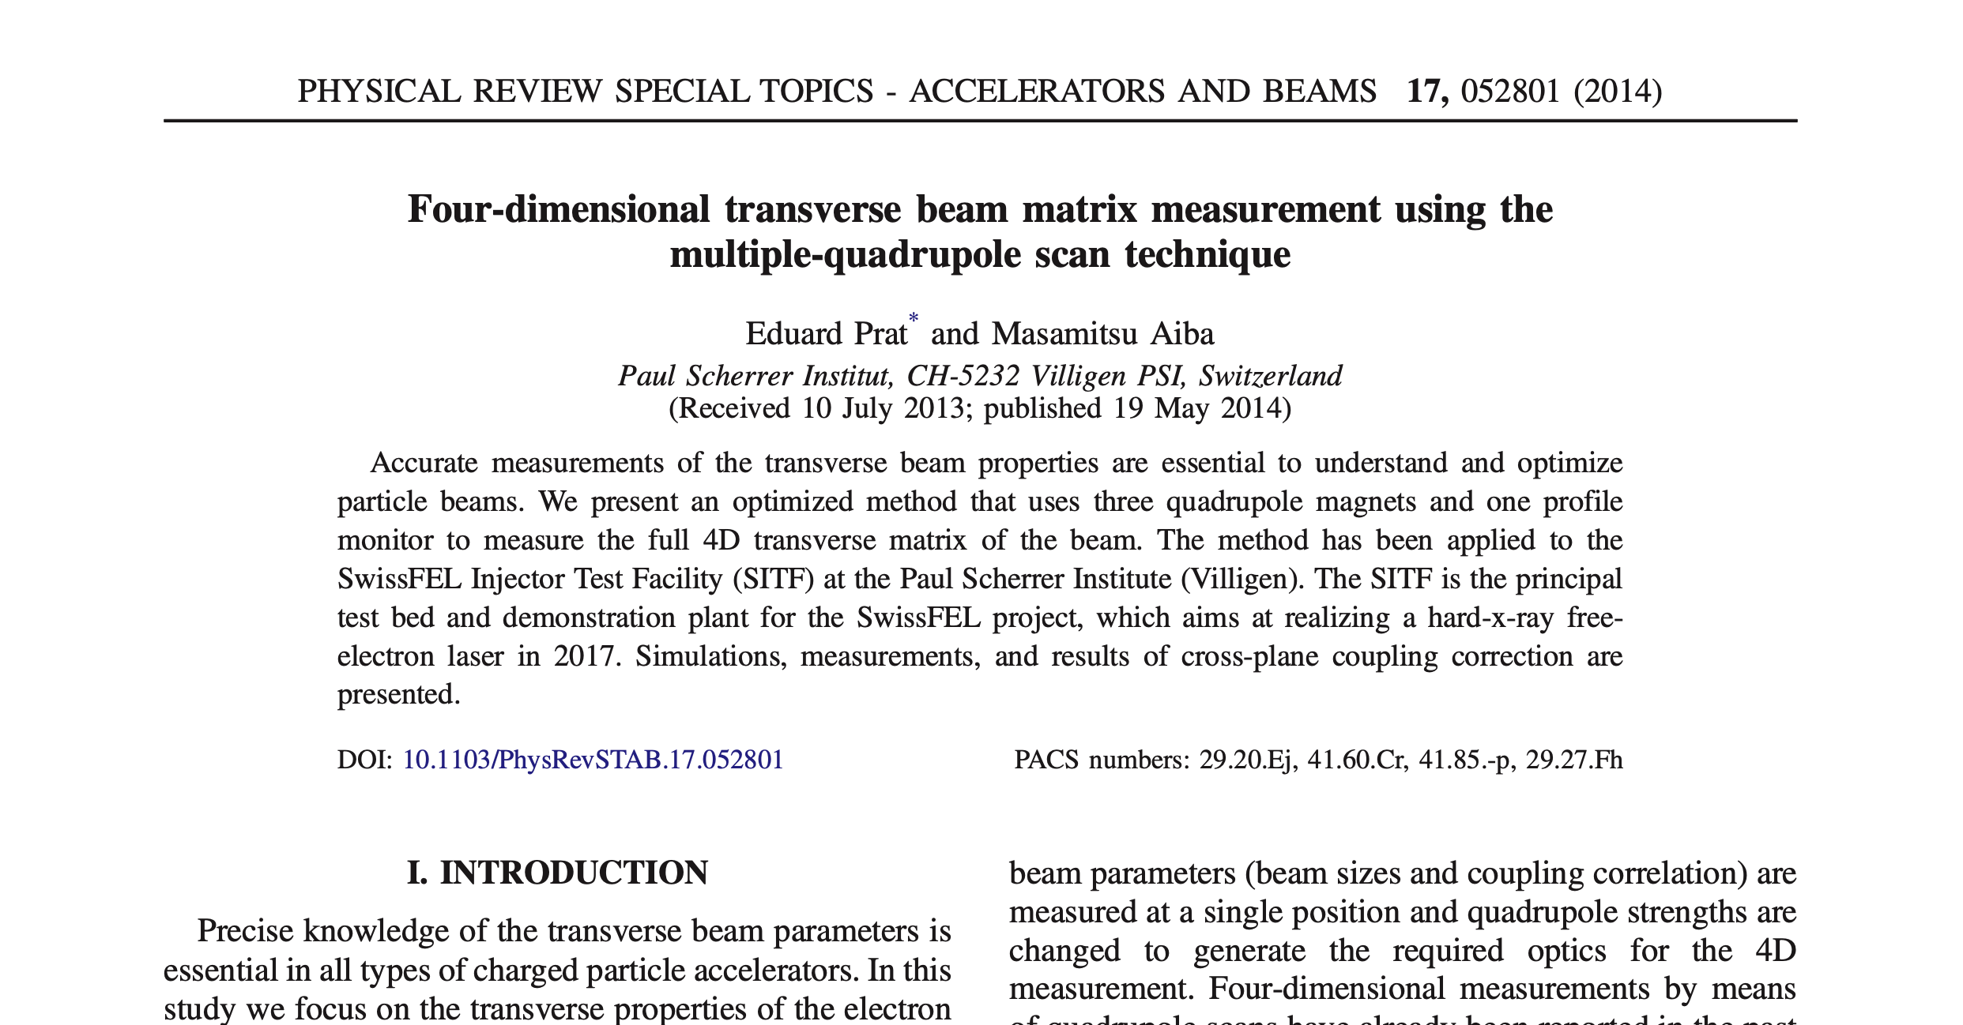
Multi quad scans
Using more than one quadrupole has the advantage that:
  The beam size at the screen can be kept constant for all measurement steps. No small beams are necessary that might be blown up by space charge.
  Both transverse planes can be scanned over a wide range in the same measurement (advantage over most single quad scans).
  Many measurement steps are possible thus measurement errors in single measurements can be found and neglected (advantage over multi-screen method).

Slide 19
Prepared quad scan for the EuXFEL injector

Slide 20
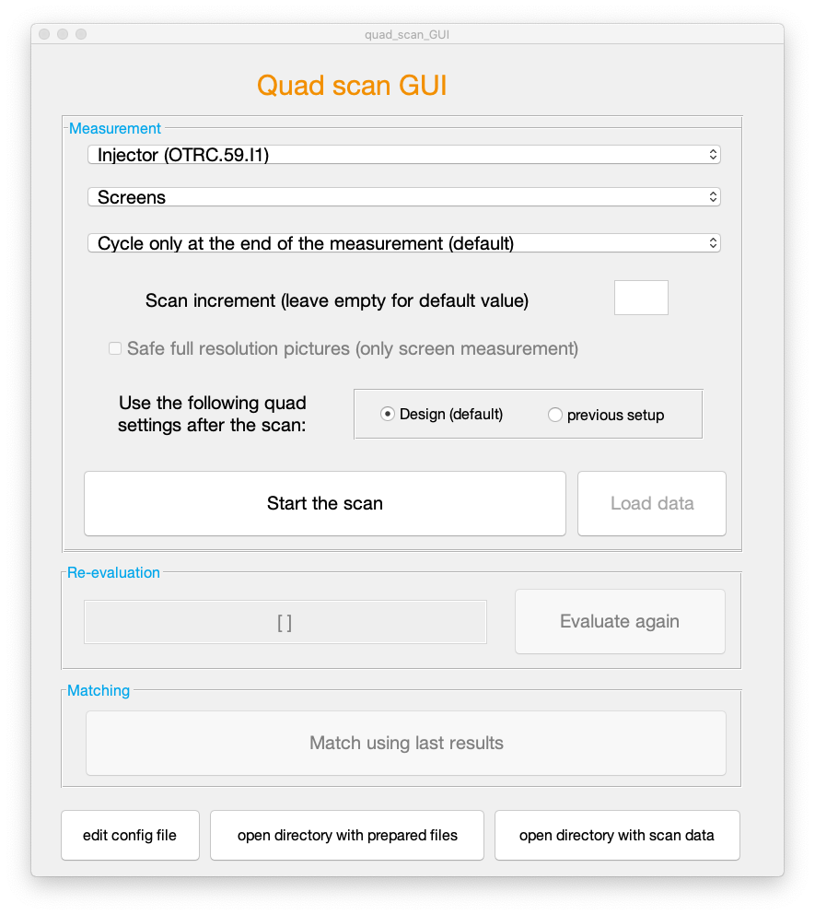
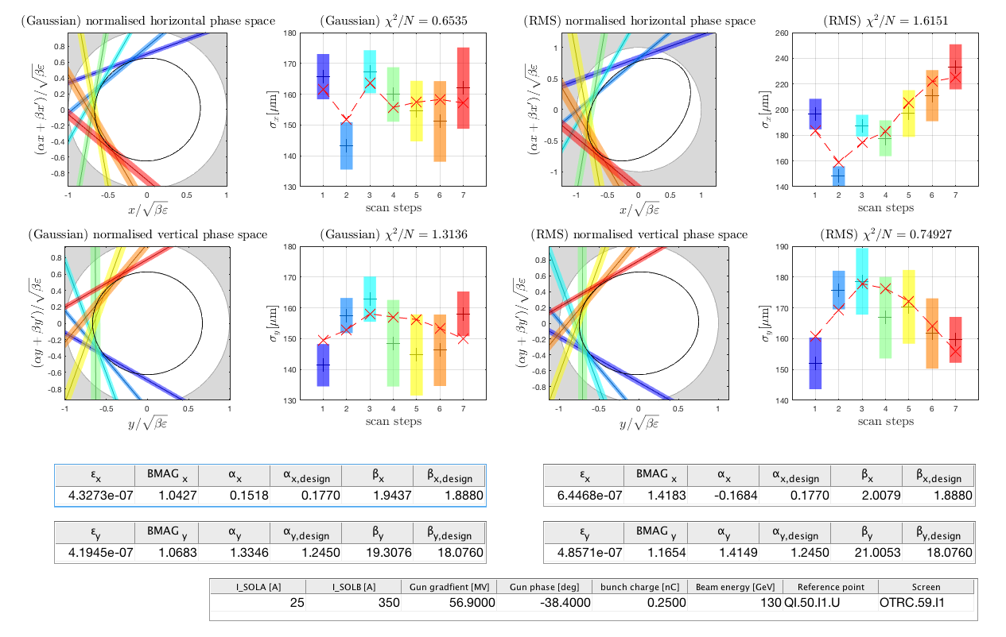
Optics matching in the injector using screen stations and multi knob quad scans

Slide 21
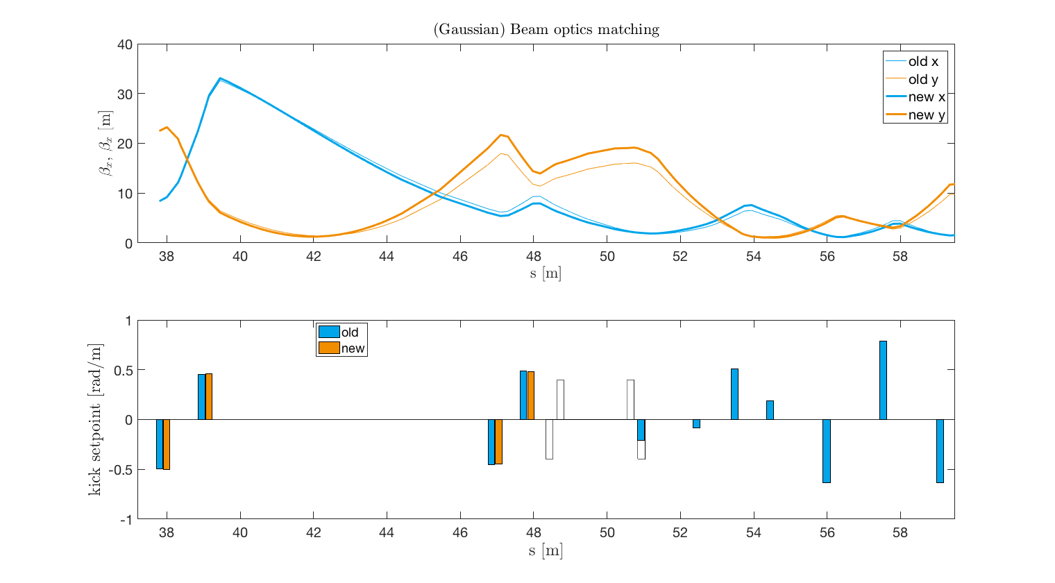
Optics matching in the injector using screen stations
The measurement result can be directly used to match the beam in the respective section.

Slide 22
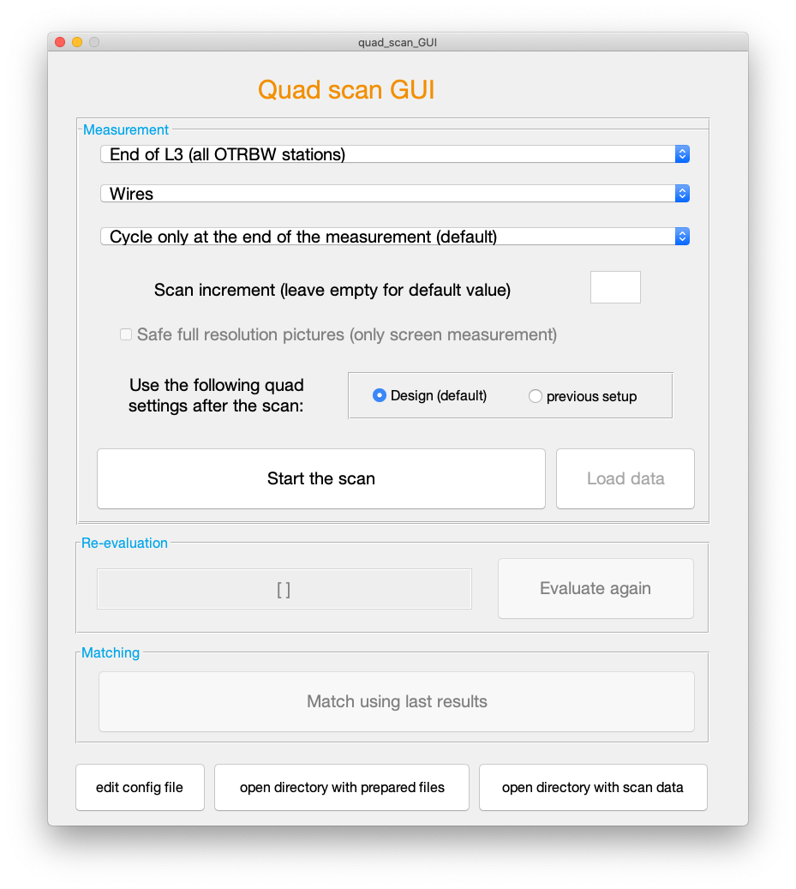
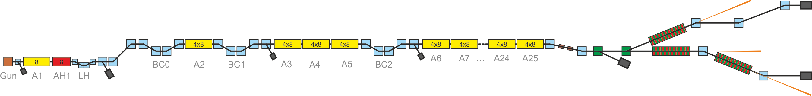
Beam optics measurements downstream L3
Final beam optics measurements and corrections at the end of the main linac.
This measurement can be carried out using either screens or wire scanners.
It ensures, inter alia, an effective collimation in the following section.

Slide 23
Prepared quad scan for L3

Slide 24
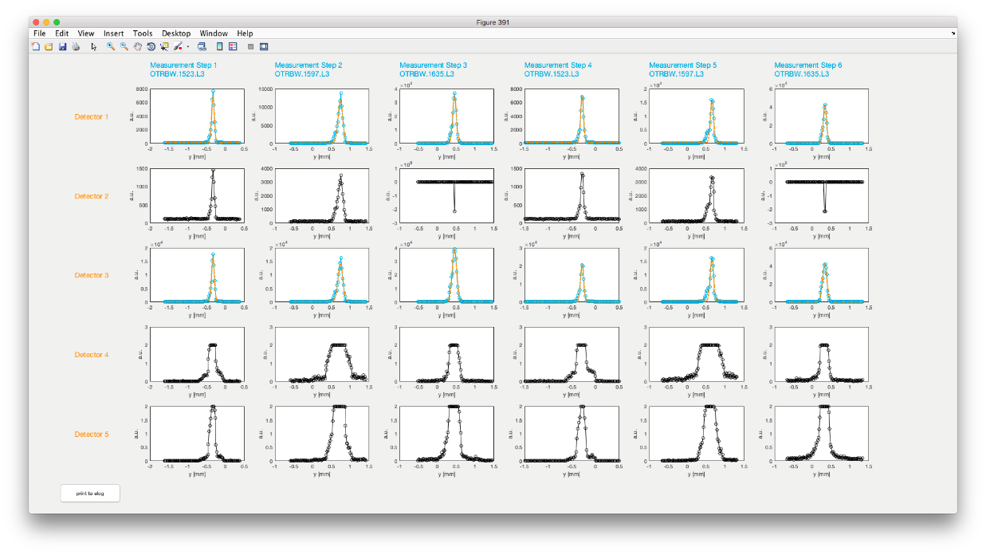
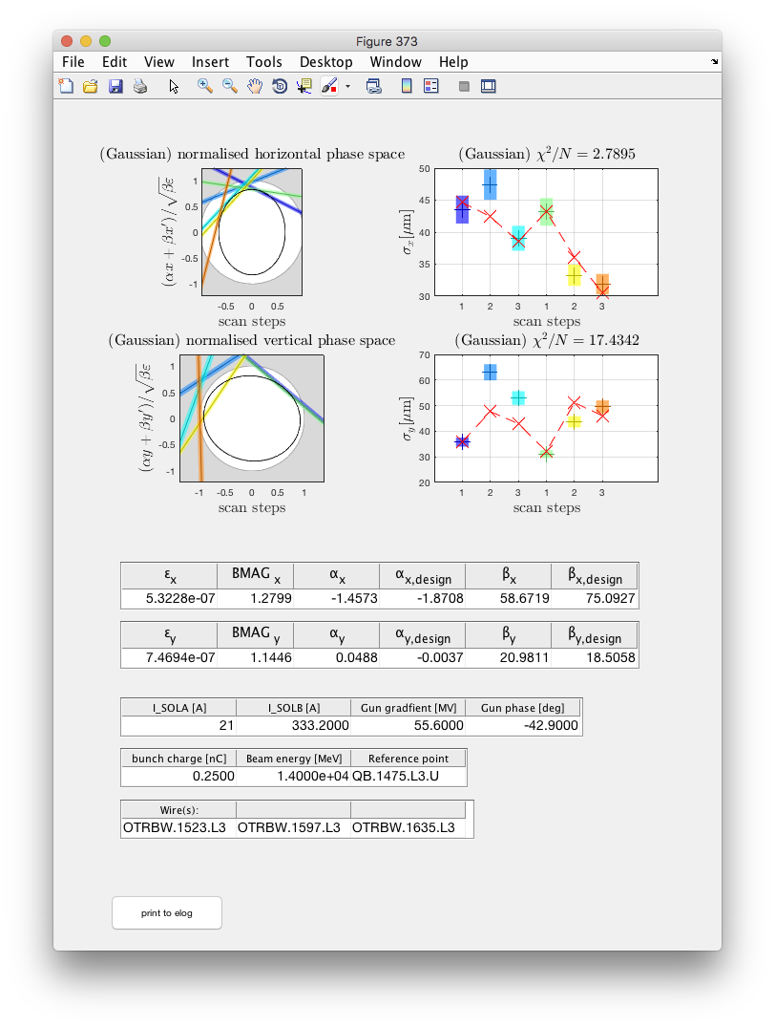
Measurement results for quad scans with wires
Signals from all wires and for all measurement steps
<- Detectors ->
<- Measurement steps ->
Blue intensity traces indicate that the data from the respective detector is used for the evaluation.
Thus, saturated signals should be presented in black, which means they are not considered in the evaluation.
The upper plot is shown twice, one plot for each plane.
Normalized phase spaces and beam sizes as well crucial scan parameters from the measurement.

Slide 25
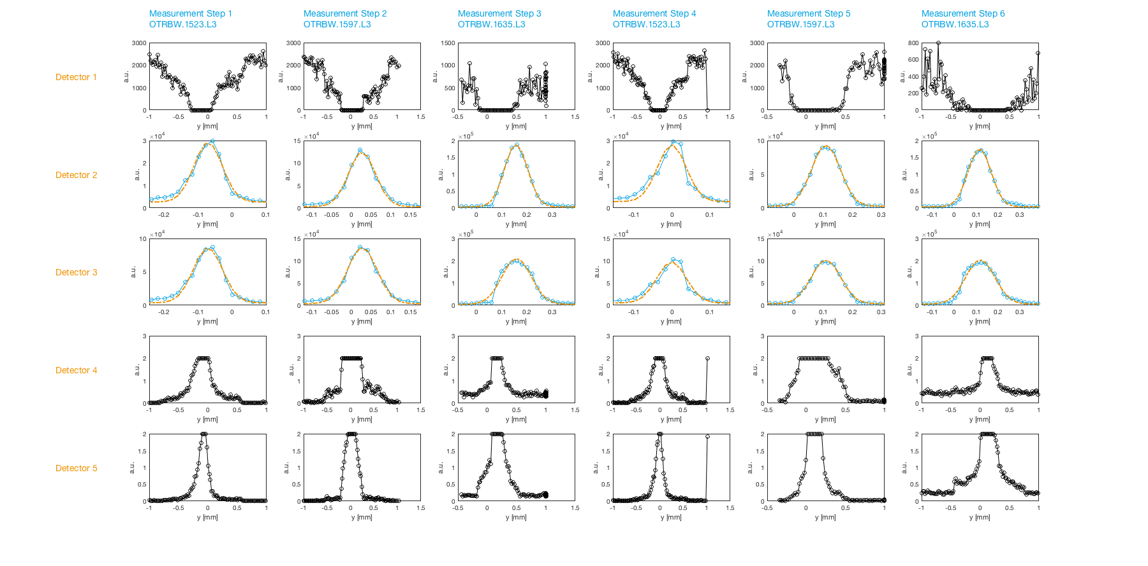
Beam optics measurements downstream L3
Electron beam profiles
A quadrupole scan using :
Two different beam optics
Three different wire scanners (or screen stations)

Slide 26
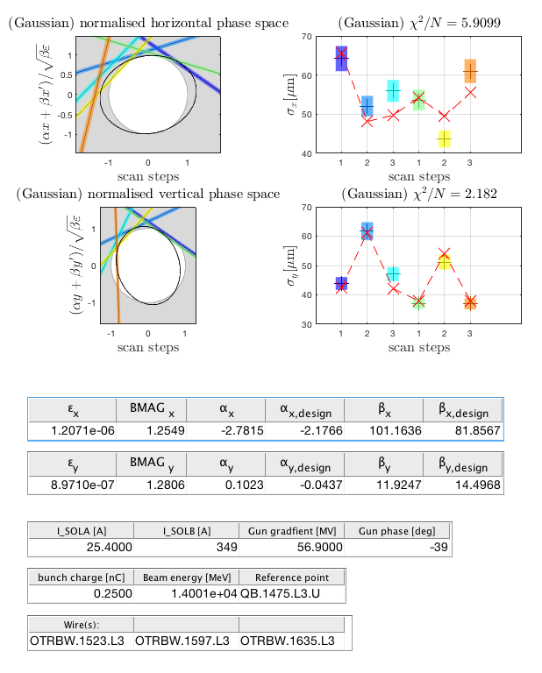
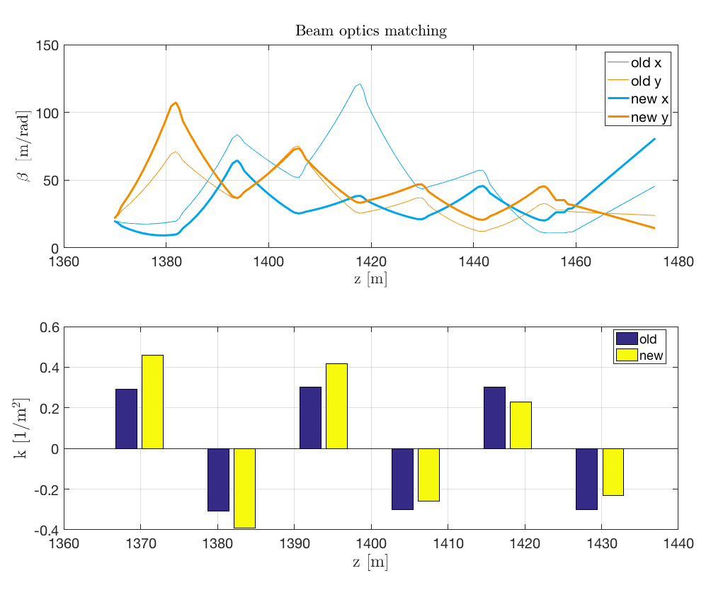
Optics matching in L3
The beam optics measurement presentation is the same as for the screen measurements.
The measurement result can used to match the beam in L3.

Slide 27
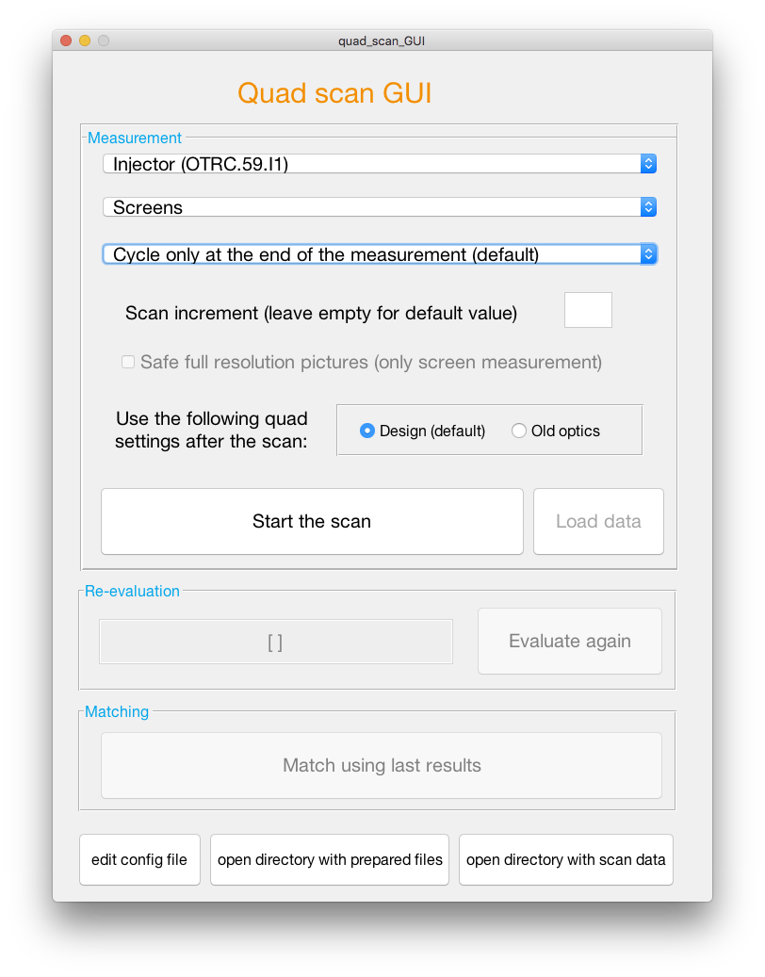
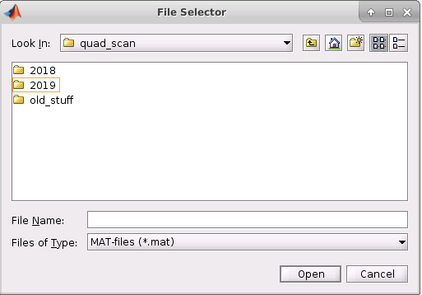
Multi quad scan GUI
Tools Advertising
Select a beamline section
Increment: only every nth step of the measurement will be taken.
Select the measurement device: Screens or wires? The default device is automatically set for each beamline section.
Chose beam optics after measurement: either design values or beam optics used before the measurement.
Select the preferred cycling procedure.
New button: load and plot old measurements. Opens a file selector GUI.
Start the scan
It is necessary to change matching quads, wire scan detectors or something else? Press ‘edit config file’.
Access to the prepared quad scan files.
Access to all quad scan measurement data.

Slide 28
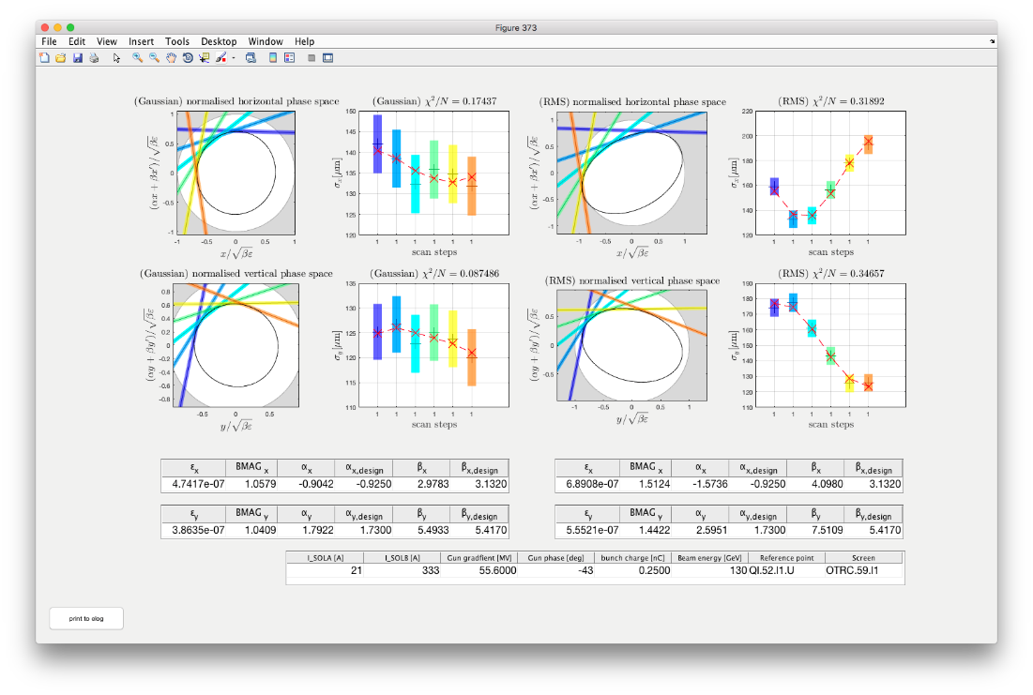
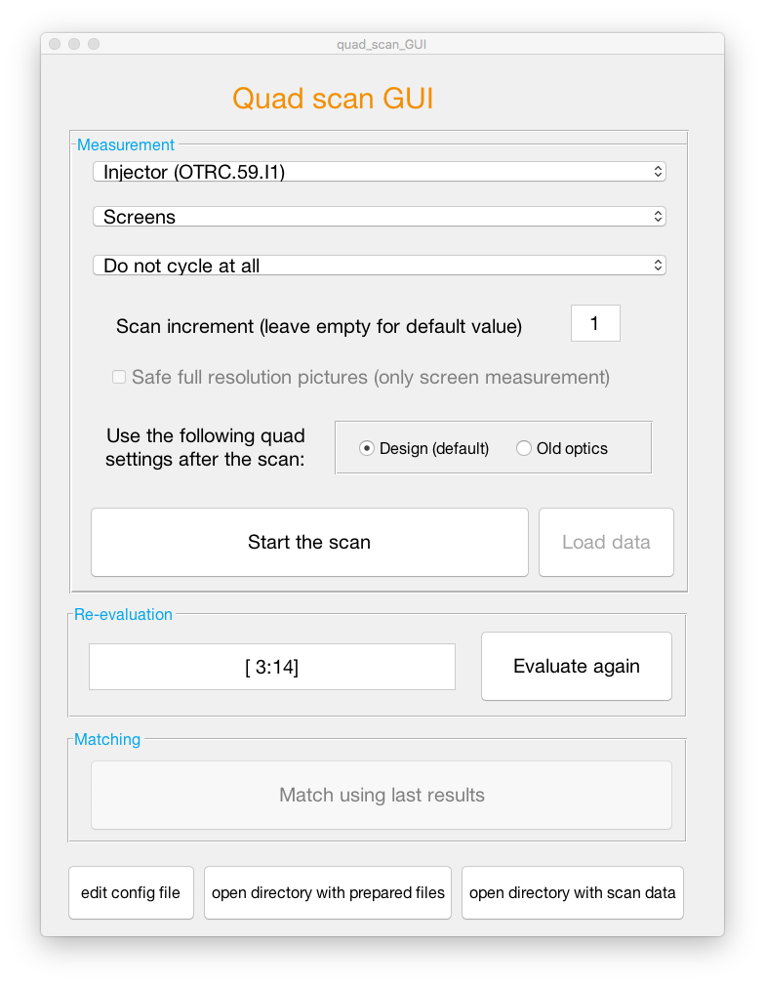
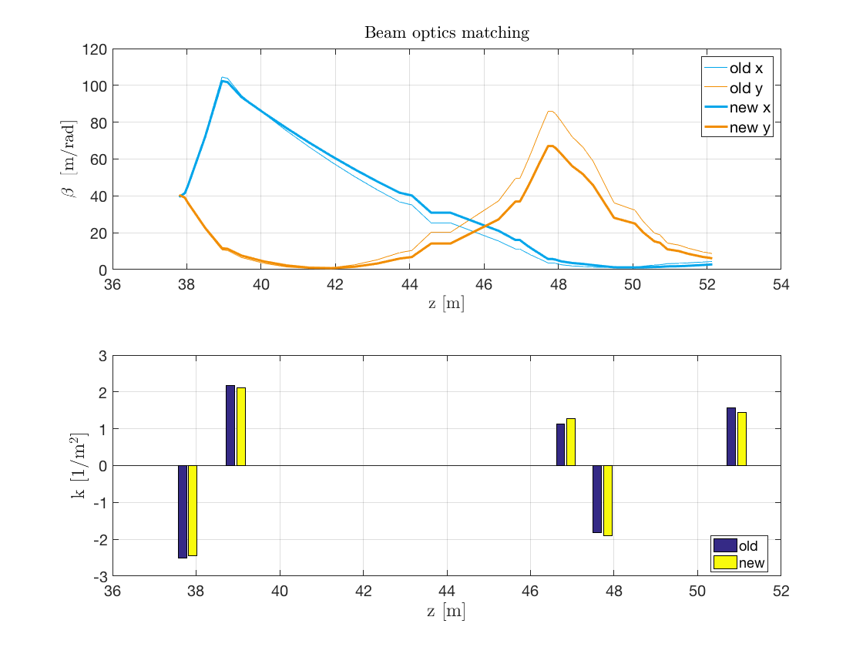
Measurement results for quad scans with screens
Tools Advertising
Well know measurement presentation after a quadrupole scan using screen as measurement devices.
The matching routine uses either the last measurement or the last re-evaluation of the measurement data.
Match using last results
Typical result after matching calculation. This plot is only shown if the algorithm found a solution.

Slide 29
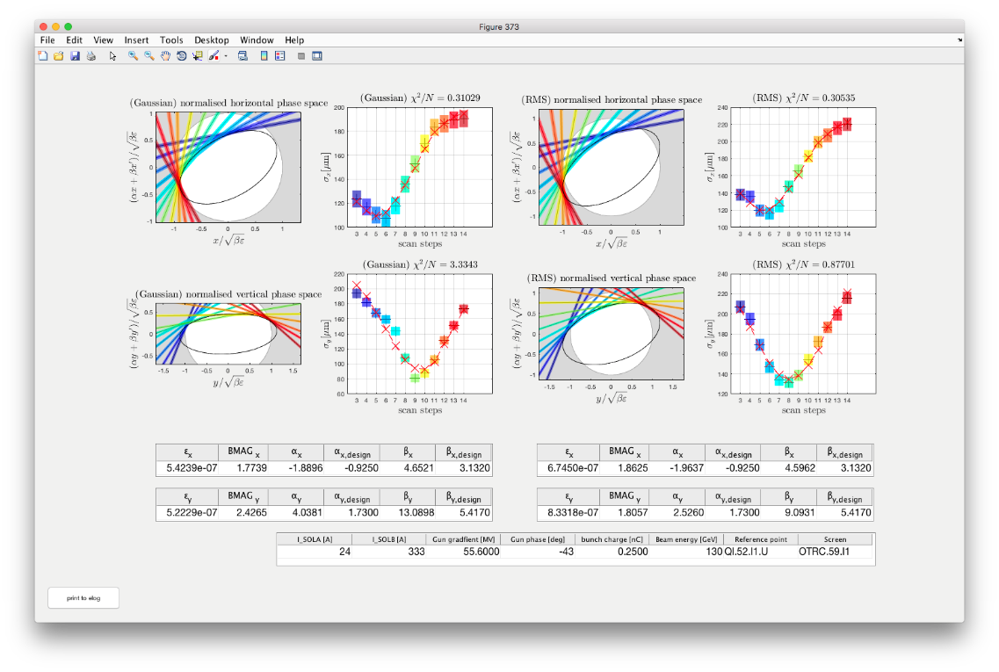
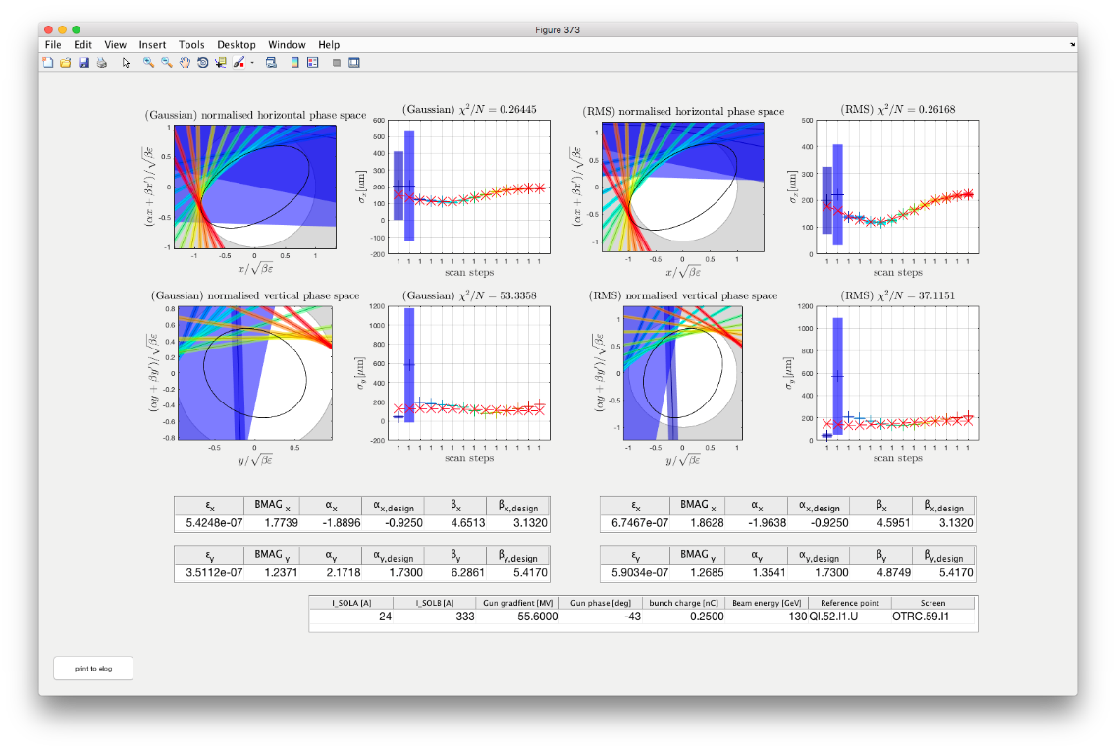
Deselecting single measurements
Tools Advertising
It is possible to evaluate only a selection of the taken data steps.
Write all step numbers that should into that field and press ‘Evaluate again’.
You can use MATLAB type vector definitions like [3:7] = [3 4 5 6 7].
Be careful with the deselection of measurement steps and with the following evaluation of the data!
This functionality must only be used to deselect measurements steps that went clearly wrong (e.g. no beam).
It must not be used to deselect ‘unwanted’ measurement steps to improve e.g. emittance size or beam optics matching!
The first two measurement steps were taken steps without beam.
After deselecting the first two measurement steps

Slide 30
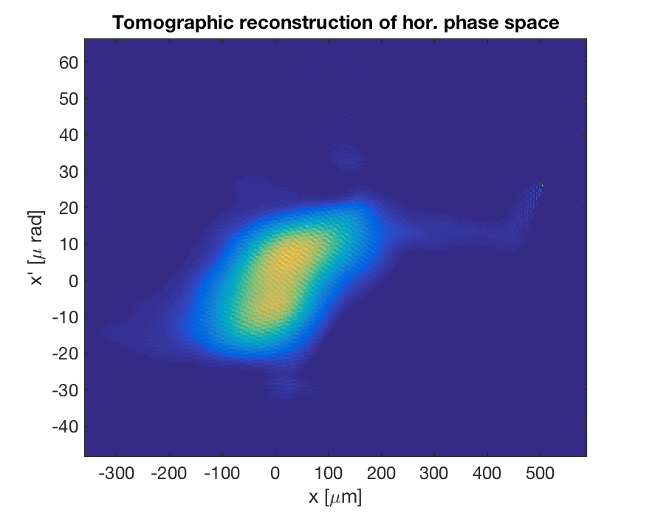
Tomographic reconstruction of transverse phase spaces
Even more information about the beam can be obtained by using not only the beam sizes but also the profiles.
The transverse phase spaces can be reconstructed using a tomographic algorithm and the profiles from different ‘angles’.
Tomographic reconstruction of the horizontal phase space for the center slice.
momentum
position
beam size

Slide 31
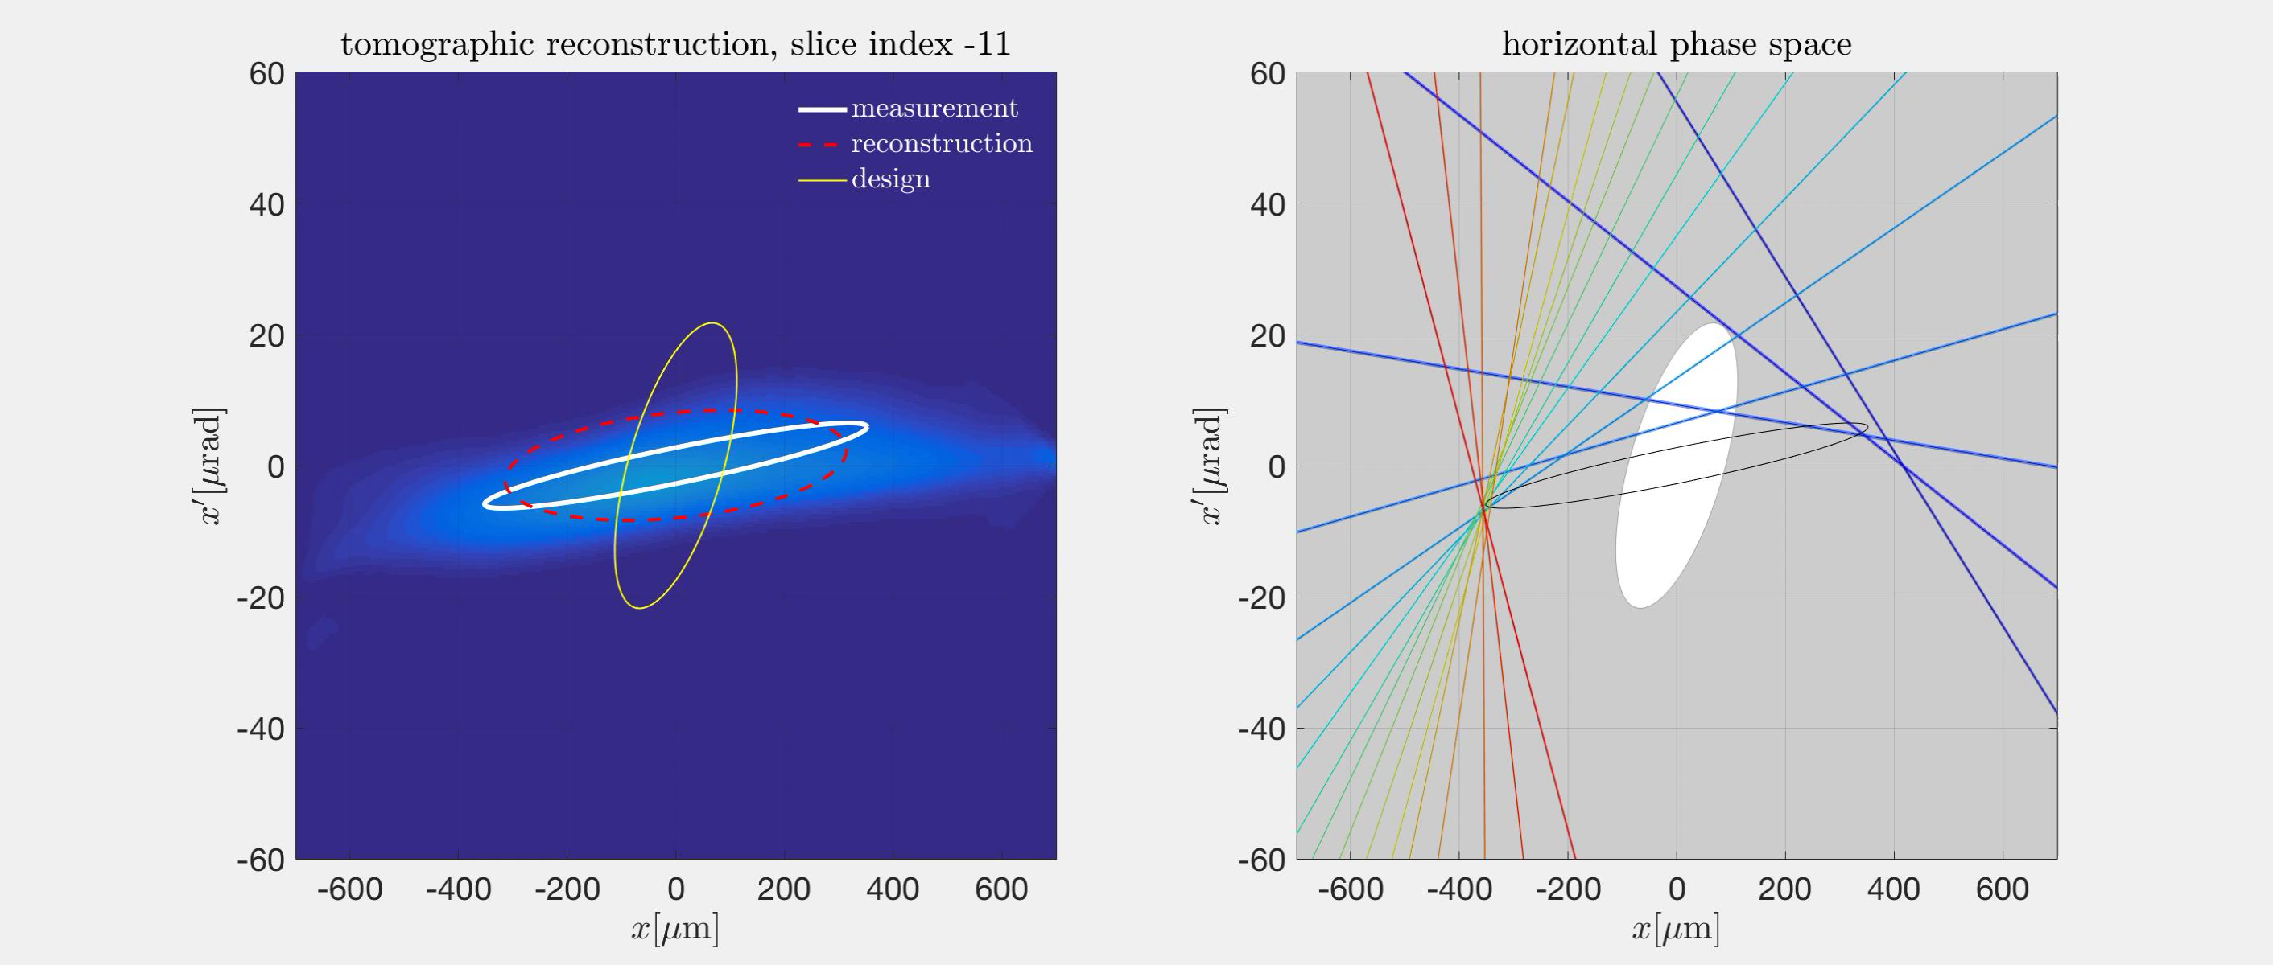
Tomographic reconstruction of the hor. phase space using a quad scan

Slide 32
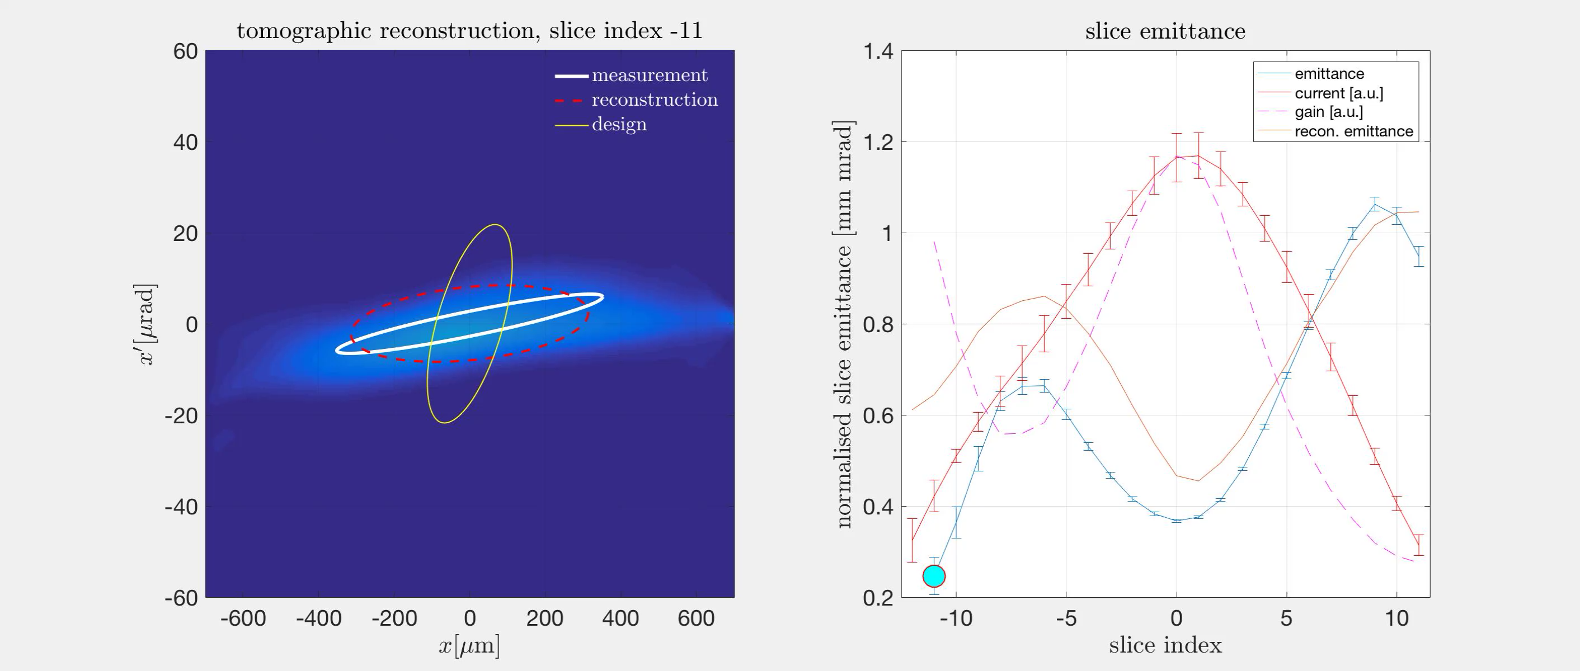
Tomographic reconstruction of the hor. phase space using a quad scan

Slide 33
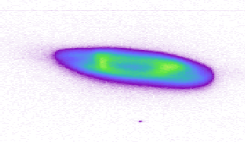
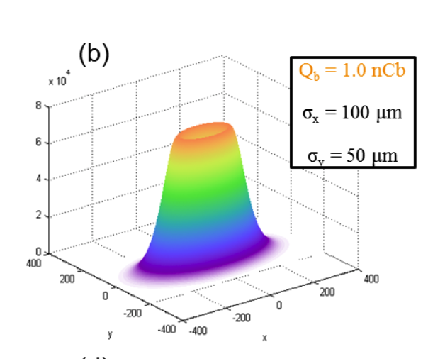

EuXFEL
Lyso screens
It turned out that measured emittances sizes depended on the beam size on the screens.
In addition, the beam spots one the screens were not gaussian shaped but looked like smoke rings.
It was not clear if the beam looks like that or if the LYSO screens can not display the bunches correctly.
No others screens were available in the machine.
y
Beam size
x
It turned out that it was a quenching effect of the scintillators.
That effect could be reproduced in simulations.
Most of the screen have been or will be replaced with YAP or GGAG.
Beta functions at screen

