Slide 1
Status report on Pilot for DOIs service at DESY
What are the features you can expect?
What are the prospects?
What is left to do to get there?
Regina Hinzmann with input from many
esp. IT collegues Johannes Reppin, Armando B Martinez, Tim Wetzel and Tobias Klann.

Slide 2
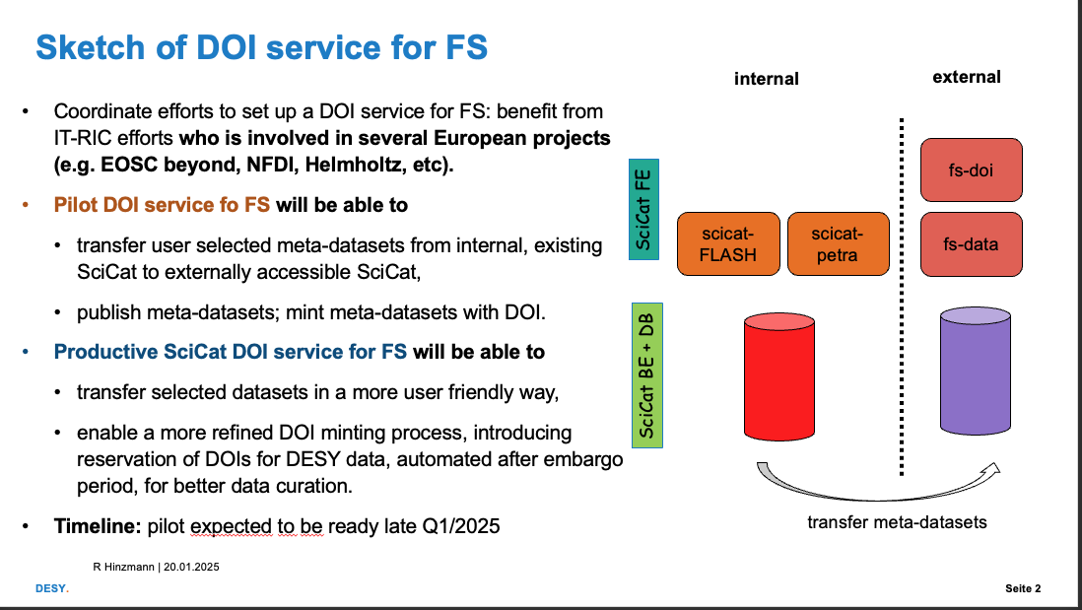
Pilot: DOI minting service and catalogue functionality at DESY
benefiting from DESY involvements in European project that triggered SciCat activities (DESY-IT-RIC)
Beginning Oct - Mar
IT and FS agreed on a set up: to handle data under embargo and those for which a DOI will be minted.
we worked on such a setup with this concept:
  to have an internal catalogue in which (all) beamline data is ingested into, just as the demonstrator instance at P08.
  From that internal catalogue the user shall select those datasets (of metadata) which are to be published and DOI minted.
  The user would need to transfer the metadatasets to an external catalogue, being exposed to the www without authentication and configured to point to a Landing page.

Slide 3
Pilot: DOI minting service and catalogue functionality at DESY
Status update since start in Okt 2024
Status
We moved away from OpenStack and use already the productive environment (systems Kubernetes cluster).
We will deploy a single instance capable of dealing with internal and published meta data.
Proprietary/industry metadata will not be ingested at all.
We moved from fs-data.desy.de to scicat.desy.de to cover also cases beyond FS.
a Landing Page has been configured and set up: doi.desy.de*
For the next 1 ½ - 2 months: test workflow, collect missing features and benefit from the second round of DAPHNE contribution to SciCat.
Outlook
pilot anticipated (early) Q2.
  catalogue function for meta datasets for all beamlines where ingestion to SciCat is setup.
  DOIs of selected metadata
  no direct data access
  no data curation
Prospects/to be decided
To provide core functions of a metadata catalogue DESY must agree on
workflow of DOI minting at DESY. The pilot offers a crude way to mint DOIs. But: combine it with curation service of library?
Needs agreement: What are automated and what manual parts in the workflow?
Define concept of data access or “download functionality”.
doi.desy.de
data
curation
SciCat FE
scicat.desy.de
DB
SciCat BE + DB
storage
not yet
integrated
available for pilot

Slide 4
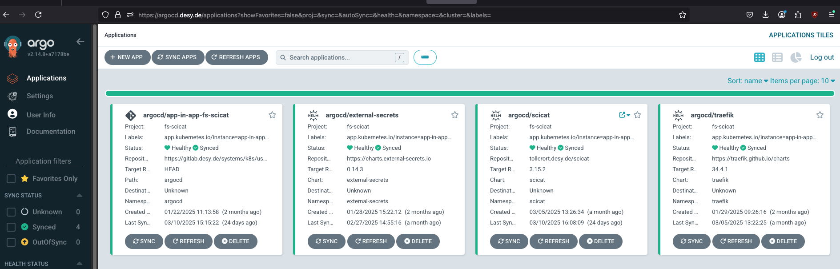
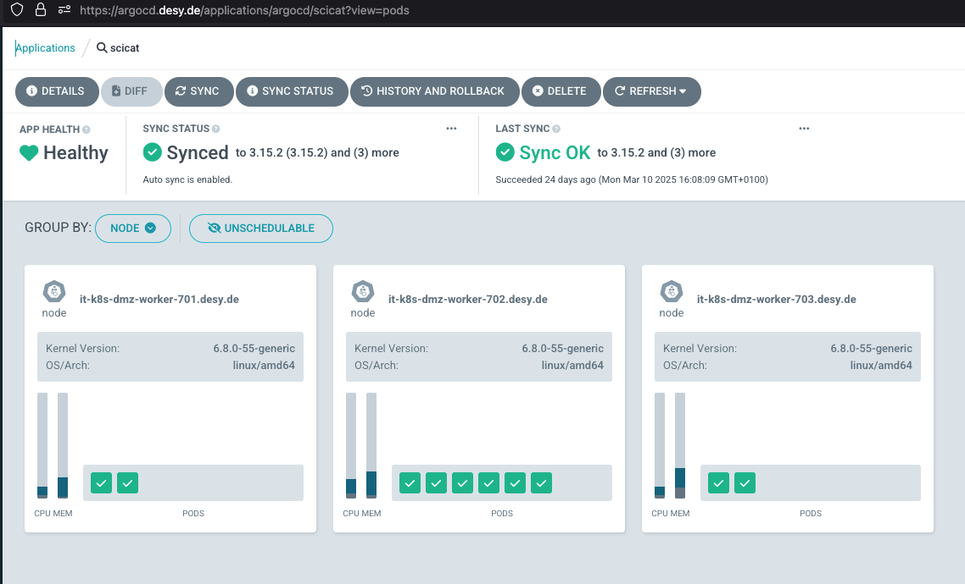
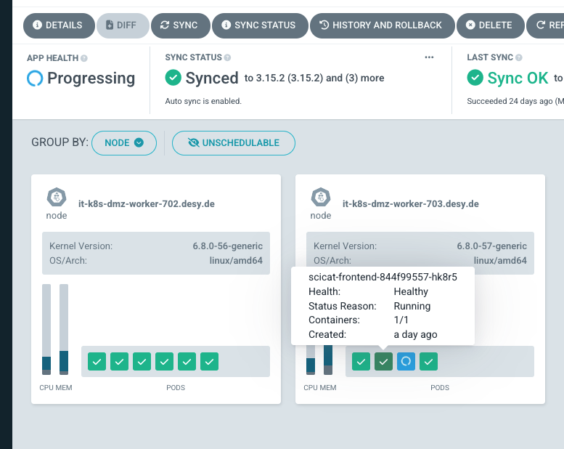
TEST instance scicat.desy.de on systems cluster
Under development and continous improvement. Don’t expect stable behavior for now!
Configured to enable each user to ingest a dataset:
  no functional account for ingestor is needed which makes it more secure.
Tweak performance: requested new features for SciCat for better administration, e.g. move the credentials of BE to DB so one can have several BE API servers for 1 DB.
Next in April: Test the DOI minting workflow with larger test data.
Plan is to dump TEST data of current SciCat instances into our pilot cleaned from any proprietary data.
credits for set up & running: My IT collegues Johannes Reppin, Armando B Martinez, Tim Wetzel and Tobias Klann.

Slide 5
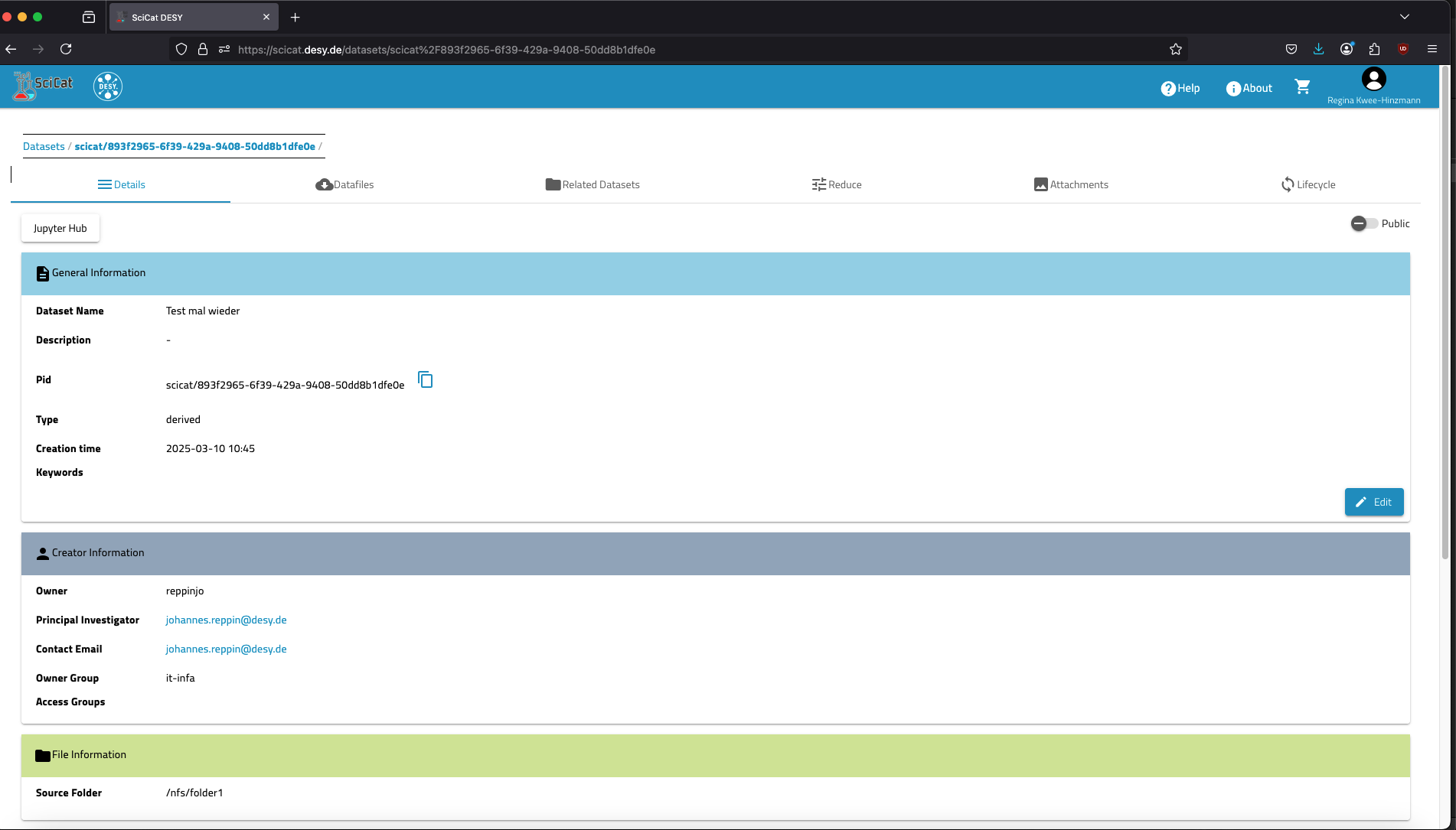
DESY-wide metadata catalogue
for all FS data under embargo
scicat.desy.de
scicat can handle
public metadatasets
scicat handles
externally defined access rights (me as part of this group have ownership for this dataset too)

Slide 6
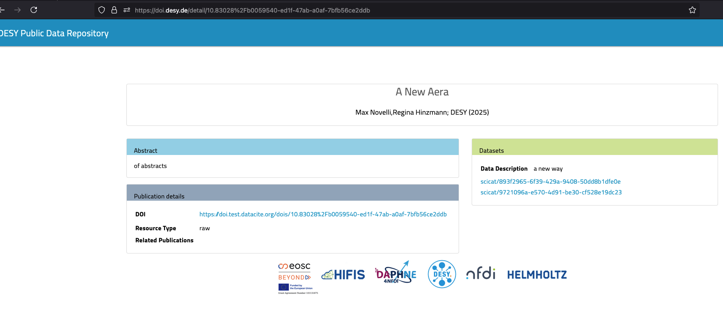
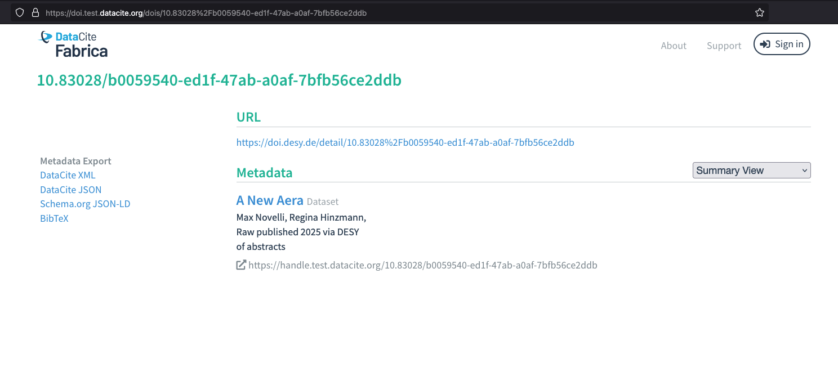
Pilot: DOI minting service and catalogue functionality at DESY
First impressions.
Selection of several datasets
SciCat covers only a minimum of
DataCite fields.
cannot edit all fields
e.g. authors, for now Creator is author
resolved to DataCite catalogue

Slide 7
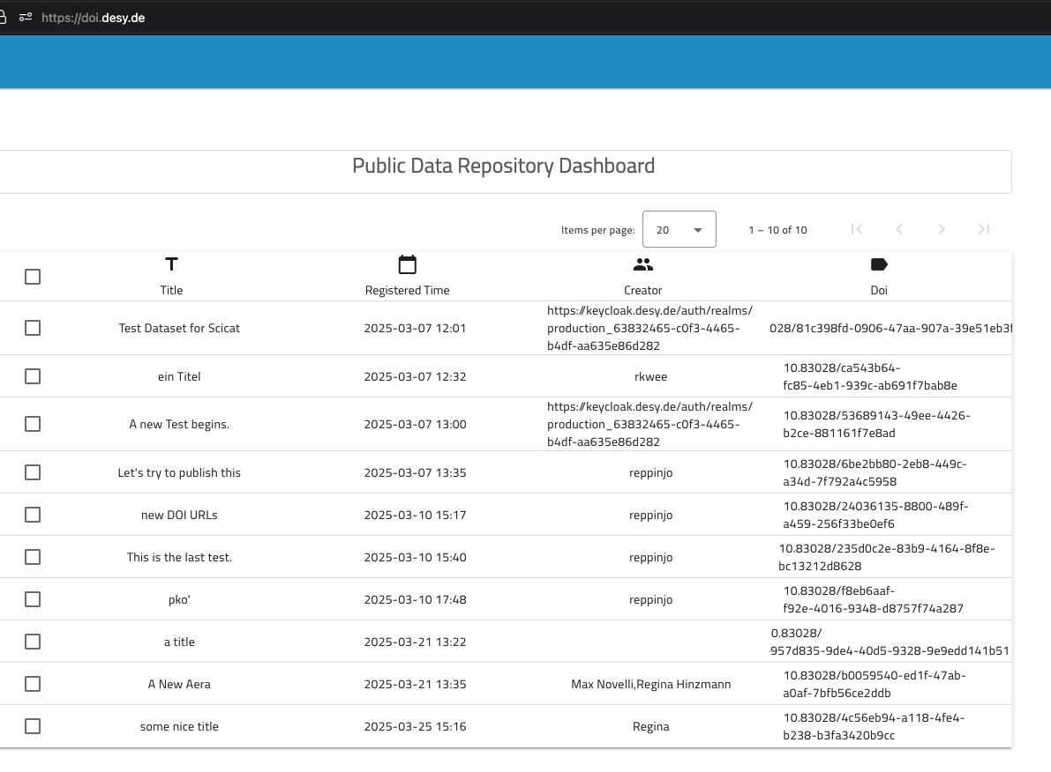
Pilot: DOI minting service and catalogue functionality at DESY
Next tasks for pilot early O3
Iteration with developers, e.g. no search on global Landing Page is currently possible.
  Be able to edit more fields than currently possible, e.g. authors.
  Remove selection column (left) or better: get rid of LP but integrate the more general approach published Data as home page
  Fix DOI minting workflow (e.g. user can still edit record after registration).
  Collect all missing features for production. With Nicolas H we worked on an improved workflow.
Test findability of datasets.
Disclaimer that no direct data access (download of data) is granted until IT/FS/L agrees and realises a concept.
Define and perform tests to test stabilty of DOI workflow. Involvement of test user and L (and FS).
Prospects: within the next (4) month, ie. early O3, significant improvement will be made. With some grace time, the pilot is considered ready (w/ agreed plan for data access).
doi.desy.de

Slide 8
additional info
(reminder)

Slide 9
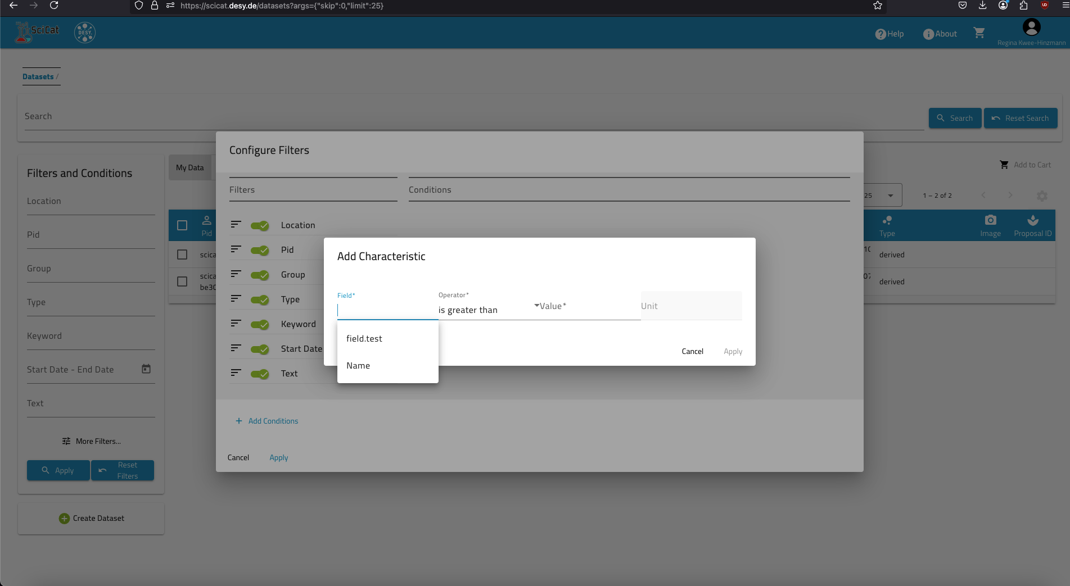
Outlook Pilot
Next items on the table:
Further improvements on UI/UX especially the search.
Refactor DOI minting procedure.
When SciCat becomes useful…
shown at SCT 2025-03-31
https://indico.desy.de/event/48566/
Improvements for the second round of DAPHNE contributions to SciCat (DCS).

Slide 10
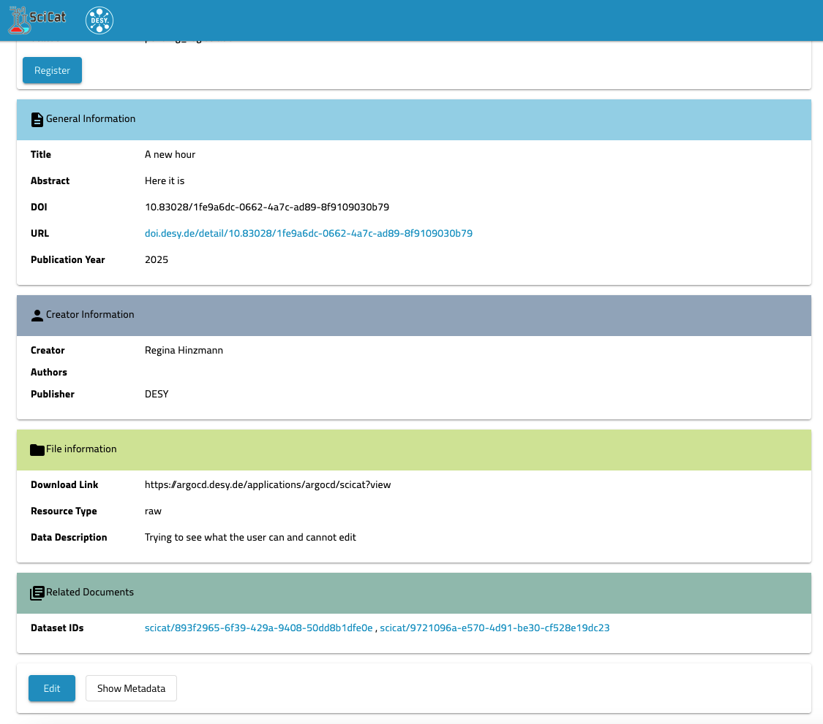
Outlook Pilot
shown at SCT 2025-03-31
https://indico.desy.de/event/48566/
Improvements for the second round of DAPHNE contributions to SciCat (DCS).
Usefulness of SciCat: DOIs
Next items on the table:
Further improvements on UI/UX especially the search.
Refactor DOI minting procedure.
From annual meeting last week we worked on a list which Max is now preparing for the next contract.
A big THANK YOU to all who contributed!

