Slide 1
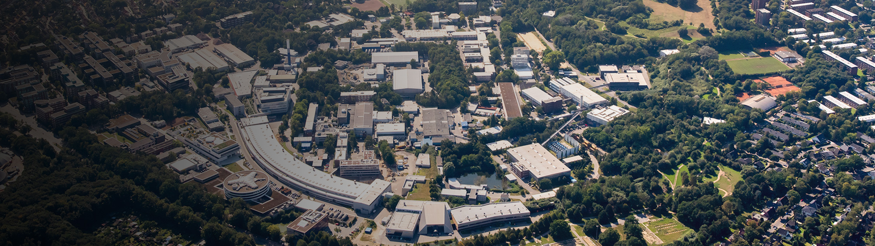



An Update from
public-data.desy.de
Tim Wetzel, Patrick Fuhrmann, Armando Bermudez Martinez, Uwe Jandt, Paul Millar, Sophie Servan, Peter van der Reest, Regina Hinzmann, Johannes Reppin, Christian Voss, Linus Pithan, Anton Barty, … (DESY)
Julia Kobus, Philipp Jordt, Linus Liedtke, Bridget Murphy (CAU Kiel)
Slides partly with courtesy from Patrick Fuhrmann
This presentation is licensed under
https://creativecommons.org/licenses/by/4.0/
FH SciComp Workshop 2025

Slide 2
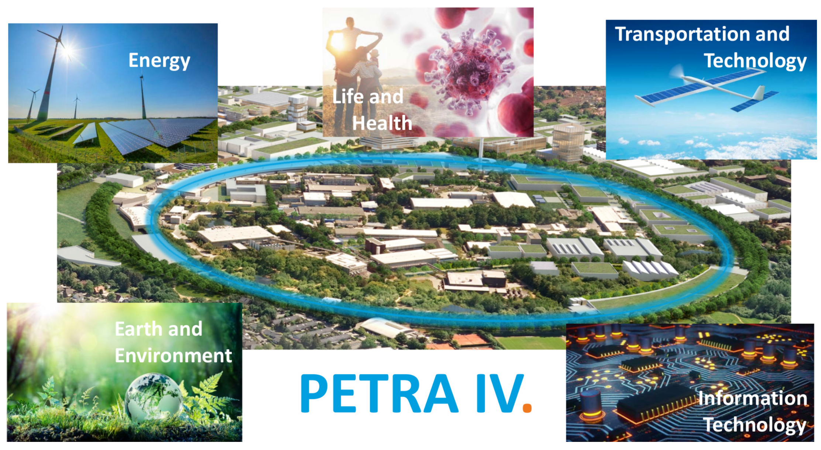
The Machine
PETRA III grows

Slide 3
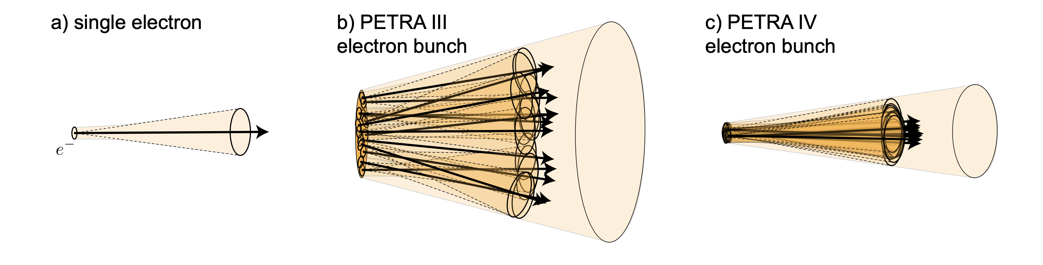
The Principle
Diffraction limits: What’s better?
A single electron emits synchrotron radiation in cone with a small opening angle and a corresponding small effective source size
In PETRA IV, the electron bunches approach the diffraction limit in both lateral size and divergence, this emitting diffraction-limited radiation up to the X-Ray energies of about 10 keV.
The electrons in the bunches in today’s synchrotron sources are distributed horizontally well beyond the lateral diffraction limit in terms of size and divergence angle.
FH SciComp Workshop 2025

Slide 4
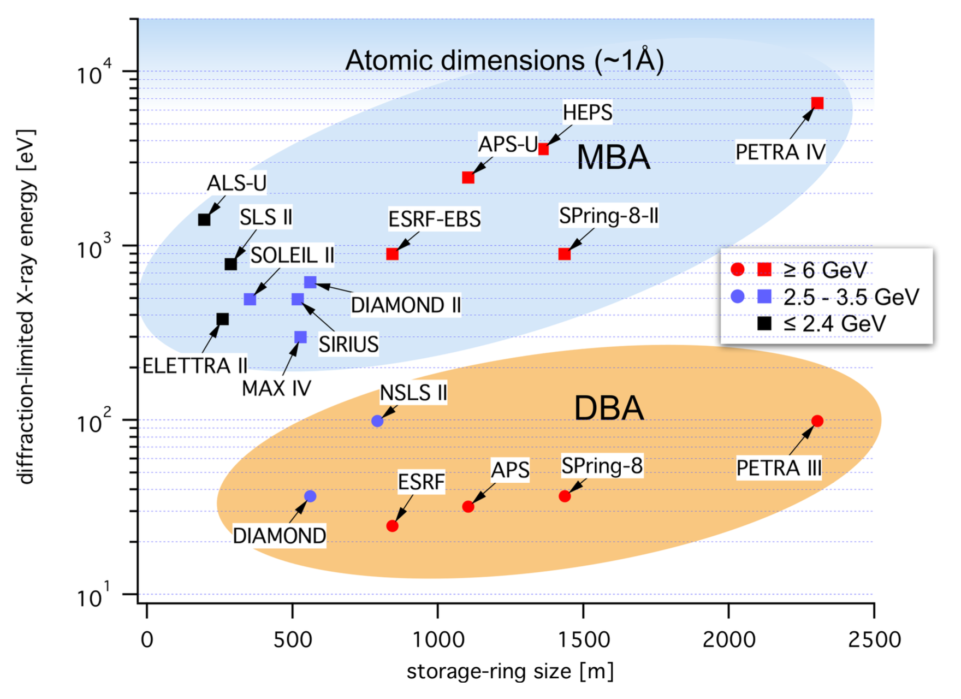
The Synchrotrons
PETRA III/IV and Friends
Diffraction-limited photon energy for some synchrotron radiation sources and their future upgraders. PETRA IV will be the first source worldwide to reach the diffraction limit for hard X-ray energies.
FH SciComp Workshop 2025

Slide 5
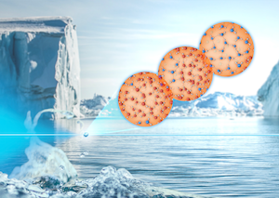
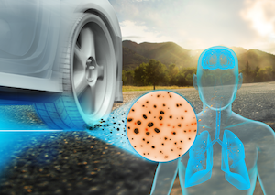
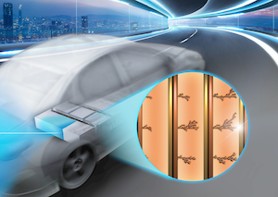
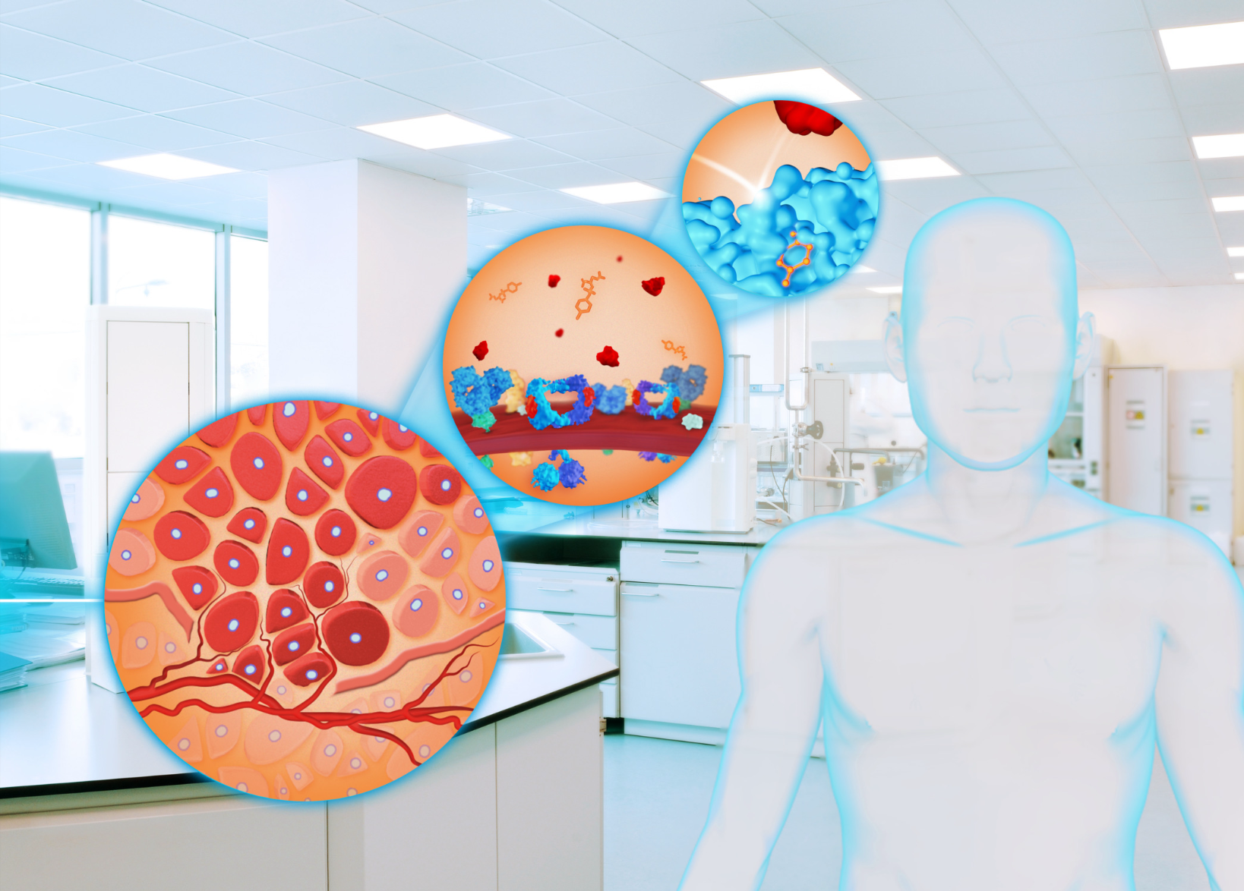
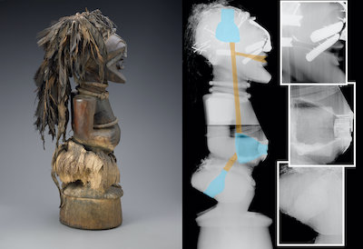
The new Science
Enabled by PETRA IV
Role of Water
The complex dynamics of water and aqueous solutions can be followed using the highly coherent X-rays of PETRA IV on time scales ranging from nanoseconds to hours.
Battery
The X-rays of PETRA IV can scan a fully functional battery and allow internal processes to be monitored under operating conditions.
Fine Dust
The highly brilliant X-rays from PETRA IV penetrate matter and can reveal the formation of fine dust particles a the contact surface between two materials during abrasion.
Tumor Research
Experiments at PETRA IV will analyse cells as part of their natural environment e.g. tumour tissue, healthy tissue in the brain) with highly brilliant X-ray light.
Cultural Heritage
PETRA IV is used in cultural heritage research to analyze artifacts and materials at a micro or nano level, enabling detailed studies of composition, deterioration, and physical-chemical processes.
FH SciComp Workshop 2025

Slide 6
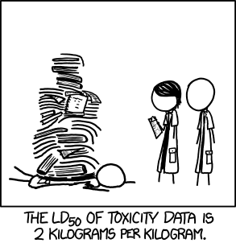
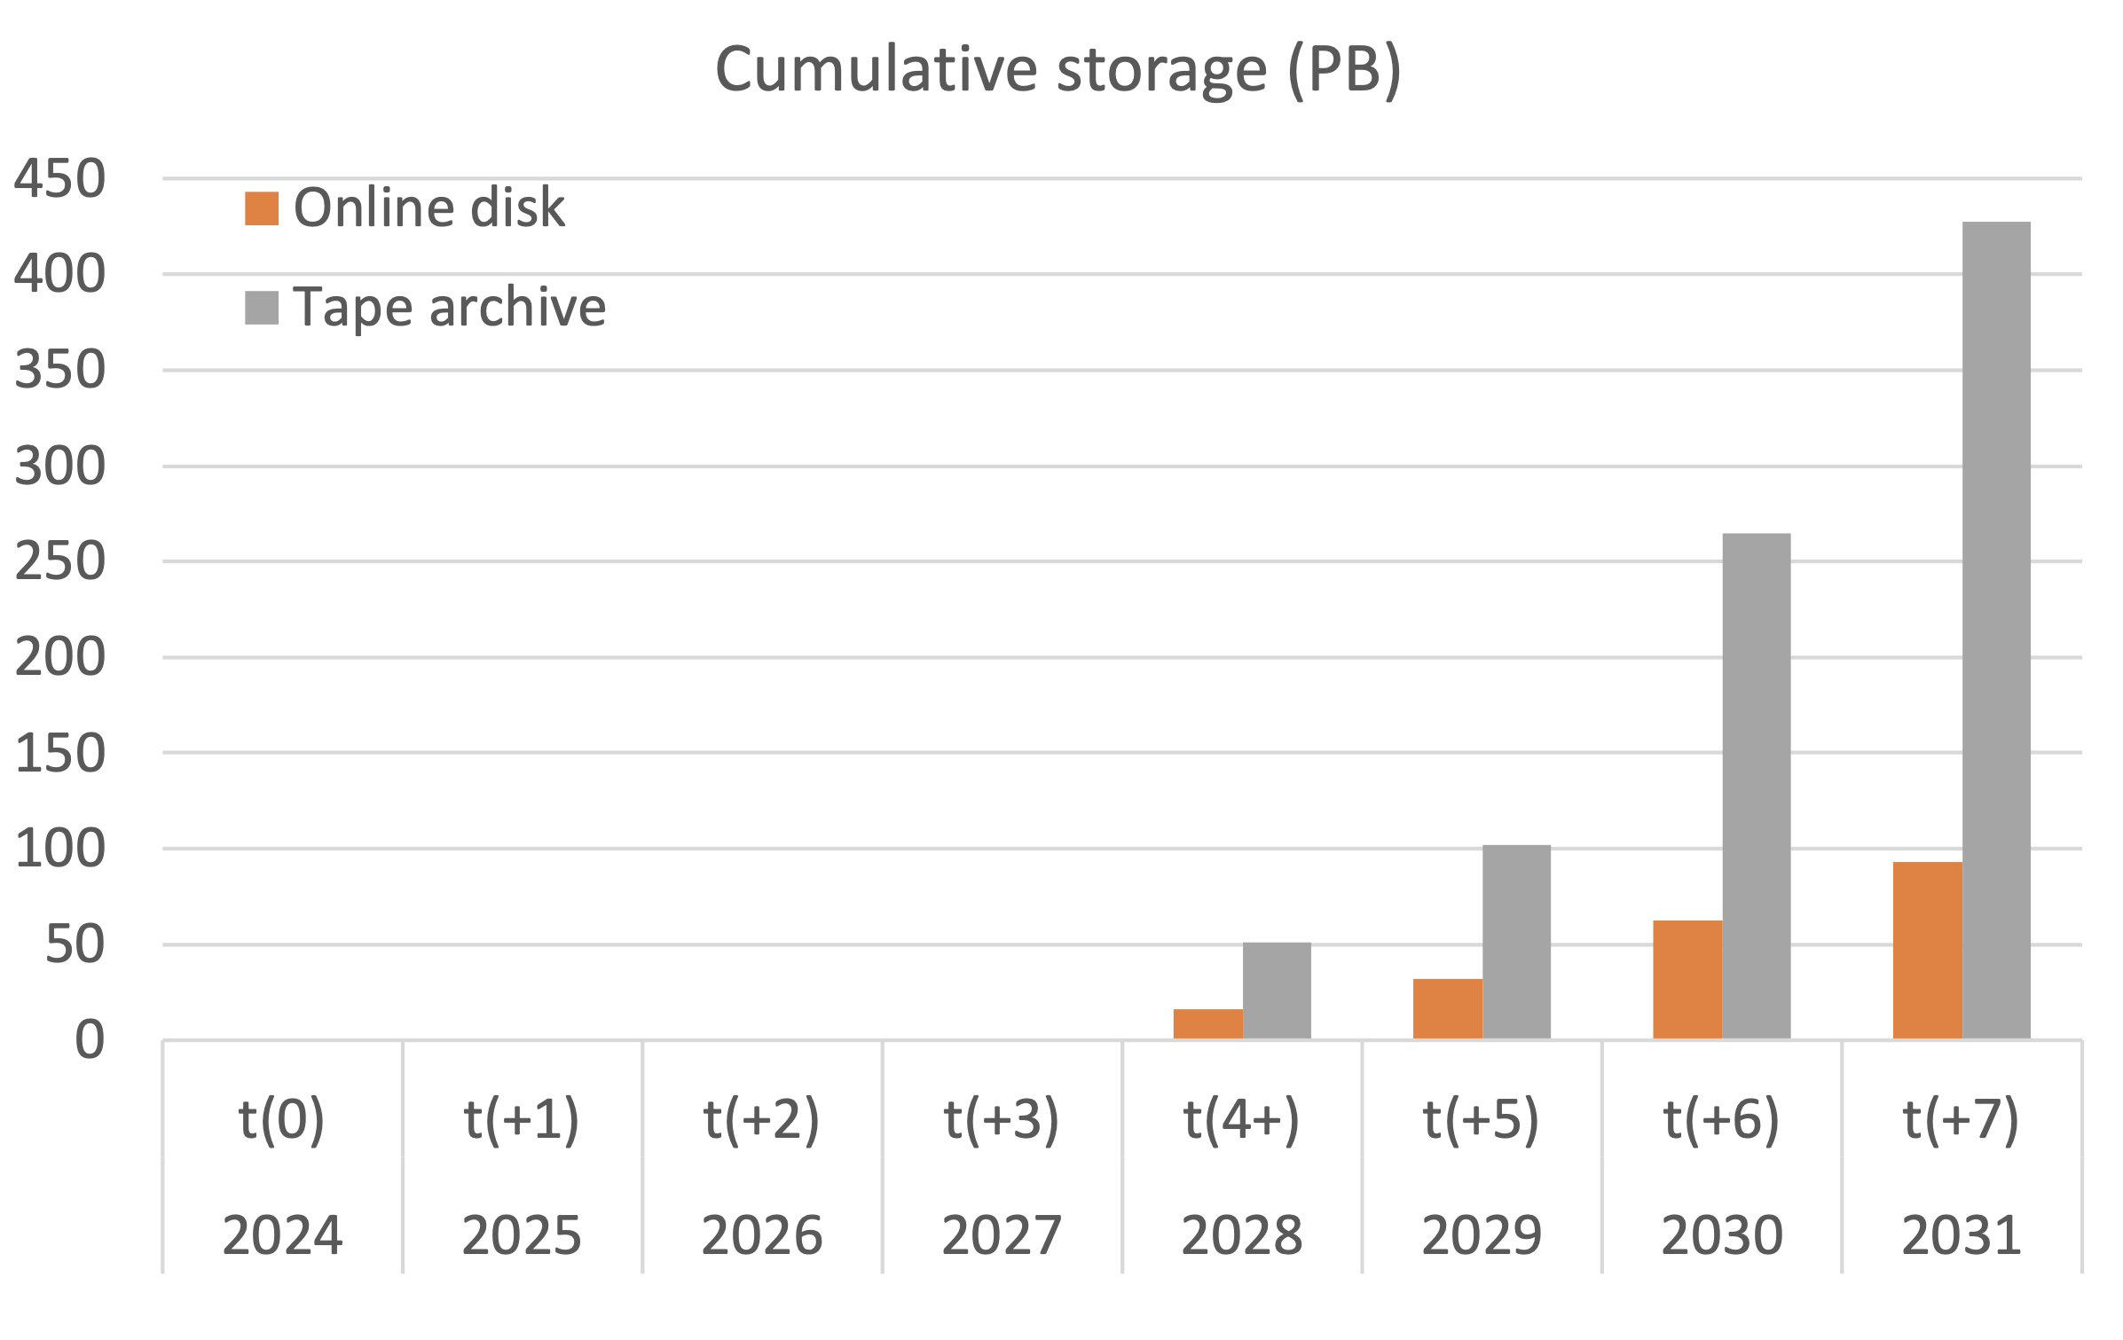
The Consequence
Storage space for PETRA IV
xkcd.com/1260
N.B.:
Timeline is shifted by one year!
FH SciComp Workshop 2025

Slide 7
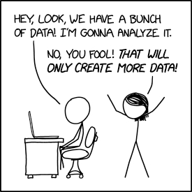
The Data
Where and by whom is it produced?
Light sources are huge infrastructures, providing extremely brilliant light, used with more than 200 techniques to look deep into matter for Biology, Material Science, Cultural Heritage and what not.
In 2019 PETRA III at DESY had more than 6300 visits from 3150 national and international users at 21 beamlines;
Those beam times produce an enormous amount of extremely precious data, under the governance of the PI.
After the ‘embargo period’ all this data is supposed to become public ‘Open Data’
Data which wasn’t used in publications is essentially lost.
After a publication, the future of the data only depends on the PI, who will have moved on to his/her next project. The future of that data is undetermined.
No one, except the original group, understands the details of those collected datasets.
xkcd.com/2582
FH SciComp Workshop 2025

Slide 8

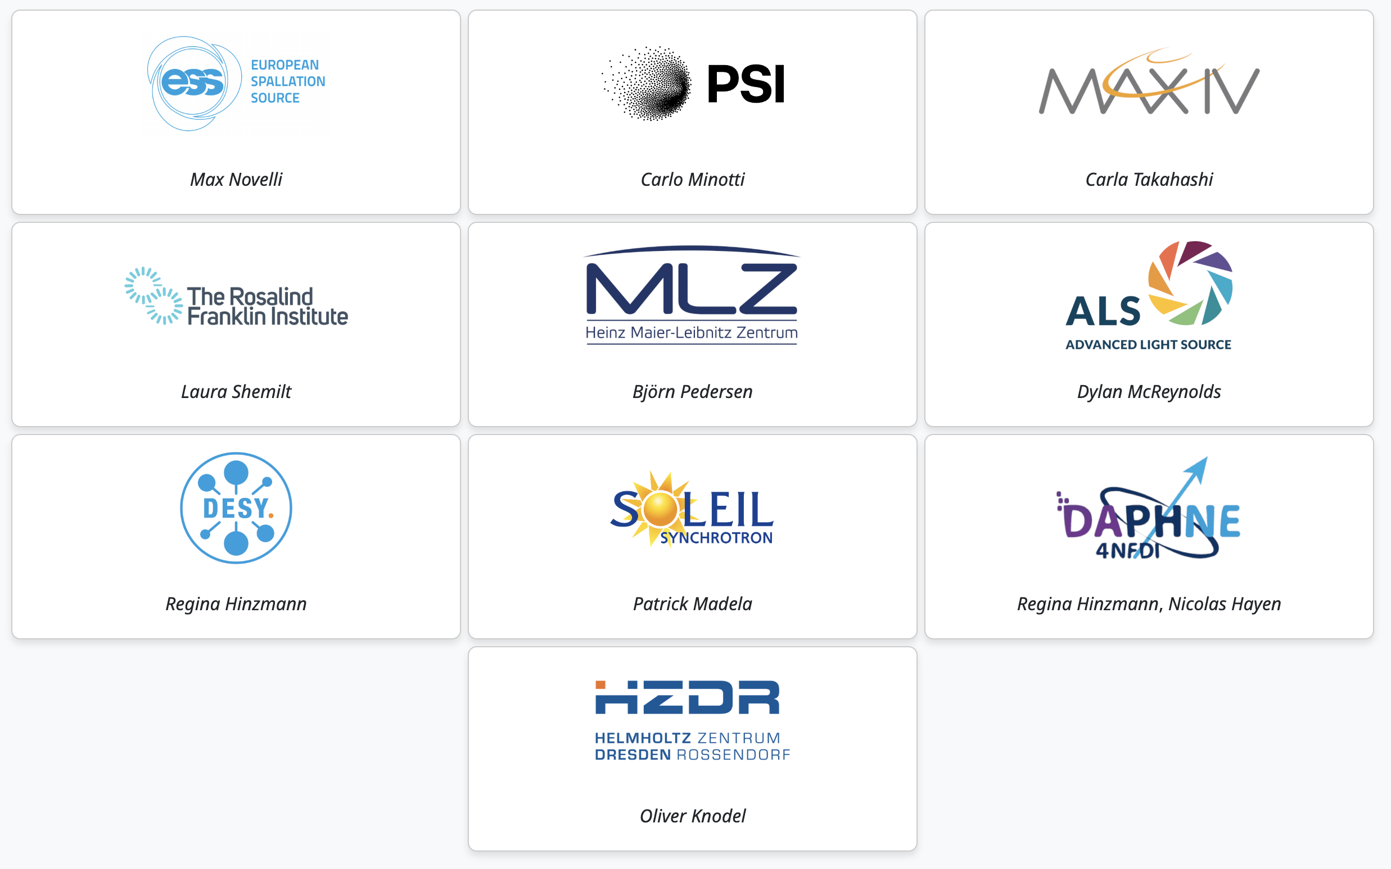

The Solution!
Mission
SciCat is a community-driven scientific metadata catalogue designed to simplify metadata management, enabling data sharing, discovery, and collaboration. By providing a central hub for metadata, SciCat makes data easily findable and accessible for the entire community. With flexible integration into diverse infrastructures and a clear path to data publication, SciCat empowers organizations to foster an open and innovative data culture, driving high-quality science forward.
FH SciComp Workshop 2025

Slide 9

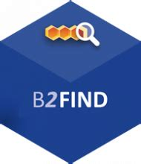






The Architecture at DESY
OAI-PMH
The High Level View – a reminder
DOI minting
Exploration
OPEN
DATA
Public Helmholtz
Spaces
Open Catalogue
Out of
Embargo
We try to use standard protocols only to allow components to be replaced by components with similar functionality.
DESY
HPC
System
Embargo’ed
Data
Synchrotron owned
Storage Spaces
Access Controlled internal Catalogue
Protected Embargo Area
FH SciComp Workshop 2025

Slide 10



The Publishing
Open Data Portal
HIFIS Staging Space
sisyphos.desy.de
User Space
Daphne
Sisyphos
Automatically or manually generated preliminary Metadata
PaN Reflectivity
Database
Upload Tool
`
DOI minting
OAI-PMH
Data
Data
Final
Publishing
Data
Landing Page
Data
Curation Process
Persistent HIFIS Space
ORSO
Metadata validation against defined schemata enforced.
UI with field annotations
Data is immutable and no longer removable
NeXus
Metadata verification
Licence/Legal checks
Data Quality verification
Data
Data
Data
HDF5
Data
FH SciComp Workshop 2025

Slide 11






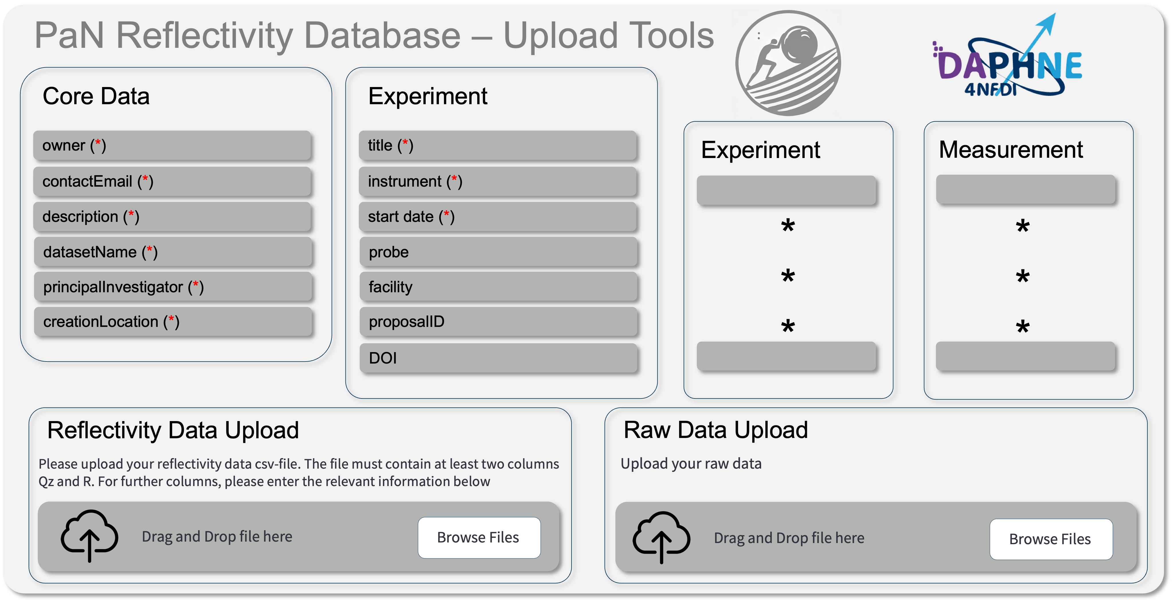

The Schemata
MDS
Convertion
W3C OWL
Metadata Schema
Registry
Metadata Description
Language
***
Reflectivity
Tomography
Domain Specific Meta Data Handling and Upload
***
Sisyphos
Meta Data Upload
Form Generator
FH SciComp Workshop 2025

Slide 12
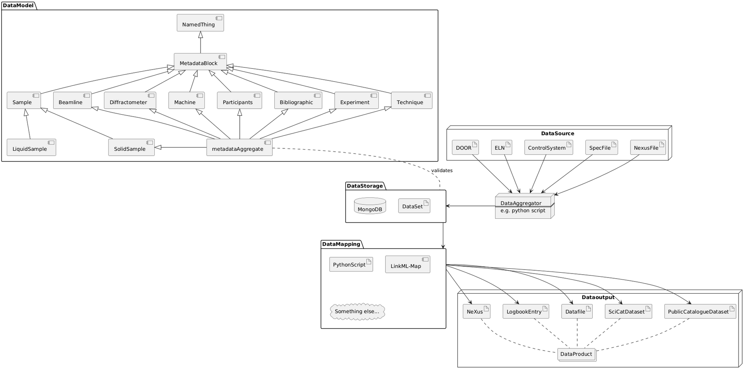
The building blocks
Building blocks make schemata
more easily reusable
better understandable
highly modular
interoperable by design
Source: P. Jordt, CAU, priv. comm.
FH SciComp Workshop 2025

Slide 13

The Form – sisyphos.desy.de
PaN Reflectivity Database – Upload Tools
Core Data
Experiment
owner (*)
title (*)
Experiment
Measurement
contactEmail (*)
instrument (*)
description (*)
start date (*)
*
*
*
*
*
*
datasetName (*)
probe
principalInvestigator (*)
facility
creationLocation (*)
proposalID
DOI
Reflectivity Data Upload
Raw Data Upload
Please upload your reflectivity data csv-file. The file must contain at least two columns Qz and R. For further columns, please enter the relevant information below
Upload your raw data
Drag and Drop file here
Browse Files
Drag and Drop file here
Browse Files
FH SciComp Workshop 2025

Slide 14
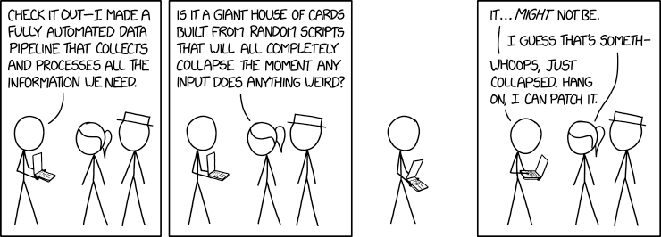
The Form – sisyphos.desy.de
Meta Data
xkcd.com/2054
FH SciComp Workshop 2025

Slide 15



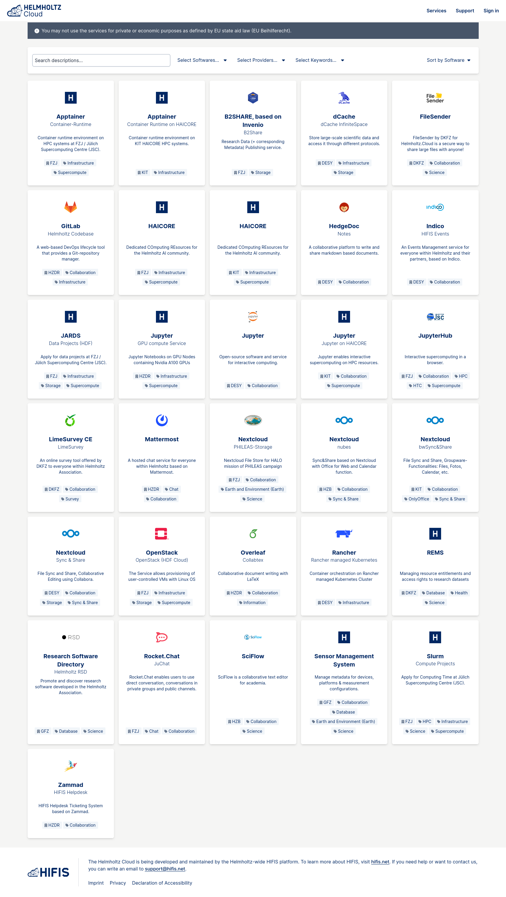


The further Landscapes
DESY, HIFIS, NFDI & EOSC
Thematic
Catalogues
Portal
Pilot Node
Candidate Nodes
Exchange Service
for the
Thematic & National Nodes
ILDG
Configuration
Catalogue
NFDI & PaNOSC
DESY
Open
Infrastructure
FH SciComp Workshop 2025

Slide 16
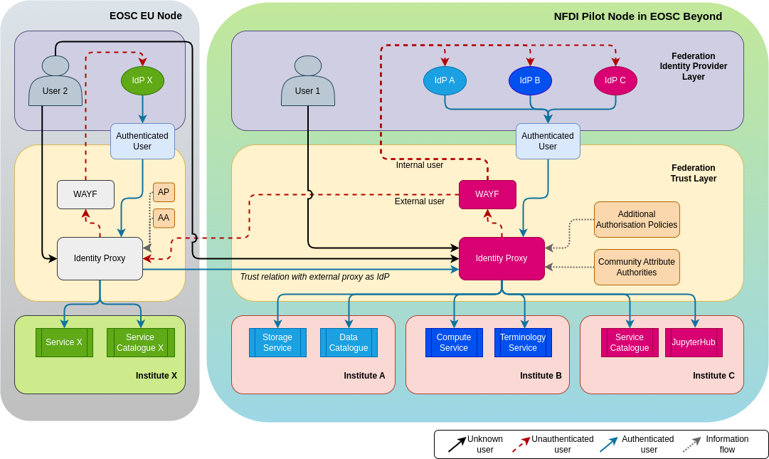
The Federations
Interfacing with other European communities and services - WIP
The European Open Science Cloud is currently being set up as a network of community-provided platforms (“Nodes”)
Each node brings their own AAI and services behind it
The nodes are designed to be interoperable in order to bring synergies and interconnections for a more efficient scientific landscape
FH SciComp Workshop 2025

Slide 17
The Federations
Interfacing with other European communities and services - WIP
Mutual trust for authentication and authorization between communities allows for cross-community usage of
Identities
Services
Data sources
Infrastructure
...
In a modular, unified and transparent way to make it useful and easy for the scientists
FH SciComp Workshop 2025

Slide 18
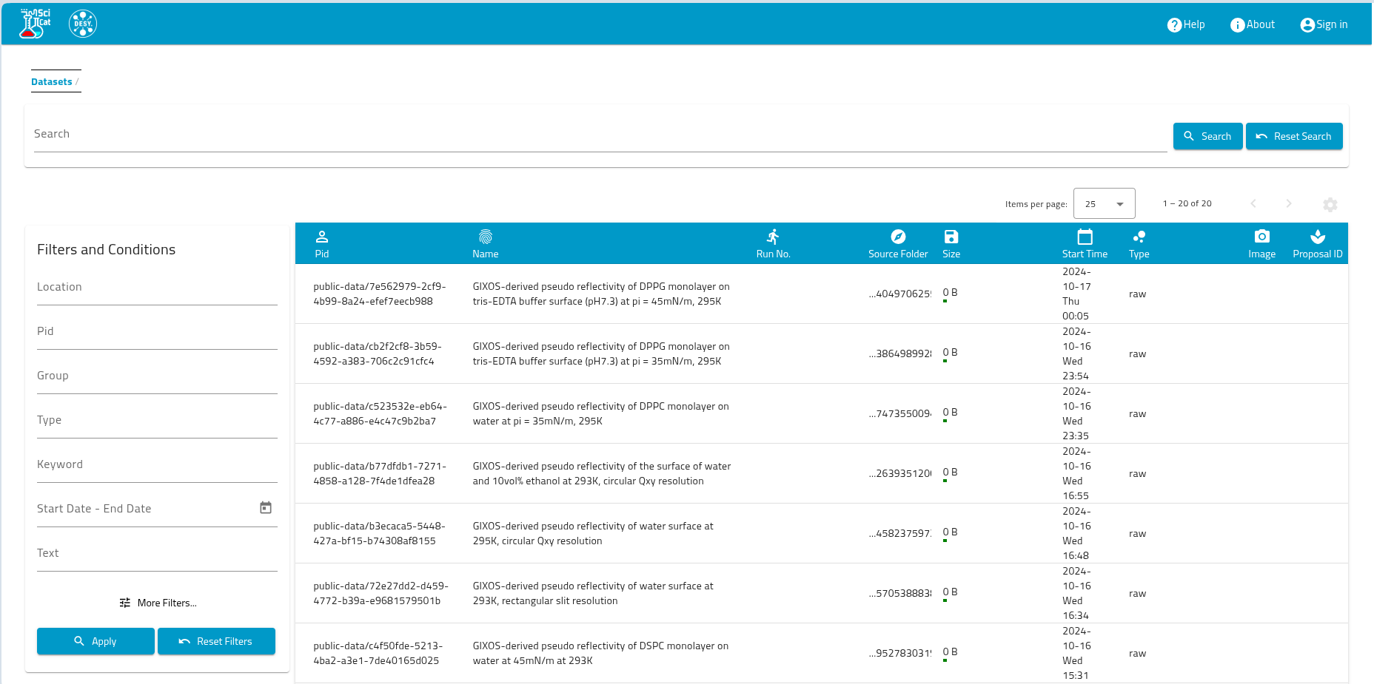
The Look
What does the catalogue look like?
FH SciComp Workshop 2025

Slide 19
The Outook
Where do we go from here?
Presented in multiple contexts over the last 12 months
  e.g. ISGC, HMC, EGI, ORSO, Helmholtz Open Science Office, IBERGRID
Positive feedback so far
Currently in early production phase with beta testers
Ingestion UI needs some more work
Bulk ingestion to be worked out next
Slow ramp-up in stored datasets expected until end of the year
FH SciComp Workshop 2025

Slide 20
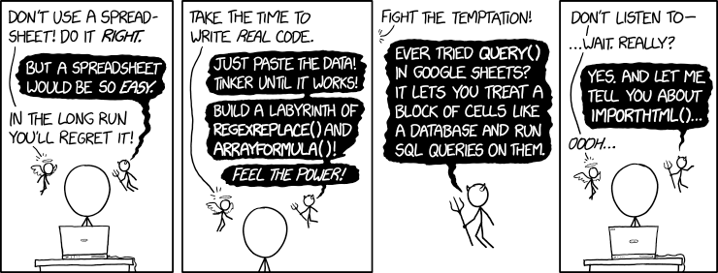
Thank you
xkcd.com/2180
Patrick Fuhrmann, Tim Wetzel
DESY IT
Patrick.Fuhrmann@desy.de, Tim.Wetzel@desy.de
FH SciComp Workshop 2025

Slide 21
Additional slides
FH SciComp Workshop 2025

Slide 22
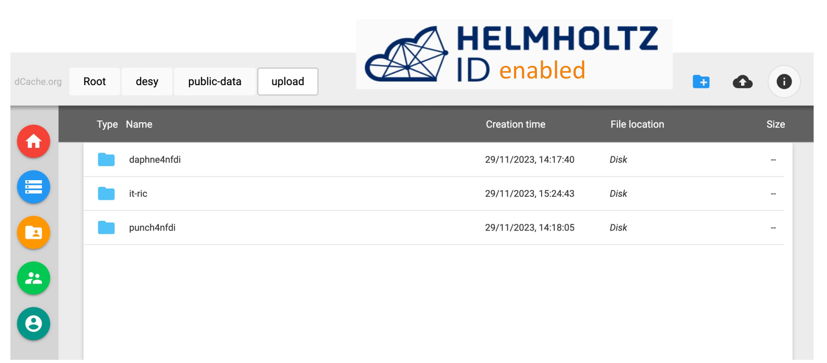
The Files
hifis-storage.desy.de

Slide 23
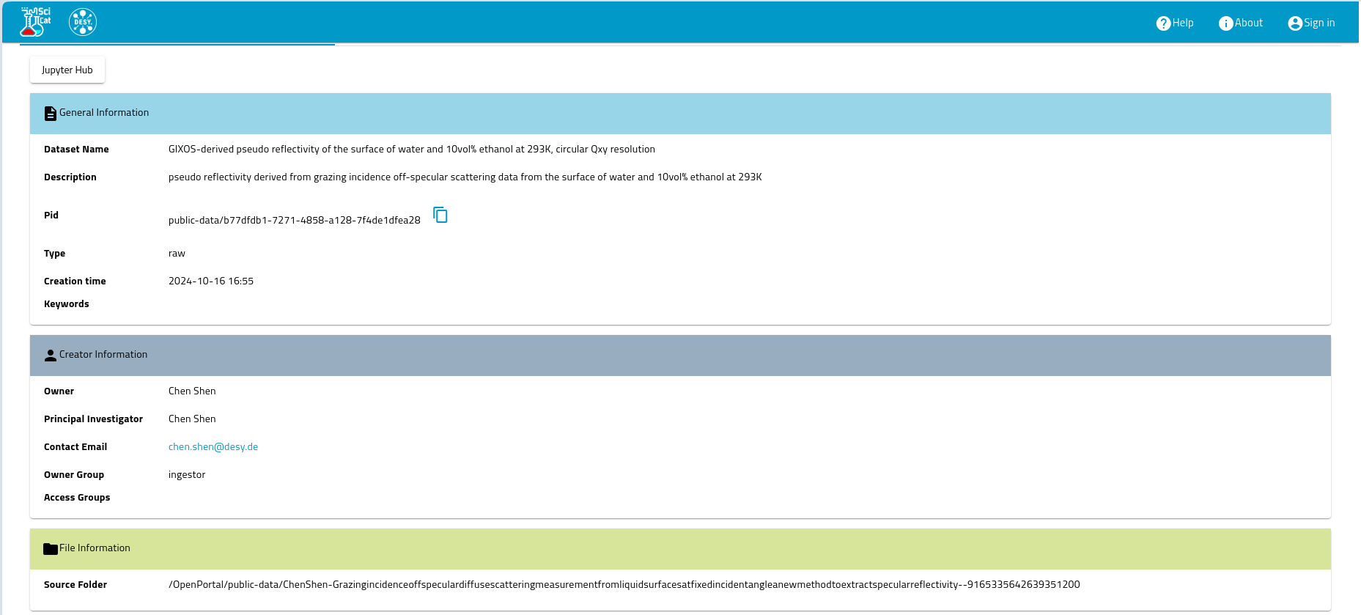
The Catalogue
public-data.desy.de
General Information
Dataset Name
Description
PID
Type
Creation Date
Keywords
Creator Information
Owner
PI
Contact
Group
Access Group
File Information
Source Folder

Slide 24
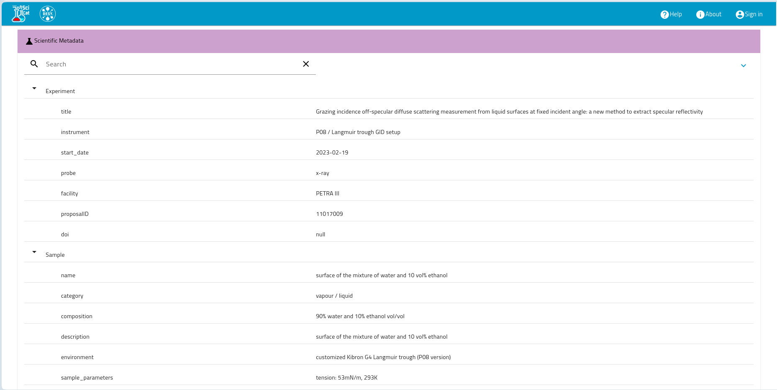
The Catalogue
public-data.desy.de
Scientific Meta Data
Search
Experiment
Title
Instrument
Start Date
Probe
Facility
Proposal ID
DOI
Sample
Name
Catagory
Composition
Description
Environment
Sample Parameters

Slide 25
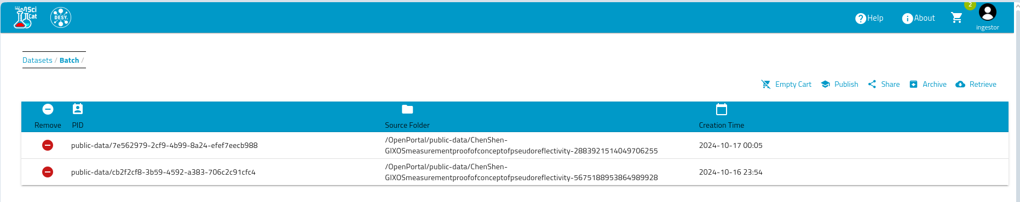
The Published Data
public-data.desy.de
PID
Source Folder
Creation Date

Slide 26
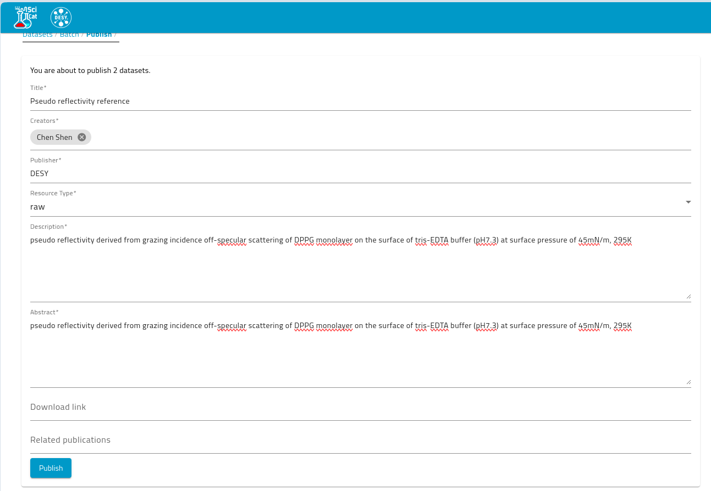
The Minting
public-data.desy.de
Your are about to publish 2 datasets
Publish

Slide 27
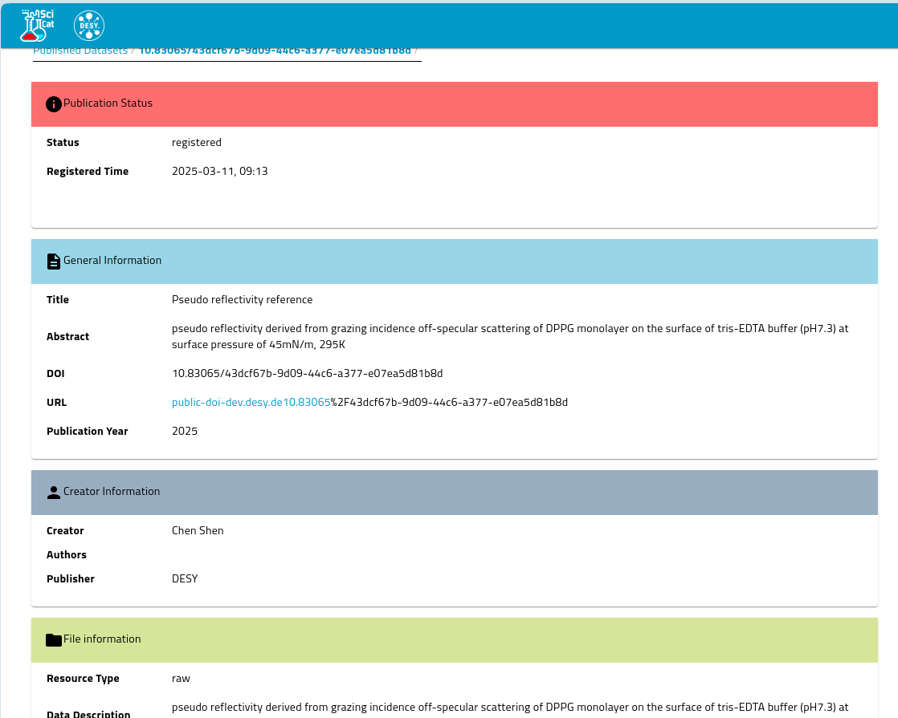
The Minting
public-data.desy.de
Publication Status
Status Registered
Registration Time 2025-03-17. T. 9:30
General Information
Creator Information
File Information

Slide 28
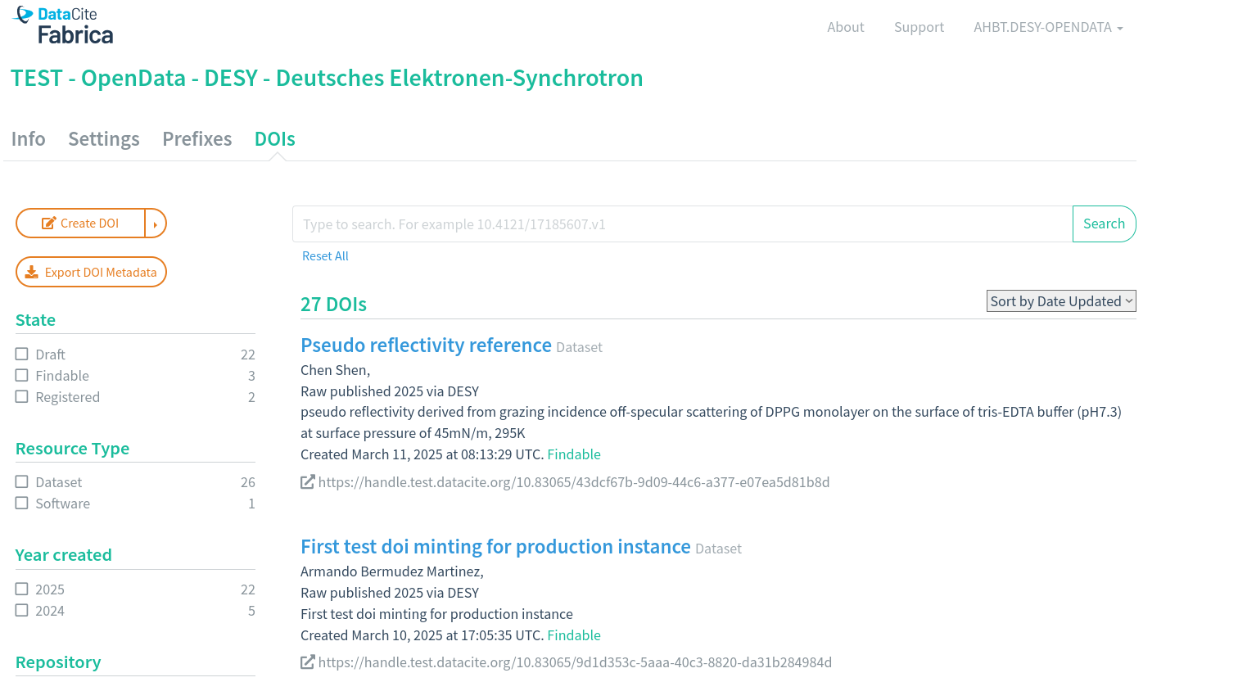
The Fabrica
DataCite Fabrica

Slide 29
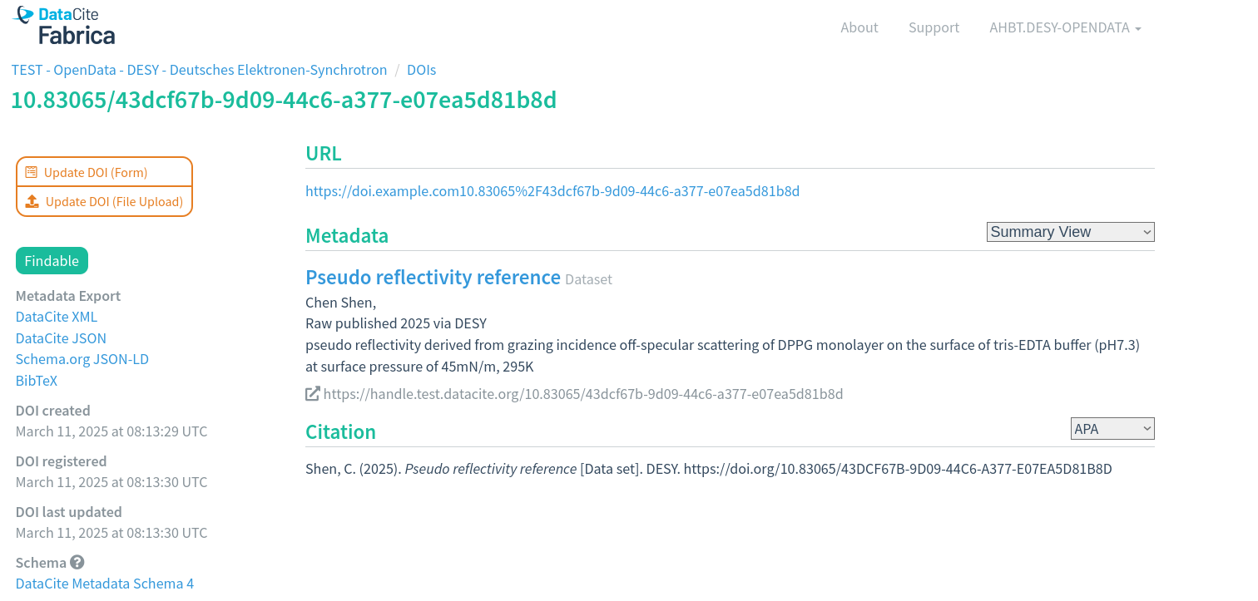
The Catch
DataCite Fabrica

Slide 30
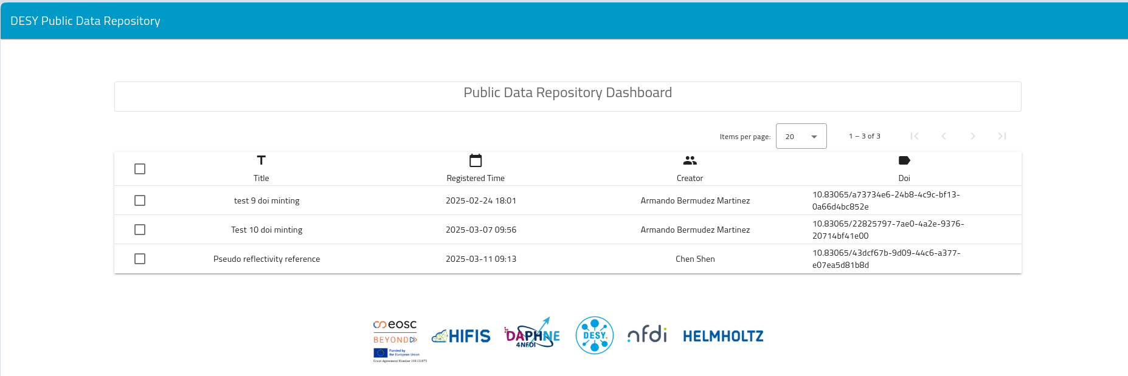
The Landing page
public-doi.desy.de
DESY Public Data Repository

Slide 31
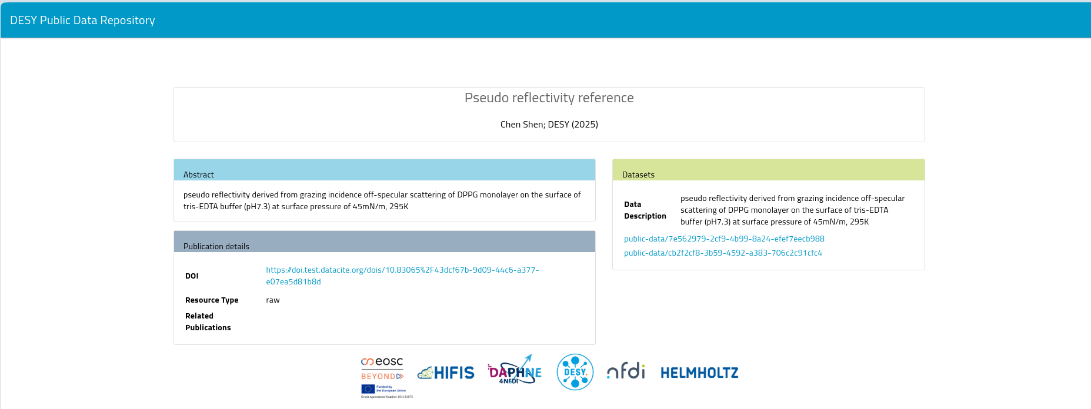
The Landing page
public-doi.desy.de
DESY Public Data Repository

Slide 32
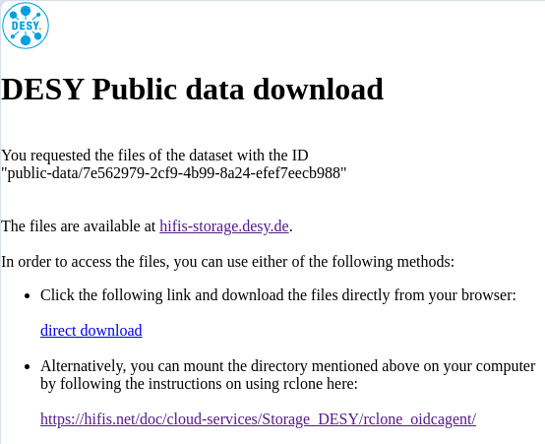
The Download
public-data.desy.de

Slide 33
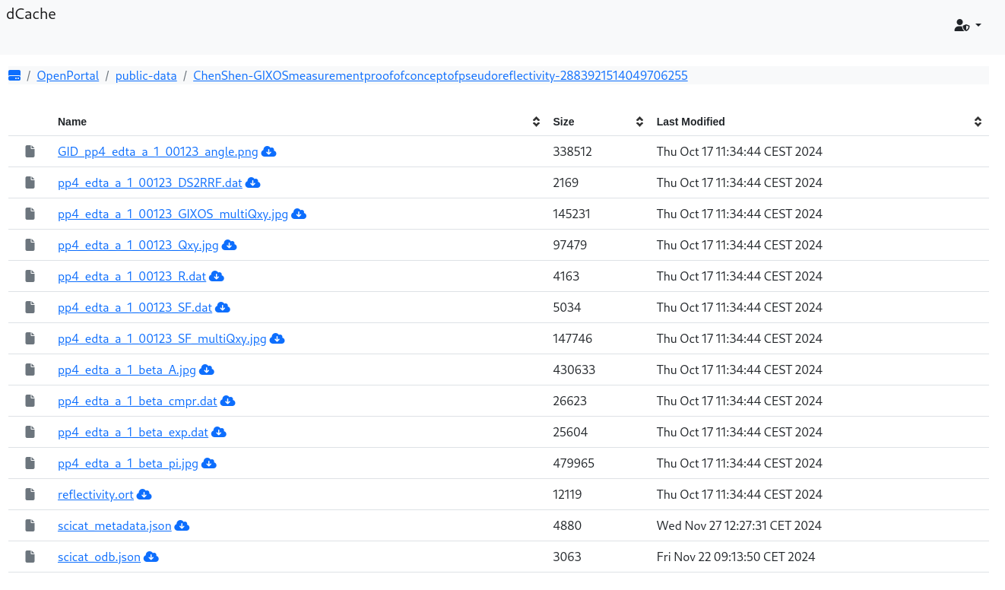
The Storage
public-data.desy.de
dCache

Slide 34
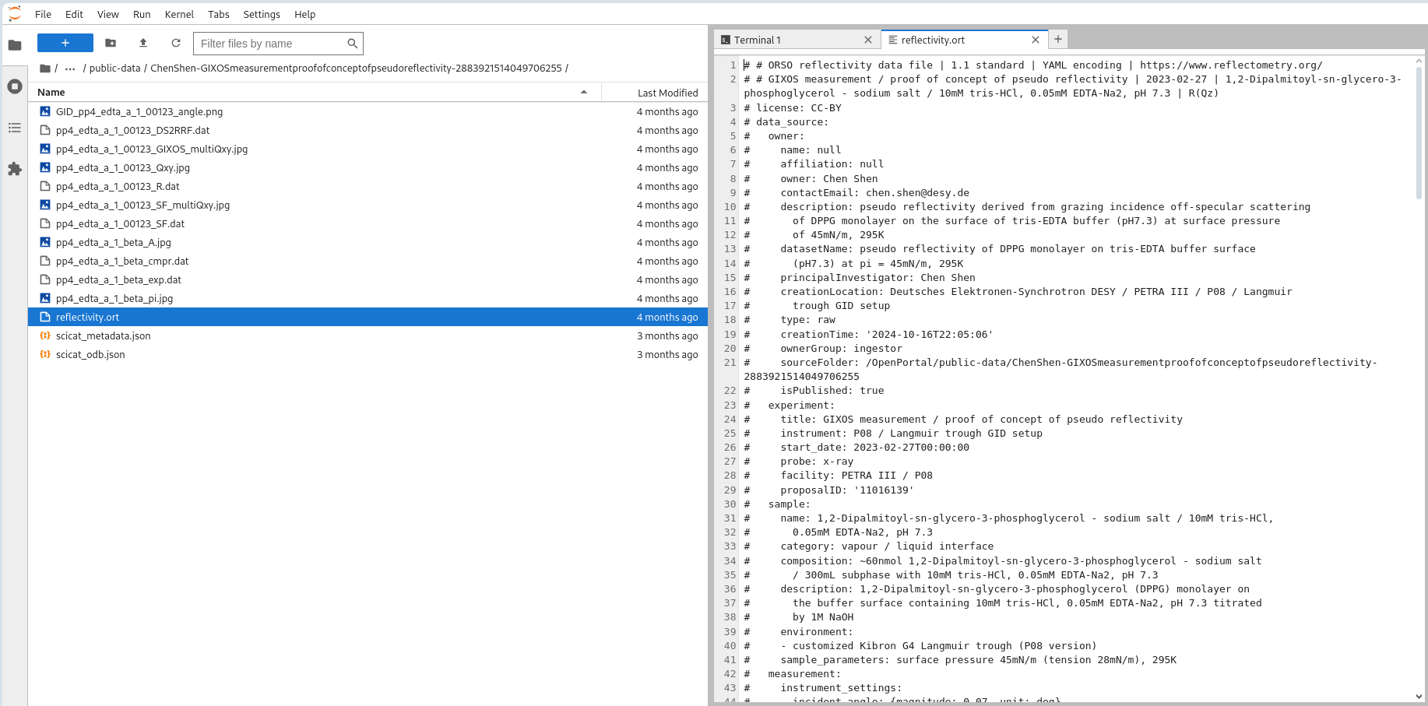
The Exploration
jupyter.desy.de

