Slide 1
Recent developments in superconducting RF.
To be honest: Just cavities – no modules, couplers, LLRF, clean rooms …
Marc Wenskat
MSL
12.7.2025
Slides stolen from: TTC2025 if not mentioned otherwise

Slide 2
Rough overview: Who and what
  DE(SY)
Indirect contributions to ESS, Planned to contribute to PIP-II
Focus on HDC EXFEL Upgrade
  EU
All in the wake of FCC – hence it is mostly (thin) film R&D
Also ESS and PIPI-II
  US
Busy with PIP-II, LCLS-II HE & SQMS
  JP
ITN (medium grain)
  PRC
SHINE, DALIA
Significant ramp up

Slide 3
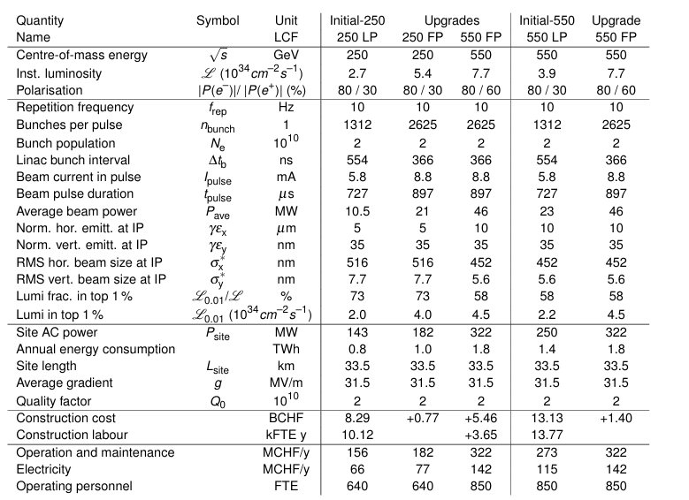
What do we need to achieve?
Two remarks:
  Yield is important
  This is operational gradient
[The Linear Collider Facility (LCF) at CERN arXiv:2503.24049]
Recent developments in superconducting RF.

Slide 4
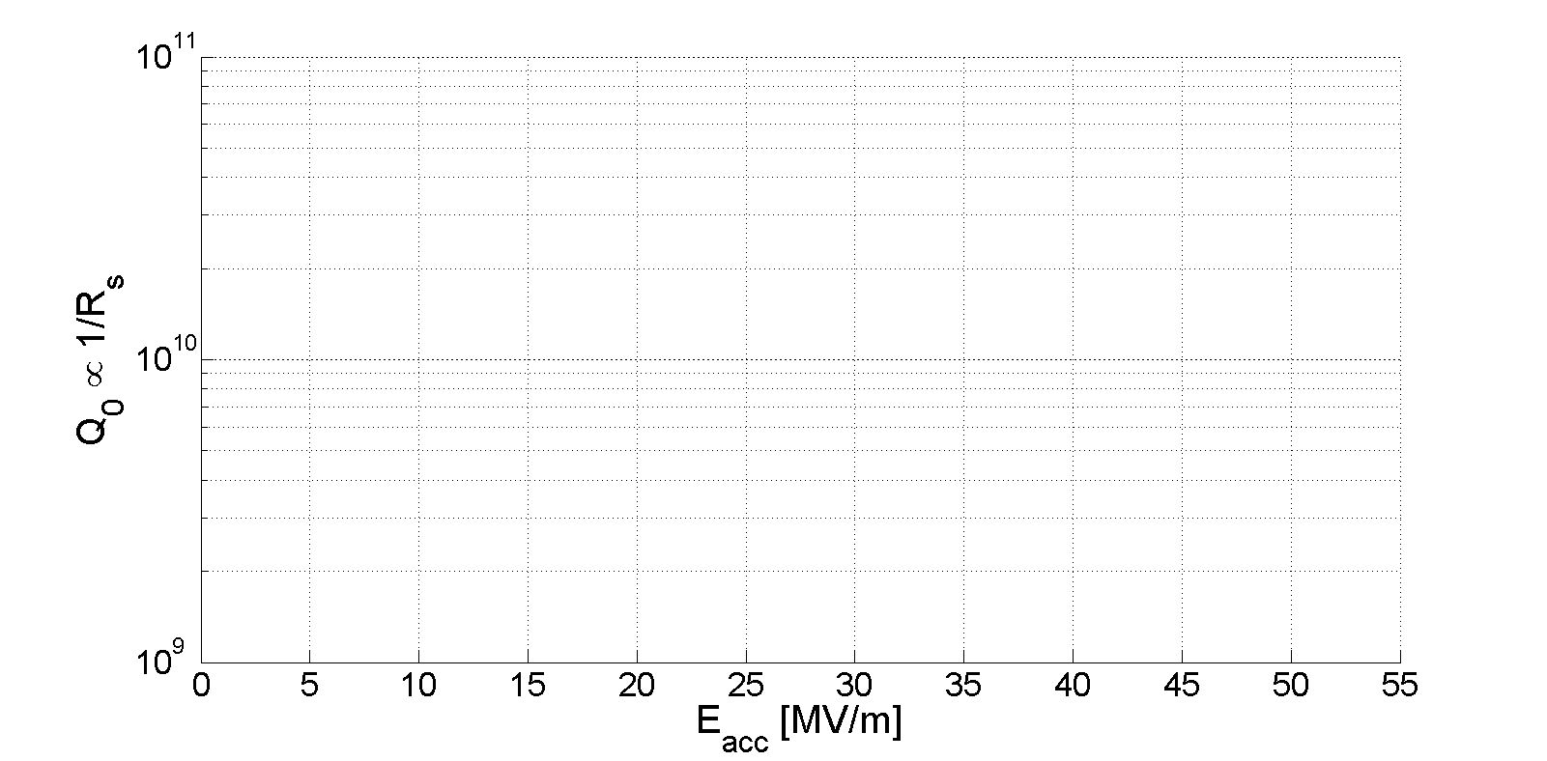
What performances do exist?
A variety of treatments – an old slide
Standard Cavity
Doped Cavity
Infused Cavity
Mid-T Bake
SIS Coating
?
LCLS-II CW
HDC Spec
LC Spec
EXFEL Spec
@2K
[Reschke et al., Phys. Rev. Accel. Beams, 20, 042004 (2017)]
[Grassellino et al., SUST, 26, 102001 (2013) ]
[Grassellino et al., SUST, 30, 094004 (2017) ]
[Posen et al., Phys. Rev. Applied 13, 014024 (2020)]
[Gurevich, APL, 88, 012511 (2006)]
Recent developments in superconducting RF.

Slide 5
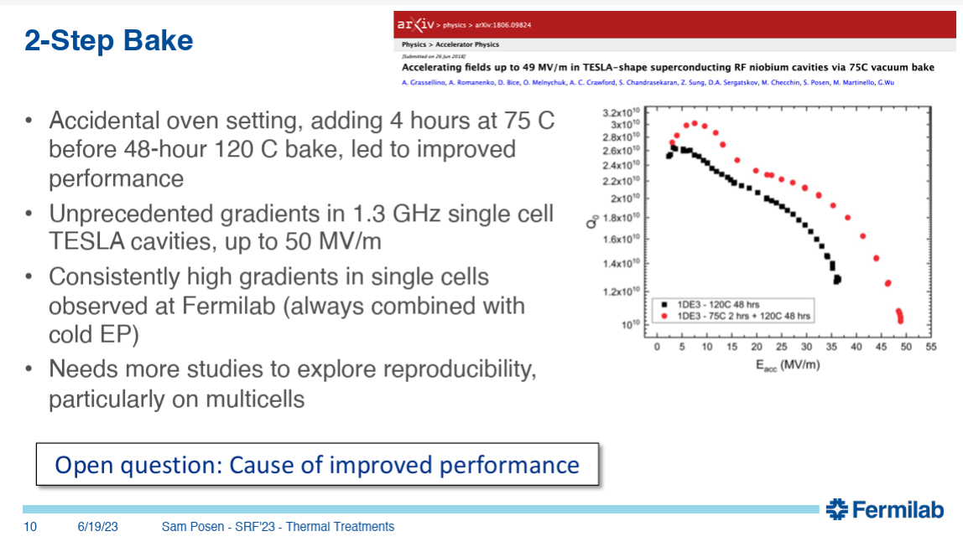
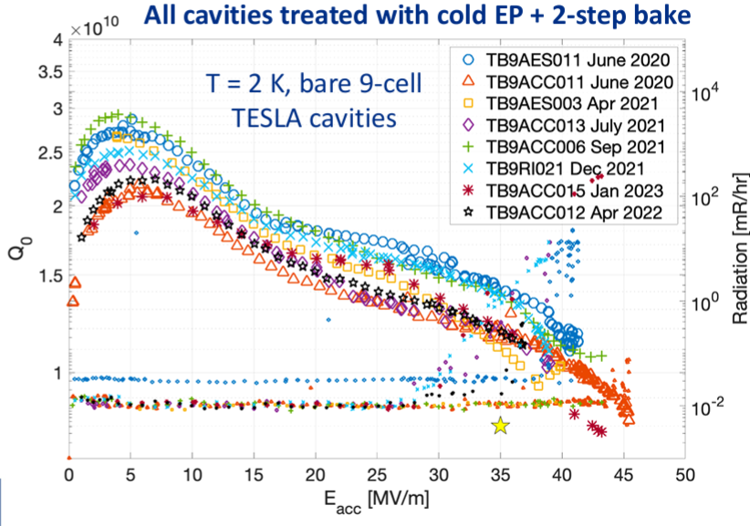
A controversial take
Recent developments in superconducting RF.

Slide 6
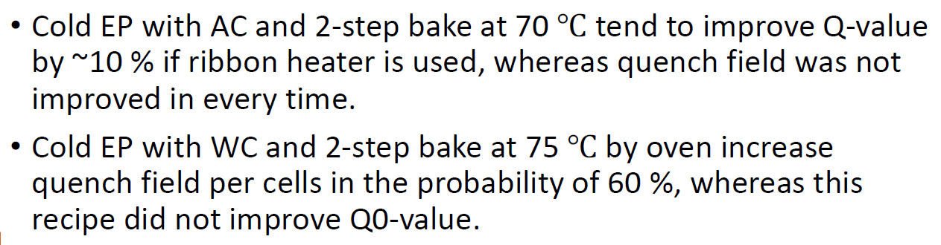
Quo vadis 2-step?
Cornell, Jlab, KEK, DESY
Cornell & Jlab dropped the R&D
KEK recently reported on their efforts „it is complicated“
China is interested in other recipes
Although we did not see a significant improvement as FNAL, we simply do a 2-step bake now instead of the „standard European XFEL“ 120°C bake. Why? Because why not – and to increase statistics.
Recent developments in superconducting RF.

Slide 7
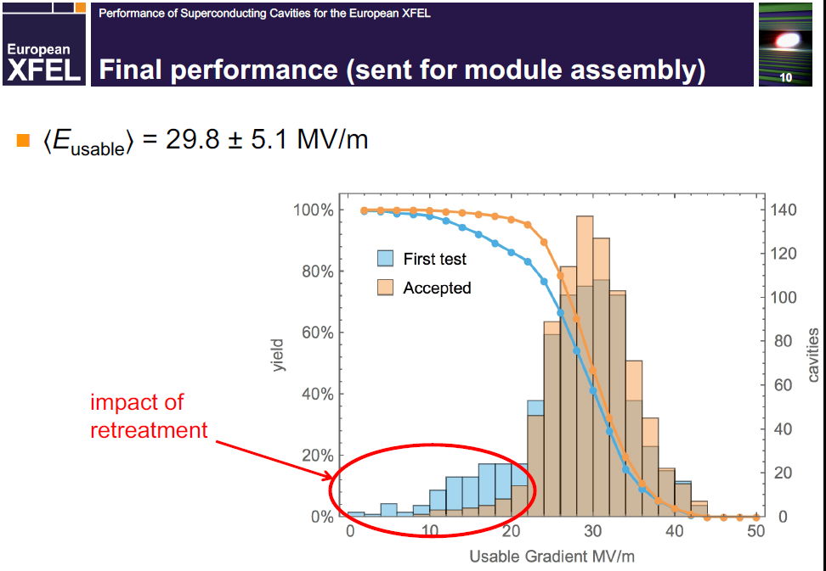
Reminder: EXFEL Fabrication VT results

Slide 8
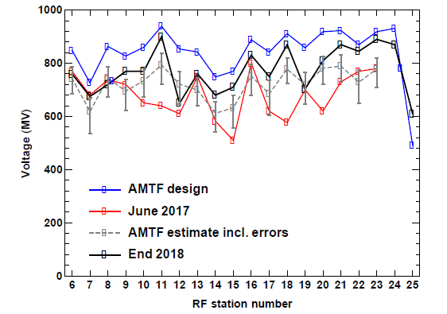
Operation of EXFEL
Incl. Installation in module, impact of waveguide system
<E_{usable}>_{VT} = 29.8 MV/m
- 20%
<E_{op}> = 23.6 MV/m
Do we need to achieve 38MV/m in VT?
Some important details:
Administrative limit @ EXFEL for CM of 30 MV/m
@EXFEL 4 modules (32 cavs) driven by 1 Klystron
Future installations will have „finer granularity“
Will allow to operate individual cavities closer to their maximum
Recent developments in superconducting RF.

Slide 9
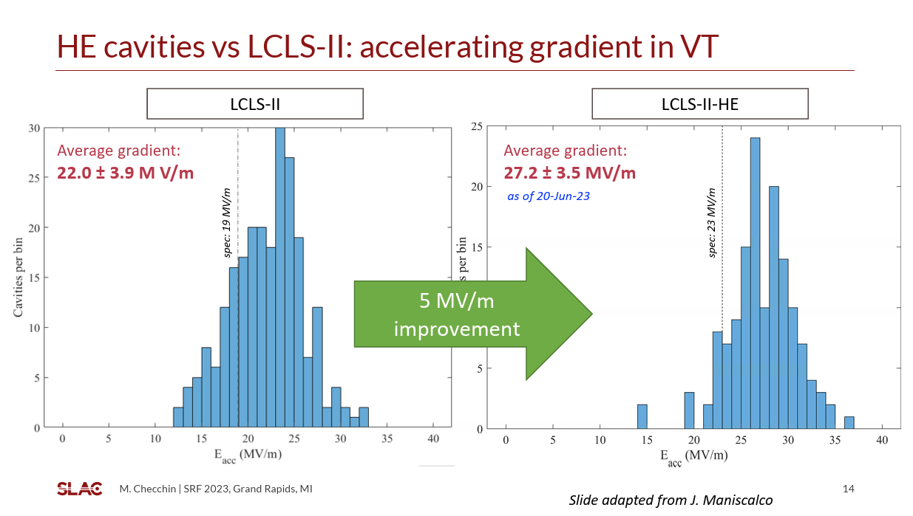
EXFEL vs. LCLS-II vs. LCLS-II HE (N-Doping)
4+4 GeV – CW – 464x 1.3 GHz cavities
284 Cavities
+ 180 Cavities
EXFEL
Modules: administrative limit @ 26 MV/m
Recent developments in superconducting RF.

Slide 10
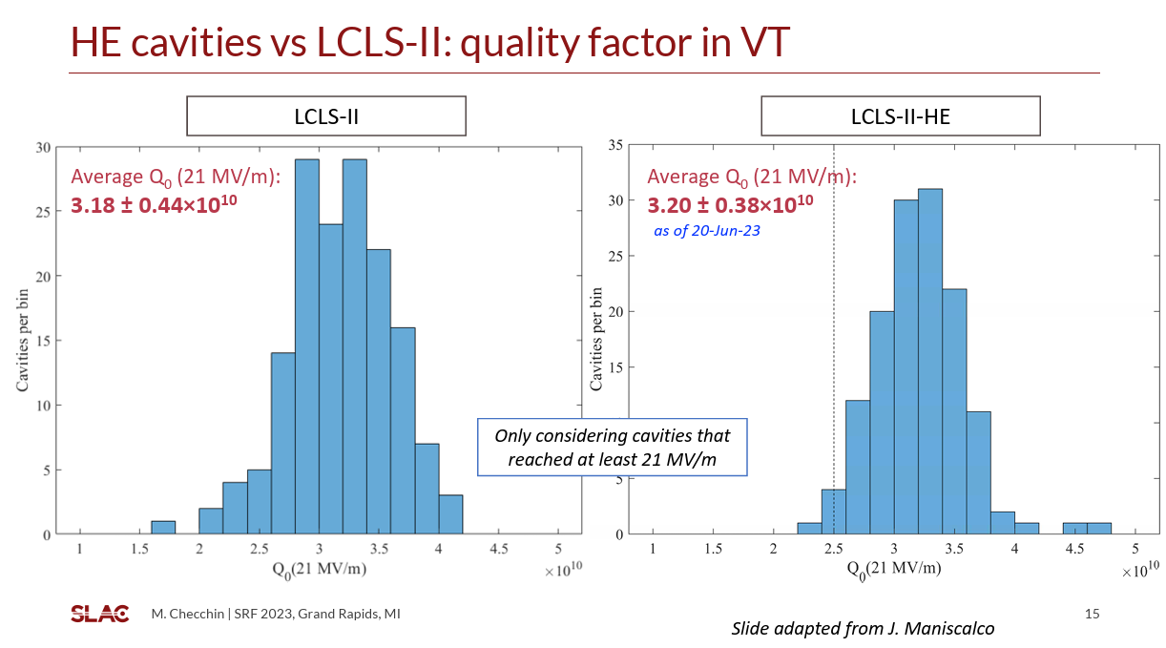
EXFEL vs. LCLS-II vs. LCLS-II HE (N-Doping)
Suitable recipe for CW but operational gradients are not sufficient for LC
EXFEL

Slide 11
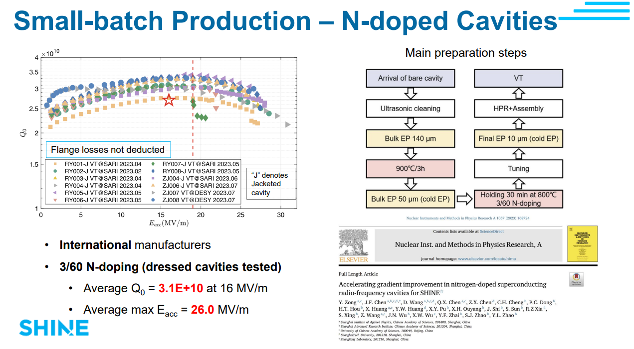
SHINE / Shanghai tested two recipes
8 GeV – CW – 600x 1.3 GHz cavites
Recent developments in superconducting RF.

Slide 12
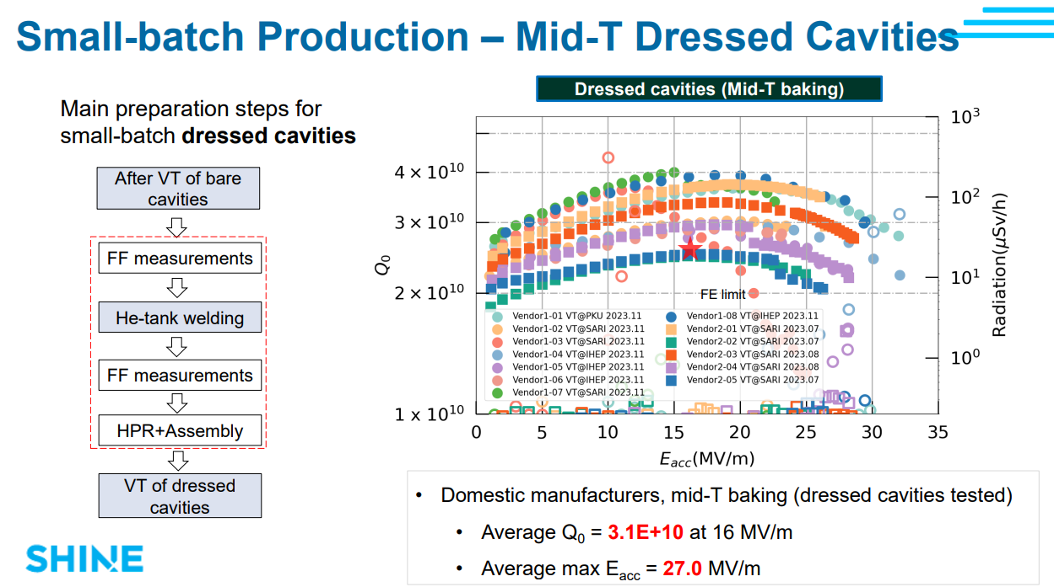
SHINE will go for Mid-T
Simpler recipe than N doping – same outcome & purely domestic fabrication!
Recent developments in superconducting RF.

Slide 13
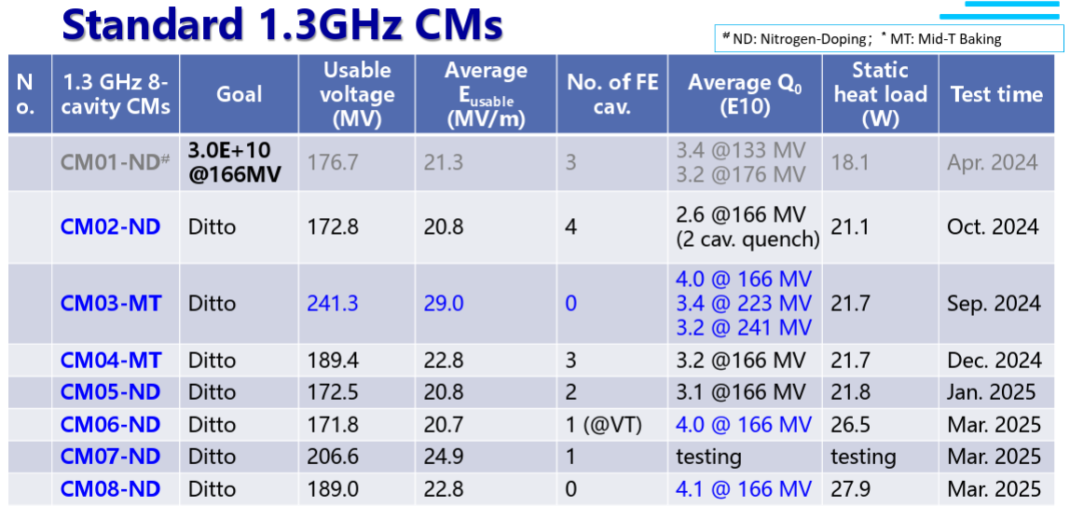
“SHINE cryomodule design adopts the TESLA technology and refers to E-XFEL and LCLS-II”
„FE and MP issues are still challenging for the rest of CMs”
Recent developments in superconducting RF.

Slide 14
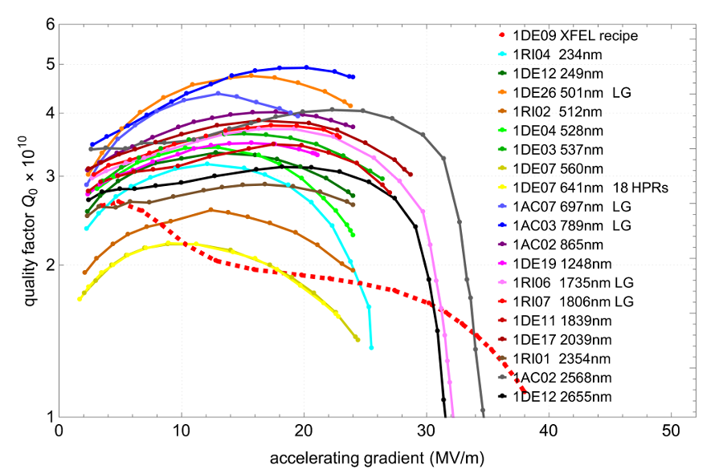
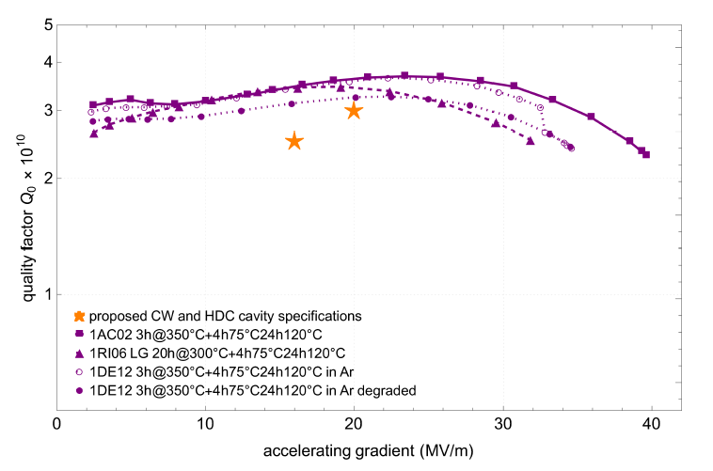
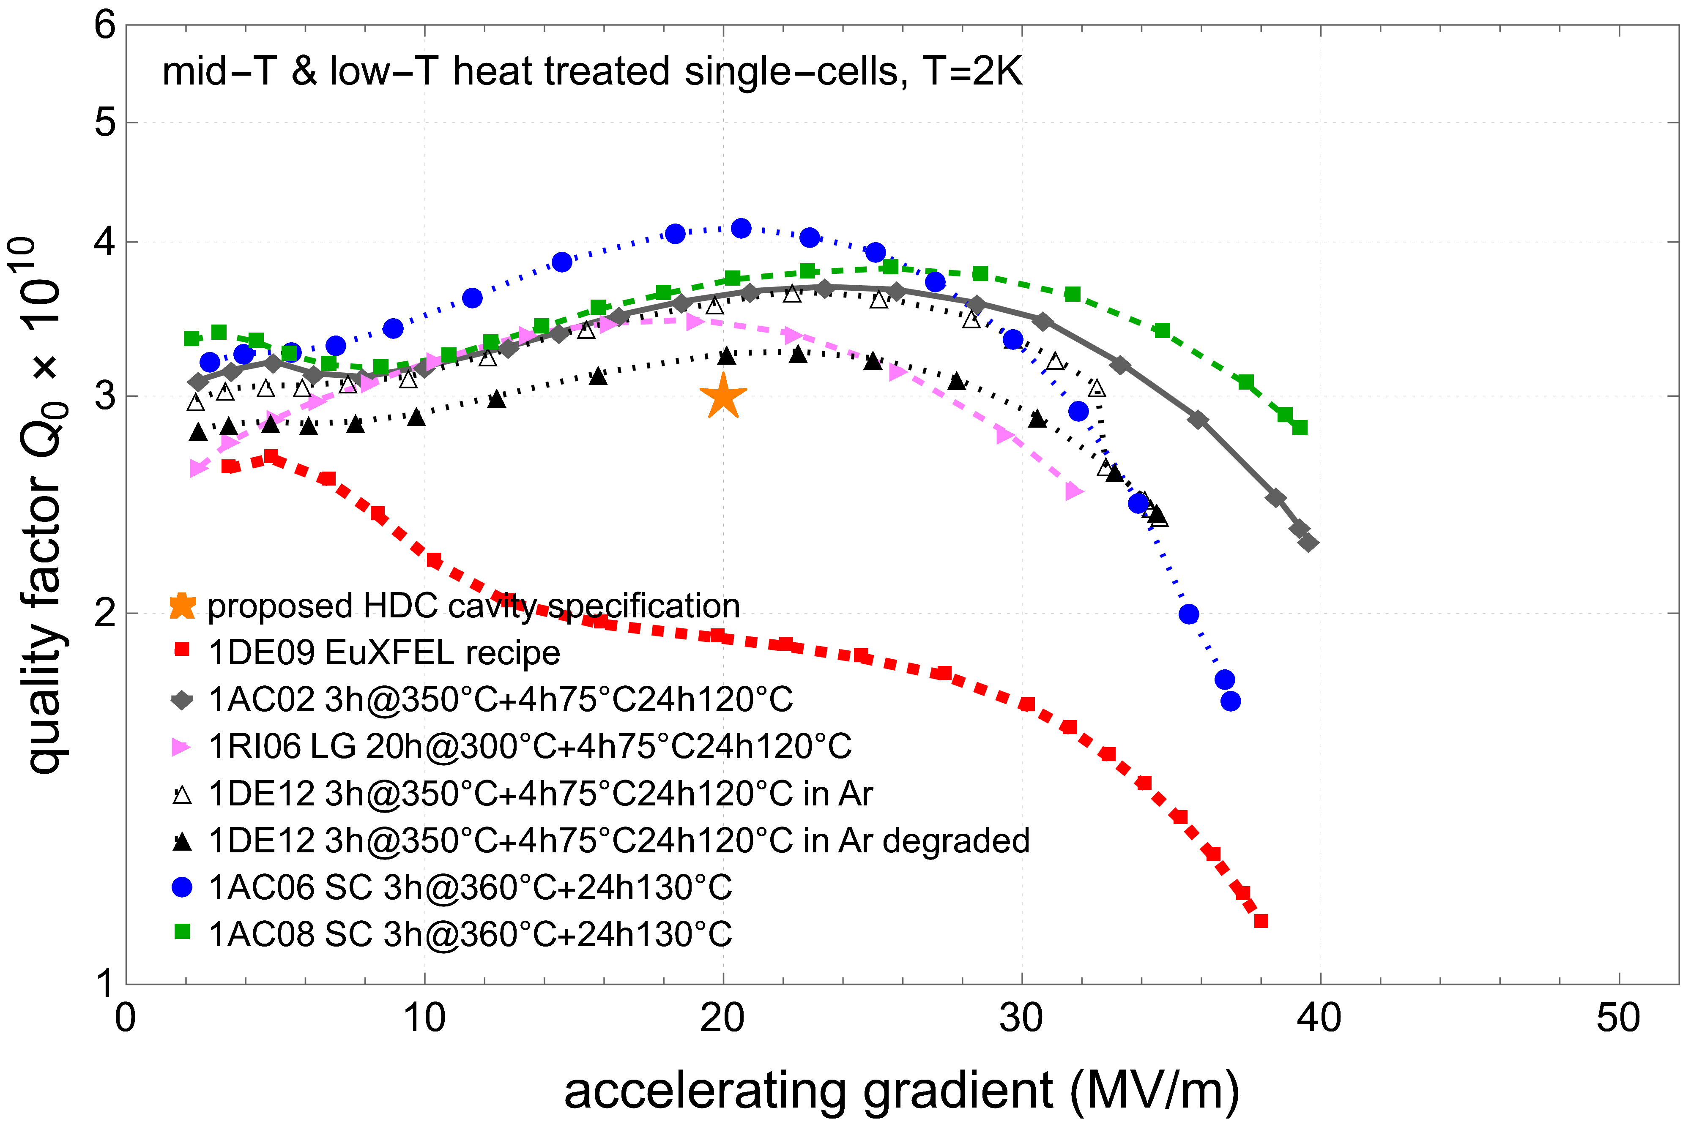
Something old & something new
A thorough parameter scan of T-t space
350°C midT shows HFQS again
  diffusion of oxygen
We know how to cure that
Do a simple lowT bake
  Either 48h@120°C (EXFEL)
  Or 2-step bake
  Significant improvent in E_{acc} and Q₀
  3/3 – but single cell
  5/5 – but single cell
Pushing for 9-cell now
Go-to recipe for HDC upgrade
        10x 9cells next year(s)
        He-Tank, then cryomodule
LC Spec
LC Spec
Recent developments in superconducting RF.

Slide 15
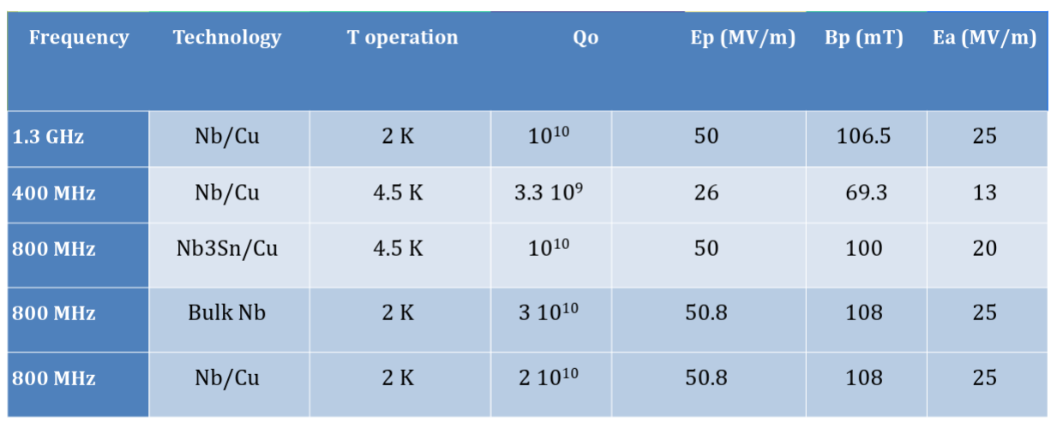
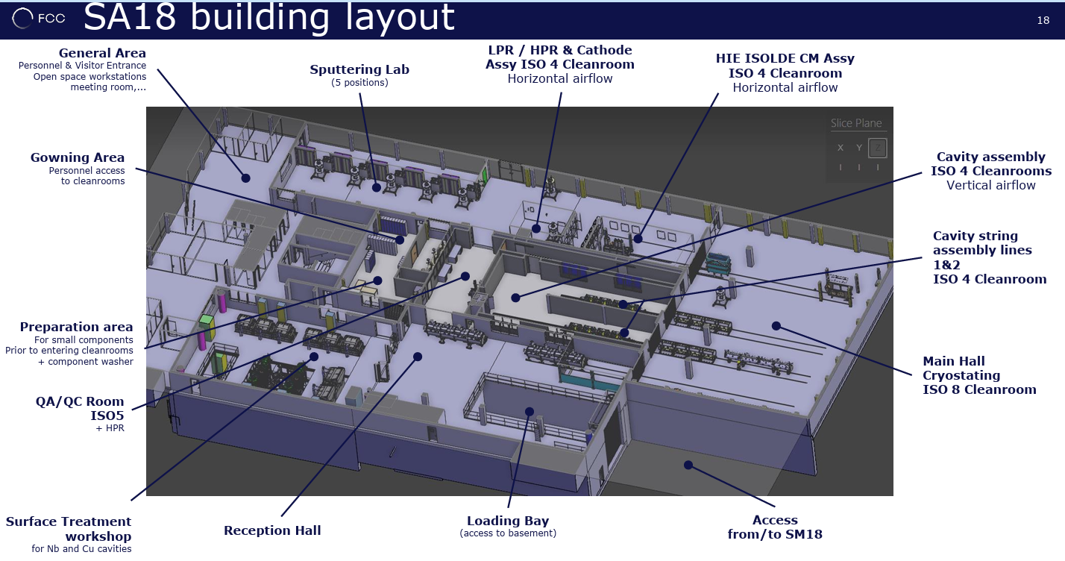
CERNs SRF R&D for FCC
The main direction is to push performance of thin films on copper cavities (Nb and Nb3Sn)
SA18 facility will undergo severe upgrade & changes
Total of ~370 cryomodules and 1500 cavities
Actual distribution (time/spatial) depends operation
Recent developments in superconducting RF.

Slide 16
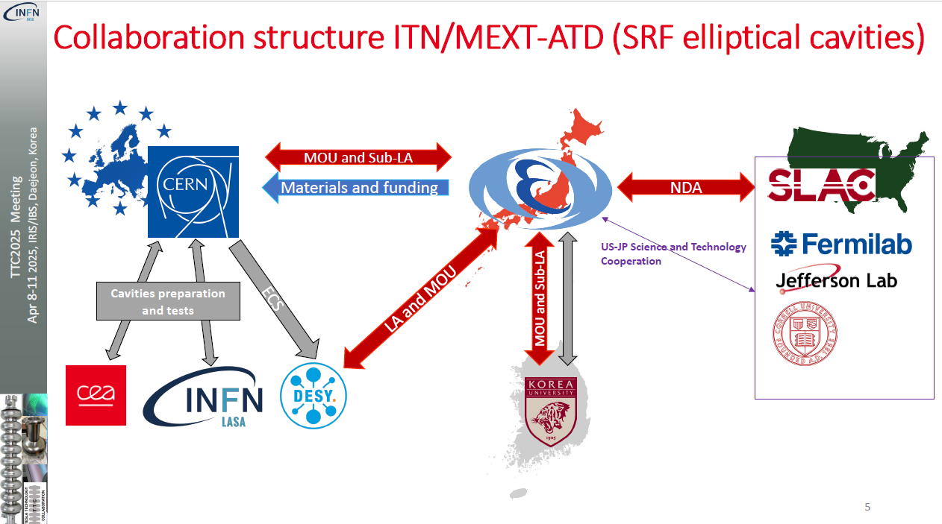
ITN - who
Recent developments in superconducting RF.

Slide 17
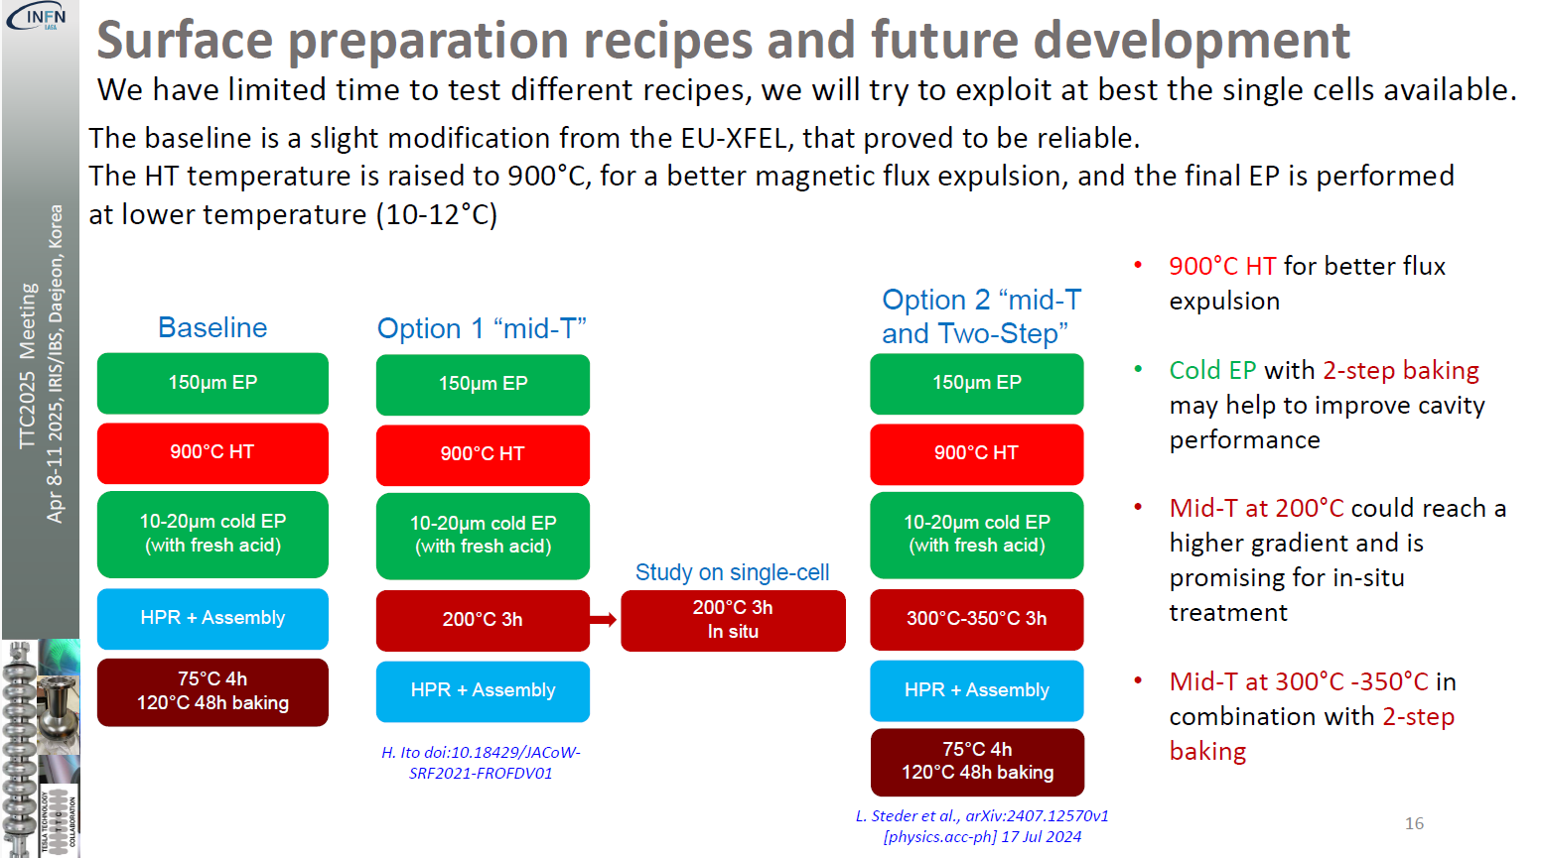
ITN – what (Europe)
Besides recipes:
  Material studies (MG)
  PED
Recent developments in superconducting RF.

Slide 18
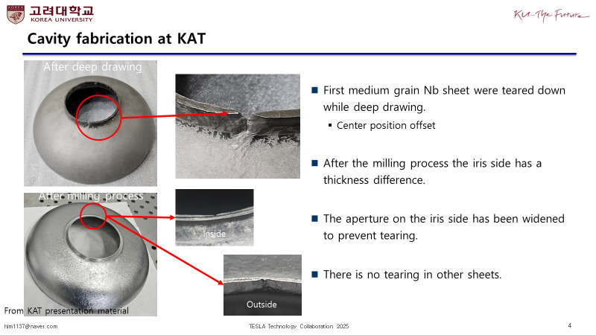
Medium grain cavity fabrication
It‘s all about the flow…
Recent developments in superconducting RF.

Slide 19
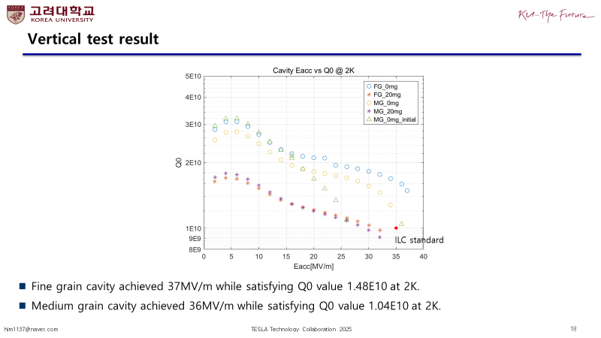
Performance is comparable
Recent developments in superconducting RF.

Slide 20
Let me be pessimistic
Other „Nb“: Medium grain (ITN)
  Same output for less cost
Nb₃Sn?
  Not for high gradients…
Travelling Wave?
  The waveguide will kill us
SIS Multilayer?
  Completely theoretical so far
Recent developments in superconducting RF.

Slide 21
How can we pull this off?
Significant expertise & capacities in the world
On a 5y scale: optimize new midT/lowT recipe on FG (coldEP) and bring it into the modules (EXFEL HDC upgrade)
Transfer it to industry & partners
On a 10y + X scale: proof-of-concept for TW and/or SIS – then do the industrialization

Slide 22
Contact
  Dr. Marc Wenskat / MSL
   +49 (0)40 8998-2032
   marc.wenskat@desy.de
Deutsches Elektronen-Synchrotron DESY
  Notkestraße 85
  22607 Hamburg
  www.desy.de

Slide 23
LC Spec

