Slide 1

DESY THEORY WORKSHOP 2025
Synergies Towards The Future Standard Model
2HDM:
Alignment limit and strong first-order electroweak phase transition
Name: Debankana Nath
DESY, Hamburg and Universität Hamburg
In Collaboration with:
Francisco Arco, Georg Weiglein, Kateryna Radchenko, Maria Olalla Olea Romacho, Sven Heinemeyer, Thomas Biekötter

Slide 2

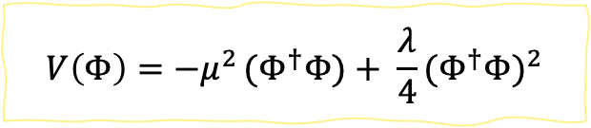

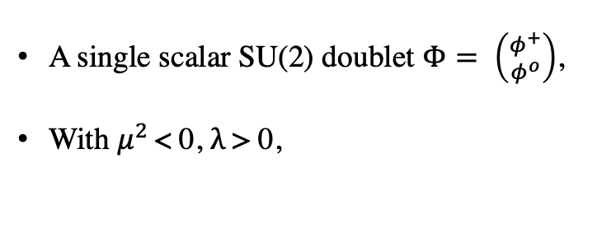



SM explains mass generation : EWPT
EW symmetry spontaneously broken to
SU(2)_{L} x U(1)_{Y} → U(1)_{EM}
A single scalar SU(2) doublet $Φ= \left({φ^{+} \atop φ^{o}}\right)$,
With $μ^{2 }$< 0, $λ$ > 0,
Mass to particles (Fermions and Gauge Bosons) and scalar Higgs boson
$$V\left(Φ\right)=−μ^{2 }{(Φ}^{†}Φ)+ \frac{λ}{4}{(Φ^{†}Φ)}^{2}$$
$$V\left(Φ\right)$$
$$V\left(Φ\right)$$
BEH mechanism
SSB
$$Φ$$
$$Φ$$
Fig 1. Smooth transition to the EW minimum
Debankana Nath
2HDM : Alignment Limit and SFOEWPT || DESY THEORY WORKSHOP 2025

Slide 3

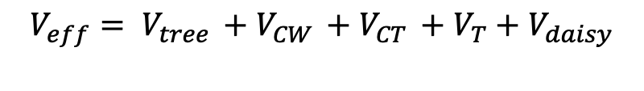

Thermal Evolution of
the Universe
$$V_{eff}\left(Φ\right)$$
$$↓ T decreases$$
At finite-temperature:
$$V_{eff}= V_{tree }+V_{CW }+V_{CT }+V_{T}+V_{daisy}$$
T-independent
thermal corrections
$V_{tree }$: Tree-level scalar potential
$V_{CW }$: One-loop Coleman Weinberg potential (Ref.2)
Smooth-crossover
in SM
$V_{CT }$: UV-finite counter-term potential
$V_{T}$: One-loop thermal corrections
$$Φ$$
$V_{daisy}$: Resummation of the daisy diagrams
[See: Lisa Biermann’s talk]
Fig 2.1: Finite-temperature potential: thermal evolution of vacuum
as a smooth cross-over
Debankana Nath
2HDM : Alignment Limit and SFOEWPT || DESY THEORY WORKSHOP 2025

Slide 4


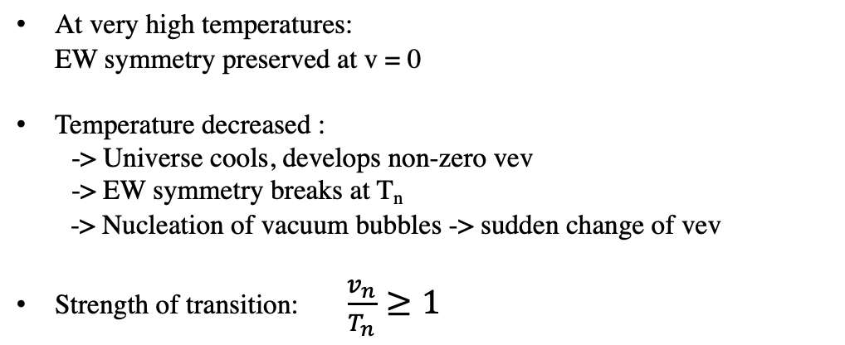


First-order Phase Transition
At very high temperatures: EW symmetry preserved at v = 0
Temperature decreased :
-> Universe cools, develops non-zero vev -> EW symmetry breaks at T_{n}
-> Nucleation of vacuum bubbles -> sudden change of vev
Strength of transition: $\frac{v_{n}}{T_{n}}≥1$
$$V_{eff}\left(Φ\right)$$
T > T_{c}
T = T_{c}
v
T < T_{c}
$v=0$
$v≠0$
$$Φ$$
Fig 2.2: First-order phase transition of the universe
Debankana Nath
2HDM : Alignment Limit and SFOEWPT || DESY THEORY WORKSHOP 2025

Slide 5


What are we looking for?
EW baryogenesis -> Strong first-order phase transition
Matter-Antimatter asymmetry
-> SM prediction: 6 . 10⁻¹⁹ ; Observed: 6 . 10⁻¹⁰
-> Sakharov conditions
(B, C and CP violation + Out-of-Thermal-Equilibrium Process)
BSM (extended) Higgs sector required!
Debankana Nath
2HDM : Alignment Limit and SFOEWPT || DESY THEORY WORKSHOP 2025

Slide 6
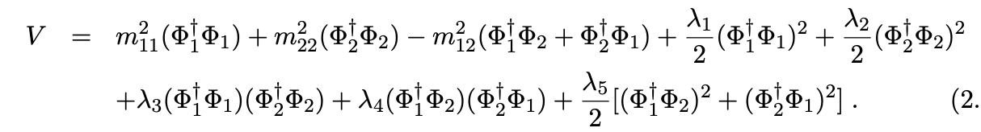
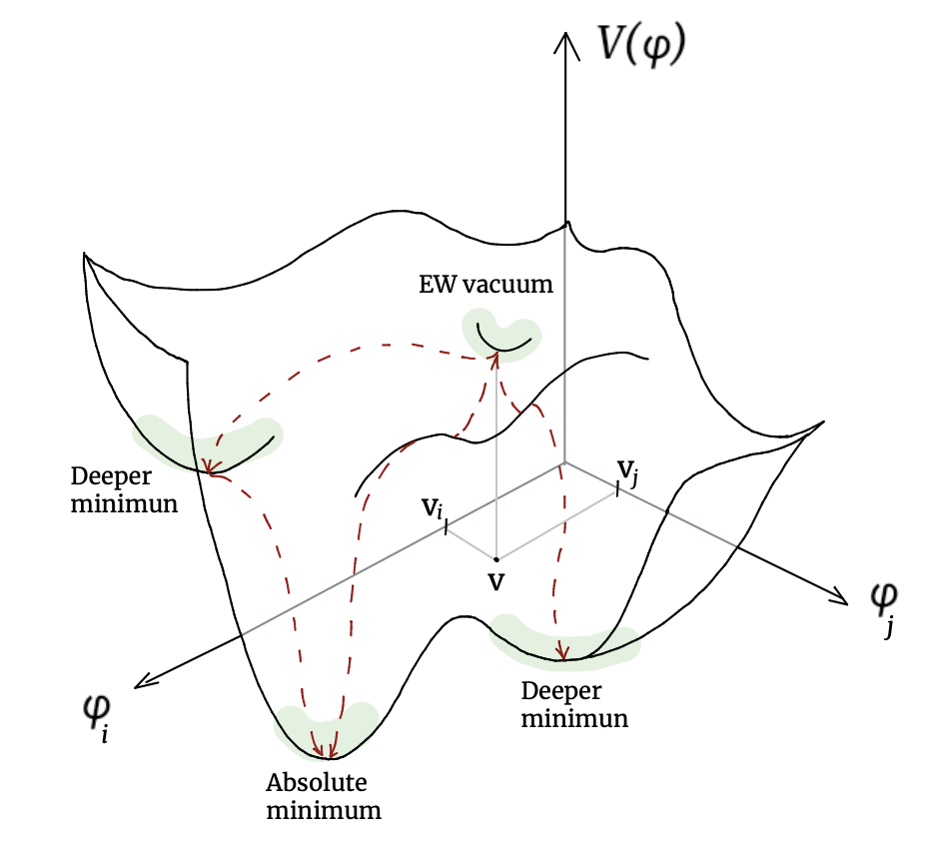
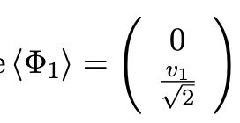
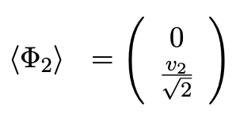

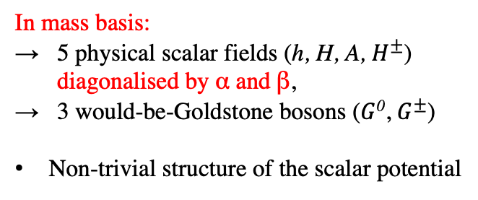
Two-Higgs-Doublet Model (2HDM)
Z₂ symmetry : Φ₁ → Φ₁
Φ₂ → −Φ₂
I, II, III, IV
In mass basis:
→ 5 physical scalar fields (h, H, A, $H^{±}$)
diagonalised by α and β,
→ 3 would-be-Goldstone bosons ($G$⁰, $G^{±}$)
Non-trivial structure of the scalar potential
SSB
Fig 3: Representation of minima structure of 2HDM (or BSM) scalar potential
Art credit: Kateryna Radchenko
Debankana Nath
2HDM : Alignment Limit and SFOEWPT || DESY THEORY WORKSHOP 2025

Slide 7
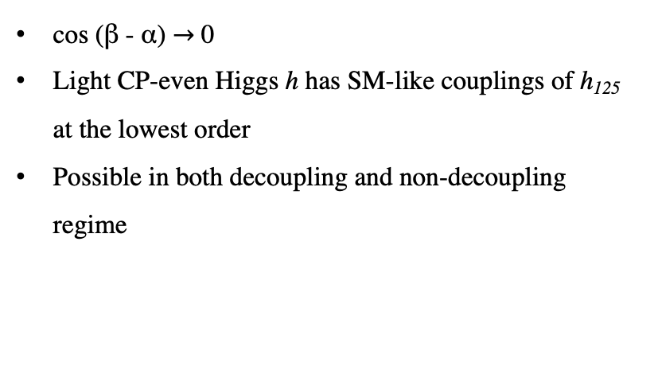
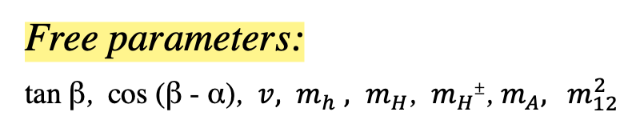
Constraints on 2HDM Parameter Space
Theoretical constraints:
Vacuum stability and boundedness-from-below
Perturbative unitarity
Free parameters:
tan β, cos (β - α), ${v, m}_{h}$ ${, m}_{H}$, $m_{H±}$, $m_{A},$ $m_{12}^{2}$
Enters in self-couplings -> barrier shape
Alignment limit:
Experimental constraints:
Electroweak precision observables
Constraints are from the limits from searches for additional Higgs bosons
Measurements of the properties of h₁₂₅
Flavour Constraints
cos (β - α) $→$ 0
Light CP-even Higgs h has SM-like couplings of h₁₂₅ at the lowest order
Possible in both decoupling and non-decoupling regime
Debankana Nath
2HDM : Alignment Limit and SFOEWPT || DESY THEORY WORKSHOP 2025
Notes:
In the 2HDM this translates into upper limits on combinations of the quartic couplings (or, equivalently, on the physical masses and mixing angles). If these limits are exceeded, the perturbative expansion becomes unreliable and predictions in that parameter region cannot be trusted.

Slide 8
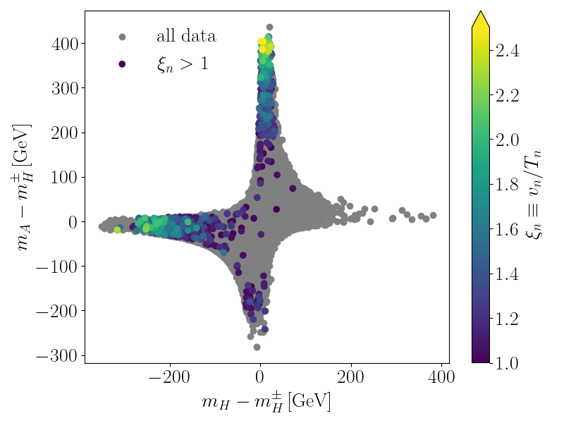
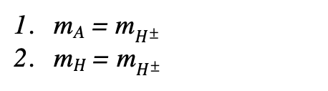

Mass splittings
Allowed Data
Key Regions:
m_{A} = m$H^{±}$
m_{H} = m$H^{±}$
Larger mass splittings m_{A} – m_{H} driven by the quartic couplings in the scalar potential correlate to stronger first-order phase transitions.
For region 1: mass splitting range: 100 – 200 GeV
For region 2: mass splitting range: 150 – 400 GeV
This dependence is constrained by perturbative unitarity.
Fig 4: SFOEWPT strength depends on the mass splittings, here the free parameters vary as $1 ≤\tan{β ≤50} and 150 ≤m_{H} ≤$1400 GeV.
Debankana Nath
2HDM : Alignment Limit and SFOEWPT || DESY THEORY WORKSHOP 2025

Slide 9
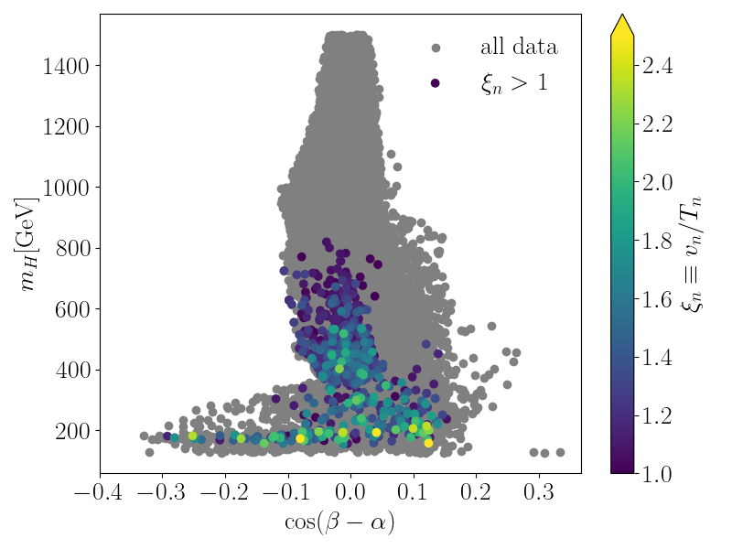
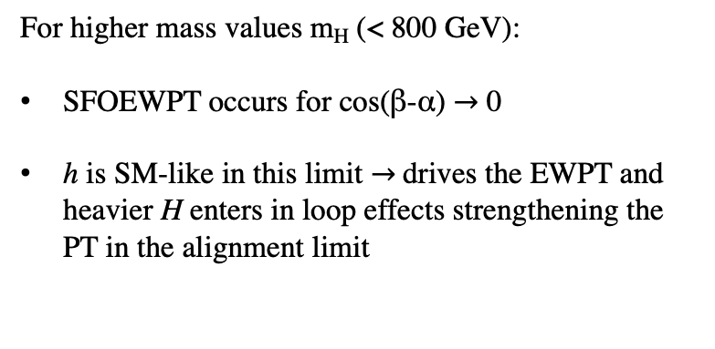
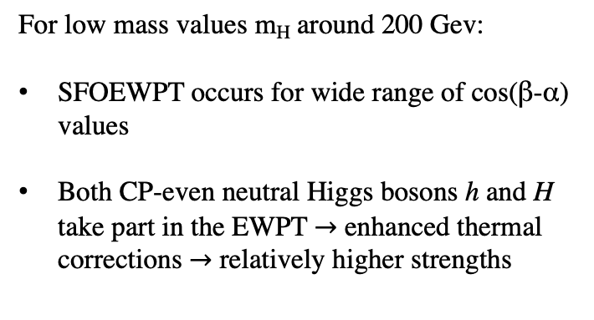
SFOEWPT in (m_{H}, cos(β-α)) plane
Allowed Data
For low mass values m_{H} around 200 Gev:
SFOEWPT occurs for wide range of cos(β-α) values
Both CP-even neutral Higgs bosons h and H take part in the EWPT $→$ enhanced thermal corrections $→$ relatively higher strengths
For higher mass values m_{H} (< 800 GeV):
SFOEWPT occurs for cos(β-α) $→$ 0
h is SM-like in this limit $→$drives the EWPT and heavier H enters in loop effects strengthening the PT in the alignment limit
Fig 5: SFOEWPT for CP-even heavy Higgs mass values, here the free parameters vary as $1 ≤\tan{β ≤50}$
Debankana Nath
2HDM : Alignment Limit and SFOEWPT || DESY THEORY WORKSHOP 2025

Slide 10
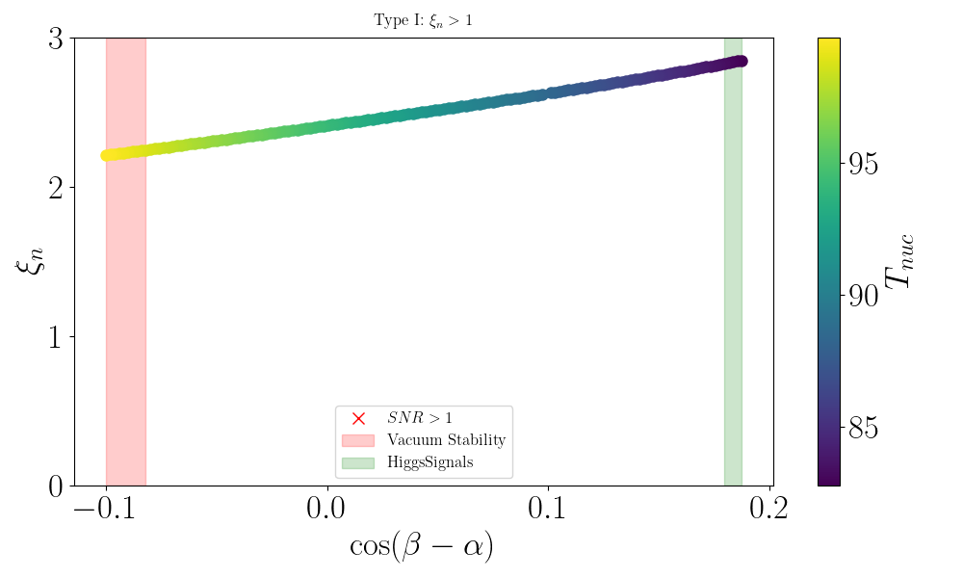
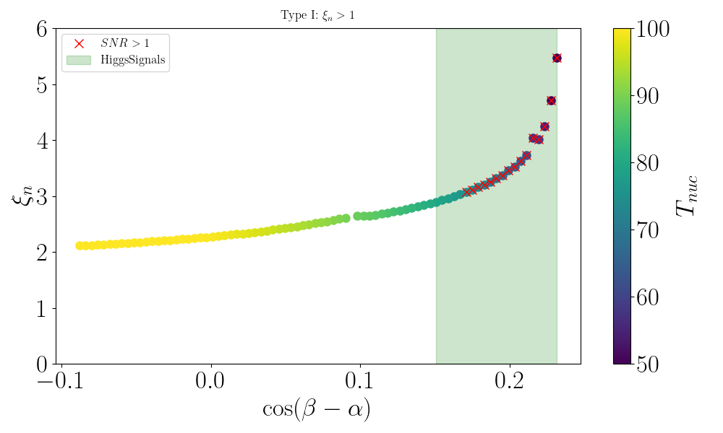
SFOEWPT vs cos (β-α) for lower m_{H}
SFOEWPT occurs for wide range of cos (β-α), strength increasing further away from the alignment limit
Type I: m_{H}= 177.3 GeV , m$H^{±}$= 155.7 GeV, m_{A} $=$564 GeV, tan β = 8.46, M = 176 GeV
Type I: m_{H}= 157.3 GeV ~ m$H^{±}$= 151 GeV, m_{A} $=$500 GeV, tan β = 19.2, M = 156.2 GeV
Fig 6a and b: Variation of strength with cos(β-α) for lower CP-even Higgs masses to correlate the SFOEWPT parameter space close to as well as away from alignment limit
Debankana Nath
2HDM : Alignment Limit and SFOEWPT || DESY THEORY WORKSHOP 2025

Slide 11
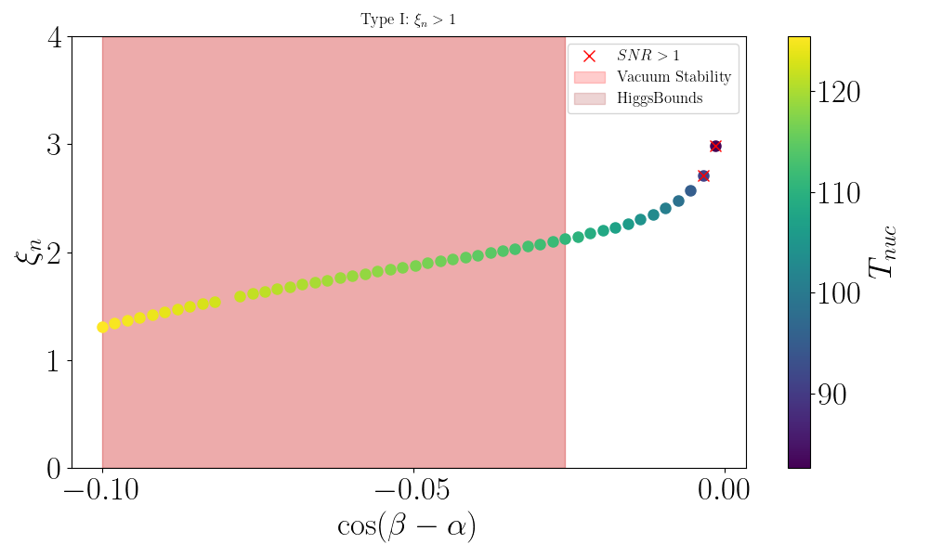
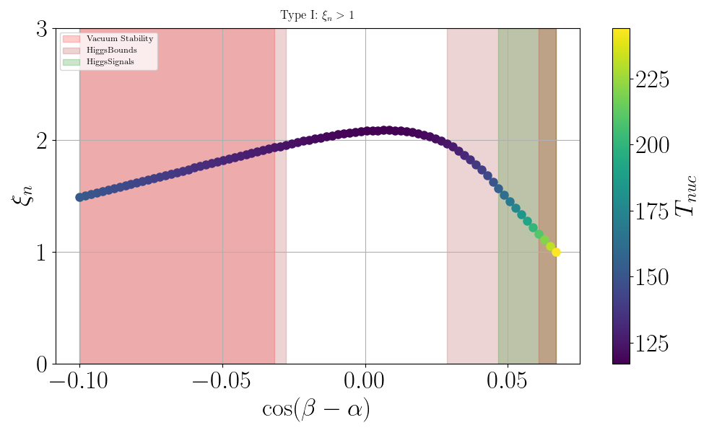
SFOEWPT vs cos (β-α) for higher m_{H}
SFOEWPT occurs strongest for cos (β-α) $→0$, i.e. strength highest at the alignment limit
Type I: m_{H}= 401.6 GeV, m_{A} $\sim$m$H^{±}$> 600 GeV, tan β = 7.7, M = 400.6 GeV
Type I: m_{H}= 517.4 GeV, m_{A} $\sim$m$H^{±}$> 700 GeV, tan β = 1.68, M = 513.5 GeV
Fig 7a and b: Variation of strength with cos(β-α) for higher CP-even Higgs masses to correlate the SFOEWPT parameter space close to alignment limit
Debankana Nath
2HDM : Alignment Limit and SFOEWPT || DESY THEORY WORKSHOP 2025

Slide 12
Conclusions
Extended Higgs sectors can feature a SFOEWPT, necessary for EW baryogenesis, can potentially lead to detectable GW signals
The parameter region giving rise to a SFOEWPT in the 2HDM has a mass splitting between m_{A} and m_{H} of about 200 GeV
For high values of m_{H} (up to 800 GeV): SFOEWPT occurs close to the alignment limit
For low values of m_{H} (~ 200 GeV): SFOEWPT possible for larger deviations from the alignment limit
Qualitatively, for SFOEWPT parameter points with higher m_{H}, the strength of phase transition increases with cos (β-α), and is highest at the alignment limit, whereas for the case of lower m_{H}, the strength is higher as we go away from the alignment limit.
Debankana Nath
2HDM : Alignment Limit and SFOEWPT || DESY THEORY WORKSHOP 2025

Slide 13
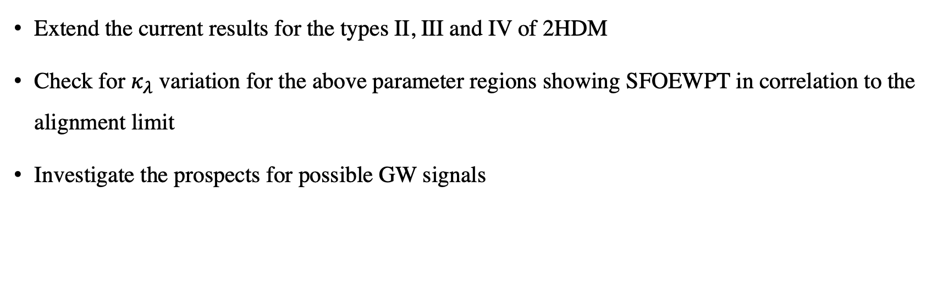
Next Steps:
Extend the current results for the types II, III and IV of 2HDM
Check for $κ_{λ}$ variation for the above parameter regions showing SFOEWPT in correlation to the alignment limit
Investigate the prospects for possible GW signals
Debankana Nath
2HDM : Alignment Limit and SFOEWPT || DESY THEORY WORKSHOP 2025

Slide 14
References
Biekötter, T., Heinemeyer, S., No, J.M., Radchenko, K., Olea Romacho, M.O. and Weiglein, G., 2024. First shot of the smoking gun: probing the electroweak phase transition in the 2HDM with novel searches for A→ ZH in $${\ell}^{+}{\ell}^{-} t\overline {t} $$ and $$\nu\nu b\overline {b} $$ final states. Journal of high energy physics, 2024(1), pp.1-44.
Coleman, S. and Weinberg, E., 1973. Radiative corrections as the origin of spontaneous symmetry breaking. Physical Review D, 7(6), p.1888.
Arnold, P. and Espinosa, O., 1993. Effective potential and first-order phase transitions: Beyond leading order. Physical Review D, 47(8), p.3546.
GWs studies: Athron, P., Balázs, C., Fowlie, A., Morris, L. and Wu, L., 2024. Cosmological phase transitions: From perturbative particle physics to gravitational waves. Progress in Particle and Nuclear Physics, 135, p.104094.
Biekötter, T., Heinemeyer, S., No, J.M., Olea, M.O. and Weiglein, G., 2021. Fate of electroweak symmetry in the early Universe: Non-restoration and trapped vacua in the N2HDM. Journal of Cosmology and Astroparticle Physics, 2021(06), p.018.
Cline, J.M. and Lemieux, P.A., 1997. Electroweak phase transition in two Higgs doublet models. Physical Review D, 55(6), p.3873.
Fromme, L., Huber, S.J. and Seniuch, M., 2006. Baryogenesis in the two-Higgs doublet model. Journal of High Energy Physics, 2006(11), p.038.
Dorsch, G.C., Huber, S.J., Konstandin, T. and No, J.M., 2017. A second Higgs doublet in the early universe: baryogenesis and gravitational waves. Journal of Cosmology and Astroparticle Physics, 2017(05), p.052.
Dorsch, G.C., Huber, S., Mimasu, K. and No, J.M., 2014. Echoes of the Electroweak Phase Transition: Discovering a second Higgs doublet through $ A_0\rightarrow H_0 Z$. arXiv preprint arXiv:1405.5537.
Dorsch, G.C., Huber, S.J., Mimasu, K. and No, J.M., 2017. The Higgs vacuum uplifted: revisiting the electroweak phase transition with a second Higgs doublet. Journal of high energy physics, 2017(12), pp.1-32.
Debankana Nath
2HDM : Alignment Limit and SFOEWPT || DESY THEORY WORKSHOP 2025

Slide 15

Thank you

