Slide 1
Silicon Pixel detectors for Relativistic Heavy Ion Collisions The present, the future and some dreams
M. Deveaux, GSI

Slide 2
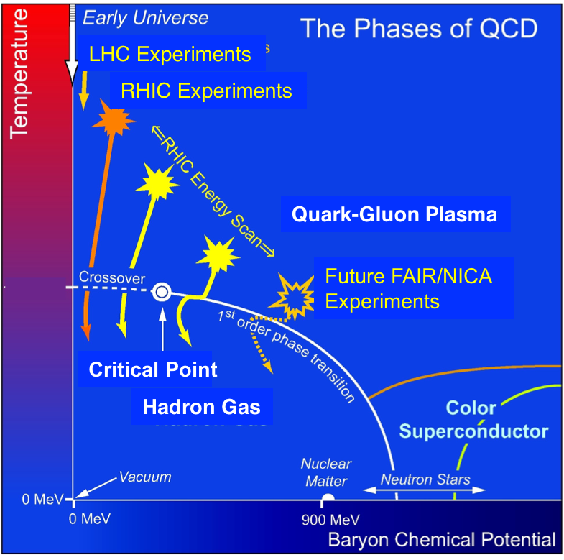
Relativistic heavy ion physics – how we search
Qualitative picture.
This is what we want to study.
Energy is exhausted, Fireball starts to
expand. Still formation of matter. Medium
acts collectively like a gas cooling down.
Hadronization: Quarks find
partner and form hadrons.
Chemical freeze out: Composition
of particles no longer determined
by thermal equilibrium.
QGP is formed: Hadrons loose binding.
Fireball establishes
Thermal freeze out: Kinetics
of particles no longer determined
by thermal equilibrium.
“Fireball” establishes (magically) a thermal
equilibrium and acts like a gas.
Ions collide. Heavy quarks are formed
in early collisions.
This is what arrives in the detector.

Slide 3
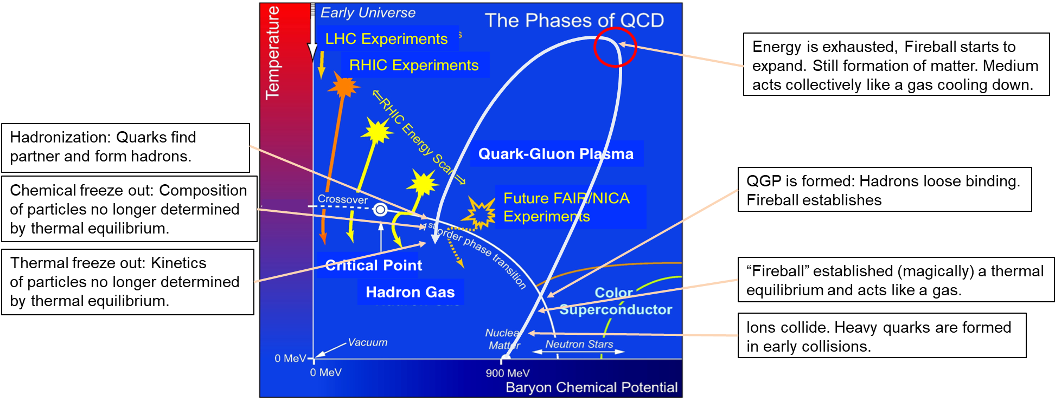
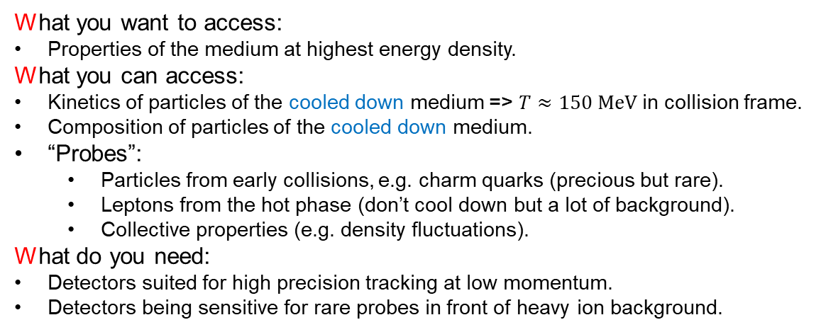
Relativistic heavy ion physics – how we search
What you want to access:
Properties of the medium at highest energy density.
What you can access:
Kinetics of particles of the cooled down medium => $T≈150 MeV$ in collision frame.
Composition of particles of the cooled down medium.
“Probes”:
Particles from early collisions, e.g. charm quarks (precious but rare).
Leptons from the hot phase (don’t cool down but a lot of background).
Collective properties (e.g. density fluctuations).
What do you need:
Detectors suited for high precision tracking at low momentum.
Detectors being sensitive for rare probes in front of heavy ion background.
Sensitivity is essential, therefore DMAPS.

Slide 4
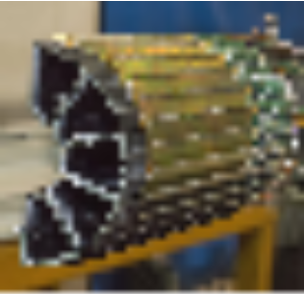
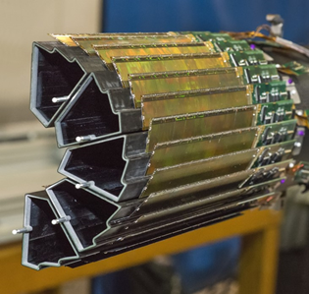
MAPS – the hope and limitations
We need both
More sensitivity
More statistics
 | Hybrid pixels (2001) | MAPS (2001)
Single point resolution | ~ 30 µm | ~2 µm
Material budget | ~ 500 µm Si | ~ 50 µm Si
Time resolution | 25 ns | ~10 ms
Radiation hardness | ~10¹⁵ n_{eq}/cm² | 10¹² n_{eq}/cm²
MAPS Hybrid
Hybrid pixels (LHC / CMS)
Massive improvement required… and was reached.

Slide 5
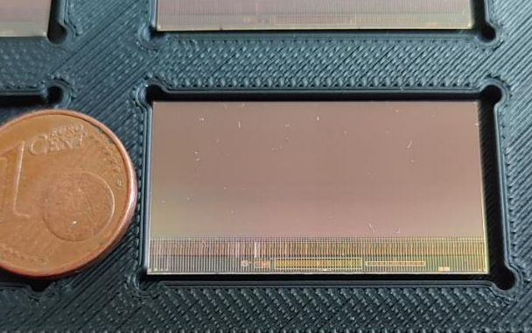

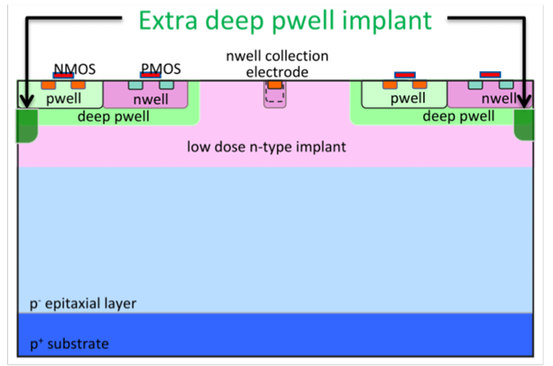
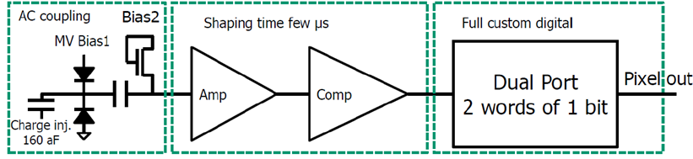
The state of the art – MIMOSIS, the pixel sensor of CBM.
Curtesy CBM-MVD collaboration
(IPHC, GU Frankfurt, GSU)
 | MIMOSIS (TJ180nm)
Pixels | 504 x 1024
Pixel size | 27 x 30 µm²
Time binning | 5 µs
Sensor type | Fully depleted, 20 V top bias
Rate (average, peak) | 20 MHz/cm², 80 MHz/cm²
Control | I2C
Readout | 8 x 320 Mbps (GBTx compatible)
MIMOSIS-1, 60µm thick
Derived from ALICE - ALPIDE
>20V HV top bias
p-stop
First proposed by H. Pernegger et al.,
2017 JINST 12 P06008
Capacitor blocks HV

Slide 6
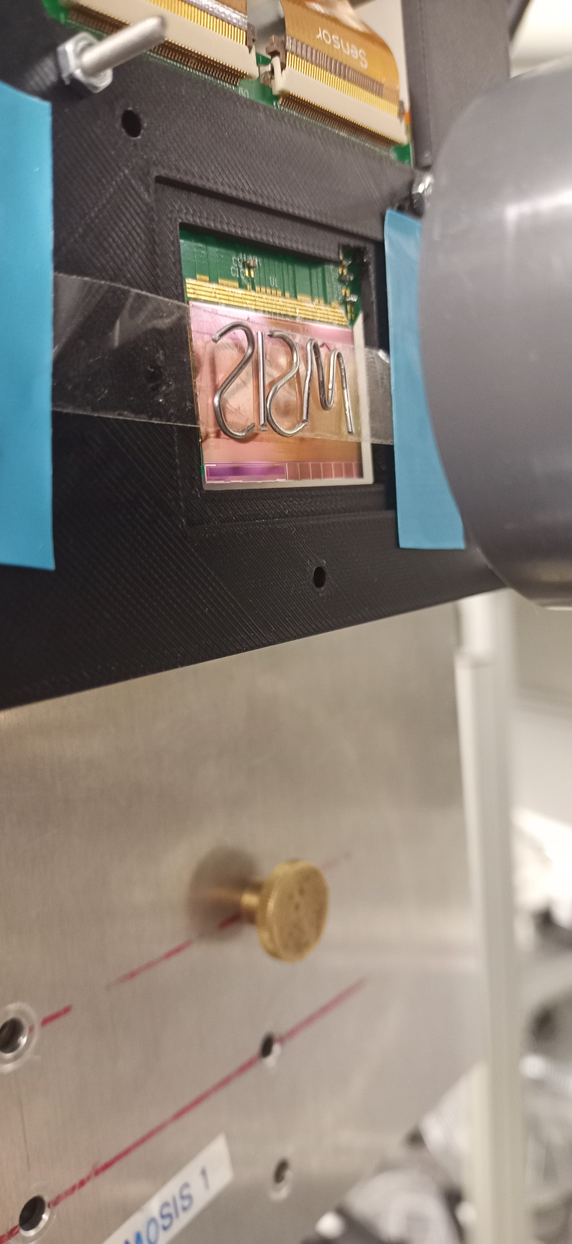
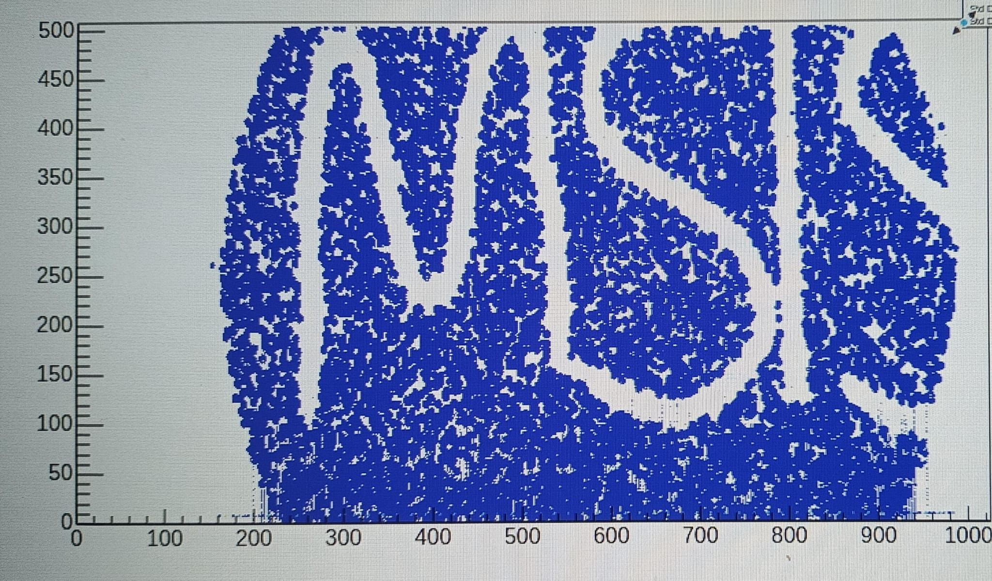
MIMOSIS prototypes - Performance
Curtesy CBM-MVD collaboration
(IPHC, GU Frankfurt, GSU)
+ 0.5 µm for longer
pixel dimension
Work in progress
ALPIDE-like
Dark rate typically <10¹⁰/pixel (2 Hz/cm²)
driven by individual hot pixels.
Optimal number of fired pixels/particle (about 2.5)
Also demonstrated:
Tolerates >10¹⁴ n/cm² + 5 MRad @ room temperature.
Tolerates exposure to > 20 MeV cm²/mg ions
So, we have the perfect sensor, but…

Slide 7
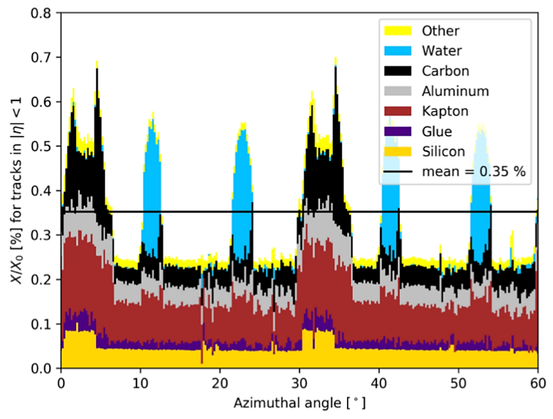
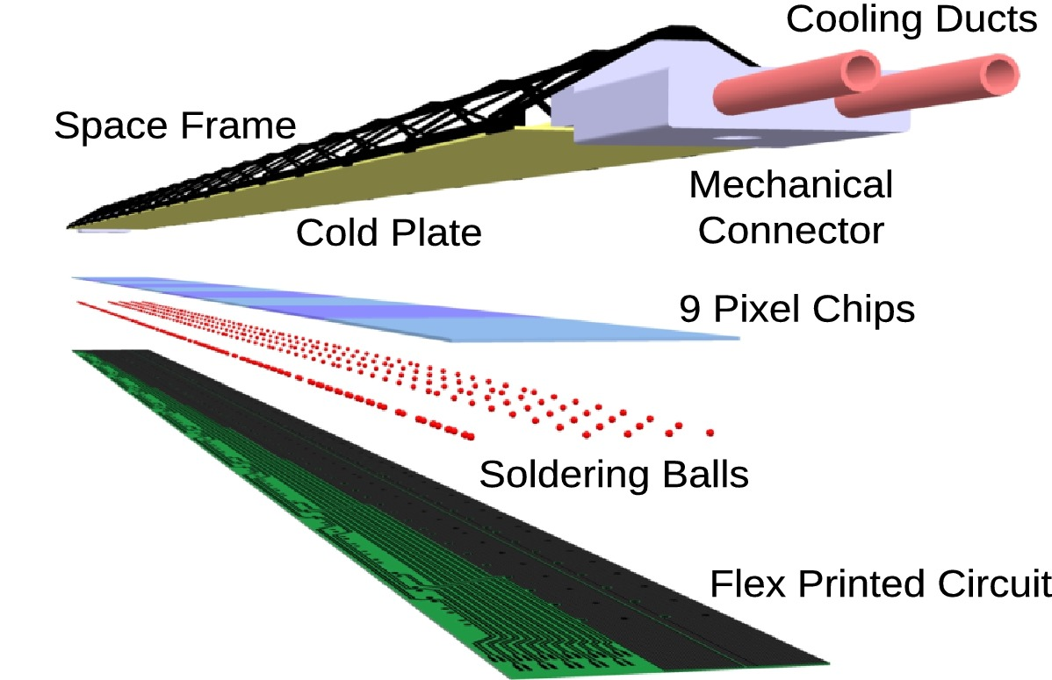
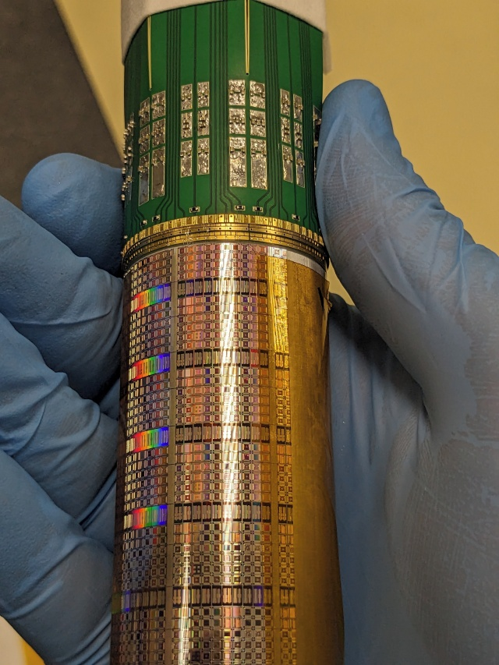
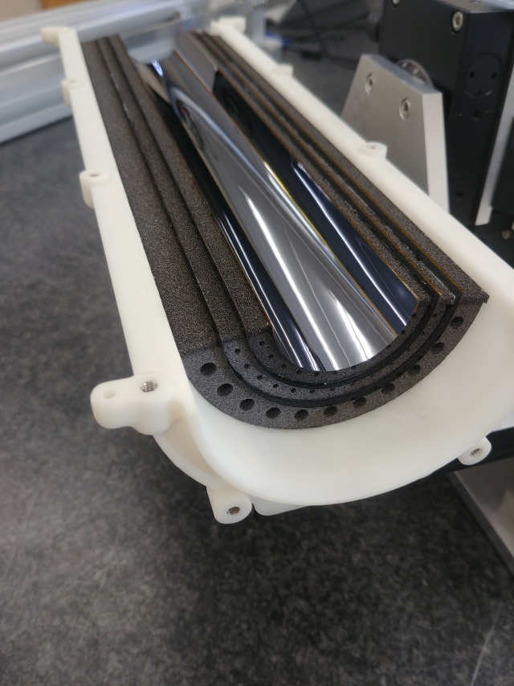
It’s the infrastructure, stup..!
Pictures: ALICE ITS-2 ladder
In DMAPS detectors, material
is determined by the supporting
infrastructure.
Must minimize this infrastructure.
Other
stuff
J. Sonneveld for ALICE, PoS(HardProbes2023)077
S. Siddhanta for ALICE, NIM-A Vol. 931 (2014) P 1147ff
Sensor
Idea to reduce the infrastructure:
Build air – cooled, self supporting, bended stations
from one or few wafer-size sensors.
=> Material budget close to 50µm thin sensors.
Pushed forward by ALICE-ITS3.
So, we have the perfect detector, but…

Slide 8
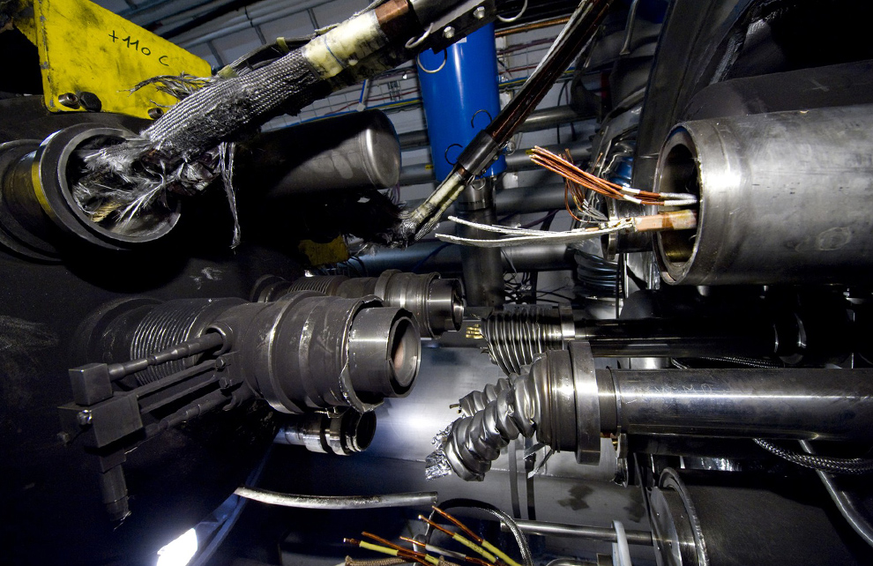
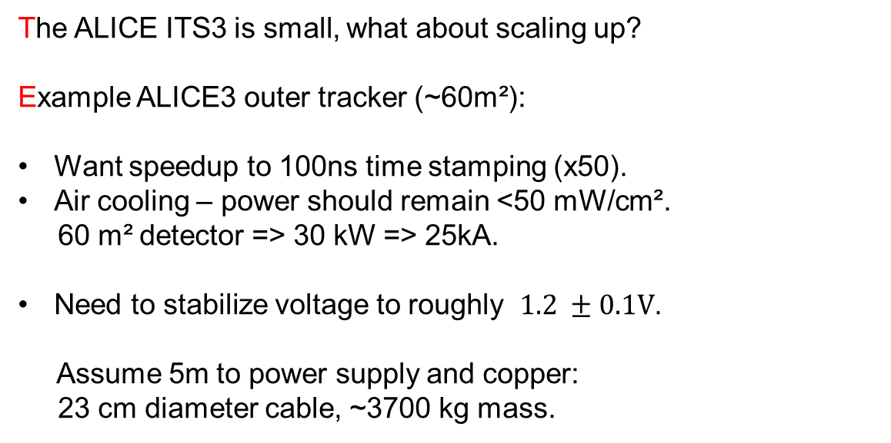
Scaling up existing solutions
This is not exactly a small current.
The ALICE ITS3 is small, what about scaling up?
Example ALICE3 outer tracker (~60m²):
Want speedup to 100ns time stamping (x50).
Air cooling – power should remain <50 mW/cm².
60 m² detector => 30 kW => 25kA.
Need to stabilize voltage to roughly $1.2 ±0.1V$.
Assume 5m to power supply and copper:
23 cm diameter cable, ~3700 kg mass.
LHC magnet failure: 12kA
This is not exactly a massless detector.
Solution so far:
Limit time resolution and rate capability
of the sensors to minimize power.
What if we aim for ~10ns and 100 MHz/cm²?
OCTOPUS Meeting Prague, Sept. 3-5 2025

Slide 9
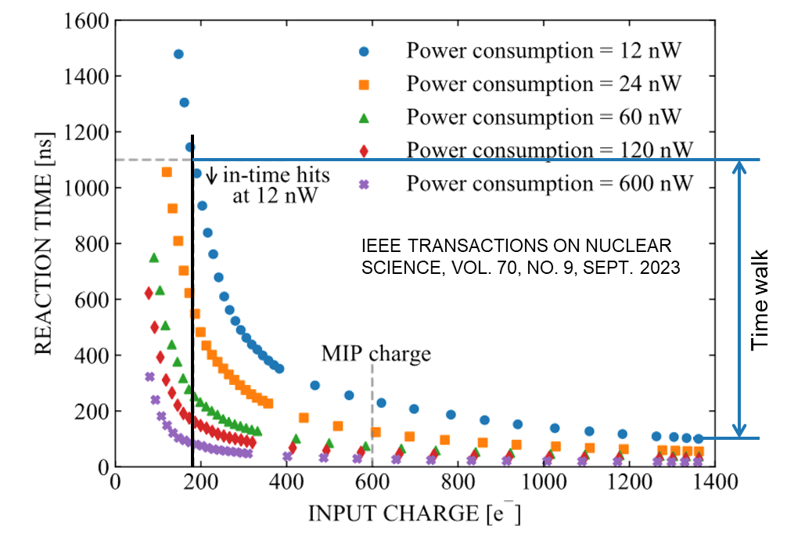

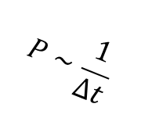
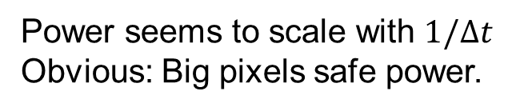
Pixel powering options
DPTS
Power seems to scale with $1/Δt$
Obvious: Big pixels safe power.
~3x
$$P∼\frac{1}{Δt}$$
$$P\sim \frac{1}{p^{2}}$$
Data extracted from IEEE TRANSACTIONS ON NUCLEAR SCIENCE, VOL. 70, NO. 9, SEPT. 2023
pitch
Welcome to the “power wall”.
3rd DRD3 week, NIKHEF Amsterdam, 2-6 June 2025

Slide 10
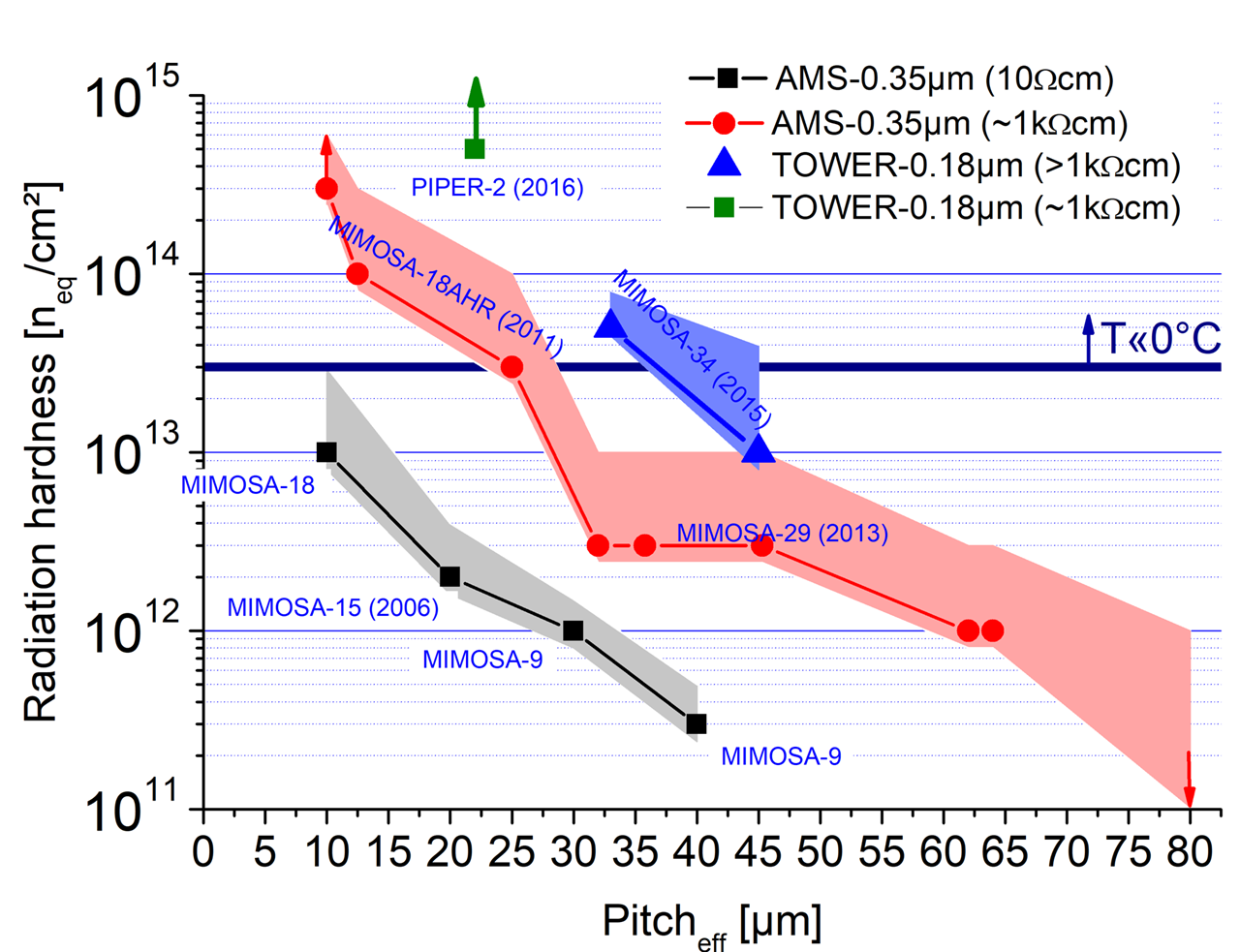
Going beyond the power wall: Radiation tolerance vs. pitch
DPTS
MIMOSIS
TOWER–0.18µm, p-stop (MIMOSIS-1)
TPSCo 65 nm (DPTS)
Using big pixels will reduce power but compromise rad. tolerance.
=> Not really an option.
DPTS: G. A. Rinella et al., arXiv:2212.08621v4
MIMOSIS-1: H. Darwish et al, proceedings of 20thTrento workshop (2025), under preparation
Others: M. Deveaux, 2019 JINST 14 R11001

Slide 11
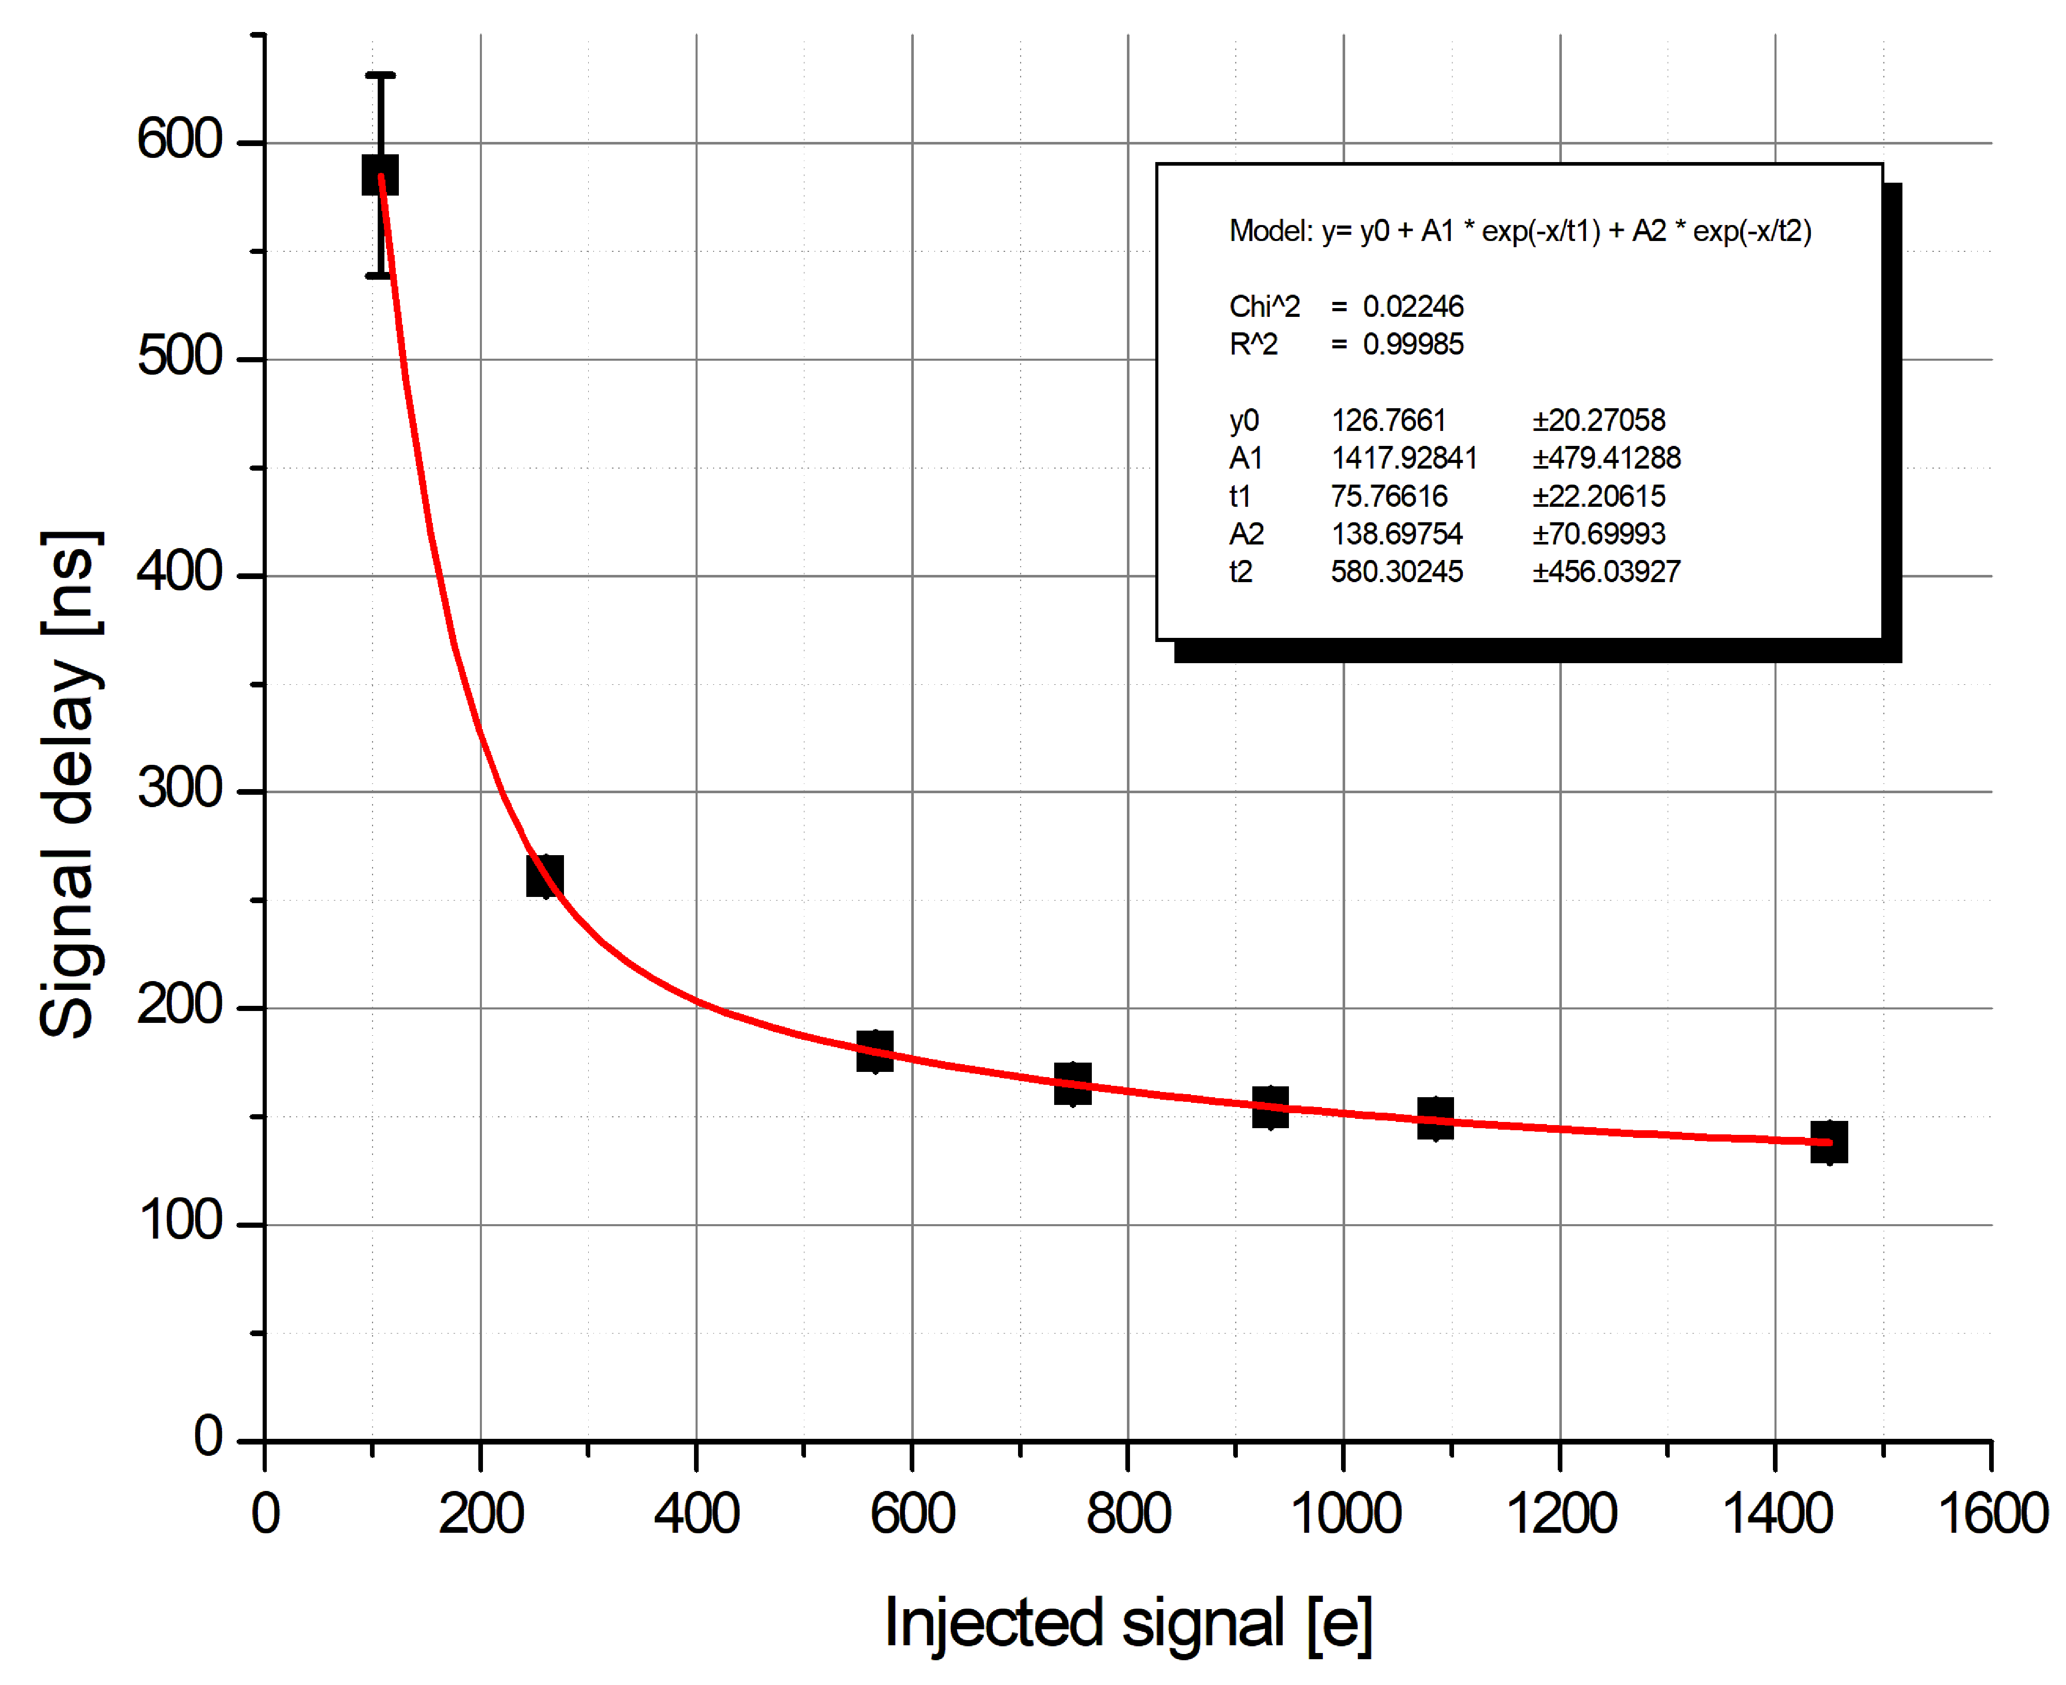
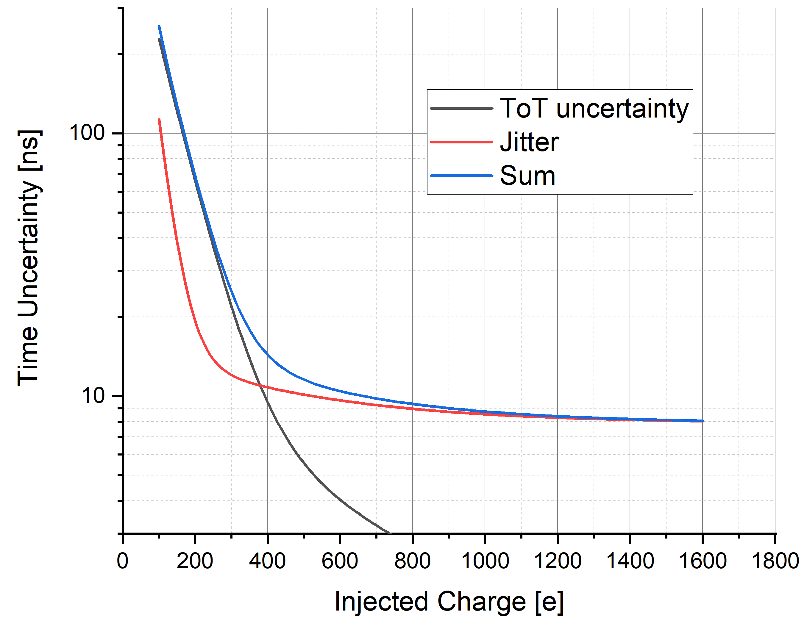
Going beyond the power wall – Time walk correction
Time walk correction
Uncertainties considered:
Jitter, ToT uncertainty of 44 e
Disclaimer: Pixel-to-pixel
variation not accounted for.
Signal 65nm (?)
Signal 180nm (?)
25 ns
M. Deveaux,
rough estimate
Idea:
Time walk depends deterministically on signal => Measure signal with ToT, correct offline.
May reduce analogue power by ~10x (t.b.c). Jitter remains.
Can’t do ToT on pixel => Send start and stop signal separately => 2x data rate.

Slide 12
Going beyond the power wall – LGADs
Most analog power is spent in pre-amplifier of pixel.
Idea: Replace pre-amplification by low gain avalanche amplification in the sensing node.
Amplification layer
e
10 x
Consequence:
Injected signal increases by LGAD gain (typically 5 – 30x).
Time walk and jitter is naturally reduced => No increased amplifier power required.
Feasibility for TJ180nm being demonstrated by DRD3/CASSIA project (there are many other projects).

Slide 13
Digital pixel power, example MIMOSIS-1/2 (TJ180 nm)
Power dissipation is composed from:
Analog power (analog front-end).
Static power (increases with irradiation).
Data cost:
~0.7 mW/MHz for MIMOSIS @~24 bit/hit.
Reduced by lower operation voltage.
Increased by higher number of bits/hit.
Precision timing – expect higher cost.
Analog & data power cost increases with increasing rate capability.
Work in progress
MMOSIS-1/2
Data cost [power/hit]
Irrad.
Static power
Curtesy CBM-MVD collaboration
Offset
Possible solution:
Optimize for low data cost (as always).
Switch-off unnecessary ressources (reduce static power).
OCTOPUS Meeting Prague, Sept. 3-5 2025

Slide 14
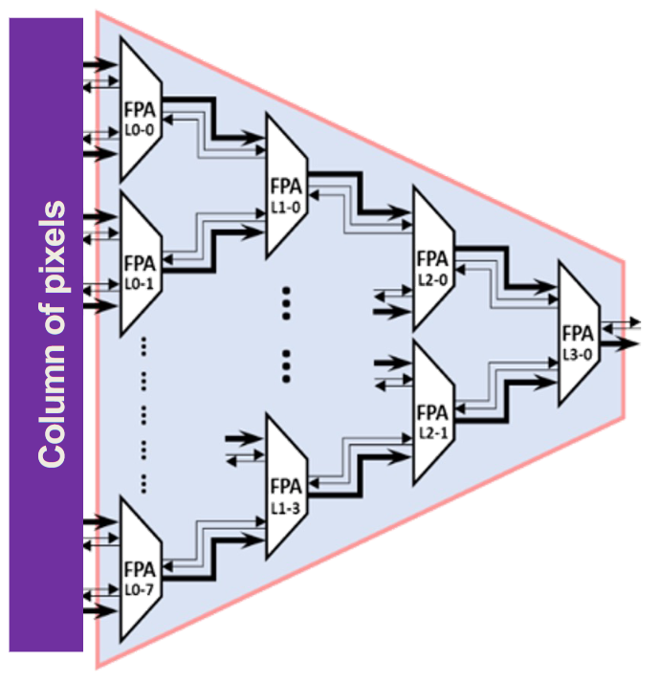
Reduce static power (pixel matrix readout).
So far: Priority encoder (ALPIDE, MIMOSIS), excellent for frame readout.
Possibly better: Arbiter readout.
Rules of individual cell:
If (signal@input) {
Forward address with highest priority to downstream cell.
Wait for clear signal from downstream cell.
Clear upstream cell with highest priority
}
In case of data collision: Process next signal immediately
E. Aguénounon et al., Sensors 2021, 21(12), 3949; https://doi.org/10.3390/s21123949
J. Soudier et al., NIM-A Volume 1067, October 2024, 169663
Advantages: Fully Asynchronous
No clock needed -> Less power, no clk driven delay.
Best possible response speed (limited by line and transistor delays).
Scalable: Each cell may serve N input lines.
Data collision => hit delayed but not lost.
Today’s estimate: Should require <<10mW/cm² @ 100 MHz/cm².
Additional power saving: Switch-off unnecessary resources where ever possible.

Slide 15
What is the best choice for 2025-2030?
One must fit all...
The dream: Save power on the system level
Today:
More sensitivity (low power)
Power vs. Performance: Hardwired
More statistics (high power)
What is the best choice for
Sensor 403 in Detector A?
Tune depending on position & application.
2030:
Versatile sensor
Statistics Sensitivity
Approach being followed up by the
DRD3 – MANTA collaboration.
OCTOPUS Meeting Prague, Sept. 3-5 2025

Slide 16
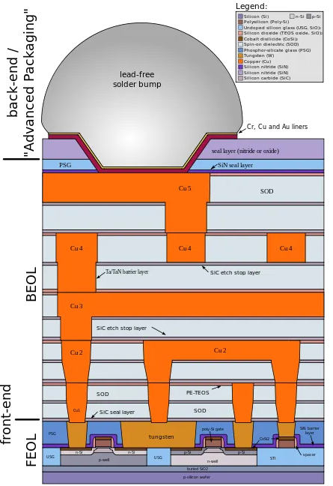
A wild dream (?): 3D integrated sensors
Distribute electronics over two layers
Minimize pixel pitch.
Small pitch => High rad. tolerance.
Optimized digital process with low core
voltage and high density.
=> Reduce “data cost”
Through silicon vias
Optimized MAPS/LGAD sensing node possibly
with analogue front-end
Minimize “analogue power”
Amplification layer
e
Multi-tear sensors have the potential to be the next big thing…
… unfortunately for >10 years already.
A next attempt is started within DRD 7.6b (talk of M. Caselle, this workshop)

Slide 17
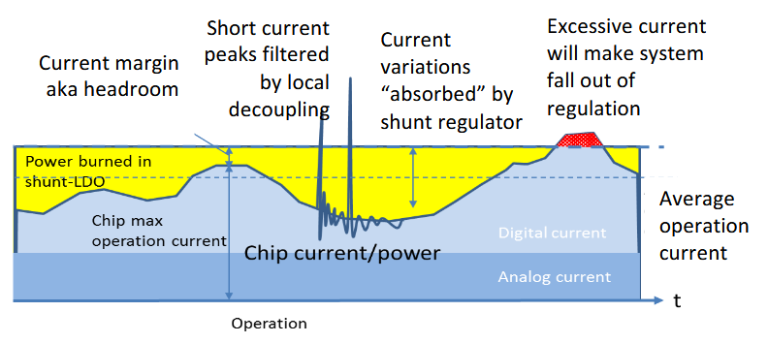

How to get rid of copper (or aluminum) – serial powering
Idea:
Serial powering allows using higher voltages => lower currents.
Voltage regulator:
Provides stable voltage to sensor.
Must be provided with sufficient current for max. sensor power (I_{max}).
Bypasses (burns) remaining current to feed consecutive sensor.
Chain current must be I_{max}.
System power is given as $P>U⋅ I_{max}=P_{max}$
Easy if:
Device power is determined by “static power”.
Data transport forms small (few 10%) additional contribution.
Advantages of the concept (despite complexity) are obvious.
12V
Voltage
regulator
Sensor
Voltage
regulator
Sensor
I(t)
I_{max}
10x
Stella Orfanelli, ACES 2018
Voltage
regulator
Sensor
GND
What about tomorrow?

Slide 18
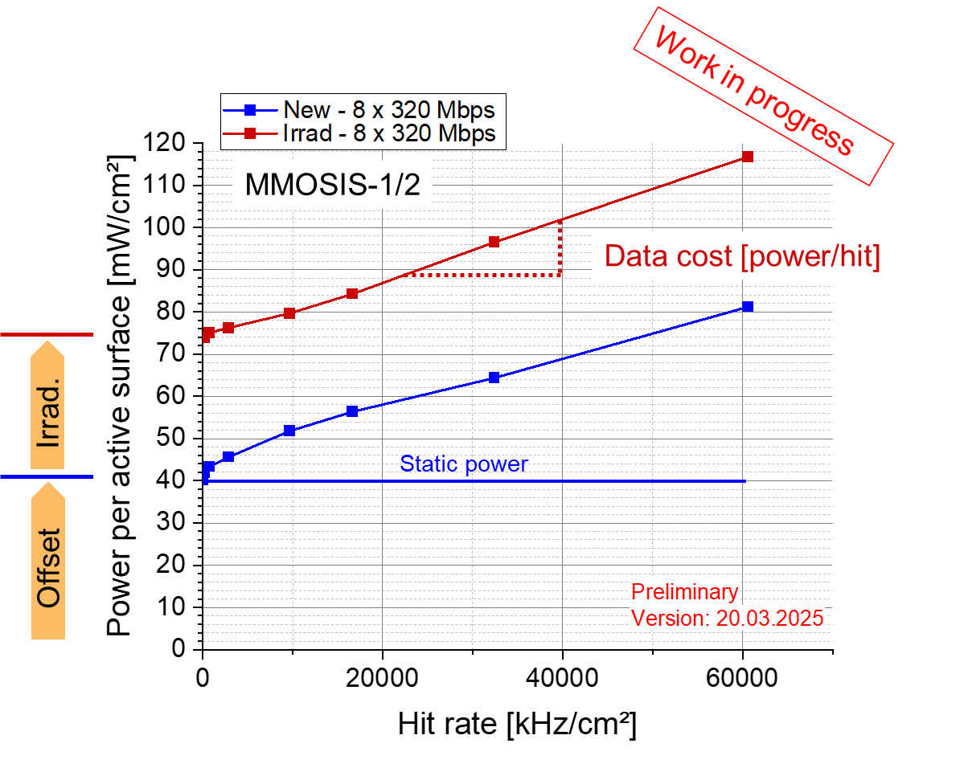
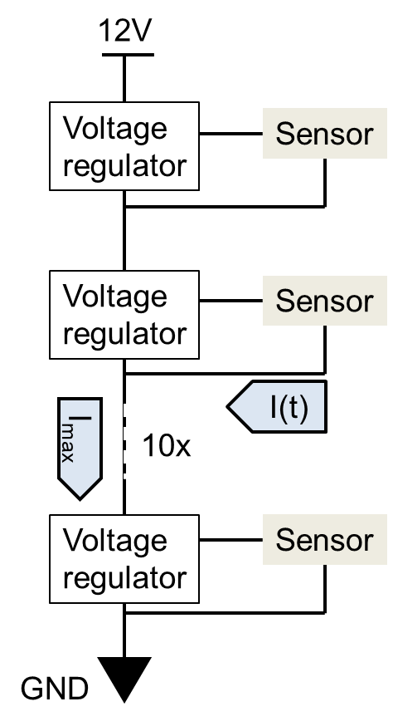
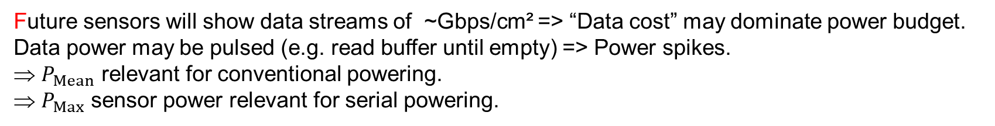


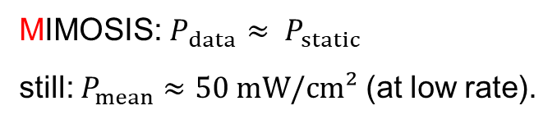
How to get rid of copper (or aluminum) – serial powering
MIMOSIS: $P_{data}≈ P_{static}$
still: $P_{mean}≈50 mW/cm²$ (at low rate).
P
Data
transport
Data
transport
$$P_{Max}$$
Thermal limit
$$P_{Mean}$$
Data
idle
Data
idle
Data
idle
t
Future sensors will show data streams of ~Gbps/cm² => “Data cost” may dominate power budget.
Data power may be pulsed (e.g. read buffer until empty) => Power spikes.
$P_{Mean}$ relevant for conventional powering.
$P_{Max}$ sensor power relevant for serial powering.
May differ substantially.
If conventional powering – few action needed (as for MIMOSIS).
If serial powering => Must flatten power curve over time (optimized data transport… ) => new design philosophy.

Slide 19
Serial powering – data transport…
Serial powering (“simple”)
Serial powering (advanced(?))
AC coupling
12V
Slave
Slave
Master
Voltage
regulator
Optical
Data
Sensor
Sensor
DAQ
Sensor
Sensor
DAQ
Data
Voltage
regulator
Optical
Data
Sensor
Sensor
Sensor
Sensor
DAQ
Voltage
regulator
Optical
Data
Sensor
Sensor
Sensor
Sensor
DAQ
GND
Combining serial powering with Master-Slave data readout (as realized in ALPIDE)
and optical links might be interesting.

Slide 20
A wilder dream
Voltage steered modulator
Optical fiber
Monolithic optical transceiver
Light feed in
Optimized digital process with low core
voltage and high density.
=> Reduce “data cost”
Through silicon vias
Optimized MAPS/LGAD sensing node possibly
with analogue front-end
Minimize “analogue power”
Amplification layer
e
Monolithic Optical Transceiver – Followed up by the Helmholtz Innovation pool project SOPHIE (DESY, KIT, GSI)

Slide 21
Summary and conclusion
Future detectors in Relativistic Heavy Ion physics have to:
Perform precision tracking/vertexing at low momentum
Need lowest material budget.
Reconstruct particles like open charm
Need best possible vertexing capability, ~5 µm spatial precision.
Need time stamping of ~1ns at rates of >100 MHz/cm² and rad. hardness of ~10¹⁵n_{eq}/cm².
Detectors would preferably be air-cooled to reach material budget goals.
Low power dissipation is driving design constraint.
Serial powering might be required for bigger systems.
Technological approaches include:
Next generation sensor readout based on fixed priority arbiter.
Integration of time walk correction based on time-over-threshold.
Tuning power vs. performance locally for best system performance.
LGAD charge amplification in MAPS.
Monolithic optical transceivers.
Light weight and low power serial powering…
2 tier sensors (digital tier for low power data processing/transport).
Followed up by DESY+GSI (DRD3/OCTOPUS and MANTA
Followed up by GSI + DESY (DRD3/MANTA)
Followed up e.g. by GSI (DRD3/CASSIA)
Followed up by DESY + KIT + GSI (HELMHOLTZ/SOPHIE)
Followed up by GSI (ALICE3)
Followed up by KIT (DRD7.6b)
Not covered
Combining those elements might create outstanding next generation instruments for future research.

