Slide 1




4D Particle Tracking with LGAD Strip Sensors and the DOGMA Readout System
Yevhen Kozymka for the HADES LGAD Team at the 11th annual MT Meeting

Slide 2
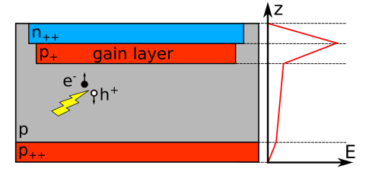
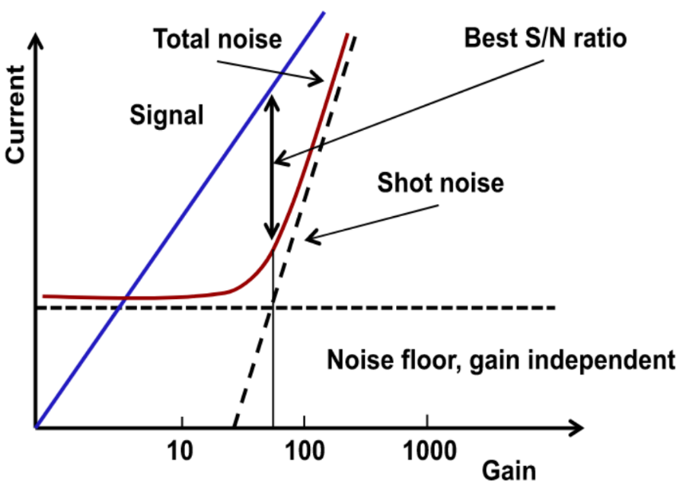
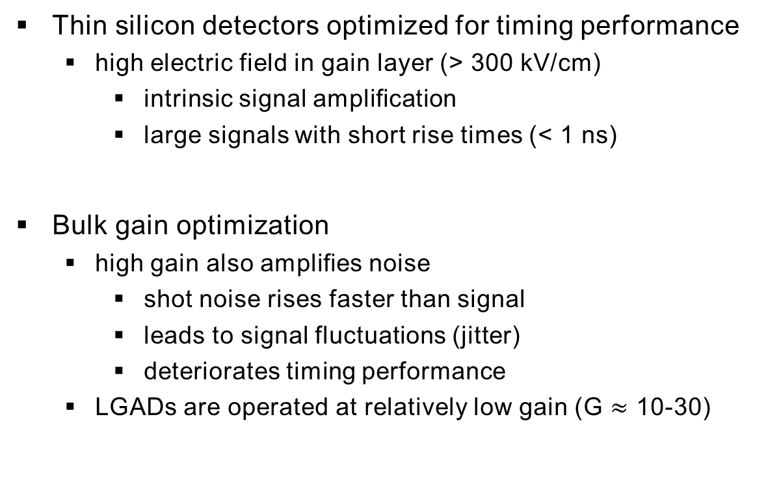
Low Gain Avalanche Diode Detectors (LGADs)
Thin silicon detectors optimized for timing performance
high electric field in gain layer (> 300 kV/cm)
intrinsic signal amplification
large signals with short rise times (< 1 ns)
Bulk gain optimization
high gain also amplifies noise
shot noise rises faster than signal
leads to signal fluctuations (jitter)
deteriorates timing performance
LGADs are operated at relatively low gain (G $≈$ 10-30)
Source: [1]

Slide 3
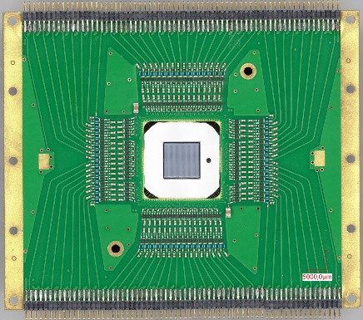
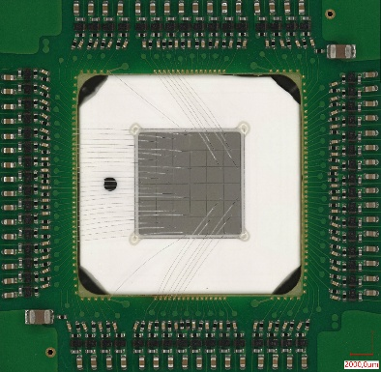
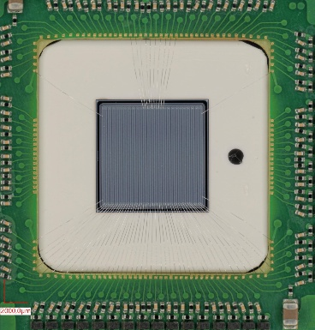
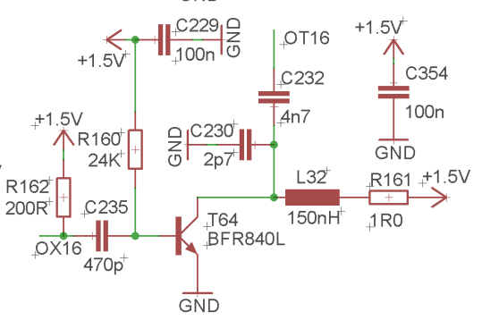
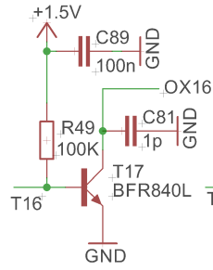
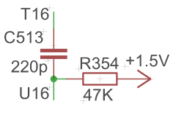
Front-end electronics
Amplification based strategy
GSI amplification board for LGAD/diamond
128 channels
AC coupled
Single- or double-sided readout
60 ps for MIPs
< 30 ps for C ions
Voltage gain: 400
128-channel readout board
Pad diamond sensor
Strip LGAD sensor
AC coupling
Stage 1
Stage 2

Slide 4
DOGMA Readout Framework
Best effort DAQ paradigm
Automatic fast reintegration after reboot
Higher reliability and fault tolerance
Enables use of commercial and cheap FPGAs
Optical data transmission and < 10 ps RMS clock
No GND issues due to galvanic isolation
Scaleable
Arbitrary system size due to no handshake latency
Ethernet protocol for easy and cheap upgrades
Keep it Small and Simple
Easy to maintain for small teams

Slide 5
DOGMA Readout Implementation
Dogma Control Module
Communication with DOGs
Trigger and clock distribution
Add-ons for more ports possible
DiRICH5d2 modules
32 channel readout
1 GbE connection to switch
10 GbE data to servers
Switches can be added
→ Used during beam time
DCM
DOGs
Source: [2]

Slide 6
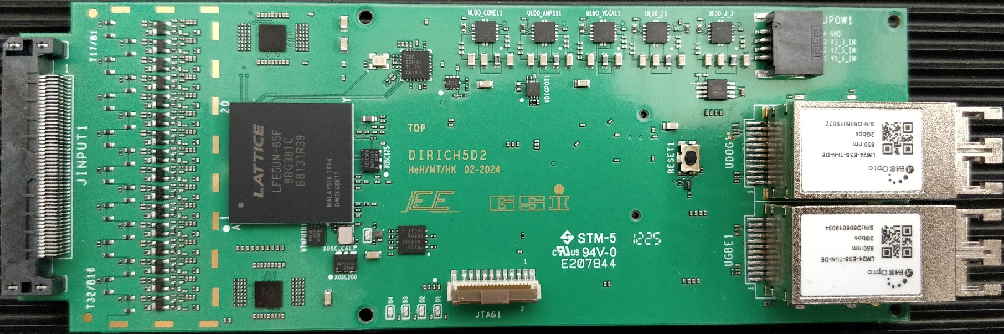
DOGMA Readout Electronics
Pre-amplifier
Main FPGA
Discriminator, TDC, DAQ, ethernet, slow control, etc.
Satellite/threshold FPGA
JTAG connector
Physical reset button
Power connector
SFF optical ports
DCM and switch labelled

Slide 7
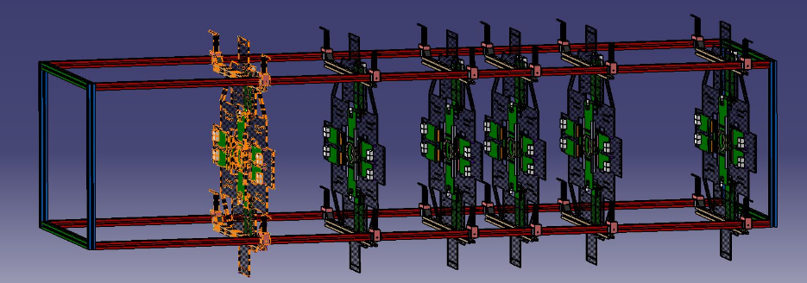
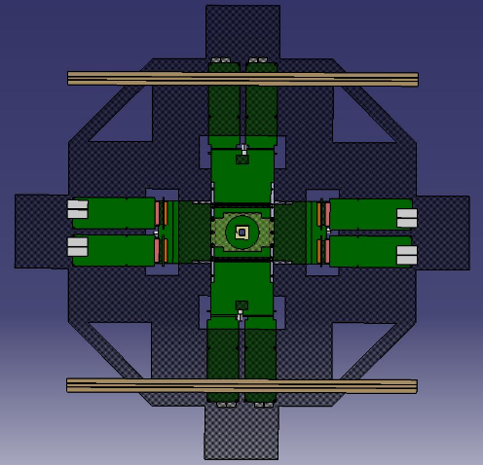
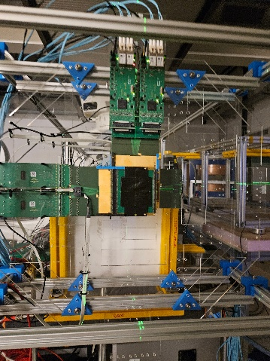
4D Tracking iCT Setup
→ Talk by F. Ulrich-Pur at 12:30
2 m long frame to fix modules
PCBs fixed to plexiglass pane
6 layers with 2 X-Y-tracking LGADs each
45 channels per LGAD, 540 channels total
Mouse placed between layers 2 and 3
90 cm ToF path between layers 4 and 5
CAD model of setup, distances not adjusted
CAD model of one layer
Laser alignment

Slide 8
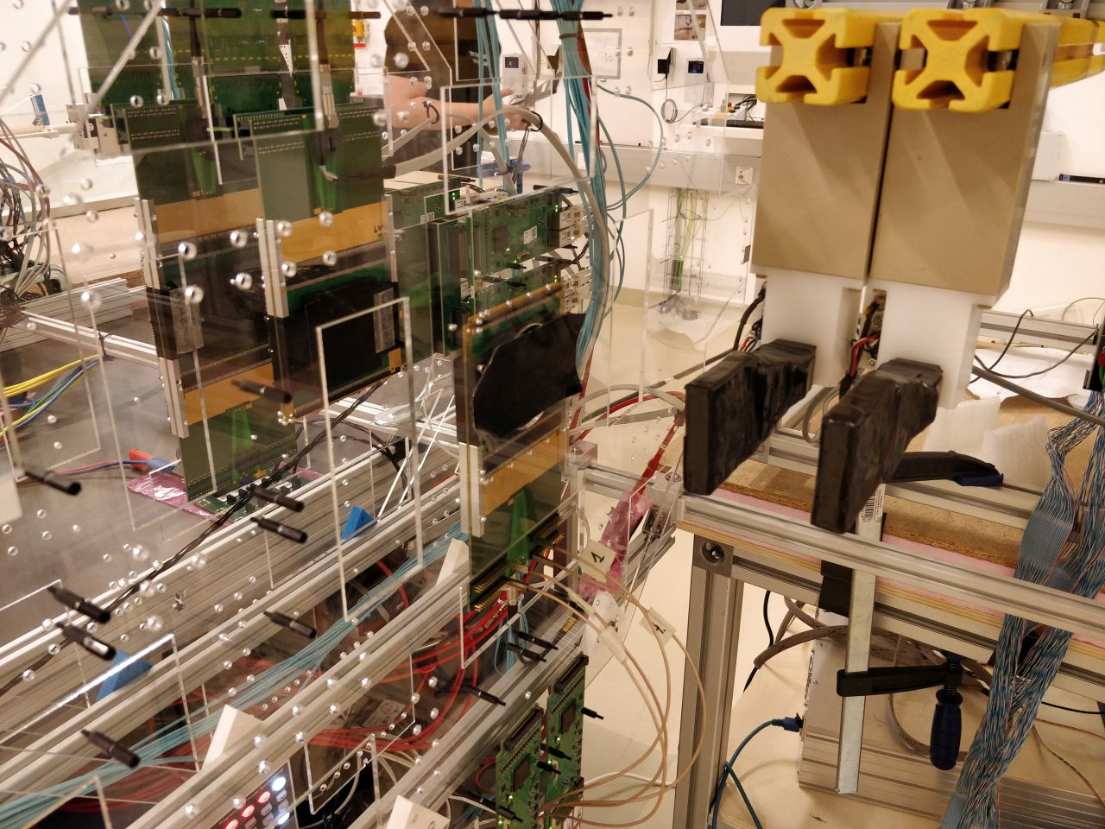
CBM T₀ Performance Study
→ Talk by M. Kis / J. Pietraszko tomorrow at 10:30
Diamond layer placed behind iCT setup
Read-out connected after scope analysis
Single-sided 6 x 6 pad sensor with aluminium metallization
Efficiency analysis at different beam energies

Slide 9
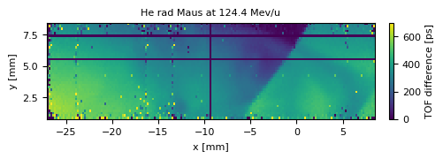
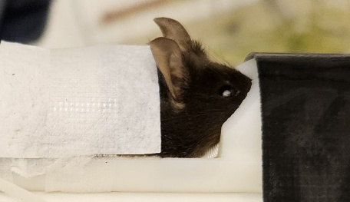
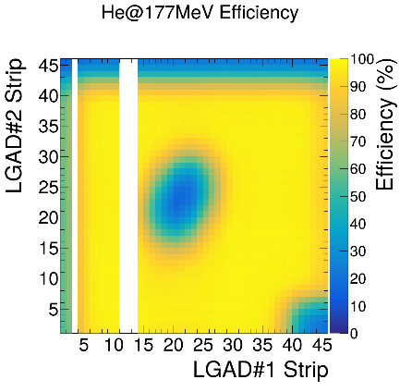
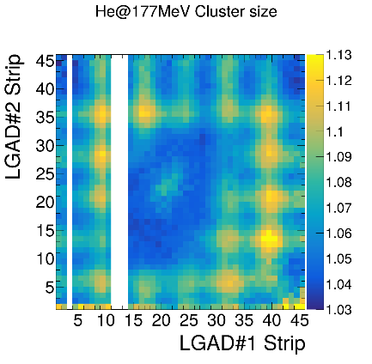
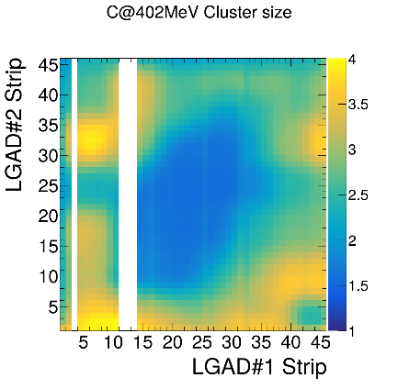
4D Setup Performance
Full analysis chain
Time over threshold normalization
Time walk correction
Cluster identification
Best timing performance so far
60 ps for 800 MeV protons
Tomography of sacrificed mouse
4D tracking algorithms currently WIP
Methods for diamond study developed
DAQ issues encountered
Lower DAQ rate
SEU data corruption

Slide 10
Outlook
Two beam times at MedAustron in Dec./Jan.
Live mouse radiography
Diamond irradiation level study
Cold box construction to demonstrate < 50 ps with MIPS
Setup for laser driven beam at ELI-NP
Vacuum operation
Shielding concerns
DOGMA improvements
DAQ rate investigation
SEU prevention

Slide 11
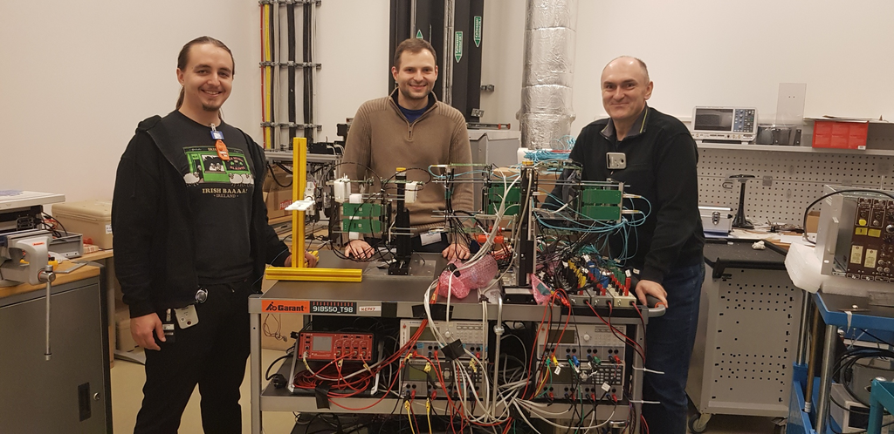
Thank you for your attention!

Slide 12
References
Sadrozinski, Hartmut F-W et al. (2017). “4D tracking with ultra-fast silicon detectors”. In: Reports on Progress in Physics 81.2, p. 026101. DOI: 10.1088/1361-6633/aa94d3
The DOGMA DAQ System. dogma.gsi.de
Ulrich-Pur, F. et al. (2022). “Feasibility study of a proton CT system based on 4D-tracking and residual energy determination via time-of-flight”. In: Physics in Medicine & Biology. ISSN: 0031-9155, 1361-6560. DOI: 10.1088/1361-6560/ac628b
Johnson, Robert P (2017). “Review of medical radiography and tomography with proton beams”. In: Reports on Progress in Physics 81.1, p. 016701. ISSN: 0034-4885, 1361-6633. DOI: 10.1088/1361-6633/aa8b1d
Ulrich-Pur, F. et al. (2023). “First experimental time-of-flight-based proton radiography using low gain avalanche diodes”. In: Physics in Medicine & Biology. DOI: 10.1088/1361-6560/ad3326

