Slide 1
Adaption of Metallic Magnetic Calorimeters to Precision X-ray Spectroscopy at Ion Storage Rings
Ph. Pfäfflein, F. M. Kröger, D. A. Müller, J. Walch, M. O. Herdrich,
S. Allgeier, M. Friedrich, D. Kreuzberger, A. Abeln, H. Hadenfeldt, P. Kuntz,
Günter Weber, D. Hengstler, A. Fleischmann, Chr. Enss, Th. Stöhlker and many more…

Slide 2
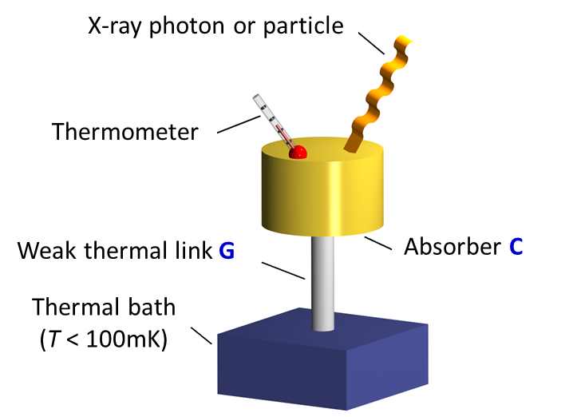
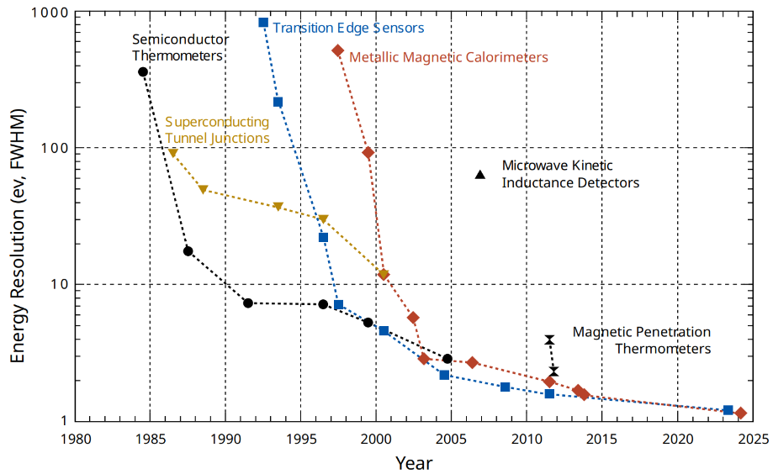
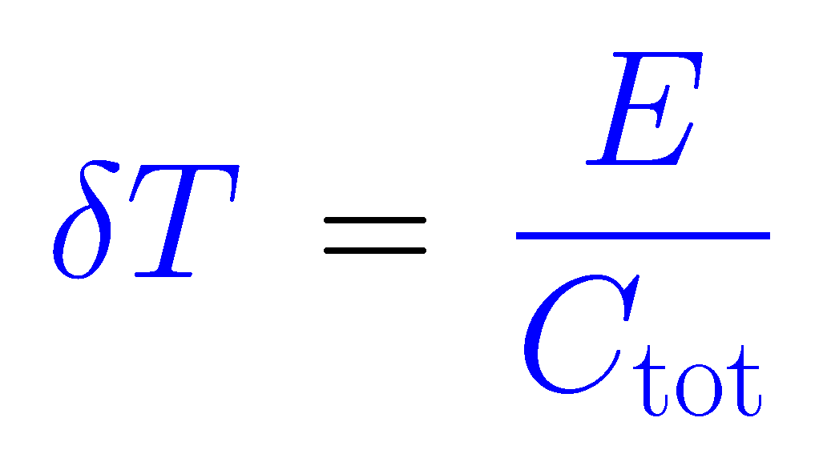
Cryogenic Microcalorimeters for Precision X-Ray Spectroscopy
The demonstrated energy resolution of cryogenic microcalorimeters has seen large improvements over the last decades …
Spectroscopic performance at 6 keV
Spectral resolution of semiconductor detectors
1 – 2 orders of magnitude improvement
Temperature change
Operation at low temperature (T < 0.1 K):
→ small specific heat
→ large temperature change
→ low thermal noise
… making microcalorimeters a very promising detector technology for x-ray science.

Slide 3
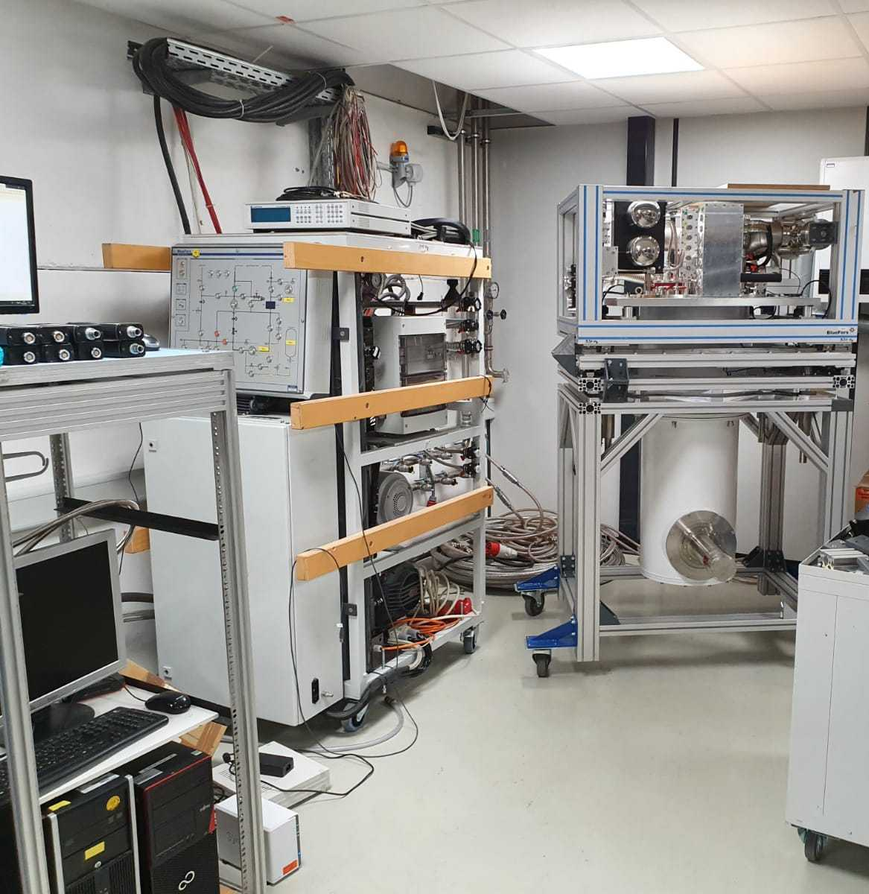
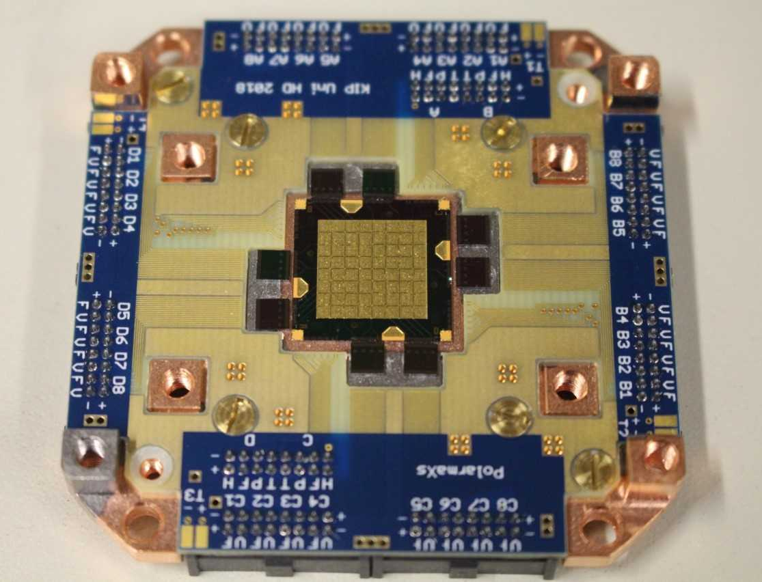


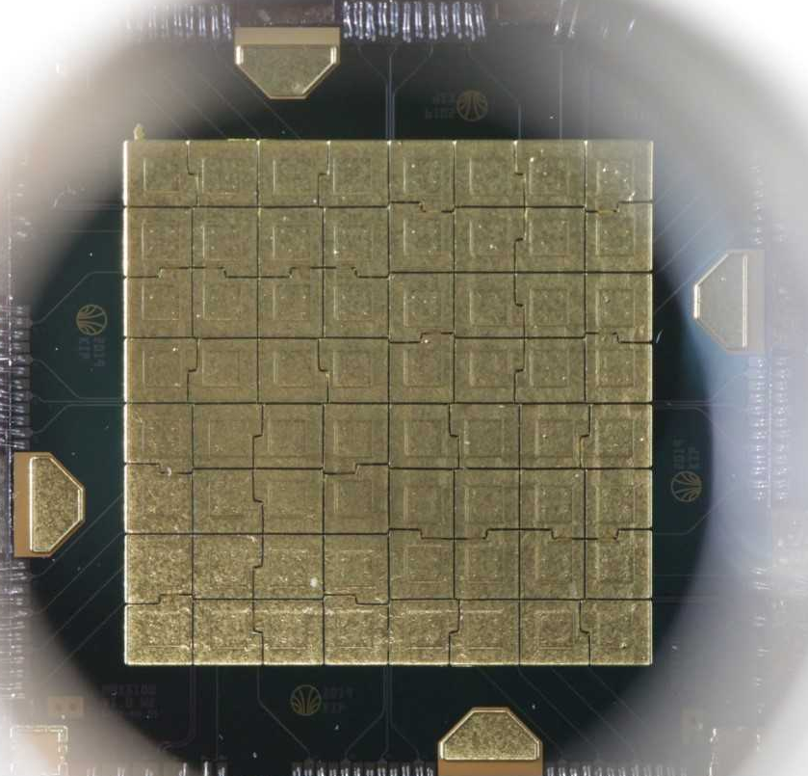
Microcalorimeter Arrays for High-resolution X-ray Spectroscopy - maXs
maXs-100 design parameters
Active area: | 100 mm² (64 pixels, 1.25 x 1.25 mm² each)
FWHM at 60 keV: | <50 eV
Efficiency at 100 keV: | 17 % (50 µm) – 35 % (100 µm)
Operating Temperature: | <20 mK
Metallic Magnetic Calorimeter (MMC)
Cryostat
Gas Handling
maXs-100
Control System
developed within
by Chr. Enss, A. Fleischmann et al.
maXs Detector
1 cm
Notes:
Area comparable to high res semiconductor detectors

Slide 4
Microcalorimeter Arrays for High-resolution X-ray Spectroscopy - maXs
Metallic Magnetic Calorimeter (MMC)
Spectral resolution almost a factor 10 better
than with a semiconductor hard x-ray detector.
Cryostat
²⁴¹Am
Gas Handling
50 eV
Control System
maXs Detector
1 cm
Notes:
Area comparable to high res semiconductor detectors

Slide 5
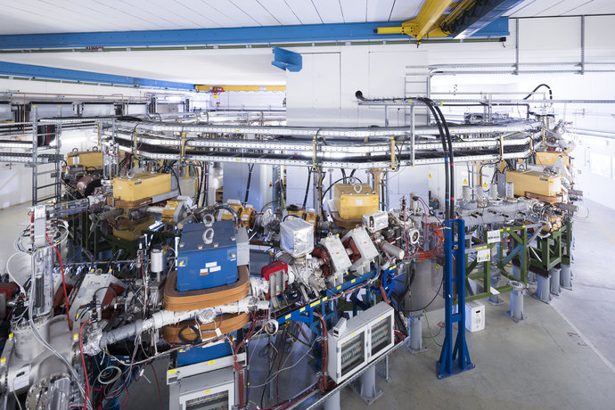
Microcalorimeter Arrays for High-resolution X-ray Spectroscopy - maXs
Metallic Magnetic Calorimeter (MMC)
CRYRING@ESR
Cryostat
Gas Handling
Control System
maXs Detector
1 cm
Notes:
Area comparable to high res semiconductor detectors

Slide 6
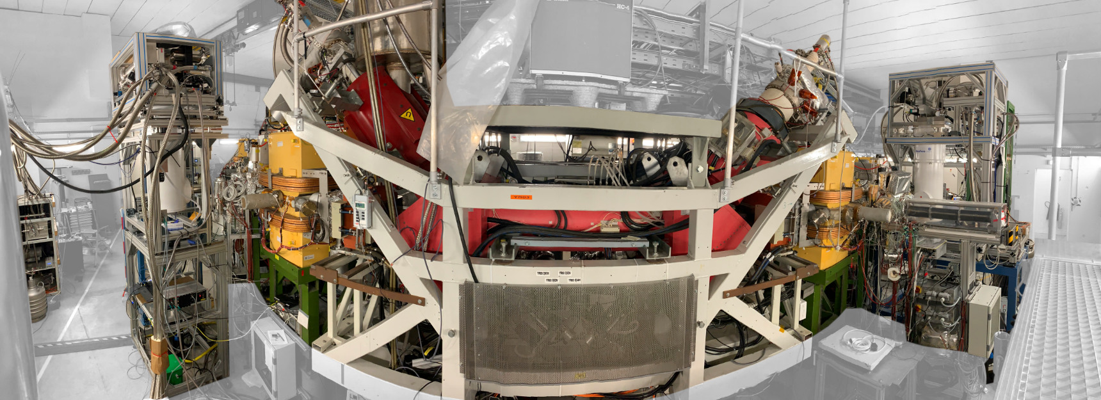
MMC Setup at CRYRING@ESR
180° detector
CRYRING electron cooler
0° detector
U⁹¹⁺
3.5 m
P. Pfäfflein et al., Phys. Scr. 97, 114005 (2022)
U⁹¹⁺ + e⁻ → U⁹⁰⁺ + X rays

Slide 7
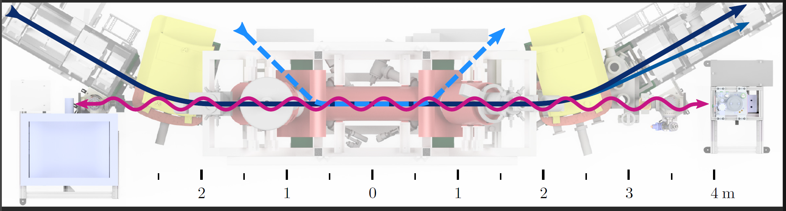

Spectroscopy Setup and Experimental Technique at CRYRING@ESR
U⁹¹⁺ beam
10 MeV/u
e⁻ beam
30 mA
Radiative recombination followed by photon emission
U⁹⁰⁺ ions
U⁹⁰⁺ ions
stopped by particle detector
maXs
0°
P. Pfäfflein et al., Phys. Scr. 97, 114005 (2022)
maXs
180°
Coincidence
condition
P. Pfäfflein et al., Atoms 11, 5 (2023)

Slide 8
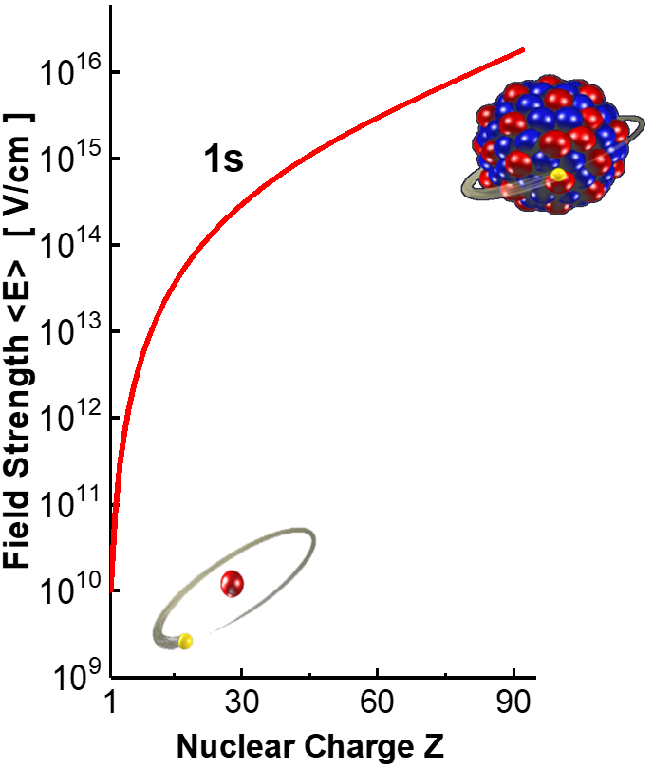
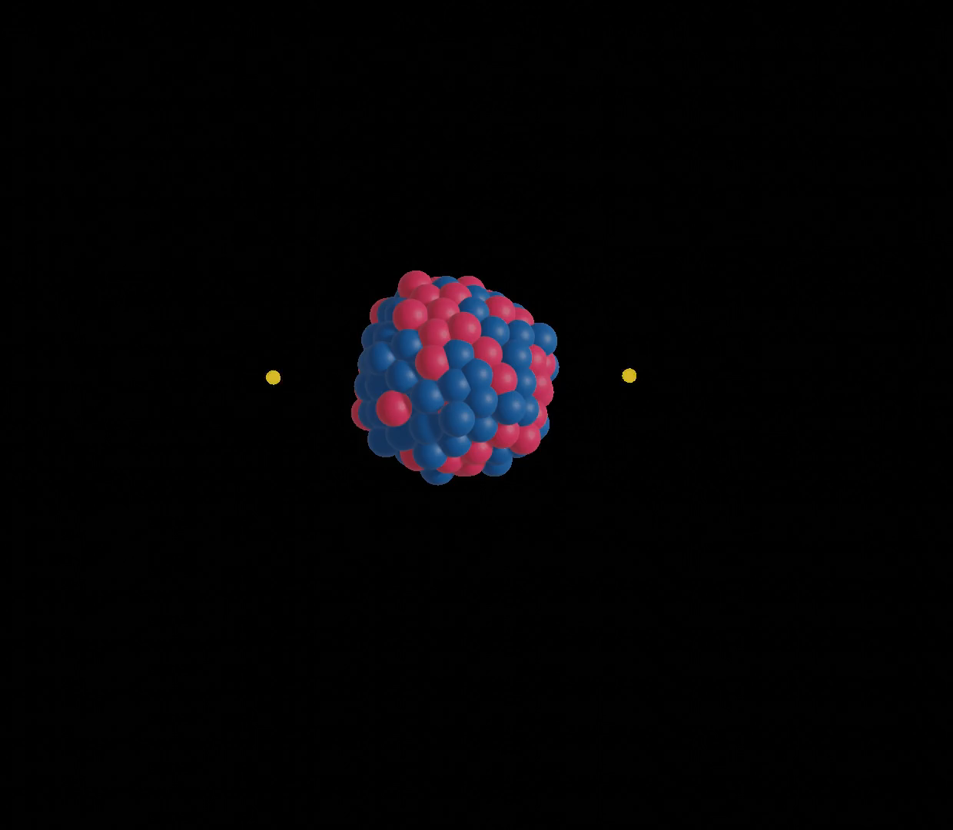
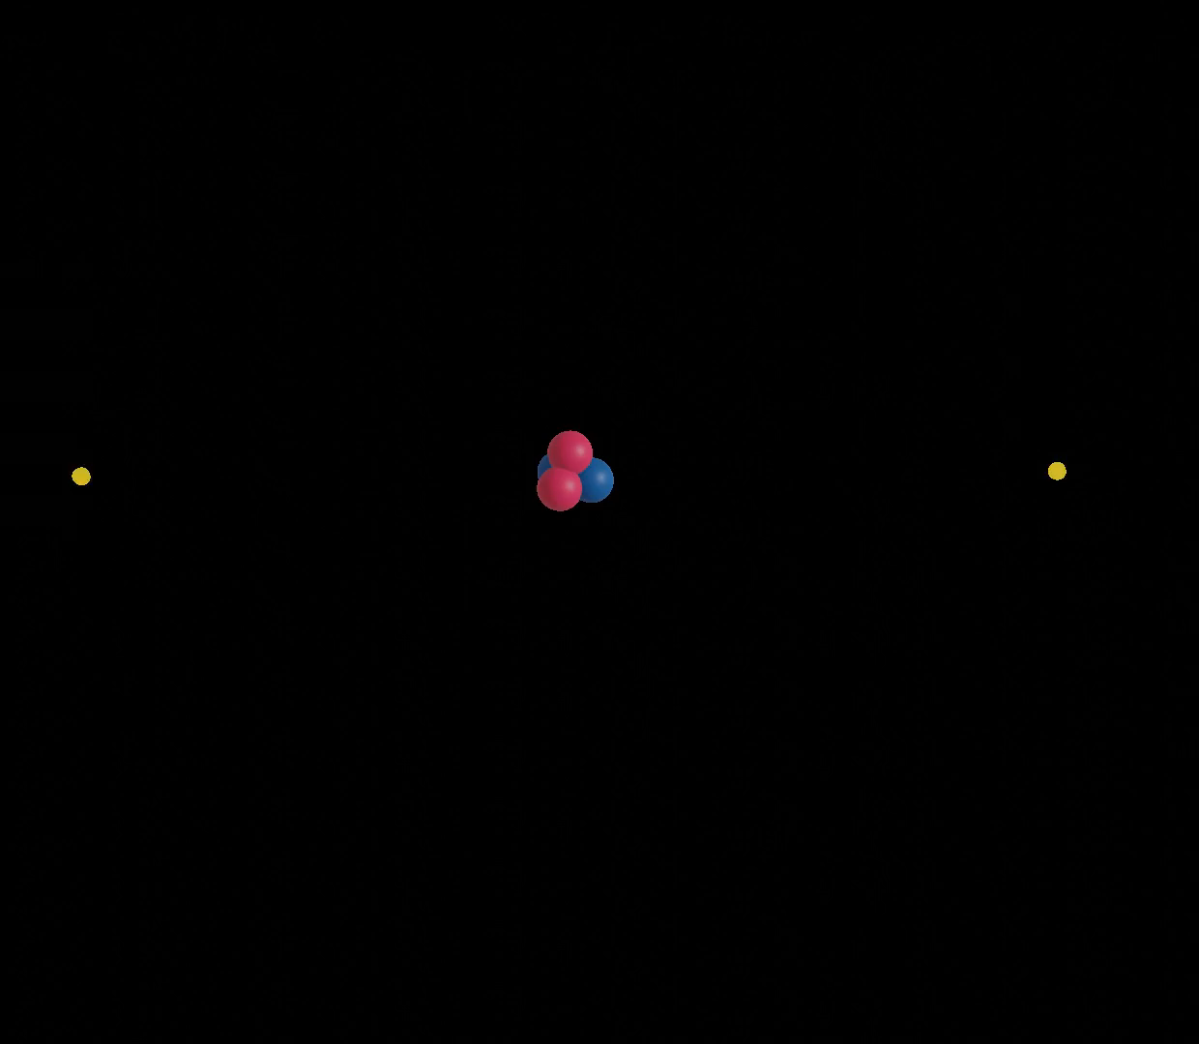
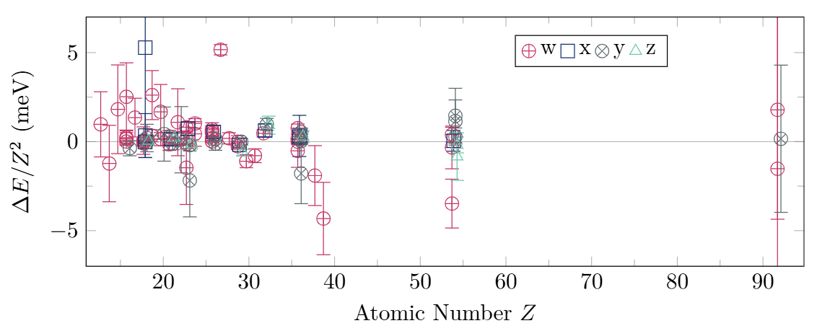
X-Ray Spectroscopy of Heavy He-like Systems
He-like Uranium
1s2p ¹P₁
No precision spectroscopy data
for L → K transitions
available for He-like systems
with Z > 54.
x
w
1s2p ³P₂
U⁹⁰⁺
1s2s ¹S₀
1s2p ³P₀
1s2s ³S₁
1s2p ³P₁
z
y
Δ(w-x) = 74 eV
Δ(y-z) = 142 eV
≈100 keV
Y. S. Kozhedub et al., Phys. Rev. A 100, 062506 (2019)
1s² ¹S₀
He
Data taken from P. Indelicato, J. Phys. B: At. Mol. Opt. Phys. 52, 232001 (2019)
A. Gumberidze et al., PRL 032712 (2004)
±100 eV
Kα₂
Kα₁
Heavy He-like systems:
Most fundamental atomic system to study many-body interaction at extreme field strengths (αZ ≈ 1).

Slide 9
X-Ray Spectroscopy of Heavy He-like Systems
He-like Uranium
1s2p ¹P₁
No precision spectroscopy data
for L → K transitions
available for He-like systems
with Z > 54.
x
w
1s2p ³P₂
U⁹⁰⁺
1s2s ¹S₀
1s2p ³P₀
1s2s ³S₁
1s2p ³P₁
z
y
Δ(w-x) = 74 eV
Δ(y-z) = 142 eV
≈100 keV
Y. S. Kozhedub et al., Phys. Rev. A 100, 062506 (2019)
1s² ¹S₀
He
For high-Z systems a spectral resolution of <100 eV FWHM is necessary to resolve the n=2 level structure and benchmark state-of-the-art theory.
This cannot be achieved with conventional semiconductor detectors. Thus, a new experimental approach is needed.
z
y
x
A. Gumberidze et al., PRL 032712 (2004)
Kα₂
w
Kα₁
Heavy He-like systems:
Most fundamental atomic system to study many-body interaction at extreme field strengths (αZ ≈ 1).

Slide 10
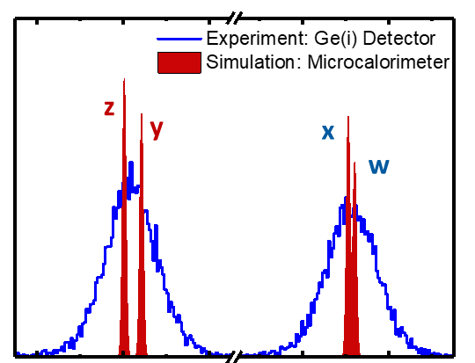
Results 2021 beam time: U⁹⁰⁺ Kα (L → K) transitions
74 eV
[1s_{1/2},2p_{3/2}] ¹P₁
About 150 Kα photons were recorded in each detector with ΔE_{FWHM} < 100 eV.
[1s_{1/2},2p_{3/2}] ³P₂
w (E1)
Kα₂
Kα₁
x (M2)
180°
[1s_{1/2},2s_{1/2}] ¹S₀
[1s_{1/2},2p_{1/2}] ³P₀
z
y
x
w
[1s_{1/2},2p_{1/2}] ³P₁
142 eV
Preliminary Results
[1s_{1/2},2s_{1/2}] ³S₁
z (M1)
y (E1)
[1s_{1/2},1s_{1/2}] ¹S₀
0°
Kα₂
Kα₁
☺
Kα₂ transitions resolved for the first time in a heavy He-like system.
z
y
Preliminary Results
x
w

Slide 11
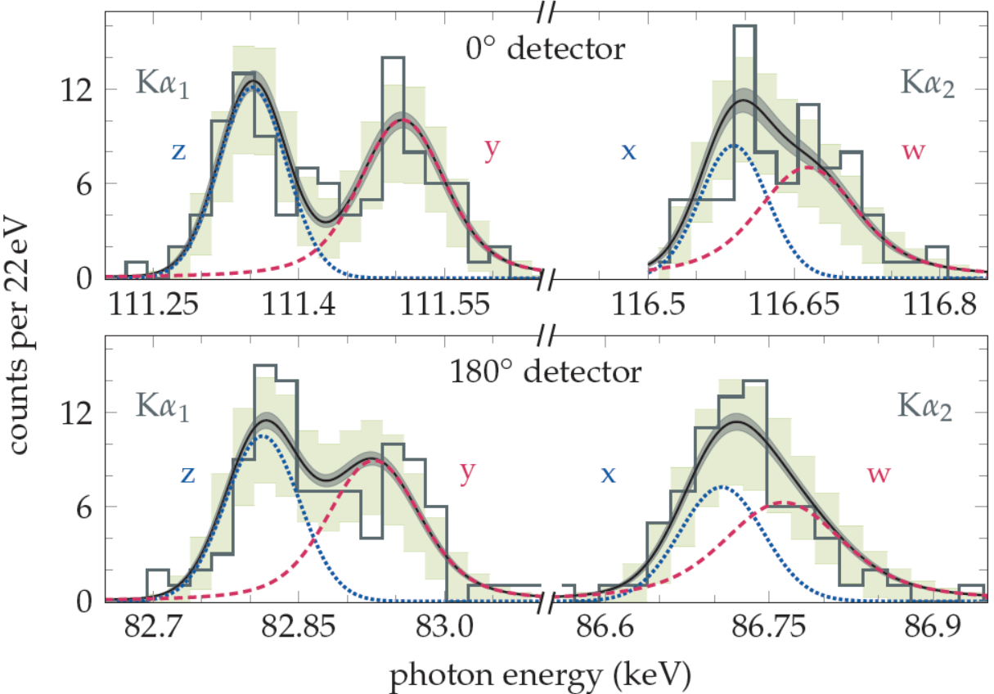
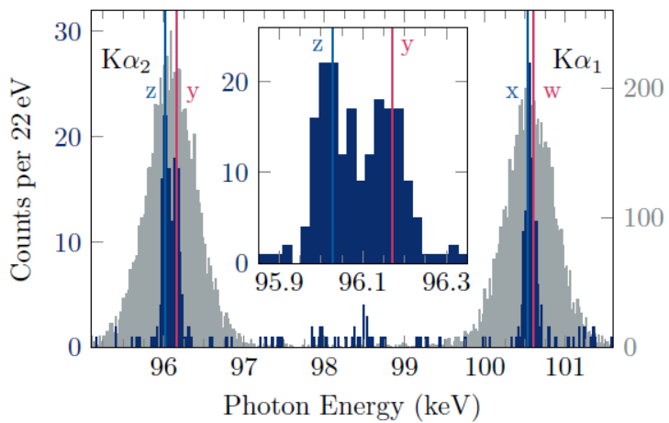
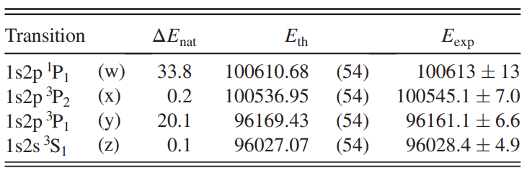
Results 2021 beam time: U⁹⁰⁺ Kα (L → K) transitions
Sum of both spectra in the emitter frame.
Maximum likelyhood adjustment of four Voigt-shaped peaks (including natural line width) in both detectors to obtain the line positions.
P. Pfäfflein et al., Phys. Rev. Lett. 134, 153001 (2025)

Slide 12
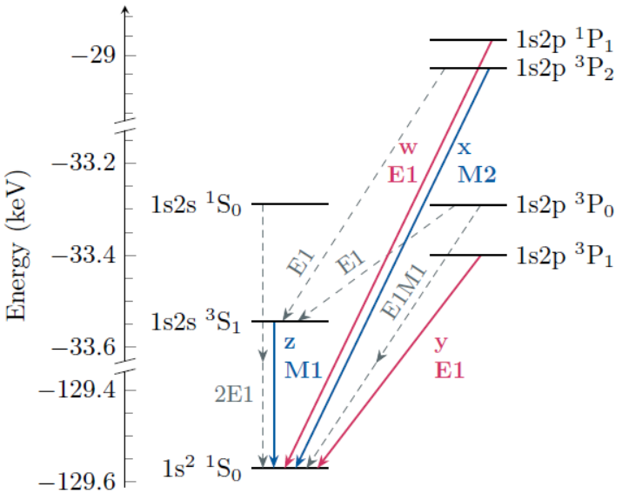
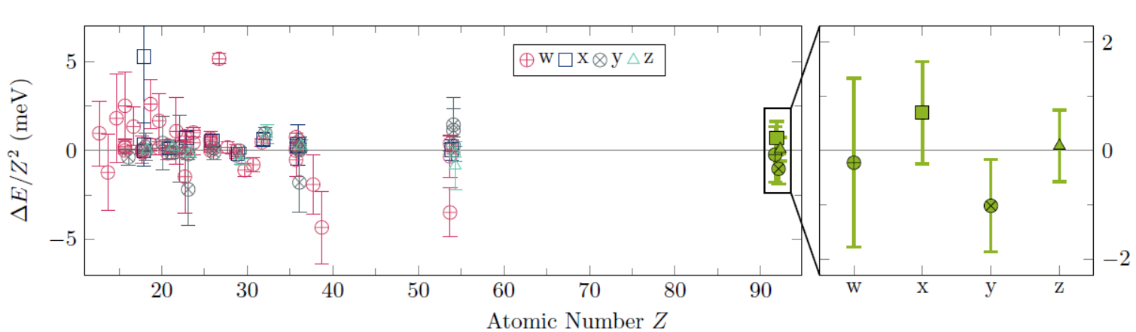
Results 2021 beam time: U⁹⁰⁺ Kα (L → K) transitions
☺
First high-precision data on Kα transitions in a high-Z system (Z > 54). No indication of a systematic deviation.
P. Pfäfflein et al., Phys. Rev. Lett. 134, 153001 (2025)

Slide 13
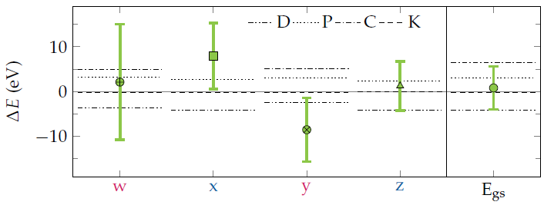

Results 2021 beam time: U⁹⁰⁺ Kα (L → K) transitions
Comparison of the present measurements and theoretical predictions of the transition energies as well as the ground state energy.
D: Drake, P: Plante, C: Cheng, K: Kozhedub (versus reference Artemyev et al.)
Still far away from 1 eV accuracy
Experimental accuracy not sufficient to distinguish between different theoretical treatments. Uncertainty is mainly stemming from statistics, thus we need more photons.

Slide 14
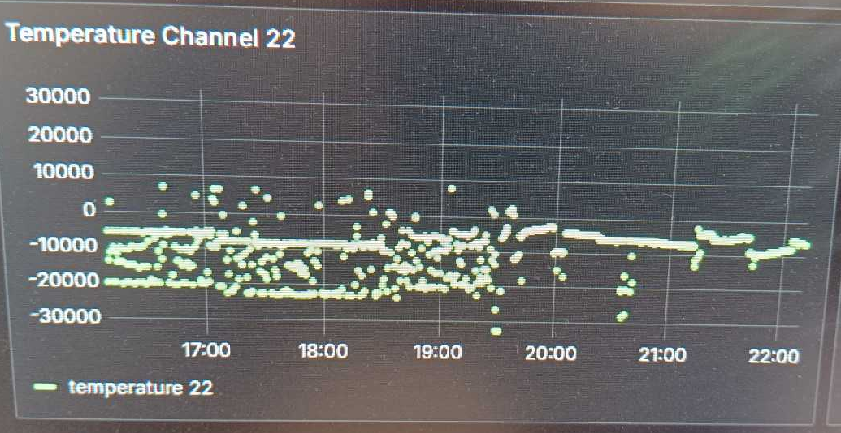
2025 surprise: instabilities due to accelerator operation
HOT FIX:
Mitigating measures with help of GSI Detector Laboratory.
Hardening/optimization of the detector system needs frequent field tests in the harsh environment of accelarators/storage rings.

Slide 15
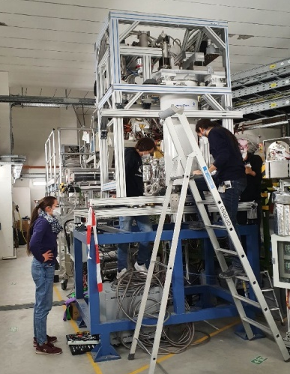
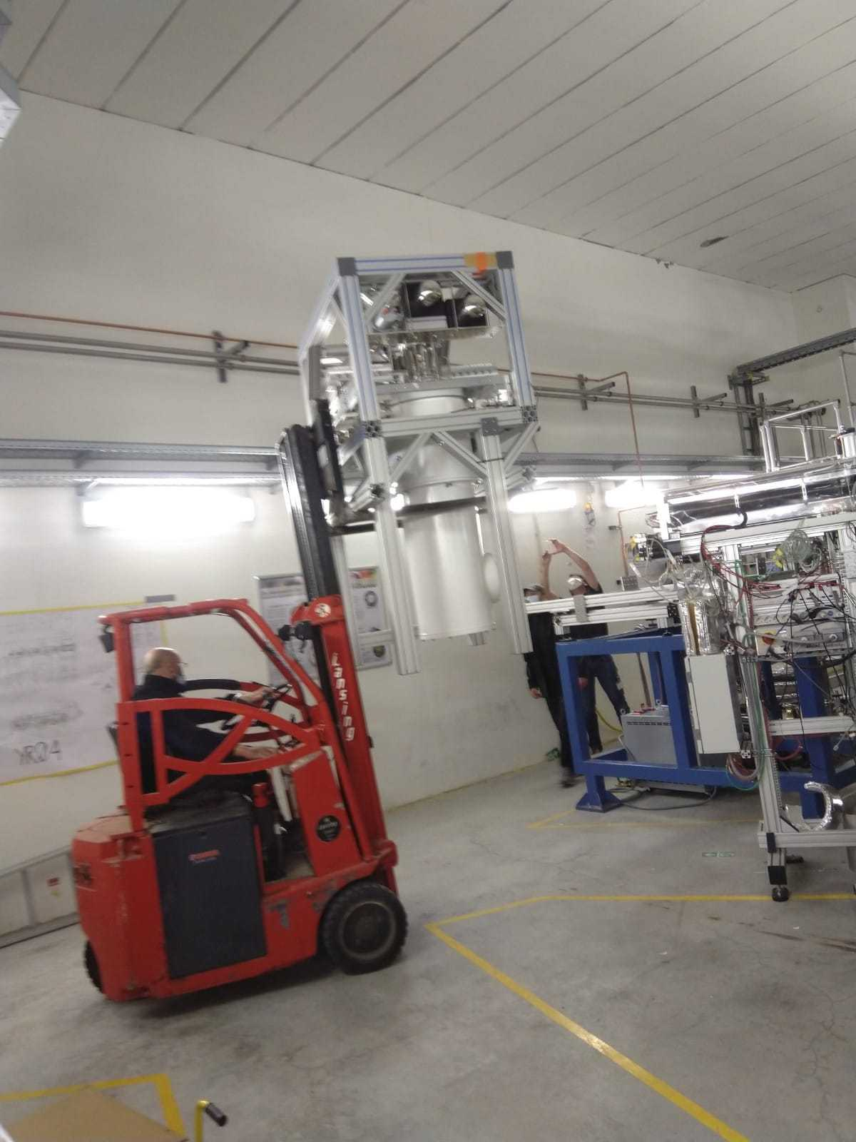
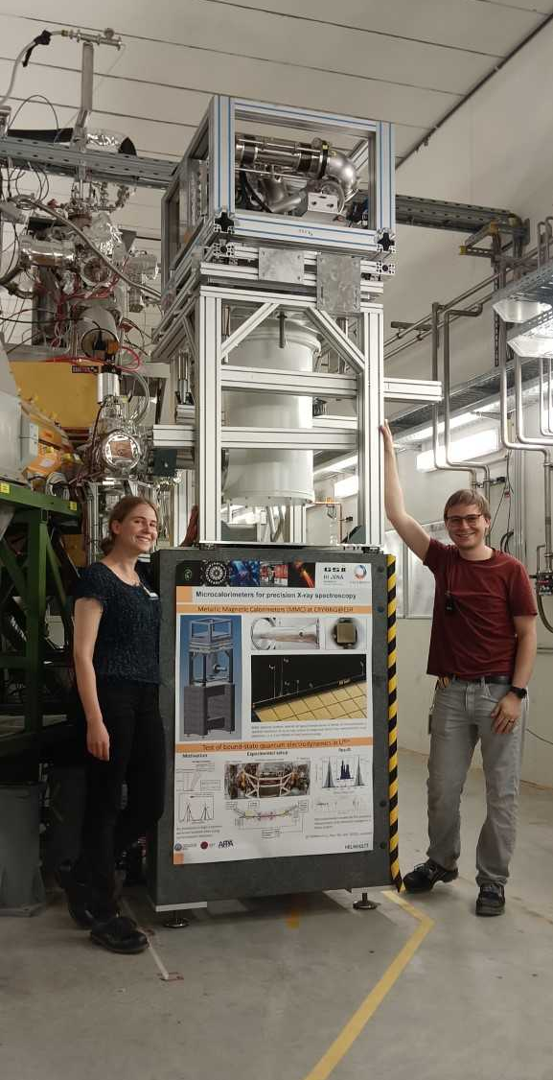

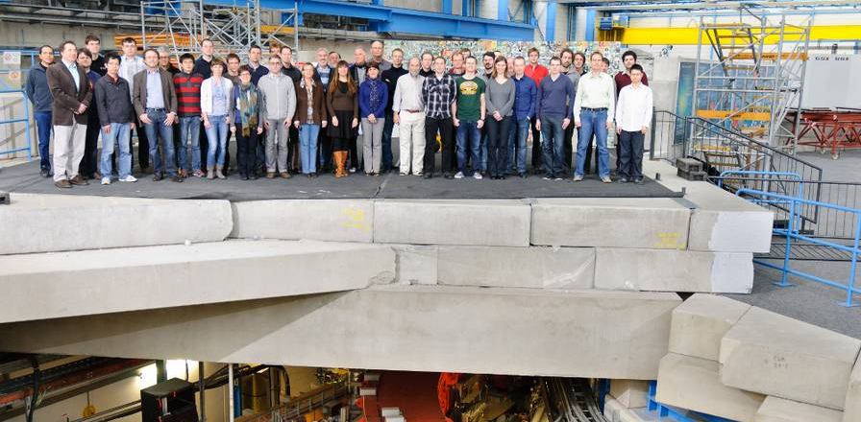



Thank you for your attention :-)
And many thanks to all the colleagues involved in this work.

