Slide 1
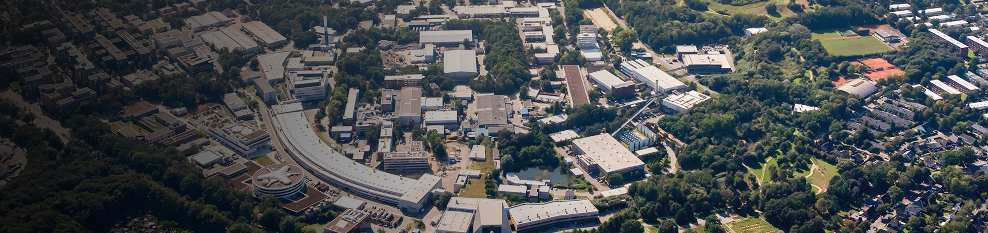
Soft X-ray detectors for synchrotrons and FELs
David Pennicard – DESY
Cornelia Wunderer, Mohammadtaghi Hajheidari, Alessandro Marras et al. - Percival collaboration (DESY, Rutherford Appleton Laboratory, Elettra, Soleil, PAL, Diamond Light Source)
Ozhan Koybasi, Marco Povoli, Angela Kok - Sintef
Rainer Richter, Alexander Bähr, Christian Koffmane, Eduard Prinker, Jelena Ninkovic - Max Planck Semiconductor Laboratory
MT Annual Meeting - GSI, Darmstadt, 3-5 Nov

Slide 2





Introduction
FLASH
Soft X-ray science
PERCIVAL – CMOS imager
LGADs for soft X-ray detection
PETRA-III
Eu.XFEL
BESSY-II
KARA

Slide 3
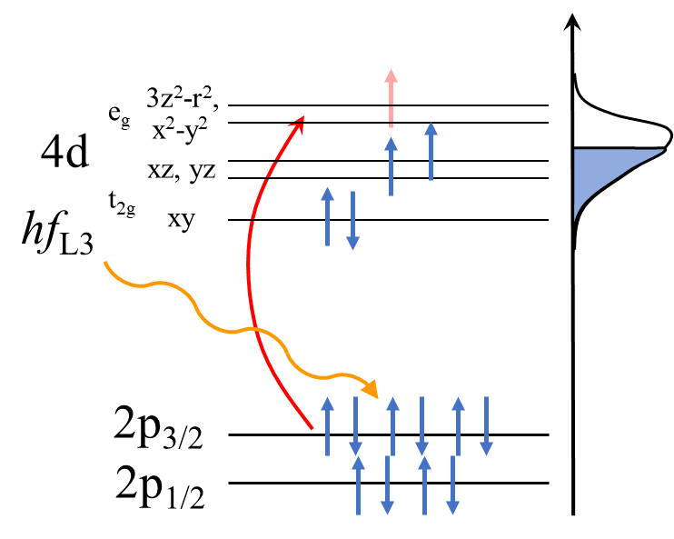
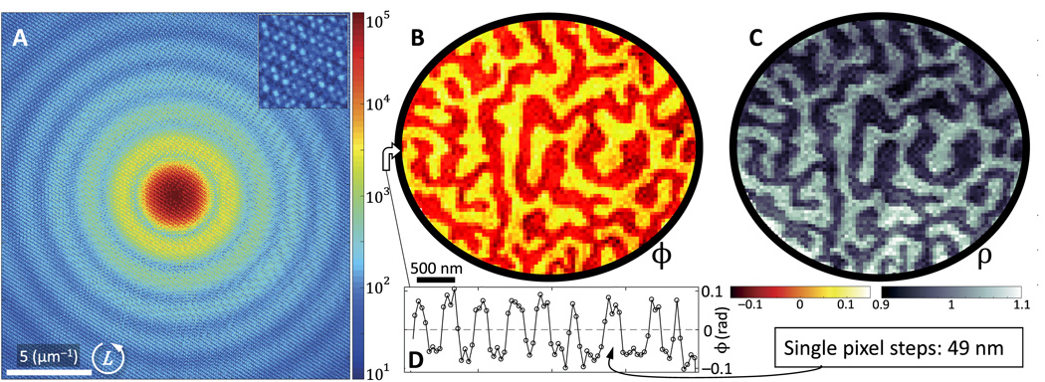
Soft X-rays (50-2000 eV)
Advantages
Shorter wavelength than visible light (~nm)
Can tune energy for sensitivity to specific elements and energy levels (e.g. carbon at 284 eV)
Polarized – sensitive to magnetism
Soft X-ray diffraction from Co/Pd multilayer
Magnetic domains in multilayer
DOI:10.1126/sciadv.aao4641
Notes:
Note – EUV up to 120 eV.
Be a bit more brief about this.

Slide 4
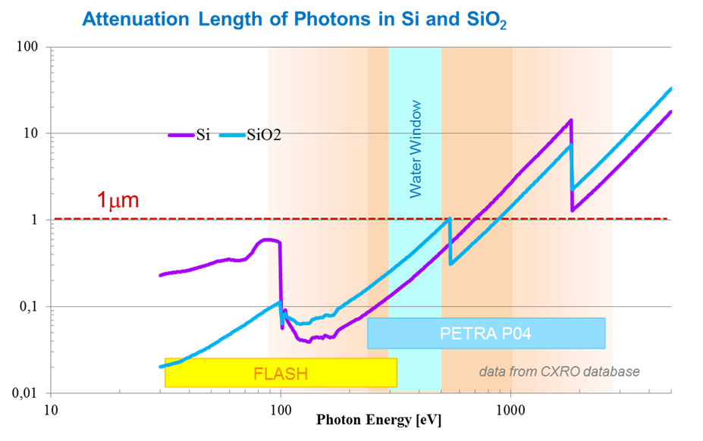
Soft X-rays (50-2000 eV)
Challenges
Lower signal per photon – e.g. 70 e- at 250 eV
Short absorption length requires minimal insensitive layer and vacuum operation
Attenuation length (µm)
Photon energy (eV)
Notes:
80 e-h pairs / micron for a MIP – so, less than a MIP would give you in 1um

Slide 5
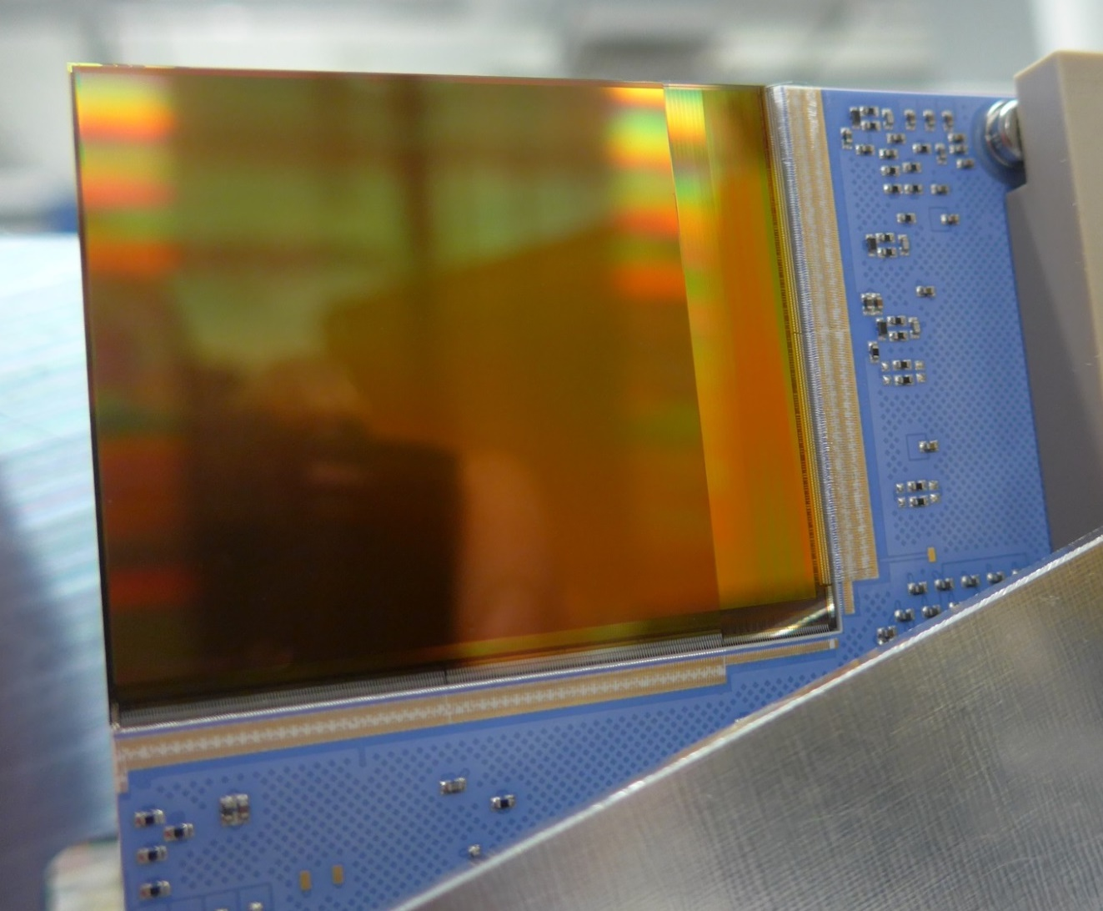






Percival soft X-ray CMOS imager
Key features:
Sensitive to single soft X-ray photons
Signal range 5 x 10⁴ photons/pix/image
300 Hz frame rate
1408 x 1408 pixels
27μm × 27μm pixel size
5 cm
Rutherford
Appleton
Lab / STFC
Elettra
Sinchrotrone
Trieste
Diamond
Light
Source
Pohang
Accelerator
Laboratory
Soleil Synchrotron

Slide 6
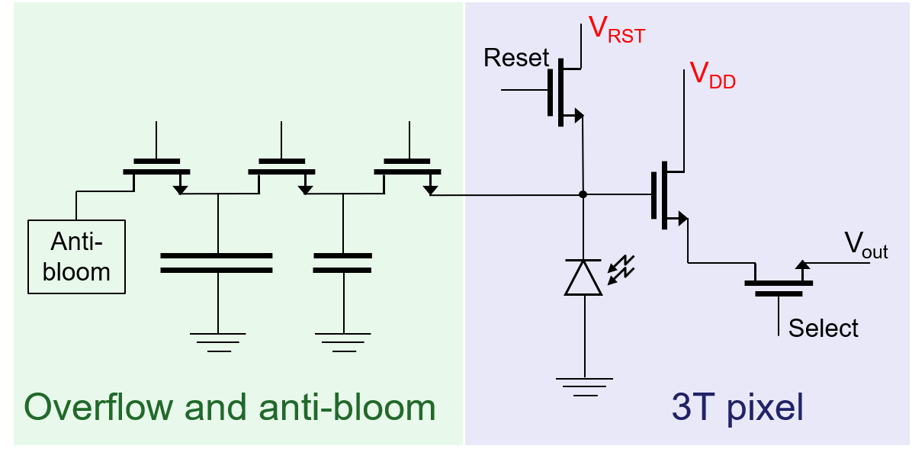
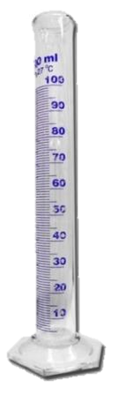

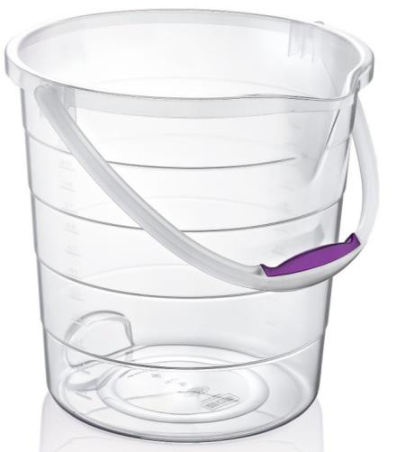

Percival 2M sensor
Designed by RAL (180 nm CMOS)
3 gain levels – overflow mechanism
~15e- noise to 3.5 Me-
On-chip ADCs
20 Gbit/s data at 300 Hz
Back-side illuminated sensor
Thin entrance implant
e-
e-
e-
h+
h+
h+
Support
wafer
Notes:
Be a bit briefer

Slide 7
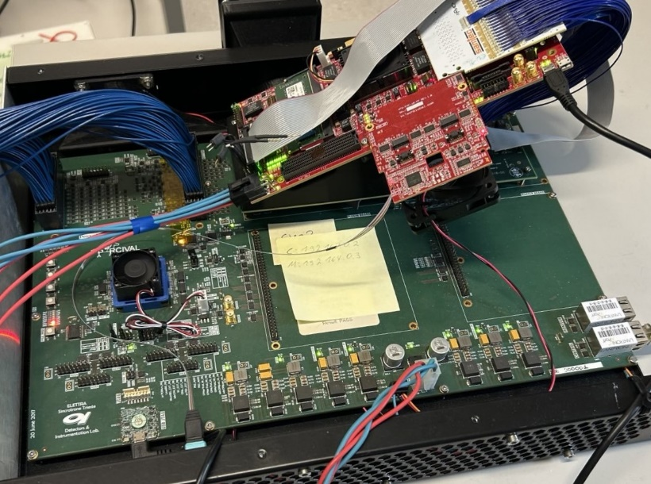
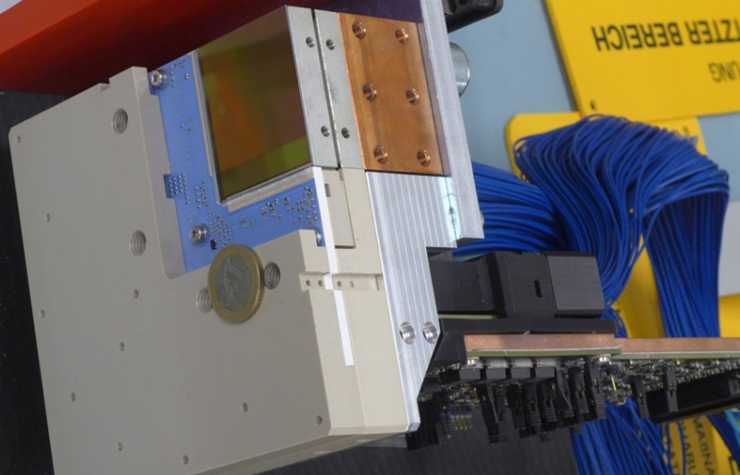
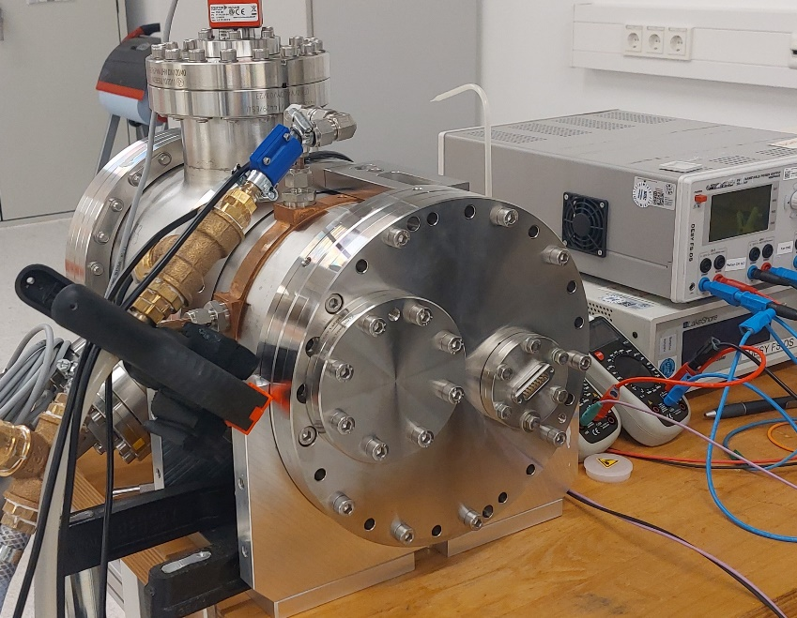
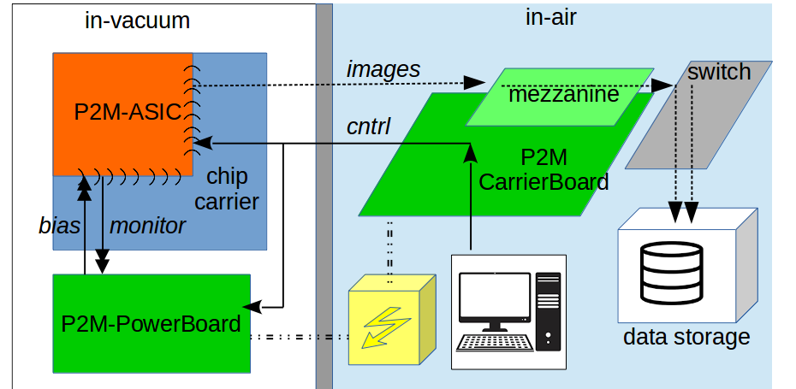
Percival system
2-side buttable design
Sensor in vacuum (cooled)
2nd generation version developed
More compact chamber with Peltier
Modernized DAQ for full readout speed
Notes:
Smaller chamber not quire operational yet

Slide 8
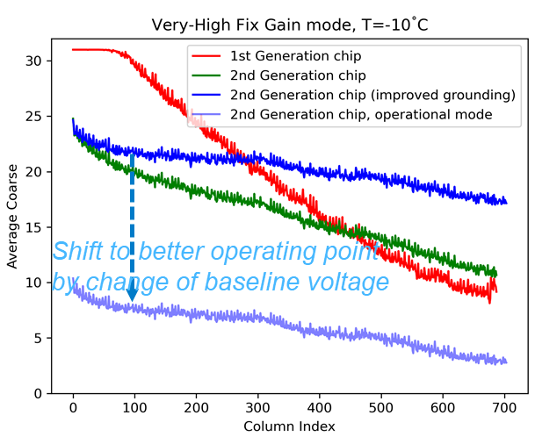
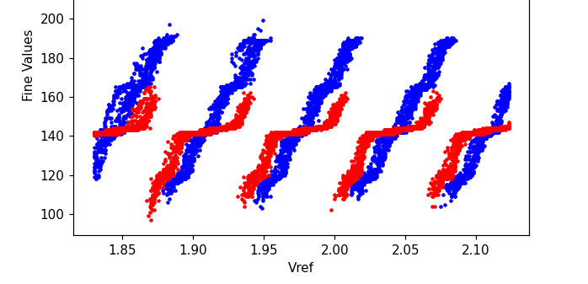
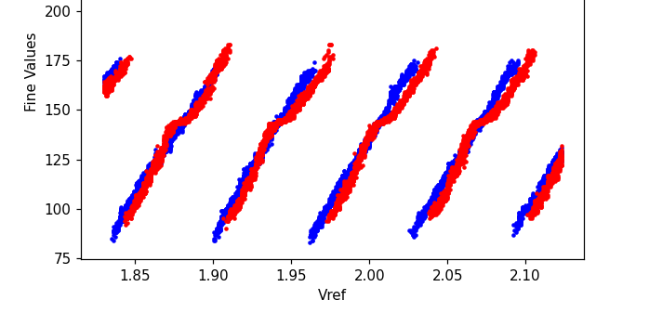
Percival 2nd generation sensor improvements
Baseline voltage lower and more uniform
ADC linearity improved (less crosstalk with pixels)
1st gen sensor
2nd gen sensor

Slide 9
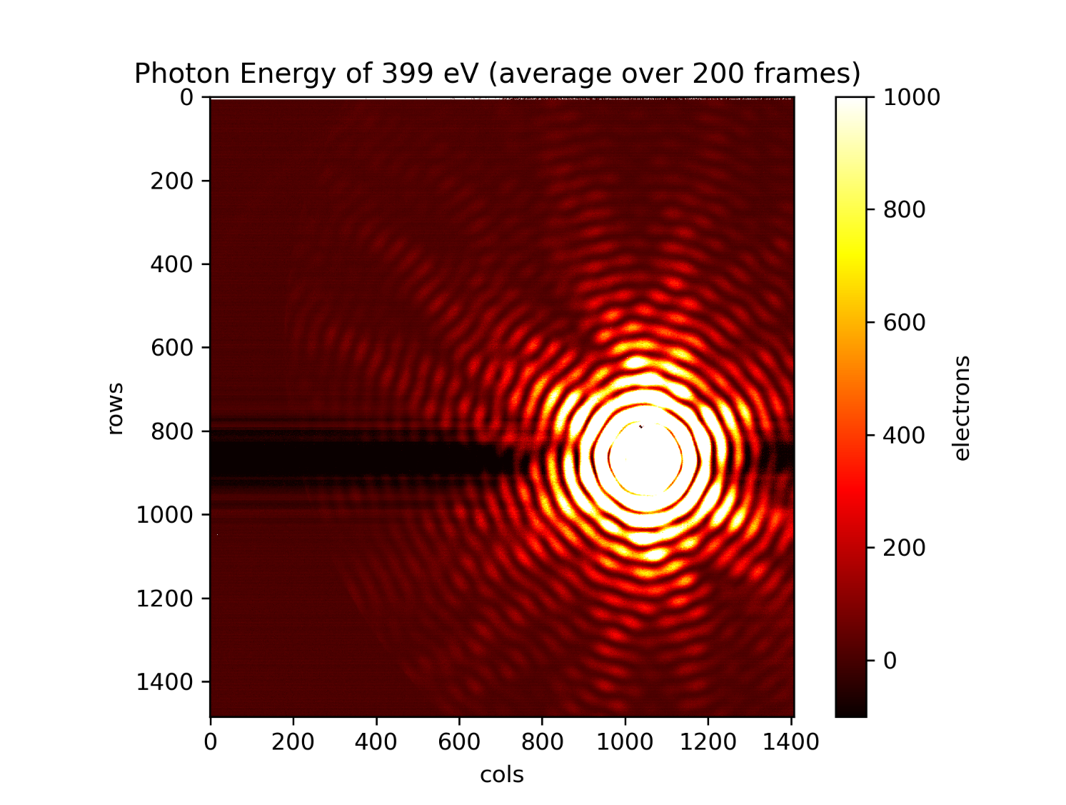
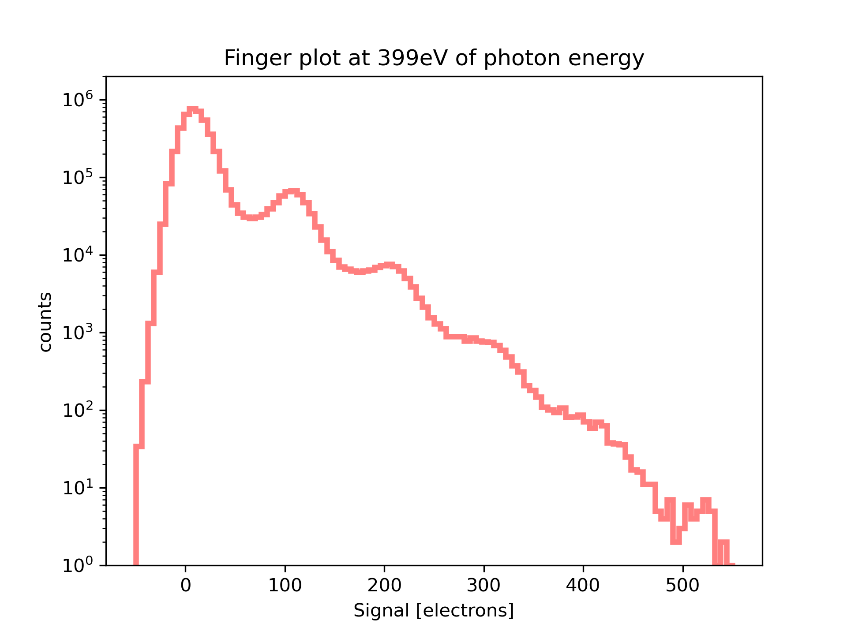
2nd gen backthinned sensor – beam tests
Measurements at PETRA-III P04, October 2025
Large dynamic range
Single photon sensitivity
NB – Backthinning provided by foundry

Slide 10


Low Gain Avalanche Diodes
LGAD boosts signal by avalanche multiplication
Allows tender X-ray ASICs to operate with soft X-rays
E.g. AGIPD operation with 1 MHz bursts at FLASH
x 25 gain factor; 300 eV photons produce signal like 7.5 keV
Collaborating with institutes producing AGIPD / Timepix LGADs
MARTHA – Monolithic Array of Reach-THrough Avalanche photodiodes
Inverse LGADs for shallow absorbed photons
J. Segal et al., NIMA 2025
https://doi.org/10.1016/j.nima.2024.169467
Notes:
Can mention collaborators – core concept of gain.

Slide 11
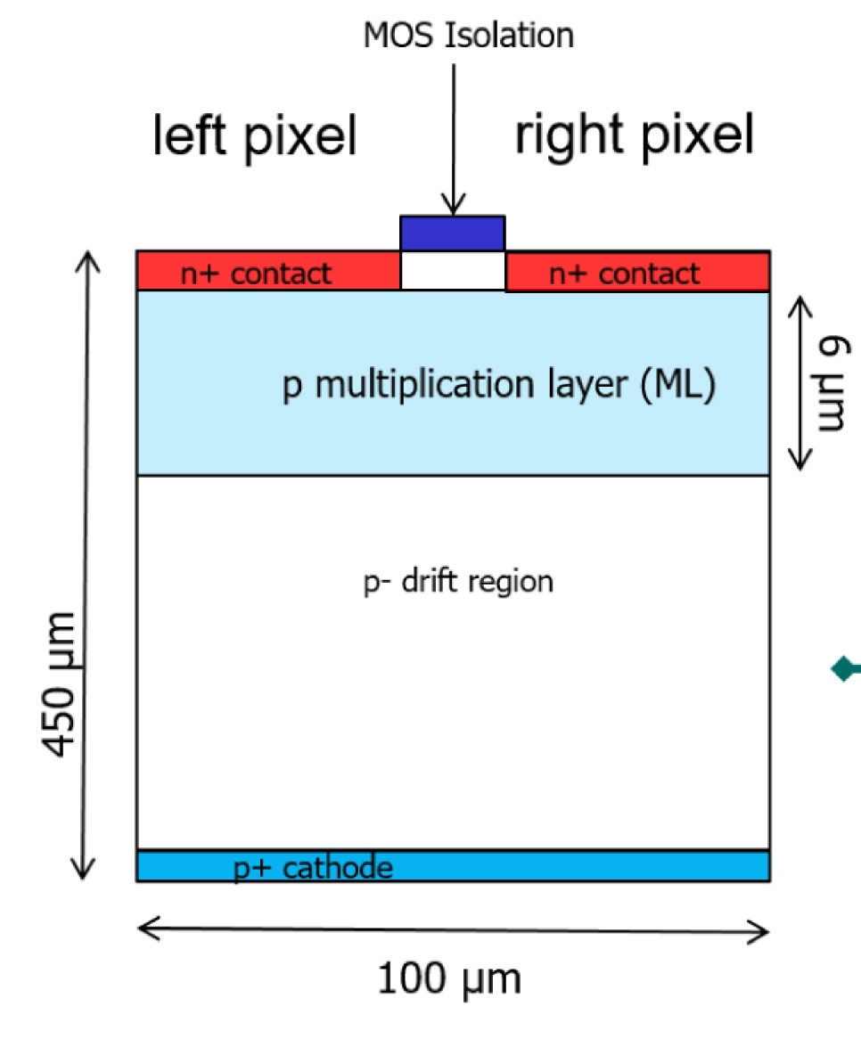
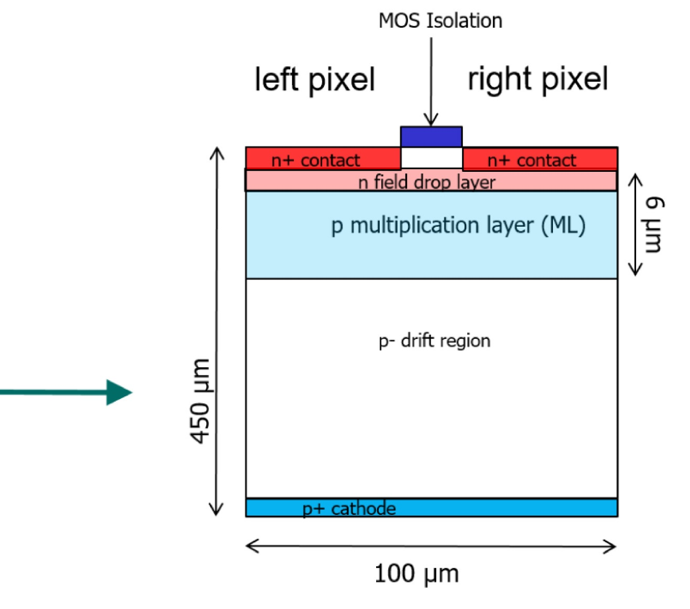
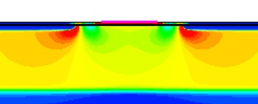
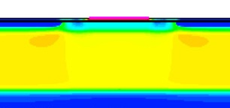
MARTHA concept
E-field
E-field
R. Richter et al. 2024, NIMA, https://doi.org/10.1016/j.nima.2024.169761

Slide 12
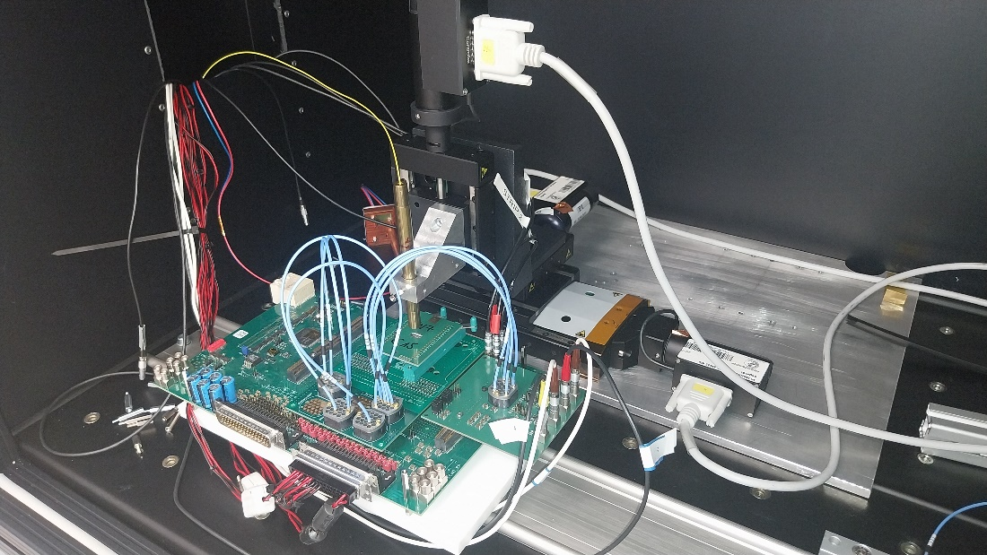
MARTHA sensor production and test
x-y-z stage + laser
Various strip and small pixel array devices produced
No Al on back surface – tests with laser
DUT
n+ pixel or strips
Vbias
via CE
Vinn_guard
MOS grid
Vframe
high field
p- bulk
backside p+ entrance window
non structured, no Al
flexible connections to different ROE

Slide 13
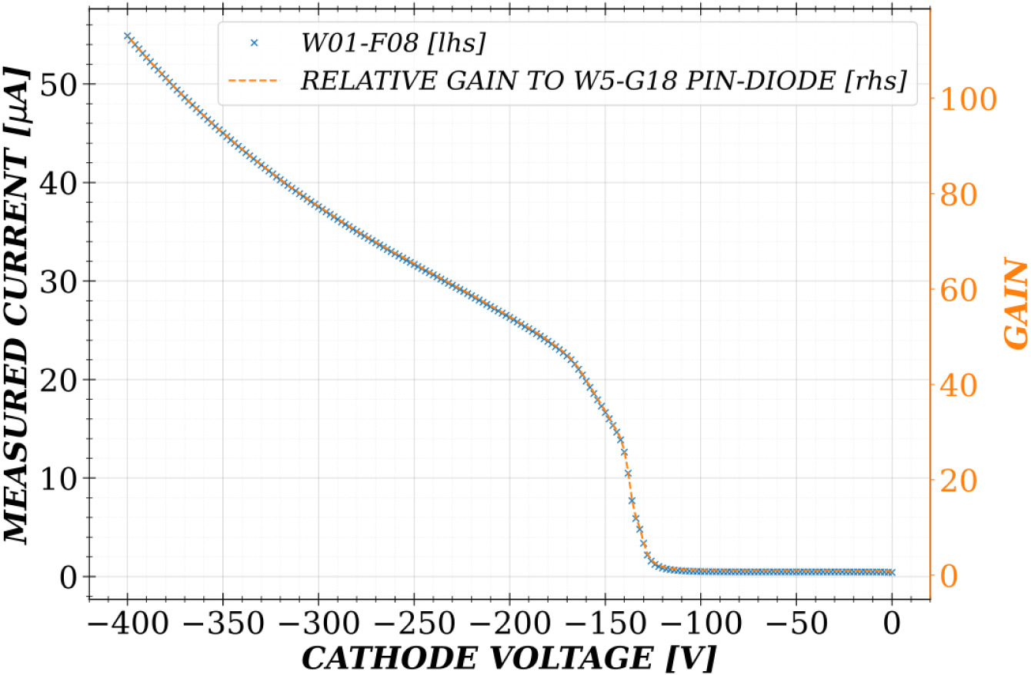
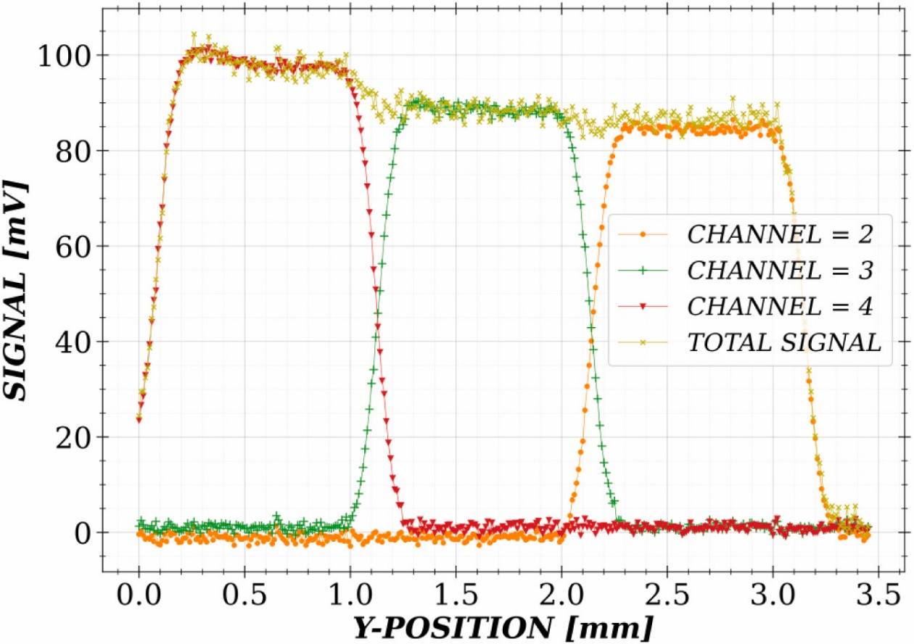
MARTHA test results
Gain factor at 300V: 26 (low gain wafer), 80 (high gain wafer)
Photocurrent under illumination
Laser scan across strips
A. Bähr et al. 2025, NIMA, https://doi.org/10.1016/j.nima.2025.171039

Slide 14
Summary
Soft X-rays allow nm-scale resolution and sensitivity to elements, band structure and magnetism
Challenges: Low signal and short absorption length
New Percival system demonstrates good functionality in PETRA beam test at 250 eV
Quantum efficiency curve still to be quantified
LGADs are a promising technology for extending the energy range of hybrid pixels
First MARTHA devices tested by HLL

Slide 15
Thank you for listening
Acknowlegements – Percival collaboration
Experiment teams
DESY:
Mohammad Hajheidari
Thomas Wendt
Jonathan Correa
Alessandro Marras
Steve Aplin (now XFEL)
Maximilian Dahlgruen
Sergei Fridman
Helmut Hirsemann
Frantisek Krivan
Sabine Lange
Magdalena Niemann
Frank Okrent
Igor Shevyakov †
Vahagn Vardanyan (now XFEL)
Heinz Graafsma
RAL:
Iain Sedgwick
Ben Marsh
Nicola Guerrini
Elettra:
Giuseppe Cautero
Dario Giuressi
Luigi Stebel
Ralf Menk
Diamond:
Alan Greer
Tim Nicholls
Mohammad Nakhostin
Shane Scully
PAL:
HyoJung Hyun
KyungSook Kim
Seonghan Kim
Sangyoun Park
Soleil:
Martin Chauvin
Francisco-Jose Iguaz
Petra III:
Moritz Hoesch
Kai Bagschik
Meng-Jie Huang
Felix Lehmkuehler
FLASH:
Barbara Keitel
Konstantin Kharitonov
Masoud Mehrjoo
Rui Pan
Elke Ploenjes
Mabel Ruiz-Lopes
Seung-gi Gang

Slide 16
BACKUP SLIDES

Slide 17
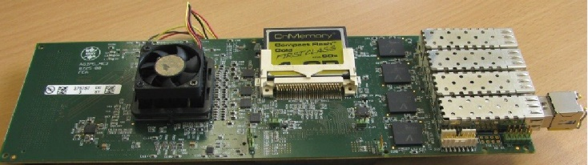
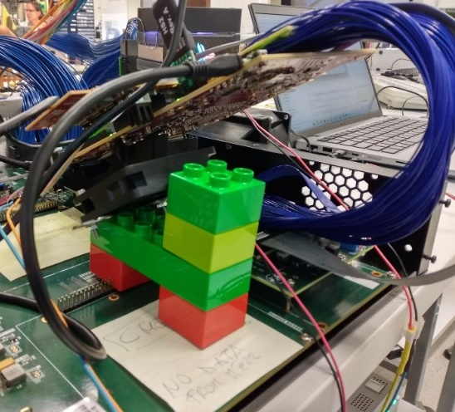
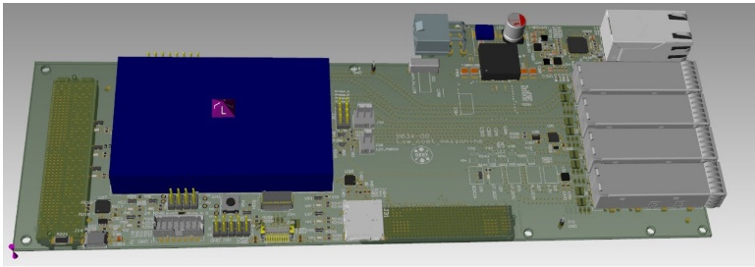
System improvements – new readout
Pre-2024 DAQ firmware not fast and flexible enough, limited sensor readout speed (83 Hz) & modes
2nd generation – based on modern Xilinx Zynq eval board
Overcomes data speed limit (250MHz instead of 125MHz)
Provides flexibility (data line delays, output sequencing & addresses, …)
Enables ROI (and thus >1k frames/s)
No longer working with ‘frozen code’
Old Mezzanine shared with 1st-gen. AGIPD and LAMBDA systems
Next steps
Record reference pixel data
Record bunch IDs (FLASH)
Compact custom board
2nd-generation DAQ development based on Xilinx Zynq Ultrascale eval board
Custom DAQ board with Trenz FPGA module

Slide 18
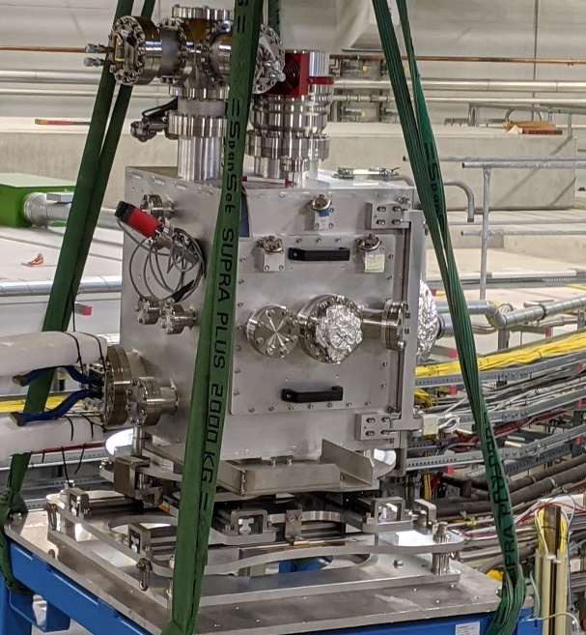
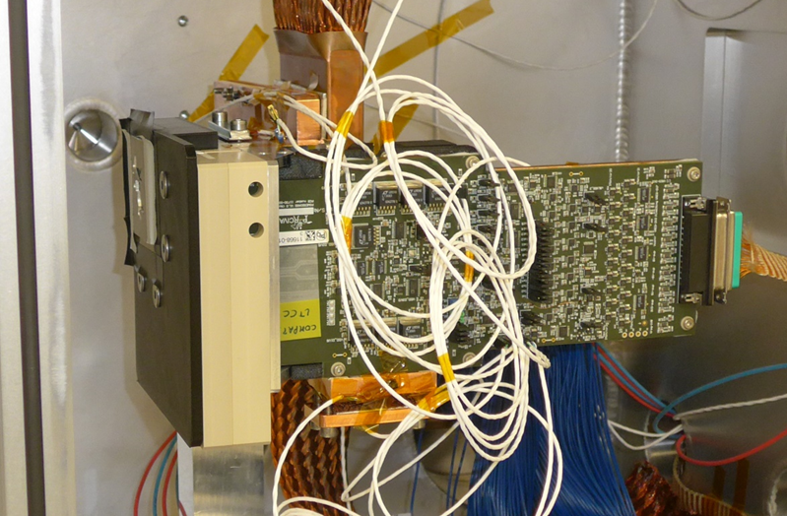
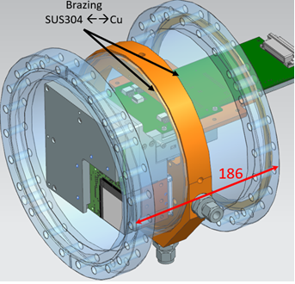
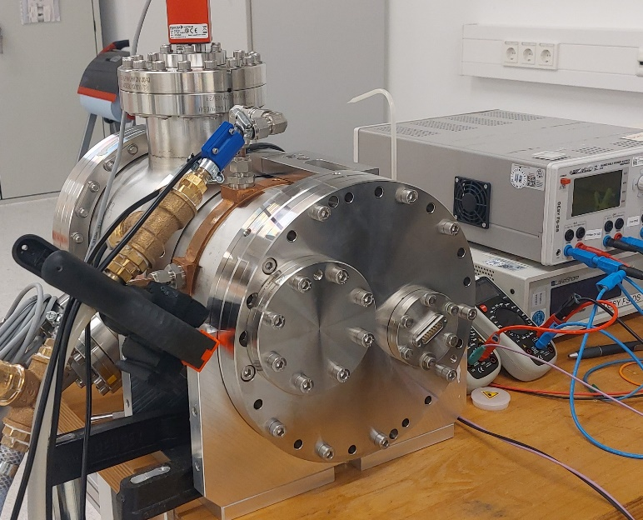
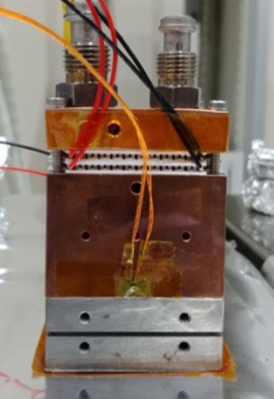
System improvements – compact system
Initial chamber devised for easy access and verification flexibility
Cumbersome
Long cooling & warmup times with Cryotiger-based setup
Compact chamber with Peltier cooling next step at DESY – utilizing Peltier element commissioned by & tested already at PAL
Much more compact (also: less access …)
Lightweight setup
almost 1t on the crane … and spacious interior
Peltier prototype @ PAL

Slide 19
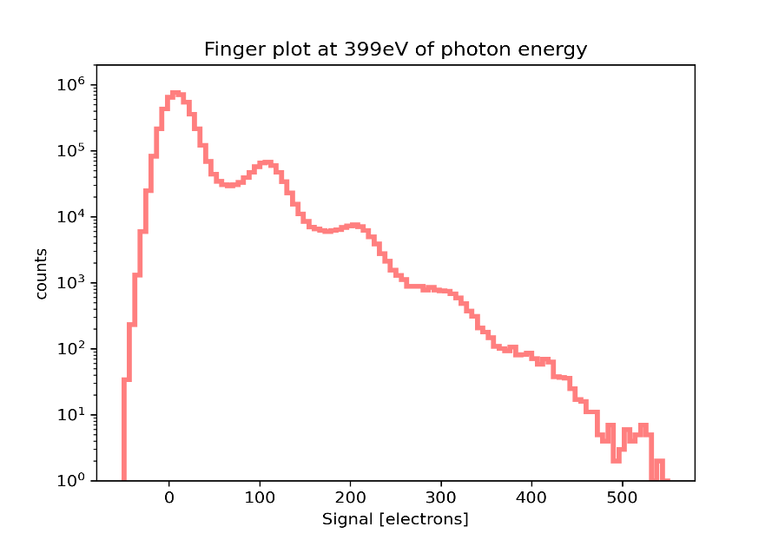
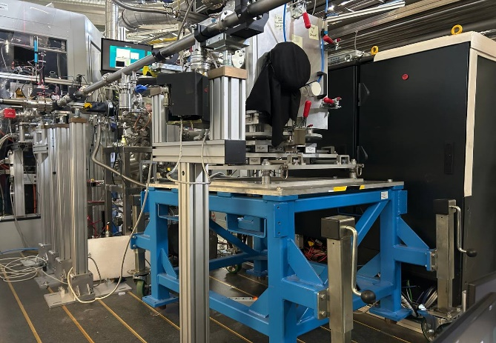
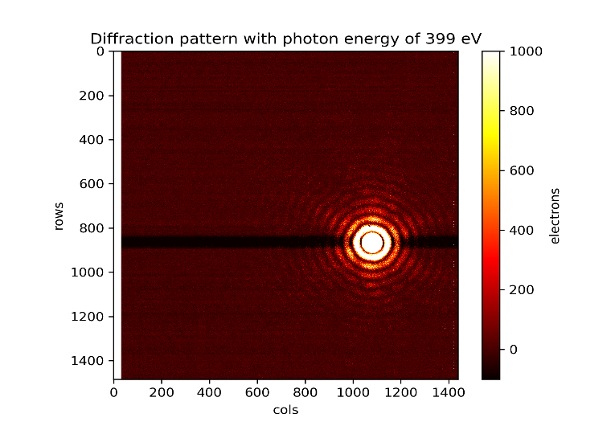

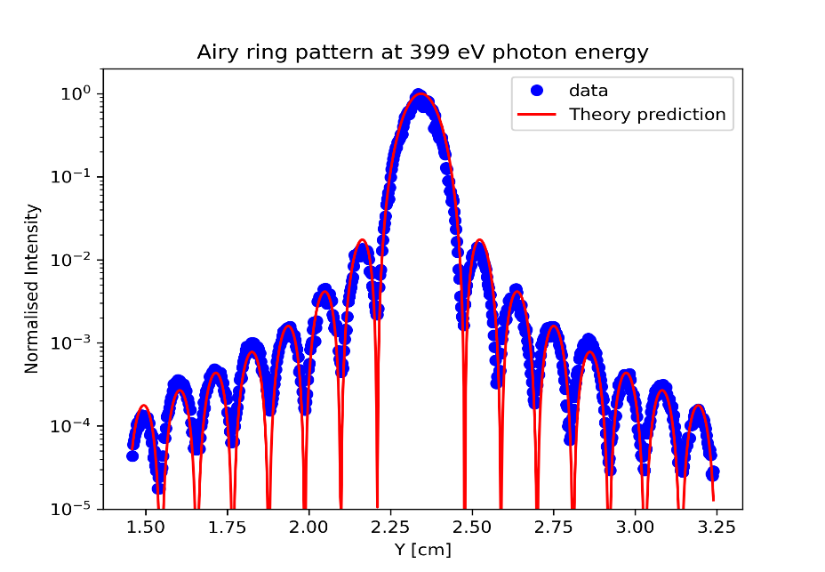
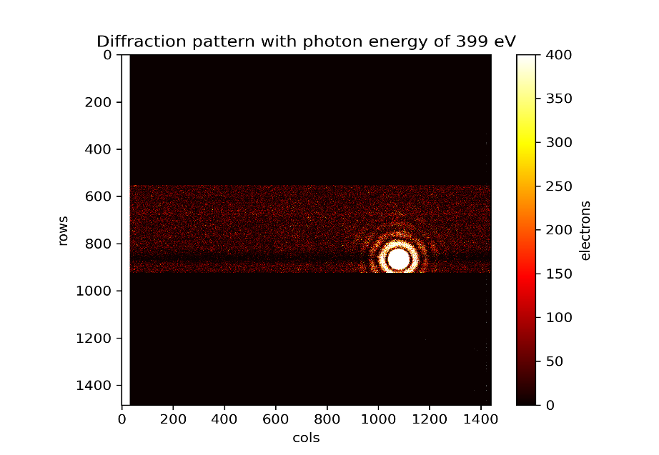
Percival at P04 – beam test results
Exposure time : 3.8 ms (263 Hz)
(Single frame image)
Exposure time : 50 ms (20 Hz)
PERCIVAL at P04 beam-line
Exposure time : 50 ms (20 Hz)
(Average image over 200 frames)
Exposure time : 1.0 ms (1000 Hz)
(Single frame image)
Exposure time : 50 ms (20 Hz)
single-shot

Slide 20
“Dry Numbers” – Achieved vs Aims, today
Frame rate today: 270Hz demonstrated, 300+Hz feasible (at increased noise)
Established ‘fast ADC operation’ enables 285Hz
Tested data clocked to 250MHz -> ~340Hz feasible
Demonstrated 1kHz frame rate in ROI operation
Dynamic range
Best respin sensor below 12e- noise (non-linear calibration might improve this further)
3Me- with dynamic gain & overflow, 3.6Me- if fixed (1st gen sensor, no change expected)
Only small variations over chip area respin sensor will enable full use of dynamic gain
Soft X-ray QE
1st gen Sensor: have seen 250eV photons without evidence of higher harmonics at P04, same for 92eV at FLASH
2nd generation: Oct 2025 test results under analysis
Design: 300 Hz, proportionally faster for partial readout
Design dynamic range:
single photons at 250eV / <15e-,
50k Photons at 250eV (3.5Me- for 100% CCE)
Soft X-ray QE: 1st generation: using NASA JPL’s delta-doping BSI process for ultrathin entrance windows (~ 5nm) and soft X-ray QE > 85% 2nd generation: foundry-supplied BSI process

Slide 21
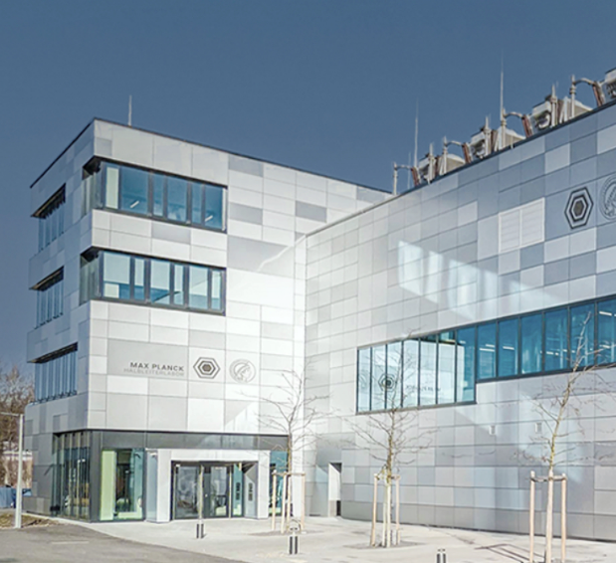
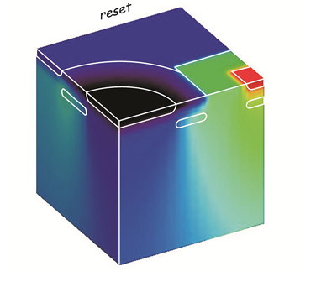
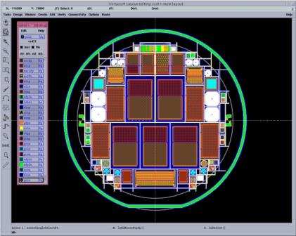
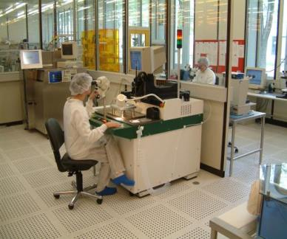
MPG HLL
New Building
IPP Campus Garching
recently moved
sensor
simulation
design
fabrication
1500 m² cleanroom area
600 m² ISO3 & ISO4 area
6/8 inch silicon process
camera
design
assembly
test
Central facility of the Max Planck Society
40 scientists, engineers and technicians
+ guest scientists, and students

Slide 22
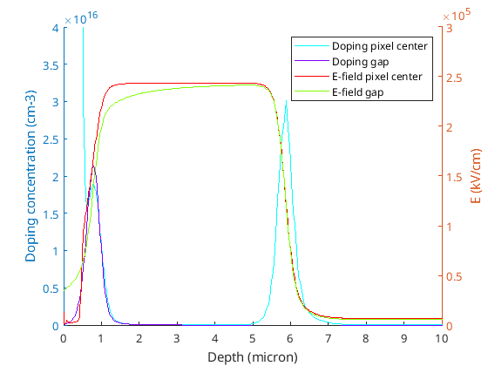
2D Simulation - electric field
left pixel
right pixel
n+ contact
n+ contact
n field drop layer
~10µm
FDL:
shift Max E-Field
prevent breakdown
deep Implant
extended ML
lower field
low k-factor
low excess noise
p multiplication layer (ML)
450µm
Field-Drop Layer (FDL)
Deep Implant
p- drift region
p+ cathode
100µm
Notes:
high energy implant + low bulk doping ensures
flat ‘plate capacitor like‘ electric field distribution
Wide high field region -> lower e-field (same gain)
-> lower k factor -> lower excess noise factor

Slide 23
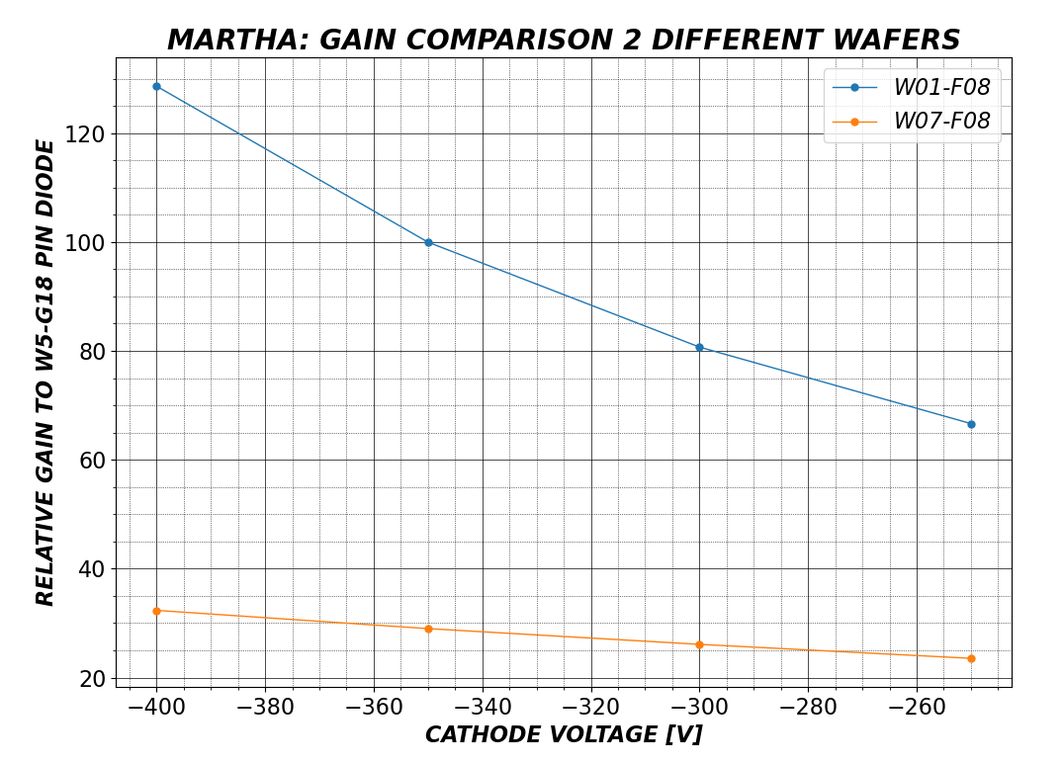
Produced Gain Range
comparision of gain of two APDs from different wafers
dose difference of 10¹¹/cm²
gain of 26 and 78 (@-300V)
full depletion @ -250V
depletion of MR + Bulk

Slide 24
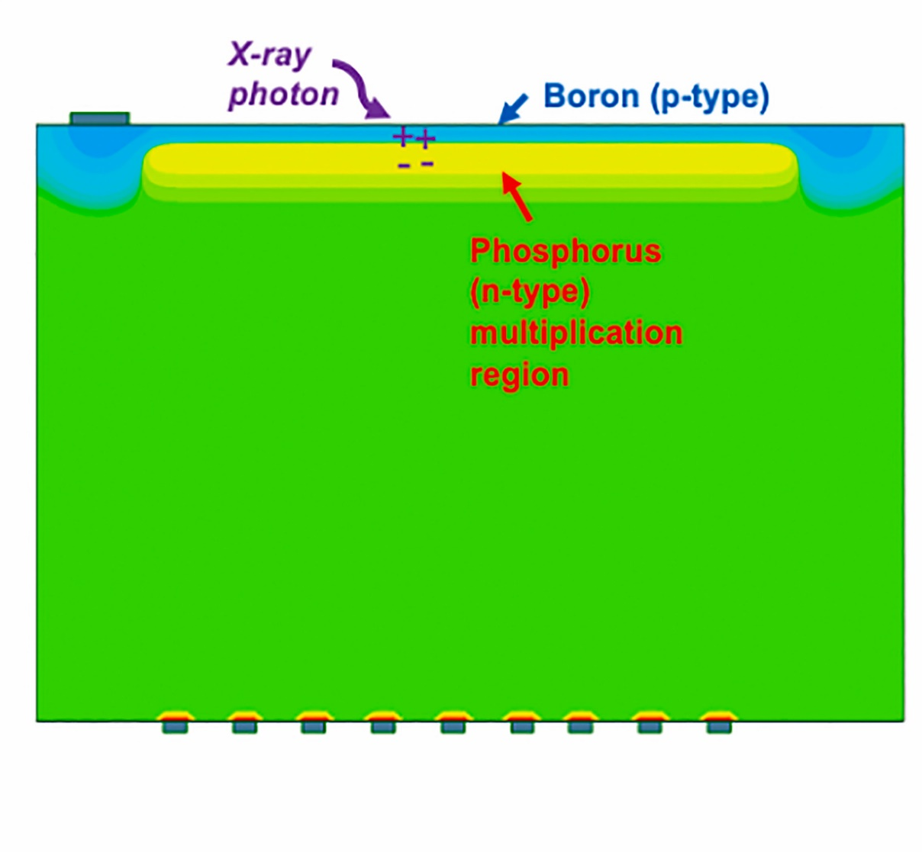
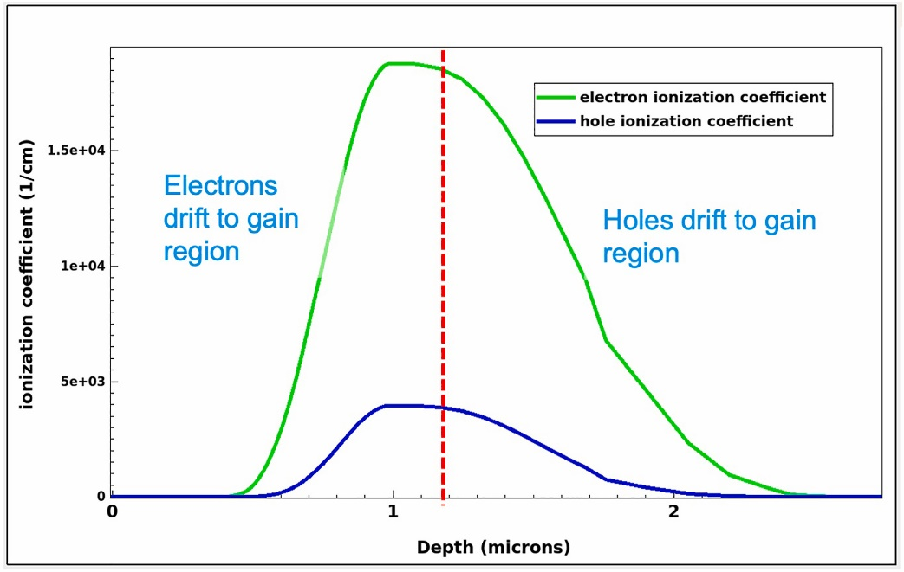
Sintef iLGAD developments
Inverse LGAD design with n-type multiplication layer and pixelation
Relies on soft X-ray photons being absorbed at sub-µm depth
Thin entrance window design
AGIPD-compatible test structures currently being bonded
n+ pixelation
J. Segal et al., NIMA 2025
https://doi.org/10.1016/j.nima.2024.169467

Slide 25
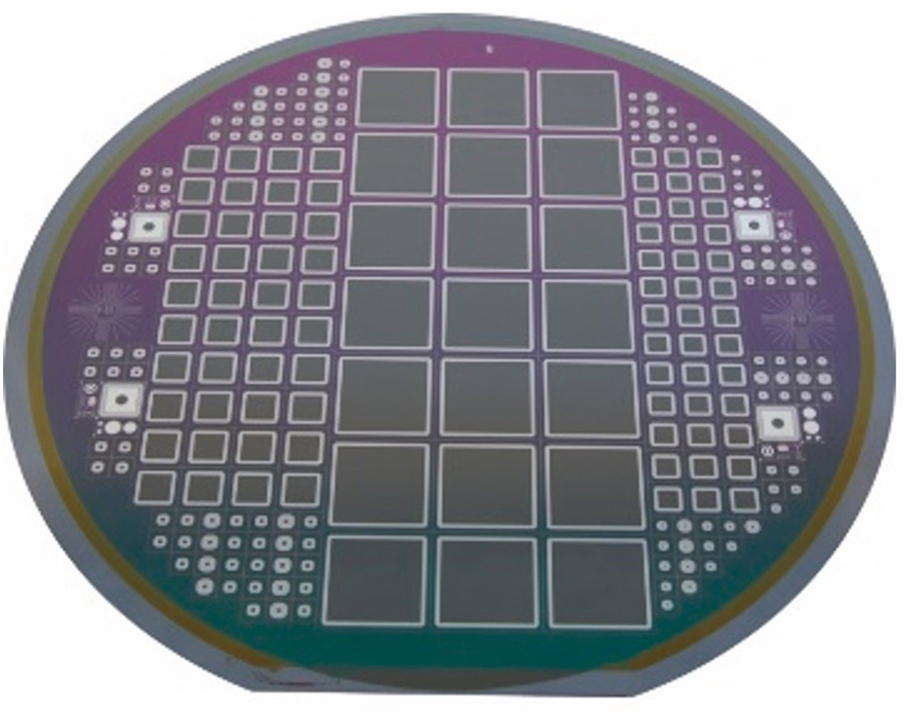
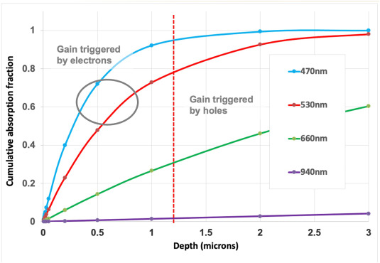
Sintef iLGAD test results
illumination | Measured Gain | Gain-generating carriers
no light | 1.4 | mostly holes
microscope light | 3.0 | unknown
470 nm | 6.9 | electrons
530 nm | 4.8 | more electrons
660 nm | 3.3 | more holes
940 nm | 1.4 | holes

