Slide 1
Status of the Pulsed Electron Lens for Space Charge Compensation at GSI
K. Schulte-Urlichs, GSI
MT Meeting, 05.11.2025

Slide 2
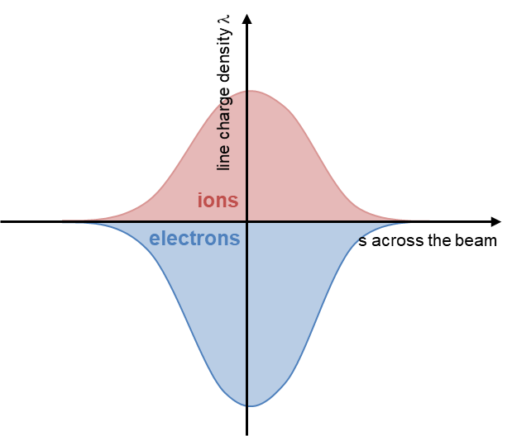
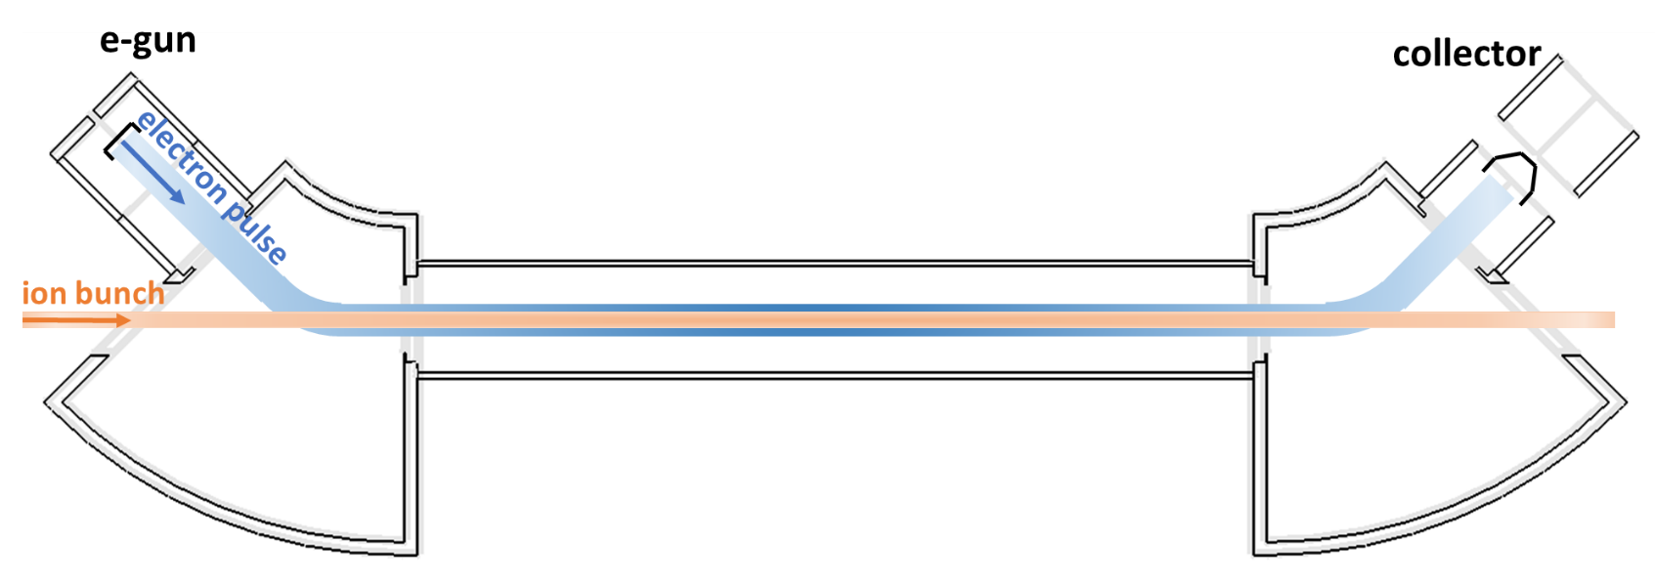
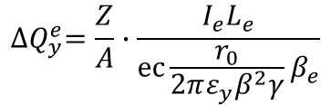
Motivation
Electron Lens Prototype for Space Charge Compensation (SCC)
Space charge represents a major intensity limitation in larger circular accelerators
R&D to increase the primary beam intensity and thus accelerator efficiency for FAIR operation
Electron Lens for SCC
Counter defocusing self-SC with electrons
Modulate e-beam to follow bunch profile
Linear compensation
Uniform transverse profile
linear fields avoiding resonance creation
Symmetry typically requires several lenses
Strategy
Design of dedicated e-lens for SIS18
Design shall be compatible with SIS100
SIS18 e-cooler as test bed for e-gun and collector to demonstrate the concept
Synchrotron | dQ
PS Booster | up to -0.69
PS | up to -0.39
SPS | up to -0.21
AGS Booster | up to –0.3
AGS | up to -0.25
JPARC RCS Booster | up to -0.35
JPARC Main Ring | up to -0.4
ISIS SR | up to -0.4
SNS SR | up to -0.15
Fermilab Booster | up to -0.6
SIS18 | up to -0.5
SIS100 | up to -0.3 (planned)
Modulation to match bunch profile
SCC scheme
E_{r}
courtesy of P. Spiller, Talk, IPAC24, WEBD3
$${∆Q}_{y}^{e}=\frac{Z}{A}∙\frac{I_{e}L_{e}}{ec{\frac{r_{0}}{2πε_{y}β^{2}γ}β}_{e}}$$

Slide 3
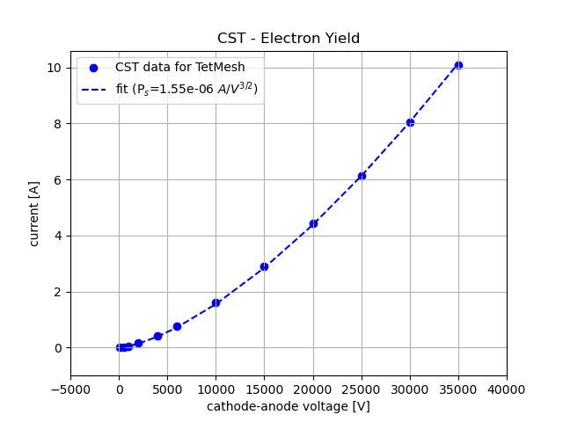
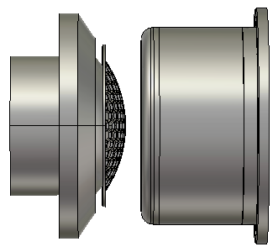
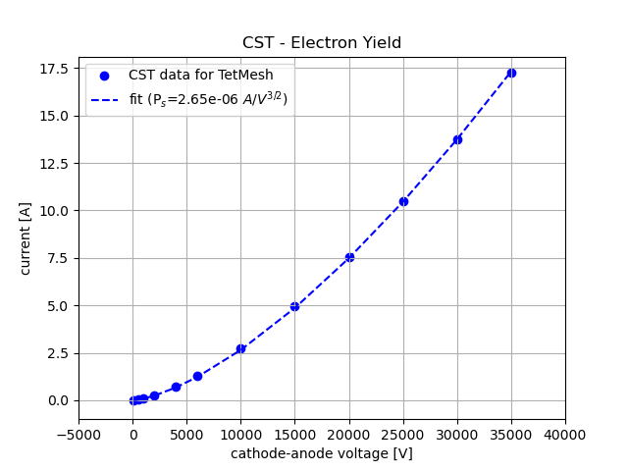
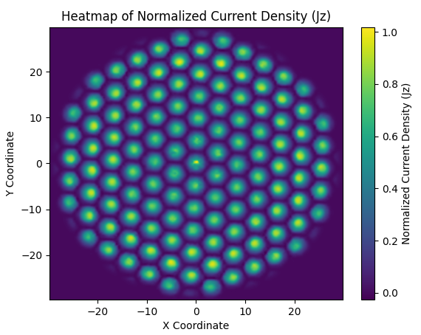
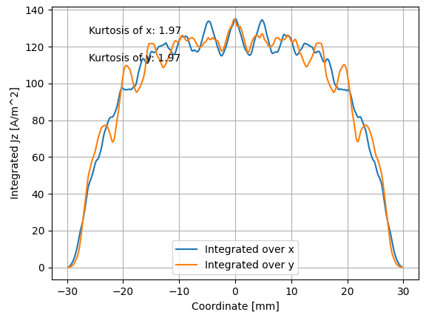
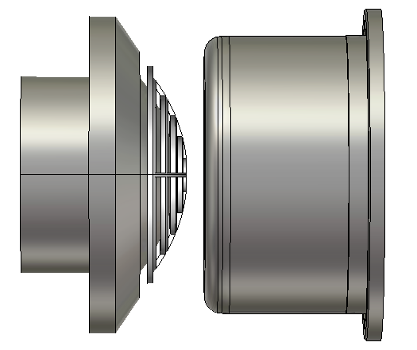

Design of Modulated Electron Gun
Requirements of design result from the SIS18 cycle:
400 kHz to 1 MHz to follow longitudinal bunch profile
grid modulation to reduce load, 3 kV on grid
two different types of modulation grid
up to 15 A @ 35 kV for SCC
modulator design
prototype within ARIES WP16
technical concept was developed
transverse, homogeneous beam density profile
immersed in solenoidal field of up to 0.4 T
despite elliptical cross section of bunch, round cross section was chosen
Electrode design with honey comb grid
kurtosis: 1.97
Evaluation of transverse beam density profile
Electrode design with target grid
normalized current density
evaluation of kurtosis
kurtosis:
$$V_{y}=\frac{\left\langle y^{4}\right\rangle }{{\left\langle y^{2}\right\rangle }^{2}}$$
kurtosis: 1.99

Slide 4
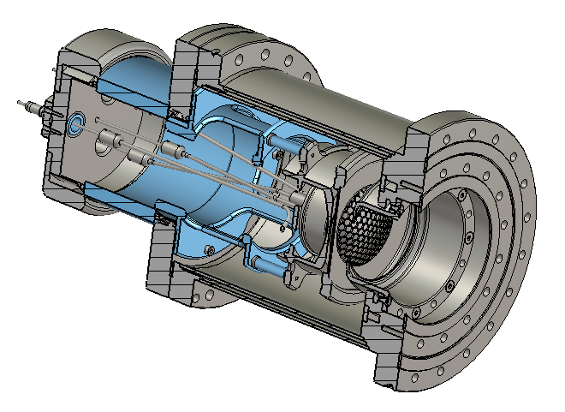
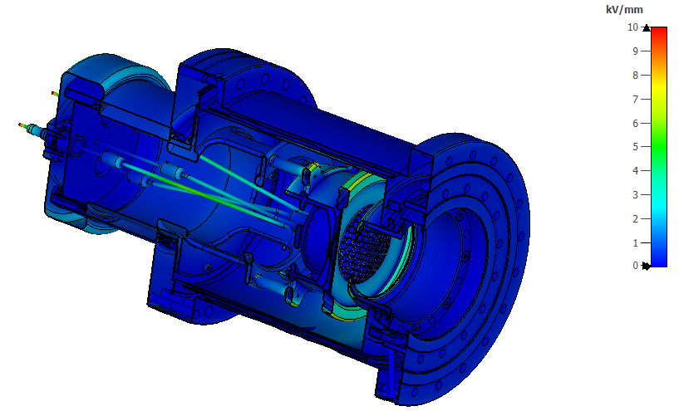
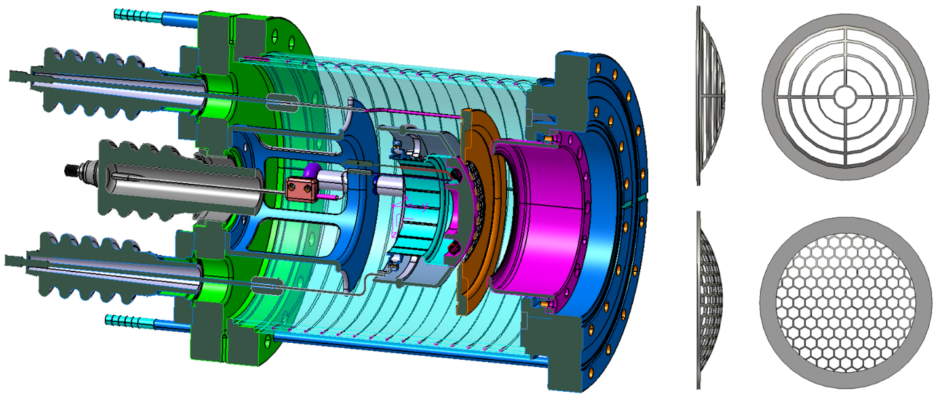
Design of Modulated Electron Gun
Status of rf-modulated E-Gun:
Preparation of preliminary e-gun design with two different grids by GSI
flexible set-up to exchange grids
BaO dispenser cathode 311XM to meet current density requirements 4 A/cm²
Production contracted in April of this year
E-gun is currently being redesigned by NTG
Expected delivery in May 2026
Commissioning at GSI test stand
E-gun layout by NTG (current status)
E-gun design by GSI
Evaluation of dielectric strength

Slide 5
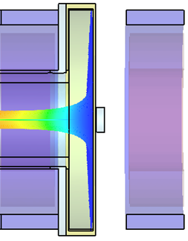
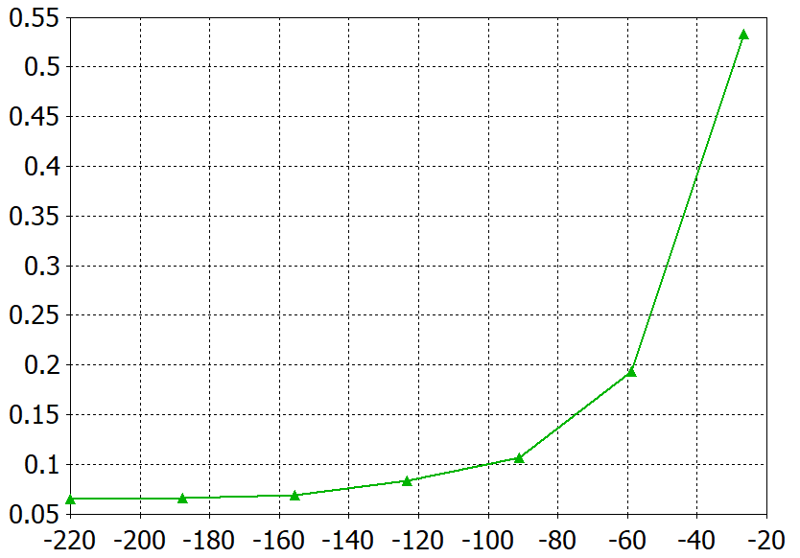
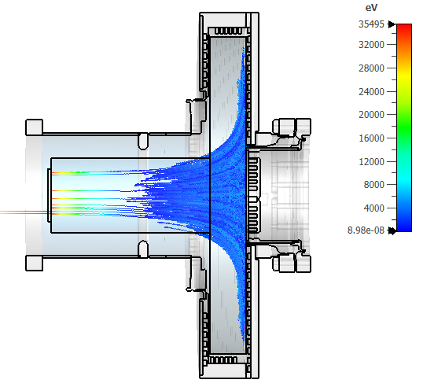
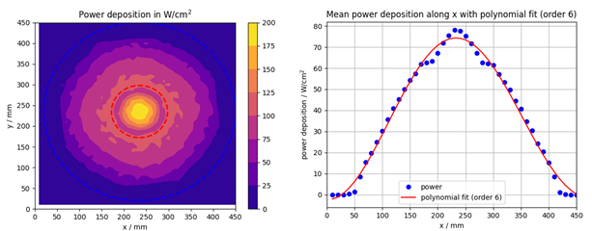
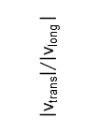
Design of Low Loss Collector
Design Challenges:
collector is operated on a HV platform and has bias potential ΔU with respect to cathode to reduce power loss
beam potential increases by deceleration
leads to reflection of beam for low ΔU between e-gun and collector
ΔU=10 kV required for conventional design
magnetic cusp field helps to rapidly expand beam
reduce beam potential
distribute beam over large area
reduction of power deposition by ~50%
Collector integrated into cusp field
Velocity ratio of electrons in cusp field
B
$${\left|\text{v}\text{trans}\right|}/{\left|\text{v}\text{long} \right|}$$
z / mm
Secondary electron mitigation
Peak power deposition
SEE backflow:
I_{back,total}=11.1mA
E-lens is only used in the beginning of the SIS18 cycle, this reduced the power deposition by ~0.3.
collector efficiency: >99.9%

Slide 6
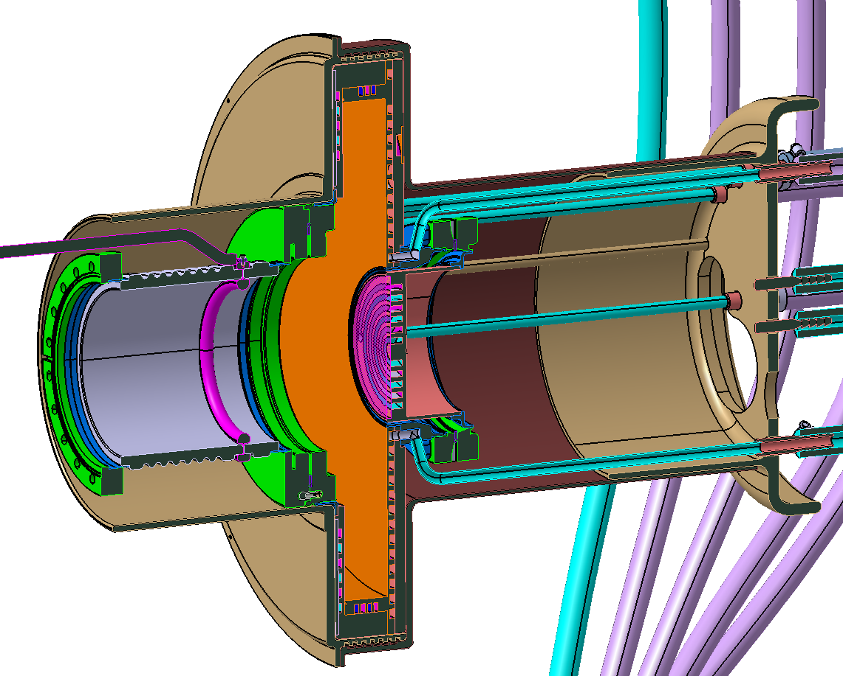
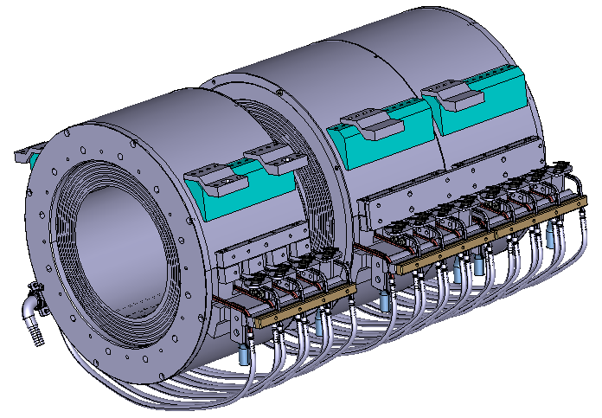
Design of Low Loss Collector
Technical Challenges:
chamber must have a small height compared to the diameter
separate cooling channels are required to allow deducing beam power distribution from the temperature of the water backflow
requires the use of advanced manufacturing methods
Design of collector chamber
Collector Parameters
Electron current max. | 15 | A
Collector bias potential max. (represents max. electron energy) | -5.5 | kV
Beam modulation frequency | 400 – 1000 | kHz
Inner collector radius max. | 215 | mm
Outer collector radius | 242 | mm
Beam radius | ≥ 215 | mm
DC power deposition | 82.5 | kW
Power deposition within cycle, max. | 20 | kW
Collector area | 1452 | cm²
Max. magnetic field | 0.4 | T
Collector chamber height | 66 | mm
Design of collector magnets

Slide 7
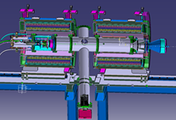
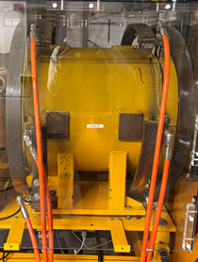
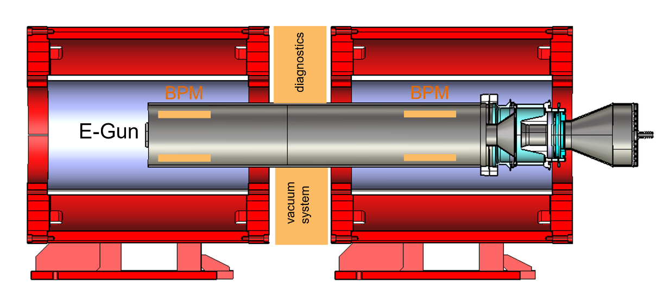
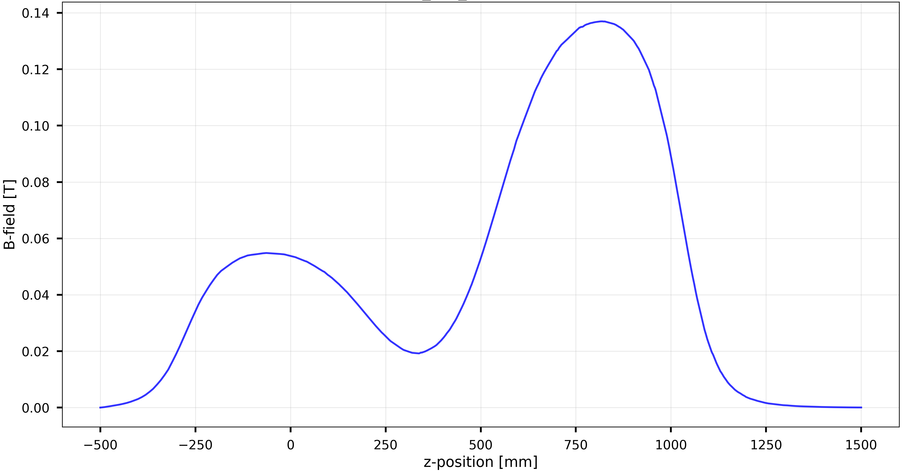
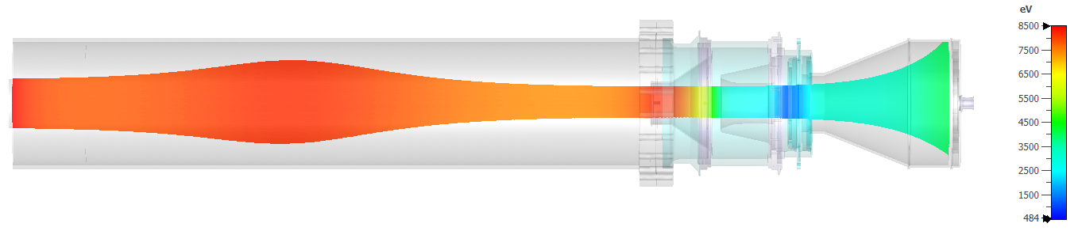
Test Bench at GSI
Test bench set-up:
commissioning of e-gun and collector
demonstration of extraction currents up to 15 A and beam profile
reusage of equipment as power supplies, vacuum pumps and solenoids from 100 keV COSY e-cooler @ FZ Jülich
used in different stages according to the experimental requirements
stage 1
existing collector with power depostion up to 10 kW and smaller aperture compared to beam diameter
preparation of transverse and longitudinal beam diagnostics
stage 2
commsioning of low loss collector
characterization of e-beam and operation modii
stage 1
Electron beam trajectories
Gun: 2.4A @ 8.5kV
collector: 9.5kW

Slide 8
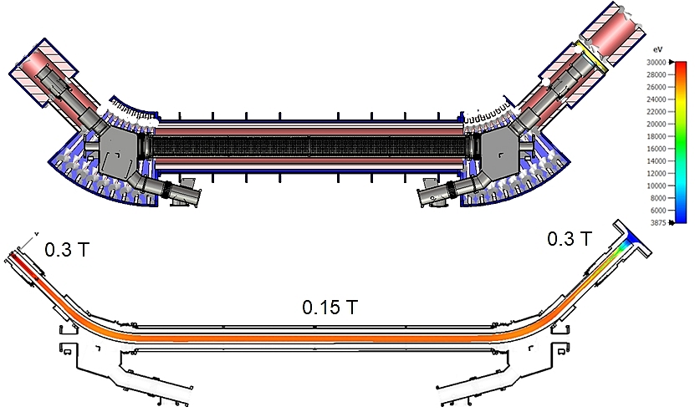
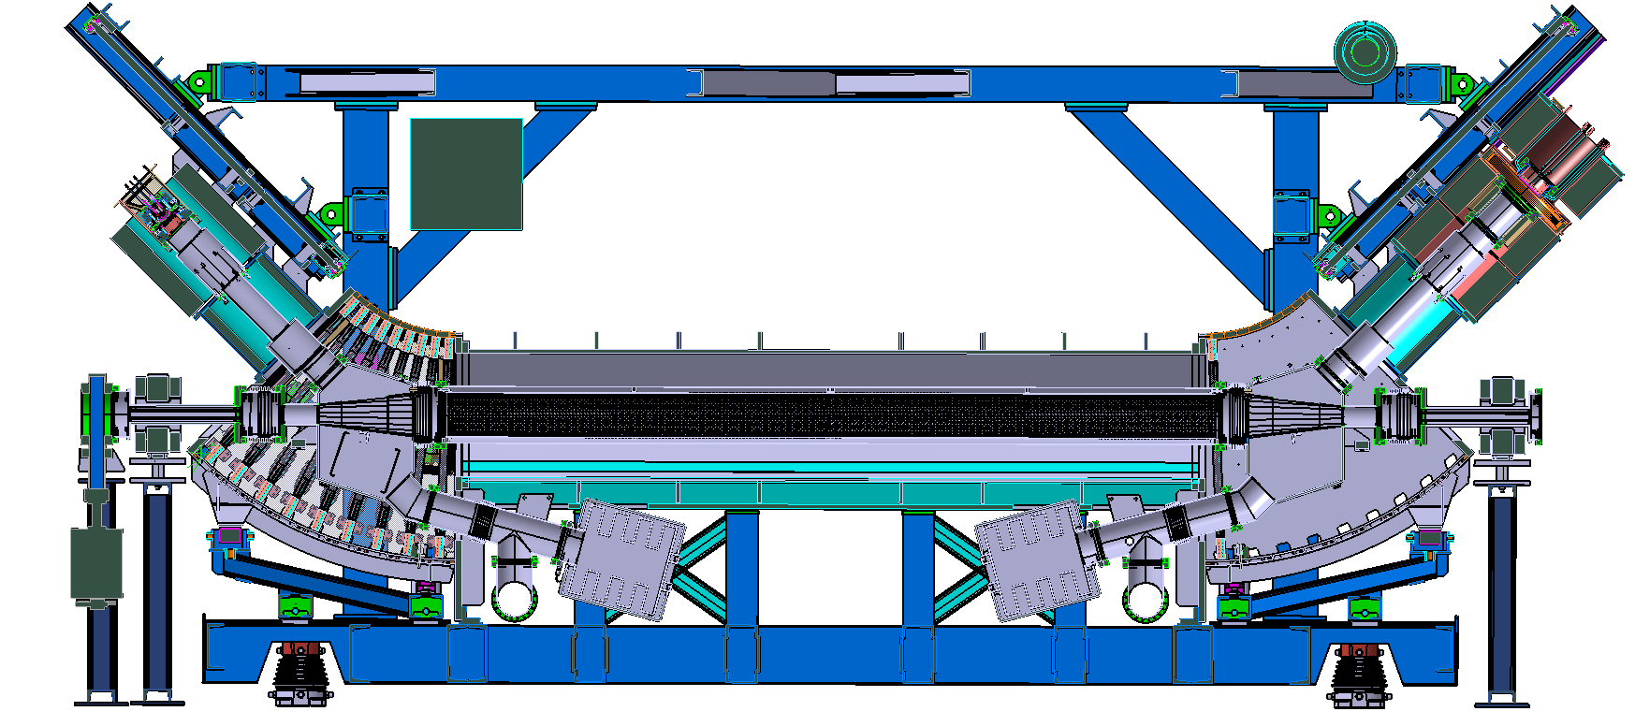
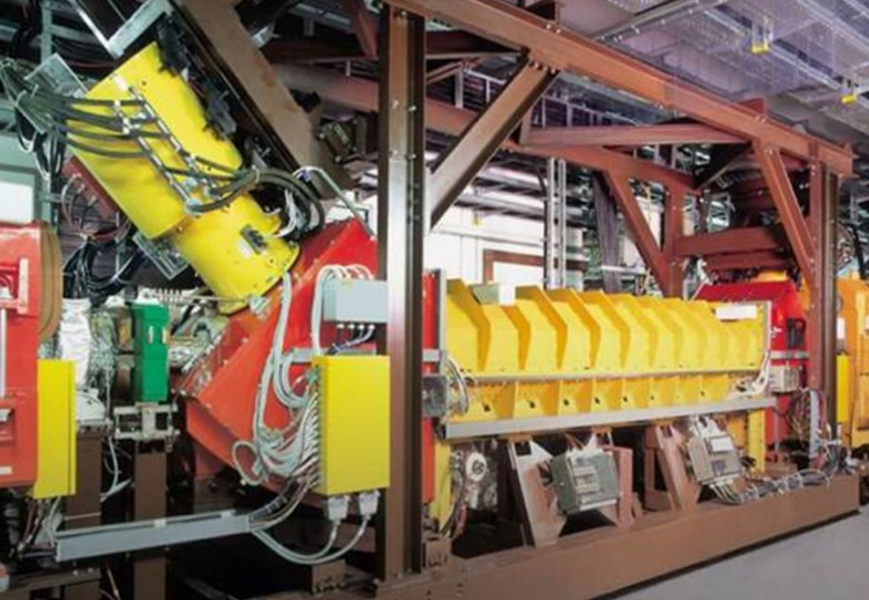
SIS18 E-Cooler as Test Bed
Modification of SIS18 E-Cooler:
E-Cooler is in Sector 10 of SIS18
Electron cooler has a maximum B-field of 0.15 T in the interaction section and 0.4 T in the gun and collector branches
simulations indicate that cooler field magnitude is feasible for demonstration experiments
The design of the electron gun and collector has been adapted so that it can be integrated into the cooler.
An additional solenoid is provided to adjust the collector system to the length of the beam tube.
next step: planning of demonstration experiments with “single lens”
Concept study: beam transport simulations
SIS18 e-cooler
Modified SIS18 e-cooler set-up

Slide 9
Outlook
Preparation of demonstration experiments
Set-up of test bench at GSI
Commissioning of rf-modulated e-gun
Construction of low loss collector
Modification of SIS18 e-cooler and machine experiments
Design of demonstrator electron lens is under preparation in parallel

Slide 10
Thanks for your attention!
Special thanks to all contributors to this project:
M. Droba², M. Kirk¹, O. Meusel², D. Ondreka¹, J. Rausch² , P. Rottländer¹, P. Spiller¹, K. Thoma^{1,2}
¹GSI Helmholtzzentrum für Schwerionenforschung GmbH,
²Goethe-University Frankfurt

