Slide 1




High-charge electron acceleration in the SM-LWFA regime at PHELIX
Johannes Hornung
Victor Winter, Pascal Boller, Mehdi Tarisien,
Antoine Maitrallain, Élodie Minjou-García, Jose Luis Henares,
Carlos Salgado, David Gutierrez, Cecilia Martínez,
Carl Simon Schultheis, Stephan Kuschel, Vincent Bagnoud

Slide 2
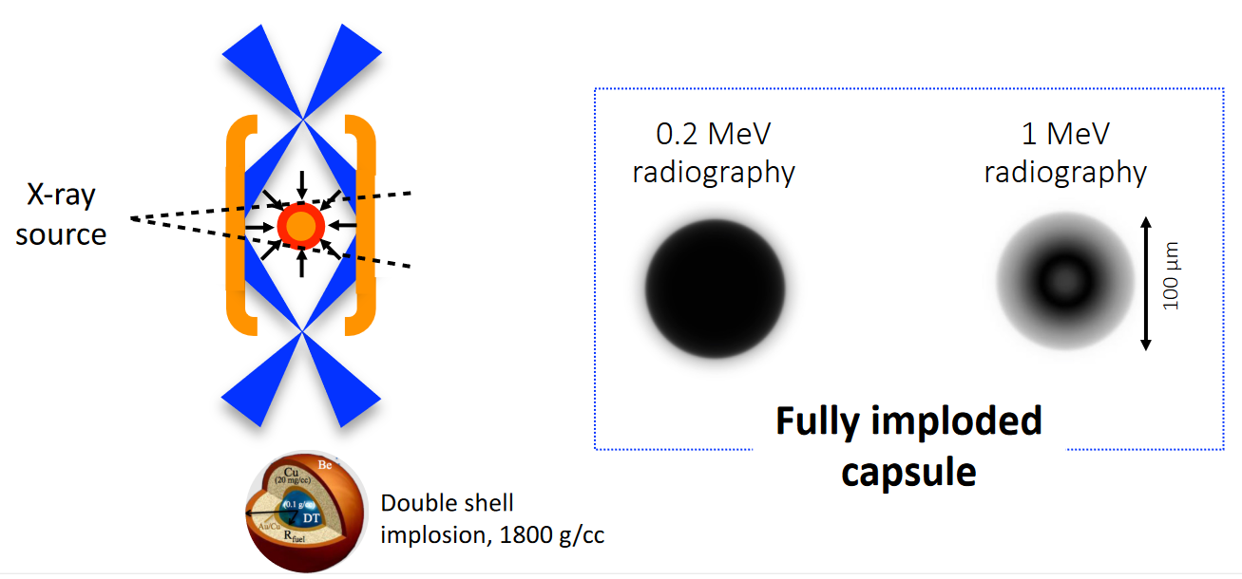
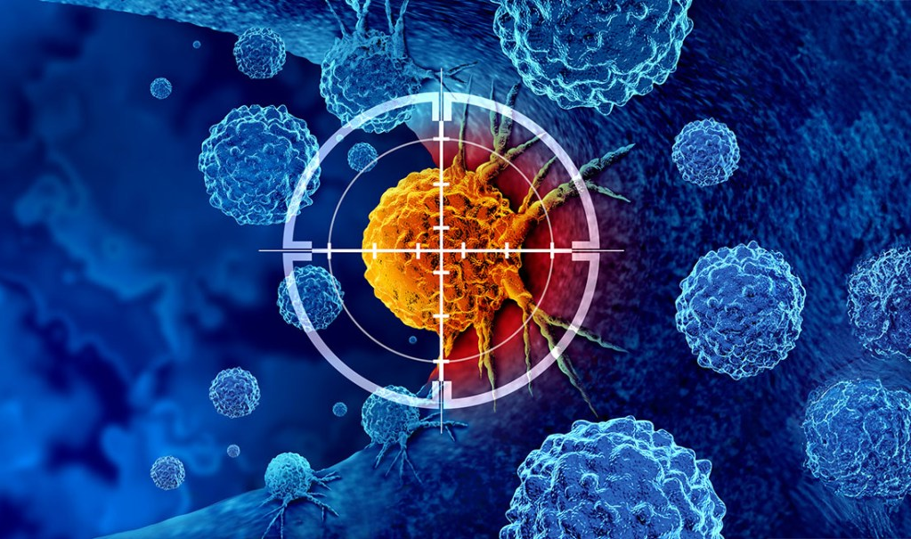
Motivation
Backlighter for Inertial Fusion Energy (IFE) / High Energy Density (HED) experiments
Ideally: High brilliance
High photon number & energy
Low beam divergence
Small source size
Short pulse duration
Generation of radioisotopes for theranostics research e.g. ⁴³Sc & ⁴⁷Sc
High photon number & energy
High repetition rate / average power
Source: NIF
https://news.med.miami.edu/how-is-theranostics-impacting-cancer-care/
Requires large number of photons

Slide 3
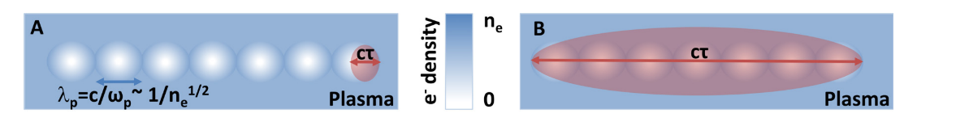
Laser-driven electron acceleration
Laser Wakefield Acceleration (LWFA)
Self-Modulated LWFA (SM-LWFA)
Phys. Plasmas 25, 056706 (2018)
Phys. Plasmas 25, 056706 (2018)
Requires ultra-short pulses (10s fs)
Very low divergence (~ mrad)
Narrow energy distribution
pC to nC-level charges (N_{e} ~ 10⁷ - 10¹⁰)
Pulse duration of 100s fs to ps
100s of mrad divergence
Exponential decaying spectrum
µC-level charges (N_{e} ~ 10¹³)
Promising acceleration mechanism

Slide 4
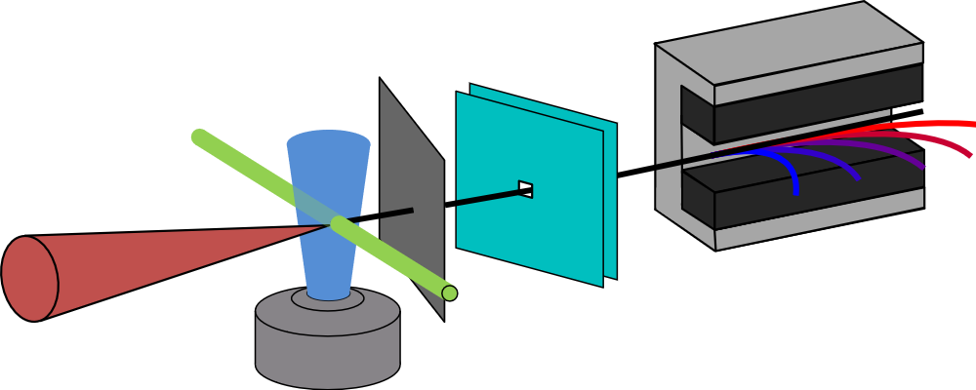
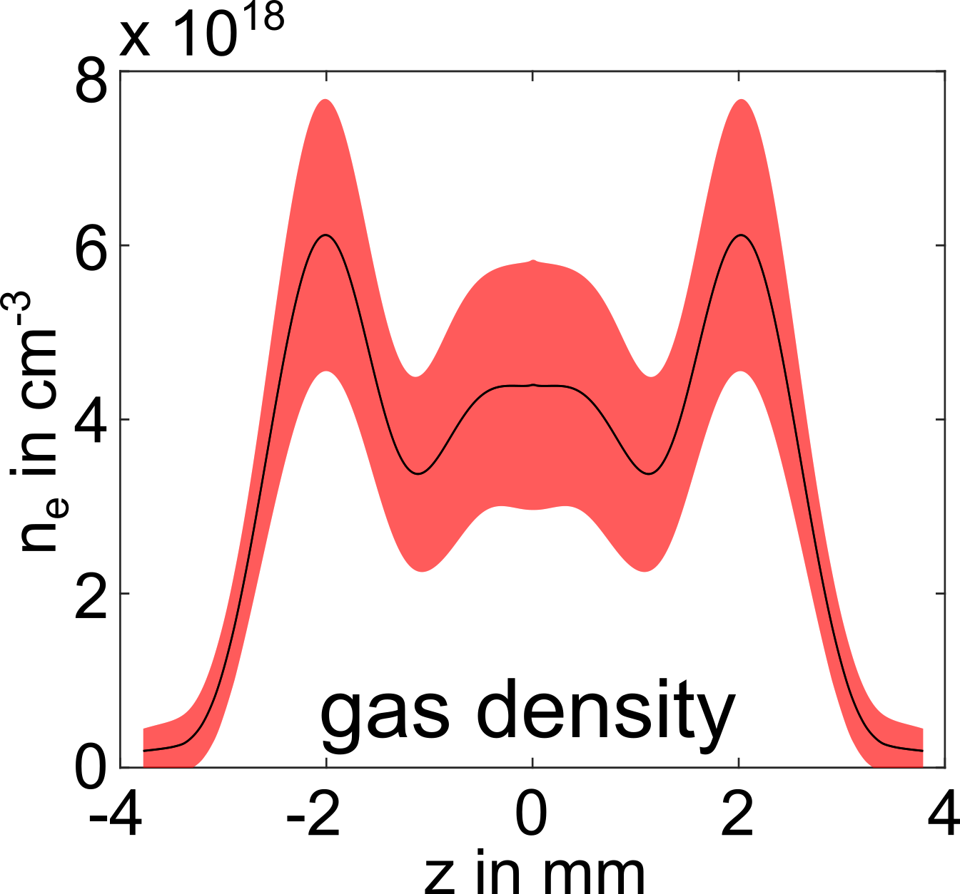
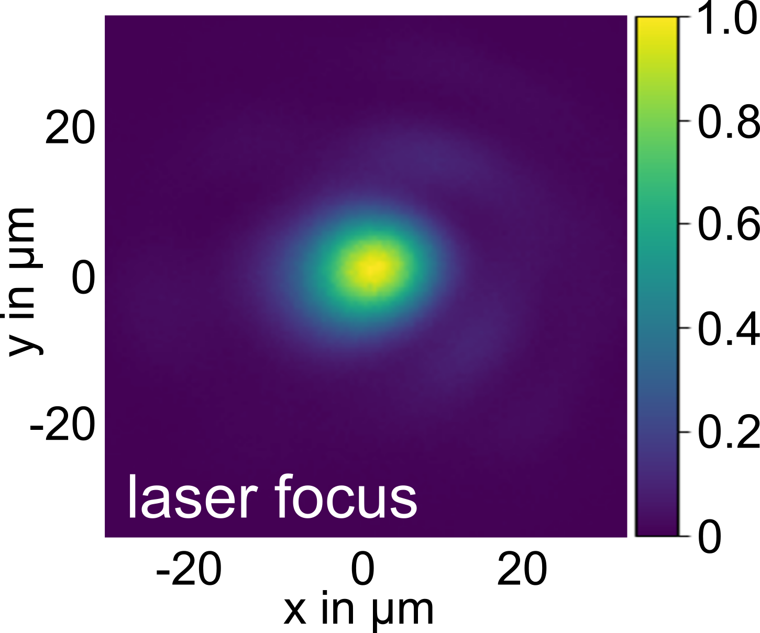

Commissioning experiment at PHELIX
scintillator /
image plate
laser dump
Probe
PHELIX parameters
E $≤$ 100 J
$Δτ$ = 500 fs
P_{peak} = $\frac{E}{Δτ}$ ≤ 200 TW
F# = f/17 (FWHM, 29 µm)
L_{target} ≈ 6 mm
n_{e} = 5 – 8 x 10¹⁸ cm⁻³ (He)
PHELIX
electron
spectrum
100 J, 500 fs
gas jet

Slide 5
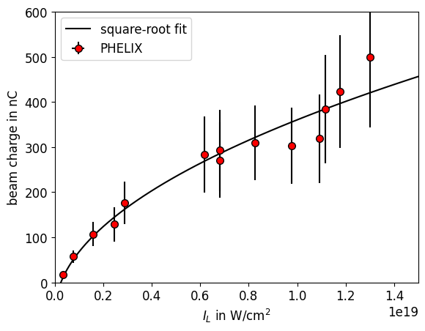
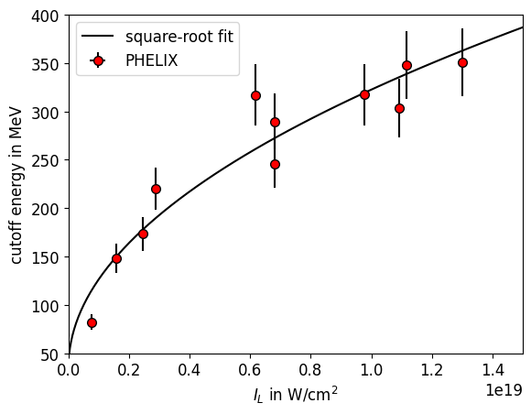
Electron beam properties @ PHELIX
beam charge vs. intensity
cutoff energy vs. intensity
Facility | I_{L} in W/cm² | Q_{e, max} in nC
PHELIX | 1.3x10¹⁹ | 500
OmegaEP¹ | 5x10¹⁹ | 700
PETAL² | 5x10¹⁸ | 1000
Comparable results at PHELIX for different laser parameters
¹J. Shaw et al., Sci. Rep. 11, 7498 (2021)
²W. Cayzac et al., High Energy Density Phys. 52 101125 (2024)

Slide 6
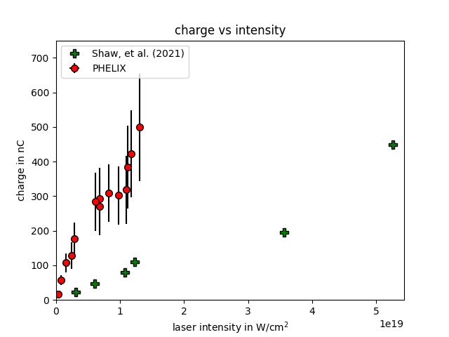
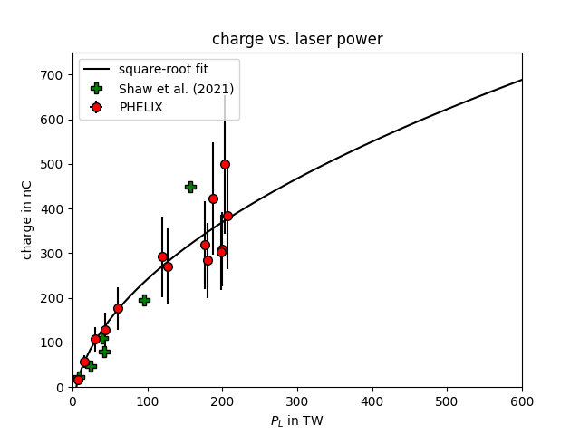
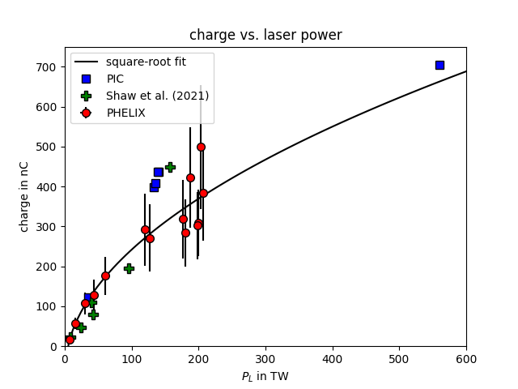
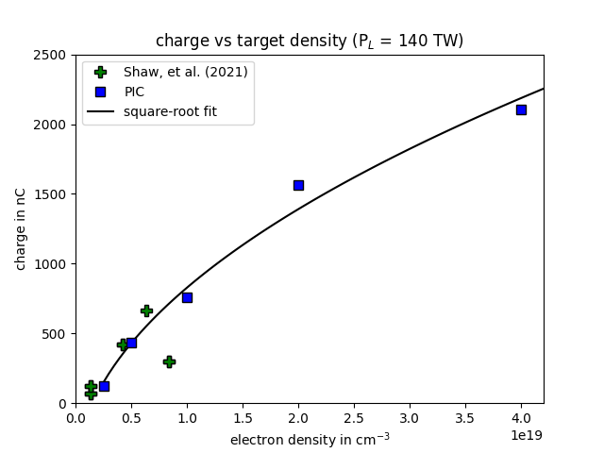


Scaling behavior and comparison to OmegaEP
beam charge vs. laser power
beam charge vs. electron density
beam charge vs. intensity
intensity difference x64
$$Q∝\sqrt{P_{L}}$$
$$Q∝\sqrt{n_{e}}$$
Power as universal comparison quantity
Weak influence of focusing geometry

Slide 7
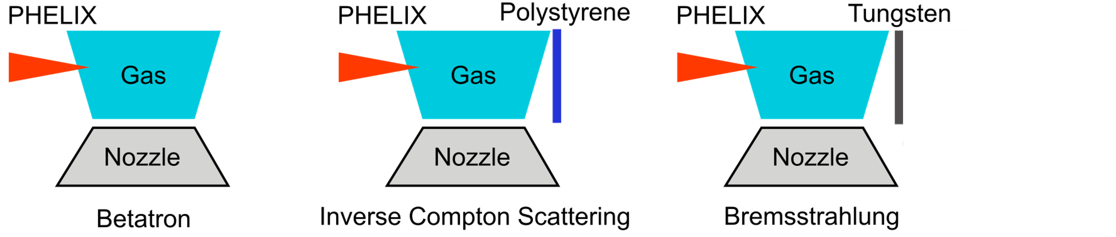

Outlook
Towards higher beam charges
PHELIX (200 J)
20 J, 100 Hz system
$Q∝\sqrt{P_{L}}$ & $Q∝\sqrt{n_{e}}$
Q_{projected} ~ 1 - 2 µC
Q_{projected} ~ 300 - 600 nC
I_{projected} ~ 30 – 60 µA
Towards applications
Bright and flexible sources for
HED / IFE experiments
@ PHELIX or FAIR
Theranostic research
in EIC Pathfinder project
“EUROPA”
Beamtime @ PHELIX in April 2026
Notes:
Development of a flexible laser-driven source for the production of artificial radioisotopes for medical research

Slide 8


Thank you for your attention!
Victor Winter, Pascal Boller, Mehdi Tarisien, Antoine Maitrallain, Élodie Minjou-García, Jose Luis Henares, Carlos Salgado, David Gutierrez, Cecilia Martínez, Carl Simon Schultheis, Stephan Kuschel, Vincent Bagnoud

Slide 9
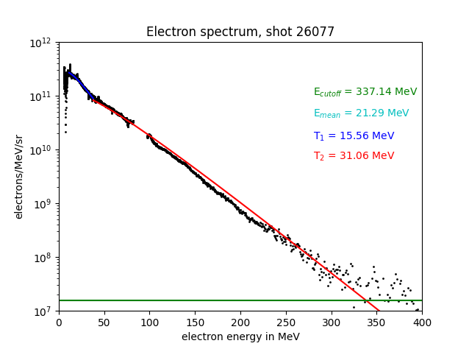
Backup: Electron spectrum
electron spectrum (E_{L} = 100 J)
Q_{tot,>2 MeV} = 500 nC
Q_{tot,>10 MeV} = 230 nC
Q_{tot,>100 MeV} = 7 nC
11th annual MT meeting, Johannes Hornung, 05.11.25

