Slide 1
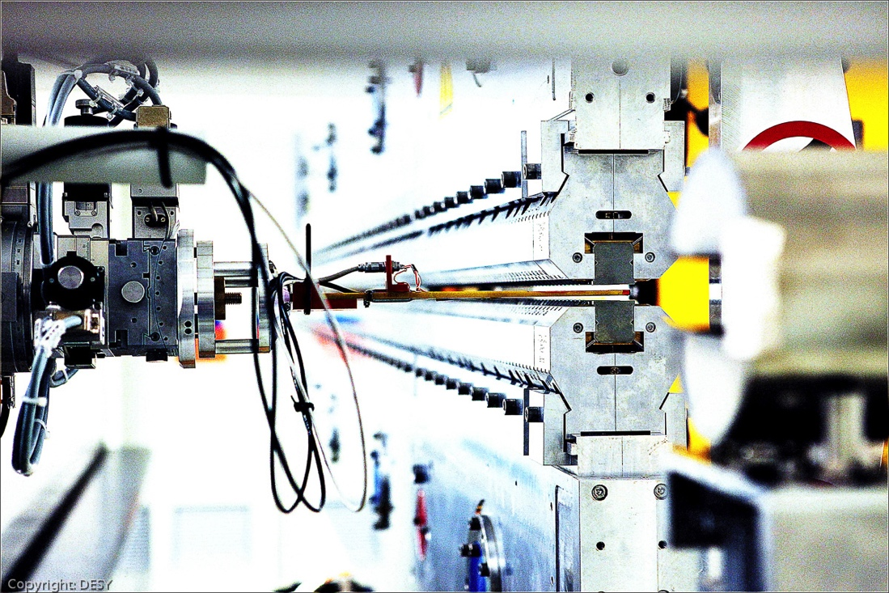
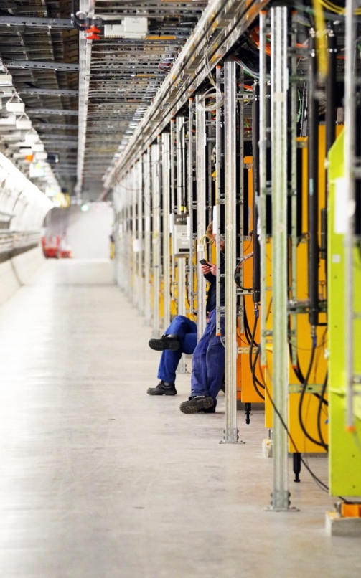
Undulator trajectory alignment
Matthias Scholz, MXL
Hamburg, April 30, 2025

Slide 2
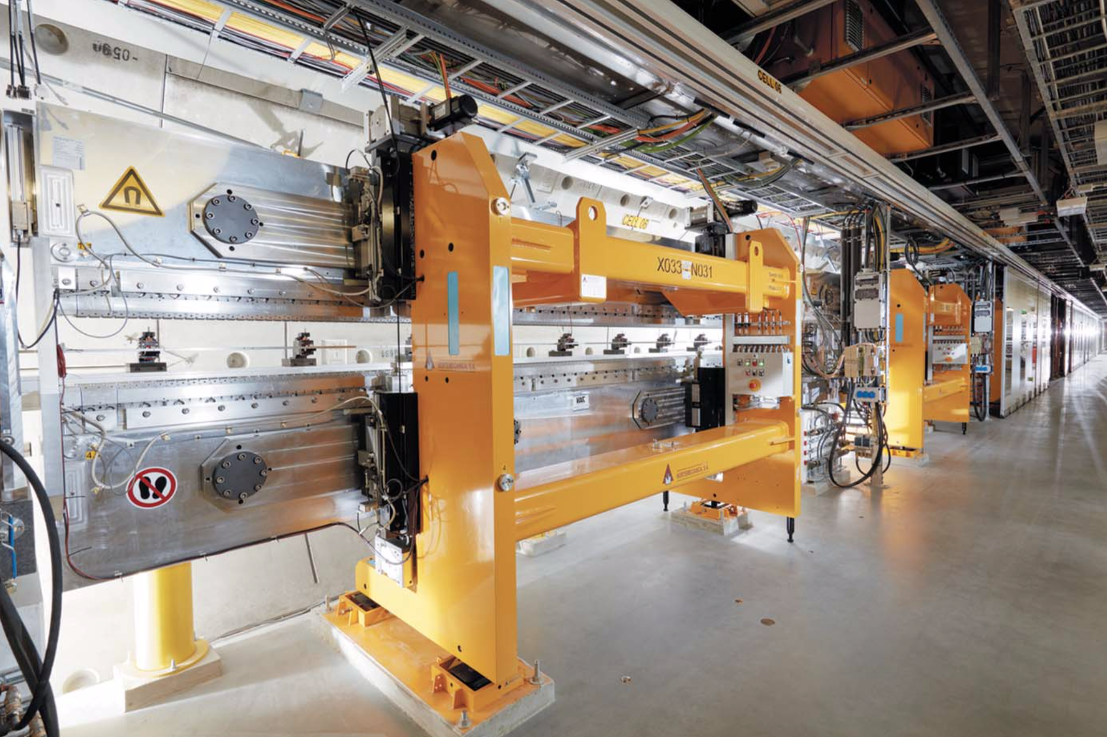
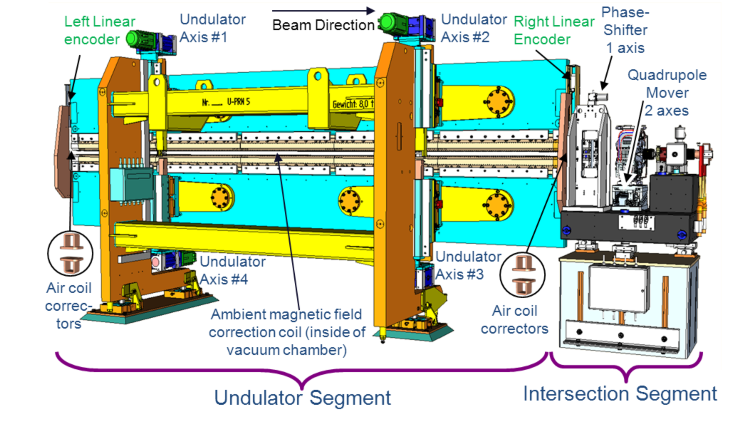
Undulator cell
An undulator cell of 5 meter length with 2 pairs of air coils at both ends. Max gap: 220 mm, minimum gap: 10.5 mm.
SA2: 37 cells installed -> 27 * 6.1 m = 225.7 m (incl. chicanes).
SASE2 undulator cells
Intersection (1.1 m) with phase shifter, quadrupole magnet on mover (2 axes) and beam position monitor.
The phase shifters are build with permanent magnets and variable gaps.

Slide 3
Start of the alignment: Electron beam based alignment
Methode
Electron Beam Based Alignment (eBBA)
Electron beams with different energies (6, 8, 12 and 17 GeV) are sent through the undulator beamline one after another.
Trajectories are measured in the undulator beamlines for each beam energy.
An algorithm calculates the offsets of the quads and the BPMs and provides correction values.
Typically, we need 5-15 iterations (each with the 4 beam energies).
File Preparation and BBA in all beamlines can take between 1 and 2 shifts.
How does it work
Quadrupole currents are the same all the time -> effective kicks from the quads change.
Quads with an offsets kick the beam. Quad kicks depend on the beam energy.
BPM offsets do not depend on beam energy.
This is how we can distinguish offsets from quads and from BPMs.
At the end of the eBBA, we measure a perfectly straight line through all BPMs. The quads are not completely steering free (as often assumed) but the kicks from the quads perfectly correct the impact of ambient fields on the bunches’ trajectory.
The trajectories of the 4 different beam energies overlap perfectly. -> The end of the eBBA

Slide 4
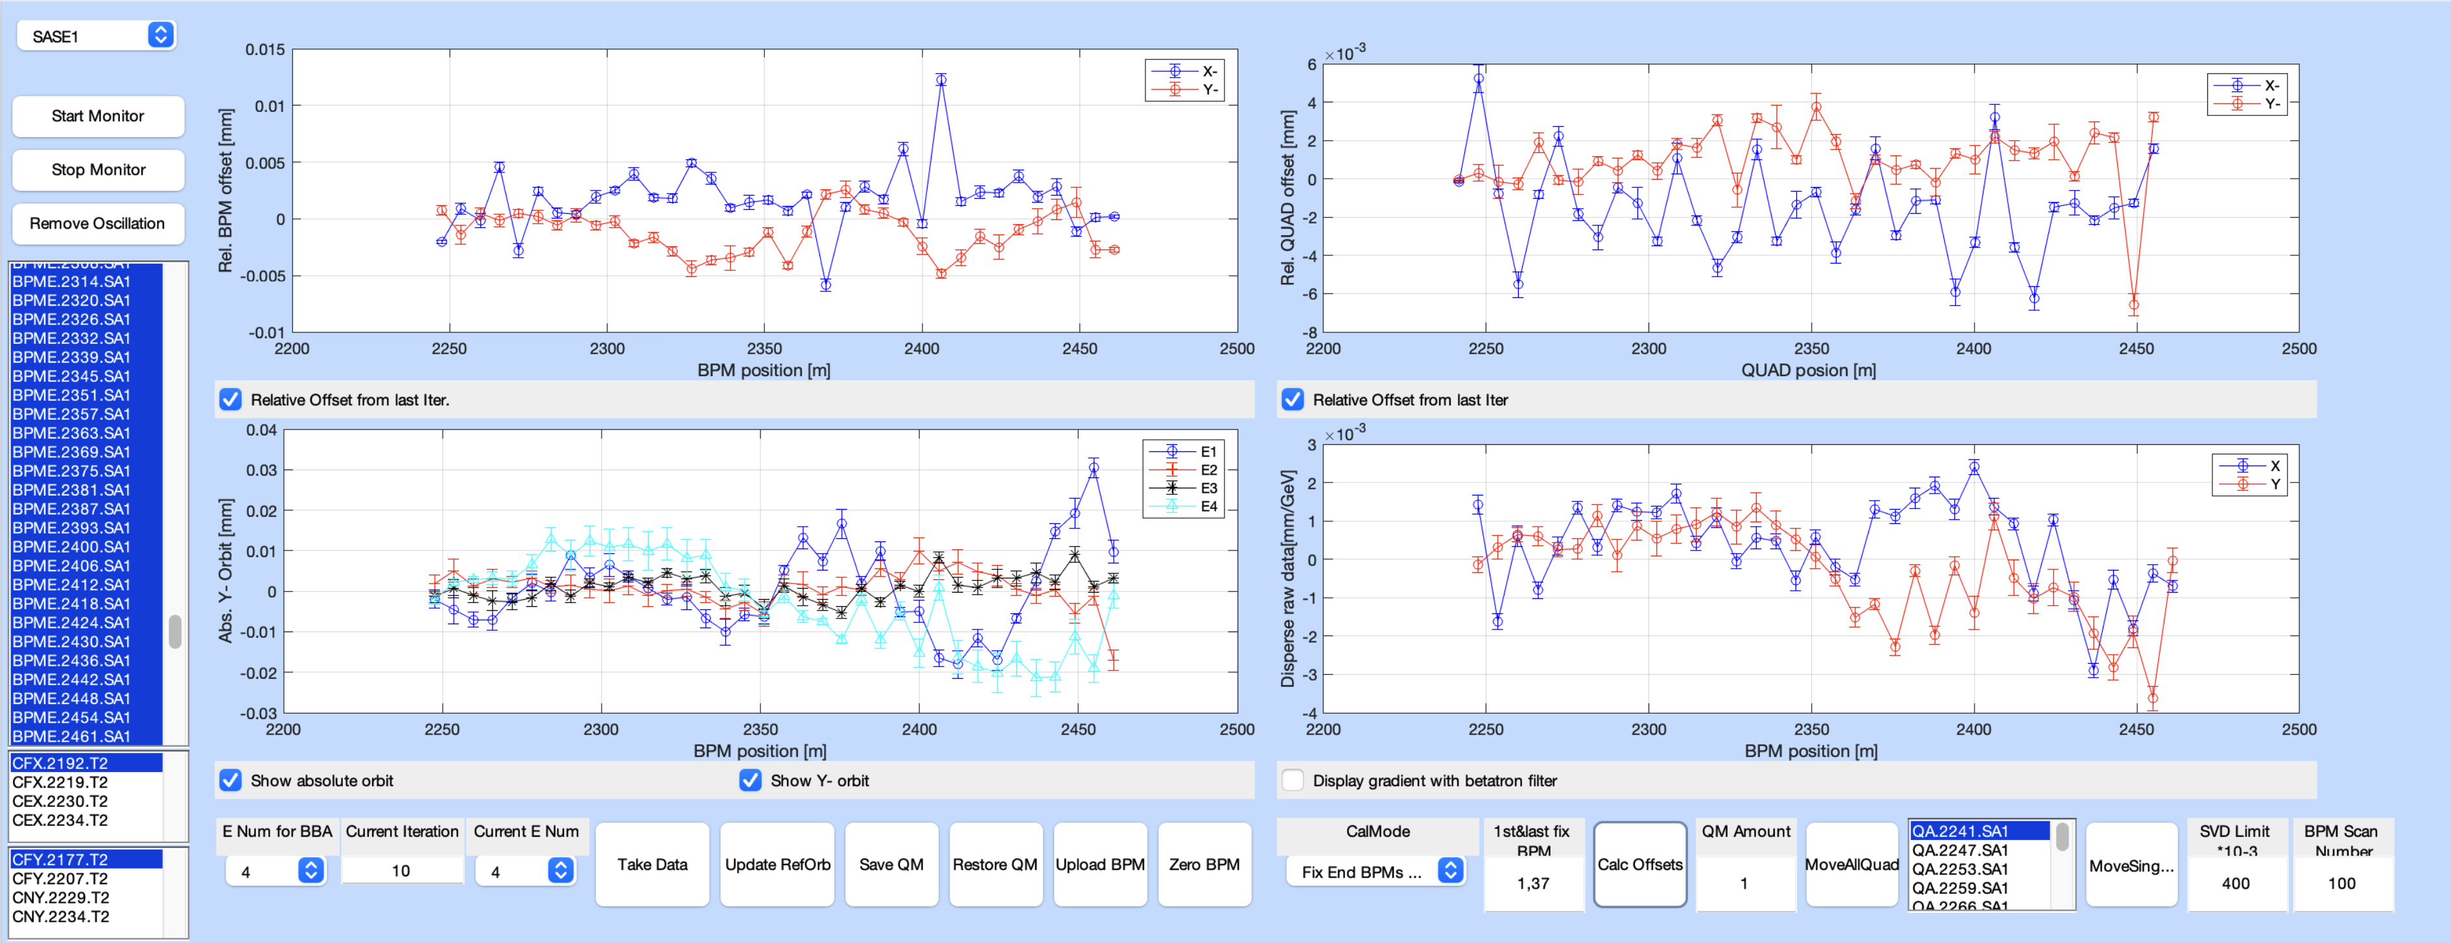
eBBA example SA1, last iteration
Calculated relative BPM offsets
Calculated relative quad offsets
It is well known, that after the eBBA, there is still work to do.
Why???
eBBA gets the quads aligned to a precision of ~10 um, but we need a better alignment, especially for high photon energies.
eBBA needs BPMs downstream a quad to calculate it’s offset. That’s an issue for quads located at the end of the undulator beamline.
Trajectories for different energies

Slide 5
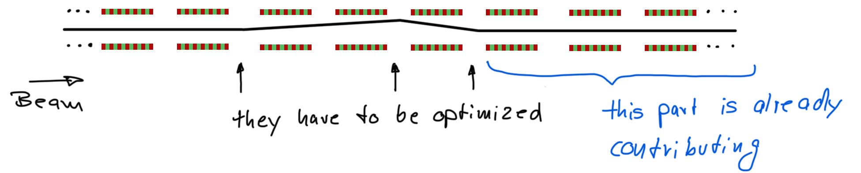
Next step: air coil alignment. How to start
Reason 1, why you should start with a minimum number of closed undulator cells
The less cells are closed, the less aircoils have to be part of your optimization.
Since the Simplex algorithm used in the optimizer is limited to ~8 actuators at the time, it makes sense to reduce the number of cells involved.
In the situation above, it can happen that you get the first problematic cell in line, but you misalign all the cells downstream -> pulse energy goes down and you will not see the improvement of the first cell. This is a very common problem.
This is not a problem, when the downstream cells are open. The minimum pulse energy should be around 100 uJ.

Slide 6
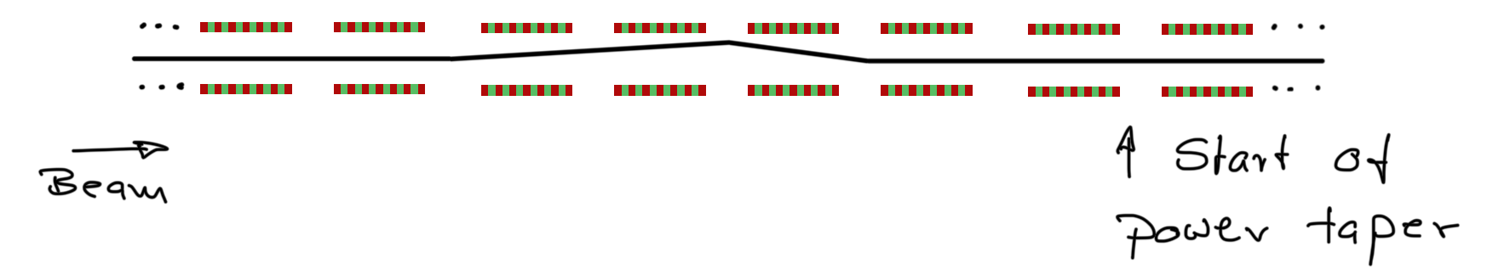
Next step: air coil alignment. How to start
Reason 2, why you should start with a minimum number of closed undulator cells
Optimizing all undulator cells is even more complicated if you have so many cells closed, that you run already with a power taper.
Let’s say the power taper starts at cell 18, which is the best setting you found with 3 cells misaligned upstream (that you don’t know about yet).
It means would you have to adjust the start of the power taper by -1 at the very moment when one of the upstream cell gets aligned. Otherwise, the taper is wrong and, in spite of the additional aligned cell, the pulse energy might drop -> you will not align the cell.
This is actually also a problem for other tuning attempts. E.g. quad optimizations upstream the undulator (should) reduce the gain length and require thus an earlier start of the power taper. If that is not adjusted accordingly, you might not find the possible improvement.
Solution: less cells at a time. And if you want/need to have so many cells closed, check every now and then whether you can reduce the start of the power taper. This gives you some headroom for further tuning steps.

Slide 7
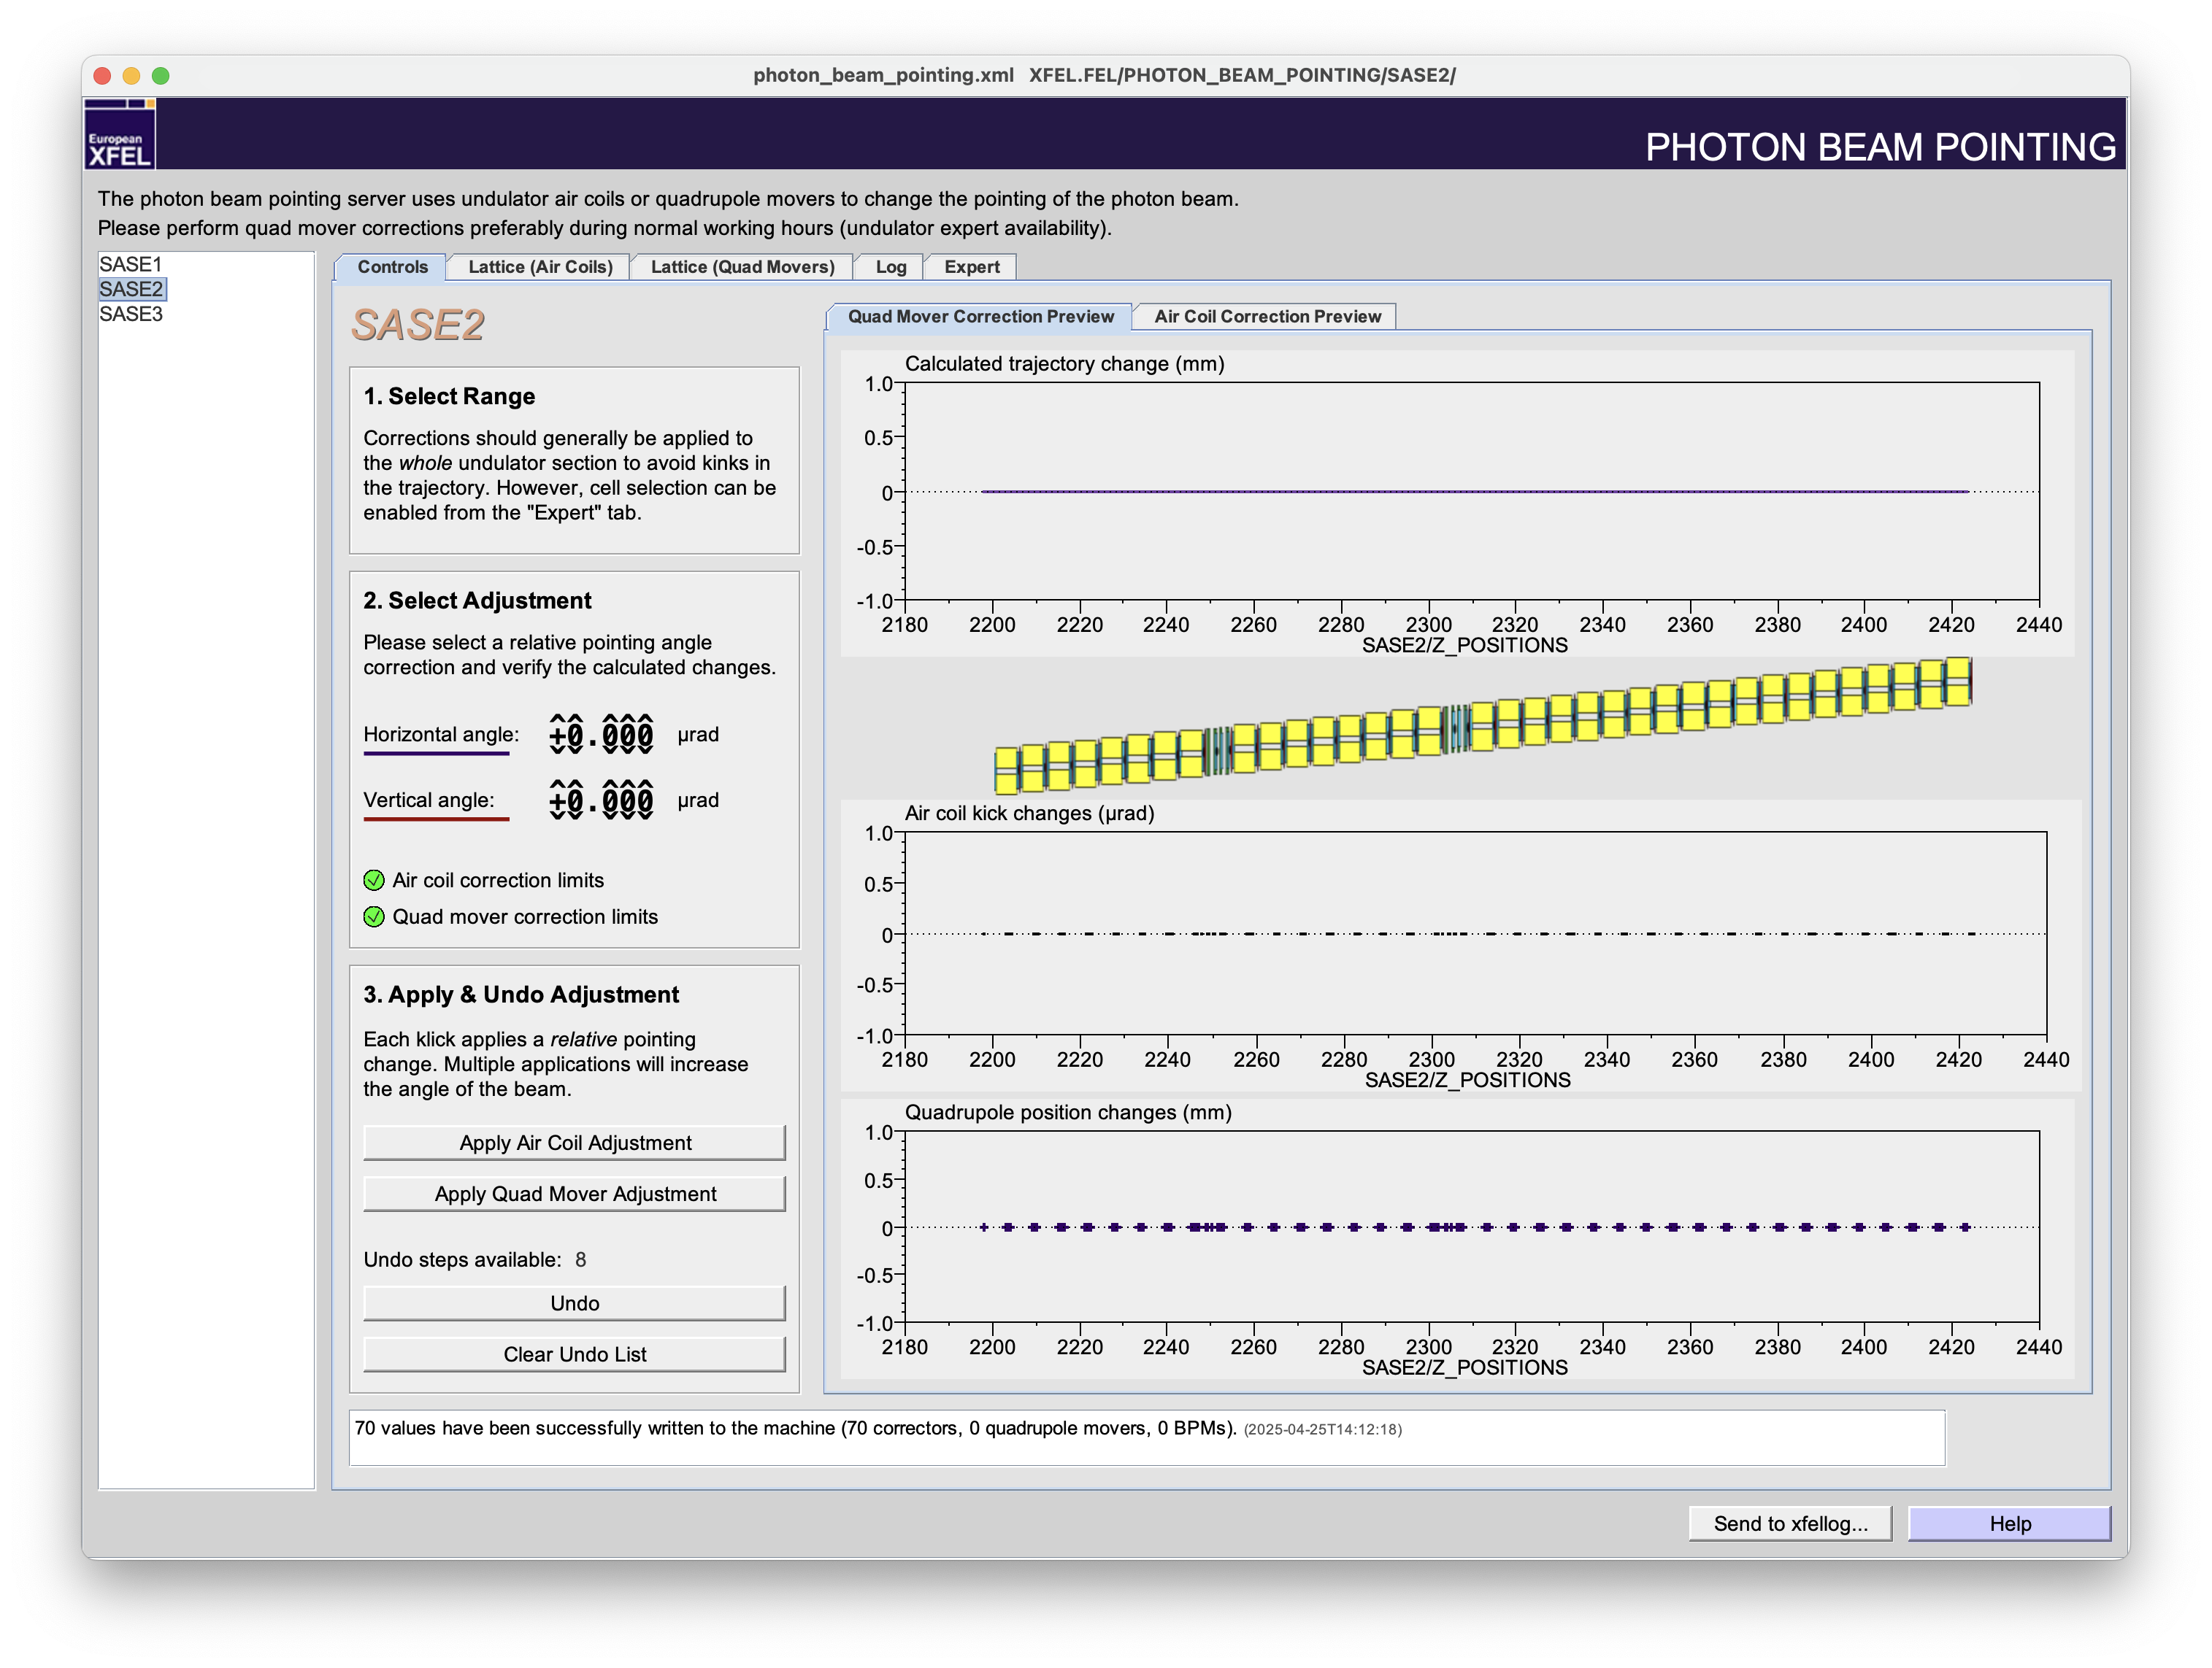
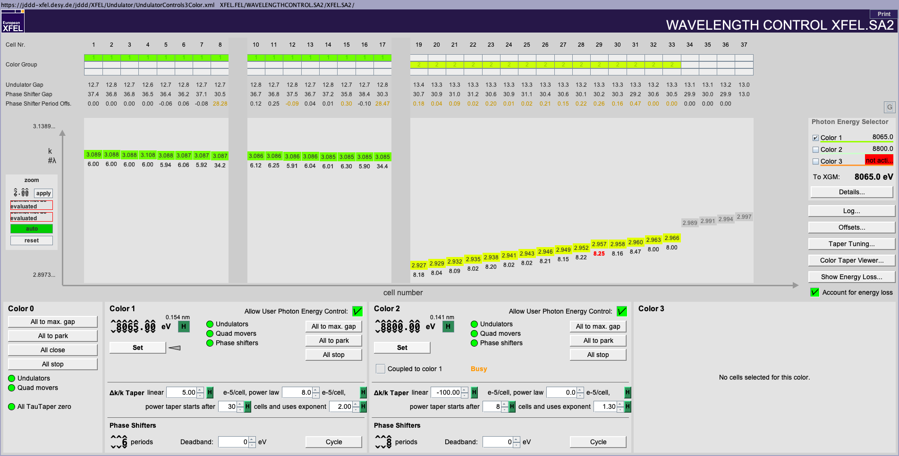
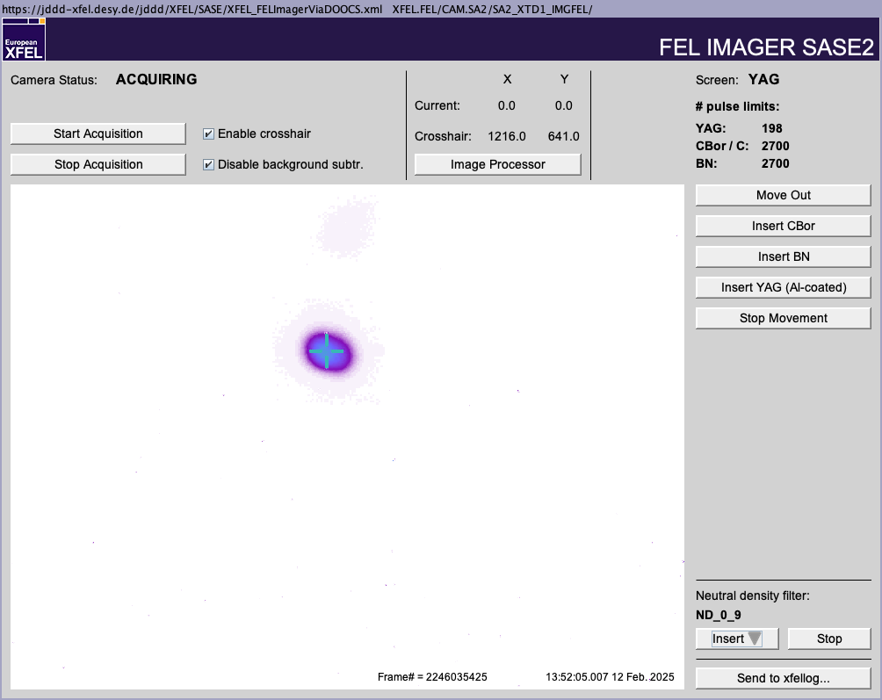
Check the beam pointing
Screenshots from February 12, 2025
Check the photon beam pointing in time, not only after the final tuning.
For pointing corrections, use the Photon Beam Pointing server shown above.
At this time, pointing corrections should be carried out with quad movers not with air coils!
Depending on the photon energy, it might be necessary to do some small air coil optimizations after a pointing correction.
It is possible to achieve the same pulse energy again as before the pointing correction!

Slide 8
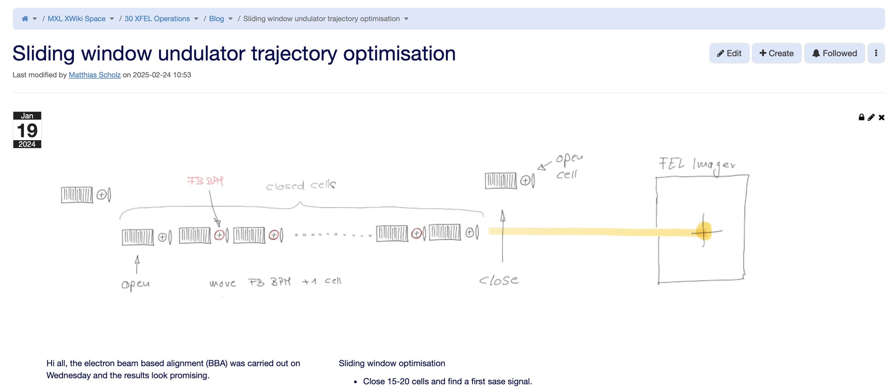
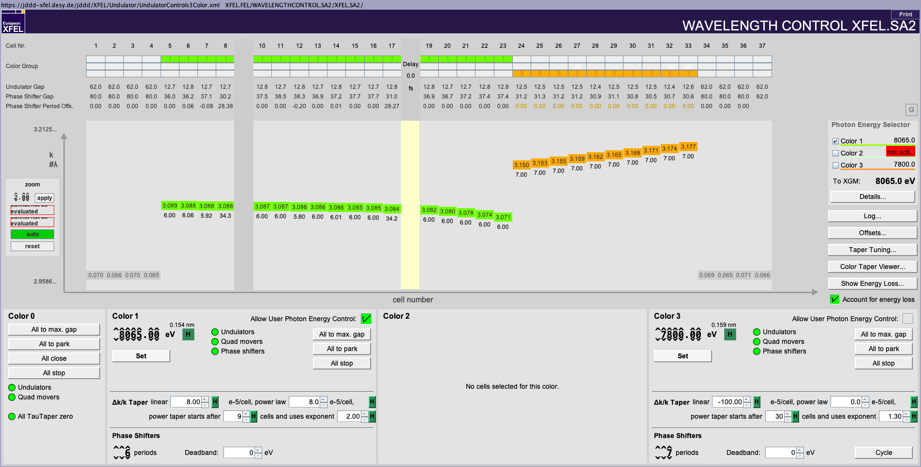
Sliding window optimization
Sliding window optimization means that cells at the beginning of the undulator are opened and others at the end are closed.
The pulse energy and pointing should be the same for all combinations of cells.
Doing this cell by cell is tedious and, in most cases, not necessary. A 3-step approach (first cells, middle cells, last cells) does the trick at most times.
This helps especially for seeding, since it can be guarantied that the last cells are well aligned.
Sliding window optimization means that cells at the beginning of the undulator are opened and others at the end are closed.
The pulse energy and pointing should be the same for all combinations of cells.
Doing this cell by cell is tedious and, in most cases, not necessary. A 3-step approach (first cells, middle cells, last cells) does the trick at most times.
This helps especially for seeding, since it can be guarantied that the last cells are well aligned.
Blog entry on SWO https://xwiki.desy.de/xwiki/short/539c6

Slide 9
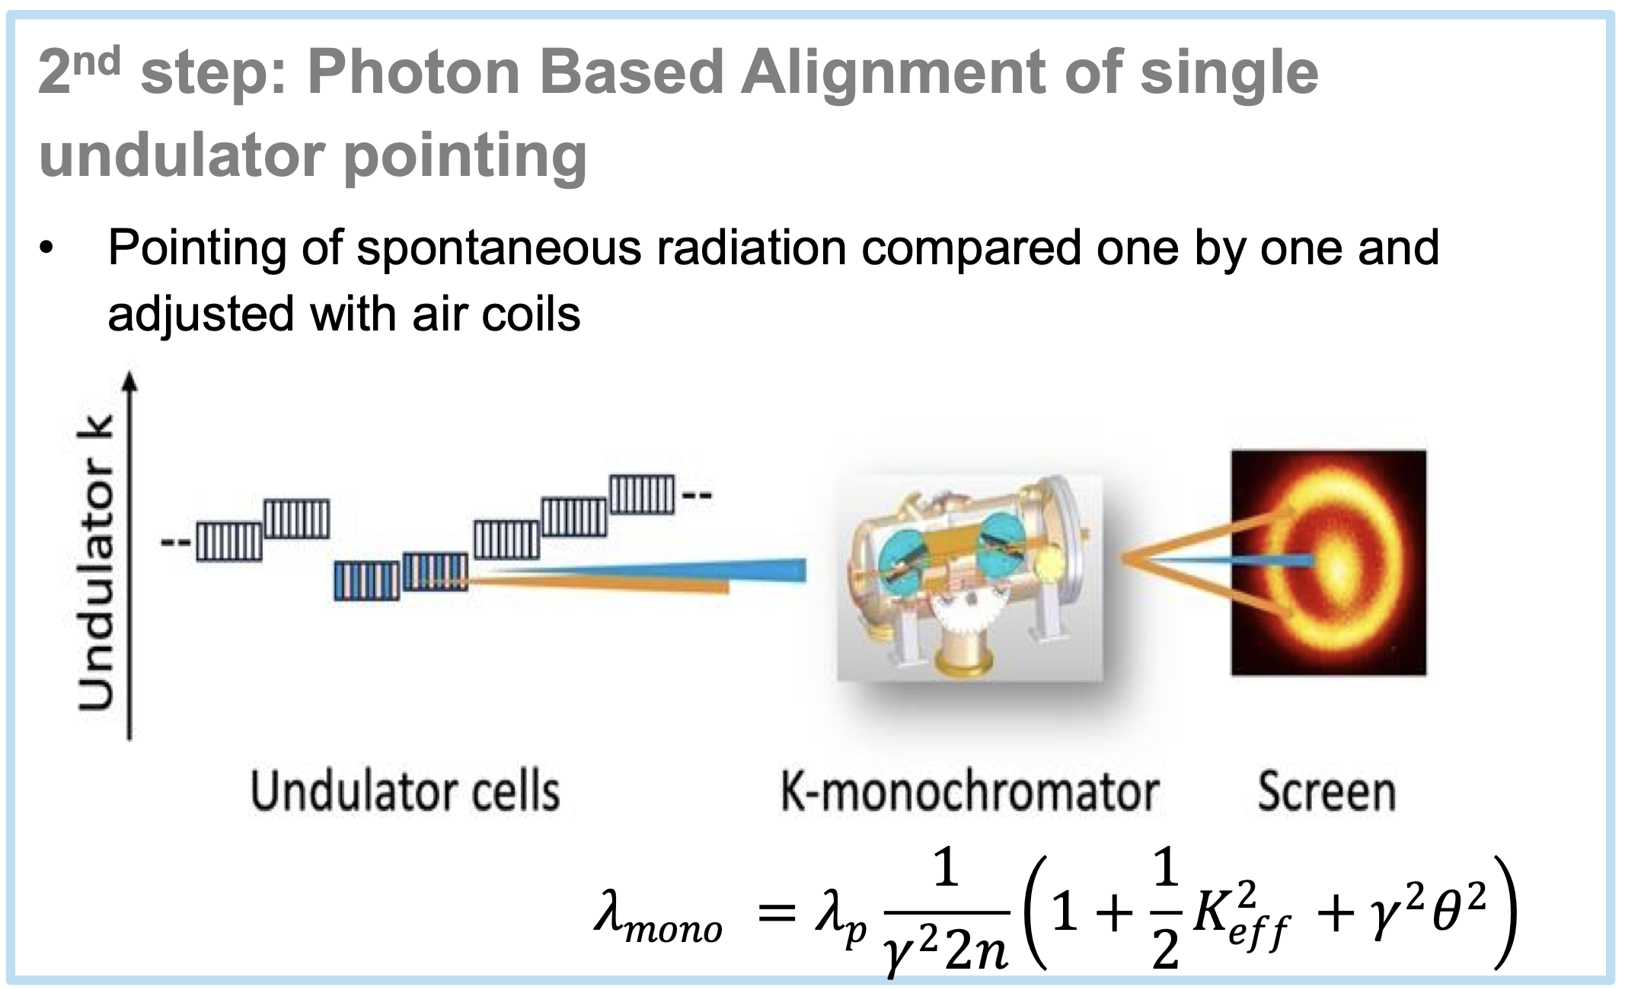
No contribution from last cells
FEL23 conference proceedings
As said on slide 4, it can be that the cells are not well aligned after eBBA -> k-mono and the pBBA the photon Beam Based Alignment can help.
First time applied for alignment in September 2023: Logbook
More info about the k-mono on XWiki (can be also found under procedures).
So far, k-mono can only be operated via Karabo and can easily be damaged, thus no manual how to start it here.
This device allows us to study the pointing of individual undulator cell one-by-one.
Typically, we check the pointing of some lasing cells and adjust the other cells to the same point.
A few more things have to be considered, but in general that works out nicely.
An alignment of the last 10-15 cells of SA1 or SA2 takes about 1 h including all preparations.
Automation will follow.
The result is good enough to find overlap/contribution but some fine tuning is still needed (air coil optimizations).

Slide 10
News
XWiki access permissions
MPS panel and magnets on spare power supplies
Phase shifter kicks
What is the best setup

