Slide 2
Deployment and Development of MicroTCA at ESS
PRESENTED BY faye chicken

Slide 3
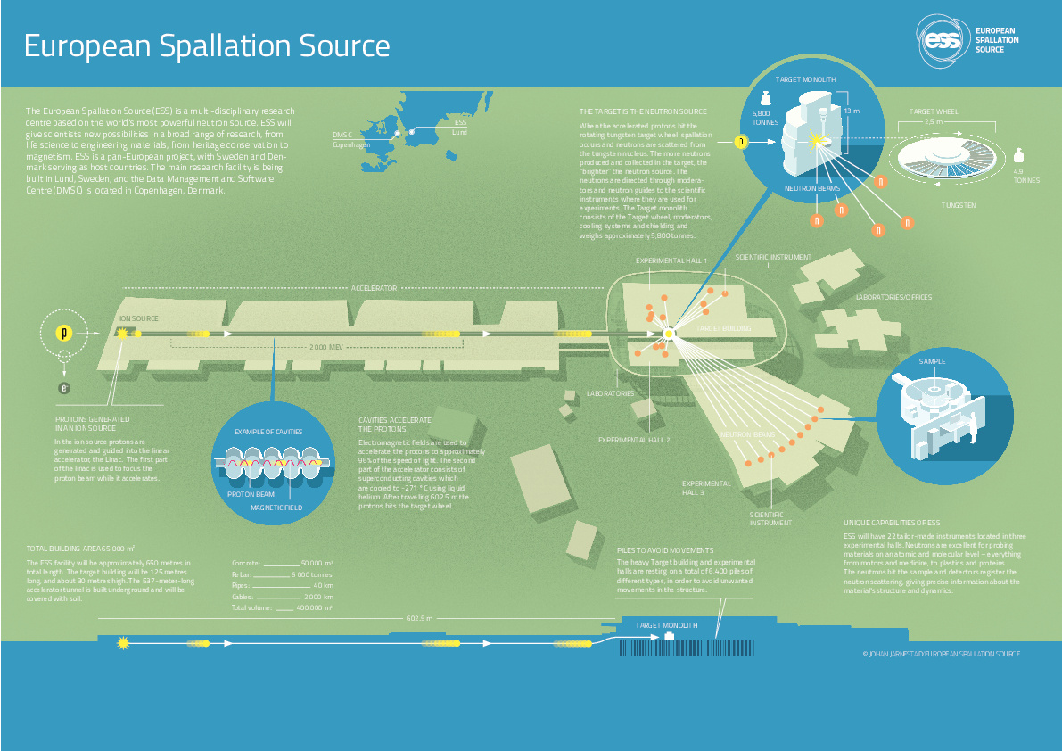

Slide 4
Layer Architecture of ESS Control Systems
ESS Main Control Room
Experiment workstations
other human interfaces
Equipment
GUIs
Alarms
Data on
Demand
NICOS
DMSC
PSS
GUIs
Config.
Tools
Techncal Network
EPICS
EPICS
IOC
EPICS
IOC
EPICS
IOC
EPICS
IOC
EPICS
IOC
Archiver
Alarm
Server
Event
Generator
Timing System
Fast Beam
Interlock System
Machine Protection
Personnel Safety Systems
PLC
PLC
Ether
CAT
MicroTCA
System
MicroTCA
System
PSS
PLC
Fieldbus
Remote
I/O
Controller
Device
Electronics
Device
Electronics
Controller
Remote
I/O
Remote
I/O
Device signals
Pump
Flowmeter
Motor
Sensor
Chopper
Power Supply
Switch
Sensor
Sensor
H₂O Flow
He Flow
Mech. Movement
RF
Proton
Neutron
etc.
Temp
Electricity
Magnetic

Slide 5
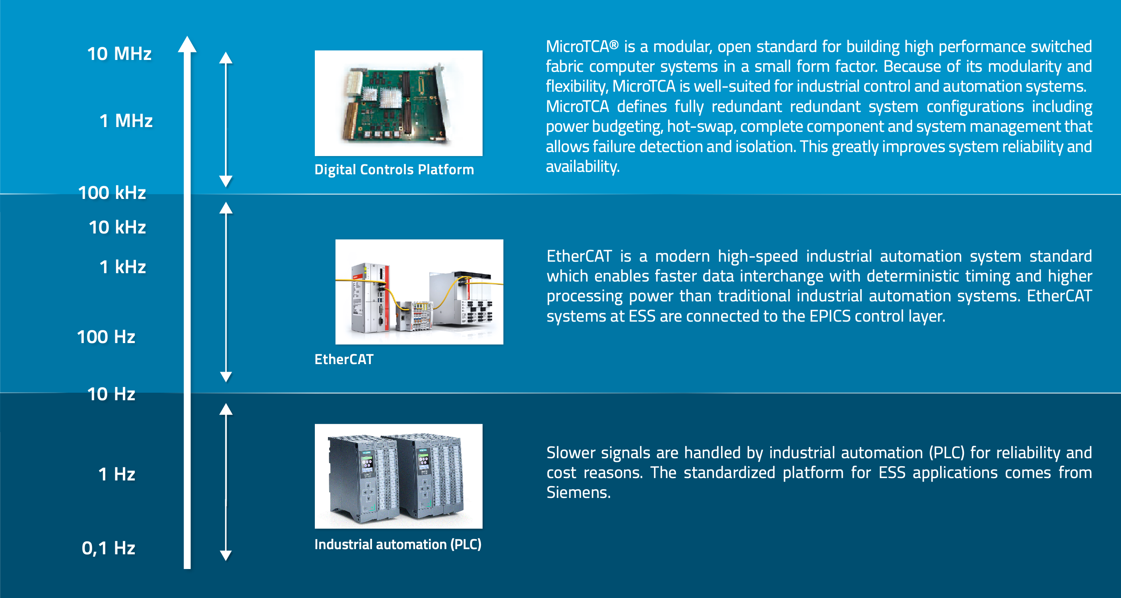
Control Systems deployed at ESS

Slide 6
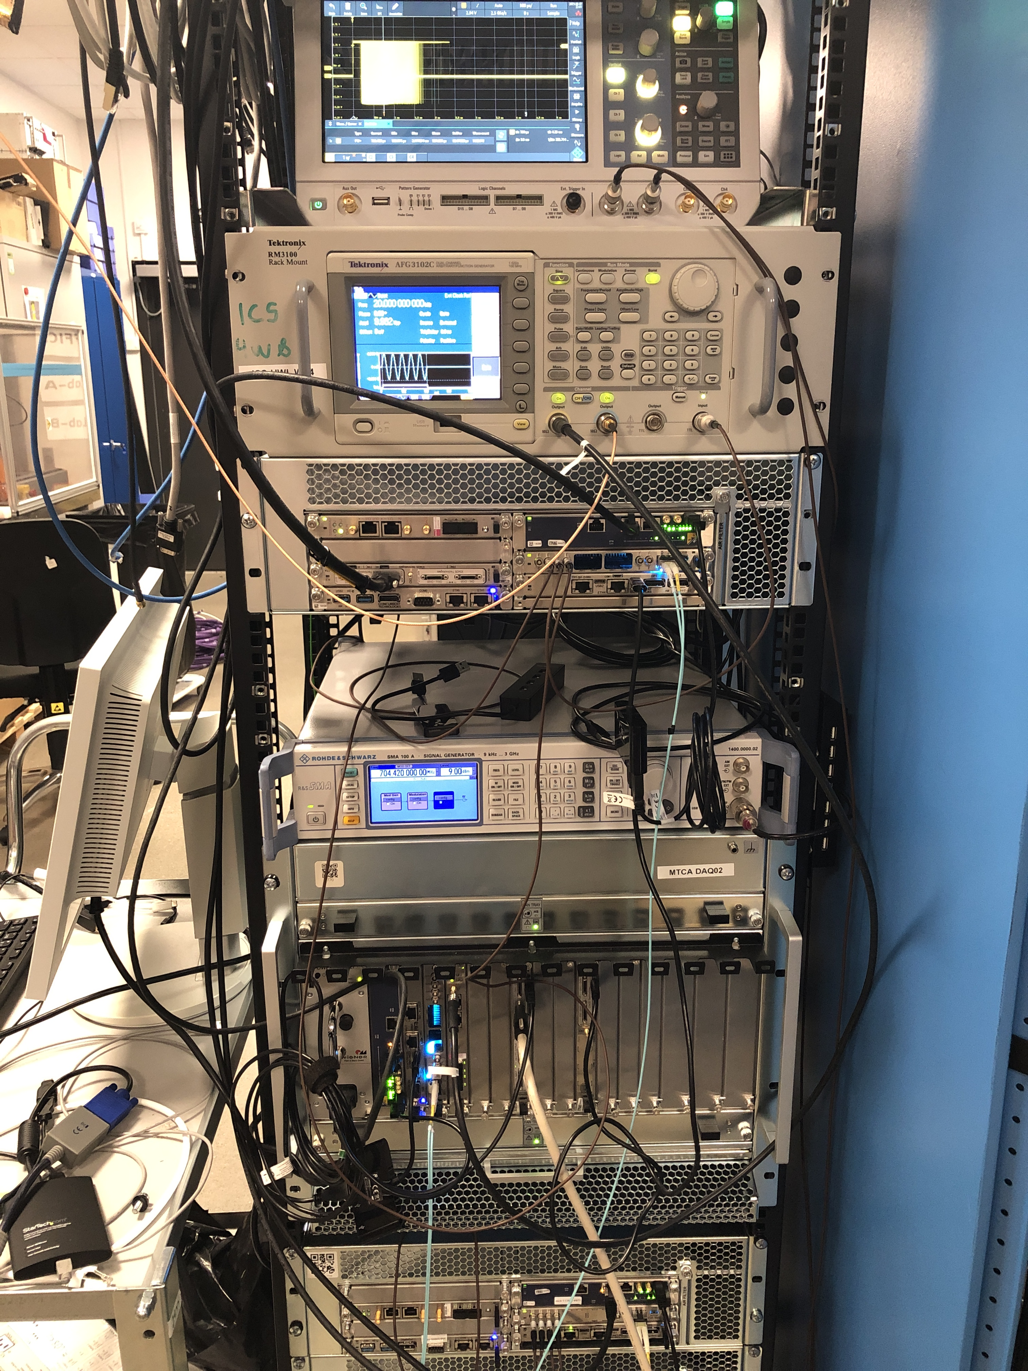
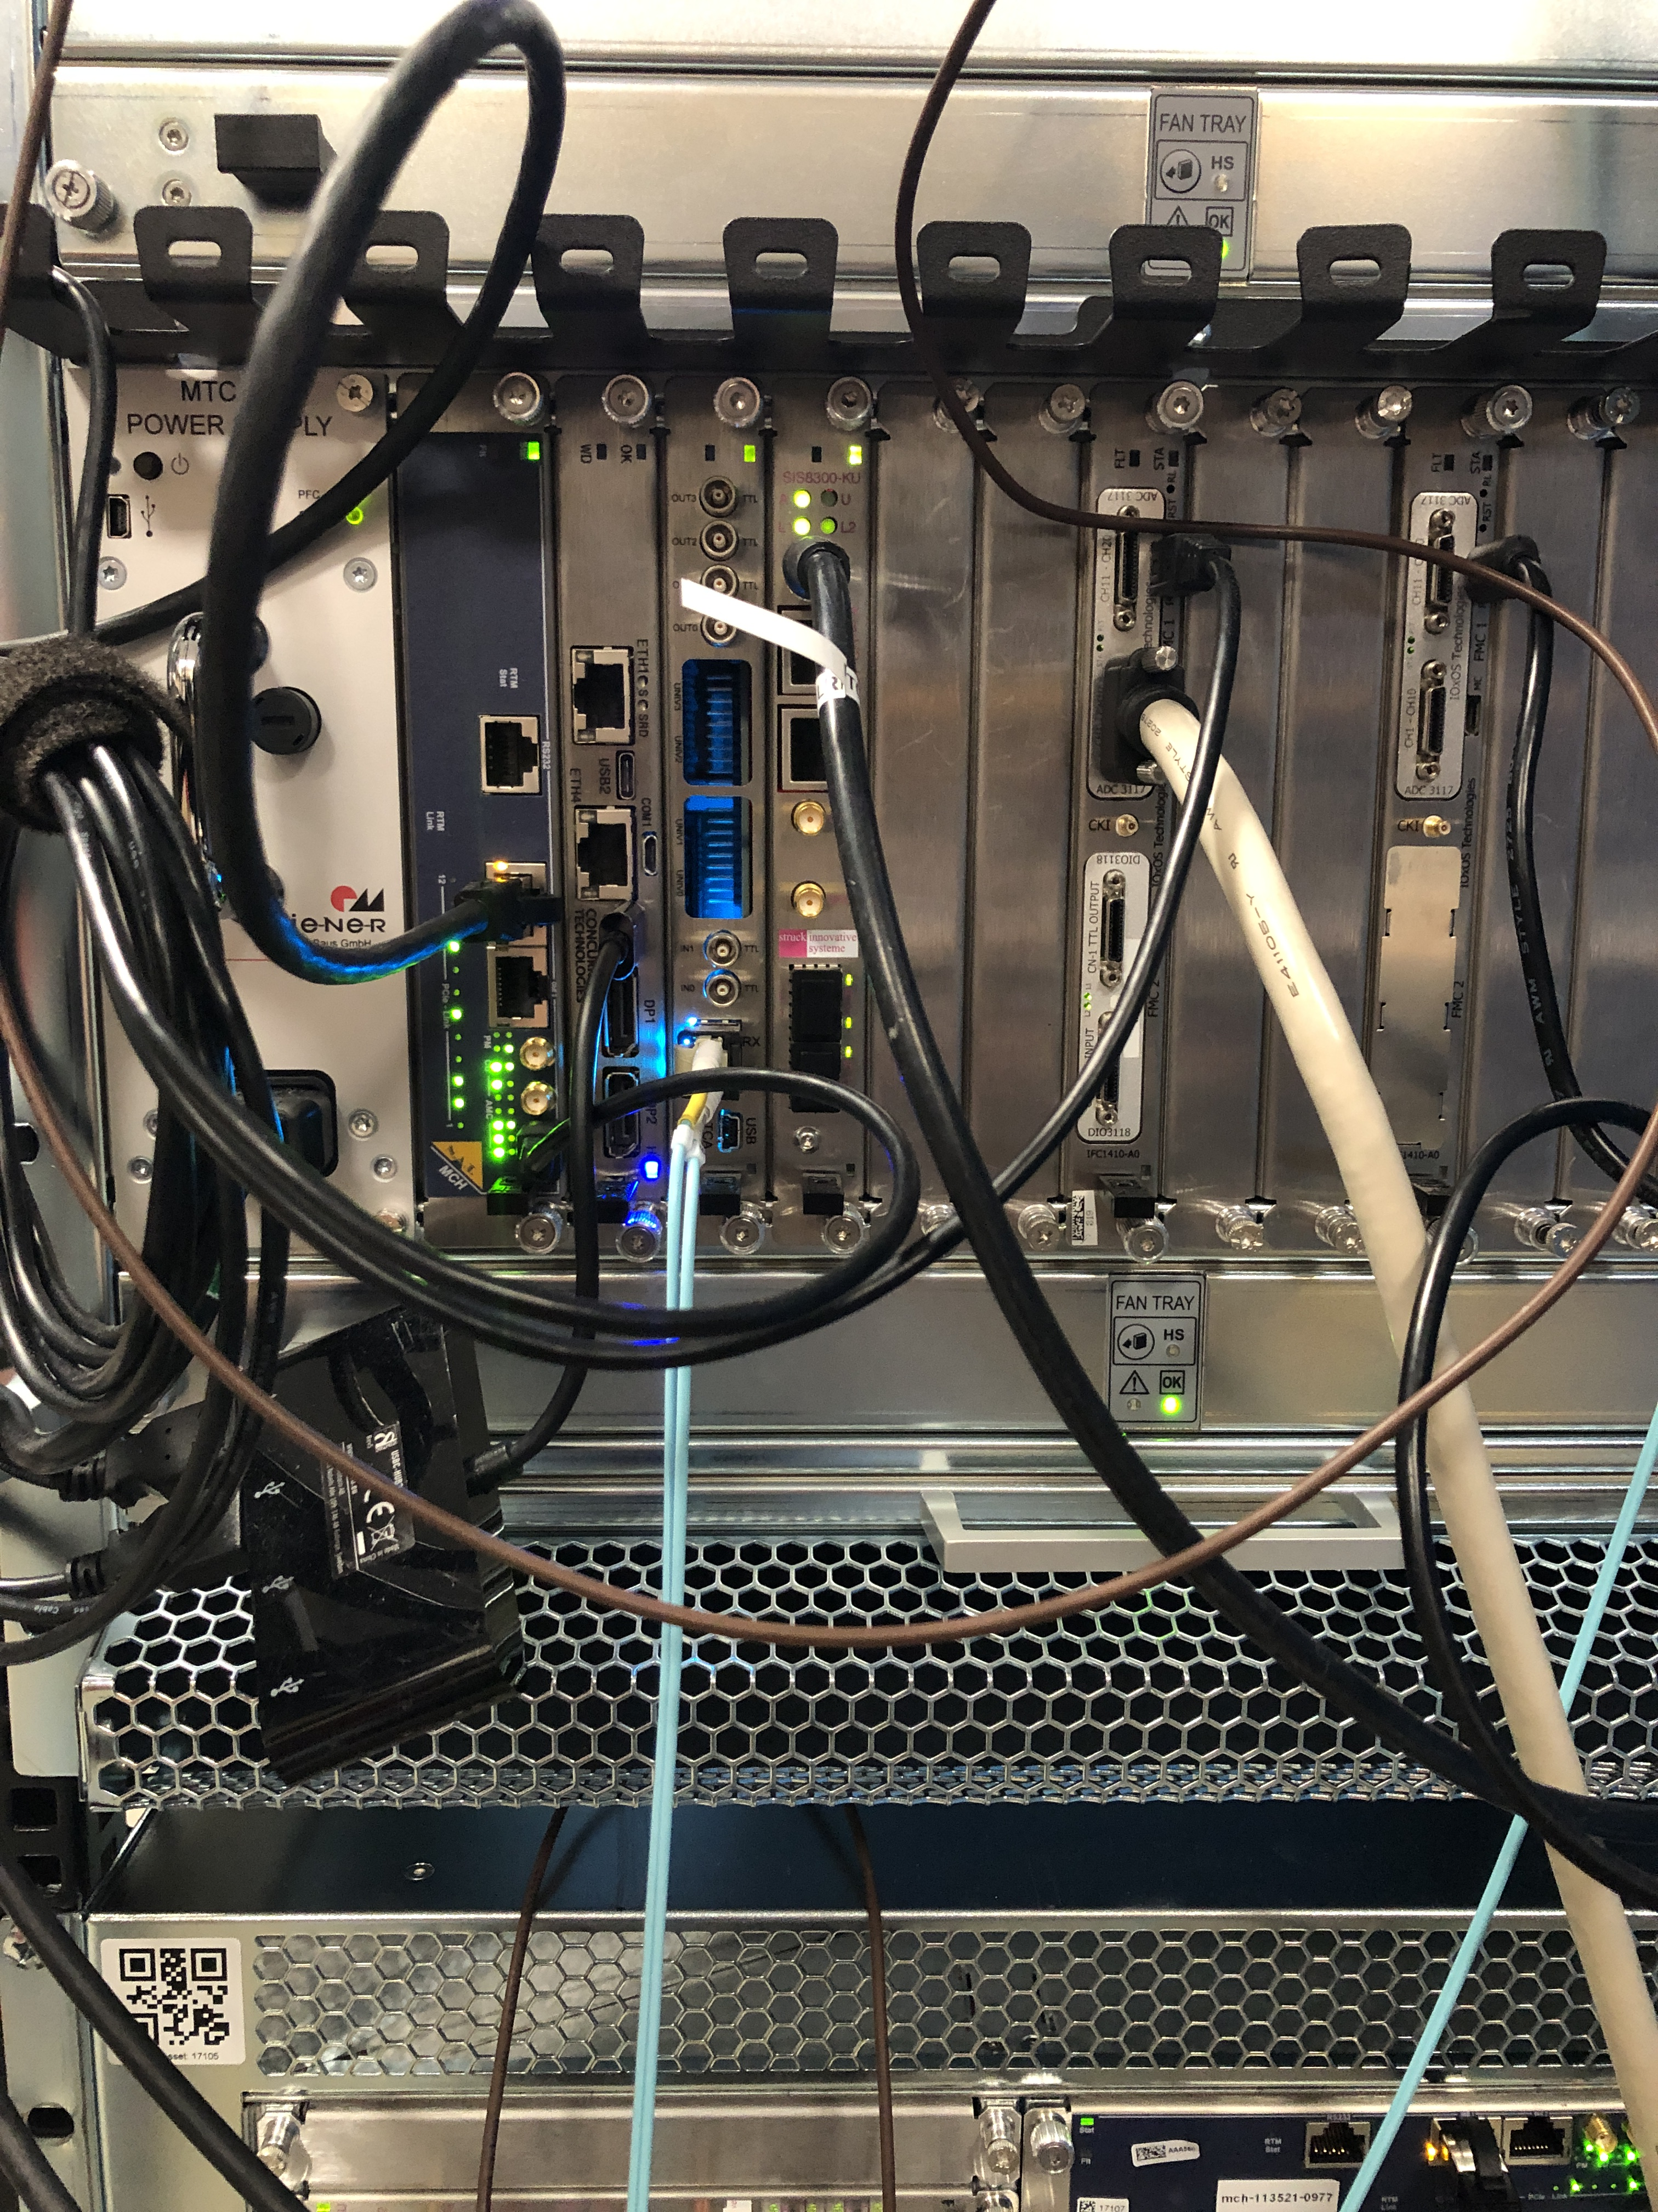
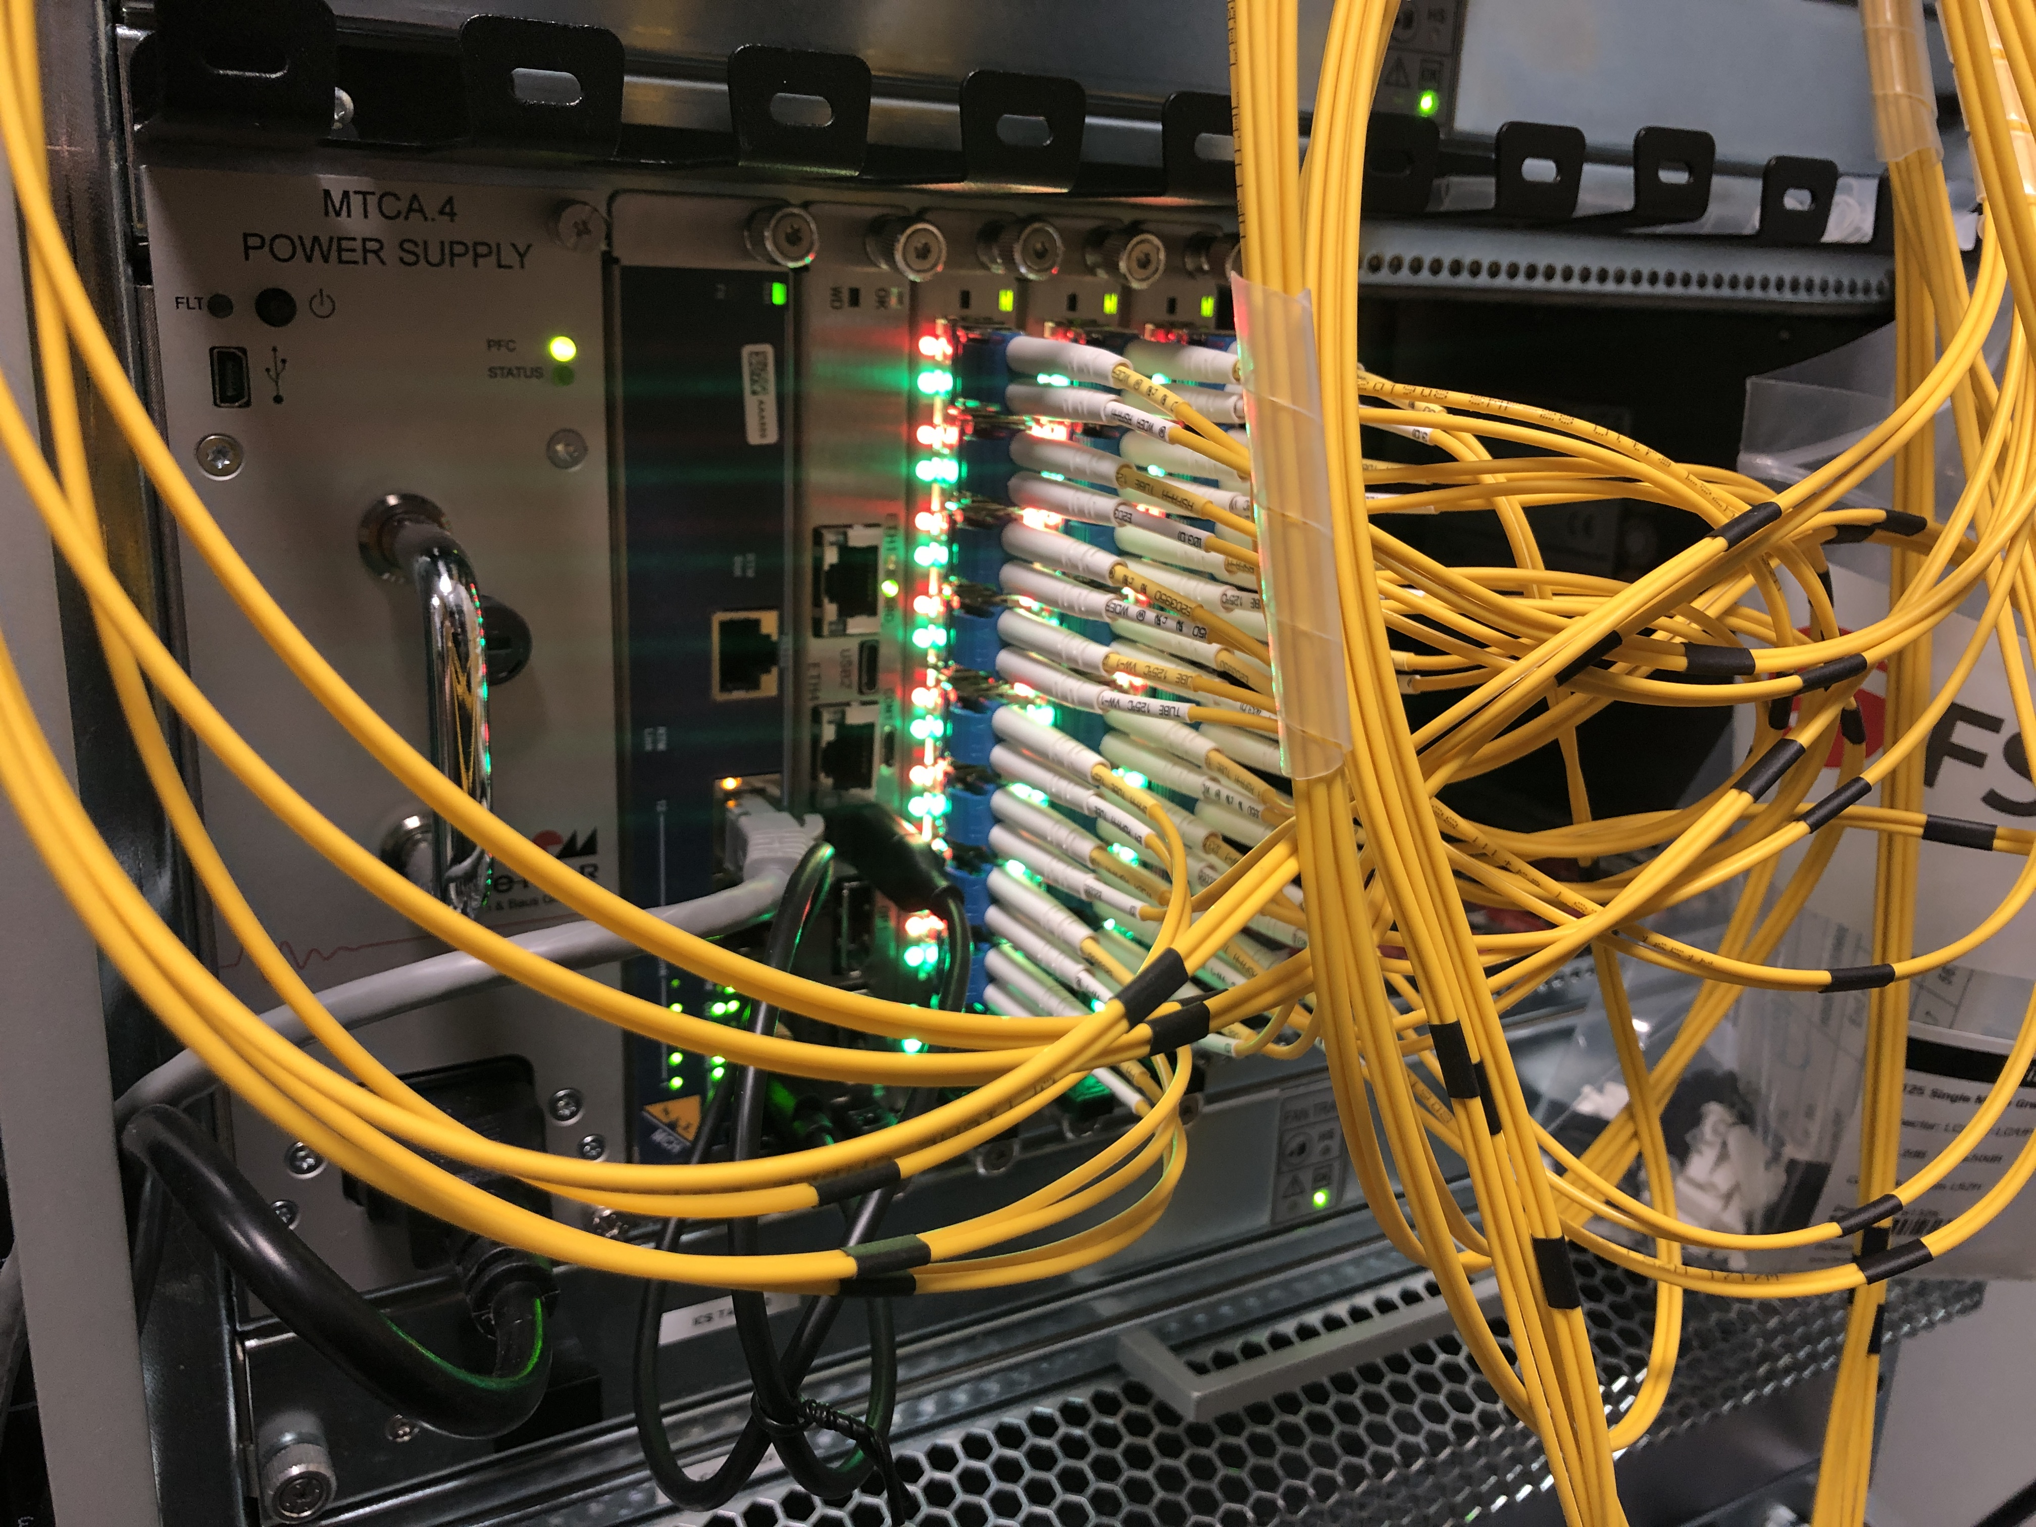
MTCA at ESS
  Have ≅250 MTCA systems in production
  Supporting Timing Distribution, LLRF, Beam Instrumentation and Fast Beam Interlock for Machine Protection.
  Many systems are now mature and running for significant time without issue
  >70% migrated to ESS Linux OS

Slide 7
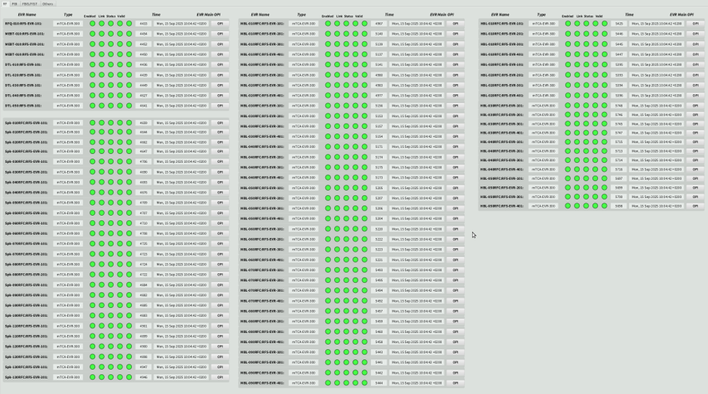

Slide 8
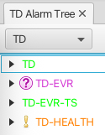
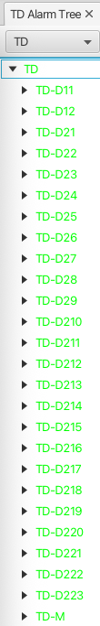


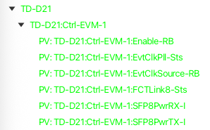
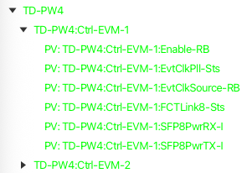
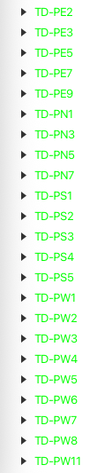
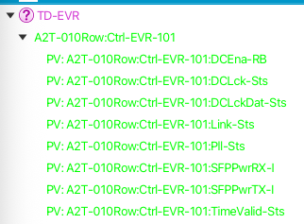
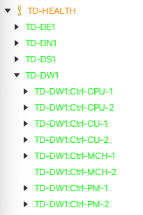
Alarm Service

Slide 9
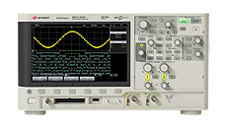
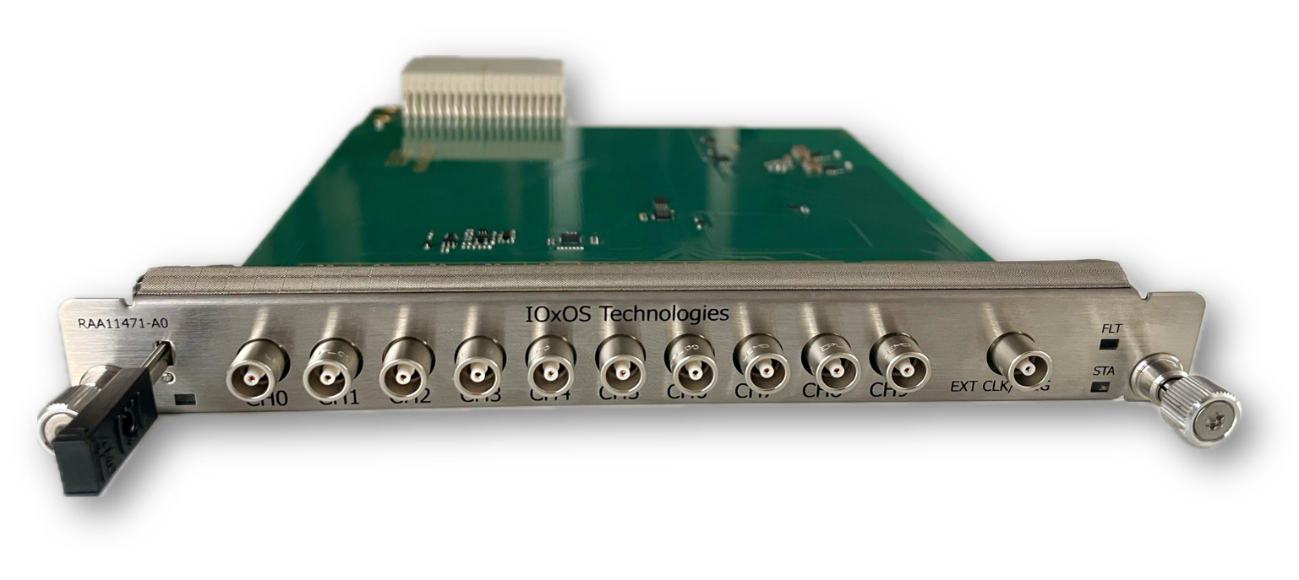
Replacement of Arc Detector Controls
Migration to MTCA based system to use hw from IOxOS
  IFC_1420 (modified for DC)
  RAA_1471 RTM
Analog readout of the arc detectors on the RF distribution chain.
Whenever there is an arc inside cavities, they want to be able to correlate with LLRF data. Need the classic “scope” application to properly acquire these signals. Currently one oscilloscope in each RF station to digitize the signals and integrate to EPICS

Slide 10
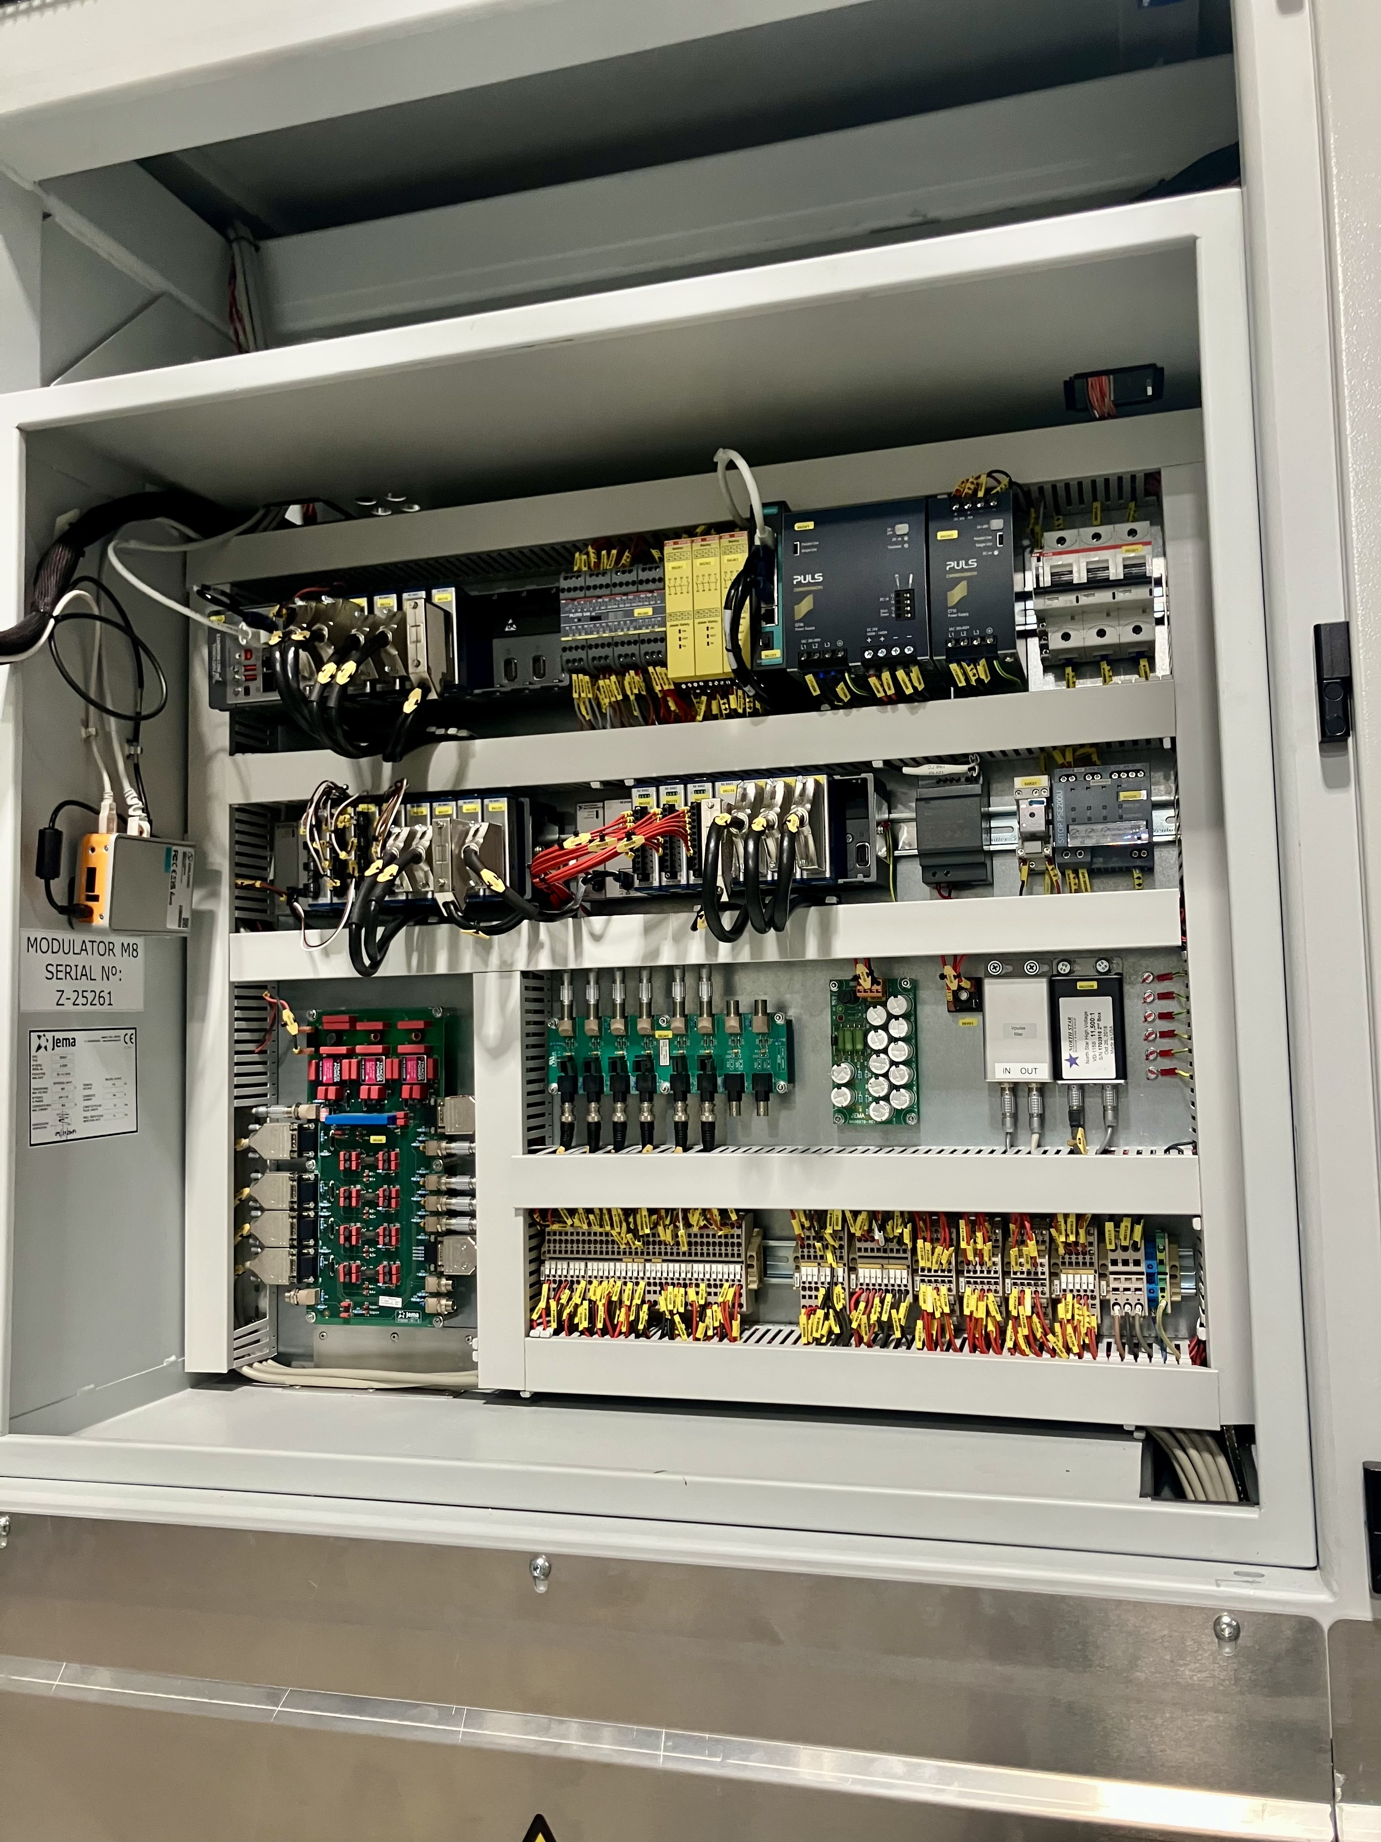
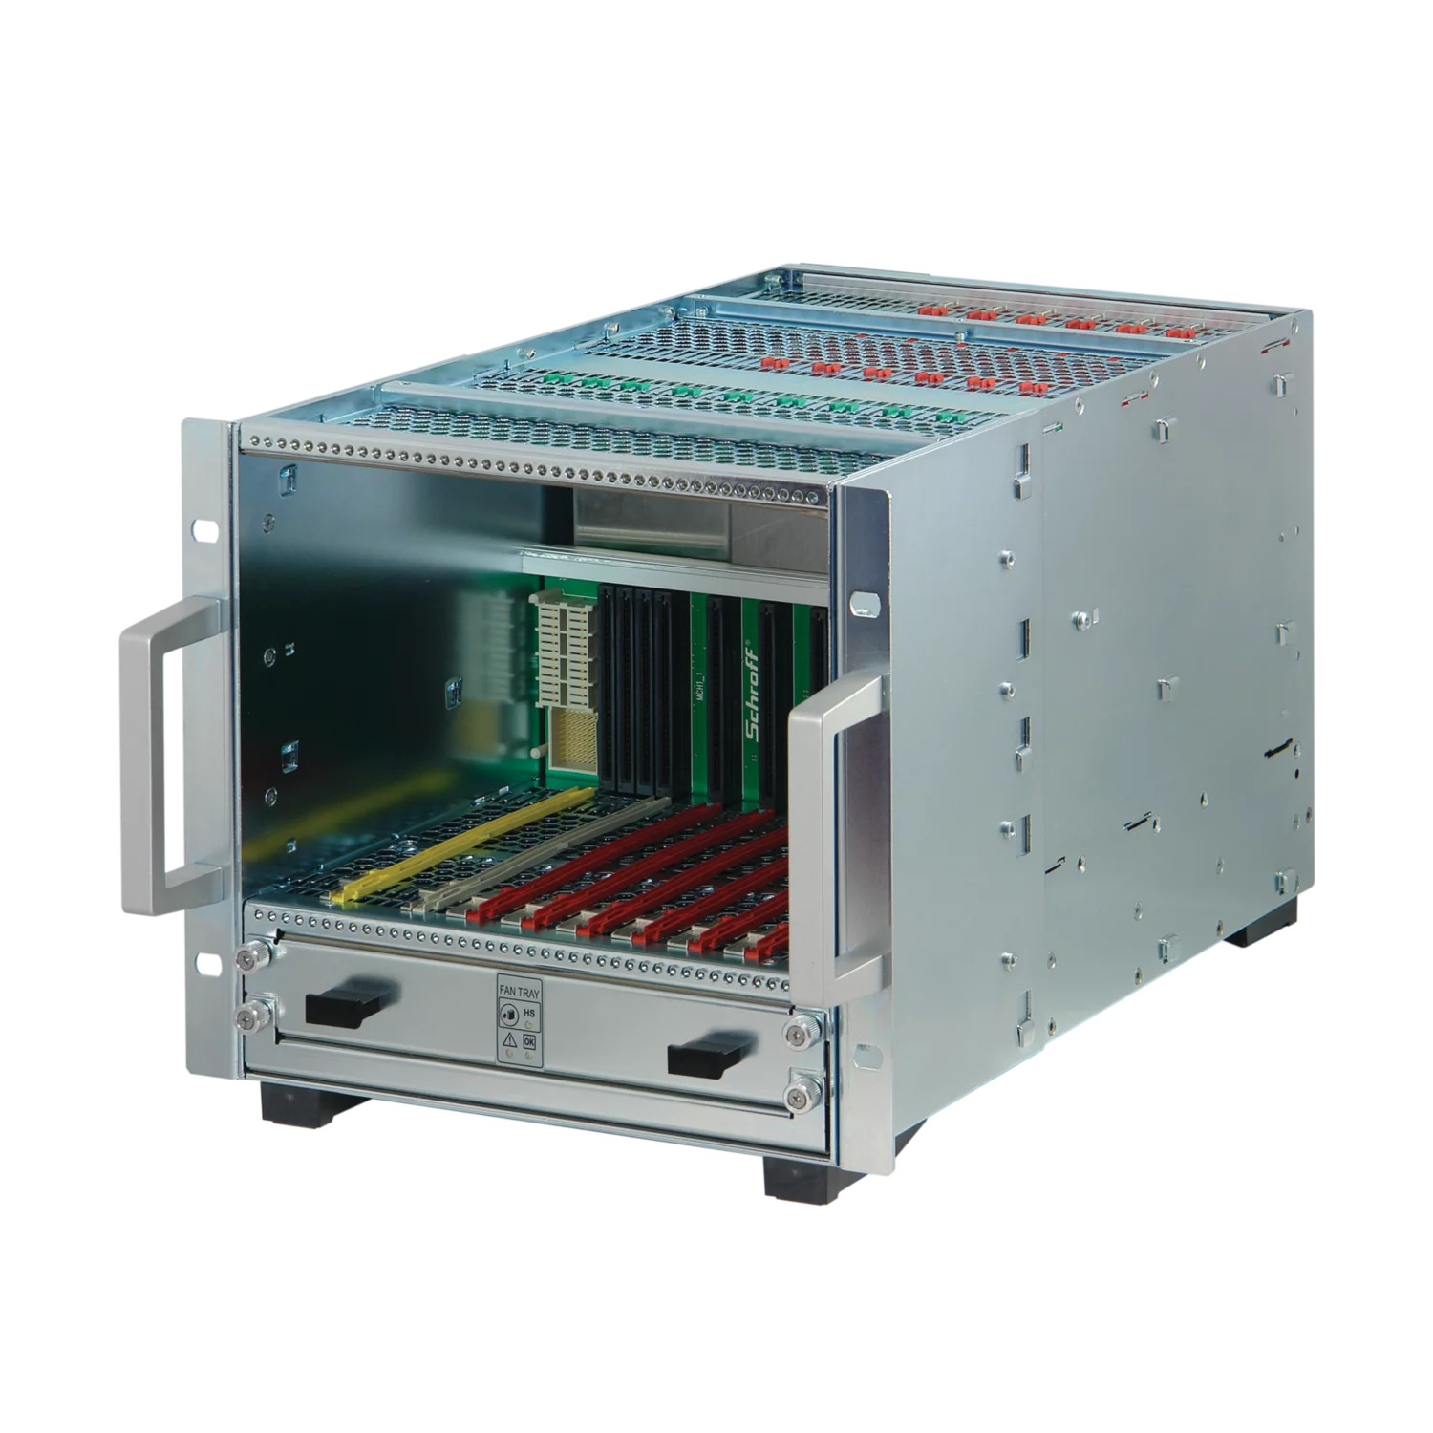
Replacement of Modulator Controls System
Currently running on NI CompactRIO HW
Change to use:
  nVent 5U (baby) Chassis
  NAT-PM-AC600D
  NAT-MCH-PHYS80
  IOxOS IFC_1412
    ADC_3117
    DIO_3118

Slide 11
Next Steps for 2026
BOD2 and BOT and production of first neutrons
Complete migration of MTCA systems to ESS Linux OS (Yocto)
Development of Arc-Detector system using IOxOS IFC and new RTM
Conversion of Modulator controls from CompactRIO to MTCA

Slide 12
Conclusions and lessons
Knowledge sharing is key; avoid brain drain and costly roadbumps
Collaboration is important; EPICs community has shown how impactful
Make full use of deployment tools from other groups/facilities
Good relationships with suppliers is critical; for questions/information but also product development
“If I had asked people what they wanted, they would have said faster horses.”
- Henry Ford

Slide 13
End

