Slide 1

RF Beam Noise Feedback System for the High-Luminosity LHC Crab Cavities
D.Marinov, B.Woolley,D.Valuch, G.Hagmann, CERN
14th MicroTCA Workshop for Industry and Research, Hamburg, Germany. 15.10.2025

Slide 2
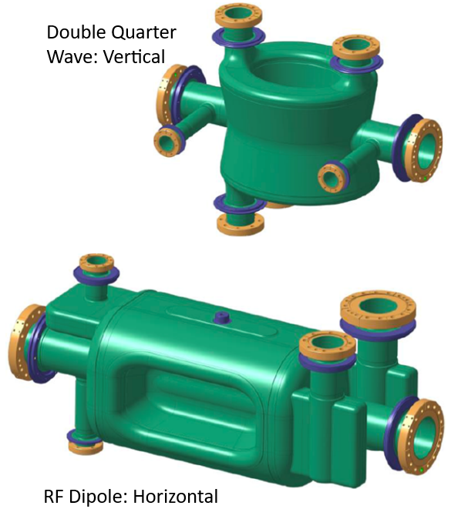
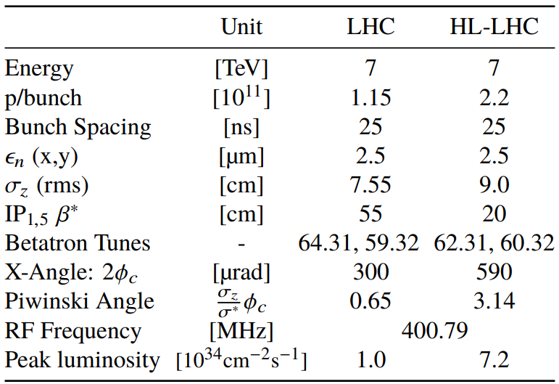
HL-LHC: Introduction
Upgrading the LHC
[1] CRAB CAVITIES FOR THE HIGH-LUMINOSITY LHC

Slide 3
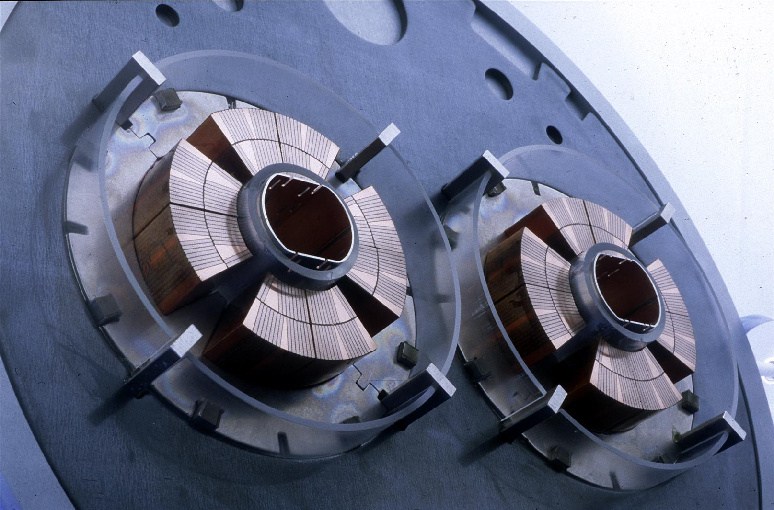
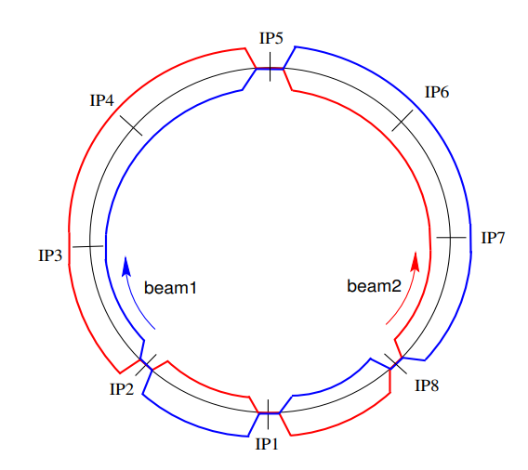
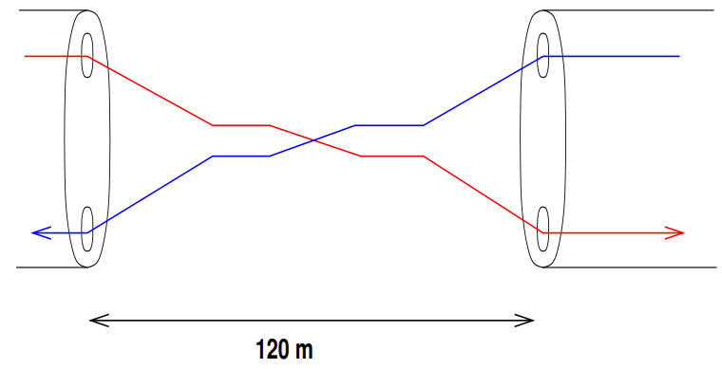
HL-LHC: Crossing Angle
LHC Beam Crossing

Slide 4
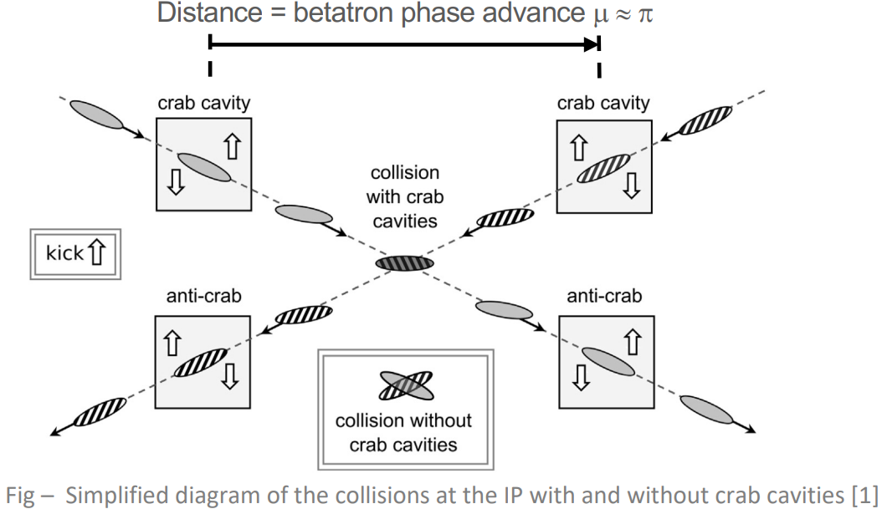
HL-LHC: Crab Cavities (1)
Pivoting the bunch to increase the collision surface
[2]Luminosity reduction caused by phase modulations at the HL-LHC crab cavities

Slide 5
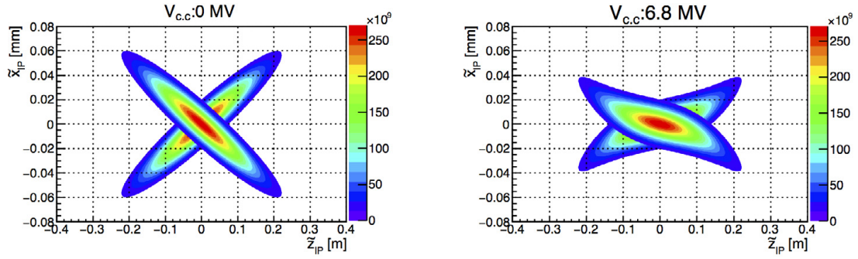
HL-LHC: Crab Cavities (2)
[2]Luminosity reduction caused by phase modulations at the HL-LHC crab cavities

Slide 6
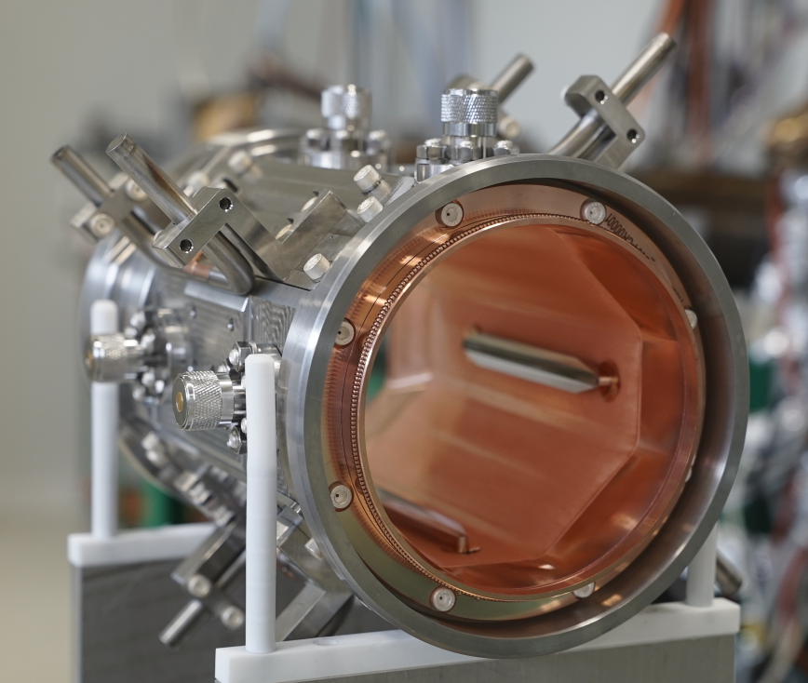
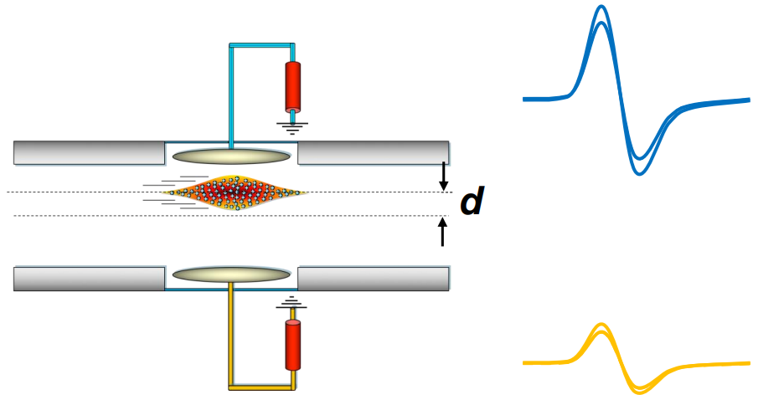
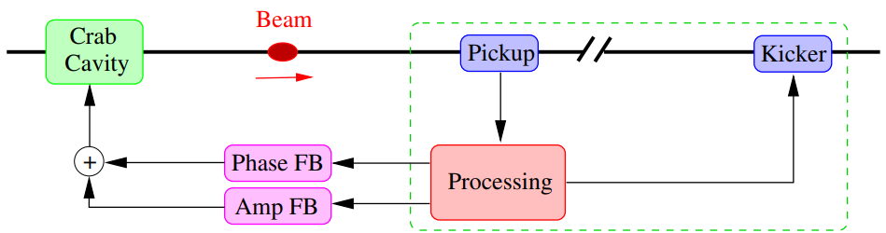

HL-LHC: RF Beam Noise Feedback System
Data Acquisition
Required ENOB
Position:14.1-bits
Tilt: 10.7-bits
RF System Noise
[3]

Slide 7
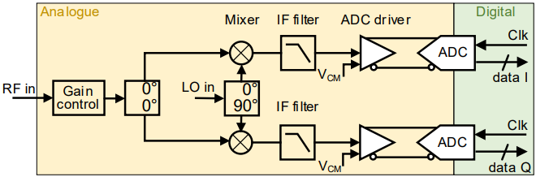
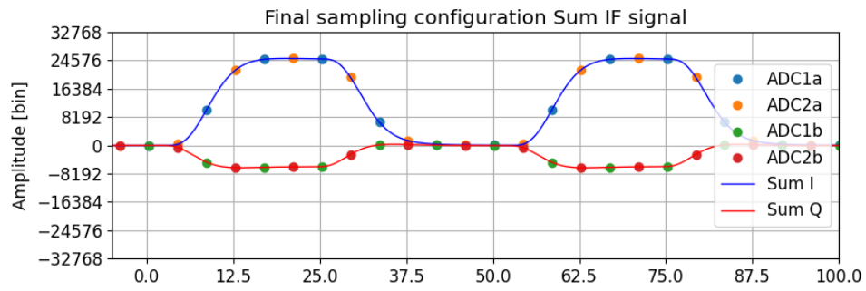
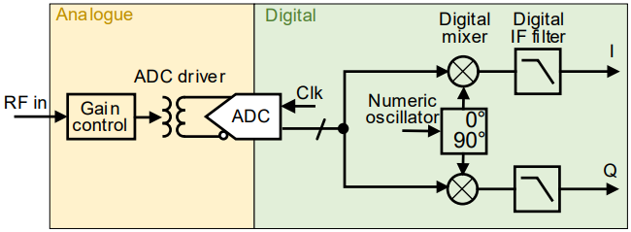
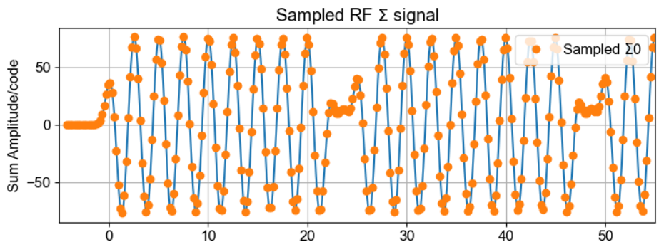
Architecture: IF vs Direct RF Sampling
Architectures
IF Design
Direct RF Design
Solutions
AMD RFSoC
TI 12DJ
[4] Performance evaluation of CC Noise feedback subsystem variants

Slide 8
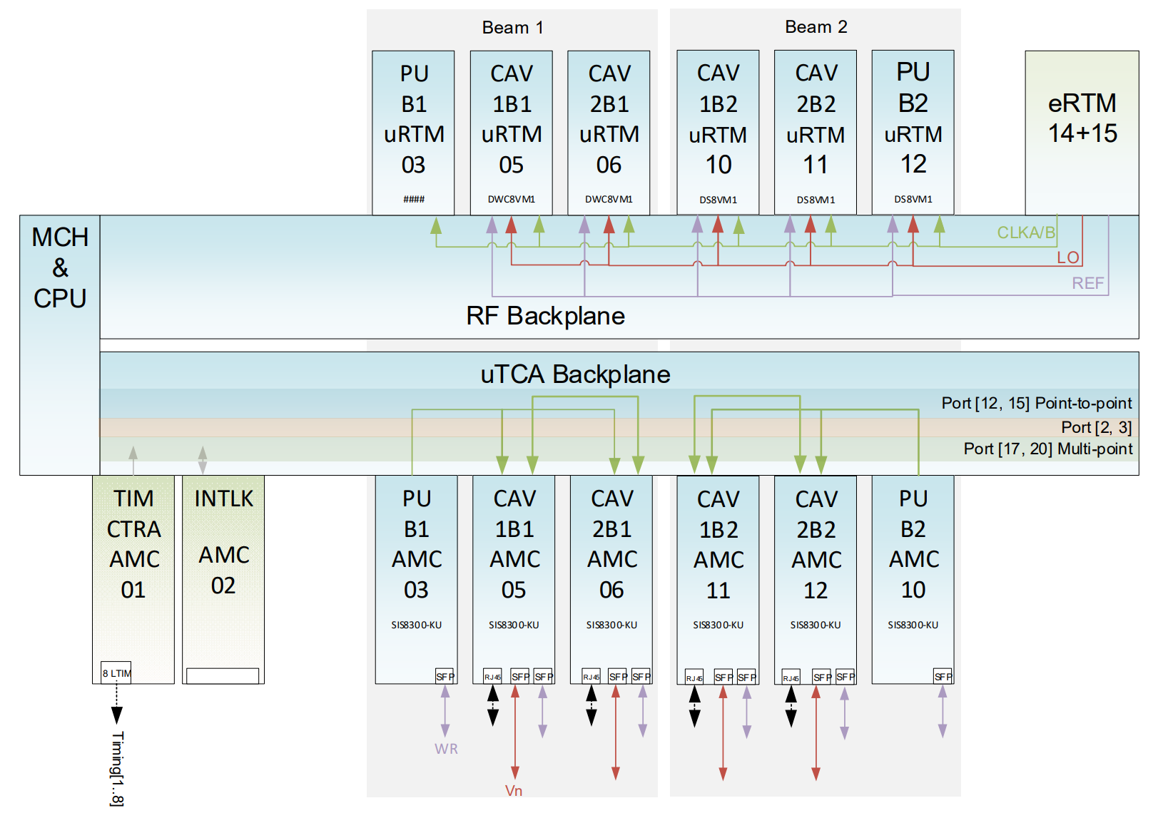

uTCA Infrastructure
2 Systems per experiment
RTM:
RF input conditioning
Clocking
System clocks
ADC clocks
White Rabbit
Over QSFP

Slide 9
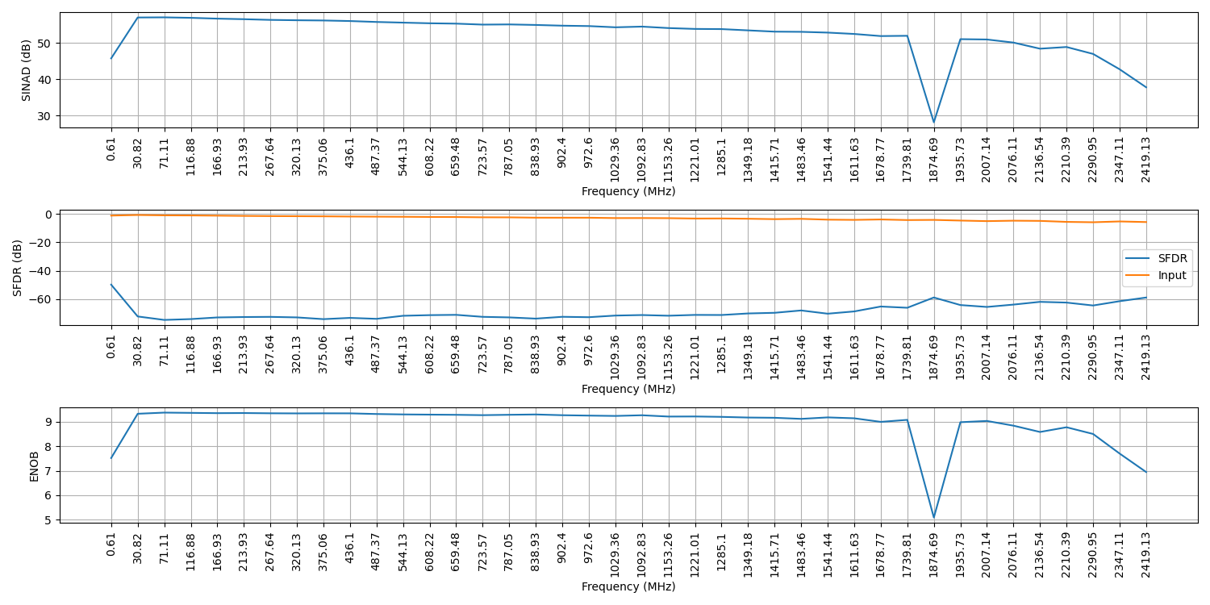
RFSoC Measurements: Spectrum
Note: SMA100b into ZCU208 + XM655 with the 10MHz-1GHz balun, Ch1

Slide 10
RFSoC Measurements: ENOB
ENOB Figures
9.34 bits from the ADC (at 400MHz)
1 bit from channels averaging
3.377 from sample averaging (108 samples)
Total: 13.71 ENOBs!
14.1 Required!

Slide 11
References
[1] “CRAB CAVITIES FOR THE HIGH-LUMINOSITY LHC”, Rama Calaga, CERN, Geneva, Switzerland. 18th International Conference on RF Superconductivity, Lanzhou, China, 17 - 21 Jul 2017, pp.THXA03. DOI: 10.18429/JACoW-SRF2017-THXA03
[2] "Luminosity reduction caused by phase modulations at the HL-LHC crab cavities", E.Yamakawa, R.Apsimon, P.Baudrenghien, R.Calaga. Nuclear Instruments and Methods in Physics Research Section A Accelerators Spectrometers Detectors and Associated Equipment 908 DOI:10.1016/j.nima.2018.08.074
[3] "Crab Cavity RF Noise Feedback and Transverse Damper Interaction", P.Baudrenghien (CERN), T.Mastoridis (California Polytechnic State Univ. (US)), B.Miller Nicholas
[4] “Performance evaluation of CC Noise feedback subsystem variants”, D. Marinov, D. Valuch Progress report at HL-LHC LLRF meeting 24.9.2025 CERN.
[5] "Transverse emittance growth due to rf noise in crab cavities: Theory, measurements, cure, and high luminosity LHC estimates" P.Baudrenghien (CERN), T.Mastoridis (Cal. Poly.). Physical Review Accelerators and Beams 27 (2024) 051001 DOI: 10.1103/PhysRevAccelBeams.27.051001
[6] “Noise feedback system for Crab Cavities in Large Hadron Collider”, D.Valuch, D.Marinov, G.Hagmann, R.Calaga. Low-Level Radio Frequency (LLRF) Workshop 2025 https://indico.jlab.org/event/939/contributions/17474/

Slide 12
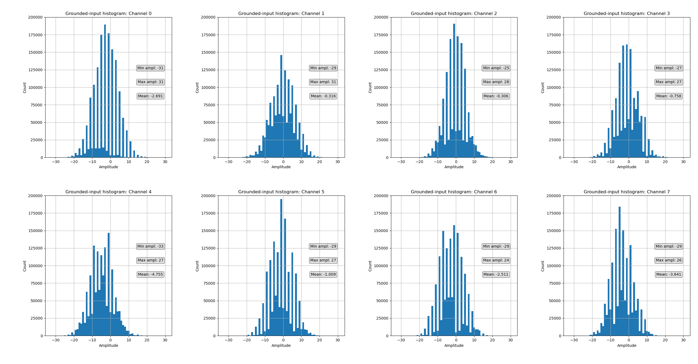
RFSoC Measurements: Noise (1), 14-bit data

Slide 13
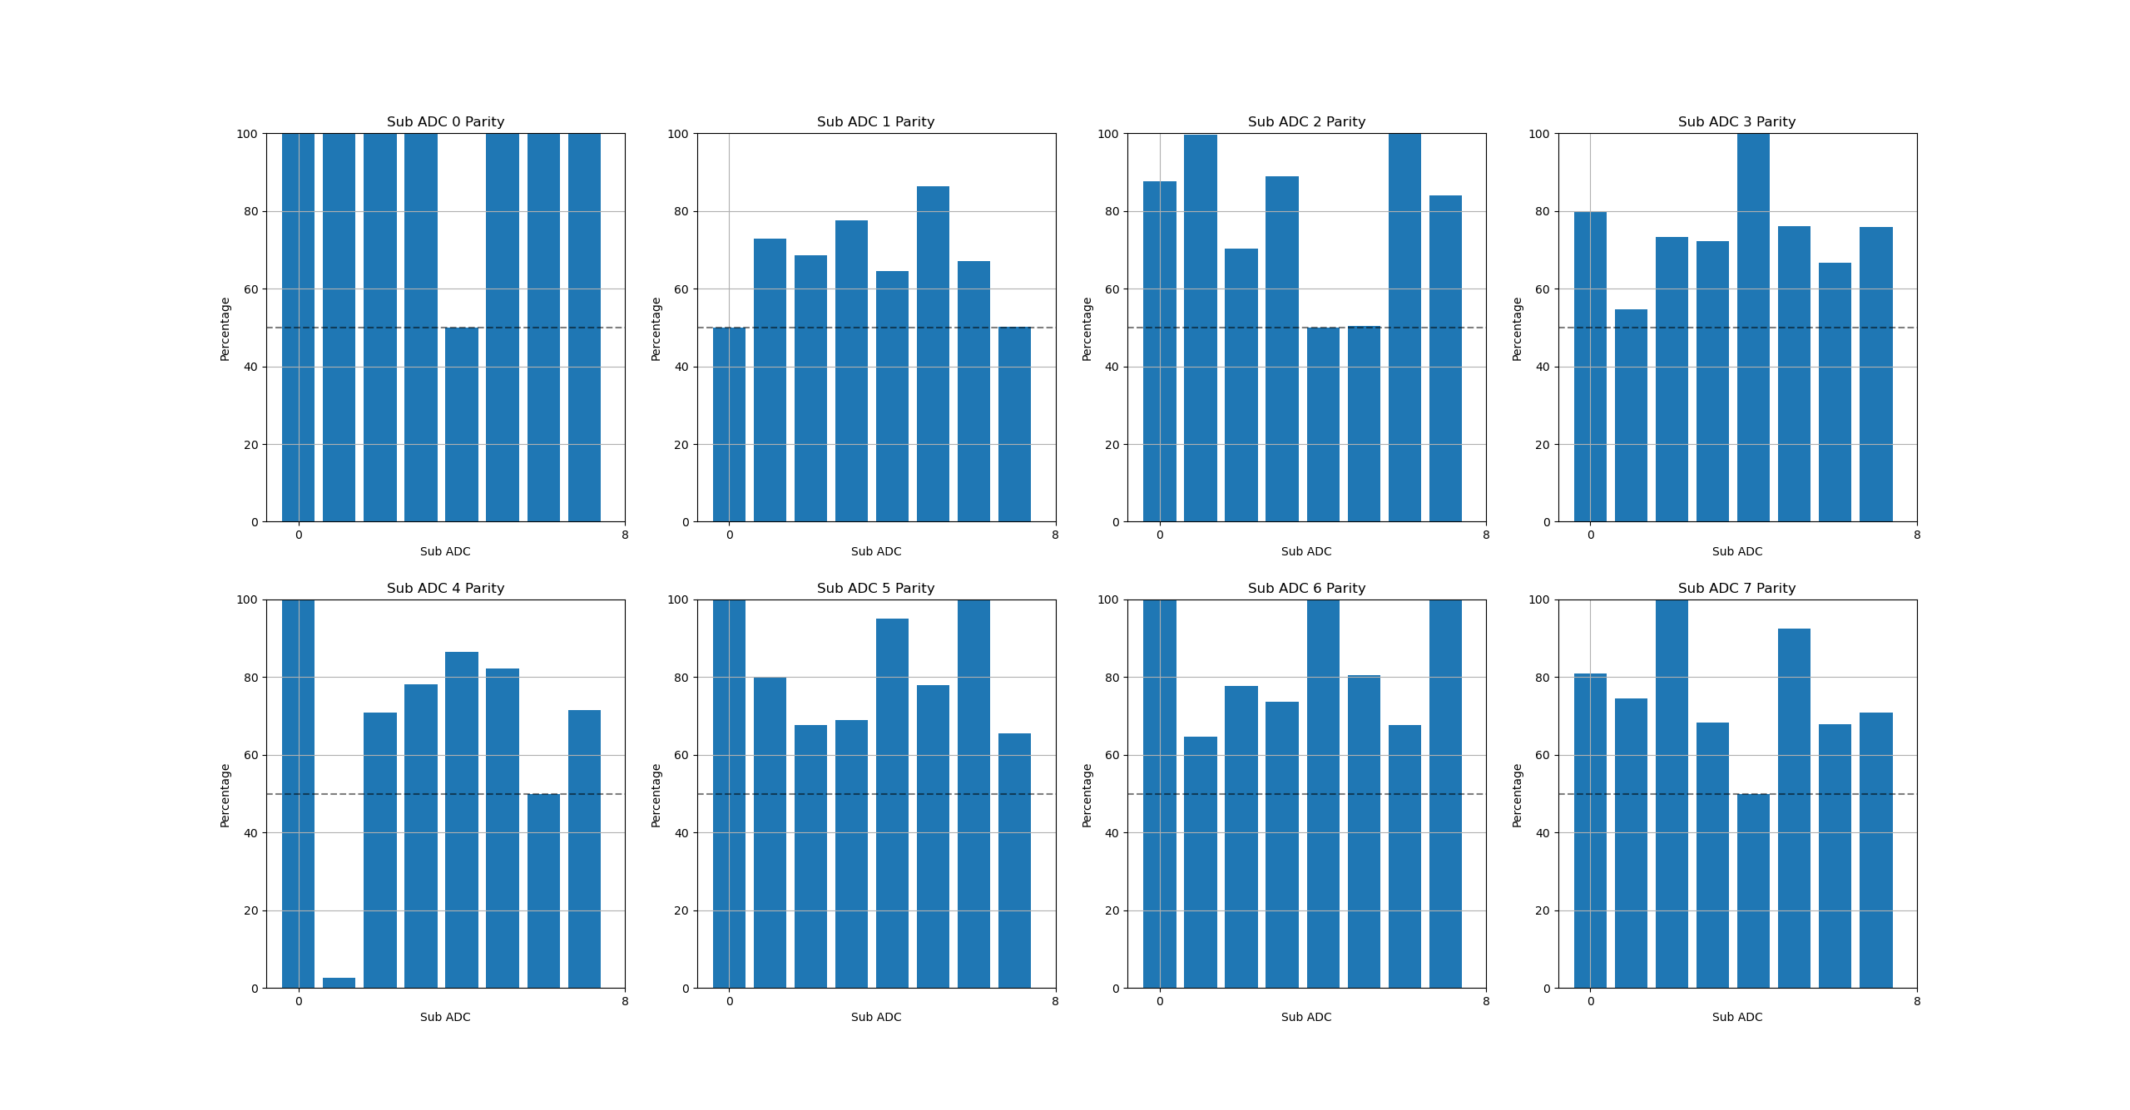
RFSoC Measurements: Noise (2), 14-bit data

Slide 14
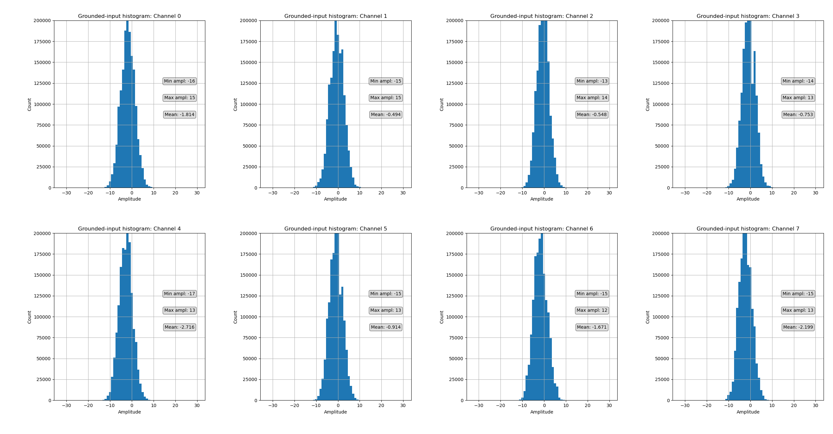
RFSoC Measurements: Noise (3), 13-bit data

Slide 15
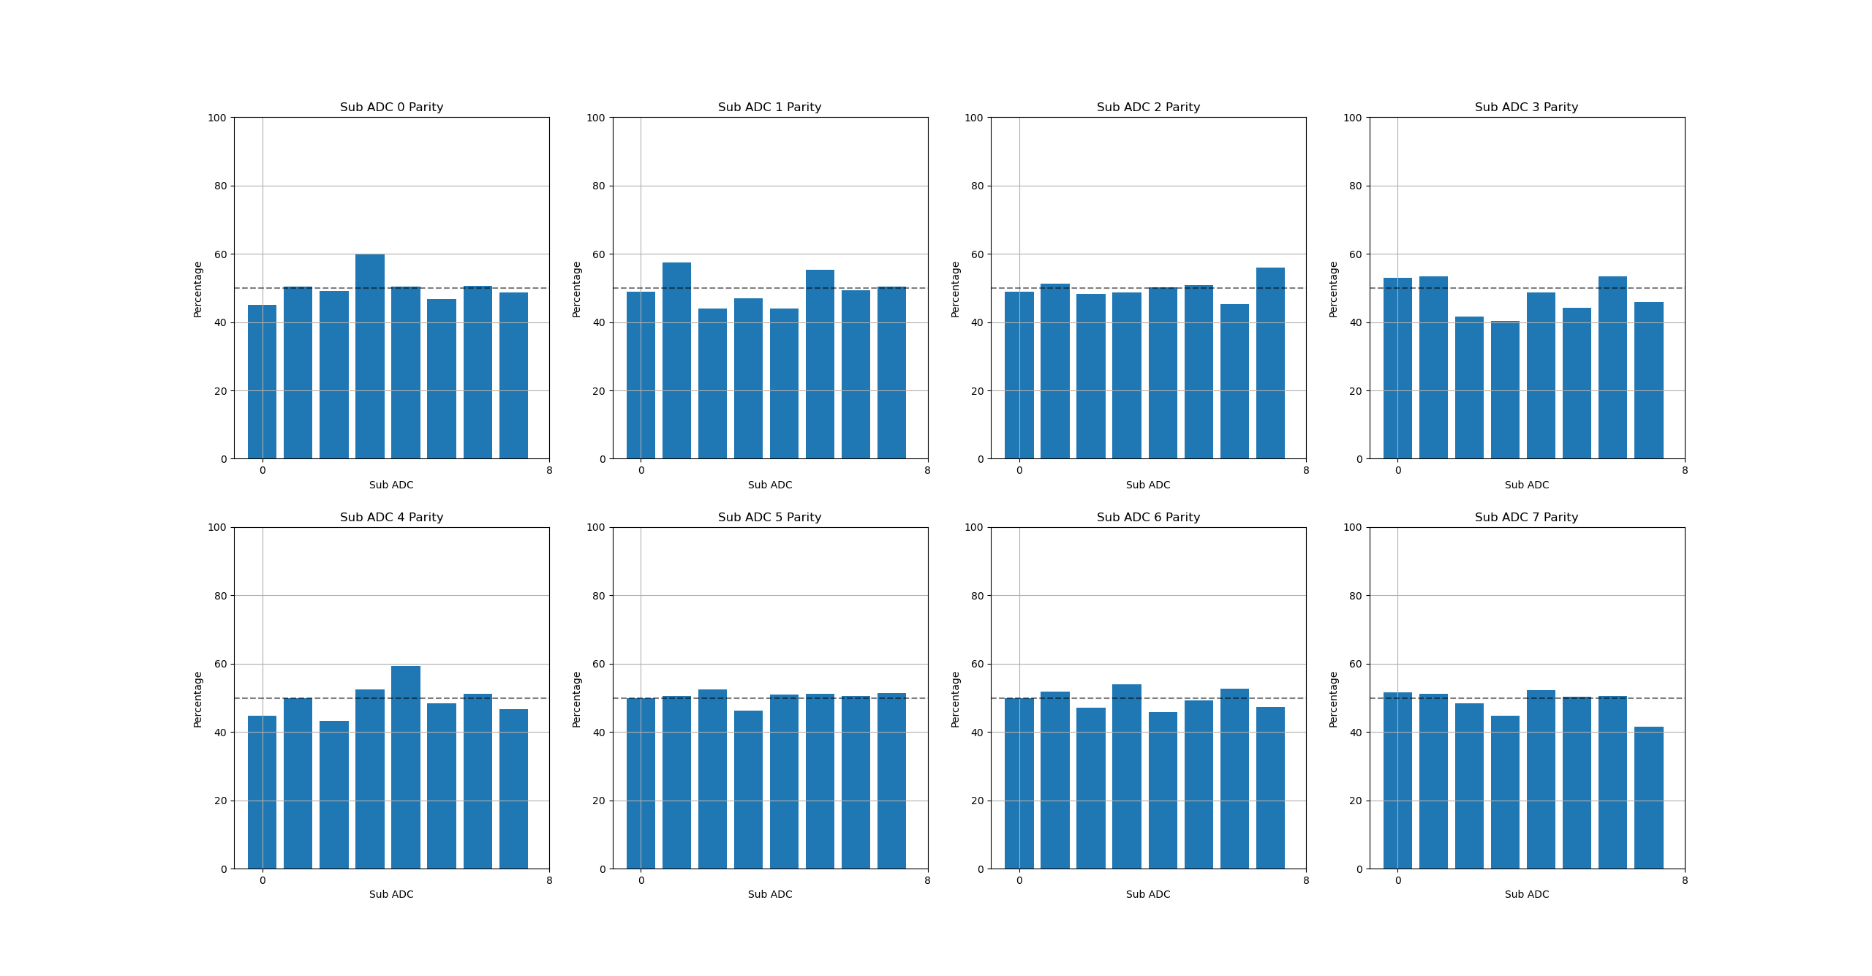
RFSoC Measurements: Noise (4), 13-bit data

Slide 16
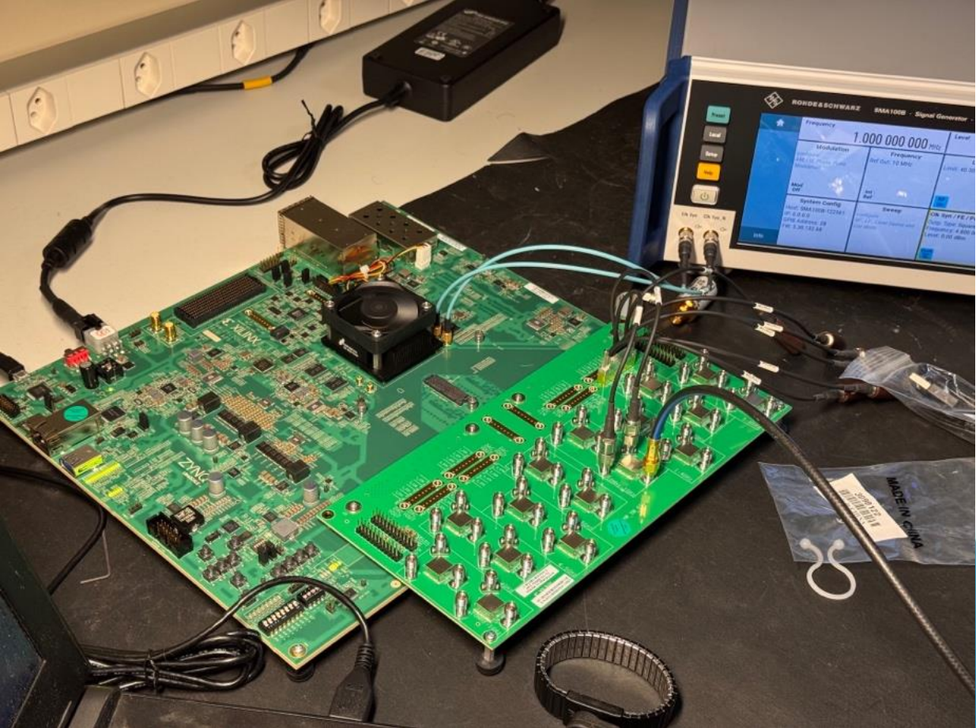
Backup Slides: RFSoC Test Setup

Slide 17
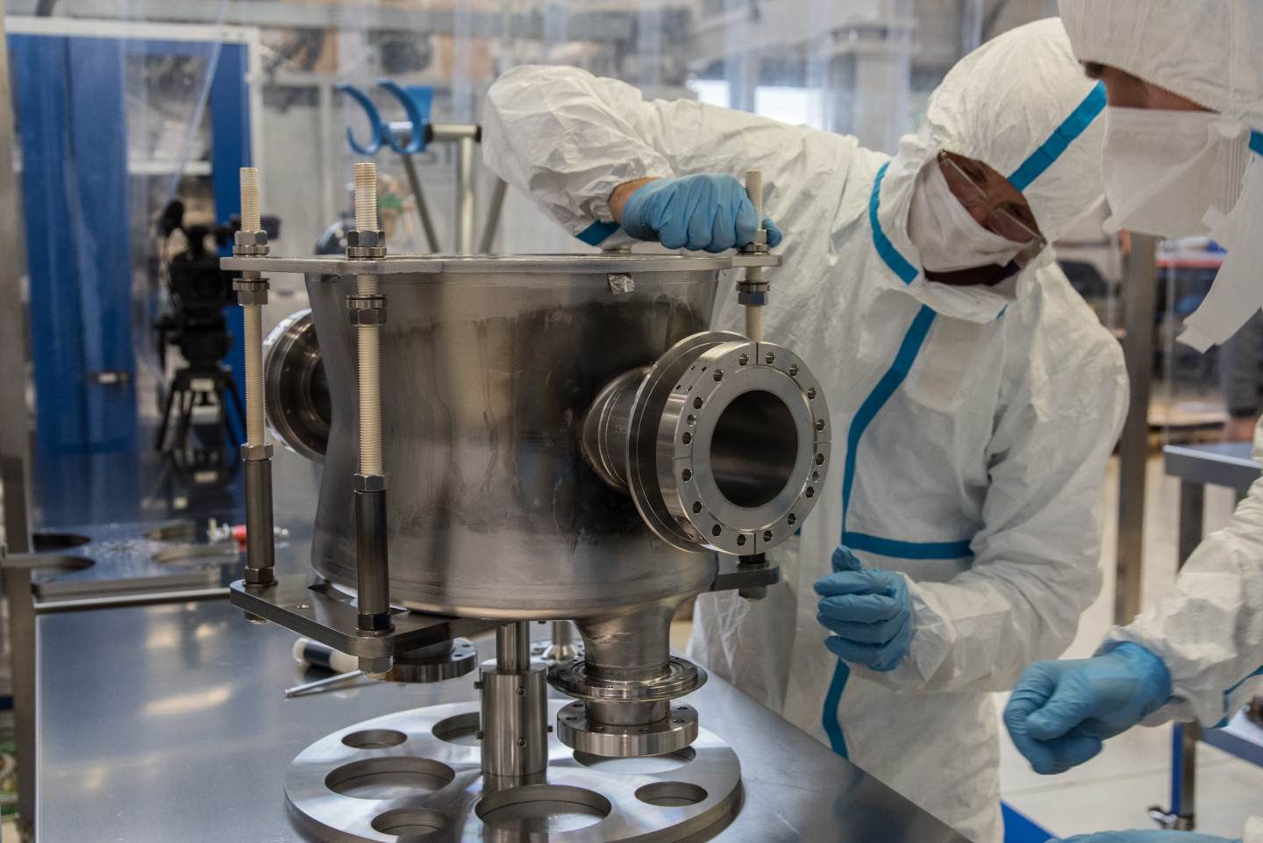
Backup Slides: Double Quarter Wave (DQW) CC

Slide 18
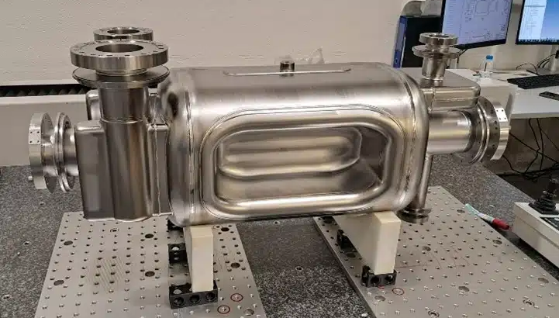
Backup Slides: RF Dipole

Slide 19
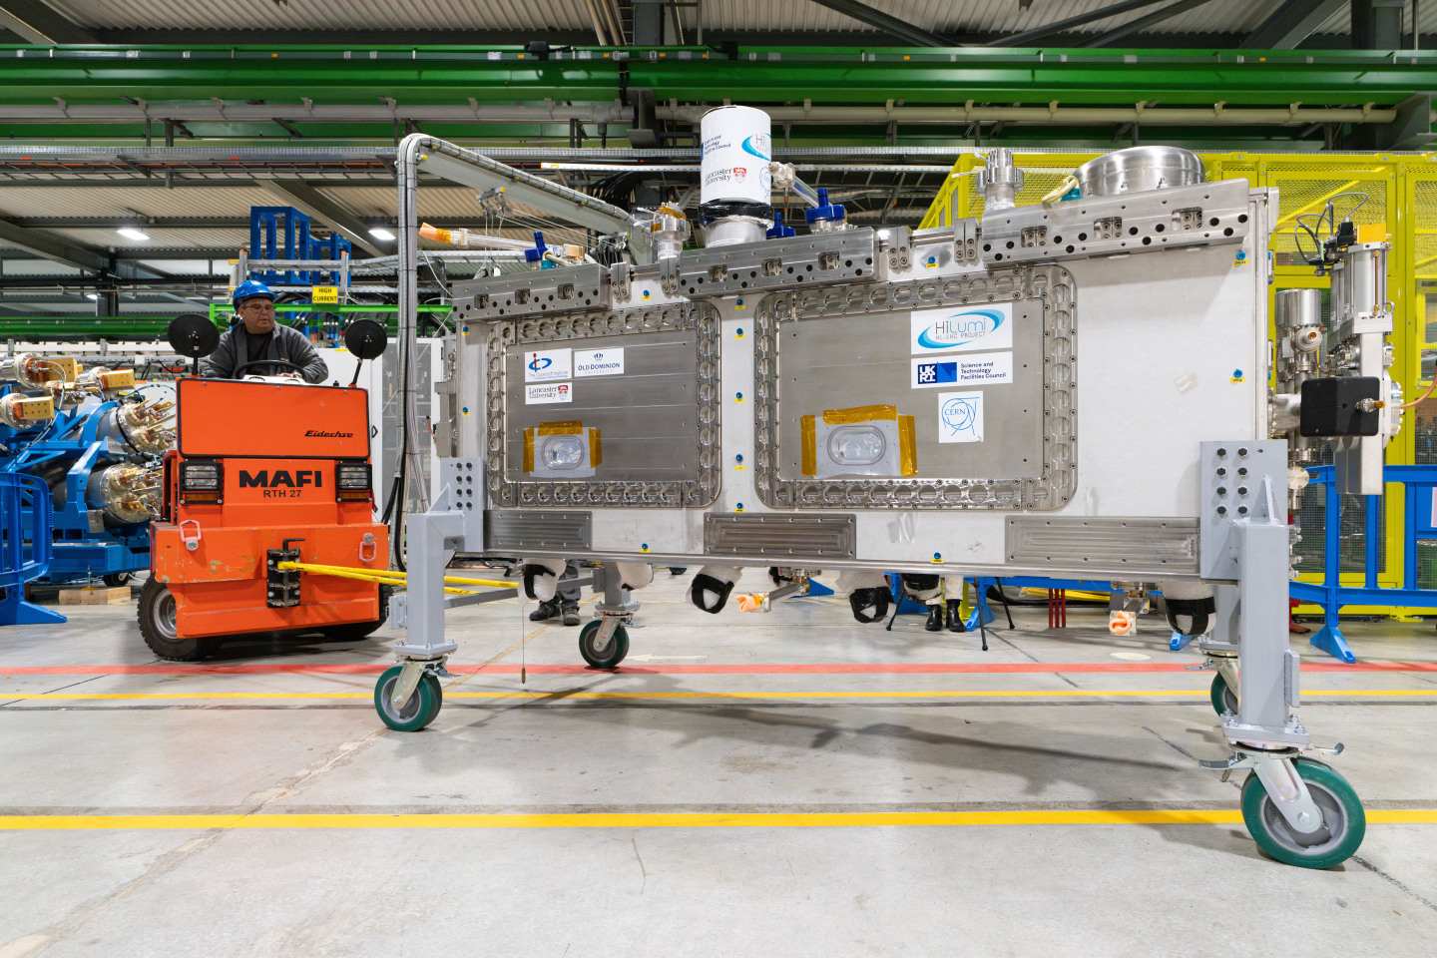
Backup Slides: Crab Cavity Enclosure

Slide 20
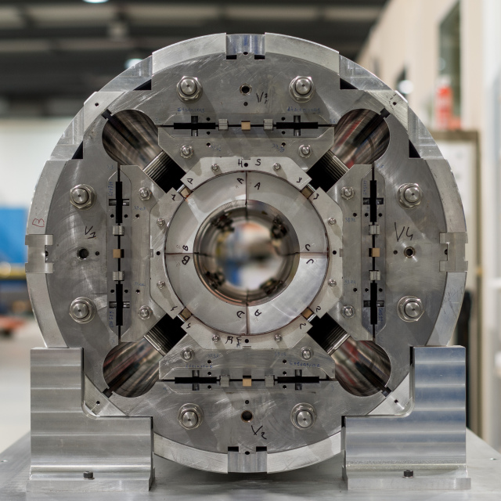
Backup Slides: HL-LHC Magnets

