Slide 1

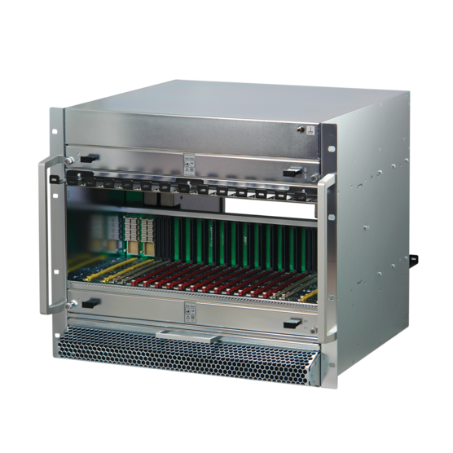
MTCA.4 Quantum Crates
Engineering Challenges in Scaling MicroTCA for High-Power Double Full-Size AMC Configurations
Christian Ganninger
12-2025

Slide 2
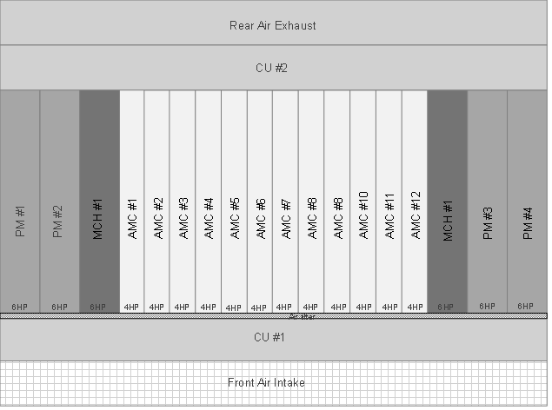
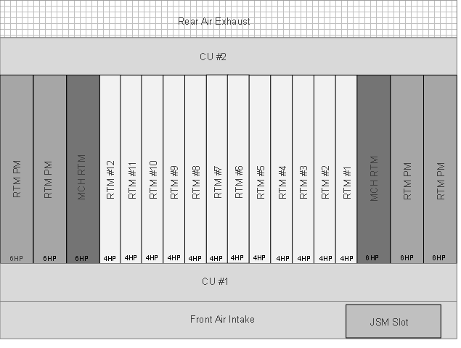
MTCA.4 & MTCA.4.1 Crates
MTCA.4 is using the Double Mid-size AMC modules with 4 HP width
With this, 12 AMC‘s + 2 MCH‘s and up to 4 PM‘s fit into a 19“ (84 HP) card cage
The RTM section can be populated with 12 AMC RTM’s + 2 MCH RTM’s and up to 4 RPM’s
JSM can be placed outside the card cage
Front
View
Rear
View

Slide 3
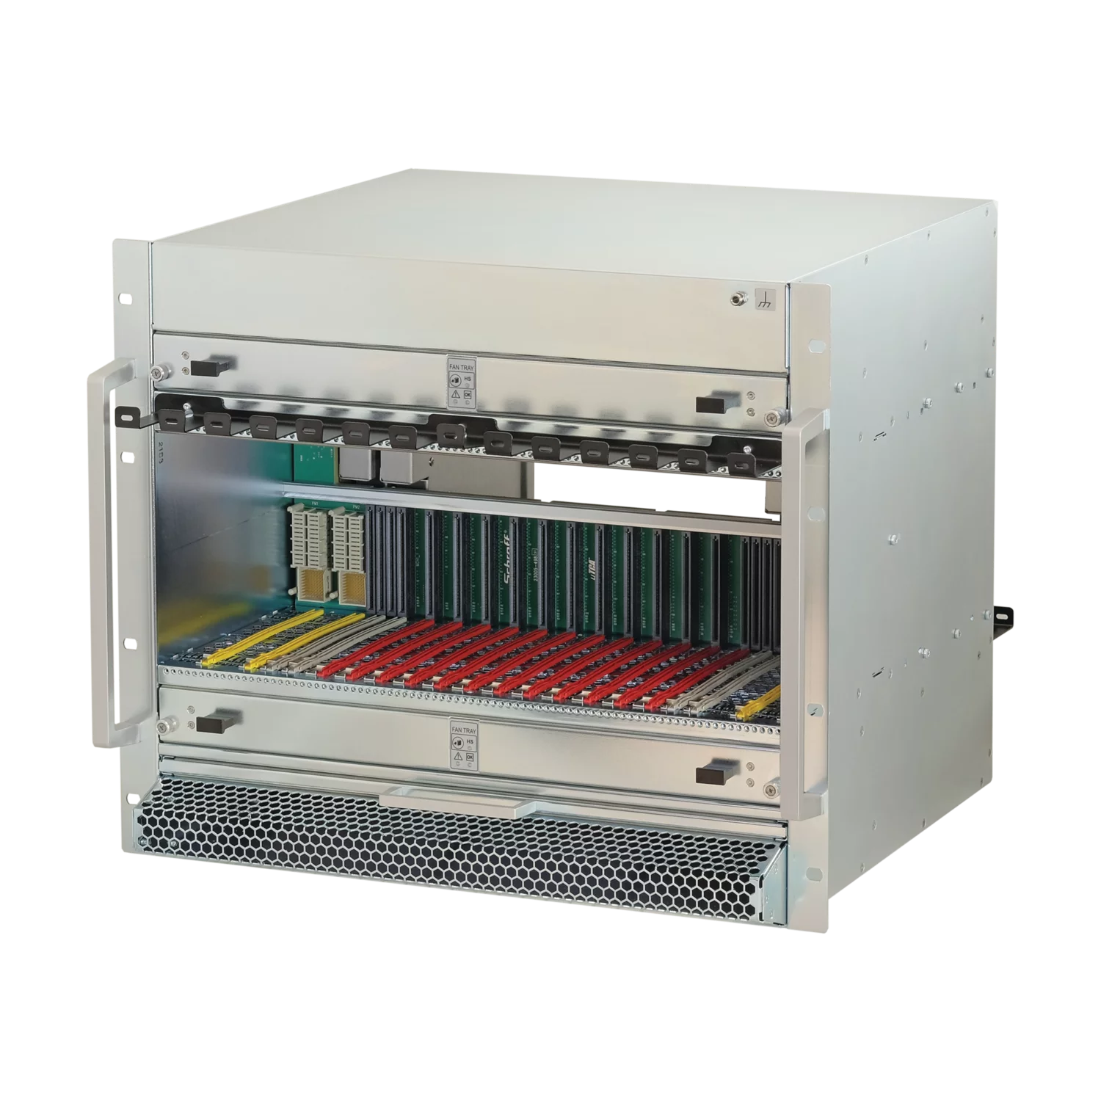
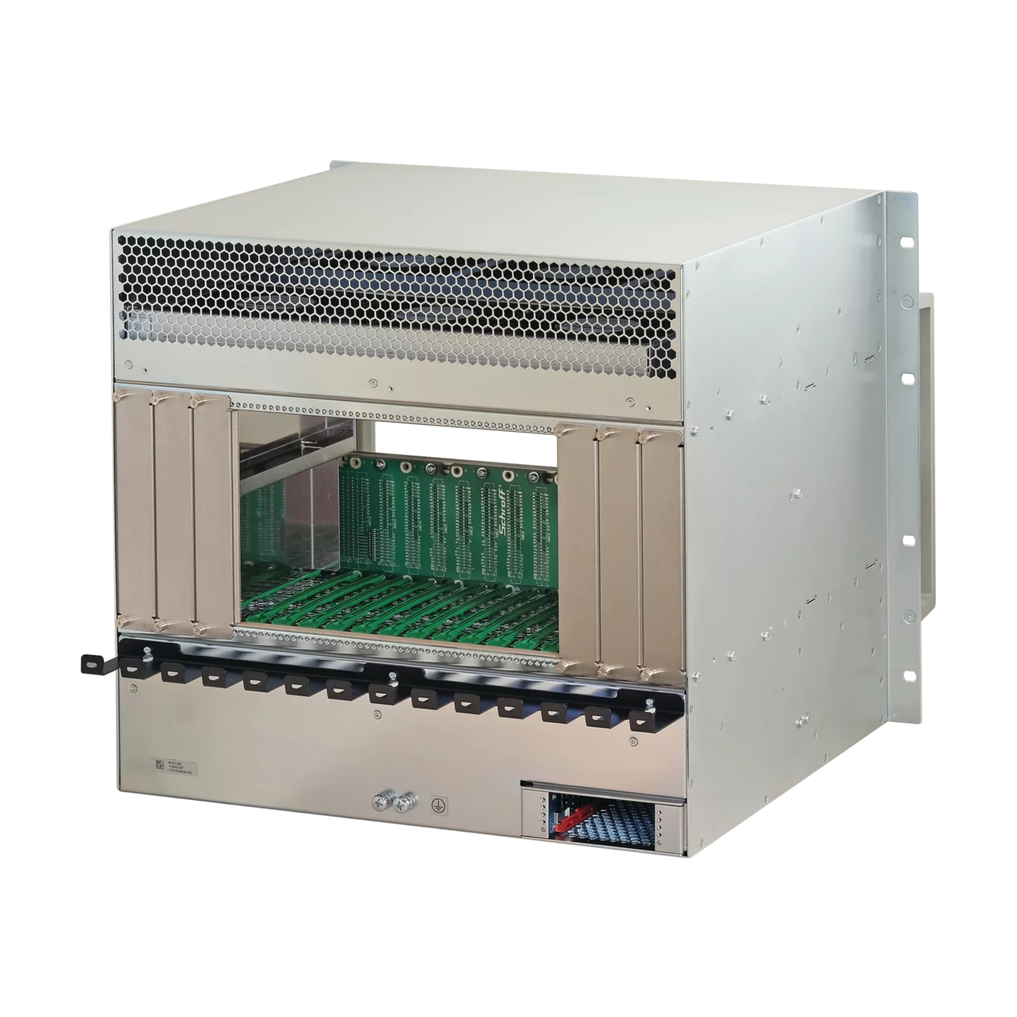
Requirements for MTCA @ Quantum Control Systems
MTCA is used as room temperature equipment of Quantum Computing systems. It‘s part of the Control System of the Quantum Computer
The maximum number of AMC modules - 12 - is mandatory
For analogue signals AMC RTM‘s are essential, some applications need in addition a rear backplane
The preferred size of the AMC‘s and RTM‘s is Double Full-size
Some users demand > 80 W per AMC
Depending on the architecture and transfer protocol, 1 or 2 MCH‘s
Minimum 1400 W (MTCA.0 Rev. 3.0), redundancy optional
Needs a new Crate architecture

Slide 4


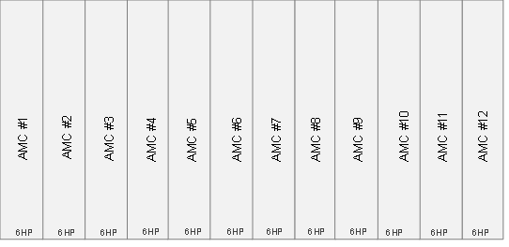
Front-Layout of 19“ Crate with 12 Double Full-size AMC Modules
12 Double Full-size (6 HP width) AMC Modules already occupy 72 HP of space
Only 2 Full-size slots left for MCH and PM
Either 1x Double Full-size PM and 1x Double Full-size MCH
Or 2x Single Full-size PM and 2x Single Full-size MCH
12 HP
12 HP
72 HP

Slide 5
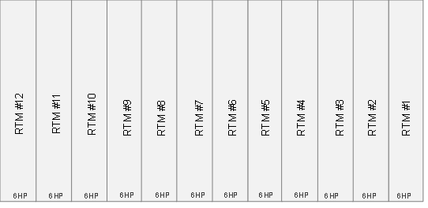

Rear-Layout of 19“ Crate with 12 Double Full-size AMC Modules
12 Double Full-size (6 HP width) RTM‘s already occupy 72 HP of space
Only the 2 Full-size slots behind the MCH and PM left
With Double Front Modules, RTM‘s are possible
Single Module connectors cover all space on the backplane, no RTM`s
Double
AMC / MCH
AMC RTM / MCH RTM
Double
PM
RTM PM
Single PM / MCH
Single PM / MCH
72 HP
12 HP

Slide 6
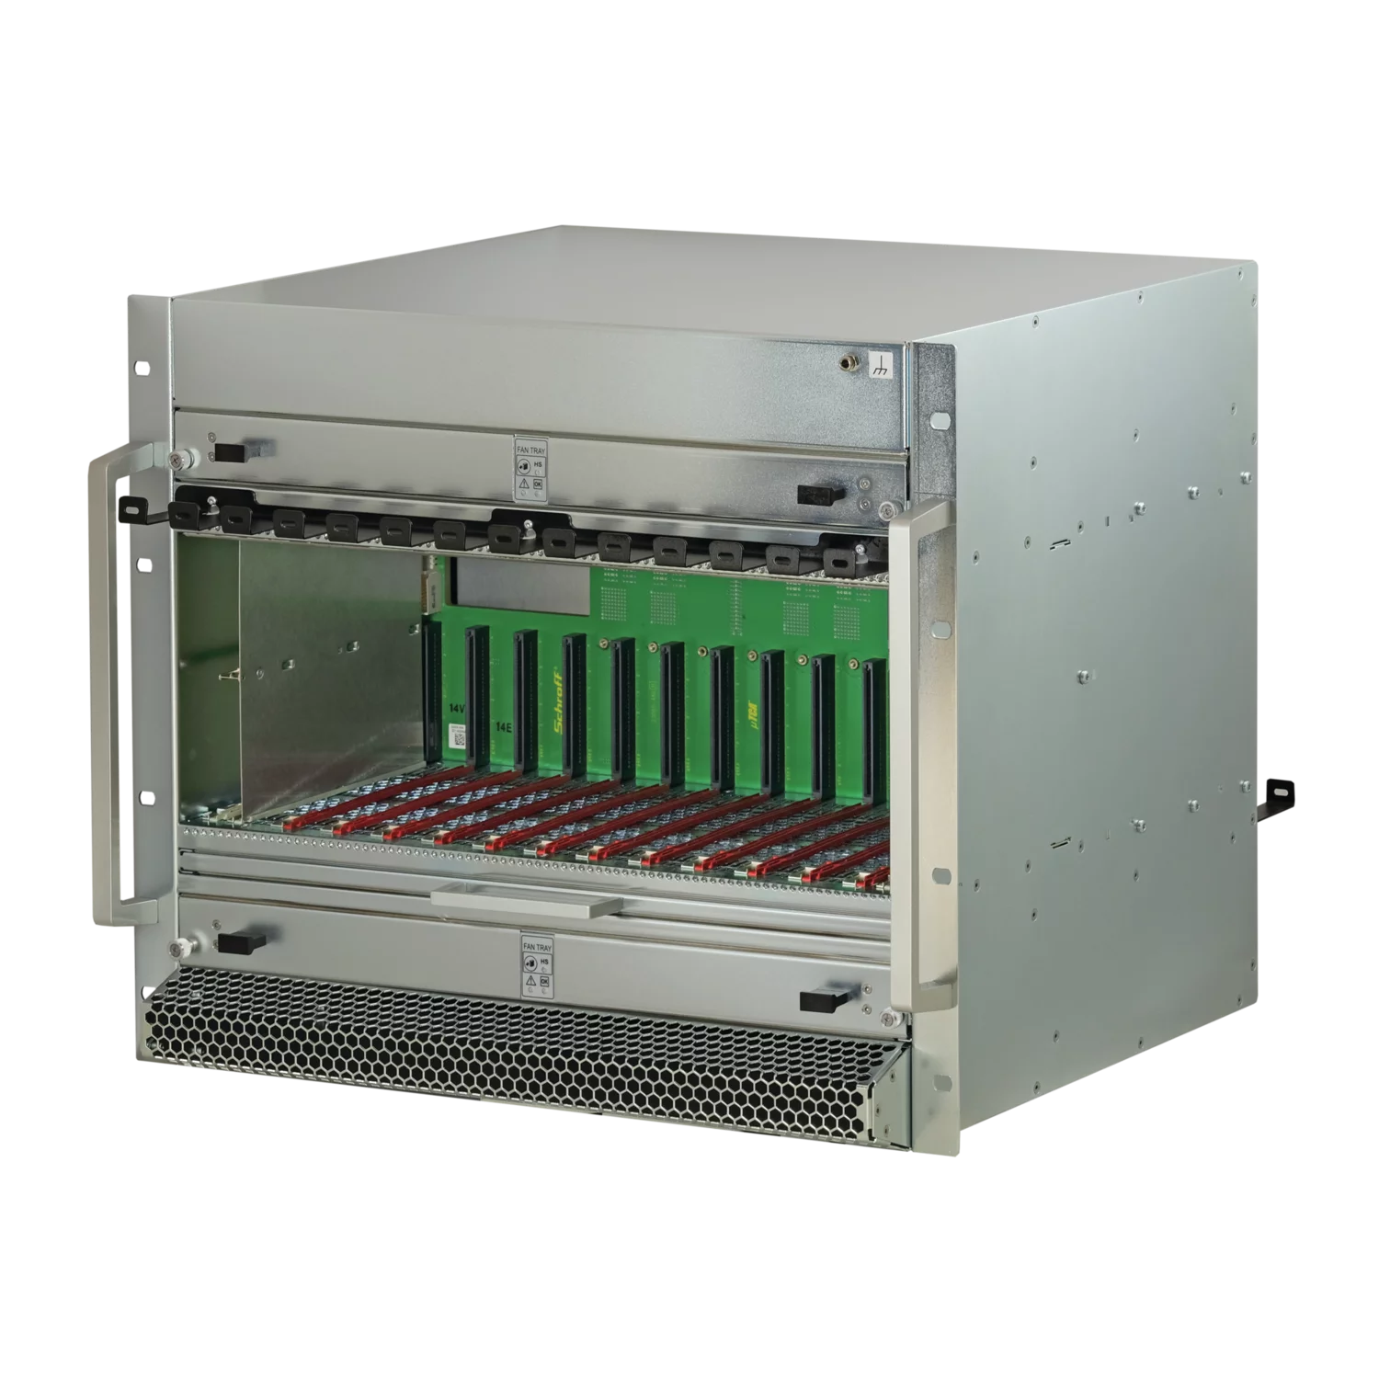
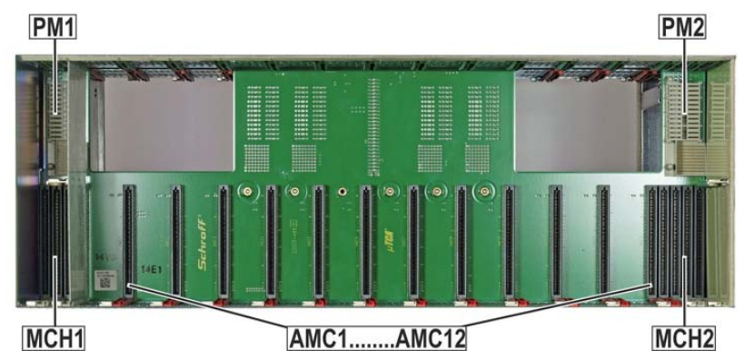
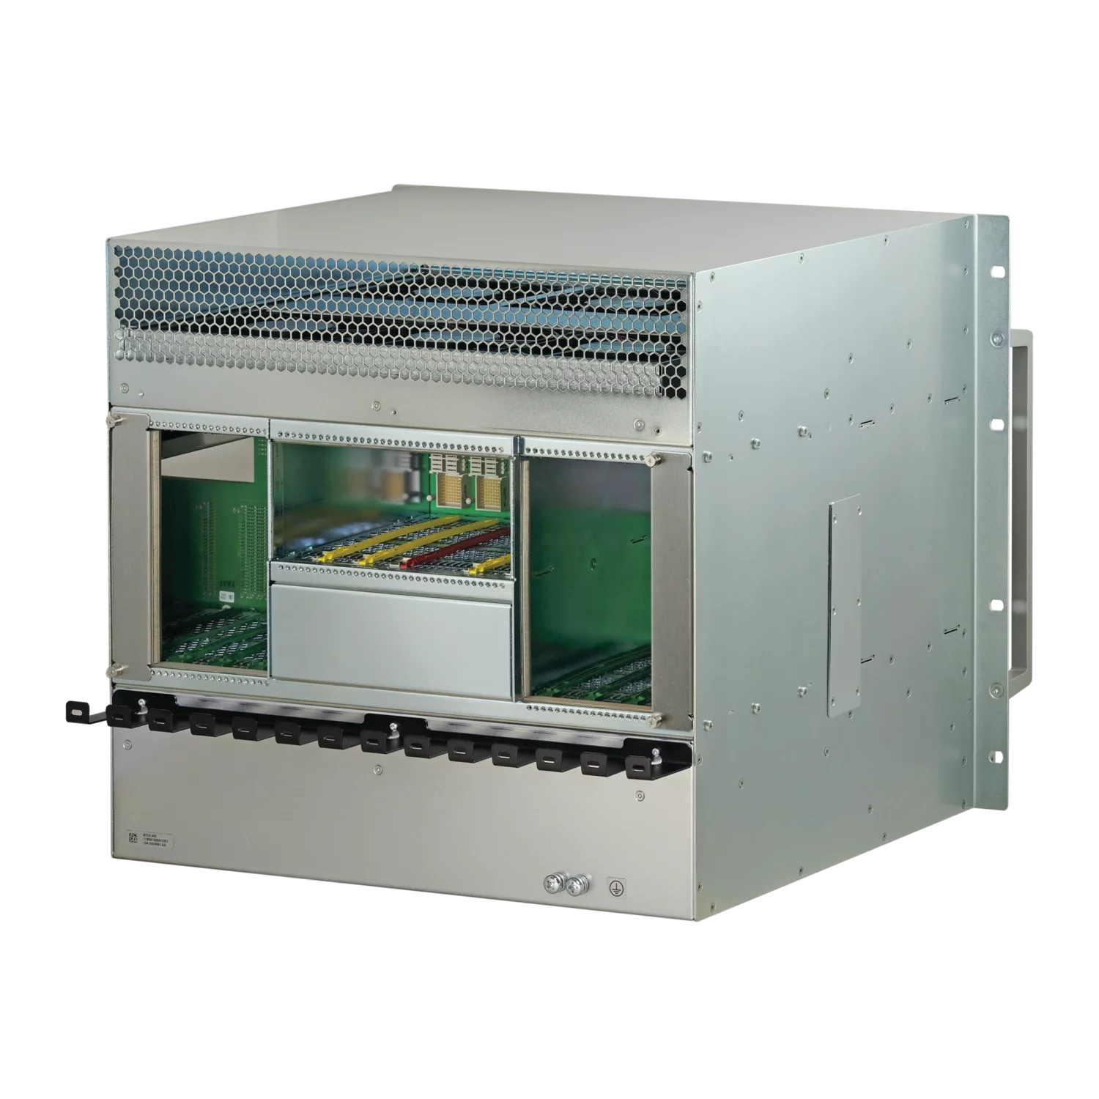
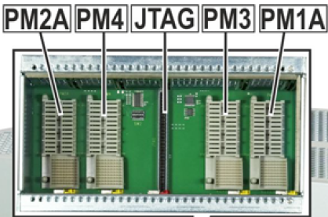
First Realization, Double Full-size AMC‘s @ MTCA.4 Crate for CMS (2015)
Front View
12 Double Full-size AMC Slots
2 Single Full-size MCH‘s left and right (MTCA.0 Rev.2)
2 Single Full-size PM‘s above the MCH‘s
Alternatively 4 PM‘s in the rear card cage
1x Single Full-size JSM slot plus 1x Single Full-size spare slot in the RTM section
The rear PM and JSM section covers 6 slots, only 6 RTM‘s possible
MCH RTM is not possible as well
Rear View

Slide 7
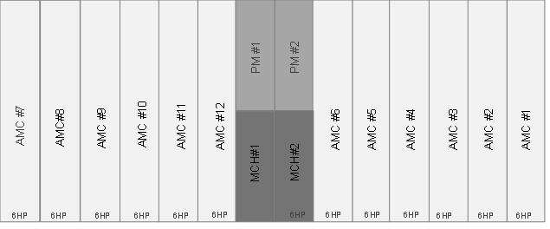
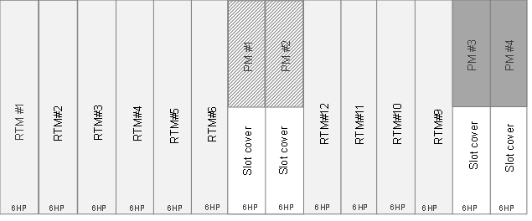
How would this Crate look like with MTCA.0 Rev. 3.0
Front View
With Rev. 3.0, the MCH must move to the middle to match the maximum trace length for PCIe Gen 5
PM#1 & 2 can be either installed in the front above the MCH‘s or alternatively in the RTM behind the MCH‘s (not both options possible in parallel)
The JSM can move to the bottom, outside the card cage
Only 2 slot‘s RTM‘s are blocked
No MCH RTM
Rear View

Slide 8
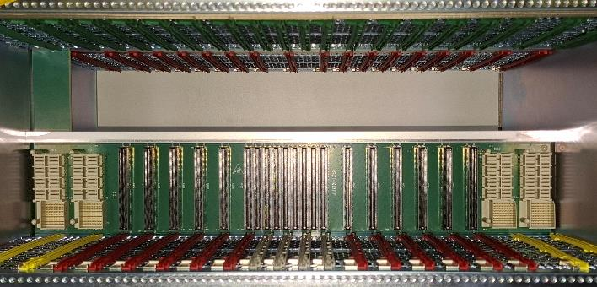
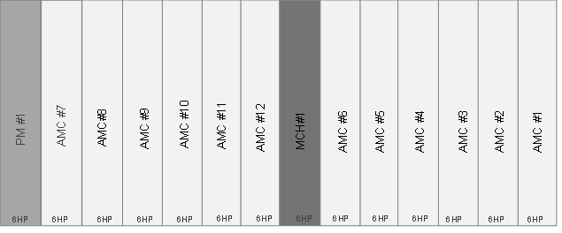
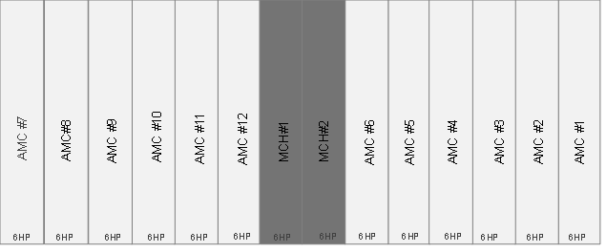
NEW challenge with MTCA.0 Rev 3.0 for Full-size AMC‘s
The upper fan tray in nVent SCHROFF Crates is connected to a backplane extension covering the leftmost slot in the Crates Card Cage
In Crates with Mid-size AMC‘s modules this is a PM Slot that doesn‘t have a zone 3 RTM connector
In non-redundant Crates, PM can be located in the leftmost slot
In redundant Crates the extension must be removed to free up zone 3
A riser board or cable harness is required
Non-redundant Crate
Redundant Crate

Slide 9
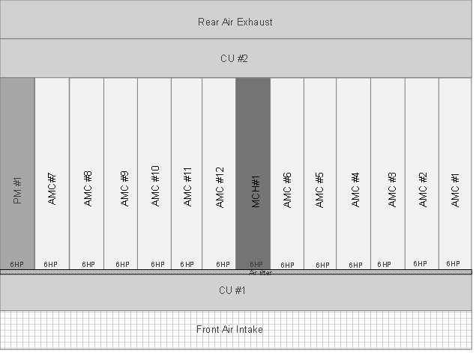
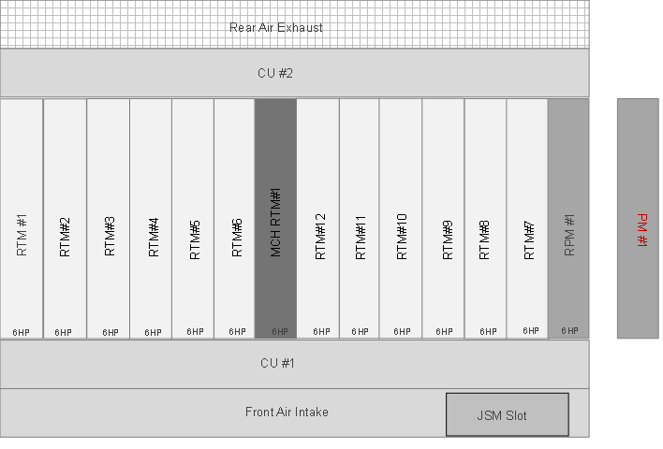
Implementations for 12 Full-size AMC Crates in accordance to Rev 3.0
Front (Non-redundant version)
1 Double Full-size PM Slot
1 Double Full-size MCH Slot
12 Double Full-size AMC Slots
Rear (Non-redundant version)
1 Double Full-size RPM Slot or PM 180° rotated
1 Double Full-size MCH RTM Slot
12 Double Full-size RTM Slots
1 Single Full-size JSM Slot
Possibility for optional RTM Backplane
Max 1300 W with DC Power Module
Double
PM
Double
PM

Slide 10
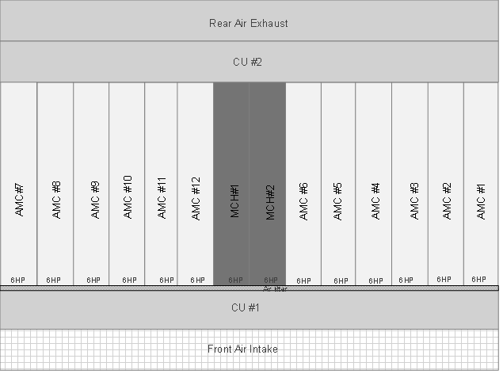
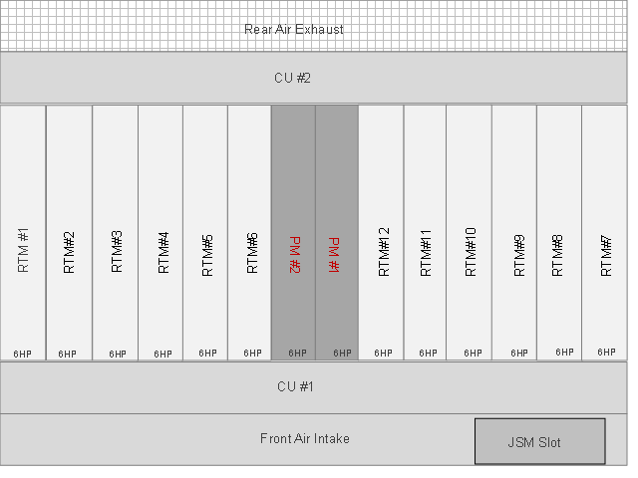
Implementations for 12 Full-size AMC Crates in accordance to Rev 3.0
Front (Redundant version)
2 Double Full-size MCH Slots
12 Double Full-size AMC Slots
Rear (Redundant version)
2 Double Full-size PM Slot (rotated by 180°
12 Double Full-size RTM Slots
1 Single Full-size JSM Slot
Option for Rear Backplane
No RPM’s possible
No MCH RTM’s possible
Double
MCH
Double
PM

Slide 11
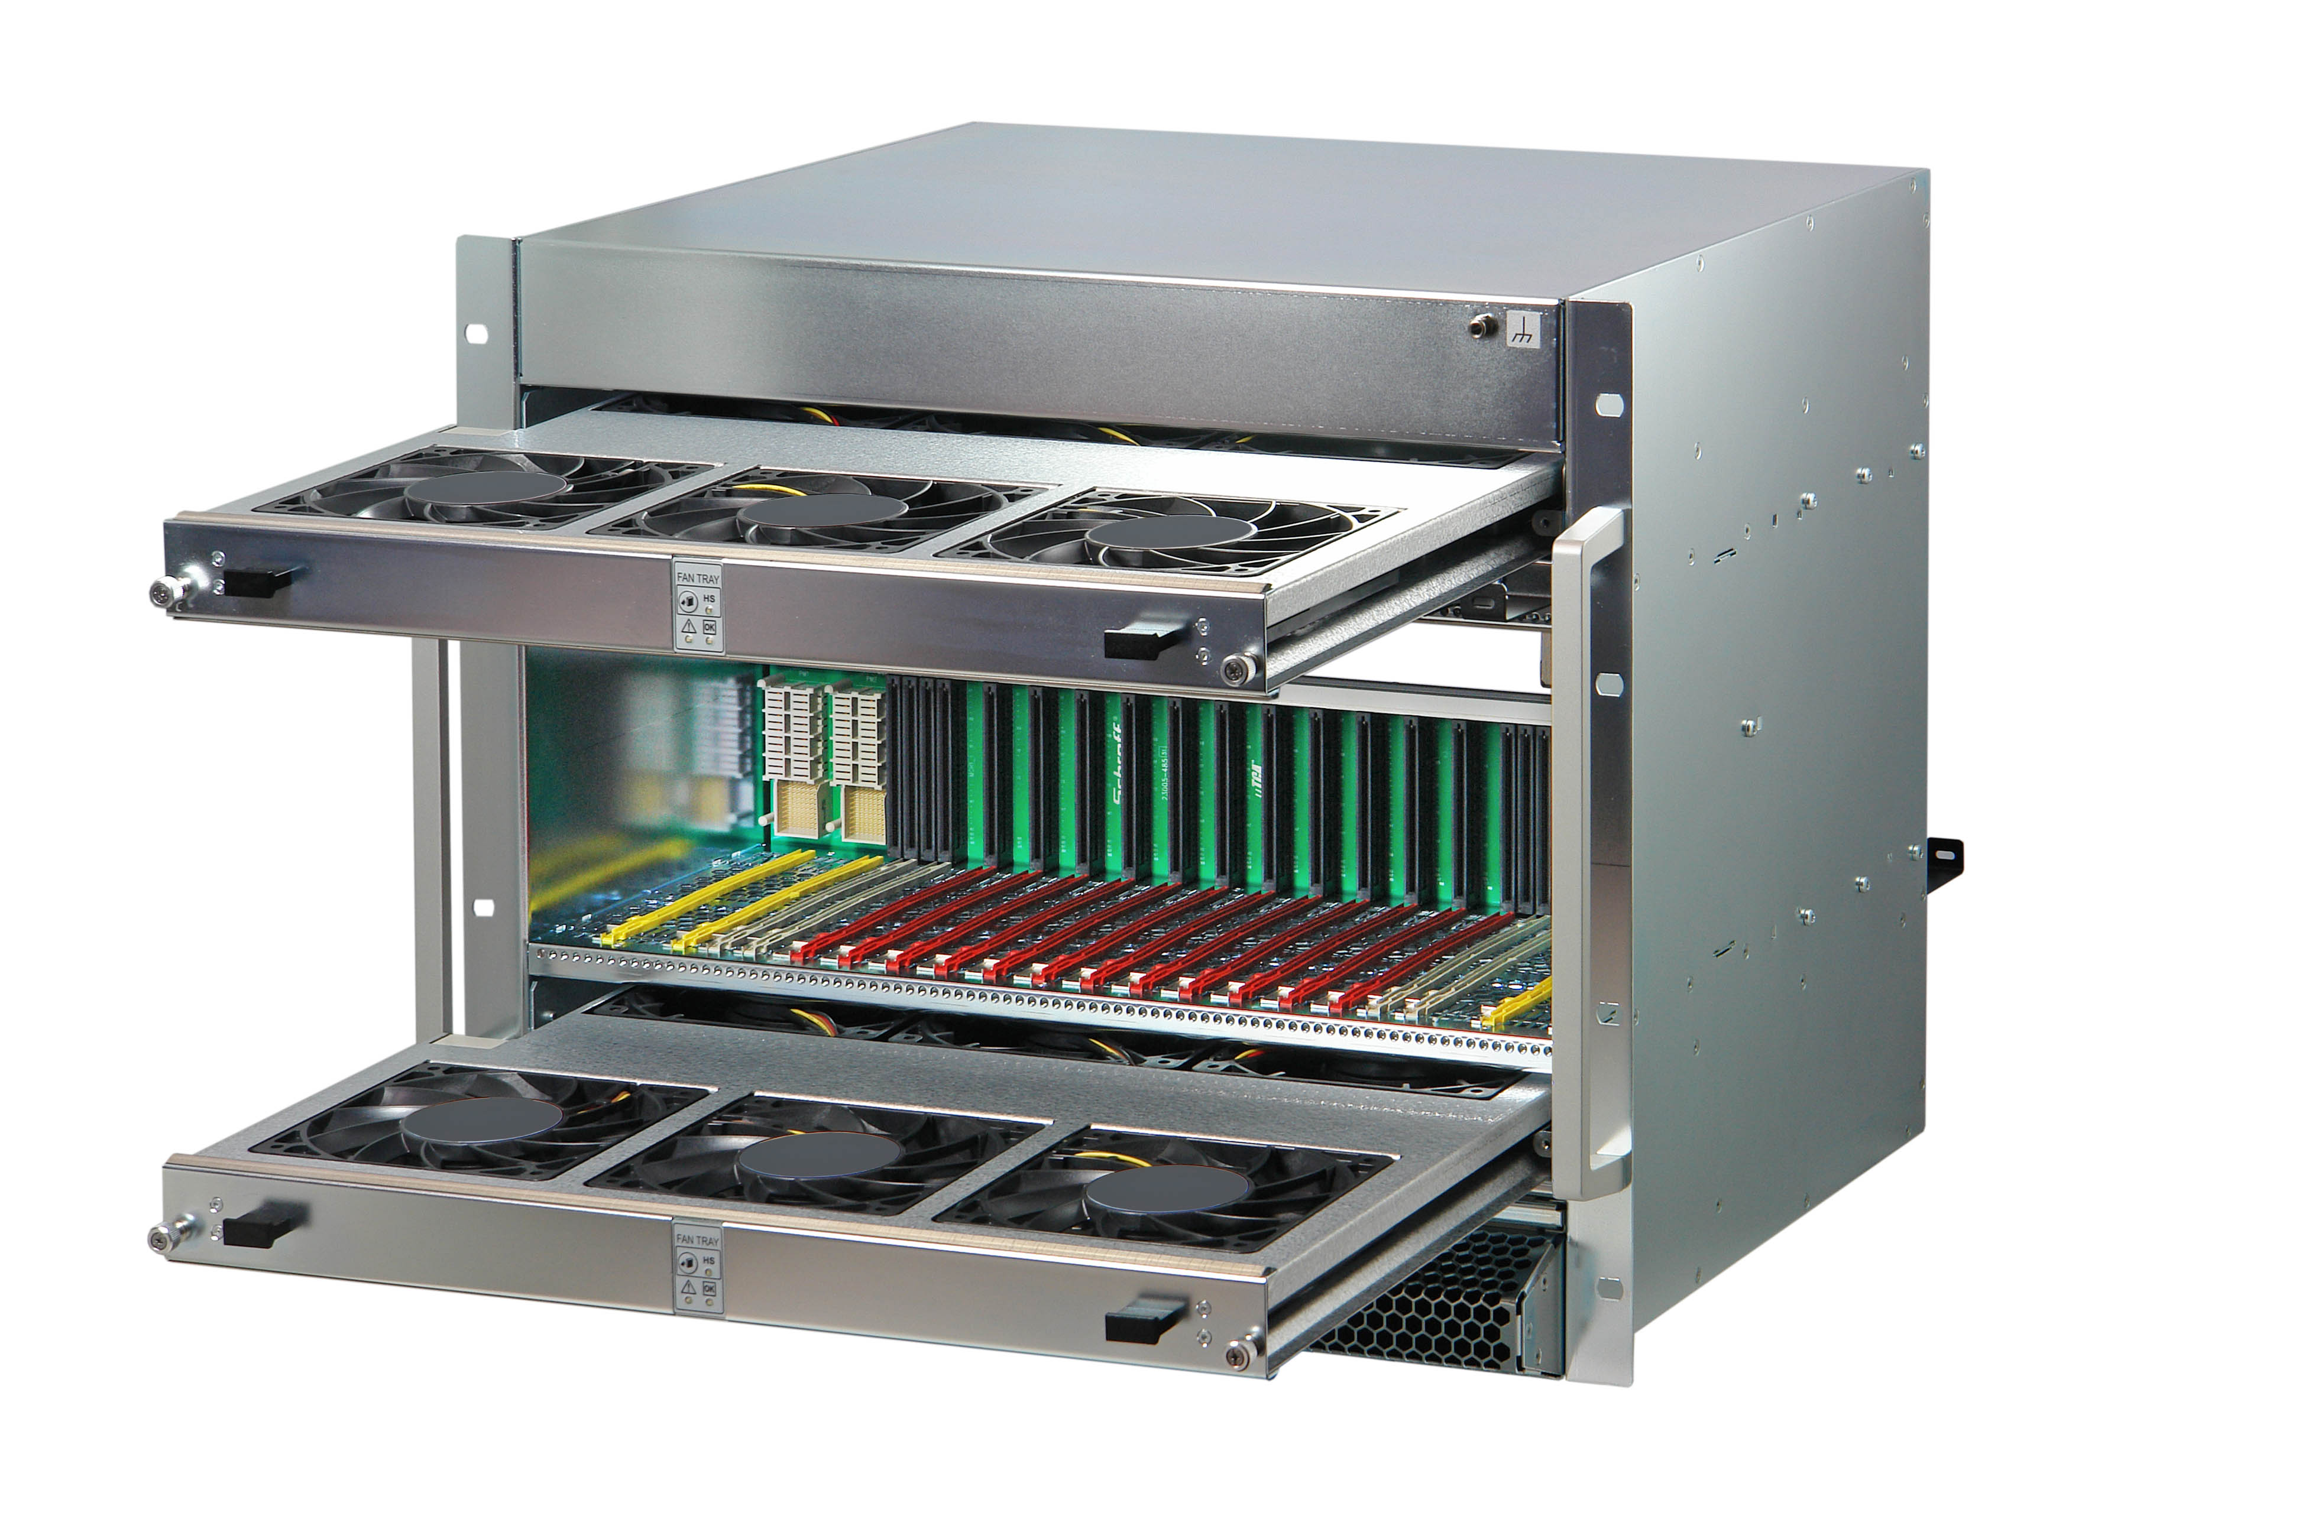
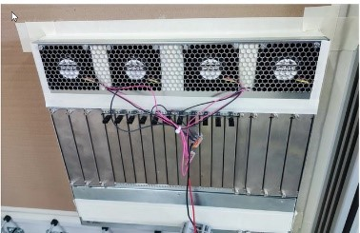
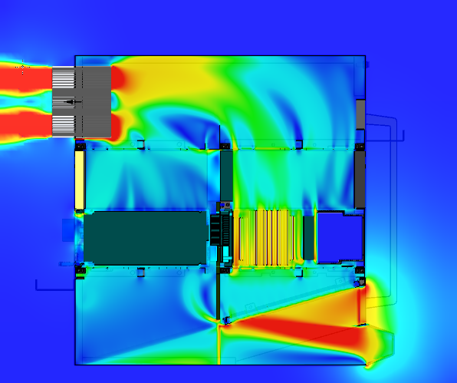
Conclusion
There are several different options to implement 12 Double Full-size AMC’s into a 19” Crate
Trade-offs either in redundancy, number of Power Modules and Rear Power Modules
As soon as Power exceeds 80 W per Module, further changes are required:
New air flow concept with 4 counter rotating fans, pulling air out at the top rear (up to 2500 W cooling capacity)
Above 2500 W, 24 V or 48 V fans are needed, powered by separate power input;
Alternatively: Cooling solutions based on liquid cooling
For crates requiring redundant power supply, the Power Modules need to move out of the rear card cage
200 W * 16 (12 AMC, 2 MCH, 2 CU) = 3200 W -> 3 + 1 redundancy: 4 * 1100 W PSU’s
200 W * 14 (12 AMC, 2 MCH, CU’s powered separately) = 2800 W -> 2 + 1 redundancy: 3 * 1400 W PSU’s

Slide 12
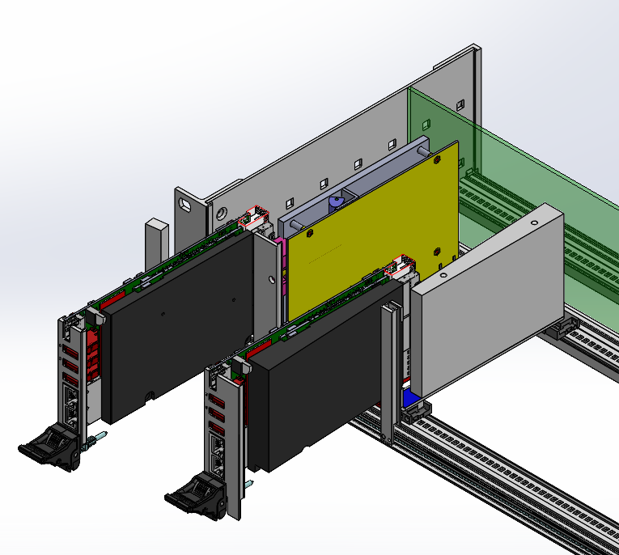
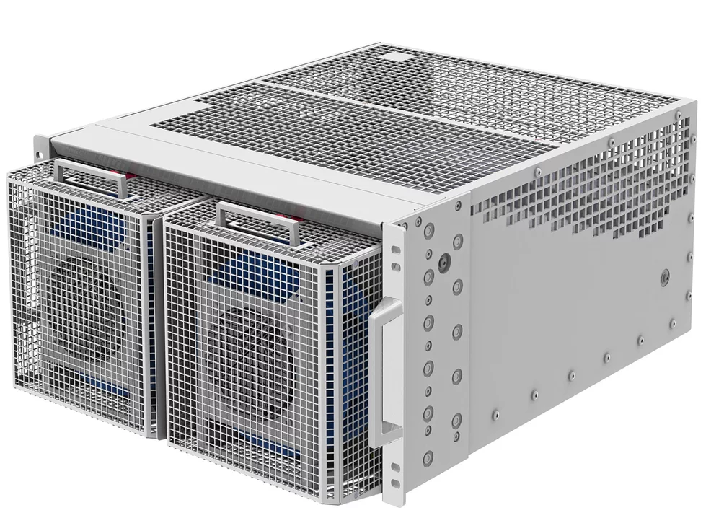
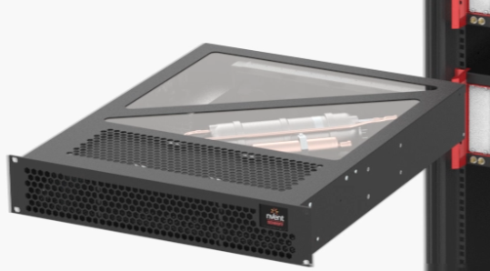
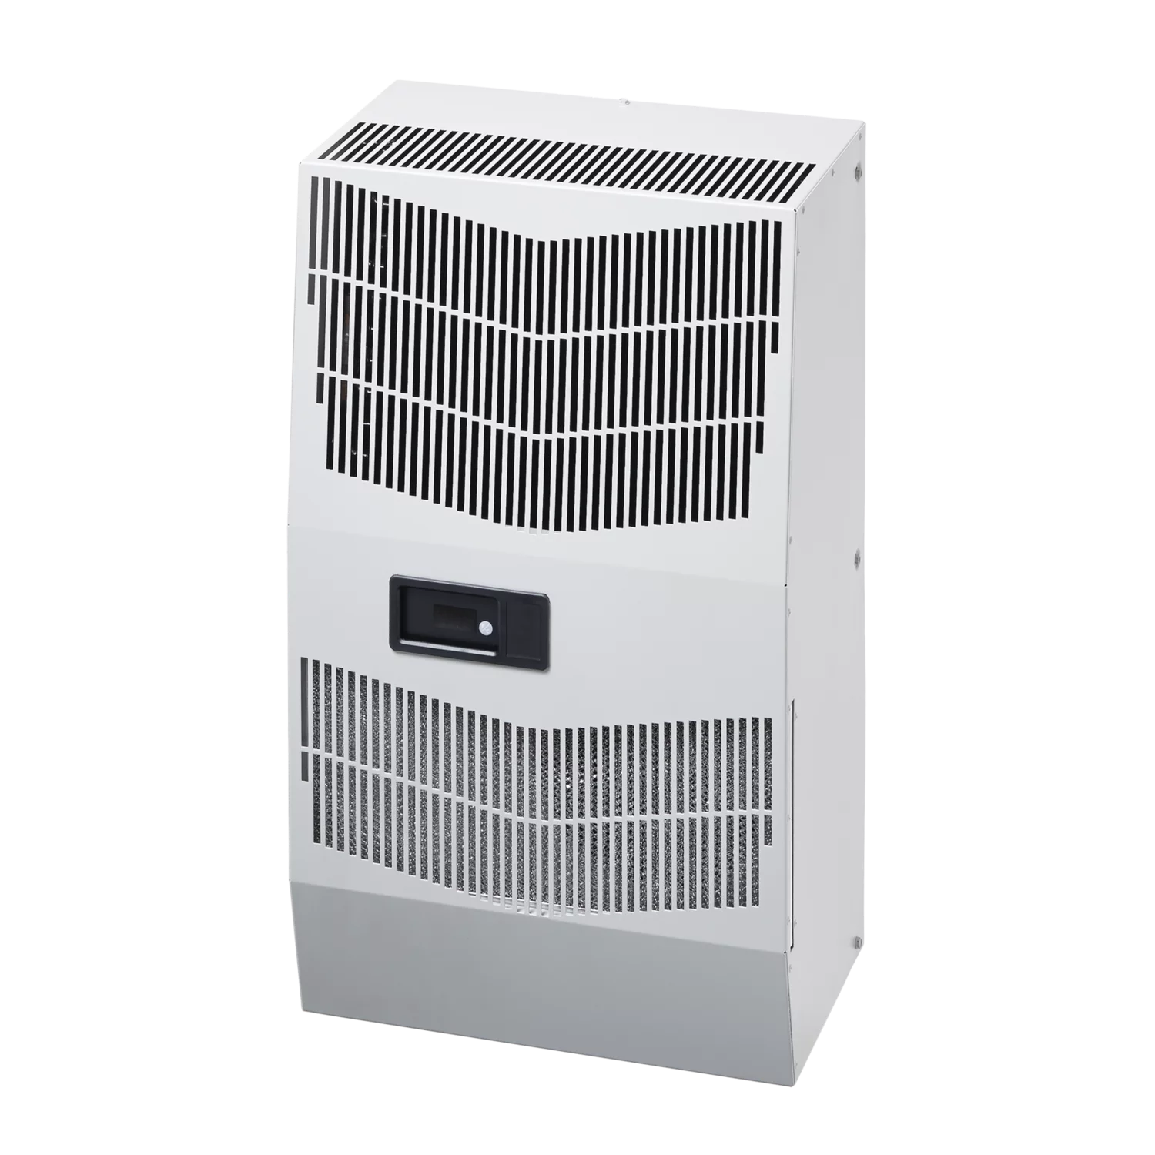
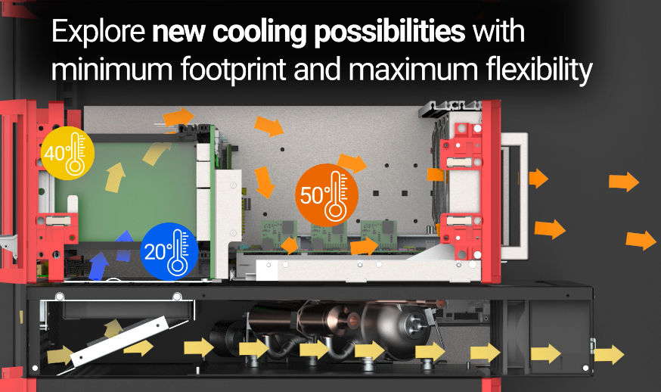
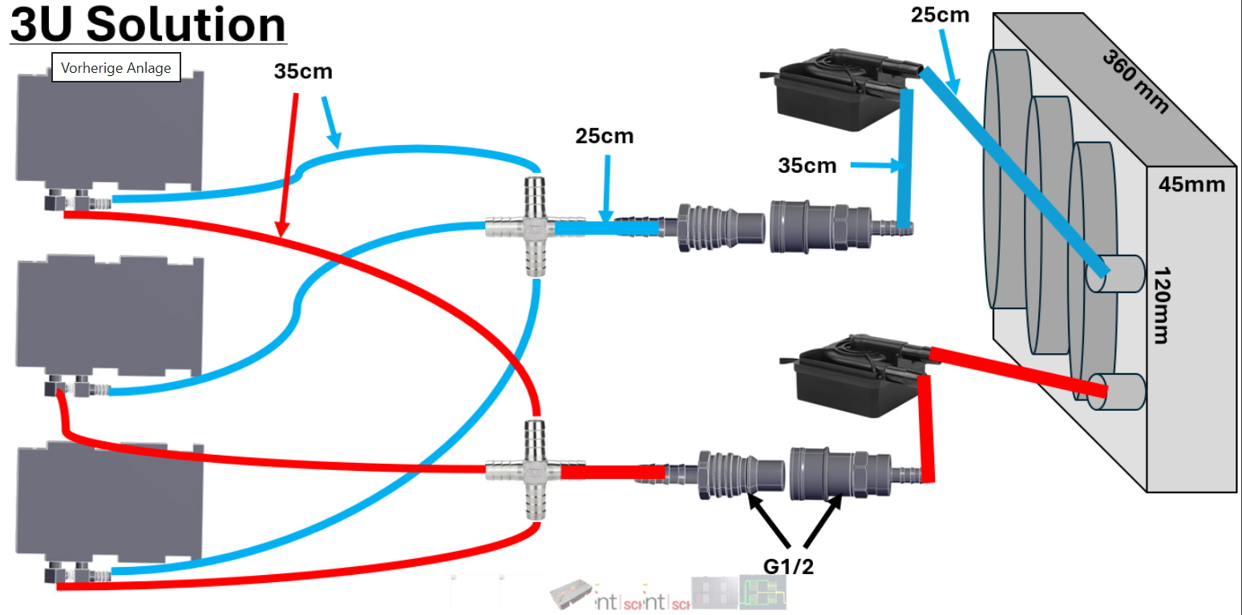
Liquid Cooling concepts for Crates
Cabinet Level
LHX (air / water heat exchanger)
Air Conditioner
Crate Level
Air Conditioner, cooling down the air inlet temperature of the Crate
Module Level
Liquid Flow Through Cold Plate

Slide 13
What are your requirements?
RPM
AMC width?
No. of AMC’s
Power
RTM BP
Redundancy
….

Slide 14
Thank You!

