Slide 1
Integration of prototyping and cost-effective XILINX-AMD SoC/FPGA platforms in the DESY Firmware Framework
Alejandro Piñas, David Andrino, Mariano Ruiz, Antonio Carpeño
Universidad Politécnica de Madrid
a.pinas@upm.es
Universidad Politécnica de Madrid

Slide 2
Outline
Motivation
Kria KR260
  Hardware Design
  Software (Yocto)
  Design Methodology
TEWS TMPE627
  Hardware Design
  Design Methodology
  ChimeraTK Integration
Open Github repositories
I2A2 research group

Slide 3
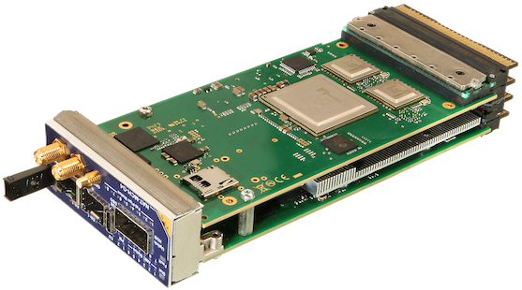
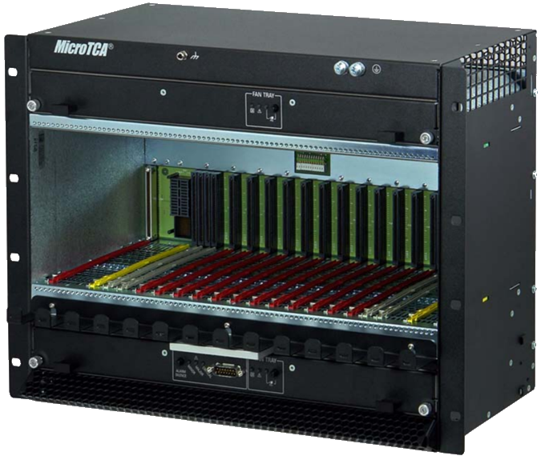
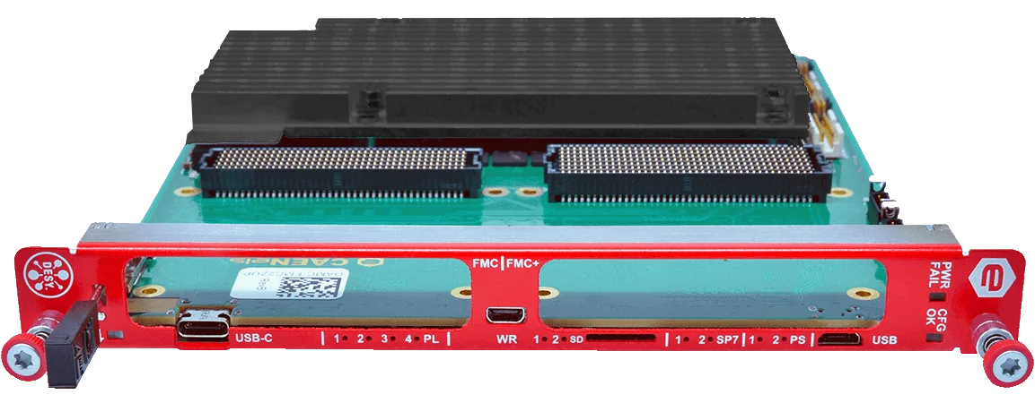
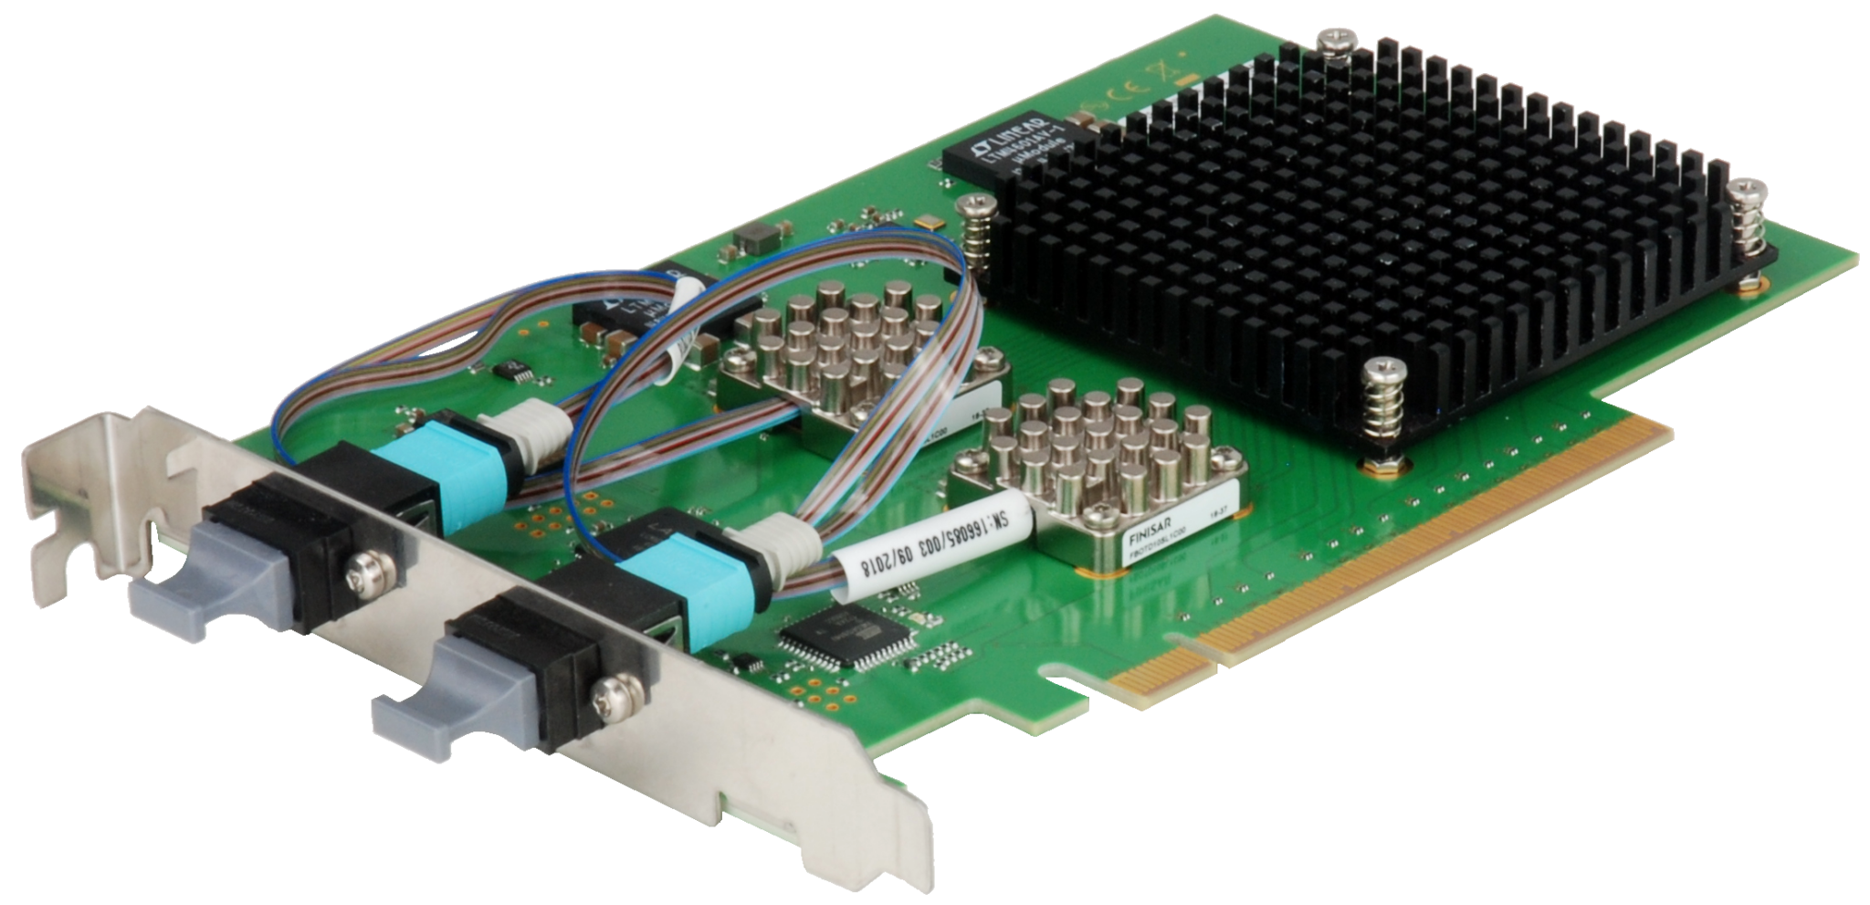
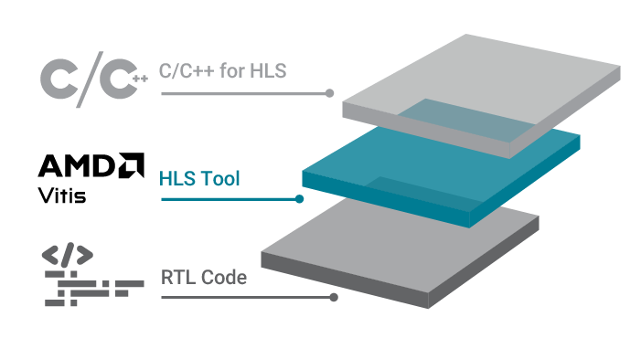
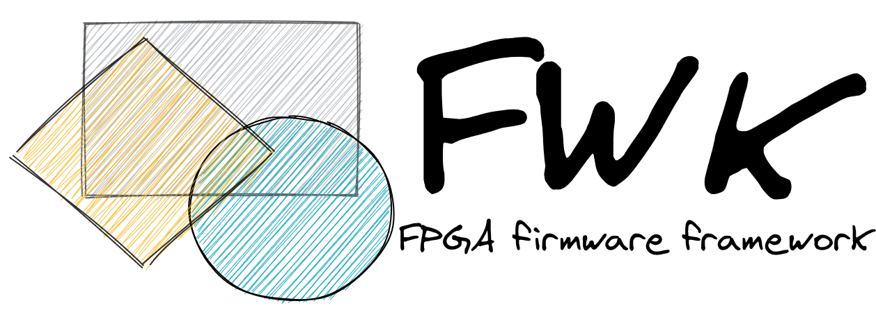
Motivation
Smooth the learning curve for the development of MicroTCA hardware and software applications.
  Complex and time consuming
  Expensive Hardware ecosystem: Chassis + MCH + AMCs (+ Uplink?)
Use cost-effective boards for quick development and prototyping
  Leverage High Level Synthesis workflows to reduce development time
  Use Desy FWK for reproducibility and collaboration!
https://nateurope.com/product/native-c8/
https://nateurope.com/product/nat-mch-g4-microtca-carrier-hub/
https://www.caenels.com/product/damc-fmc2zup/

Slide 4
Topics to learn thinking in a MTCA AMC based on AMD/XILINX SoC
Basic knowledge
  VIVADO ML and VITIS for hardware and software design and integration
  Integrate ADC/DAC/DIO interfaces
  Integrate high-speed communication interfaces (Ethernet, PCIe, Serial links….)
  Embed Linux using Yocto (or Petalinux)
  Deploy Linux applications
  Debug, integrate and deploy applications in a real device SoC/FPGA
Additional knowledge
  Integration of FMCs
  Specific firmware frameworks (i.e., Desy FWK)
  Control system integration (ChimeraTK, EPICS…)

Slide 5

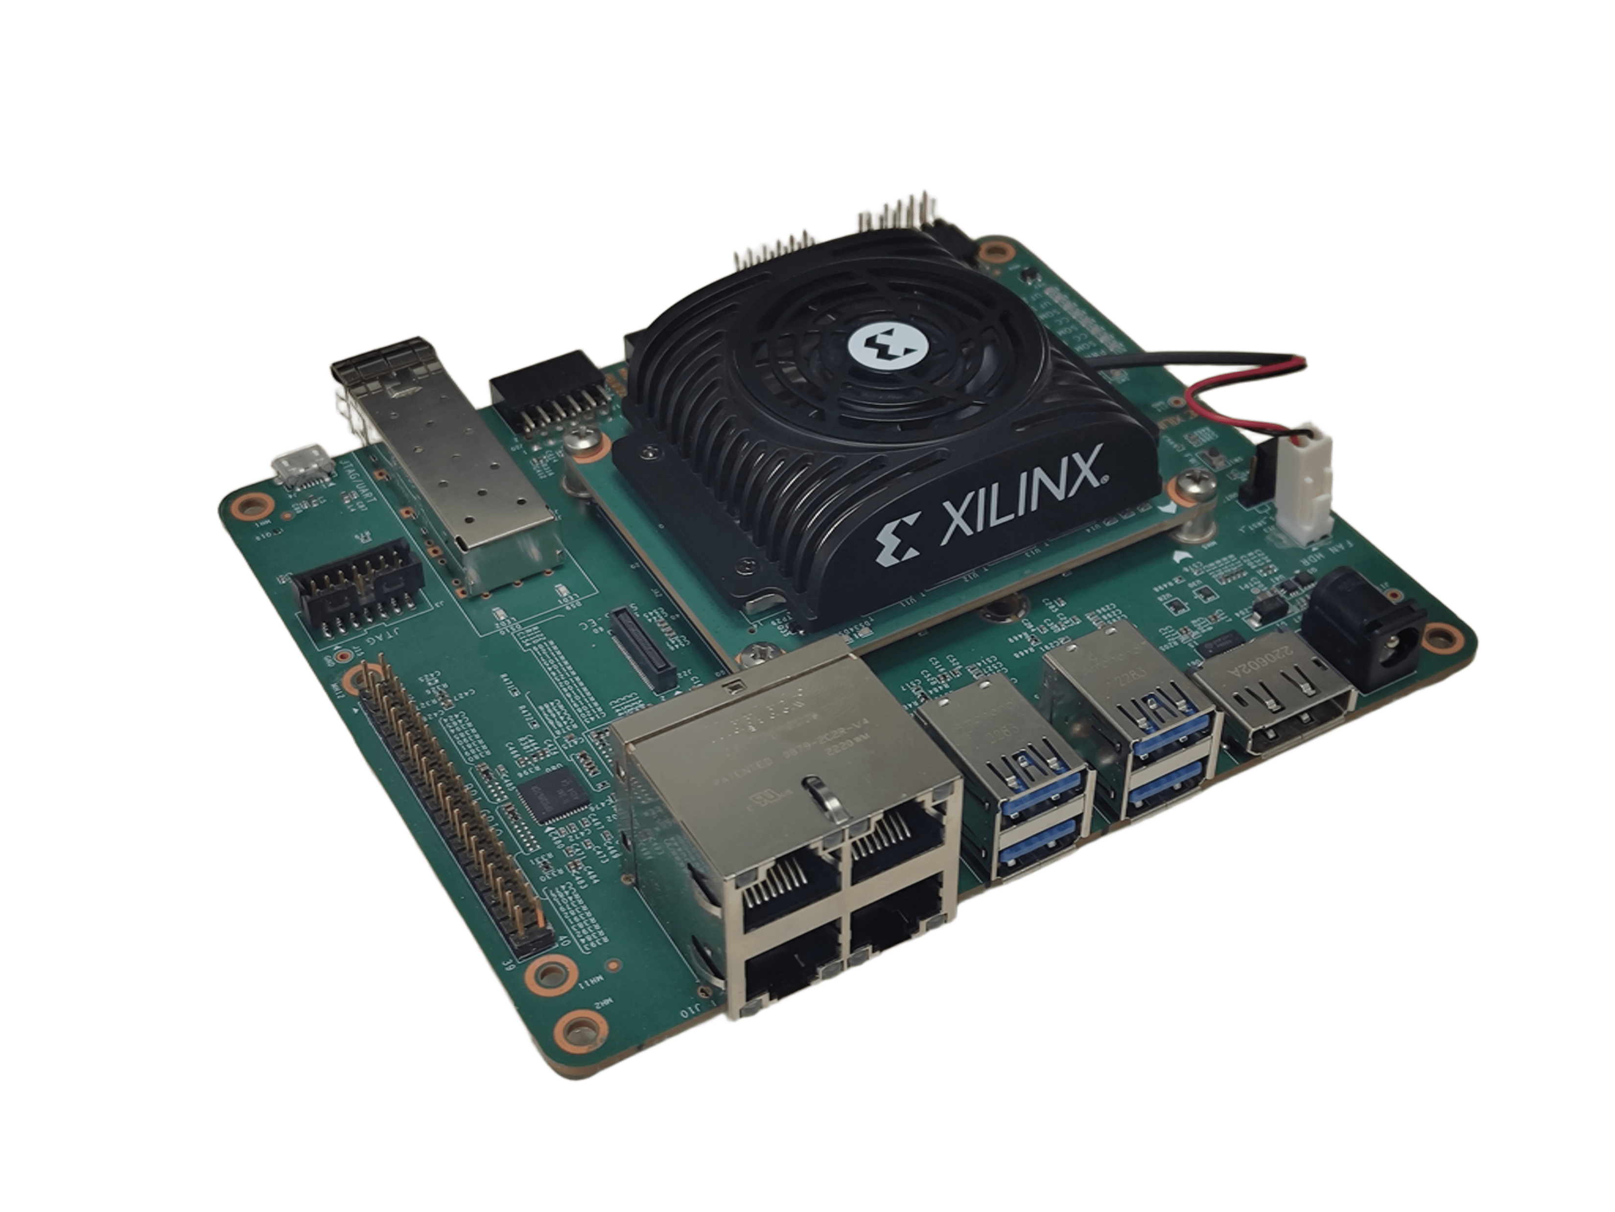
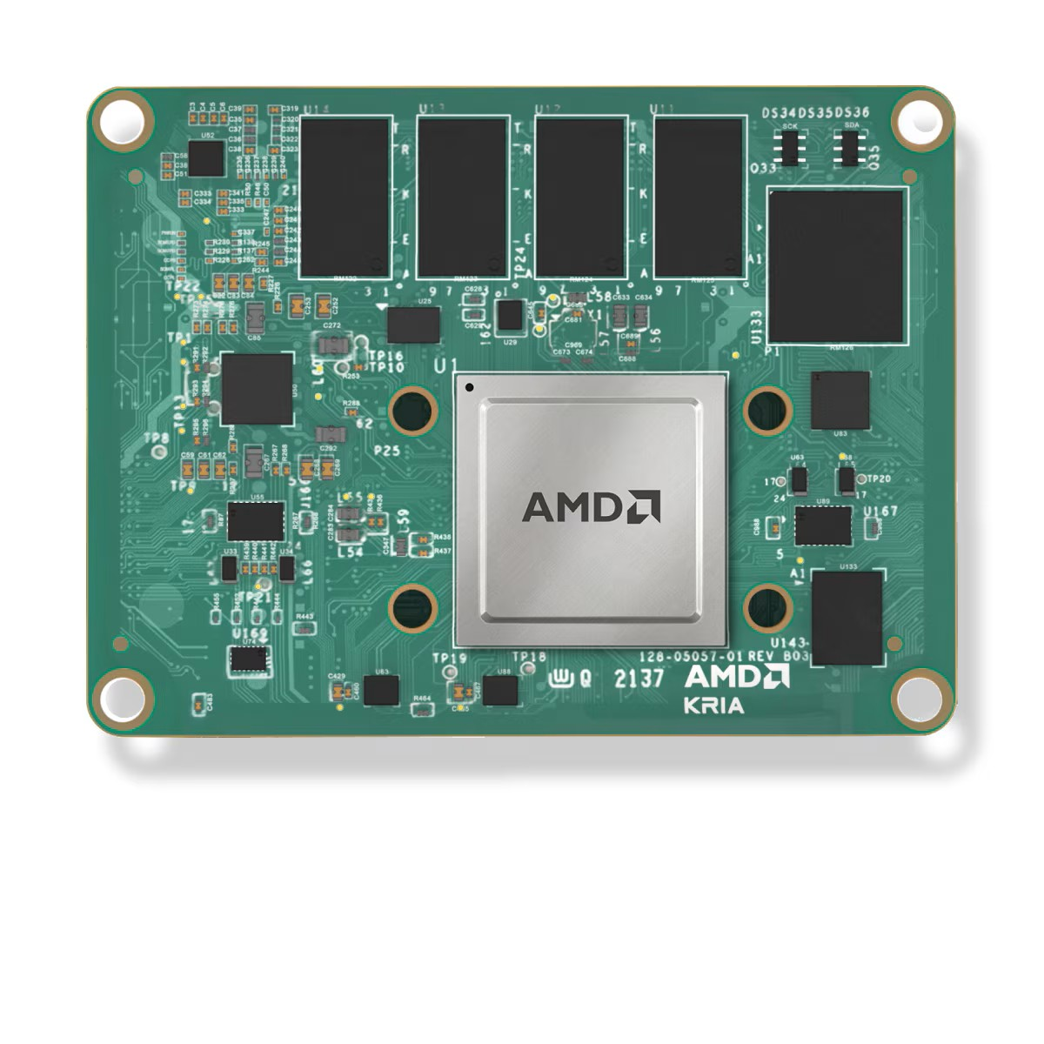
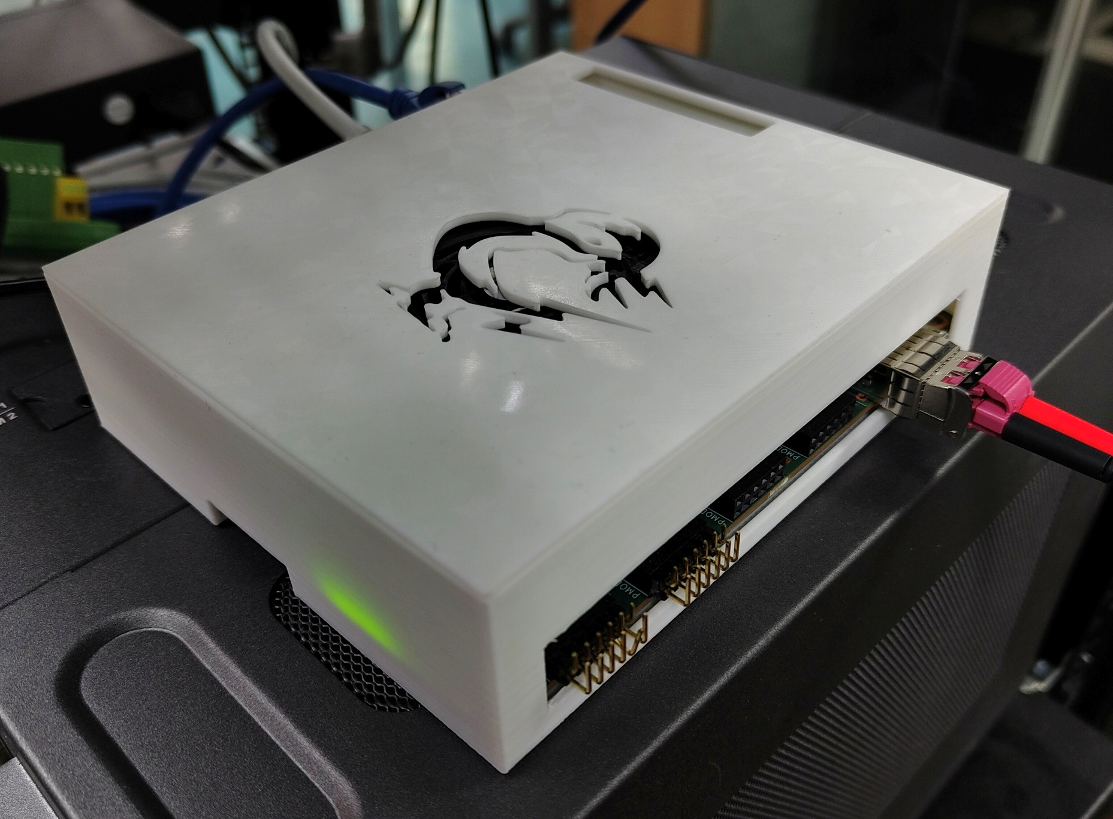
KR260 Robotics Starter Kit
Really low cost (~400€)
Kria K26 SOM with ZynqMP UltraScale+ Device (SoC) + 4 GB DDR4
Plenty of I/O (Provided by carrier)
  4x PMOD + RPI header
  4x USB, 4xEthernet Ports (2 connected to PS, 2 to PL)
  1 SFP+ Cage
  But no PCIe ☹ (SoM has PCIe hard core, carrier does not have PCIe connectors )
  But no FMC ☹ (There are carriers with FMC)
Huge support from AMD
  Example designs
  Yocto layers
https://www.amd.com/es/products/system-on-modules/kria/k26/k26c-commercial.html

Slide 6
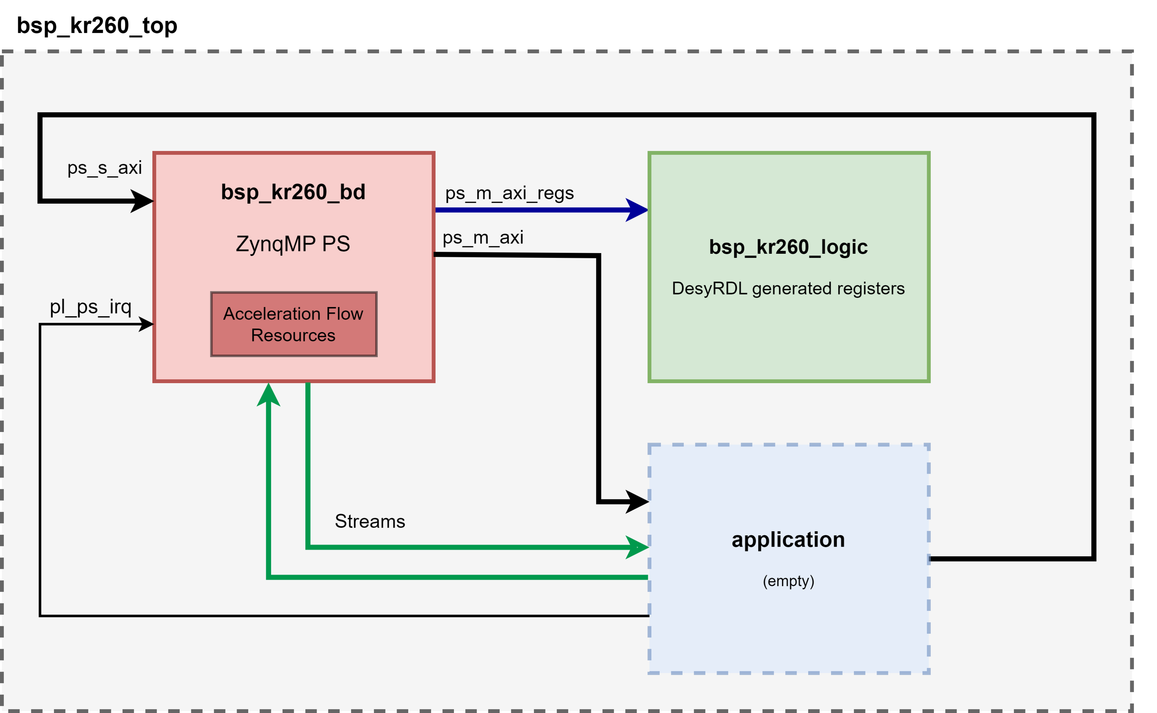
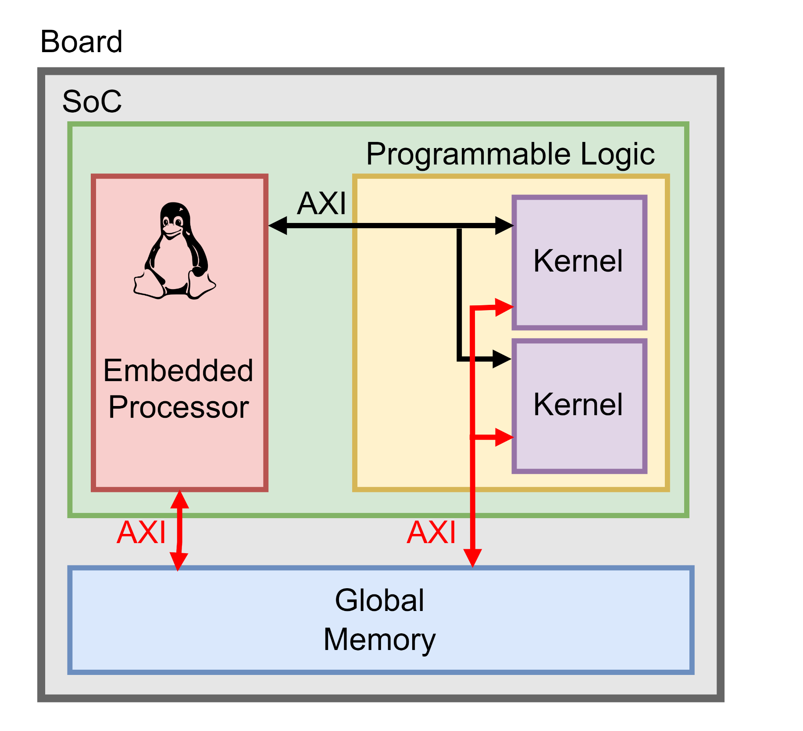
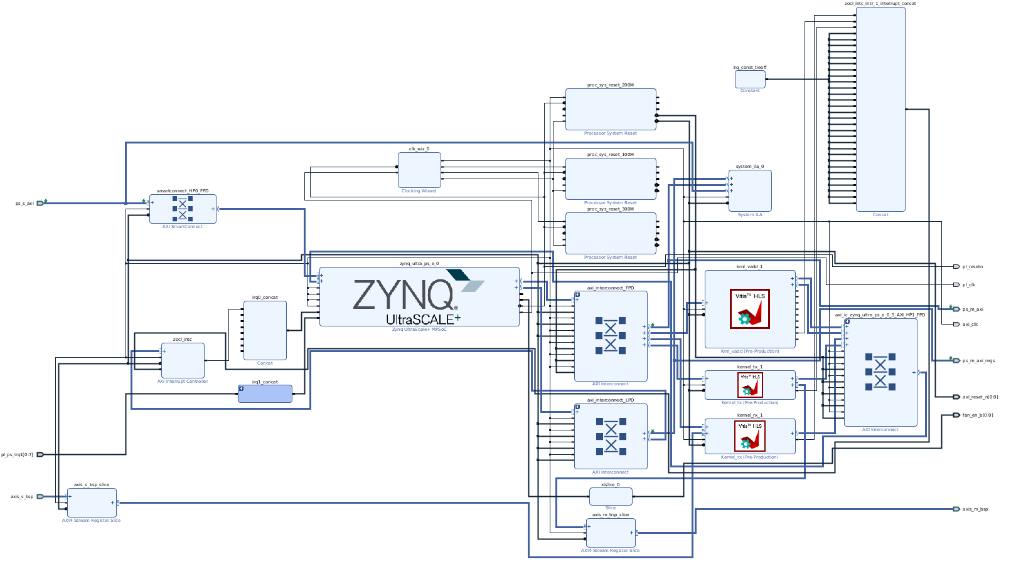
KR260 Robotics Starter Kit (HW)
Follows DESY FWK architecture
  BSP Block Design containing all core logic
  Module for custom application logic
  DesyRDL-generated registers
  Adds support for VITIS hardware acceleration flow
Why AMD acceleration flow?
  Describe hardware functions (kernels) with HLS, using a C/C++ syntaxis
  Host program written in C/C++, runs on the ARM CPU and manages kernel execution and data transfers
  Evaluate complex DSP solutions and AI-based applications

Slide 7
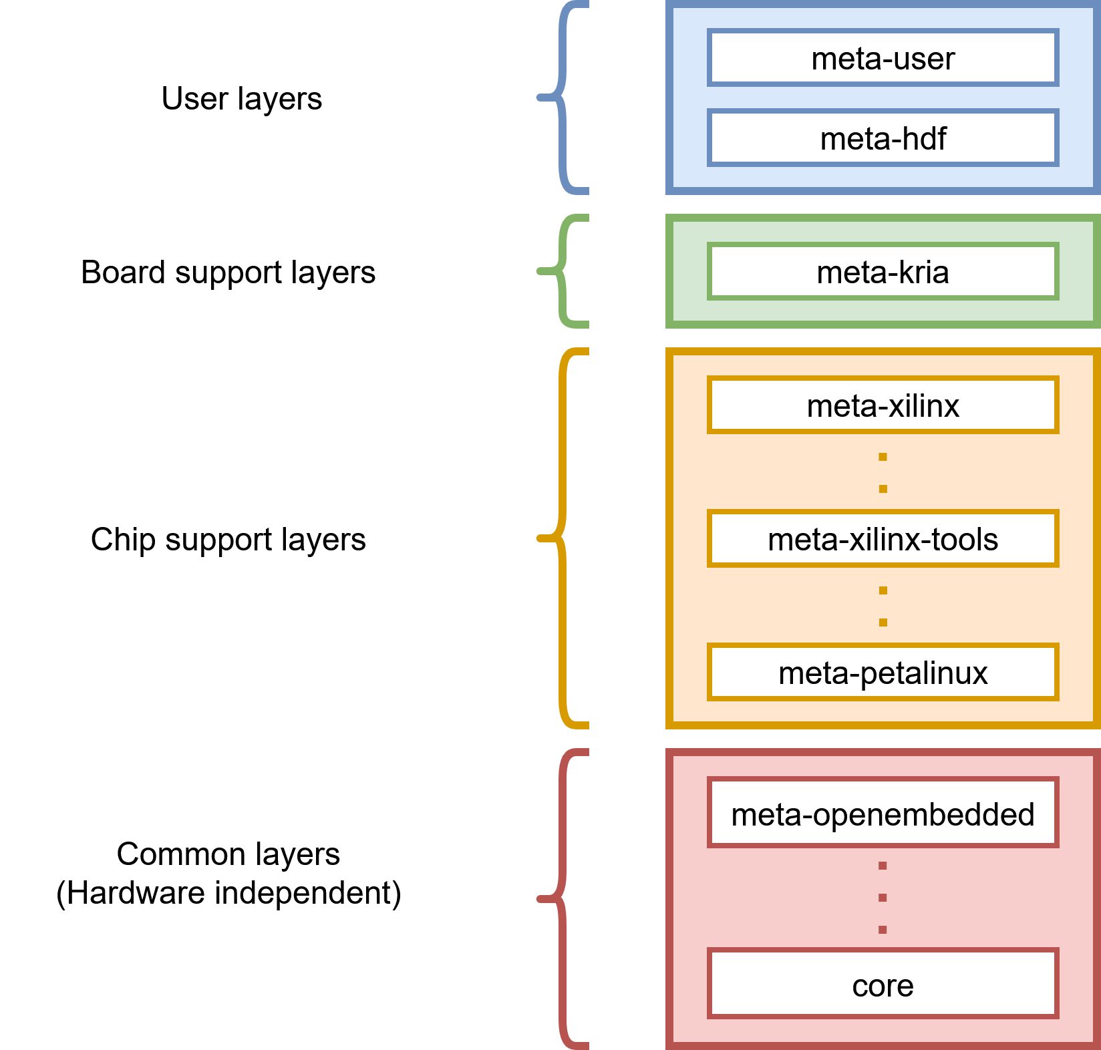
KR260 Robotics Starter Kit (SW)
Highly customizable Linux image, generated using Yocto
  Enable kernel features, drivers, packages…
FPGA Bitstream is loaded from Linux, which can be reloaded at runtime (xmutil utility)
  No system reboot required
Adds the OpenCL headers and the zocl (Zynq OpenCL) driver to run accelerated applications

Slide 8
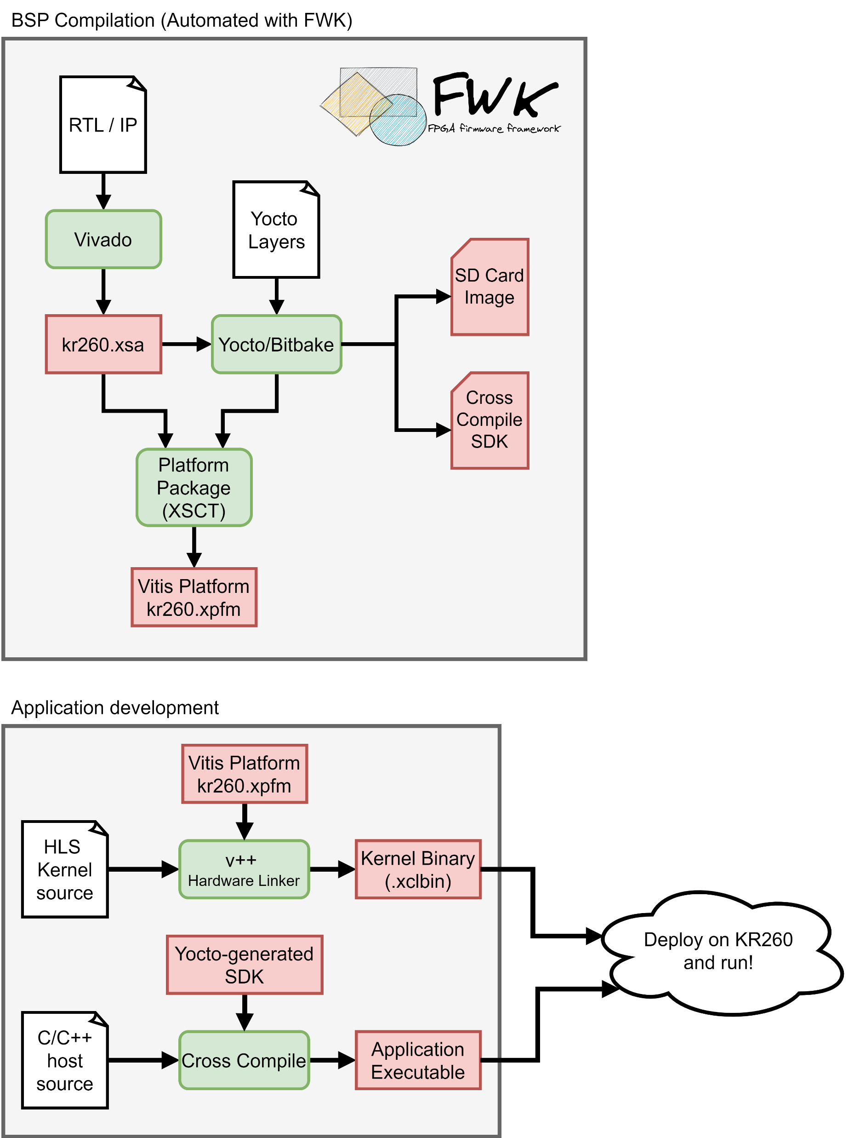
KR260 Robotics Starter Kit (Development Flow)
Fully automated compilation flow using Desy FWK
  Generate XSA from RTL sources using Vivado
  Compile custom embedded Linux Image using Yocto
  Generate cross-compile toolchain
  Package everything into a Vitis Platform for later use deploying accelerated applications
This only needs to be done once

Slide 9
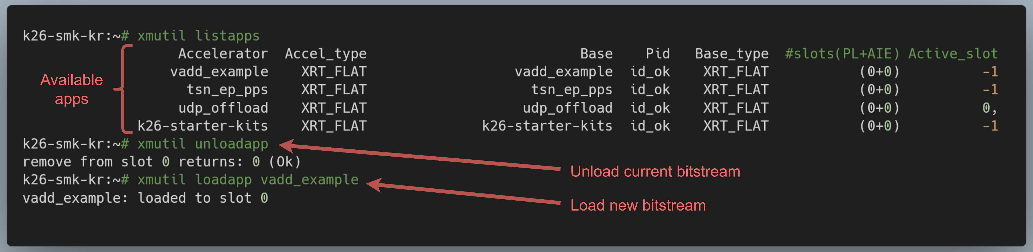
KR260 Robotics Starter Kit (Development Flow)
Import generated platform into Vitis
Describe hardware functions (kernels) using HLS
The Vitis hardware linker (v++) automatically connects the kernels to the platform interfaces (AXI4-MM or AXI4 Stream)
  Abstraction from hardware
Compile host program (OpenCL API), using the cross-compile toolchain
Deploy on KR260 and run!

Slide 10
Topics covered using the Kria Module
Basic knowledge
  VIVADO ML and VITIS for hardware and software design and integration
  Integrate ADC/DAC/DIO interfaces
  Integrate high-speed communication interfaces (Ethernet, Serial links….)
  Embed Linux using Yocto (or Petalinux)
  Deploy Linux applications
  Debug, integrate and deploy applications in a real device SoC/FPGA
Additional knowledge
  Integration of FMCs
  Specific firmware frameworks (i.e., Desy FWK)
  Control system integration (ChimeraTK, EPICS…)

Slide 11
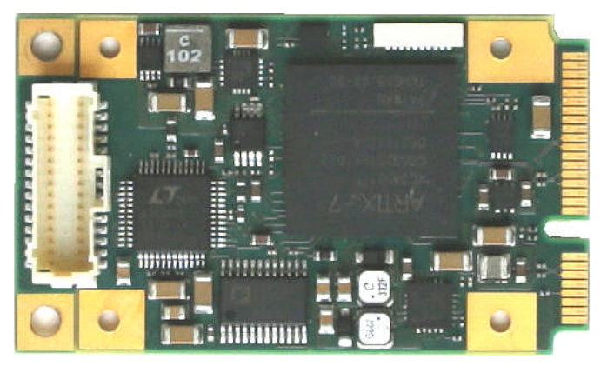
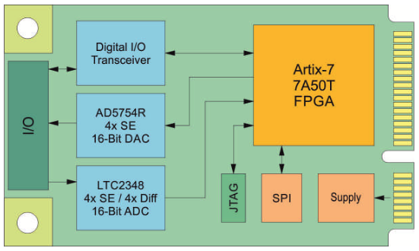
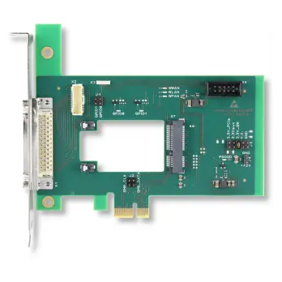
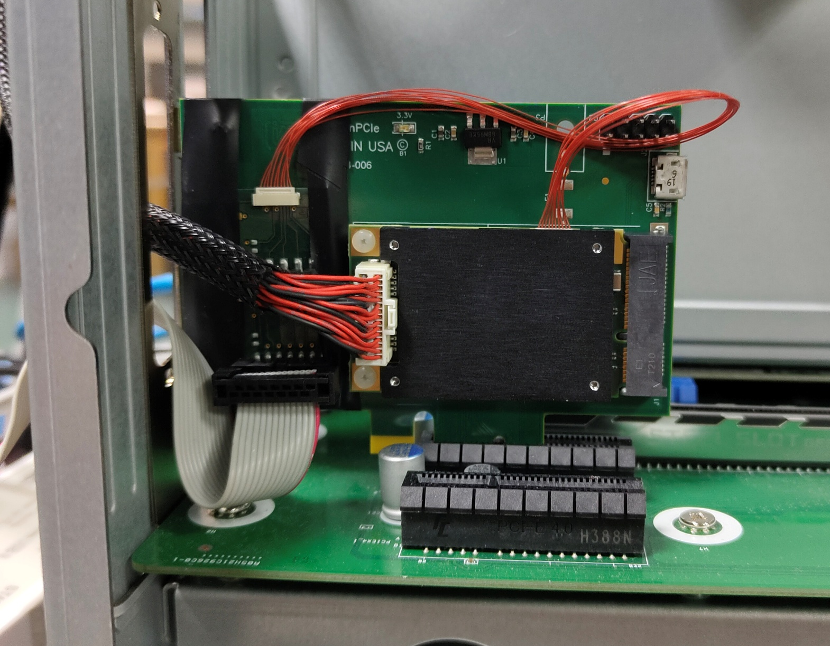
TEWS TMPE627 Mini PCIe Module
mPCIe board: Artix 7 (~1200€ ) PCIe Gen2 hard-core
Integrated data converters and DIO
  4xChannel 16-bit ADC (Up to 200 Ksps)
  4xChannel 16-bit DAC (10 µs conversion time)
  14 digital I/O TTL lanes
Project contains
  ADC/DAC and PCIe interfaces
  Register configuration interface
https://www.tews.com/products/mpcie/tmpe627/

Slide 12

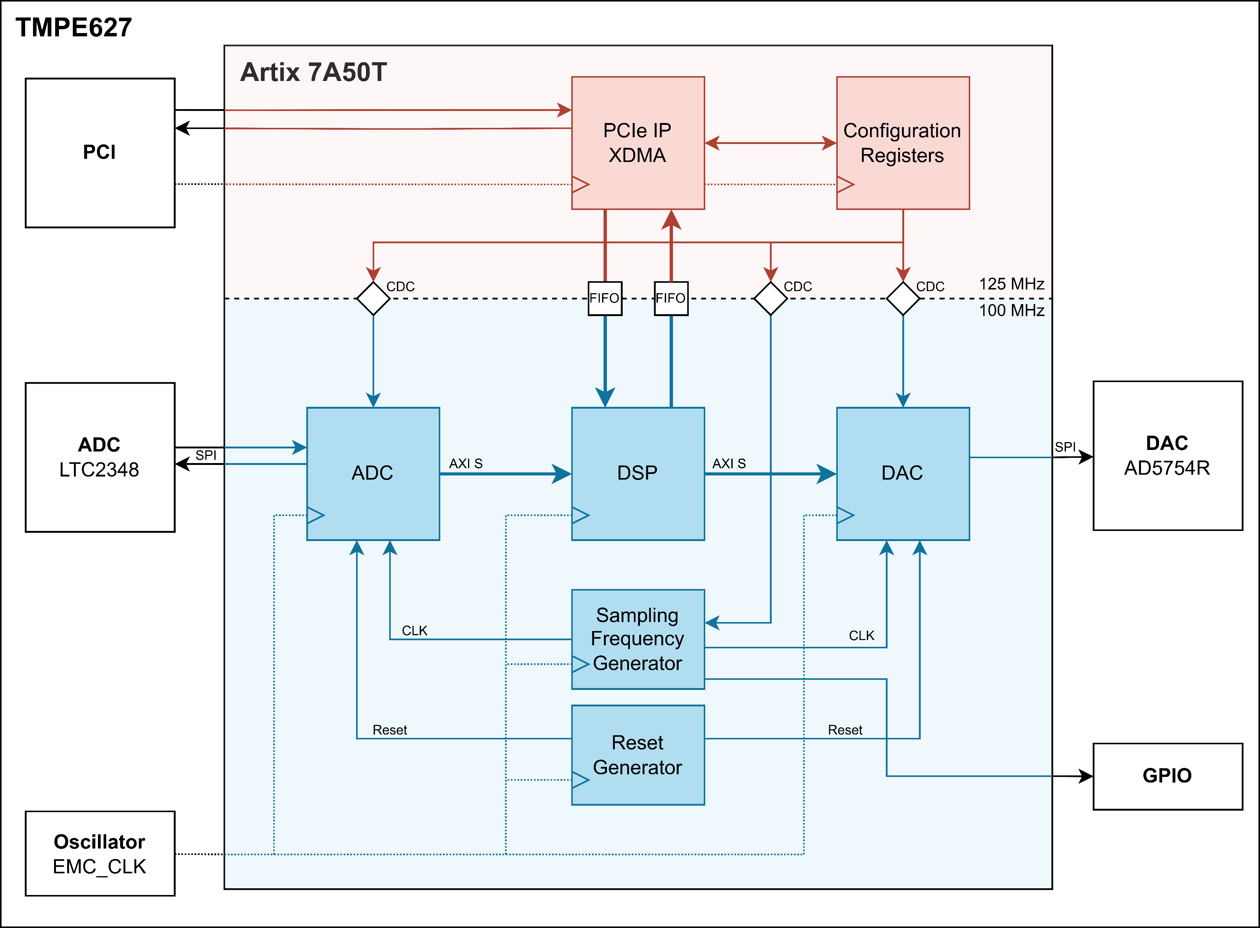

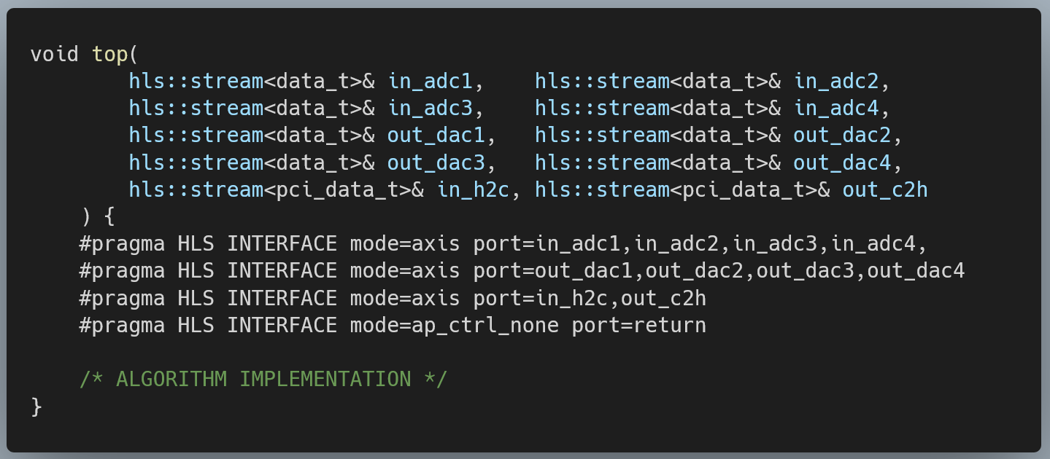
TEWS TMPE627 (Hardware: tmpe-fwk)
XDMA for PCIe communication
  AXI Stream mode
  AXI Lite for configuration registers
    DESY RDL-generated (Configure sampling rate, nº samples, etc)
ADC/DAC Interface using SPI
Clock domain crossing handling
User logic goes into the “DSP” block
Ready to integrate HLS kernels with the following AXI Stream interfaces:
  4 streams from ADC channels
  4 streams for DACs
  PCIe input stream from host computer
  PCIe out stream for host computer

Slide 13
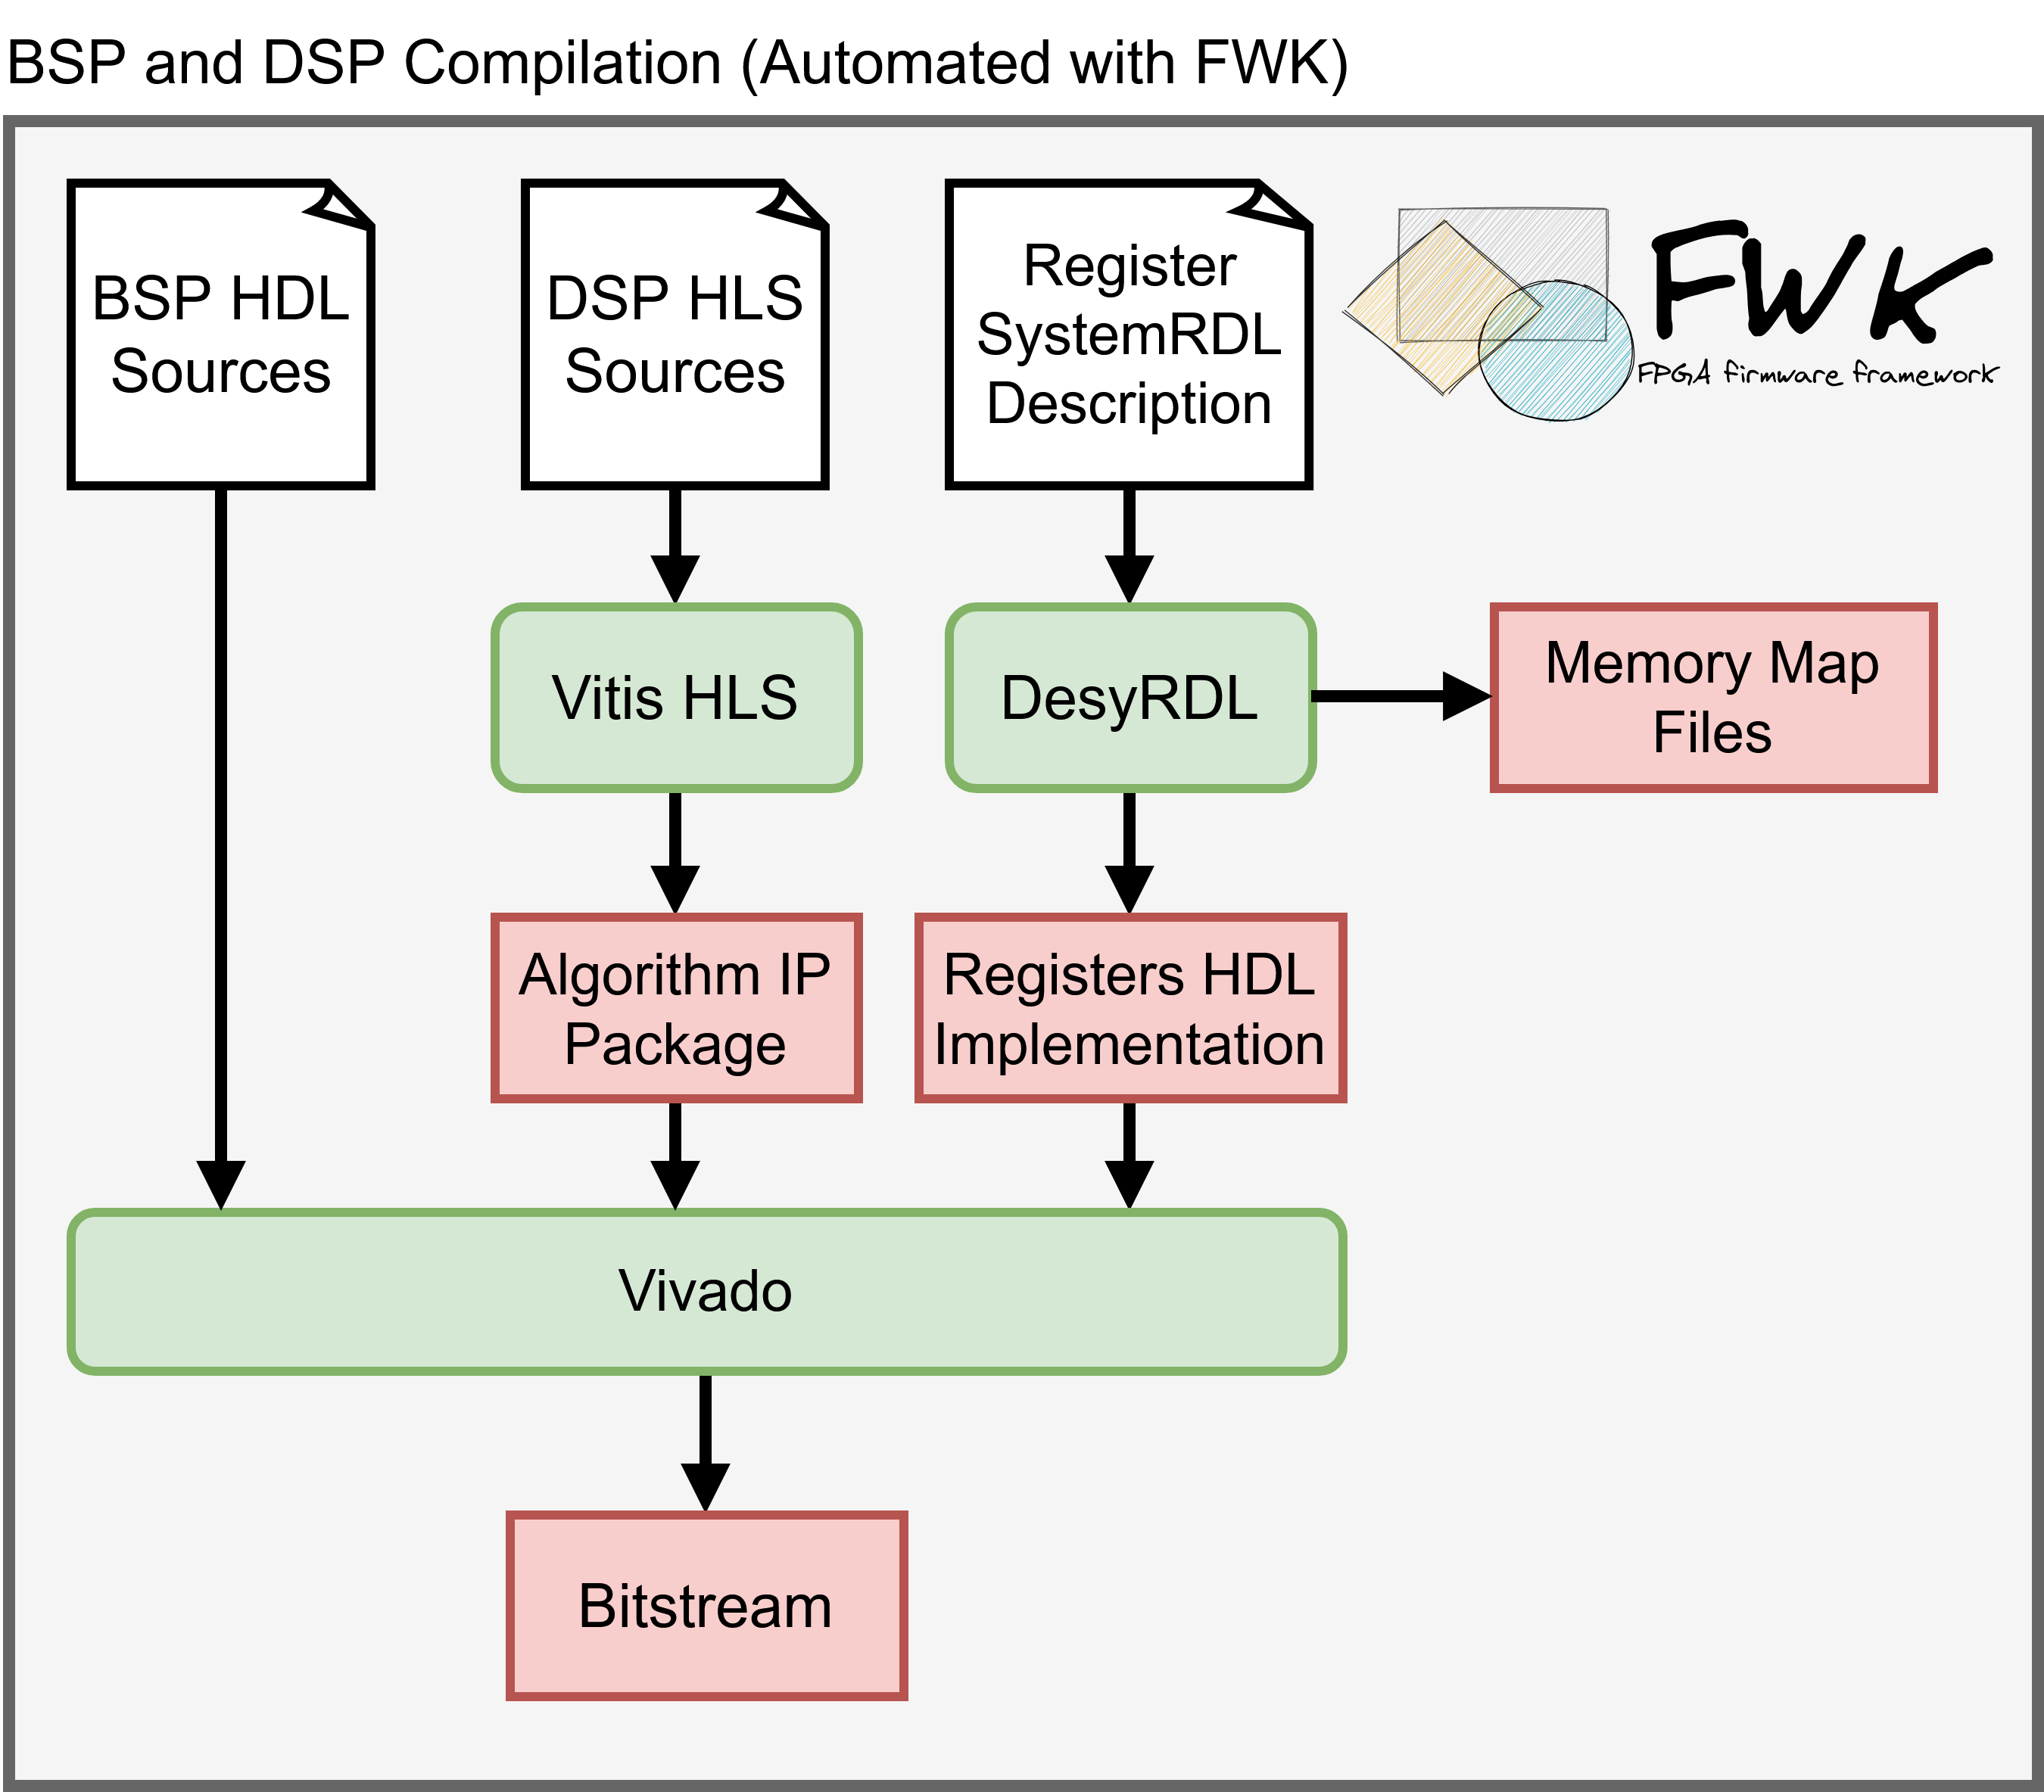
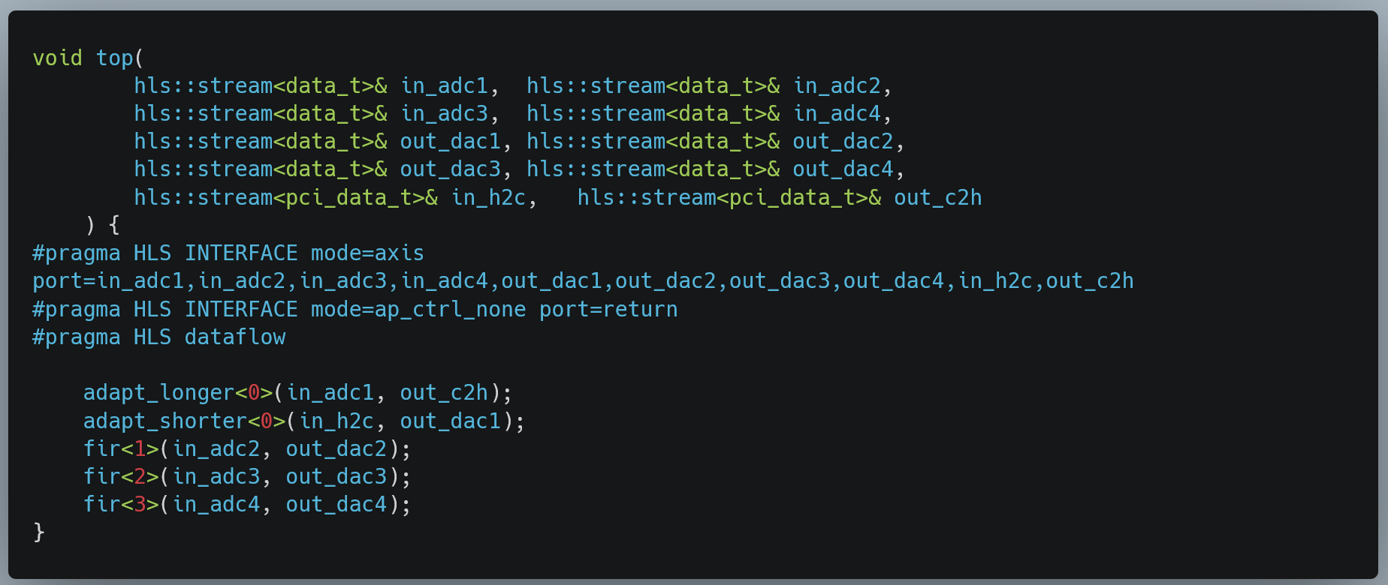
TEWS TMPE627 (Development Flow)
Fully automated compilation with FWK
  Compile DSP HLS algorithm with Vitis HLS
  DesyRDL generates registers HDL source
  Generate bitstream using Vivado
The project contains an example HLS kernel
  Data movement from FPGA to host PC through PCIe
  Data movement from host PC to FPGA through PCIe
  FIR filter:
    ADC → FIR → DAC

Slide 14
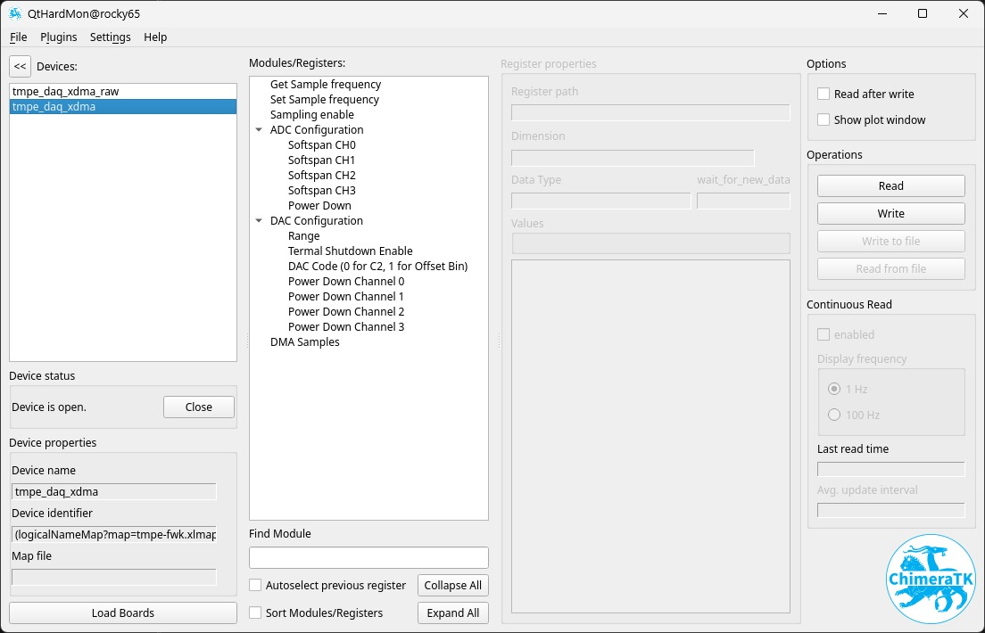
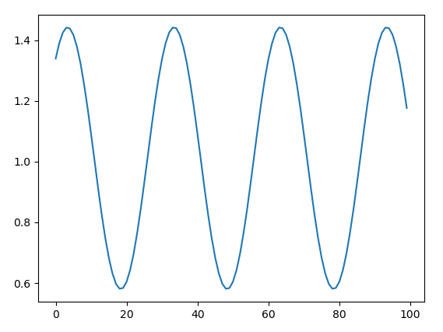
TEWS TMPE627 (Software: tmpe-chimeratk)
Use of XDMA Linux Device Driver
FWK generates the required files for ChimeraTK Integration
Qt Hardware Monitor for the configuration of the main registers in ADC and DAC chips and basic data acquisition parameters
Examples of configuration and acquisition using DeviceAccess written in:
  C++
  Python
  Rust

Slide 15
Topics covered using the TEWS module
Basic knowledge
  VIVADO ML and VITIS for hardware and software design and integration
  Integrate ADC/DAC/DIO interfaces
  Integrate high-speed communication interfaces (PCIe)
  Embed Linux using Yocto (or Petalinux)
  Deploy Linux applications
  Debug, integrate and deploy applications in a real device SoC/FPGA
Additional knowledge
  Integration of FMCs
  Specific firmware frameworks (i.e., Desy FWK)
  Control system integration (ChimeraTK, EPICS…)

Slide 16
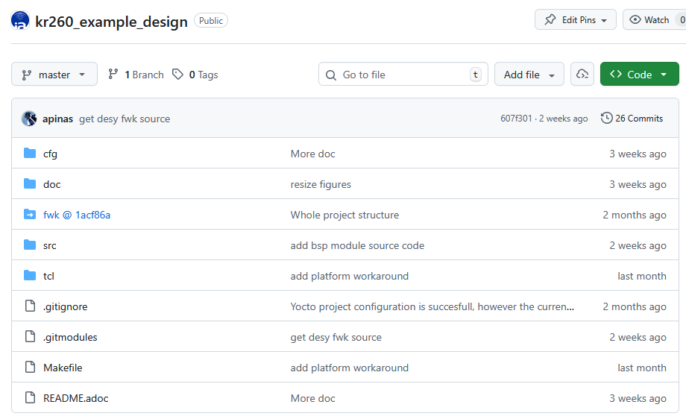
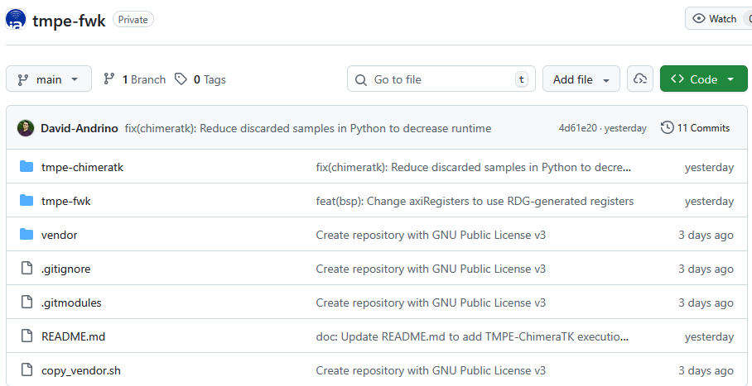
Conclusions
Integration in DESY FWK of:
  Accelerated platforms
  Support for Kria KR260
  Support for a mPCIe XILINX-based DAQ device
Two repositories containing the source code for hardware and software parts
  Open access to GitHub repos
  Repositories contain documentation about requirements and build instructions
  https://github.com/i2a2/kr260_example_design
  https://github.com/i2a2/tmpe-fwk

Slide 17
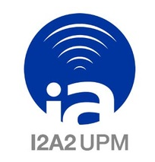
Who are I2A2
I2A2-UPM is a research group in UPM
40 people
Working in close collaboration with Industry and research entities
I2A2 is a collaborator of ITER, Max Planck IPP and CIEMAT in Big Science Area
We train young engineers in advanced instrumentation and embedded systems through participation in R&D activities.
We are eager to participate in research projects

Slide 18
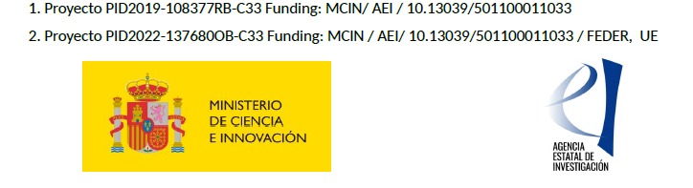
Thanks for your attention
Alejandro Piñas: apinas@upm.es

