Slide 1
Update on the development and deployment of the MicroTCA based detector controller, NGCII
Mathias Richerzhagen, Matthias Seidel, Alexander Rüde,
Max Engelhardt, Omar Sqalli

Slide 2
Abstract: In the time since the last MicroTCA workshop we have achieved laboratory first-light with the final two detector families to be supported by our MicroTCA.4 based general detector controller, NGCII. Besides CCDs, the workhorse detector for ground-based astronomy, we have also brought up Geosnap, a fully digital detector transmitting its pixel data through high-speed digital signals. Meanwhile, we are in the process of preparing CMOS detector systems for large scale deployment. We are developing test tooling for post-production testing, estimating the need for, and starting the procurement of spare parts, and are in the process of performing final environmental tests for CMOS detector specific systems.

Slide 3
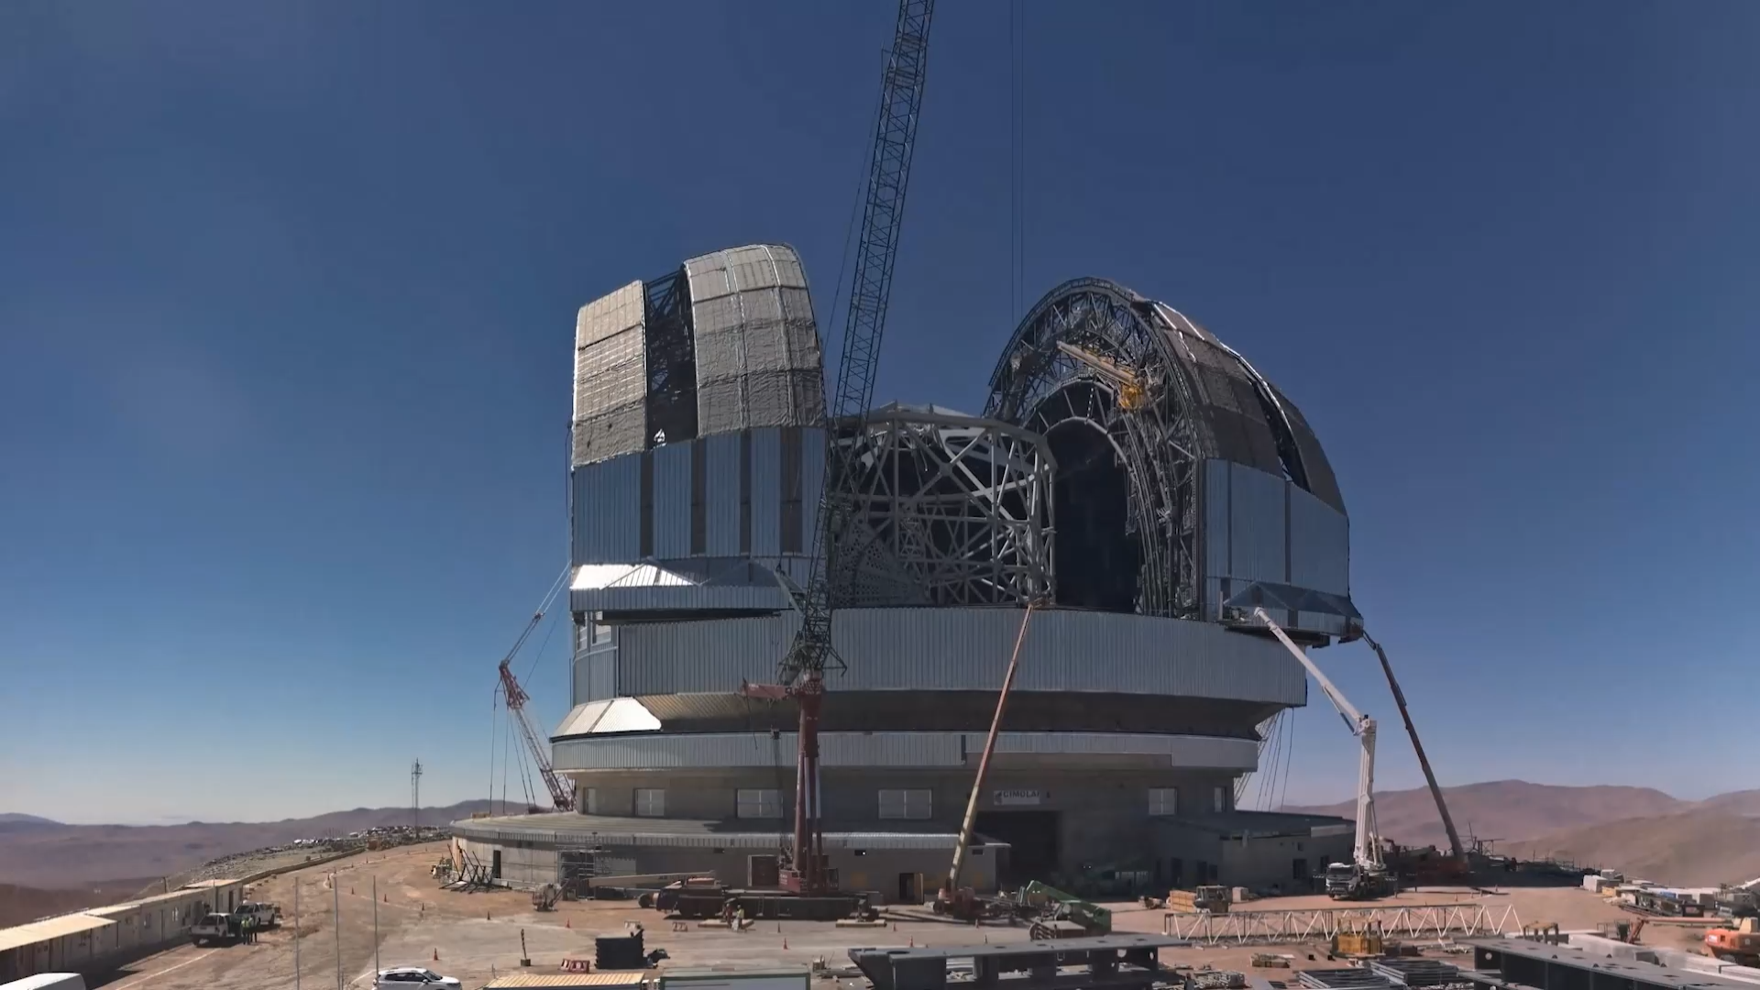
It moves!

Slide 4
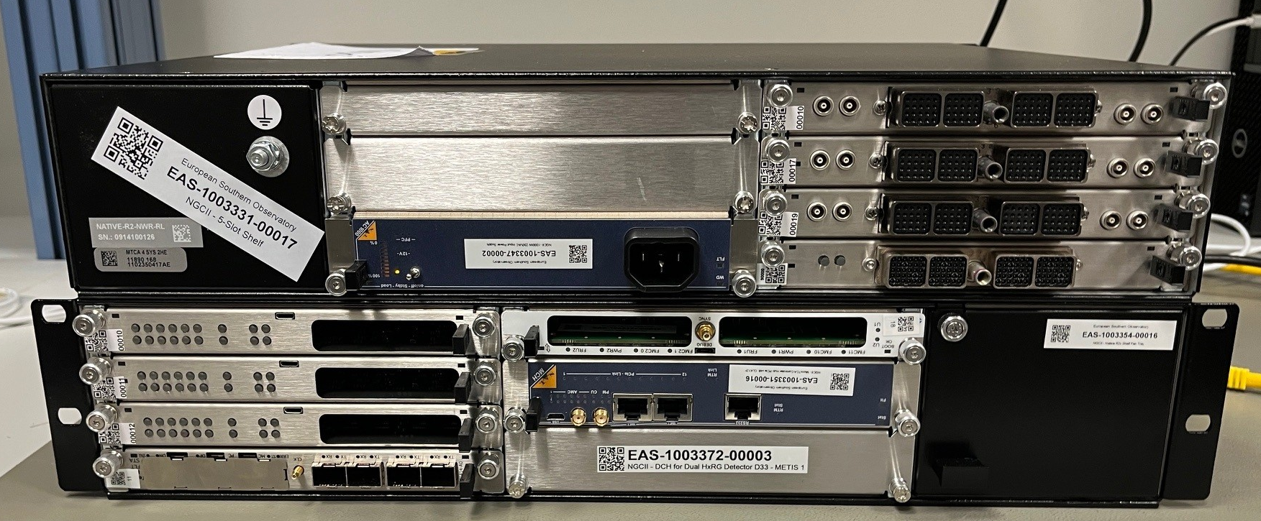
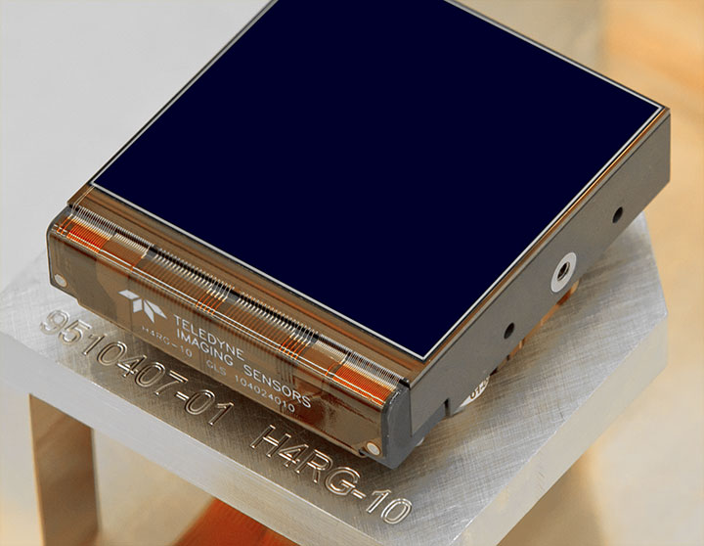
System Overview
MicroTCA Based Detector Controller - Recap
Detector
Interface
AC or DC
Power
Network
Interface

Slide 5
Detector Status

Slide 6
Analog CMOS Detectors
HAWAII-xRG Hybrid CMOS / SAPHIRA eAPD CMOS
Detector performance fully validated in 2023 and 2024
Need to deliver ~25 Systems in 2026 and 2027

Slide 7
Analog CMOS Detectors
HAWAII-xRG Hybrid CMOS / SAPHIRA eAPD CMOS
Manufacturing Readiness Review
Environmental Test
We are here
Prototype
Pre-Series
Series
All assembly and testing done in-house.
Very limited external delivery.
Assembly and testing done by external contractor.
External delivery within Europe.
Considered “Series” if environmental testing passes
Assembly and testing done by external contractor.
External delivery.
Managed by technology
development programme
Managed by directorate of engineering

Slide 8
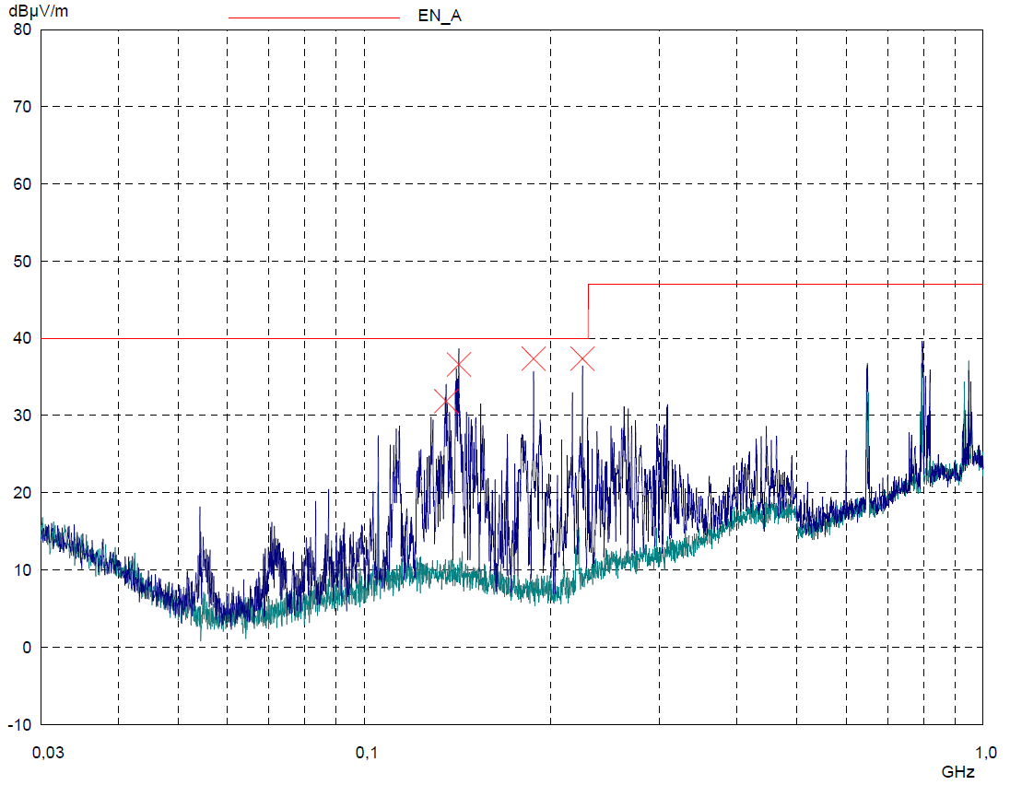
Analog CMOS Detectors
Thermal Test (In-House):
✅High-Temperature Operation (+40°C)
✅Low-Temperature Operation (+0°C)
✅Cold Start (−10°C)
✅Survival (−5°C to +45°C)
Environmental Test
EMC Immunity Test (External Test Site):
✅IEC61000-4-2 Electrostatic Discharge (8kV/15kV)
✅IEC61000-4-8 Power Frequency Magnetic Field
✅IEC61000-4-3 Electromagnetic Field
✅IEC61000-4-4 Burst
✅IEC61000-4-6 Conducted RF
EMC Emission Test (External Test Site):
✅CISPR 11 Radiated Emission

Slide 9
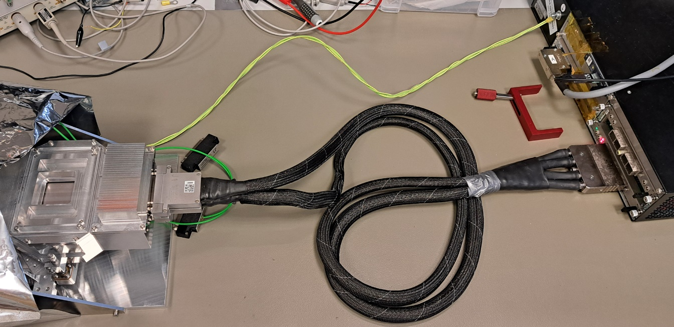
Fully Digital Detectors
Geosnap 2K x 2K Mid-IR (13.5µ) Detector
Detector Head
With ROIC
8x 1.6Gbps
NGCII
Controller

Slide 10
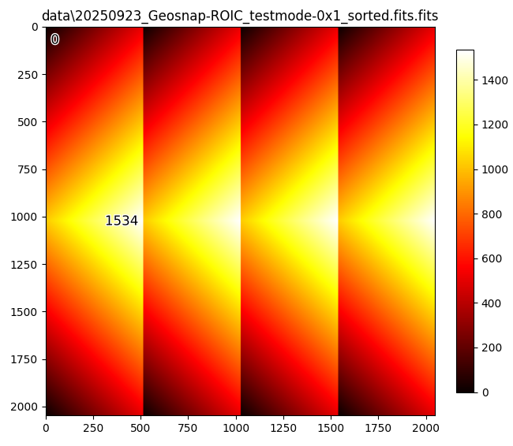
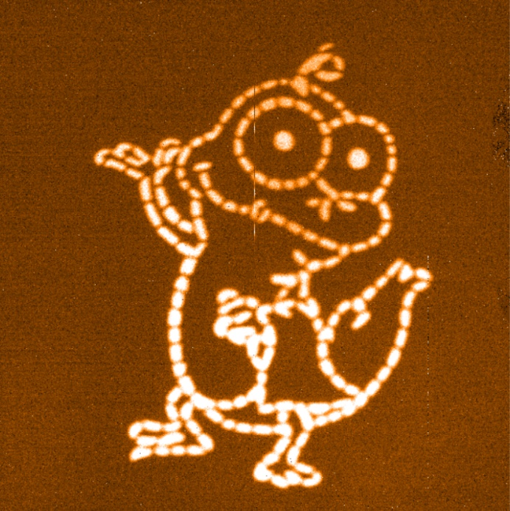
Fully Digital Detectors
Geosnap 2K x 2K Mid-IR (13.5µ) Detector
Test Pattern Image
Visible Light Mask Image
First time reading fully-digital detector at ESO, enabled by MicroTCA

Slide 11
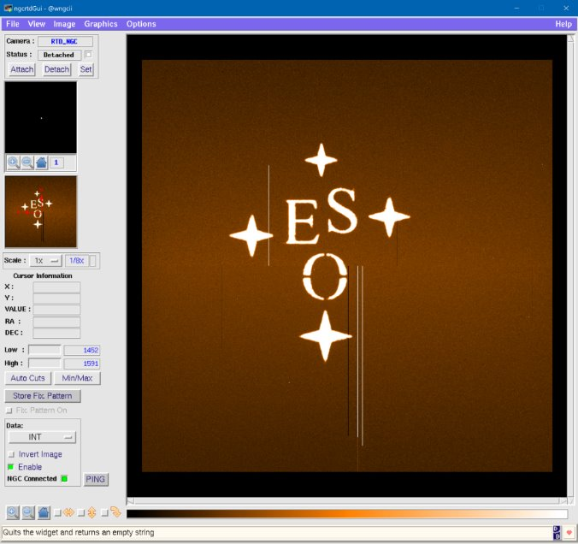
Analog CCD Detectors
What a selection! – This is a subhead for an emotional addition to the headline
First light achieved!
3e−_{RMS} noise observed
Same as previous controllers
Different parameters than other controllers
Very analog detector control, complex debugging necessary and ongoing.

Slide 12
Miscellaneous

Slide 13






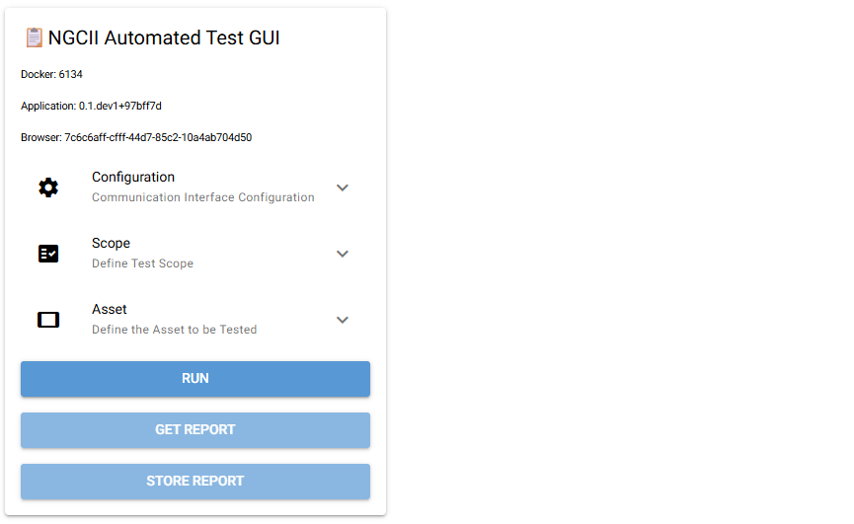





Self-Test Software
SSH Tunnel through
Detector Workstation
Device-under-test
With Loopback Plug
Integrated Test System
PyTest Based
Test Server
Web-Browser Client
2
1
Everything linked by ESO-Global Asset Tags
3
+ JIRA Ticket System
IBM Maximo Inventory
S3 Report Storage
Bucket
© xnimrodx – Flaticon
© Payungkead – Flaticon
© Icongeek26 – Flaticon
© Freepik – Flaticon

Slide 14
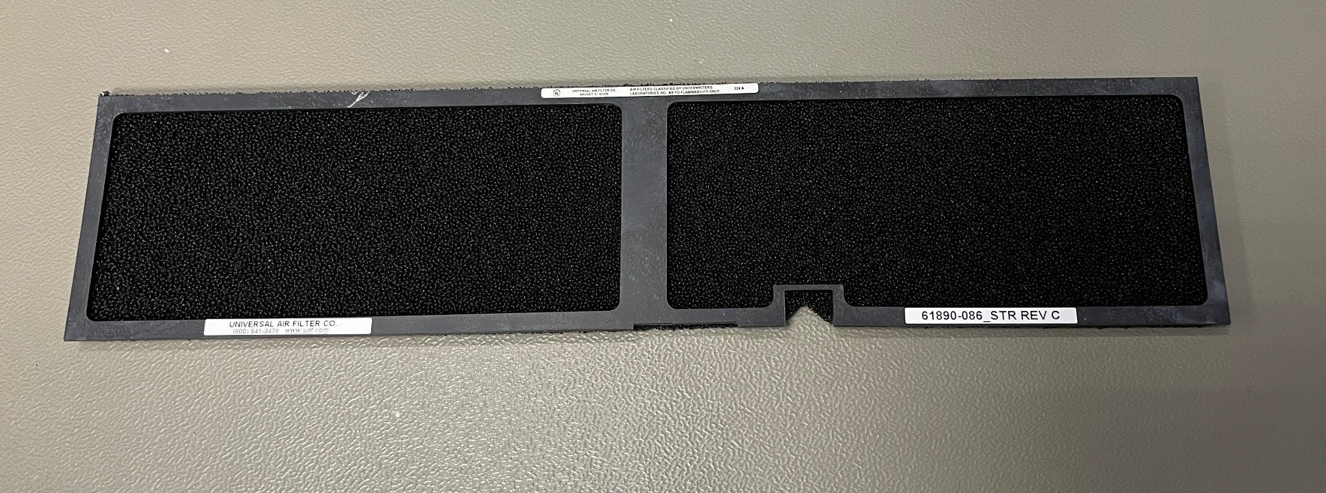
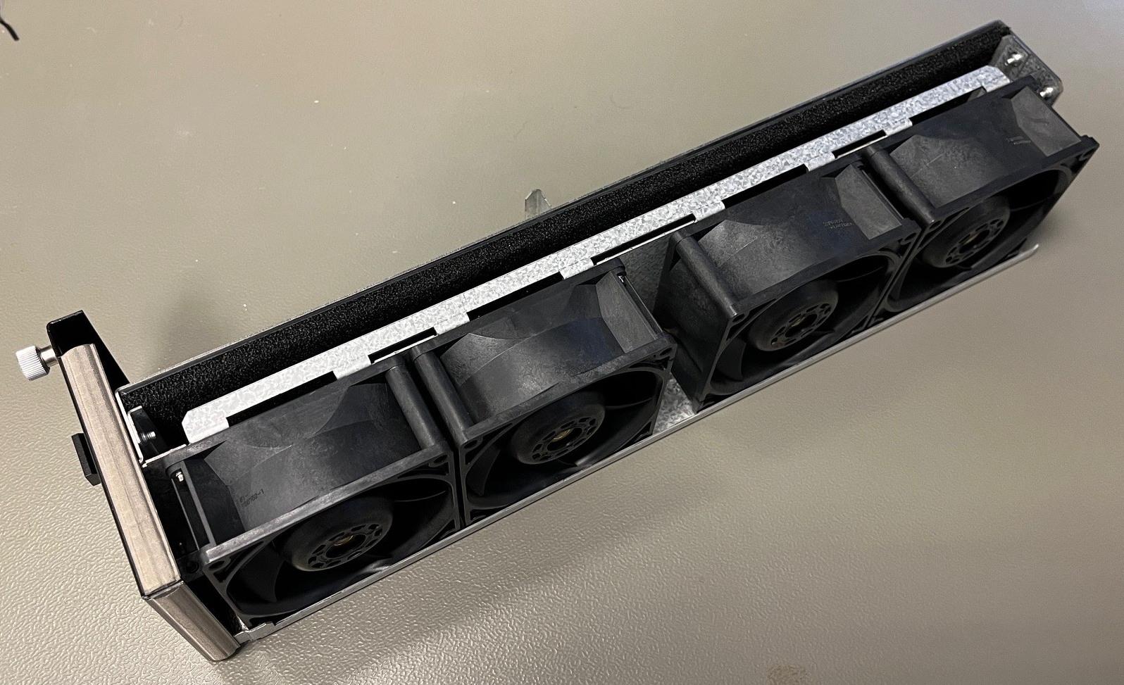
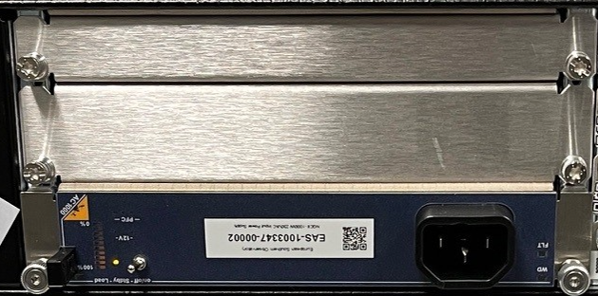
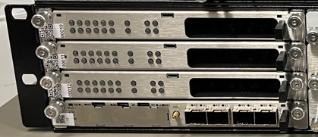
Shopping List
30x Native R2x Spare Fan Tray
We’d like to buy a few mechanical parts!
250x Native R2x Air Filter
100x Mid-Size to Full-Size Adapter
500x FMC Filler Panel

Slide 15
Mathias Richerzhagen
mathias.richerzhagen@eso.org
@ESOAstronomy
@esoastronomy
@ESO
european-southern-observatory
@ESOobservatory

