Slide 1

2025 Status Report – MYRRHA/MINERVA LLRF System
Andrea Bellandi and the ACE team - 04/12/2025

Slide 2
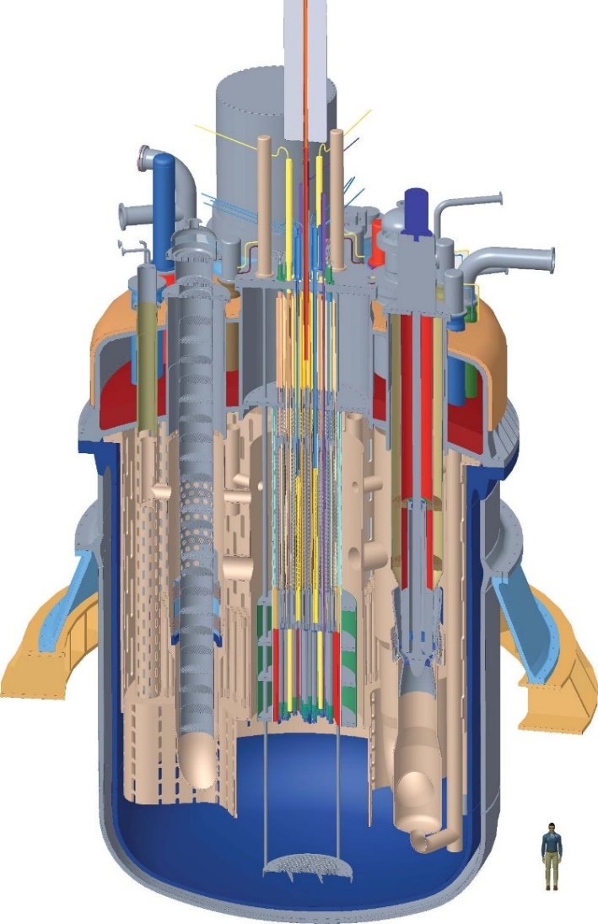
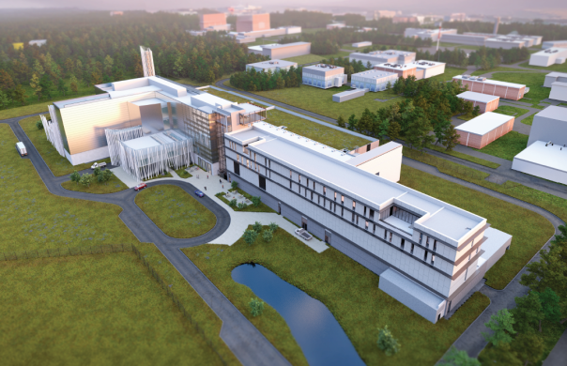
MYRRHA accelerator-driven system
600 MeV CW proton LINAC with 2.4 MW beam power
MYRRHA phase 1 (MINERVA) in construction in Mol, Belgium. Energies up to 100 MeV, 4 mA beam current (400 kW beam power)
100 MW_{th} Pb-Bi subcritical fast reactor (kₑ_{ff} ≈ 0.95, effective neutron multiplication factor)

Slide 3
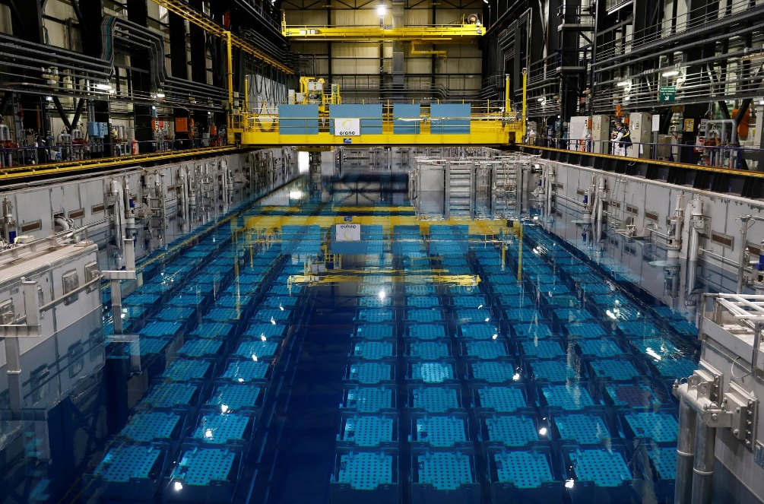
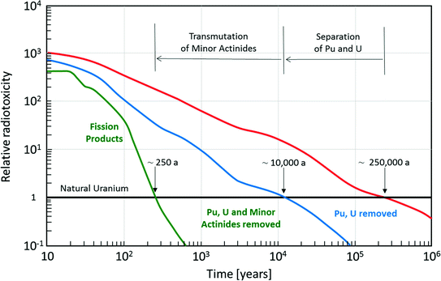


Spent nuclear fuel radiotoxicity
Neutron
Fission product
Neutron
Target nuclei
Neutron
Fission product
Neutron

Slide 4
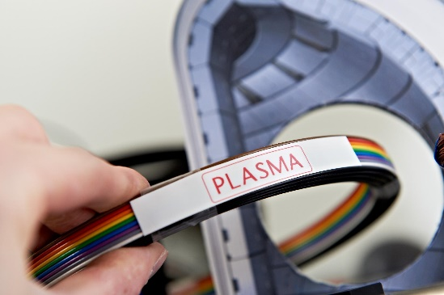

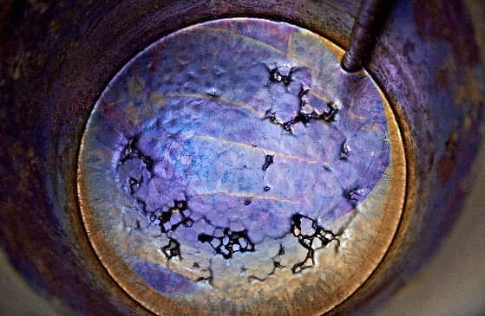
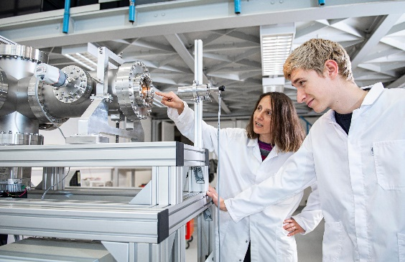
A multi-disciplinary research platform
Fusion
400 kW target station for neutron production
Fusion material research
Medical
Production of high purity theranostic radio-isotopes
Targeted cancer therapies
Fission
Validation of Pb-Bi technology
Innovative fuel studies
Nuclear physics
Isotope Separation OnLine (ISOL) system
Radioactive Ion Beams (RIB)

Slide 5
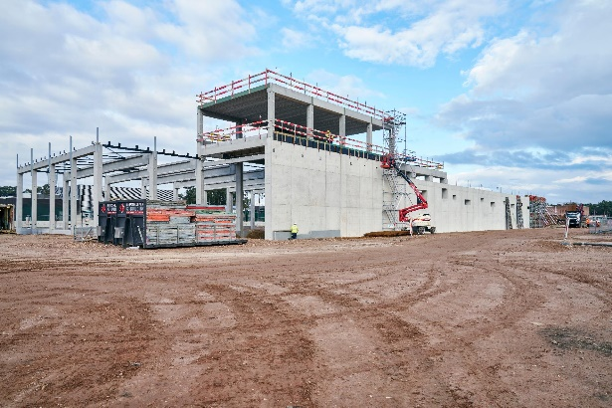
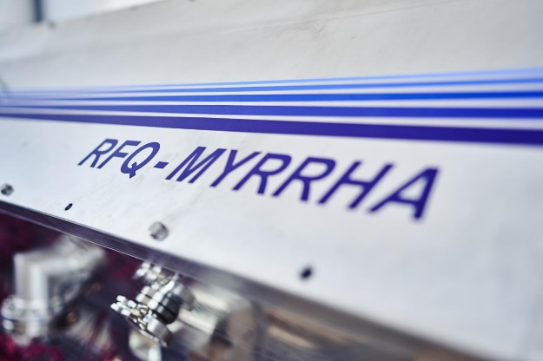
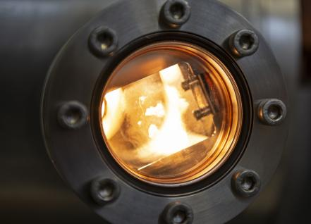

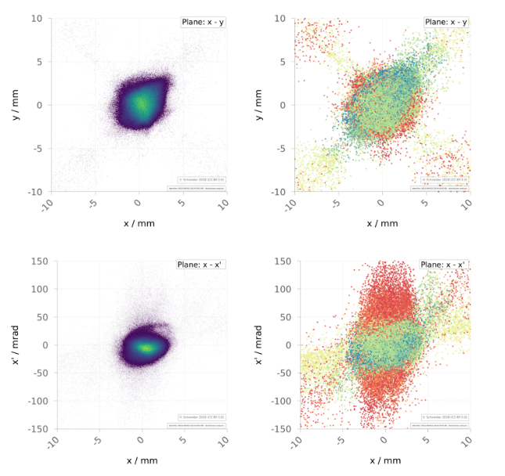
Milestones of MYRRHA phase 1
Ground-Breaking Auxiliary Units and Cryogenics Compressor buildings
Start of accelerator installation
Commissioning of experimental facilities
Q4 2024
Q1 2026
Q1 2027
Q1 2028
Q2 2030
Ground-Breaking Accelerator tunnel
Commissioning of accelerator

Slide 6
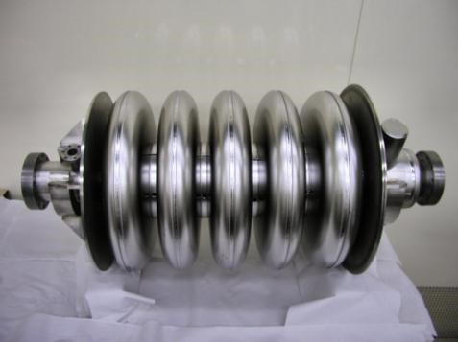
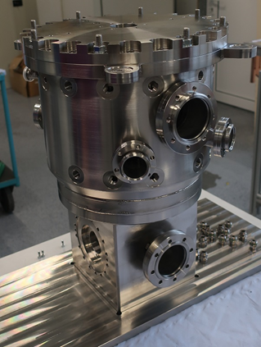
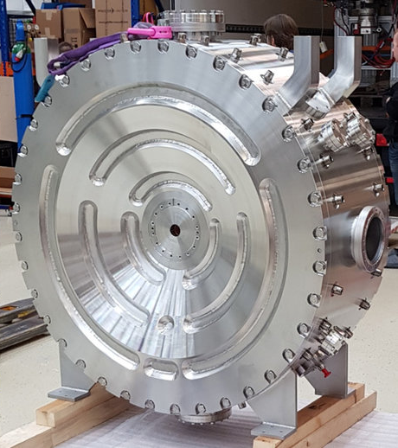
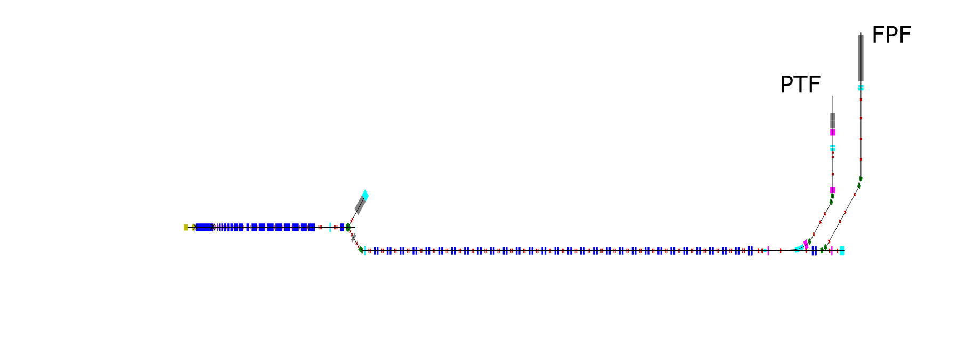
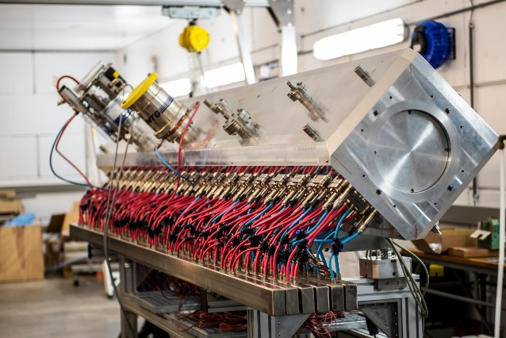
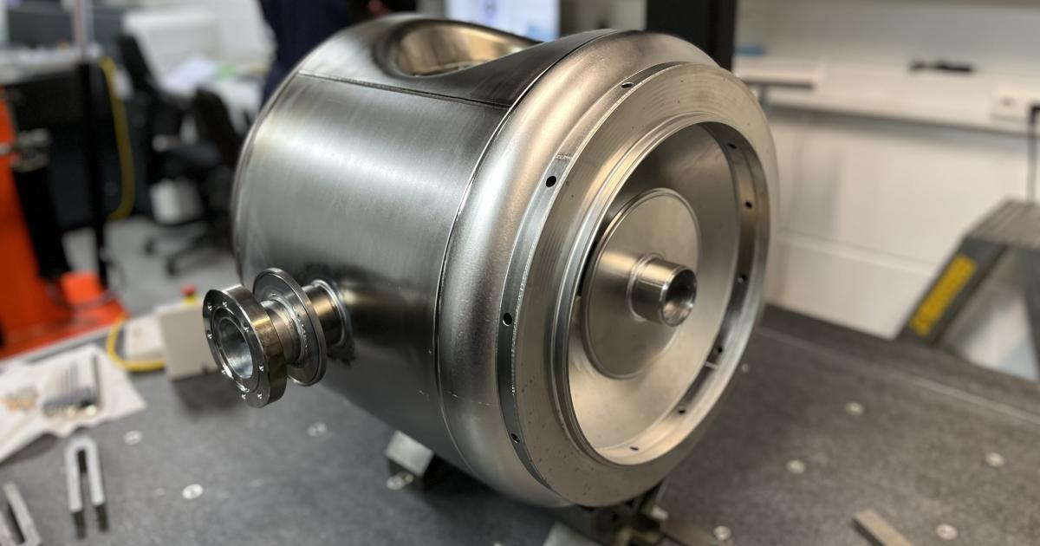
MYRRHA RF cavity zoo
Proton Target Facility
Full Power Facility
?
176.1 MHz Quarter-Wave Resonators (QWR)
176.1 MHz Crossbar-H (CH) cavities
704.4 MHz elliptical SRF cavities
Not yet designed
Only for phase 2
x15
ECR source
x2
Injector dump
100 MeV
1.5 MeV
x1
16.6 MeV
MYRRHA phase 1
176.1 MHz Radio-Frequency Quadrupole (RFQ)
x60
MYRRHA phase 2 (not approved yet)
352.2 MHz single-spoke SRF cavities

Slide 7



LLRF requirements
Performance: RMS accelerating field stability of 0.1% and 0.1° in amplitude and phase
Flexibility: Compensation of non-periodic beam loading with cycles of 4 ms
Reliability: maximum single trip duration of 3 s over a 90-days operational period. Automatic re- configuration of the LLRF system.

Slide 8
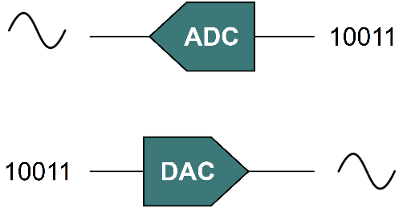

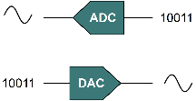
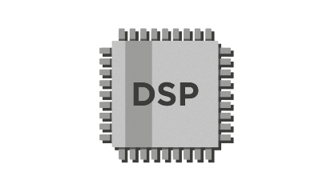
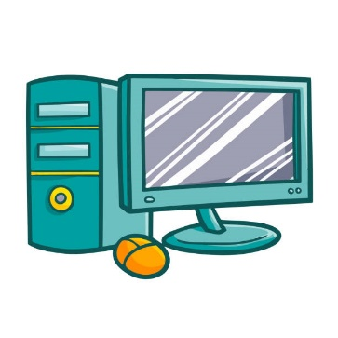
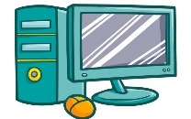

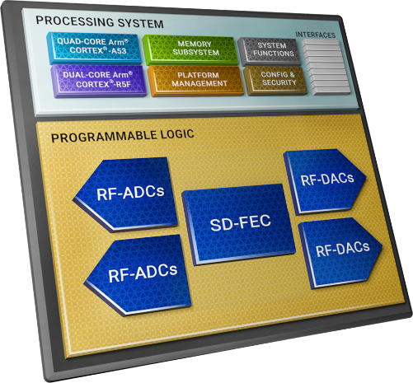
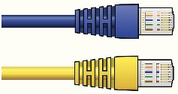
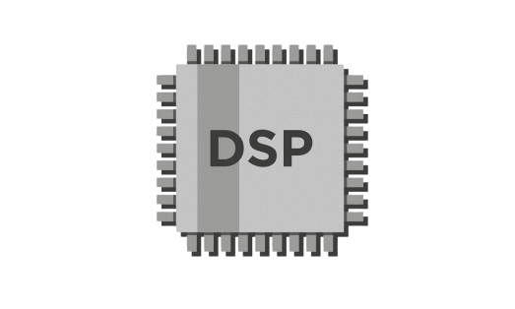
DAMC-DS5014DR: a new paradigm for LLRF
Conventional LLRF system
SoC-based direct-sampling LLRF system
LLRF board
LLRF board
✘ Higher footprint vs
features compromises
✘ Harder to achieve
redundancy
✘ Harder to develop and
debug
✘ Narrowband analog
frontend
One-chip-does-all
Easier redundancy
Coherent and self-aware ecosystem
Broadband analog frontend.
Better linearity, easier harmonics rejection (no mixers, GS/s sample rates)
RFSoC
Communication bus
?
Network
Network

Slide 9
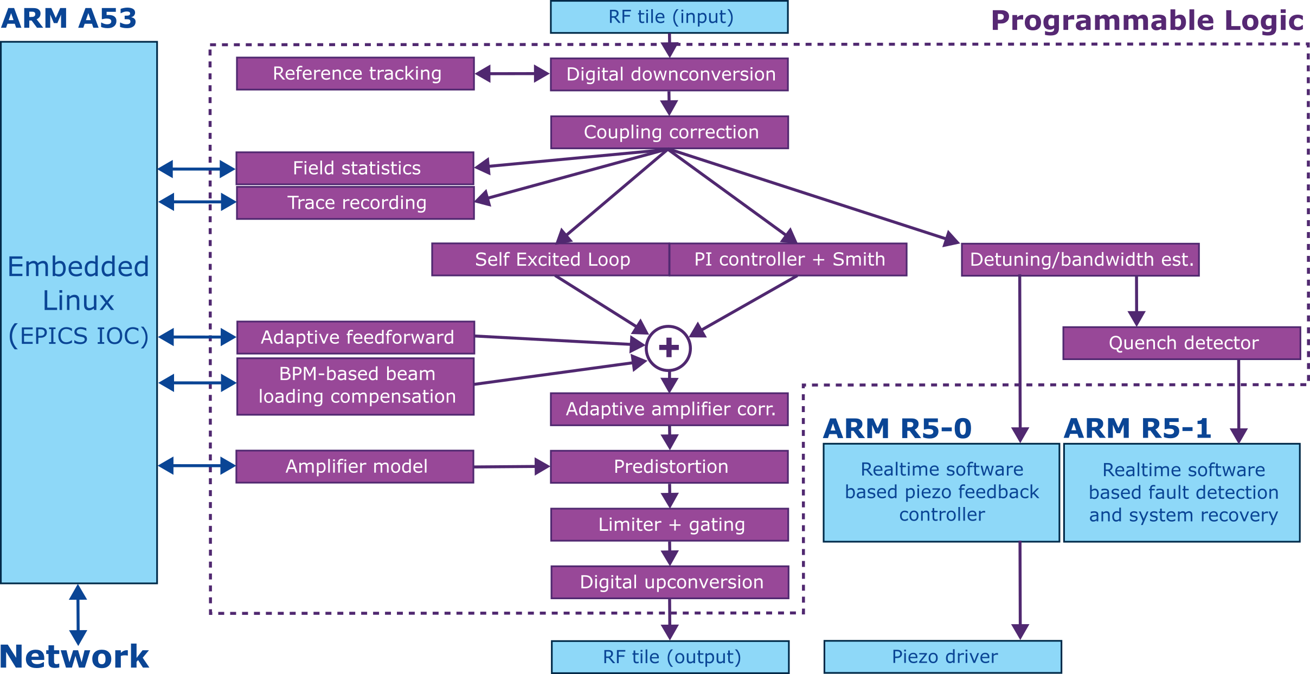
LLRF high level scheme

Slide 10


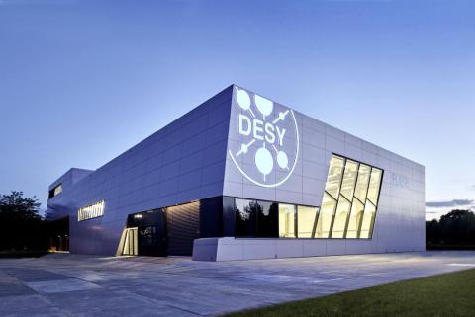
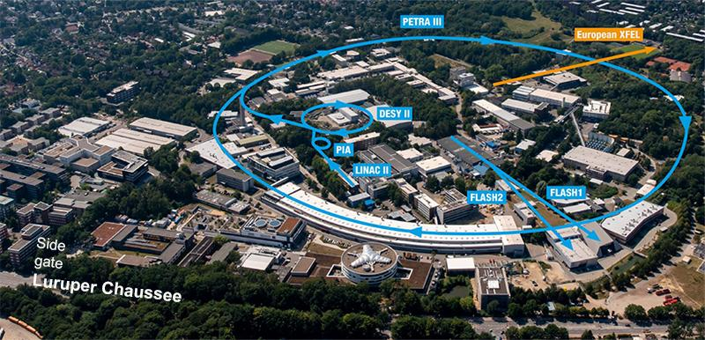
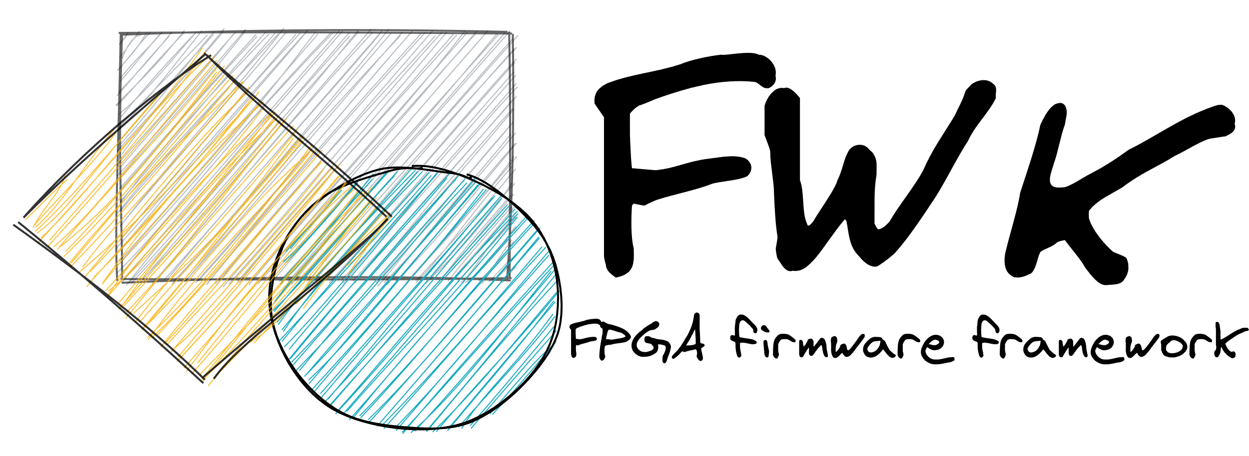
Strong partnership with MSK/DESY
Technical support for the development of our system
FWK and ChimeraTK for LLRF development
Reuse of DESY LLRF IPs
Linux images created using DESY’s Yocto recipes
Exploring together the options for next-generation LLRF systems for CW superconducting linear accelerators

Slide 11
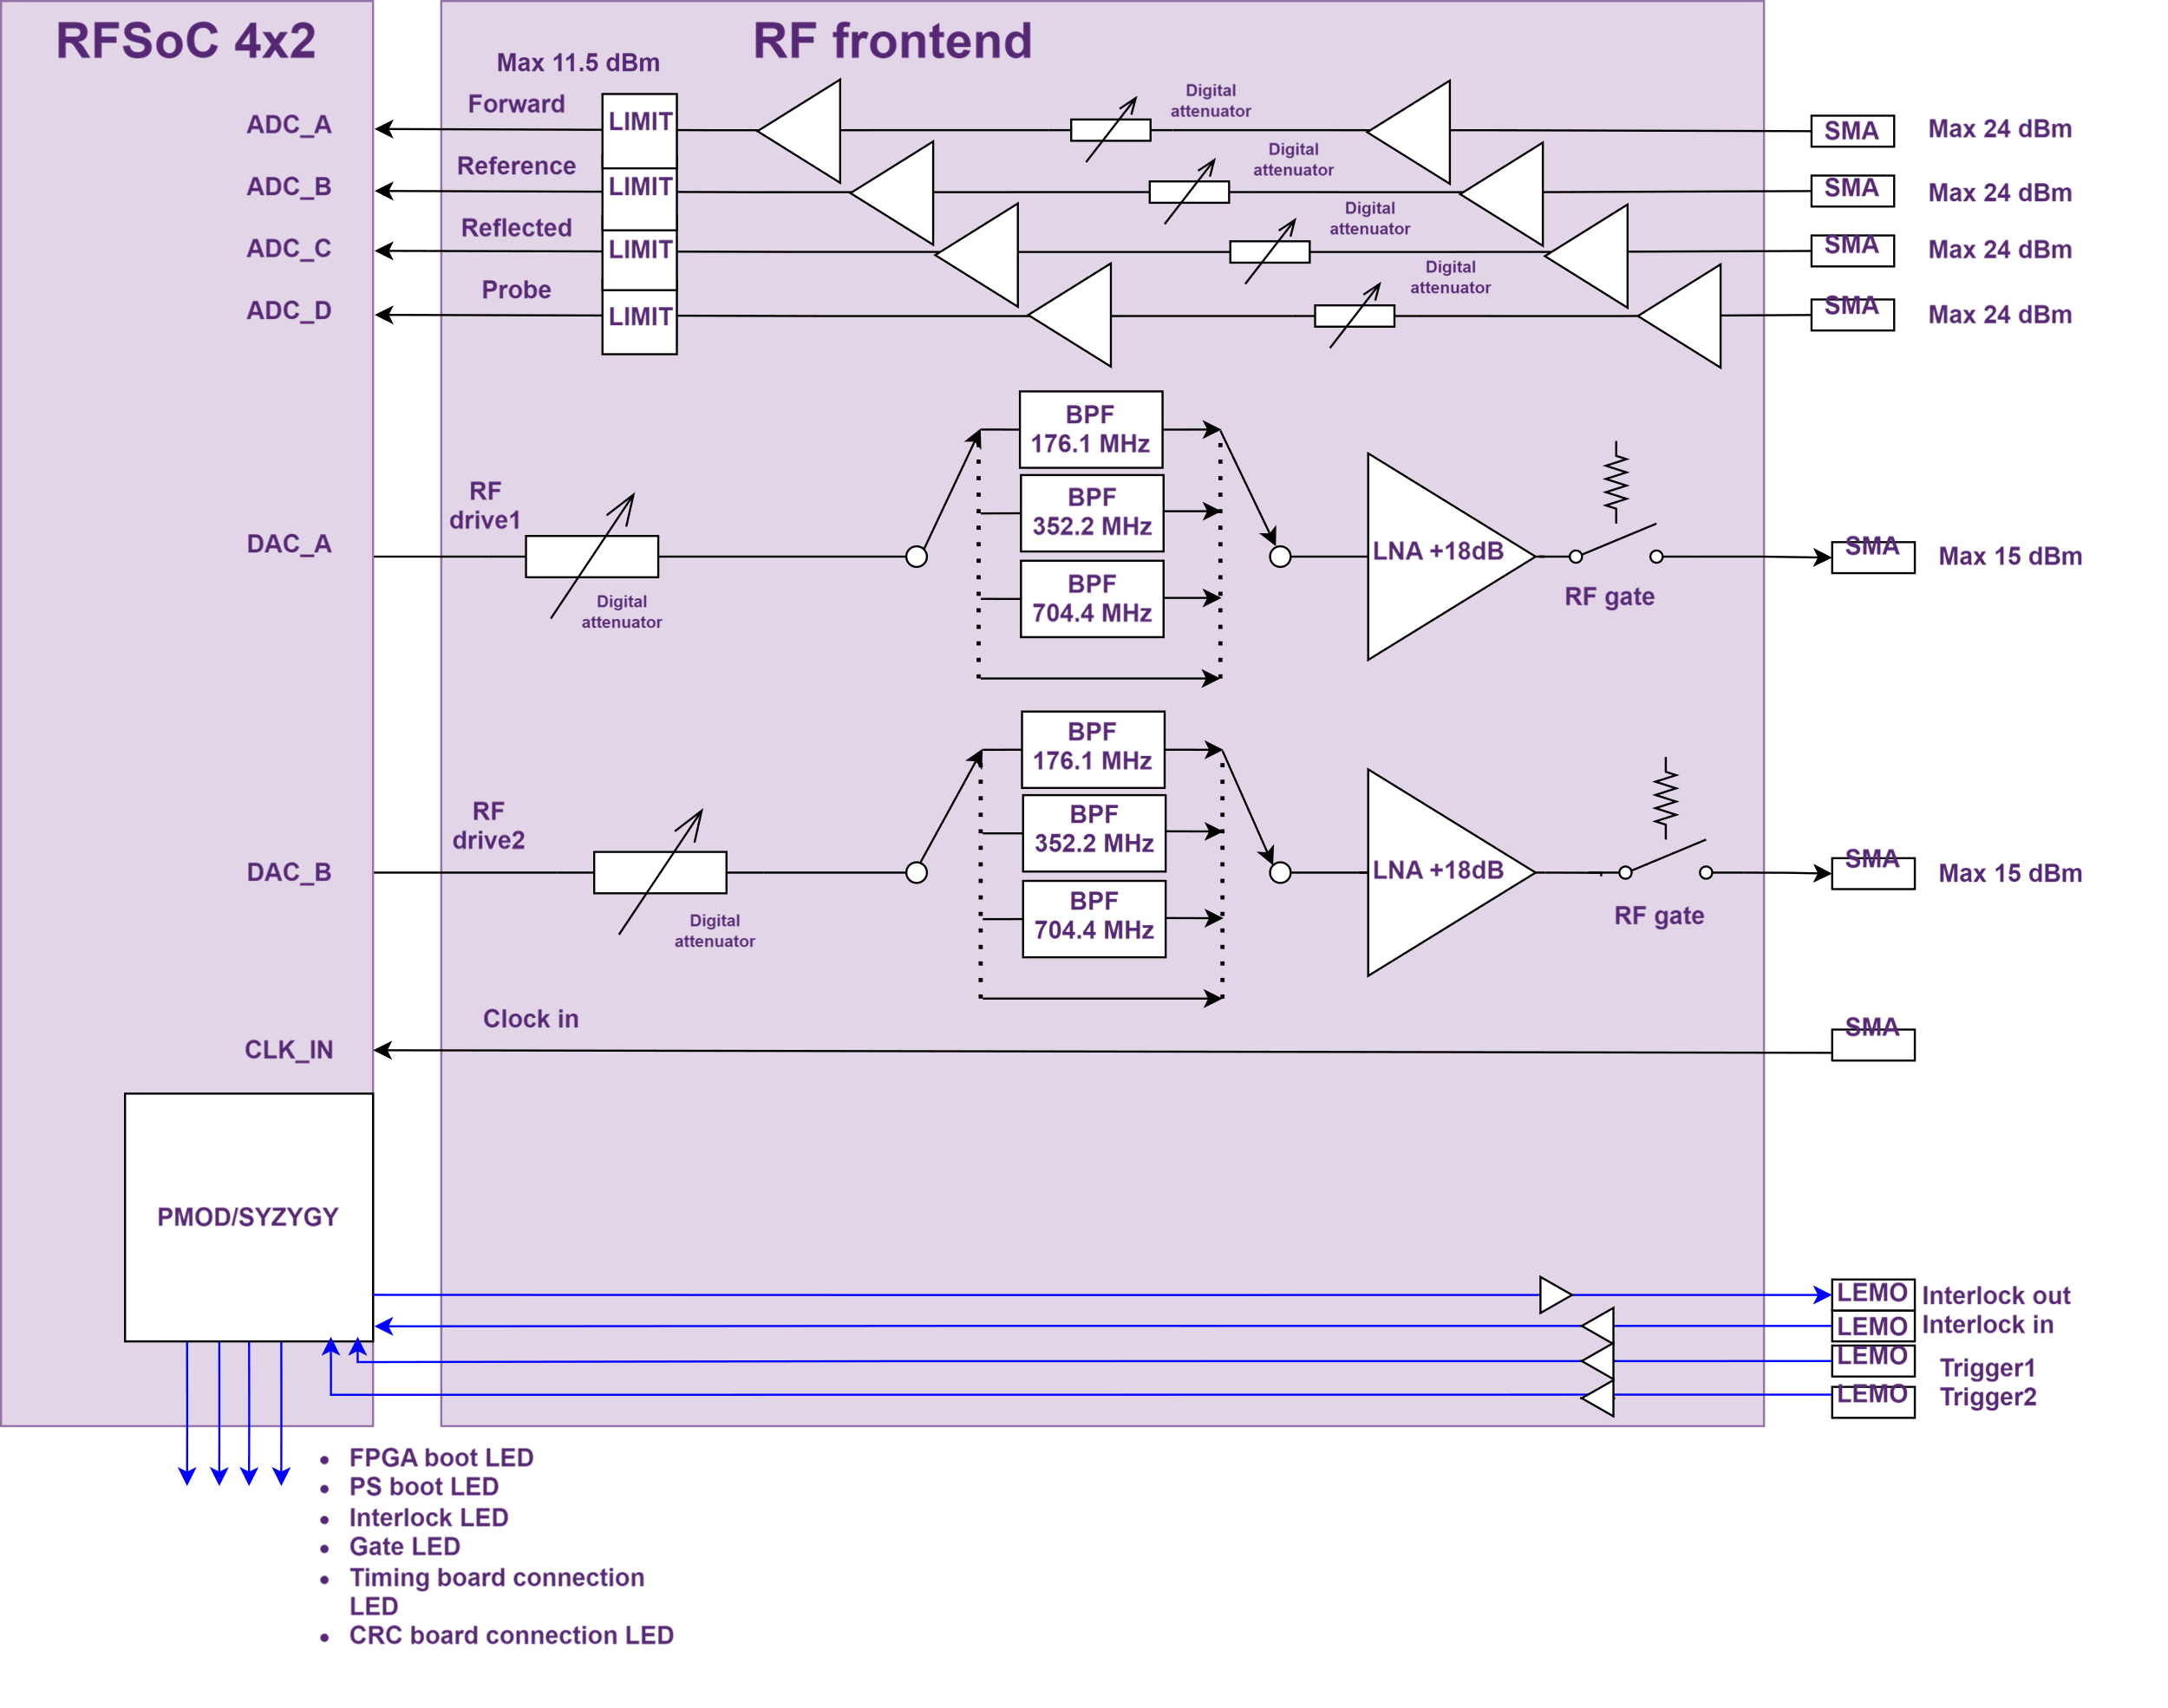
Analog frontend
Prototype analog frontend for RFSoC4x2 under development
Test platform for a future RTM development
32 dB digital step attenuators
Plug-in amplification modules
Used for normal conducting and superconducting test stands

Slide 12
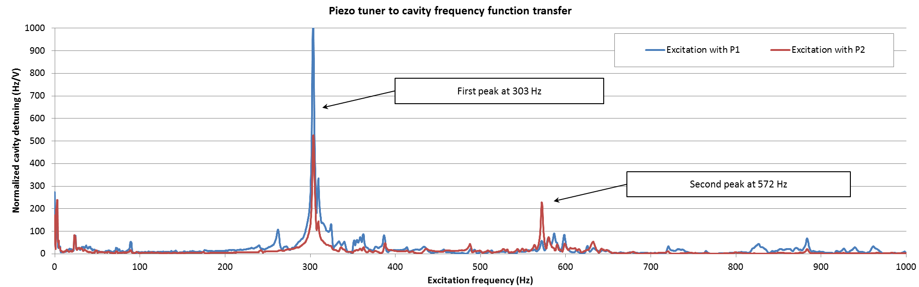
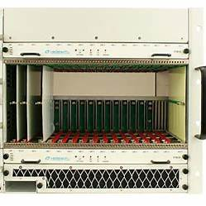
Piezo driver options
Relatively few solutions exists in the MTCA.4 format
Exploring different architectures
5.5 𝜇F, -40V/+160V 1kHz analog bandwidth driver
Gandolfo, Nicolas, et al. "Development and Performances of Spoke Cavity Tuner for MYRRHA Linac Project."
MTCA.4 driver
Digital driver
Analog driver
P2P communication
SFP communication
Intermediate FMC carrier for A/D D/A conversion
RFSoC
RFSoC
RFSoC
RFSoC
RFSoC
RFSoC
RFSoC
Driver
FMC
FMC
Driver
RFSoC
RFSoC
RFSoC
Driver PSU
Driver
Driver
Driver
Driver
Driver
Driver
Driver
Driver

Slide 13
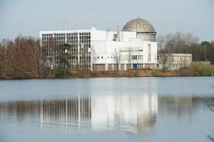
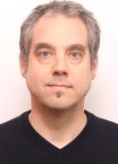
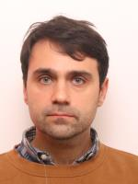
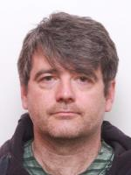
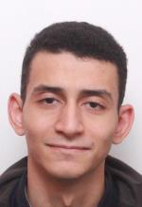
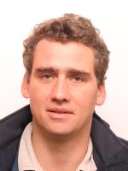
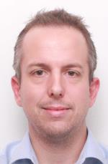
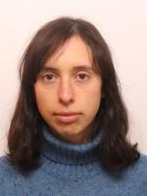
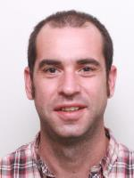
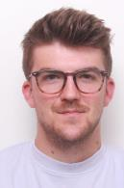
Final Remarks
Prototype firmware almost finalized using MSK/DESY’s IPs
RFSoC4x2 as hardware test platform
Successful calibration of RFSoC’s ADC/DACs from embedded linux
Development of a test Python-based prototype LLRF server ongoing using DeviceAccess-PythonBindings
First tests on low-power normal-conducting cavities in Q1 2026
Thanks for your attention from the ACE team

Slide 14
Copyright © SCK CEN
PLEASE NOTE!
This presentation contains data, information and formats for dedicated use only and may not be communicated, copied, reproduced, distributed or cited without the explicit written permission of SCK CEN. If this explicit written permission has been obtained, please reference the author, followed by ‘by courtesy of SCK CEN’.
Any infringement to this rule is illegal and entitles to claim damages from the infringer, without prejudice to any other right in case of granting a patent or registration in the field of intellectual property.
SCK CEN
Belgian Nuclear Research Centre
Foundation of Public Utility
Registered Office: Avenue Herrmann-Debrouxlaan 40 – BE-1160 BRUSSELS
Operational Office: Industriezone Boeretang Zuid – Boeretang 190 – BE-2400 MOL

Slide 15
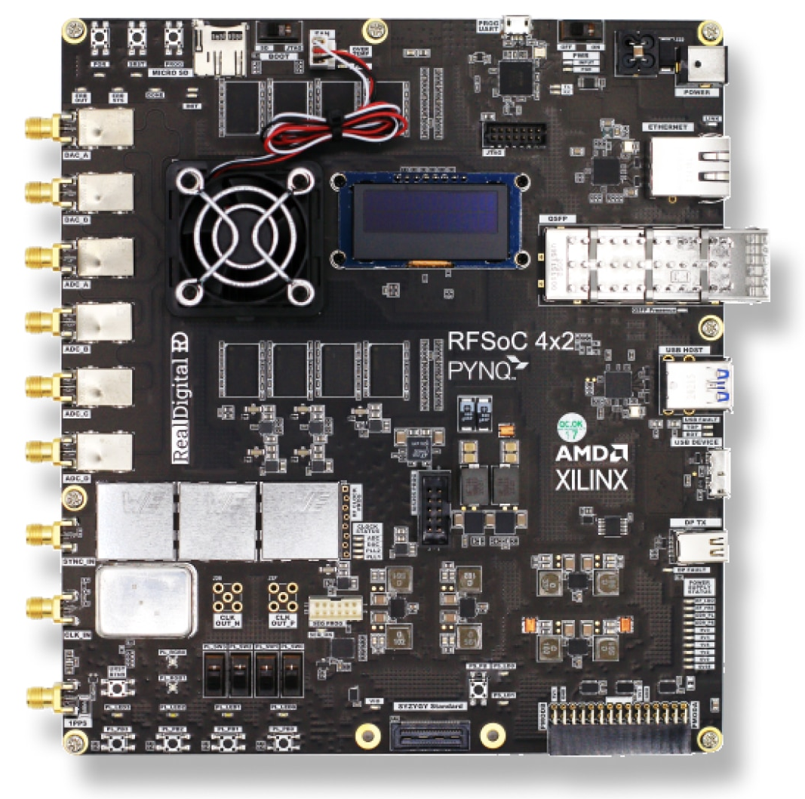
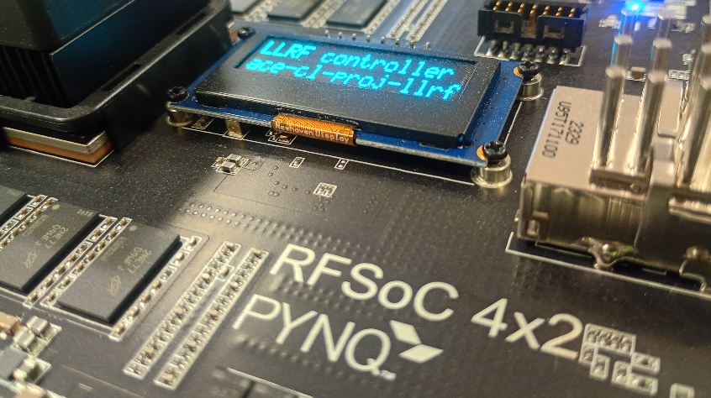

RFSoC4x2 prototype board
Easy low cost RFSoC development platform
Fully supported by FWK
Temporary replacement for the DAMC-DS5014DR
It gives us and DESY team a feedback to improve future RFSoC-based solutions

Slide 16
Notes:
More icons on: imagebank.sckcen.be

Slide 17
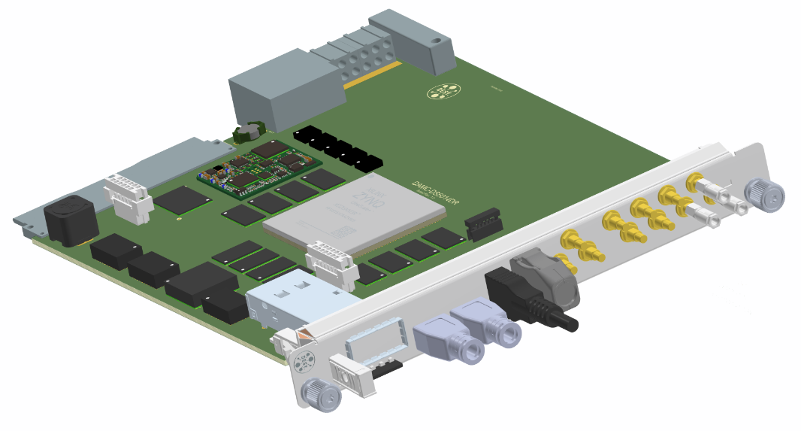
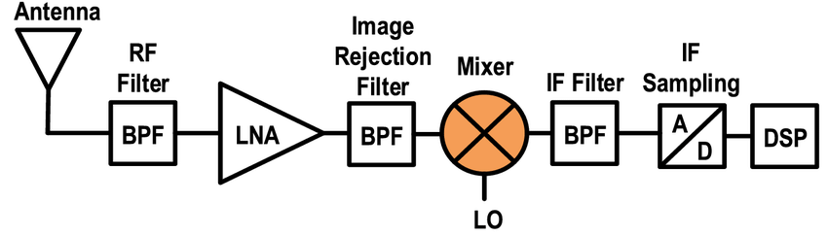
DAMC-DS5014DR: a new paradigm for LLRF (analog)
Analog downconversion with separate ADCs
Direct sampling
Higher design complexity
Different frequencies often require different hardware
More difficult to achieve sampling rates at GS/s level
Reduced complexity
A single AMC+RTM can handle RF cavities at 176.1, 352.2 and 704.4 MHz
Out-of-the-box 5 GS/s ADC sample rate
Higher linearity and matching
Lower latency

Slide 18
<generated automatically>
altenative reference
ISC: Restricted
Notes:
More icons on: imagebank.sckcen.be

