Slide 1
MicroTCA Development for PIP-II Beam Instrumentation at Fermilab
FERMILAB-SLIDES-25-0307-AD-PIP2
December, 2025
R. T. White
AD/BI Hardware Design Engineer
Senior Engineer

Slide 2
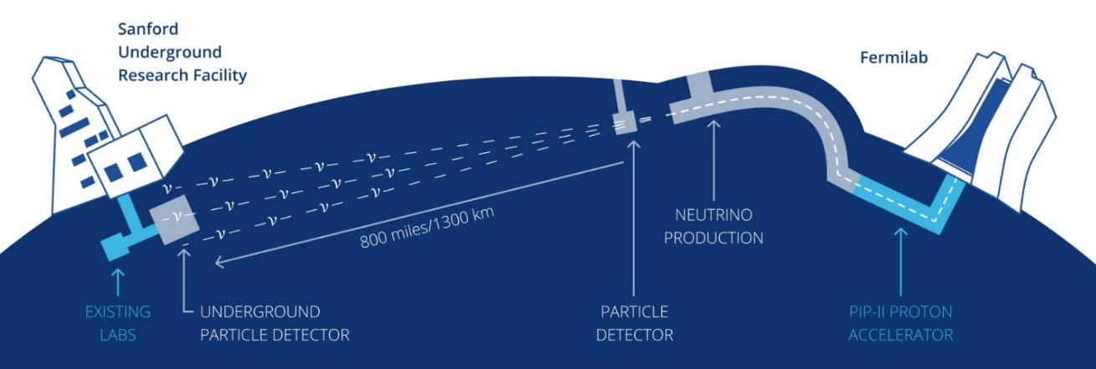
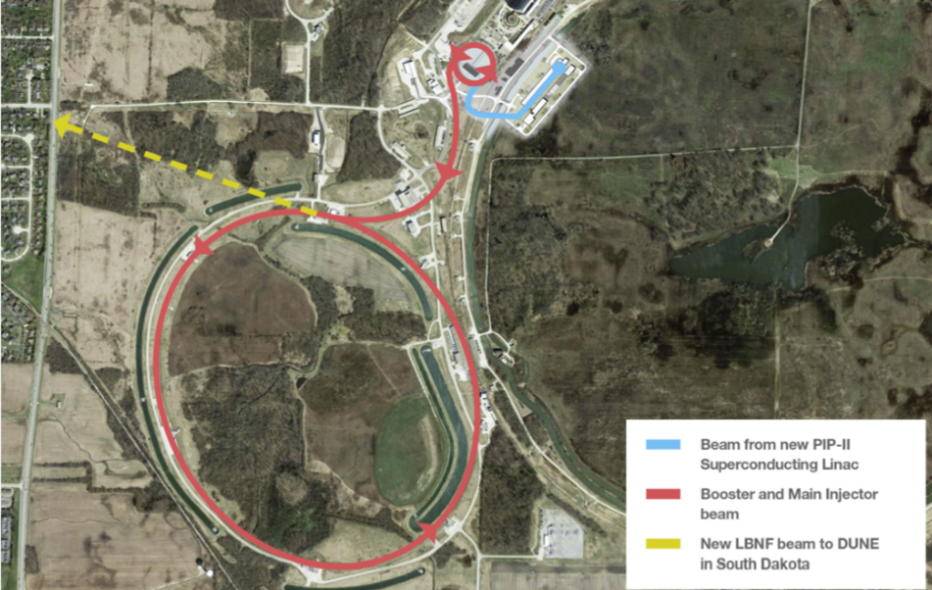

Slide 3
MicroTCA at Fermilab
Instrumentation
Alleviate technical debt and maintenance issues from legacy VME crates
VME often required external crates to achieve signal conditioning
MicroTCA will be involved in the majority of systems moving forward, PIP-II or otherwise
Future Projects
Othe projects see the learning curve and high cost of entry as barriers
Encourage other projects to utilize and build upon instrumentation MicroTCA knowledge base

Slide 4
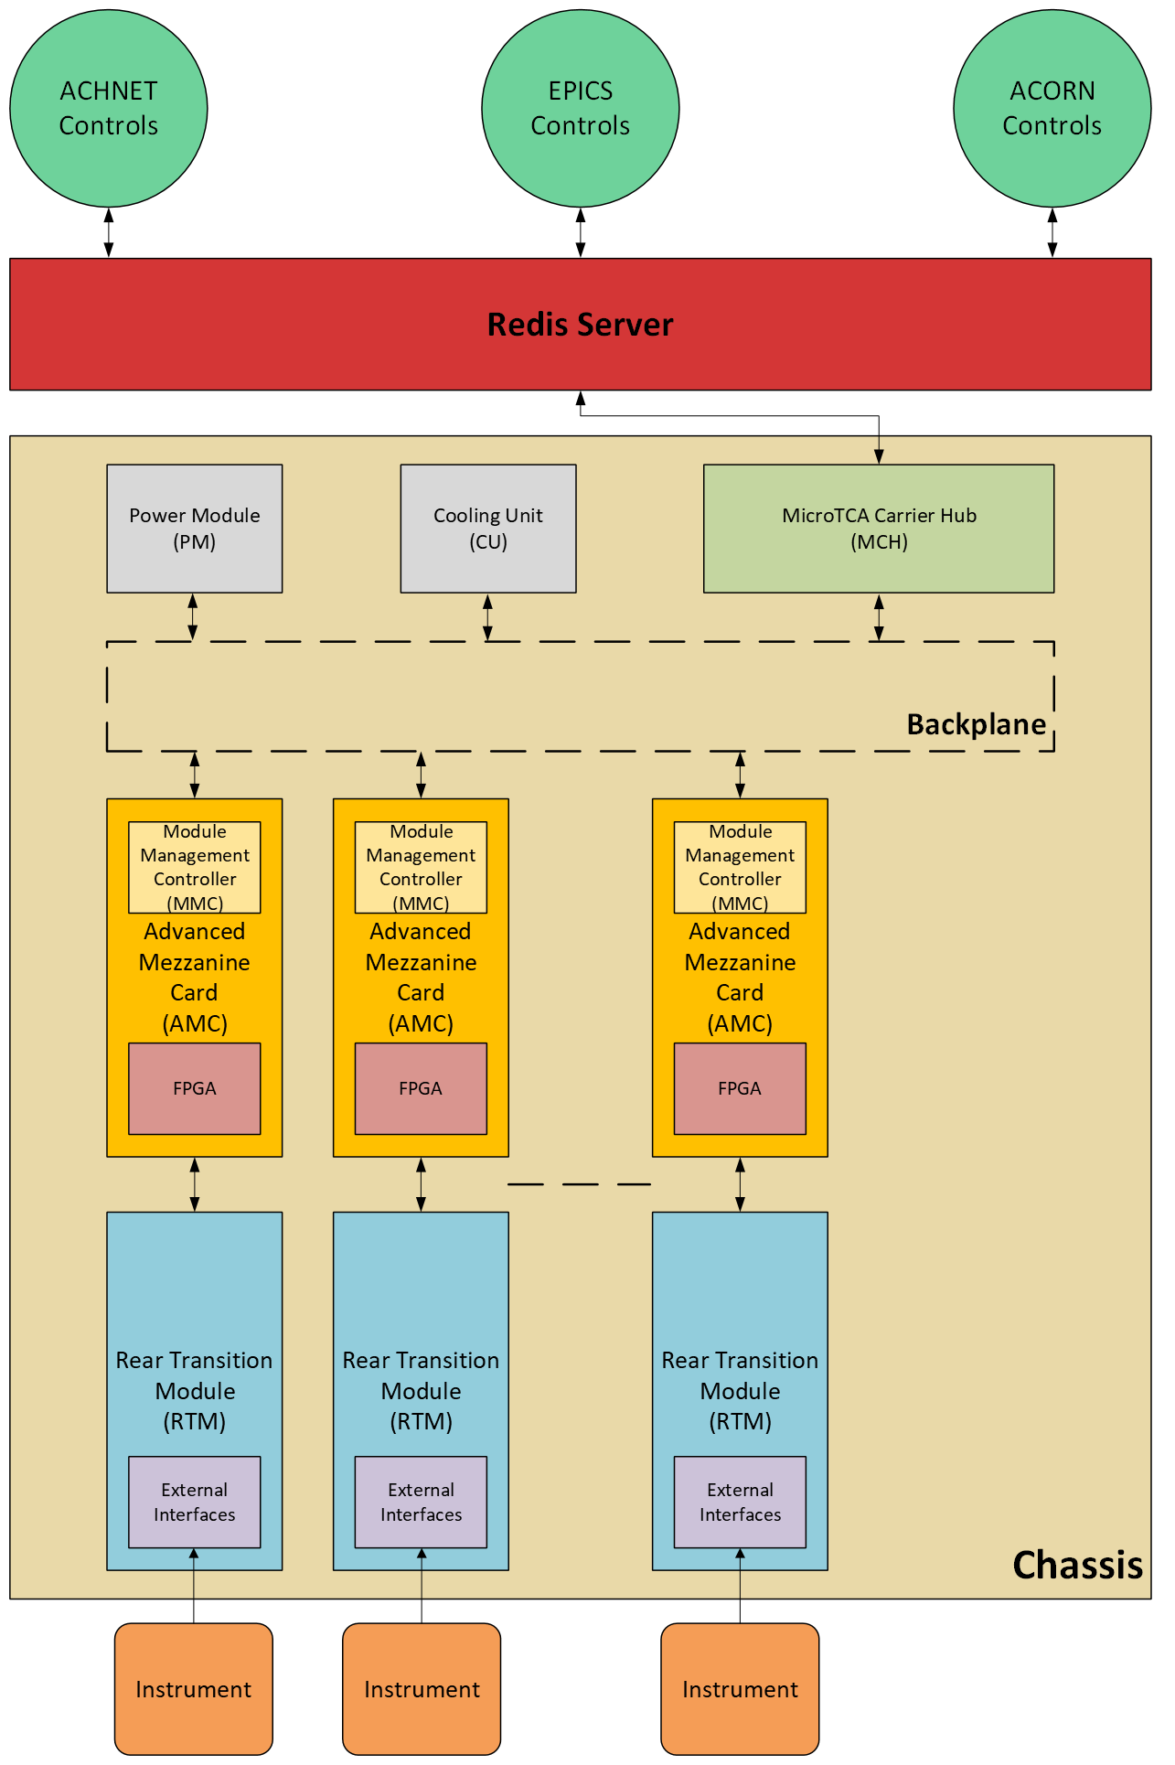
High-Level HW Architecture
Instrumentation to MicroTCA Chassis
Intend to have fiber optic connection between MCH and Redis/data server
  Likely will be mix of copper and fiber optic
Redis/data server will then push data to controls networks

Slide 5
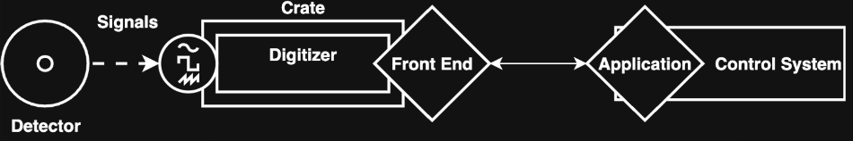
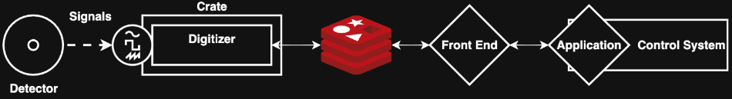
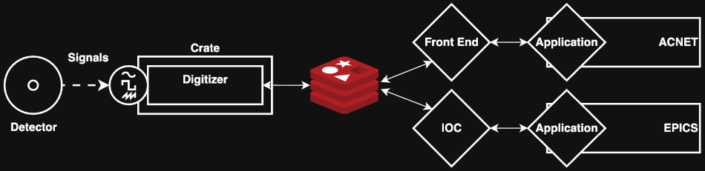
Redis
The perfect solution to an imperfect problem
Old
Controls infrastructure is undergoing a transition period that may last years
  Legacy-ACNET
  PIP II-EPICS
  ACORN
Instrumentation is required to interface with every controls system
REDIS
  Open source, high speed database
  Hosted on Fermilab servers
  Provides a layer of abstraction to simplify data management for medium to high latency applications
Digitizers primary job is to push data to REDIS
Future work would included white rabbit to enable deterministic timestamps
New
Benefit
D. Steinkamp, “Control-Agnostic Beam Instrumentation with Redis at the Core,” in 14th International Beam Instrumentation Conference IBIC 2025, 2025

Slide 6
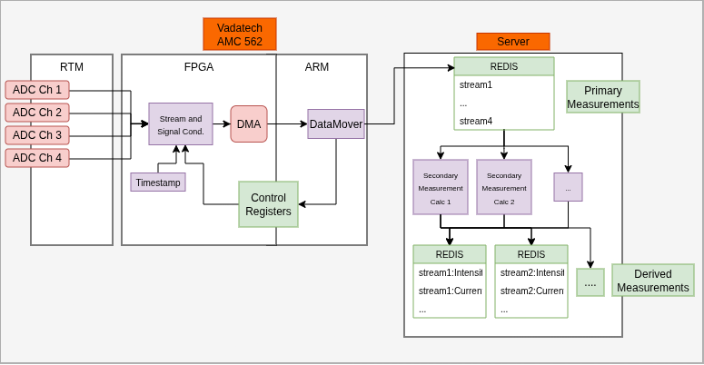
Firmware
FPGA
  Digital Filtering
  Timestamp
ARM Processor
  “REDIS Adapter”
  Moves data
  Applies parameter changes

Slide 7
Instrumentation Systems Using MicroTCA
Beam Current Monitors (BCM)
Beam Loss Monitors (BLM)
Beam Position Monitors (BPM)
Beam Profile Monitors (BProM)
Average Beam Intensity
Localized Beam Loss
(Ion Chamber, PMT, ND)
Beam Position And Orbit
Transverse Beam Profiles
(TWS, MW, LW)
Bunch Chopping Efficiency
(RWCM)
Beam Phase And Timing
Traverse Emittance
(AES, LW)
Relative Beam Intensity
Longitudinal Bunch Profiling
(FFC, BSM, MEBT LW)

Slide 8
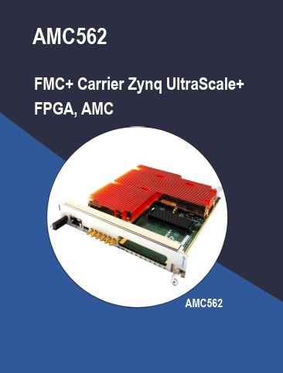
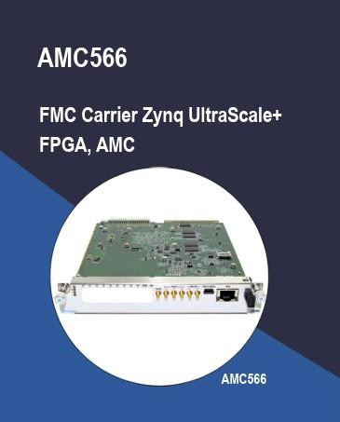
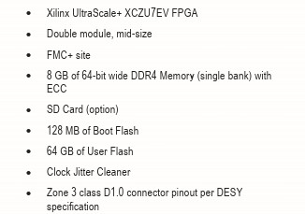
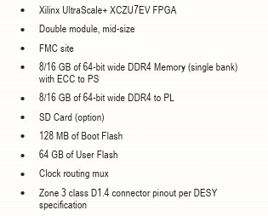
Off The Shelf vs In-House Designs
RTMs are the only portion of the system designed in house
We are still in the selection process for the MCH
Vadatech will be the vendor for the remainder of the system
AMC562
  Low bandwidth instruments like ACCT BCM
  Developed with Fermilab input
AMC566
  High bandwidth instruments like BPMs
  Developed with Fermilab input

Slide 9
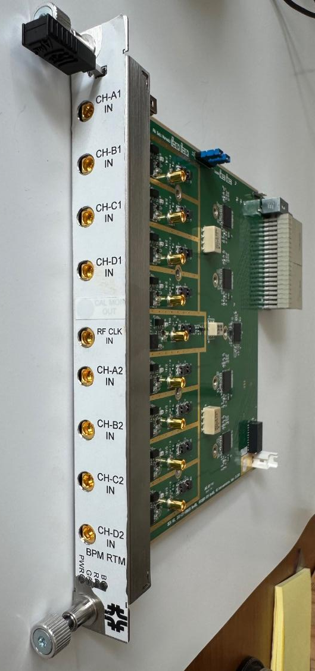
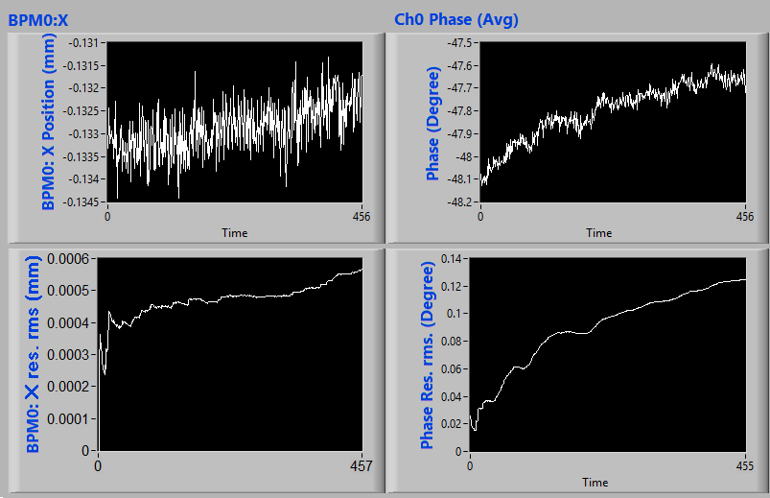
Beam Position Monitor RTM
BPM RTM is farthest along in development
A modified version is being installed in the MI-8 line and is expected to produce data in the next run
Shengli Liu designed both the hardware and firmware
A bunch-by-bunch version is in development
S. Liu, N. Eddy, A. Semenov, and B. Fellenz, “Development of BPM electronics for PIP-II at Fermilab,” in 14th International Beam Instrumentation Conference IBIC 2025, 2025

Slide 10
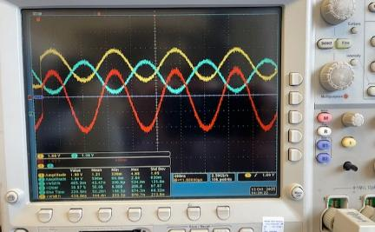
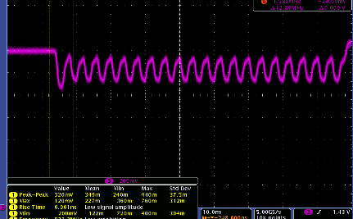
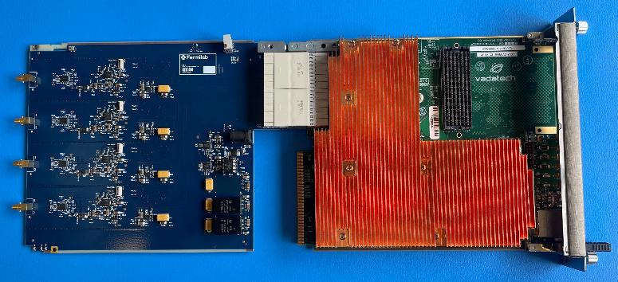
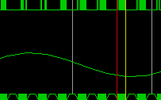
Beam ACCT Monitor RTM
Verified amplification of voltage input
  Present input is a single ended coaxial cable soldered into differential cable resulting in unintended offset that should not exist in pure differential setup.
Verified proper LVDS signals exist and communication with AMC
  We now have low voltage differential probe to more accurately characterize signals
Verified AMC is able to digitize signal
  Very excited about this step
Differential Amplifier Output
LVDS Clock Input to ADC
Digitized Sine wave in Xilinx
R. T. White and J. R. Berlioz, “Design of Digital Acquisition for Beam Current Monitor,” in 14th International Beam Instrumentation Conference IBIC 2025, 2025

Slide 11
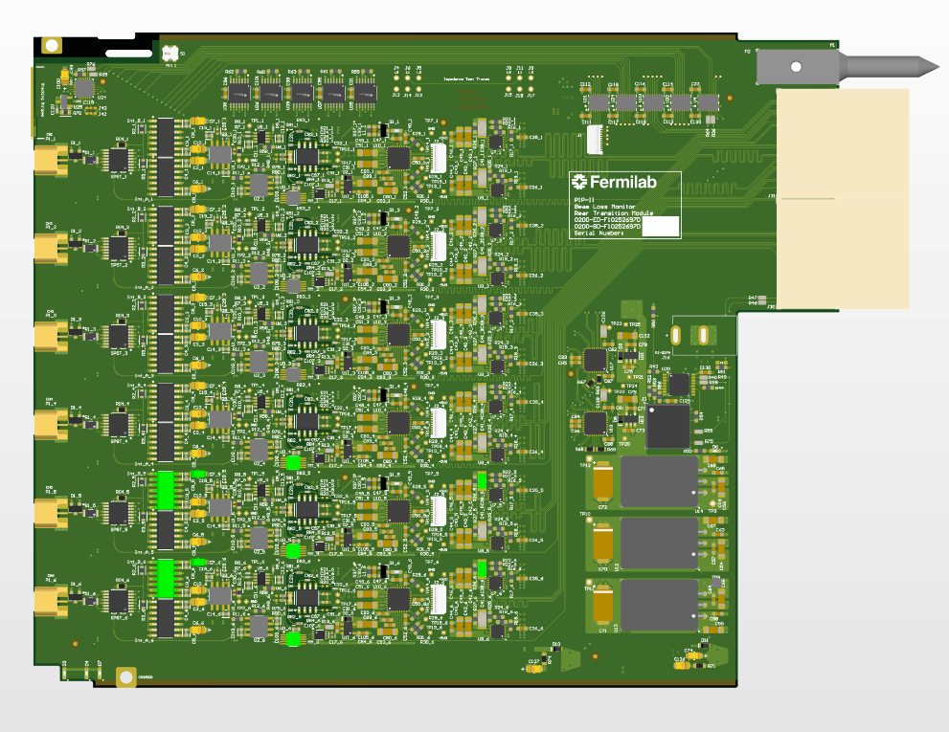
Beam Loss Monitor RTM
Alternating integrators
Analog portion verified in isolation on previous revisions
ADC circuitry is shared with BCM
Production intent prototypes ordered

Slide 12
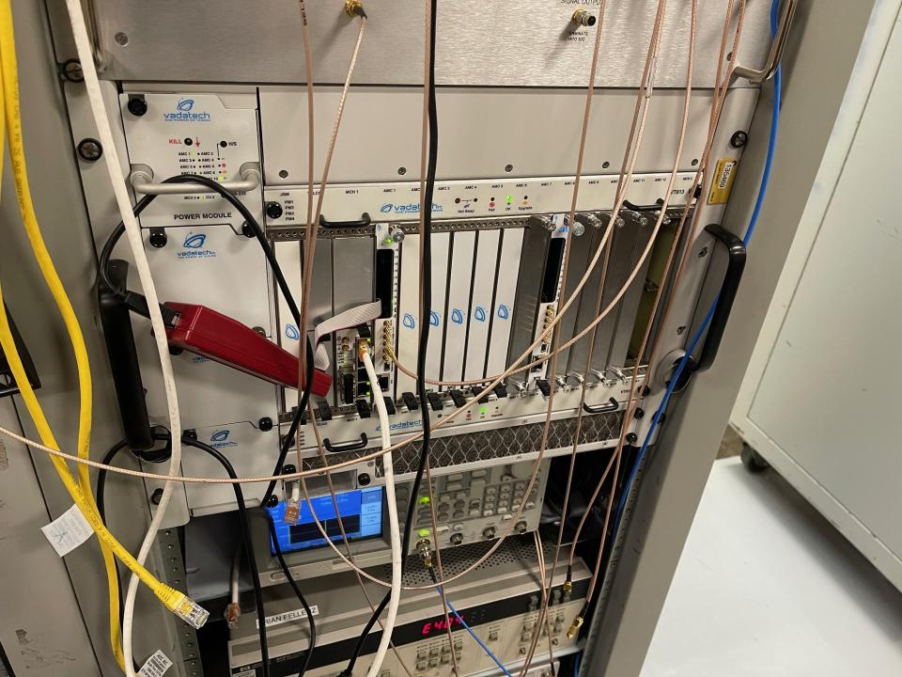
Overall Project Status (MicroTCA Specific)
Large portions of PIP-II system have been purchased
RTM design work should be completed within the next year
  One outstanding design not mentioned in this presentation
Majority of production RTM purchases have been initiated

