Slide 1
MRF Timing on mTCA.4
14th MicroTCA Workshop
DESY, December 2nd, 2025
Jukka.Pietarinen@mrf.fi / Micro-Research Finland

Slide 2
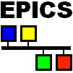
Micro-Research Finland Oy
MRF Timing System Development
The MRF Timing system originally developed for the Swiss Light Source (SLS), Paul-Scherrer Institute in 1999
Current users include:
SLS, PSI, Switzerland
Diamond Light Source Ltd., U.K.
SSRF, Shanghai, China
Australian Synchrotron
ALBA, Spain (Tango)
Elettra, Trieste, Italy (Tango)
BEPCII, Insitute for High Energy Physics, Beijing, China
LCLS, Stanford Linear Accelerator Center, USA
KEK, Japan
FERMI, Trieste, Italy (Tango)
TLS, Taiwan
KIT, Germany
NSLS II, Brookhaven, USA
PAL-XFEL, Pohang, South Korea
LANSCE upgrade, Los Alamos, USA
FRIB, Michigan, USA
SwissFEL, PSI, Switzerland
STFC, Daresbury, U.K.
ESS, Sweden
APS-U, Argonne National Lab, USA
ELBE, HZDR, Germany
Bessy II, Germany
Most of the sites listed above are using EPICS
jukka.pietarinen@mrf.fi

Slide 3
Micro-Research Finland Oy
What do you need a timing system for?
Phase and frequency locked clocks at different locations
Trigger something at different locations at the same time with high accuracy
Make something happen in sequence with predefined time intervals
Synchronize the local time at different locations with high precision
Timestamp events at different locations to analyze what happened first or timestamp data acquisition

Slide 4
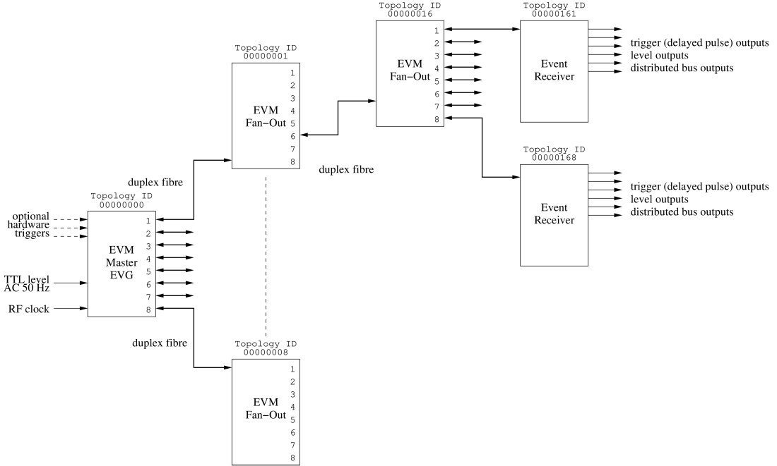
Typical System Layout - Delay Compensation (DC)
Event link protocol carries:
8 bit event codes @ event rate max. 166 MHz
8 bit distributed data bits @ ½ event rate
Data buffer transfers up to 2 kbyte
Segmented data buffers up to 128 x 16 bytes
Max. data transfer rate 83 Mbytes/s

Slide 5
Micro-Research Finland Oy
Operating Principle of the MRF Timing System
Event based system
256 Event codes, one event code/cycle (6 ns - 20 ns or 50 MHz to 166 MHz)
In addition to events there are eight signals (distributed bus) that are updated at half the rate (12 ns - 40 ns or 25 MHz to 83 MHz)
Synchronous data transfers
Transmission medium: optical fiber
multi-mode 850 nm, OM3 or better up to 550 m
single-mode 1310 nm, up to 10 km
Line code or “event stream” based on 8B10B encoding

Slide 6
Micro-Research Finland Oy
Event Clock
Base clock of MRF timing system
Typically driven from external source e.g. accelerator RF signal
Event clock from 50 MHz to 166 MHz (6 ns to 20 ns event clock cycle)
Event clock provided to the Timing System Master, all other nodes regenerate this clock from the event stream received through the fiber
The Timing Master has an input divider to divide the RF clock by 1, 2, 3, ..., 12, 14, 15, 16, ..., 32.

Slide 7
EVG Basic Building Blocks
Trigger Events
Multiplexed Counters
Sequencers
Software Event
Time distribution logic
Configurable Size Data buffer
Segmented Data buffer

Slide 8
Trigger Event
A Trigger Event has one event code assigned to it
Upon a trigger this event code is sent out
Sources for triggers:
External signal
Multiplexed Counter edge
AC main synchronization logic

Slide 9
Multiplexed Counter
32 bit counters running at the event clock rate
Can produce frequencies from event clock rate/(2³² - 1) to event clock rate/2
Counters can be reset simultaneously by software
Configurable polarity / phase offset

Slide 10
Sequencer
A sequencer sends out events in predefined order with predefined timing
2k dual-port memory for 32-bit timestamp, event code and mask
Operating modes: single, normal (trigger) and recycle

Slide 11
Sequencer triggering
Multiplexed counter
AC Synchronization logic
External trigger
Software trigger

Slide 12
Sequencer operating modes
Single sequence mode
Plays back sequence once until end sequence event
Normal mode
Plays back sequence and waits for next trigger after end sequence event
Recycle mode
Plays back sequence and immediately restarts sequence from beginning after end sequence event

Slide 13
Time Distribution Logic
Support for 32 bit Seconds register
32-bit sub second register - e.g. 1 us precision can be used
Seconds value is sent out with event codes
Sub-second clock is sent out as an event or on the distributed bus
1 PPS and a faster clock e.g. 1 MHz have to be supplied externally and these two clock must be rising edge aligned

Slide 14
Configurable Size Data Buffer
2k byte dual-port memory
Transfer size 4 bytes to 2k in 4 byte increments
Controlled by software

Slide 15
Segmented Data Buffer
Introduced with Delay Compensation hardware
2k byte dual-port memory
128 16-byte segments
Can send a single or multiple segments at a time
Controlled by software
Last segment #127 is reserved for delay compensation
delay compensation data
Topology ID

Slide 16
EVR Basic Building Blocks
Event Mapping RAM
Pulse Generators
Prescalers
Timestamping logic
Event FIFO
Event Log
Data buffer
Segmented Data buffer

Slide 17
Event Mapping RAM
256 x 128 bit dual-port RAM
Each event code has 128 bits assigned and these bits define what functions are to be performed
Map bit | Default event code | Function
127 |  | Save event in FIFO
126 |  | Latch timestamp
125 |  | Led Event
124 |  | Forward event
123 | 0x79 | Stop log
122 |  | Log event
101 | 0x7A | Heartbeat
100 | 0x7B | Reset Prescalers
99 | 0x7D | Timestamp reset event
98 | 0x7C | Timestamp clock event
97 | 0x71 | Timestamp Seconds ‘1’
96 | 0x70 | Timestamp Seconds ‘0’
95 - 64 |  | Trigger pulse generator 31 - 0
63 - 32 |  | Set pulse generator 31 - 0 output high
31 - 0 |  | Reset pulse generator 31 - 0 output low

Slide 18
Pulse Generator
Recent addition adds capability for pulse trains

Slide 19
Prescaler
Programmable counter that can produce different frequencies
All prescalers are reset by one event code, thus all prescalers on all EVRs can be synchronized
Can be output directly on I/O or used to trigger pulse generators

Slide 20
Timestamping Logic and Event FIFO

Slide 21
Event Log
Similar to Event FIFO, but with ring buffer
Event FIFO stops when full
Event Log rolls over and overwrites old events
Can be used for diagnostics: stop log event e.g. after beam loss, read out log events

Slide 22
Data Buffer
Receive Data Buffer send by EVG
Data buffer has to be armed to receive anything
Data buffer is automatically disable after a received buffer
Data buffers can be lost if buffer is not read and re-armed before EVG sends next buffer
Software interrupt upon reception

Slide 23
Segmented Data Buffer
Receive Segments send by EVG
Segmented Data buffer is enabled all the time
Flags for each segment: receive complete, checksum mismatch, overflow flag
Each segment has a received data bytes counter
Software interrupt configurable for each segment independently

Slide 24
Micro-Research Finland Oy
Delay Compensation
RF input
VME-EVM
Delay Compensation Master
Beacon event 0x7A, @ ~4 kHz
Master DC Data Packet: delay value ½ of round-trip delay to next stage
Triggers
Fan-Out / Concentrator
Send back beacon event
Measure internal delay (beacon propagation time)
Send beacon forward
DC Data Packet: sum of received delay value + internal delay + ½ of round-trip delay to next stage
VME-EVM
VME-EVR
EVR
Send back beacon event
Measure receive FIFO delay
Adjust FIFO and recovered clock phase so that received delay value + FIFO delay matches target delay

Slide 25
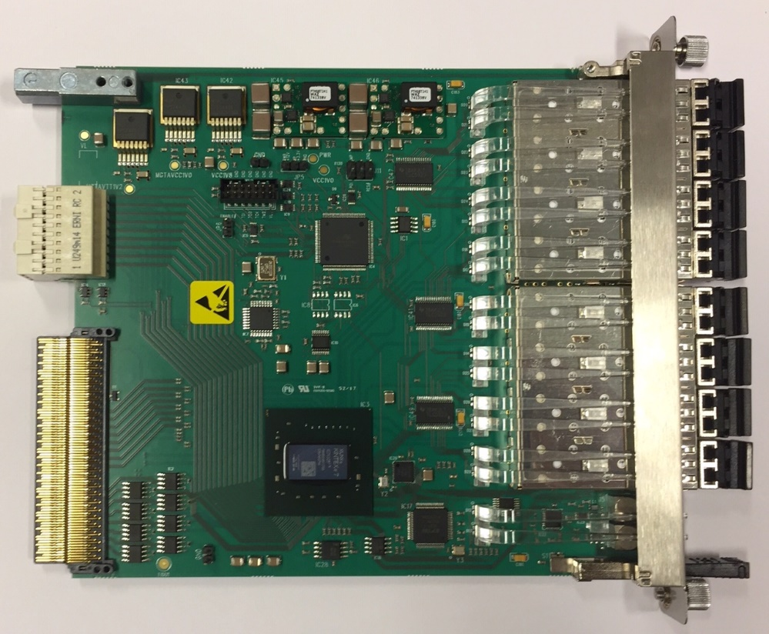
mTCA-EVM-300
Event Generator (EVG)
2 sequencers with maskable events
Max. 2047 events/sequence
32 bit timestamp
8 multiplexed counters
data buffer up to 2k bytes
segmented data buffer
127 segments, 16 bytes each
7-Way Fan-Out/Concentrator
Two Event Receivers (EVR)
8 internal pulse outputs
one sequencer
Event rate conversion (with some data buffer related limitations)
Front panel input phase monitoring/select features
Distributed bus phase selection
RF input monitoring
Support for rear transition module

Slide 26
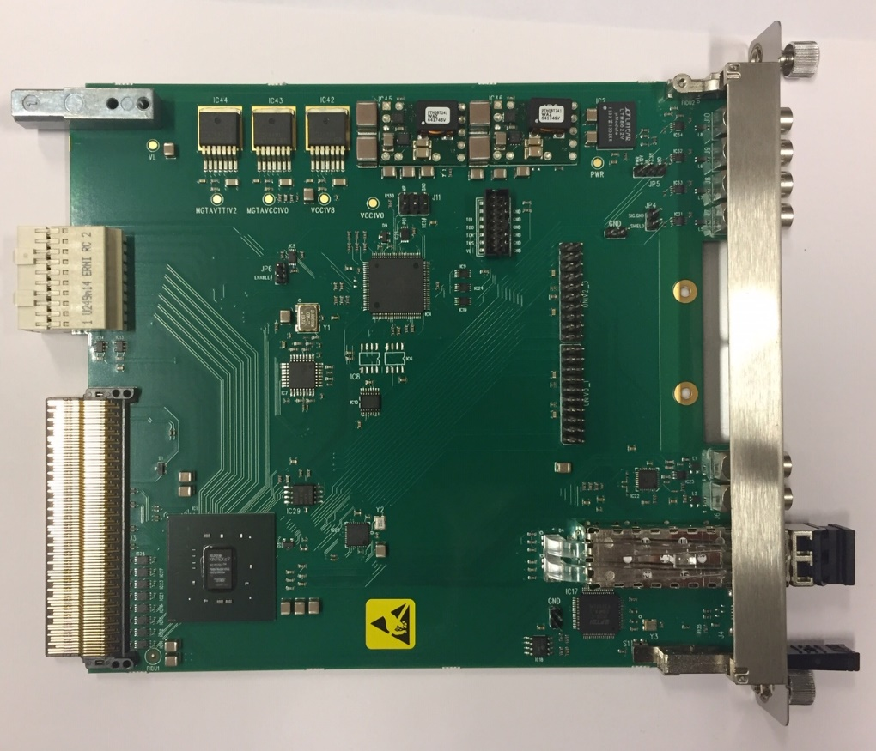
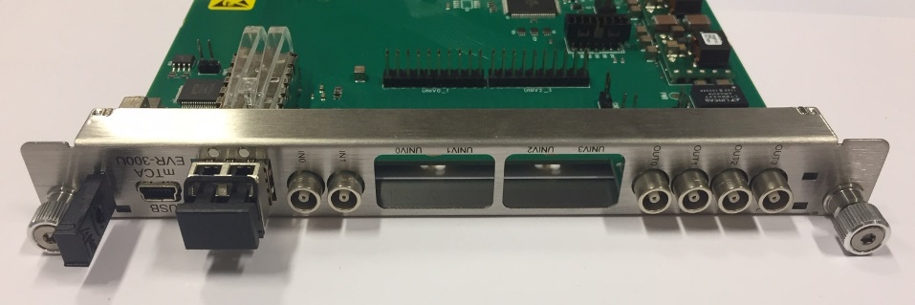
Micro-Research Finland Oy
mTCA-EVR-300U
Event Receiver (EVR)
Two Universal I/O slots
both compatible with -DLY modules
Four LVTTL outputs
Two TTL inputs for external triggers
Backplane triggers
Can drive TCLKA/TCLKB clocks with GTX logic
RTM interface

Slide 27
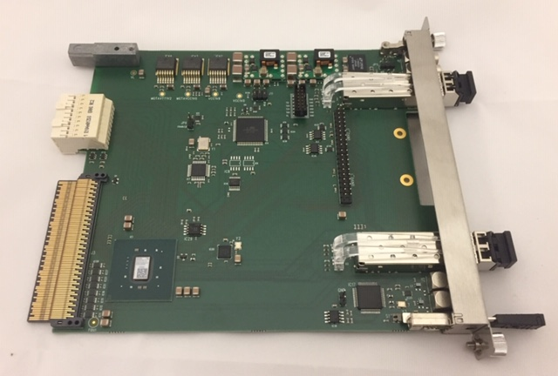
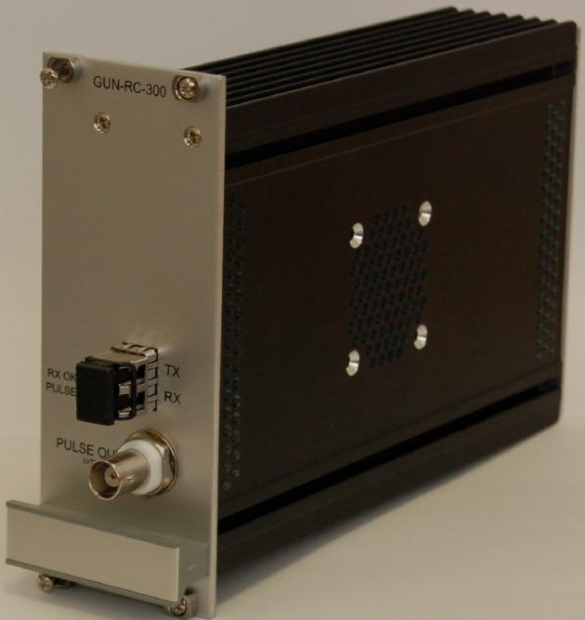
Micro-Research Finland Oy
mTCA-EVR-300RF / GUN-RC-300
Event Receiver (EVR)
Two Universal I/O slots
both compatible with -DLY modules
One slot driven by two GTX outputs
One SFP Output for GUN-RC-300
One Differential CML Output (GTX)
GTX outputs support fine tuning delay with 1/2560 event clock resolution (~3 ps @ 125 MHz)
Two TTL inputs for external triggers
Backplane triggers
Can drive TCLKA/TCLKB clocks with GTX logic
RTM interface
Optical connection to EVR
One 5V TTL output
Supplied by 9-36 V
Can be mounted in high voltage rack

Slide 28
Micro-Research Finland Oy
mTCA-EVR-300GTX
New product in development (availability 3Q/2026)
Similar to mTCA-EVR-300U (in photo)
Both slot driven by two GTX outputs
GTX outputs support fine tuning delay with 1/2560 event clock resolution (~3 ps @ 125 MHz)

Slide 29
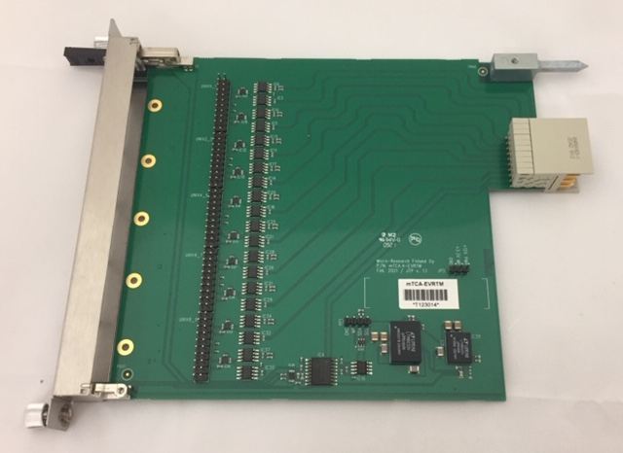
Micro-Research Finland Oy
mTCA-EVRTM-300
Supports up to 5 Universal I/O Modules
Up to ten inputs or outputs
Can be used for mTCA-EVM-300, mTCA-EVR-300U and mTCA-EVR-300RF
Supports –DLY modules

Slide 30
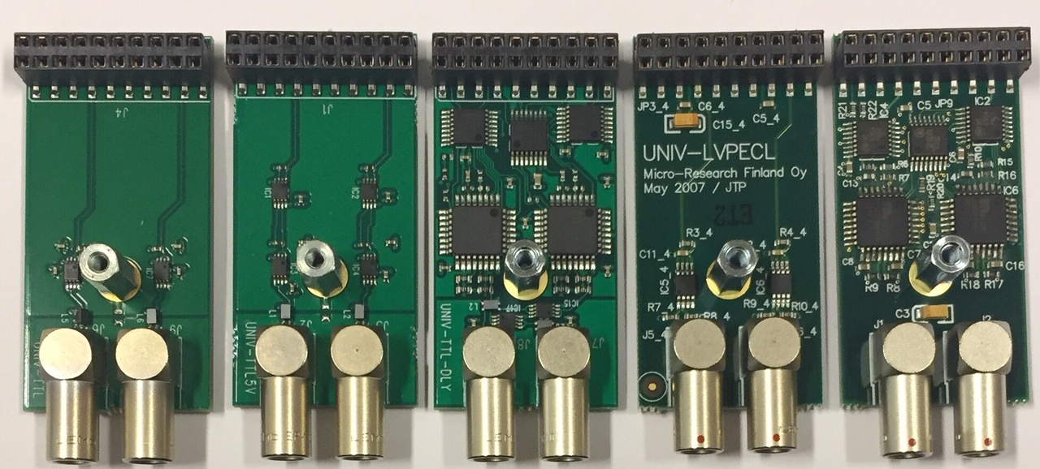
Micro-Research Finland Oy
Universal I/O Modules
UNIV-TTL
LVTTL output
UNIV-TTL5V
5V TTL output
UNIV-TTL-DLY
LVTTL output
Delay tuning 1024 steps of ~9 ps
UNIV-LVPECL
differential LVPECL output
UNIV-LVPECL-DLY
differential LVPECL output
Delay tuning 1024 steps of ~9 ps
UNIV-TTL
UNIV-TTL5V
UNIV-TTL-DLY
UNIV-LVPECL
UNIV-LVPECL-DLY

Slide 31
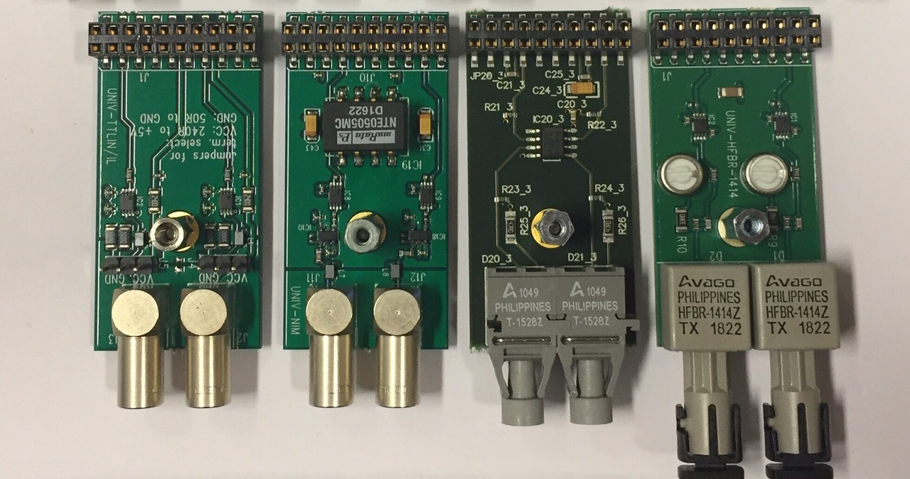
Micro-Research Finland Oy
Universal I/O Modules
UNIV-TTLIN/IL
UNIV-NIM
UNIV-HFBR-1528
UNIV-HFBR-1414
UNIV-TTLIN
TTL input
configurable term.
240 ohm to +5V
50 ohm to GND
UNIV-NIM
NIM output
UNIV-HFBR-1528
650 nm Optical Output
POF
UNIV-HFBR-1414
820 nm Optical Output
50/125 μm, 62.5/125 μm, 100/140 μm, 200 μm PCS

Slide 32
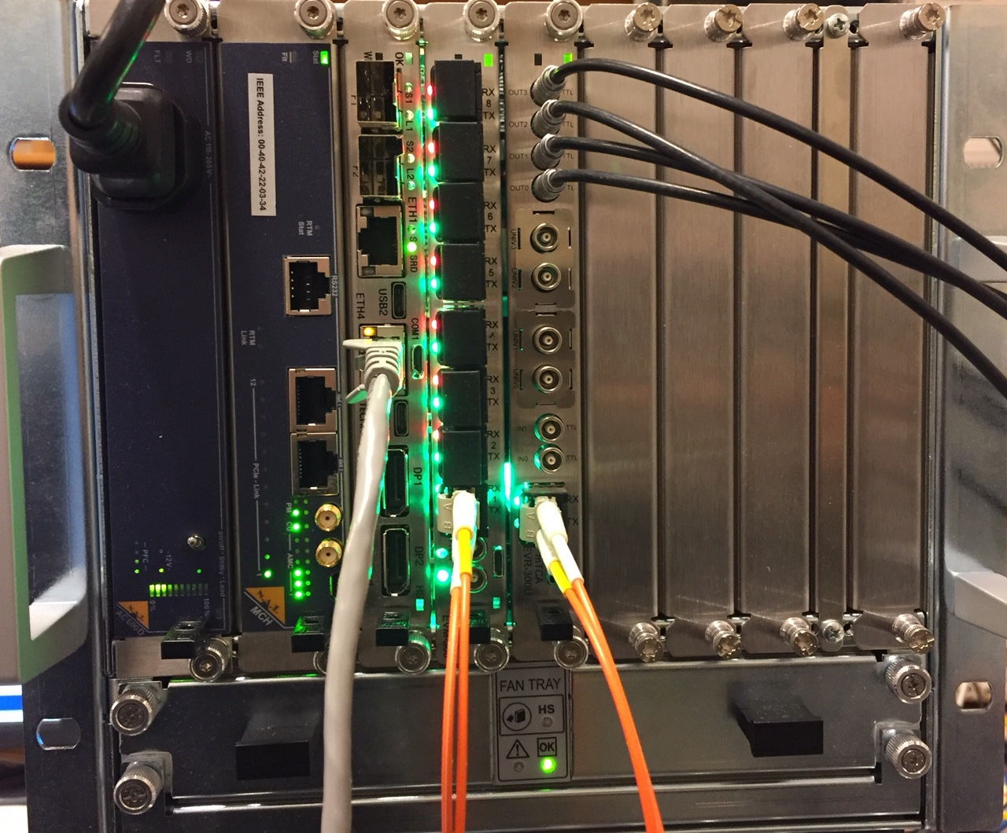
Example System Set Up
MTCA-7S-PH5a (PowerBridge)
11850-21 Chassis
NAT PM-AC600D
NAT MCH-PHYS
AM G64/471-41 CPU
Ubuntu pre-installed
MRF mTCA-EVM-300
Event Master/Generator
MRF mTCA-EVR-300U
Event Receiver

Slide 33
Linux Driver
Available on https://github.com/jpietari/mrf-linux-driver
Provides memory mapped (mmap) interface to event hardware
Support for upgrading FPGA firmware
Compatible with all MRF PCI/PCI Express hardware

Slide 34
Starting from a fresh (pre-installed) Ubuntu installation
Install ssh (to be able to use system remotely)
sudo apt-get install openssh-server
Install git
sudo apt-get install git
Update & Upgrade
sudo apt-get update
sudo apt-get upgrade
sudo apt-get dist-upgrade
Install packages required for building kernel modules
sudo apt install dkms build-essential linux-headers-`uname -r`
sudo apt install libelf-dev
sudo apt-get install linux-headers-generic

Slide 35
Linux Driver Installation
Get driver sources
git clone https://github.com/jpietari/mrf-linux-driver
Build driver
cd mrf-linux-driver
make
Add group privileges for user space driver access
sudo groupadd -g 502 mrf
sudo usermod -a -G mrf user
Install driver
sudo make modules_install
sudo depmod -a
Add udev-rules and load driver
sudo ./module_load
Driver will be loaded automatically at next reboot
EVG devices show up as /dev/ega0..3, /dev/egb0..3, /dev/egc0..3, …
EVR devices show up as /dev/era0..3, /dev/erb0..3, /dev/erc0..3, …
user@MTCA-7S-PH5a:~/mrf-linux-api$ ls -al /dev/eg* /dev/er*
crw-r----- 1 root mrf 238, 0 Sep 30 09:02 /dev/ega0
crw-rw---- 1 root mrf 238, 1 Sep 30 09:02 /dev/ega1
crw-r----- 1 root mrf 238, 2 Sep 30 09:02 /dev/ega2
crw-rw---- 1 root mrf 238, 3 Sep 30 09:02 /dev/ega3
crw-r----- 1 root mrf 239, 0 Sep 30 09:02 /dev/era0
crw-rw---- 1 root mrf 239, 1 Sep 30 09:02 /dev/era1
crw-r----- 1 root mrf 239, 2 Sep 30 09:02 /dev/era2
crw-rw---- 1 root mrf 239, 3 Sep 30 09:02 /dev/era3

Slide 36
Application Programming Interface
Available on https://github.com/jpietari/mrf-linux-api
Functions for programming EVG/EVR in C
Shell wrapper functions to control devices from command line

Slide 37
Requirements for Building (Ubuntu installation)
See slide 3 for packages needed for building driver
For building documentaton doxygen and latex are needed
Install doxygen
sudo apt-get install doxygen
Install latex
sudo apt-get install texlive-full

Slide 38
API Installation
Get sources
git clone https://github.com/jpietari/mrf-linux-api
Build api, shell wrappers and documentation
cd mrf-linux-api
make

Slide 39
mmap_test – Tool to access registers
Commands
d – dump memory block of 128 bytes
m – modify memory
q – quit

Slide 40
mmap_test – Display memory
Usage: d [<address offset>]
user@MTCA-7S-PH5a:~/mrf-linux-api/api$ ./mmap_test /dev/era3
Buffer 0x7fcf9449c000
test-> d 0
00: 00010000 00000000 00000007 00000000
10: 00000000 00000000 00000000 40000000
20: 00001000 00110000 00110000 180e0207
30: 00000000 00000000 00000000 00000000
40: 00000000 00000000 00000000 00000058
50: 40000200 00000000 00000000 00000000
60: 00000000 00000000 00000000 00000000
70: 00000000 00000000 00000000 00000000
test-> d
80: 079e41ed 00000000 00000003 00000000
90: 00000000 000000ff 00000000 00000000
a0: 00000000 00000030 00000000 00000000
b0: 00080000 00000000 00000000 00000000
c0: 00000000 00000000 00000000 00000000
d0: 00000000 00000000 00000000 00000000
e0: 0000003f 00000000 00000000 00000000
f0: 00000000 00000000 00000000 00000000
test->

Slide 41
mmap_test – Modify memory
Usage: m [<address offset>][,<size in bytes, 1, 2 or 4>]
test-> m 8
00000008: 00000007 ? 7
0000000c: 00000000 ? .
test-> m 0xb,1
0000000b: 05 ? 05
0000000c: 00 ? .
test->

Slide 42
System Hardware Setup
EVG/EVM and EVR in the same crate
Duplex fiber connected from EVM port 1 to EVR
EVR TTL Outputs connected to oscilloscope
EVG/EVM:
Set up event frequency – we will use internal reference programmed to 125 MHz
Set up delay compensation
EVR:
Set up event frequency 125 MHz (reference clock needed by GTX to be able to lock to EVG/EVM clock)
Set up delay compensation with target delay
Clear RX violation flag & check status

Slide 43
Setting up EVM
Set up EVM to use internal event clock generator (fractional synthesizer) and disable external RF divider:
jpietari@MTCA-7S-PH5a:~$ cd wrapper
jpietari@MTCA-7S-PH5a:~/wrapper$ ./EvgSetRFInput /dev/ega3 0 12
Set up event clock frequency:
jpietari@MTCA-7S-PH5a:~/wrapper$ ./EvgSetEventFrequency /dev/ega3 125
124.997067
Enable the EVM to operate as Delay compensation master:
jpietari@MTCA-7S-PH5a:~/wrapper$ ./EvgSystemMasterEnable /dev/ega3 1
1
Enable Beacon event required by delay compensation:
jpietari@MTCA-7S-PH5a:~/wrapper$ ./EvgBeaconEnable /dev/ega3 1
1

Slide 44
Setting up EVR
Set up EVR reference clock:
jpietari@MTCA-7S-PH5a:~/wrapper$ ./EvrSetEventFrequency /dev/era3 125
124.997067
Enable EVR Delay compensation mode:
jpietari@MTCA-7S-PH5a:~/wrapper$ ./EvrDCEnable /dev/era3 1
1
Set up EVR Target delay:
jpietari@MTCA-7S-PH5a:~/wrapper$ ./EvrSetTargetDelay /dev/era3 0x200000
2097152
Clear violation (and verify link is up if we can clear the violation flag):
jpietari@MTCA-7S-PH5a:~/wrapper$ ./EvrGetViolation /dev/era3 1
0
Check Delay Compensation Status:
jpietari@MTCA-7S-PH5a:~/wrapper$ ./EvrDumpDC /dev/era3
DC Enable 1
DC Status 0x0100
DC Delay Target 00200000, (1000.000000 ns)
DC Delay Value 001fb6e0, (991.073608 ns)
jpietari@MTCA-7S-PH5a:~/wrapper$ ./EvrDumpDC /dev/era3
DC Enable 1
DC Status 0x0701
DC Delay Target 00200000, (1000.000000 ns)
DC Delay Value 0020000c, (1000.005722 ns)

Slide 45
Working with Events
EVR has an event FIFO to store received events
We use evr_fifo_monitor tool in API to show received events
Enable EVR
Set up EVR mapping RAM to store event codes 0x01 to 0x04 in FIFO
Enable mapping RAM
Start evr_fifo_monitor

Slide 46
Setting up EVR (2)
Enable EVR:
jpietari@MTCA-7S-PH5a:~/wrapper$ ./EvrEnable /dev/era3 1
1
Enable events to be stores into event FIFO:
jpietari@MTCA-7S-PH5a:~/wrapper$ ./EvrSetFIFOEvent /dev/era3 0 1 1
jpietari@MTCA-7S-PH5a:~/wrapper$ ./EvrSetFIFOEvent /dev/era3 0 2 1
jpietari@MTCA-7S-PH5a:~/wrapper$ ./EvrSetFIFOEvent /dev/era3 0 3 1
jpietari@MTCA-7S-PH5a:~/wrapper$ ./EvrSetFIFOEvent /dev/era3 0 4 1
Enable map RAM 0:
jpietari@MTCA-7S-PH5a:~/wrapper$ ./EvrMapRamEnable /dev/era3 0 1
Start evr_fifo_monitor tool (in another window):
jpietari@MTCA-7S-PH5a:~/api$ ./evr_fifo_monitor /dev/era3

Slide 47
Sending Events with EVG
EVG can send software events
Enable EVG
Enable EVG software events
Send software events
Monitor events received by EVR

Slide 48
Sending Software events with EVG/EVM
Enable EVG:
jpietari@MTCA-7S-PH5a:~/wrapper$ ./EvgEnable /dev/ega3 1
1
Enable software events:
jpietari@MTCA-7S-PH5a:~/wrapper$ ./EvgSWEventEnable /dev/ega3 1
1
Send software events:
jpietari@MTCA-7S-PH5a:~/wrapper$ ./EvgSendSWEvent /dev/ega3 1
1
jpietari@MTCA-7S-PH5a:~/wrapper$ ./EvgSendSWEvent /dev/ega3 2
1
jpietari@MTCA-7S-PH5a:~/wrapper$ ./EvgSendSWEvent /dev/ega3 3
1
jpietari@MTCA-7S-PH5a:~/wrapper$ ./EvgSendSWEvent /dev/ega3 4
1
evr_fifo_monitor shows received events (timestamping has not been set up yet):
jpietari@MTCA-7S-PH5a:~/api$ ./evr_fifo_monitor /dev/era3
FIFO Code 00000001, 00000000:00000000
FIFO Code 00000002, 00000000:00000000
FIFO Code 00000003, 00000000:00000000
FIFO Code 00000004, 00000000:00000000

Slide 49
Setting up MXC and trigger events with EVG/EVM
We set up a multiplexed counter to run and generate an event at 1 Hz
Set MXC0 prescaler to 125000000
Enable MXC0 to trigger Trigger event 0
Set up Trigger event 0 to produce event code 1
Set up timestamp counter on EVR to count with 1us resolution
This is just an example – in a real use case we would setup timestamping by providing 1 Hz and 1 MHz clock directly to the EVG/EVM and the real time would be passed automatically on to the EVR

Slide 50
Setting up MXC and trigger events with EVG/EVM
Set up multiplexed counter 0 (MXC0) for 1 Hz:
jpietari@MTCA-7S-PH5a:~/wrapper$ ./EvgSetMXCPrescaler /dev/ega3
Usage: ./EvgSetMXCPrescaler /dev/ega3 <MXC> [<prescaler_value>]
jpietari@MTCA-7S-PH5a:~/wrapper$ ./EvgSetMXCPrescaler /dev/ega3 0 125000000
125000000
Reset/synchronize multiplexed counters:
./EvgSyncMxc /dev/ega3
Set up MXC0 to trigger Trigger event 0:
jpietari@MTCA-7S-PH5a:~/wrapper$ ./EvgSetMXCTrigMap
Usage: ./EvgSetMXCTrigMap /dev/ega3 <MXC> [<map_value>]
jpietari@MTCA-7S-PH5a:~/wrapper$ ./EvgSetMXCTrigMap /dev/ega3 0 0
Set up Trigger event 0 to produce event code 01:
jpietari@MTCA-7S-PH5a:~/wrapper$ ./EvgSetTriggerEvent /dev/ega3
Usage: ./EvgSetTriggerEvent /dev/ega3 <trigger event> [<event code> <enable>]
jpietari@MTCA-7S-PH5a:~/wrapper$ ./EvgSetTriggerEvent /dev/ega3 0 1 1
1 1

Slide 51
Setting up MXC and trigger events with EVG/EVM
Set up EVR internal counter for timestamping:
jpietari@MTCA-7S-PH5a:~/wrapper$ ./EvrSetTimestampDivider /dev/era3 125
evr_fifo_monitor starts to display event at 1 Hz:
FIFO Code 00000001, 00000000:00084283
FIFO Code 00000001, 00000000:001784c3
FIFO Code 00000001, 00000000:0026c703
FIFO Code 00000001, 00000000:00360943

Slide 52
Setting up a sequence on EVG/EVM
We set up a sequence of events that is triggered at 1 Hz. We want to produce the following events:
Event 2, 5 event clock cycles after triggering
Event 3, 10 event clock cycles after triggering
Event 4, 50 event clock cycles after triggering
Write events into sequence RAM
Append end-of-sequence event 127
Set up sequence triggering and enable

Slide 53
Setting up a sequencer on EVG/EVM
Set sequence RAM 0 events:
jpietari@MTCA-7S-PH5a:~/wrapper$ ./EvgSetSeqRamEvent /dev/ega3
Usage: ./EvgSetSeqRamEvent /dev/ega3 <ram> <pos> <timestamp> <event code>
jpietari@MTCA-7S-PH5a:~/wrapper$ ./EvgSetSeqRamEvent /dev/ega3 0 0 5 2
jpietari@MTCA-7S-PH5a:~/wrapper$ ./EvgSetSeqRamEvent /dev/ega3 0 1 10 3
jpietari@MTCA-7S-PH5a:~/wrapper$ ./EvgSetSeqRamEvent /dev/ega3 0 2 50 4
jpietari@MTCA-7S-PH5a:~/wrapper$ ./EvgSetSeqRamEvent /dev/ega3 0 3 100 127
Dump sequence RAM contents:
jpietari@MTCA-7S-PH5a:~/wrapper$ ./EvgSeqRamDump /dev/ega3 0
Ram0: Timestamp 00000005 Code 02
Ram0: Timestamp 0000000a Code 03
Ram0: Timestamp 00000032 Code 04
Ram0: Timestamp 00000064 Code 7f
Set up sequence RAM triggering:
jpietari@MTCA-7S-PH5a:~/wrapper$ ./EvgSeqRamControl /dev/ega3
Usage: ./EvgSeqRamControl /dev/ega3 <ram> <enable> <single> <recycle> <reset> <trigsel>
jpietari@MTCA-7S-PH5a:~/wrapper$ ./EvgSeqRamControl /dev/ega3 0 1 0 0 0 0

Slide 54
Setting up a sequencer on EVG/EVM
evr_fifo_monitor starts to display sequence RAM events and MXC0 event at 1 Hz:
FIFO Code 00000001, 00000000:691e0103
FIFO Code 00000002, 00000000:691e0103
FIFO Code 00000003, 00000000:691e0103
FIFO Code 00000004, 00000000:691e0104
FIFO Code 00000001, 00000000:692d4343
FIFO Code 00000002, 00000000:692d4343
FIFO Code 00000003, 00000000:692d4343
FIFO Code 00000004, 00000000:692d4344
FIFO Code 00000001, 00000000:693c8583
FIFO Code 00000002, 00000000:693c8583
FIFO Code 00000003, 00000000:693c8583
FIFO Code 00000004, 00000000:693c8584

Slide 55
Setting up pulse generators and HW output on EVR
We want to see actual hardware signals on EVR
We setup pulse generators for each event code 1 through 4 and map the pulse generator outputs to front panel TTL outputs
Set up mapping RAM to trigger pulse generator 0 from event 1, pulse generator 1 from event 2, etc.
Set up pulse generators with pulse delay of 10 event clock cycles and pulse widths from 100 to 400 event clock cycles
Map pulse generators to front panel outputs
Configure and enable pulse generators

Slide 56
Setting up EVR HW Outputs
Setup event code to pulse generator trigger mappings:
jpietari@MTCA-7S-PH5a:~/wrapper$ ./EvrSetPulseMap
Usage: ./EvrSetPulseMap /dev/era3 <ram> <code> <trig> <set> <clear>
jpietari@MTCA-7S-PH5a:~/wrapper$ ./EvrSetPulseMap /dev/era3 0 1 0 -1 -1
jpietari@MTCA-7S-PH5a:~/wrapper$ ./EvrSetPulseMap /dev/era3 0 2 1 -1 -1
jpietari@MTCA-7S-PH5a:~/wrapper$ ./EvrSetPulseMap /dev/era3 0 3 2 -1 -1
jpietari@MTCA-7S-PH5a:~/wrapper$ ./EvrSetPulseMap /dev/era3 0 4 3 -1 -1
Setup pulse generator parameters, prescaler, delay, width:
jpietari@MTCA-7S-PH5a:~/wrapper$ ./EvrSetPulseParams
Usage: ./EvrSetPulseParams /dev/era3 <pulse> <presc> <delay> <width>
jpietari@MTCA-7S-PH5a:~/wrapper$ ./EvrSetPulseParams /dev/era3 0 0 10 100
jpietari@MTCA-7S-PH5a:~/wrapper$ ./EvrSetPulseParams /dev/era3 1 0 10 200
jpietari@MTCA-7S-PH5a:~/wrapper$ ./EvrSetPulseParams /dev/era3 2 0 10 300
jpietari@MTCA-7S-PH5a:~/wrapper$ ./EvrSetPulseParams /dev/era3 4 0 10 400
Setup Front Panel TTL output mappings:
jpietari@MTCA-7S-PH5a:~/wrapper$ ./EvrSetFPOutMap
Usage: ./EvrSetFPOutMap /dev/era3 <output> <map>
jpietari@MTCA-7S-PH5a:~/wrapper$ ./EvrSetFPOutMap /dev/era3 0 0x3f00
jpietari@MTCA-7S-PH5a:~/wrapper$ ./EvrSetFPOutMap /dev/era3 1 0x3f01
jpietari@MTCA-7S-PH5a:~/wrapper$ ./EvrSetFPOutMap /dev/era3 2 0x3f02
jpietari@MTCA-7S-PH5a:~/wrapper$ ./EvrSetFPOutMap /dev/era3 3 0x3f03

Slide 57
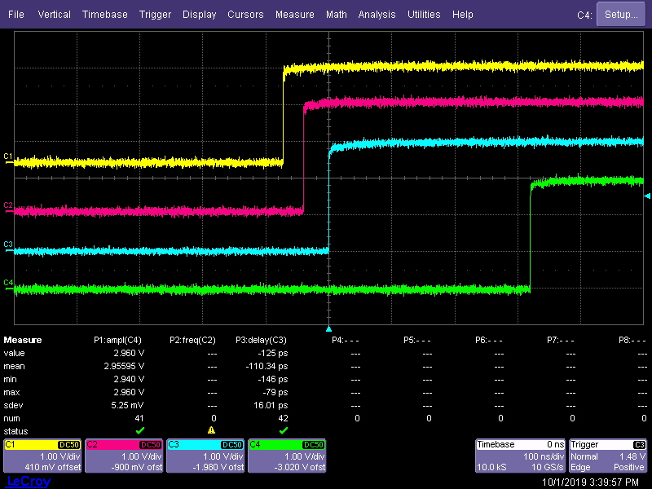
Setting up EVR HW Outputs (2)
Setup pulse generator properties, enable triggering and enable pulse generators:
jpietari@MTCA-7S-PH5a:~/wrapper$ ./EvrSetPulseProperties /dev/era3
Usage: ./EvrSetPulseProperties /dev/era3 <pulse> <polarity> <map_reset_ena> <map_set_ena>
<map_trigger_ena> <enable>
jpietari@MTCA-7S-PH5a:~/wrapper$ ./EvrSetPulseProperties /dev/era3 0 0 0 0 1 1
jpietari@MTCA-7S-PH5a:~/wrapper$ ./EvrSetPulseProperties /dev/era3 1 0 0 0 1 1
jpietari@MTCA-7S-PH5a:~/wrapper$ ./EvrSetPulseProperties /dev/era3 2 0 0 0 1 1
jpietari@MTCA-7S-PH5a:~/wrapper$ ./EvrSetPulseProperties /dev/era3 3 0 0 0 1 1
CH1 (yellow): TTL OUT0 mapped to pulse gen. 0
CH2 (pink): TTL OUT1 mapped to pulse gen. 1
CH3 (blue): TTL OUT2 mapped to pulse gen. 2
CH4 (green): TTL OUT3 mapped to pulse gen. 3
Pulse gen. 0 triggered by event 0x01 (seq. Trigger)
Pulse gen. 1 triggered by event 0x02 (seq. event #1)
Pulse gen. 2 triggered by event 0x03 (seq. event #2)
Pulse gen. 3 triggered by event 0x04 (seq. event #3)

Slide 58
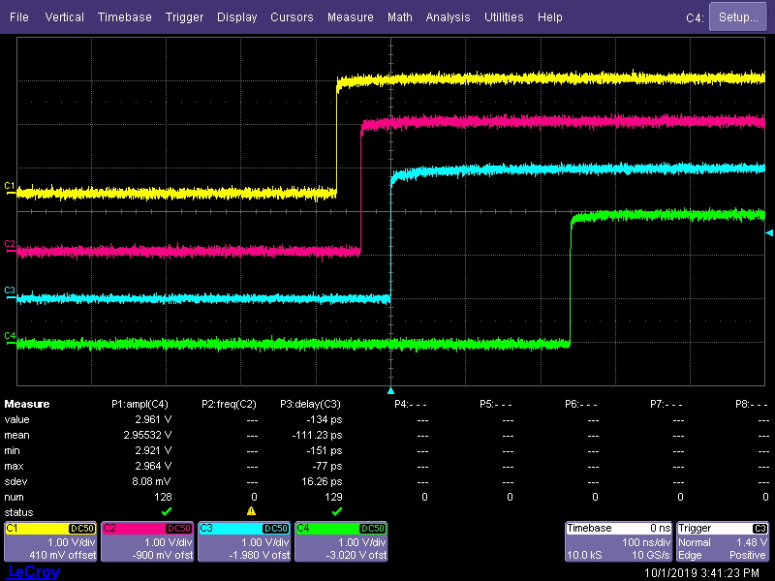
Setting up EVR HW Outputs (3)
Change delay of pulse generator 3 from 10 to 0:
jpietari@MTCA-7S-PH5a:~/wrapper$ ./EvrSetPulseParams /dev/era3 3 0 0 400
CH4 (green): pulse has moved by -80 ns

Slide 59
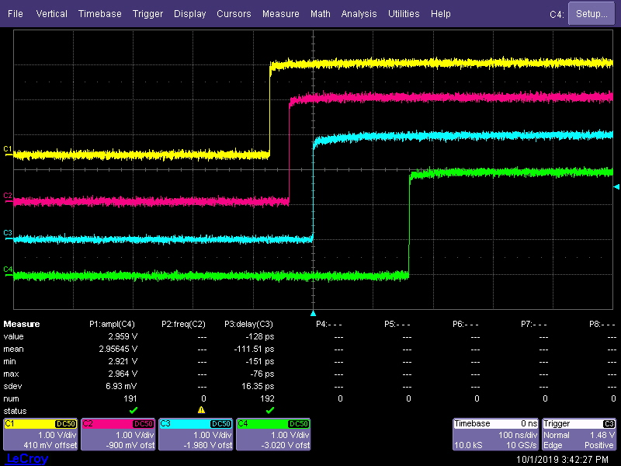
Setting up EVR HW Outputs (4)
We move event 3 in sequence by -10 cycles (timestamp changed from 50 to 40):
jpietari@MTCA-7S-PH5a:~/wrapper$ ./EvgSetSeqRamEvent /dev/ega3 0 2 40 4
CH4 (green): pulse has moved another -80 ns

