Slide 1
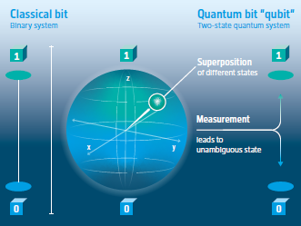

Quantum Computing in Experiment
The Quantum – Train is moving fast
opening many novel opportunities
Hamburg
Zeuthen

Slide 2
Quantum Computing in Particle Physics in Theory and Experiment.
Novel methods and tools → get ready today !
International working group – wrote a White Paper exploring the use of QC4HEP
Quantum computing for high-energy physics: State of the art and challenges
PRX QUANTUM 5, 037001 (2024),
https://doi.org/10.1103/PRXQuantum.5.037001
DESY Semiar 15.4.2025
https://cernbox.cern.ch/s/kfCkghFXZtwgpaK
Theory
Experiment

Slide 3
Quantum Computing in Experiment.
Novel methods and tools → get ready today !
QC - faster simulations, better data processing, novel experimental techniques
  Enabling efficient sampling for MC simulations
  Solving combinatorial problems
  Quantum state representation
  Hilbert space allows for higher representation power
Quantum Computing in Experimental HEP
Simulating Quantum Systems:
  Event generation
  Solving path integrals
  Mostly based on variational algorithms: QAE, QAOA, VQE
Data analysis:
  Detector simulation, anomaly detection
  Signal extraction and event classification
  Mostly based on variational algorithms: QNNs
Quantum sensing:
  Analyzing the data from quantum-enhanced sensors used in rare interaction detection
  Currently underexplored

Slide 4
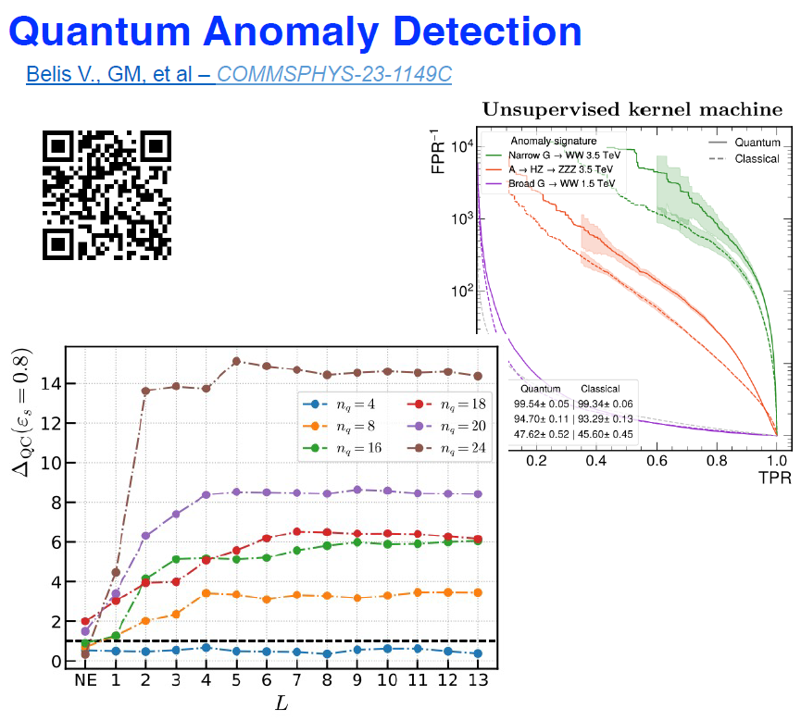
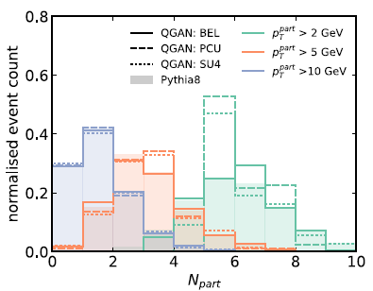
Quantum Computing in Experiment.
Novel methods and tools → get ready today !
Quantum Generative Models for hadronization and jet substructure
A novel tool for studying multi-body particle systems, like jets, to reproduce jet constituent properties and inner correlations → providing new insights into QCD and jet substructure.
Yacine Haddad, Vincent Alexander Croft, Michele Grossi, Cenk Tüysüz

Slide 5
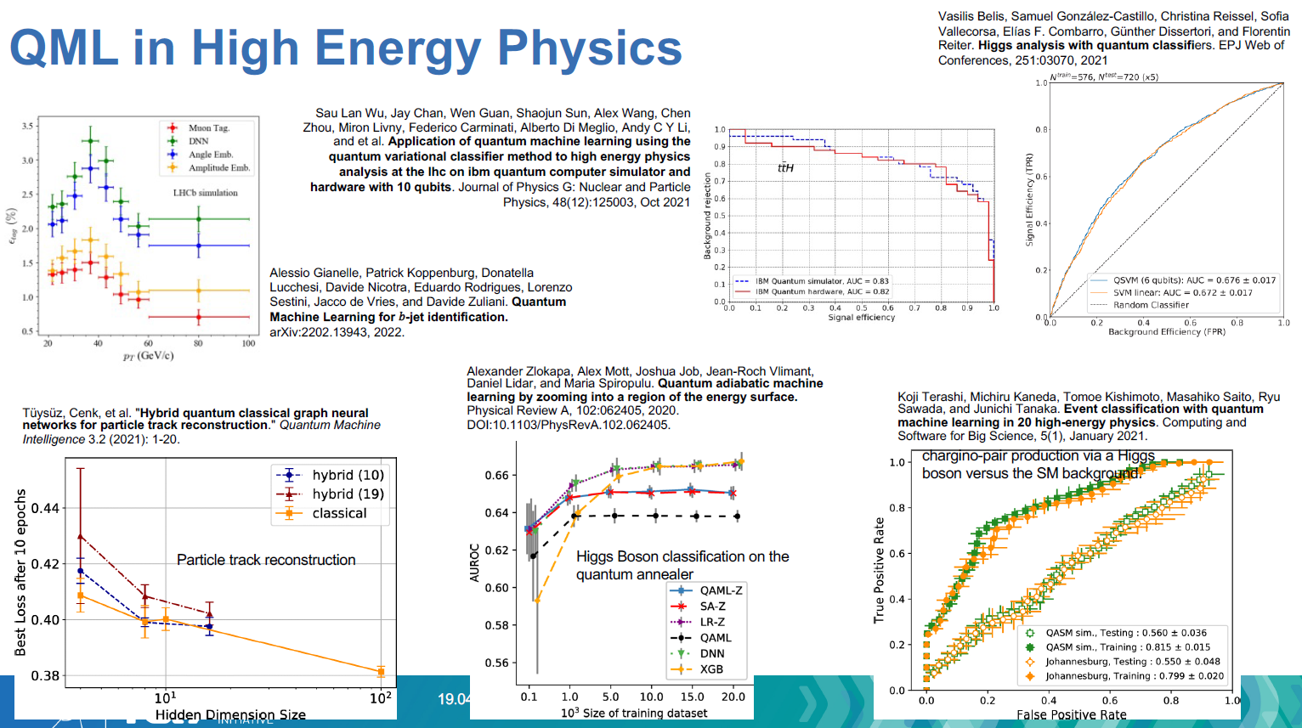
Quantum Computing in Particle Physics in Theory and Experiment.
Slide from
Sofia Vallecorsa
CERN QTI
Novel methods and tools for the 100x100 Challenge→ get ready today !

Slide 6


Let‘s take the Quantum – Train in PoF V
Any
Questions ?

