Slide 1
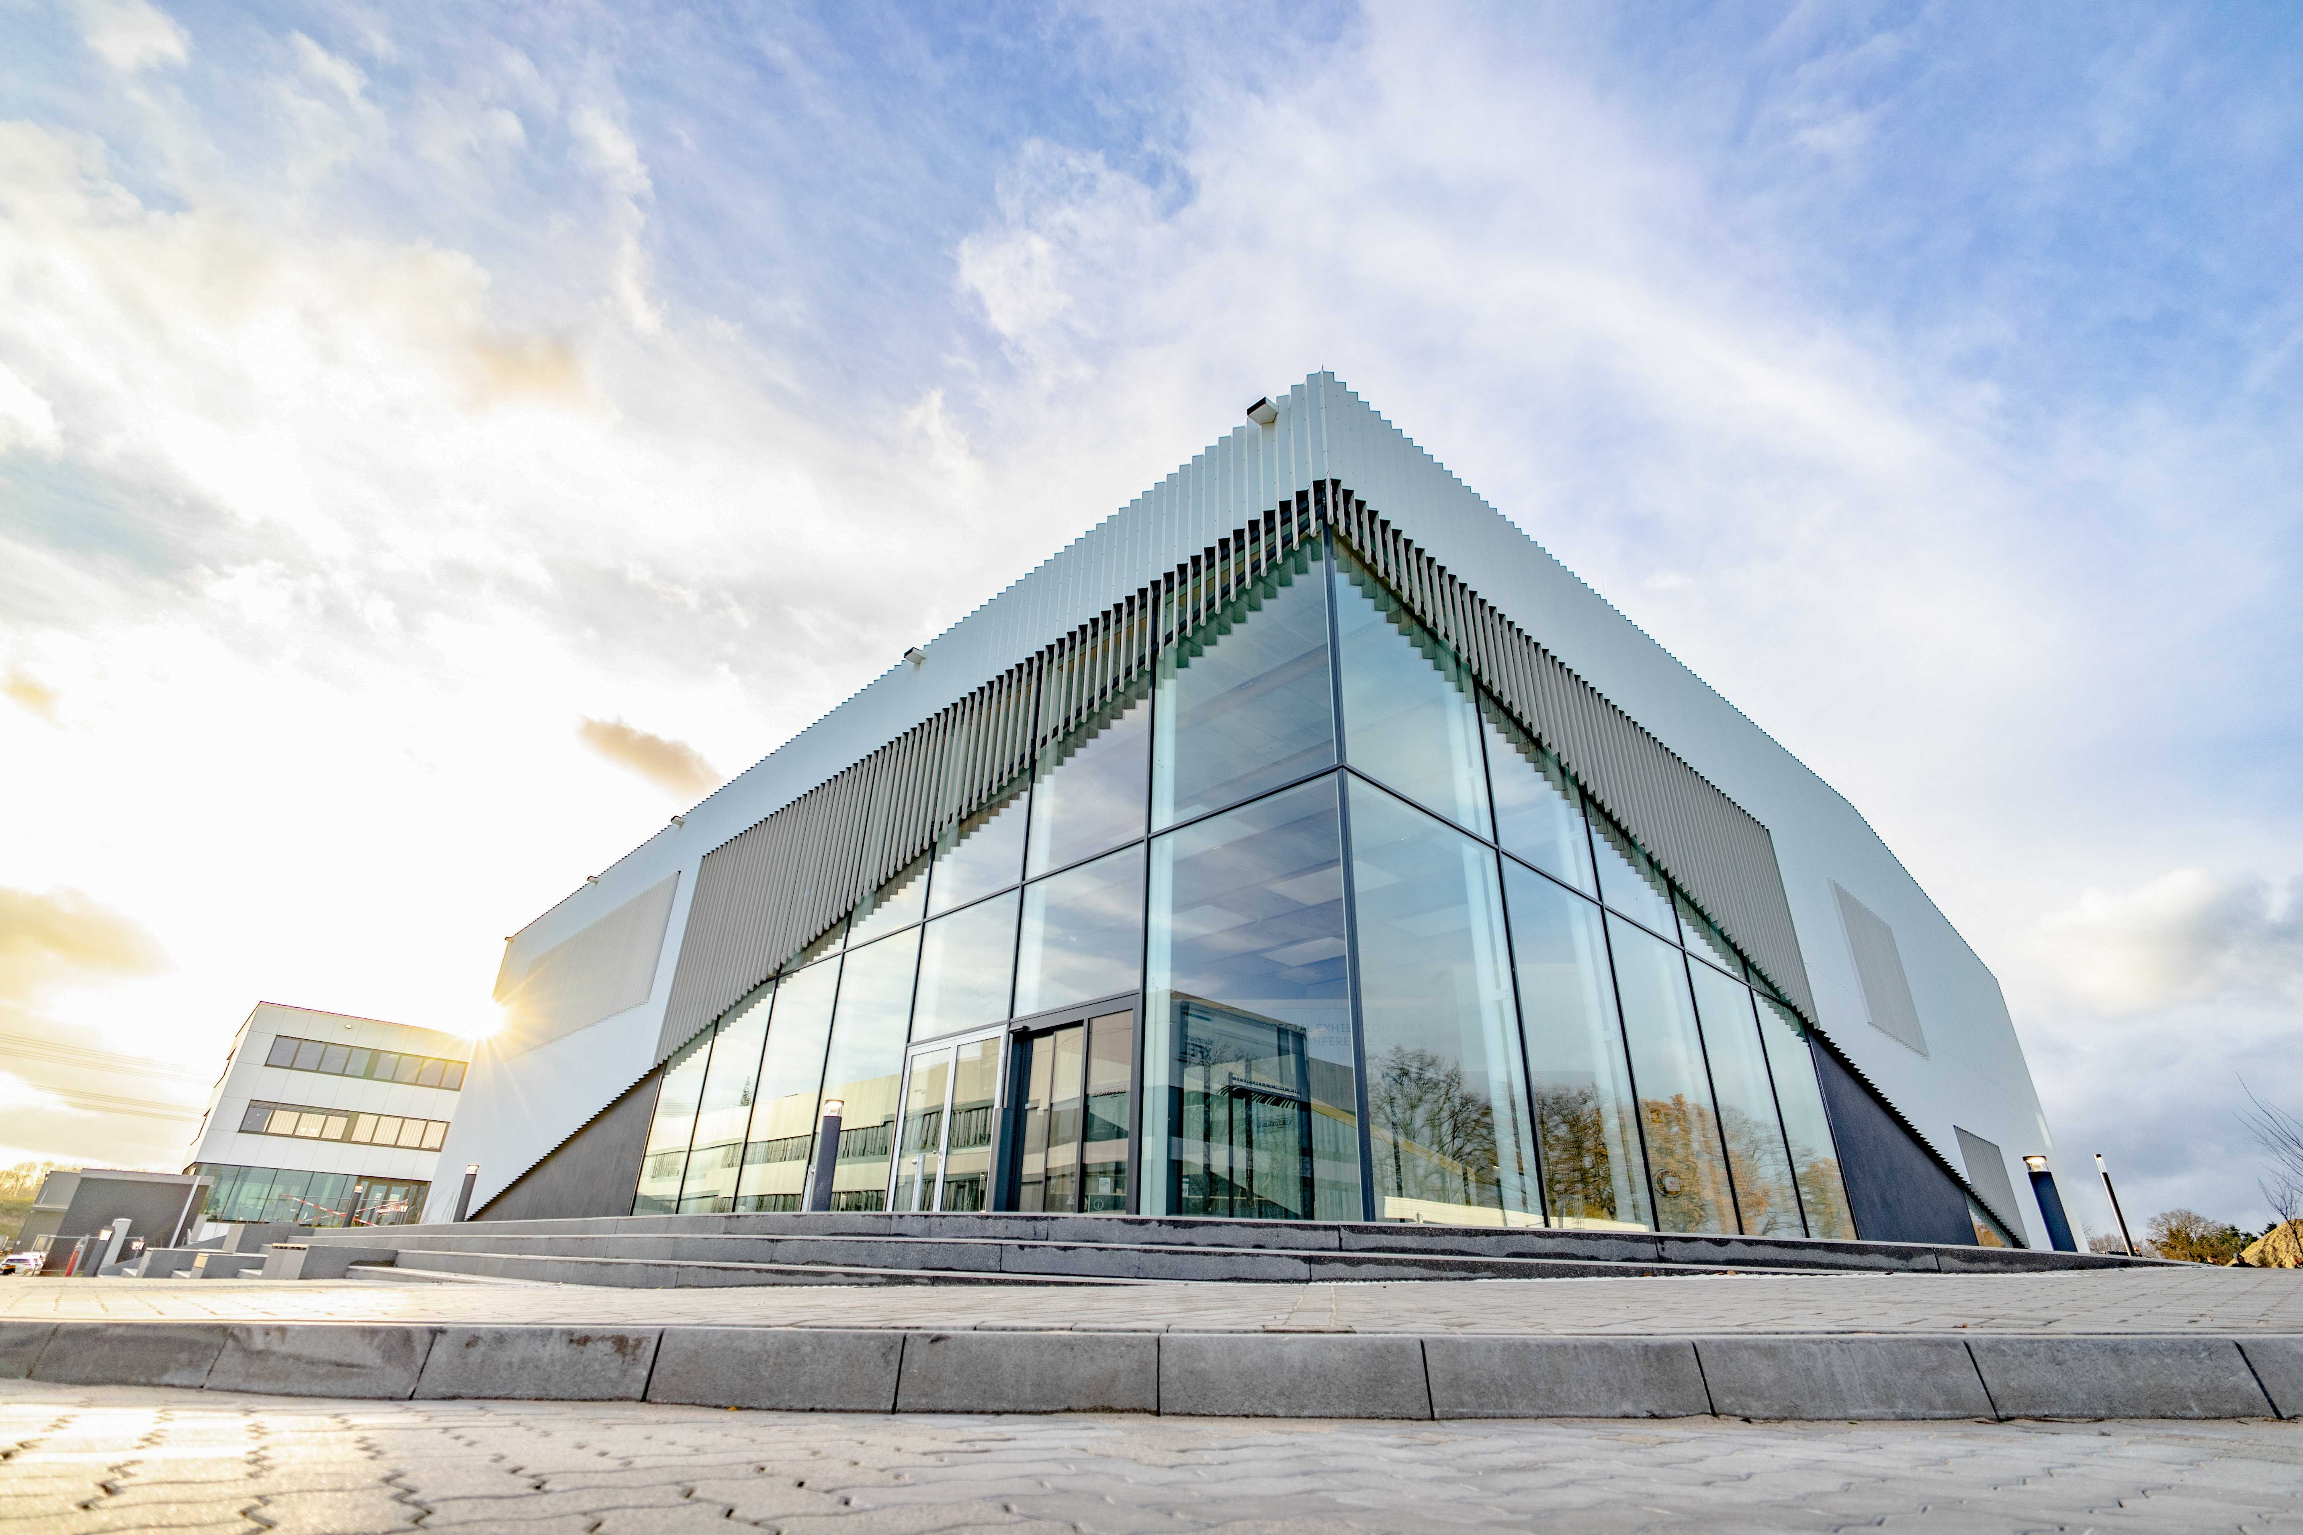


Welcome to the FH Retreat!
Claper Q&A instructions for mobile phones:
No App required!
Browser URL: https://app.claper.co/
Enter code (letters only): #P22FS
Please ask a question WITH QUESTION MARK!

Slide 2
1) Is the current prioritization of FH projects for PoF V sensible

Slide 3
2) Is the DESY Fellow Program still relevant and effective in today's scientific lands

Slide 4
3) Should DESY strengthen its role in Artificial Intelligence? If so, how

Slide 5
4) What should be the focus of the FH detector program post-LHC upgrade?
a

Slide 6
5) Do we have the right technical support structure in FH

Slide 7
6) How can we foster DESY’s role as a German hub for particle physics

Slide 8
7) The DESY campus is developing rapidly. How do we deal with it intelligently?

Slide 9
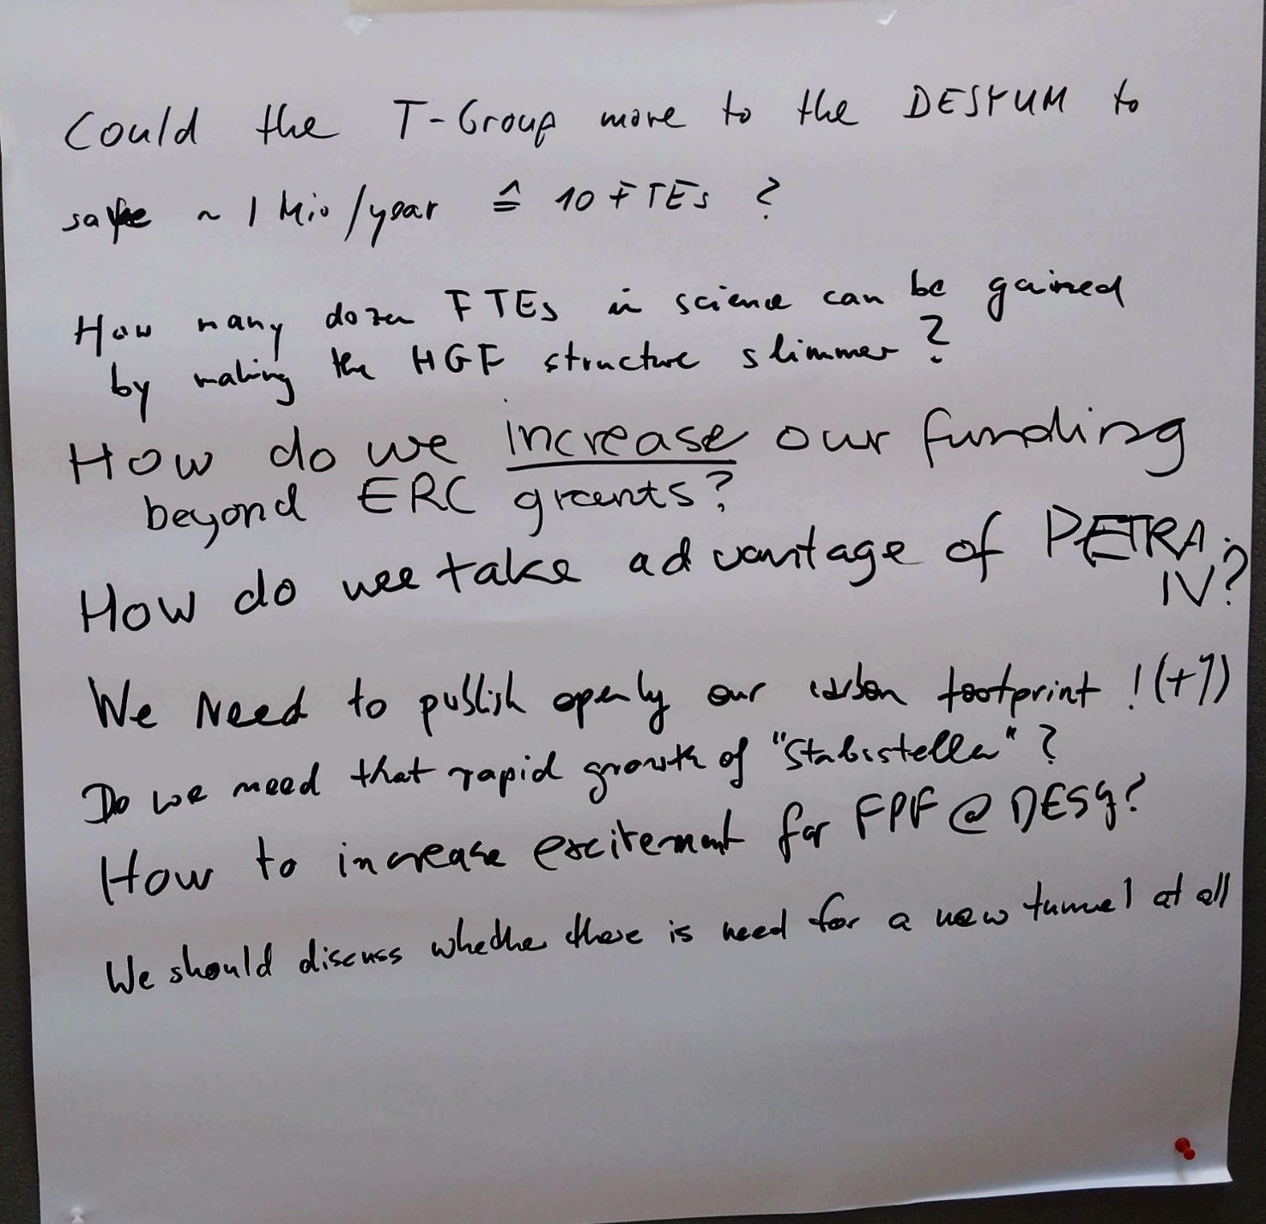
8) The “Joker Poster”: What else do you want to discuss

Slide 10
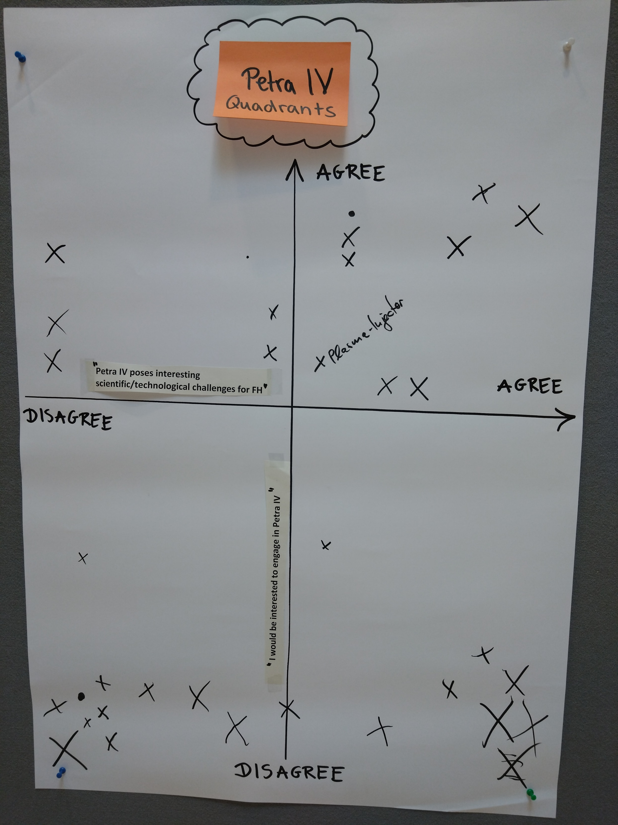

Slide 11
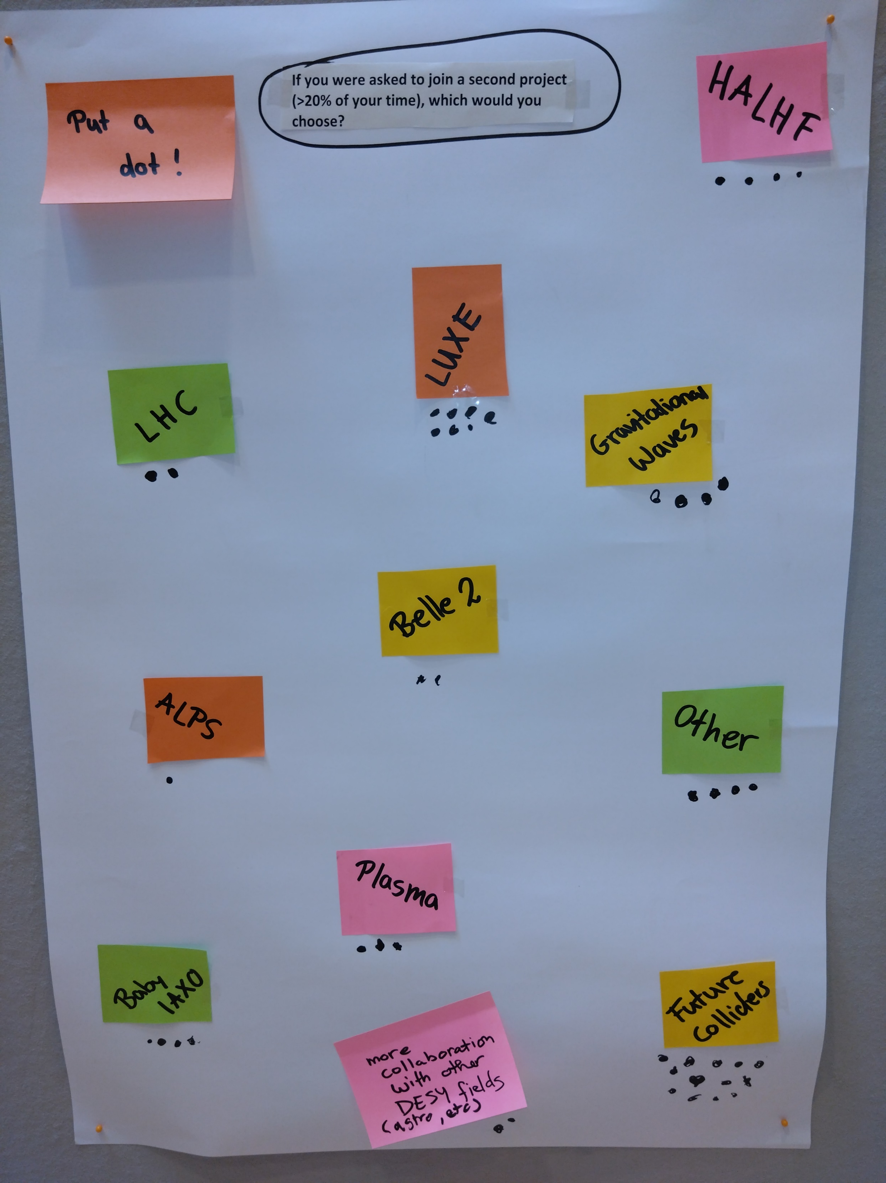

Slide 12
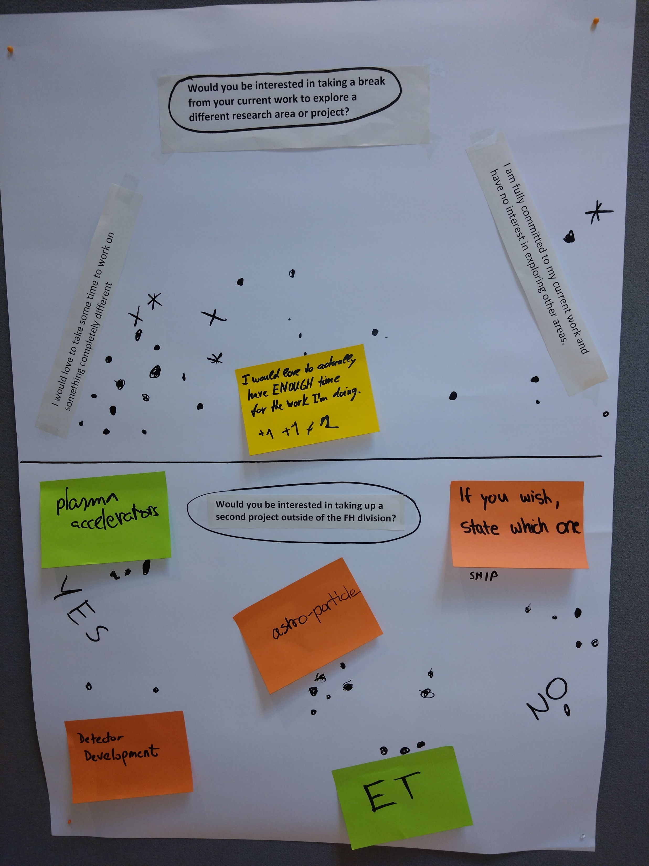

Slide 13
