Slide 1
Effect of dynamic ion motion in plasma accelerators
using advanced numerical methods
HALHF Monthly Meeting
Alexander Sinn
Hamburg, 3.6.2025

Slide 2
HALHF: Hybrid Asymmetric Linear Higgs Factory
Proposal for e⁺e⁻ Higgs Factory (250 GeV c.o.m. variant)
e⁺: Low energy using RF-based accelerator (42 GeV)
e⁻: High energy using beam-driven multi-stage plasma-accelerator (48 stages, 375 GeV)
Goal to reduce cost compared to other Higgs Factory Proposals
B. Foster, R. D’Arcy, and C. A. Lindstrøm, New Journal of Physics, vol. 25, no. 9, p. 093 037, Sep. 2023
B. Foster, E. Adli, T. L. Barklow, et al. Physics Open, vol. 23, p. 100 261, 2025
Effect of dynamic ion motion in plasma accelerators | Alexander Sinn

Slide 3
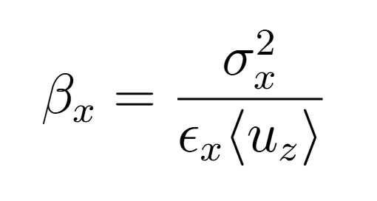
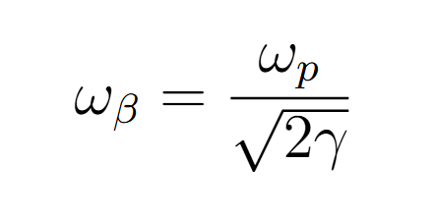
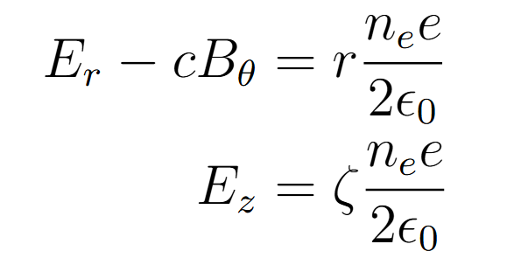
Physics of a beam-driven plasma Wake
T. Mehrling, Dissertation, Universität Hamburg, 2014, p. 206.
Effect of dynamic ion motion in plasma accelerators | Alexander Sinn

Slide 4
Physics of a beam-driven plasma Wake with ion-motion
T. Mehrling, Dissertation, Universität Hamburg, 2014, p. 206.
Effect of dynamic ion motion in plasma accelerators | Alexander Sinn

Slide 5
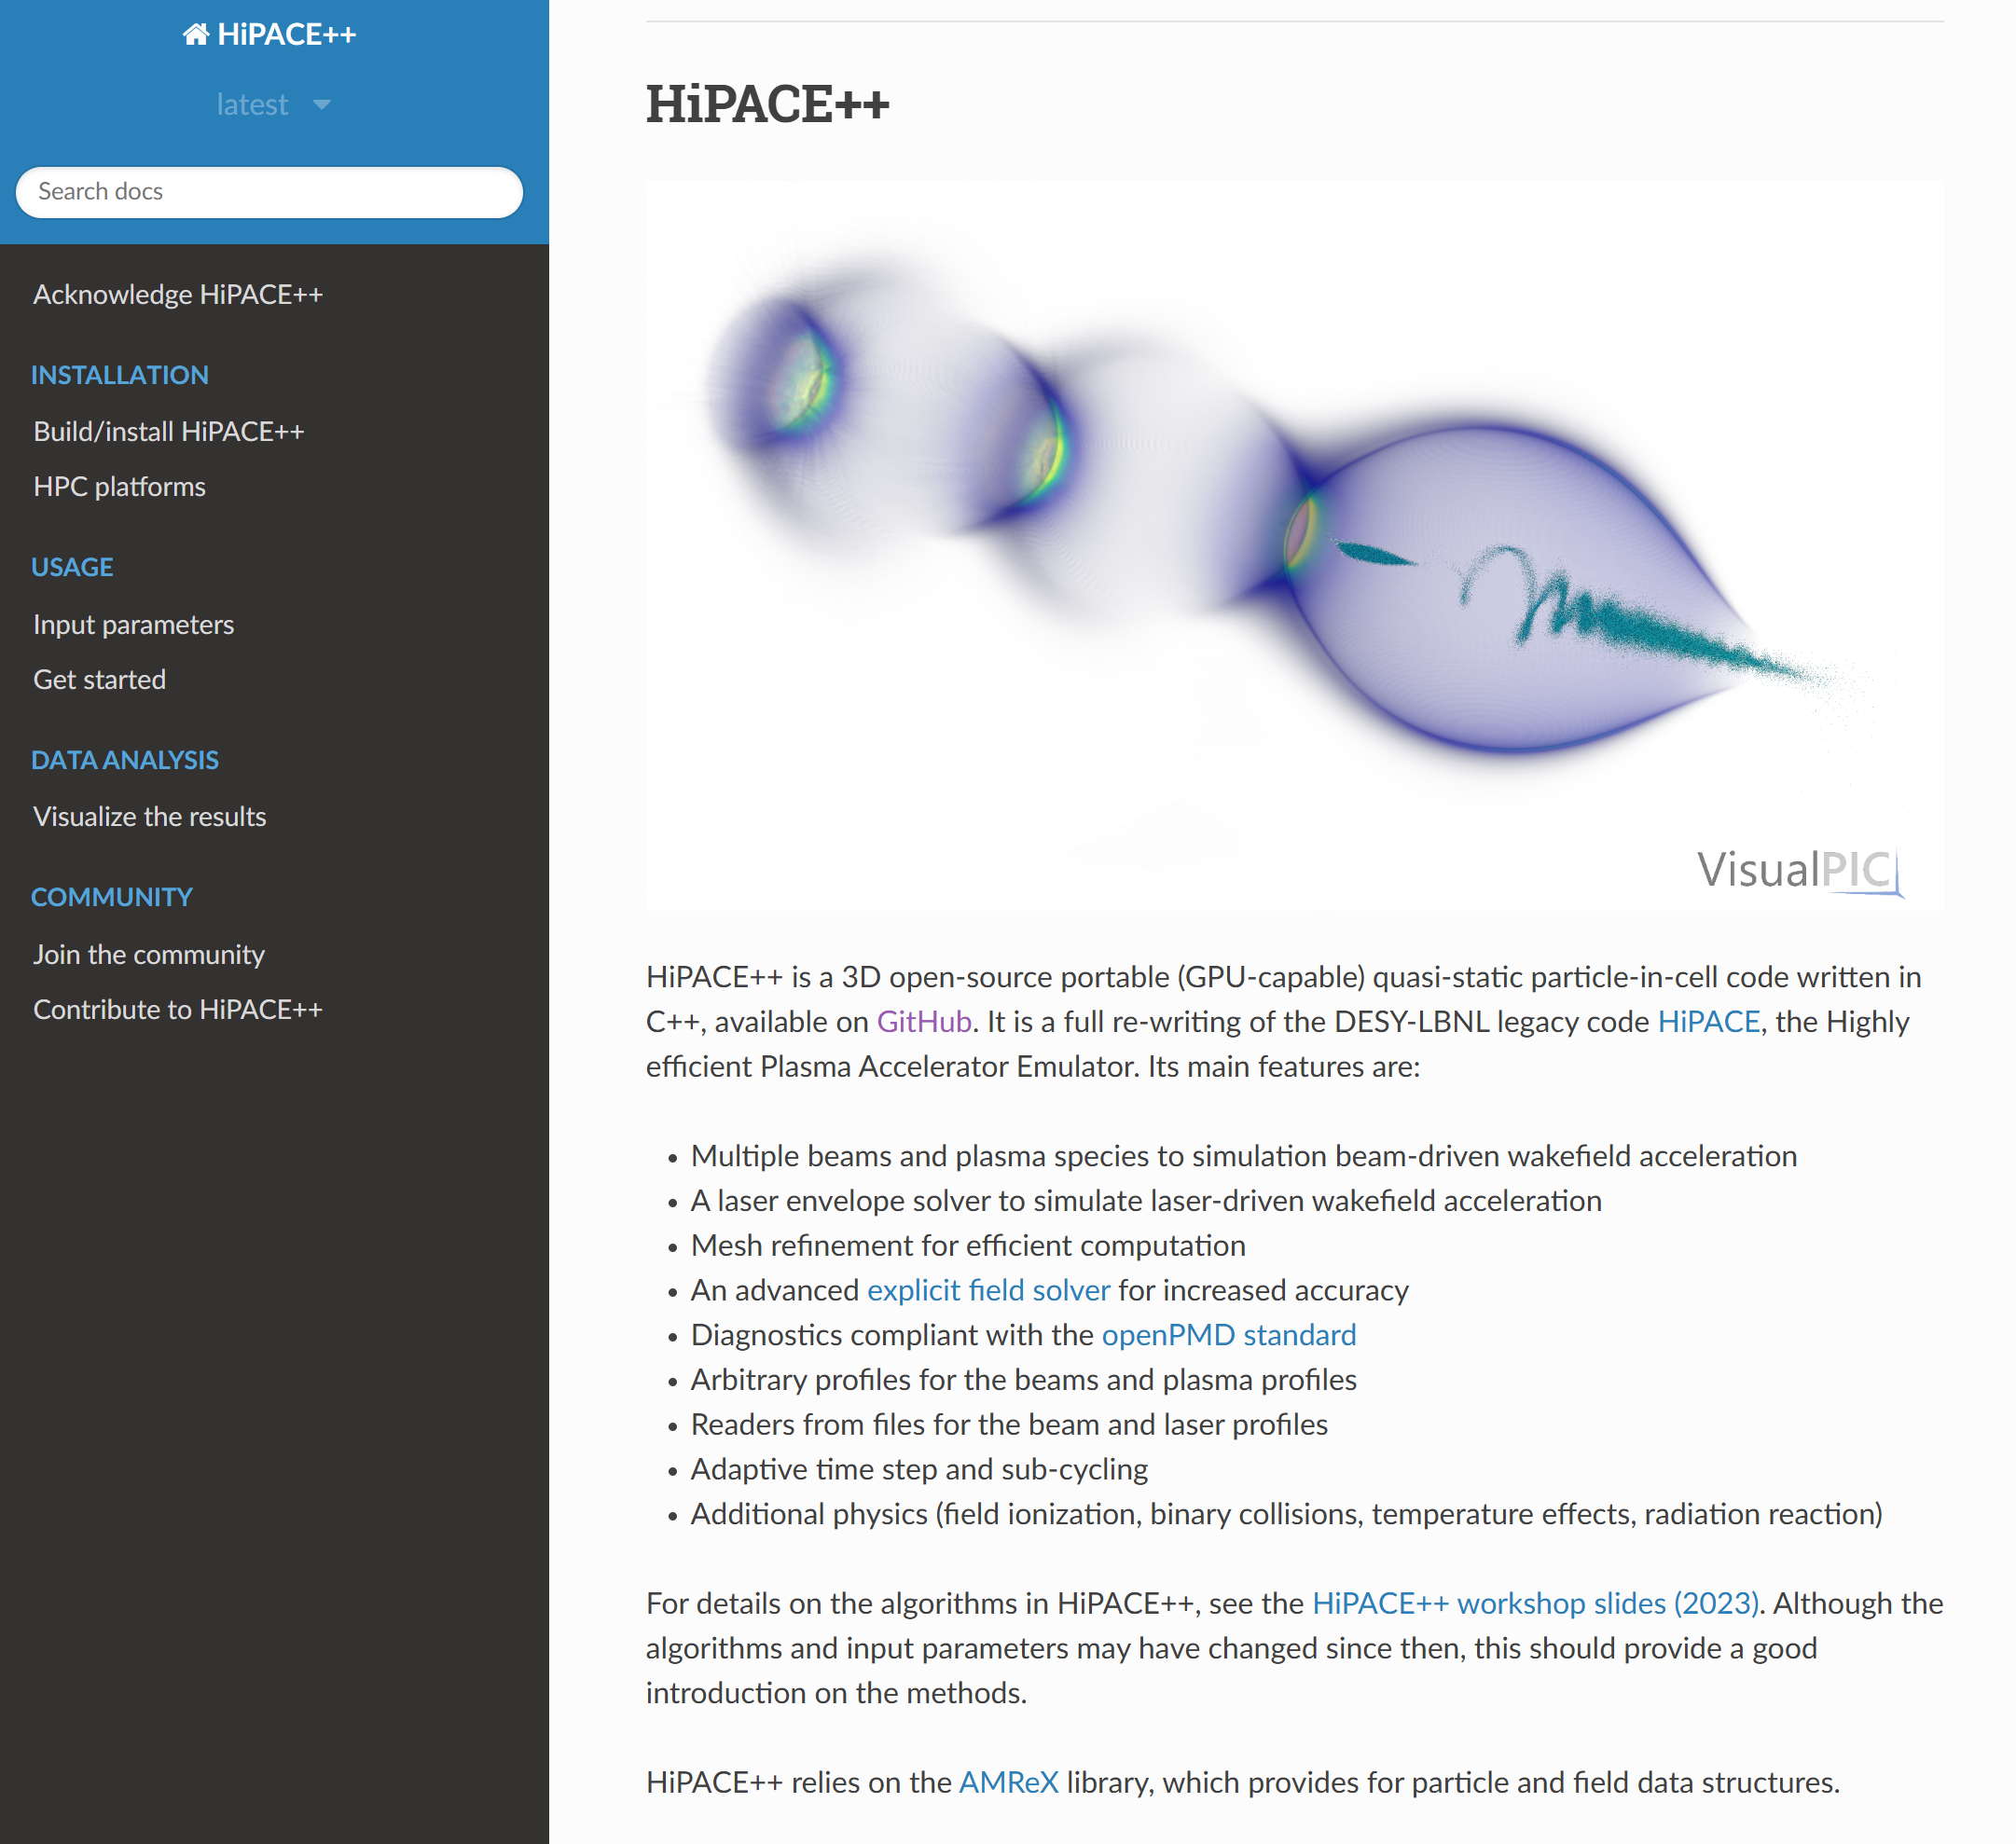
Simulating the Plasma Wake in HALHF with HiPACE++
3D quasi-static particle-in-cell simulations with HiPACE++
Mesh refinement to resolve ion motion at witness
In-situ diagnostic to greatly reduce data output
Each simulation uses ~75 GPU-hours on JUWELS Booster
S. Diederichs, C. Benedetti, A. Huebl, et al. Computer Physics Communications, vol. 278, p. 108 421,2022
T. Mehrling, et al. 2018 IEEE Advanced Accelerator Con-cepts Workshop (AAC), 2018, pp. 1–5
Effect of dynamic ion motion in plasma accelerators | Alexander Sinn

Slide 6
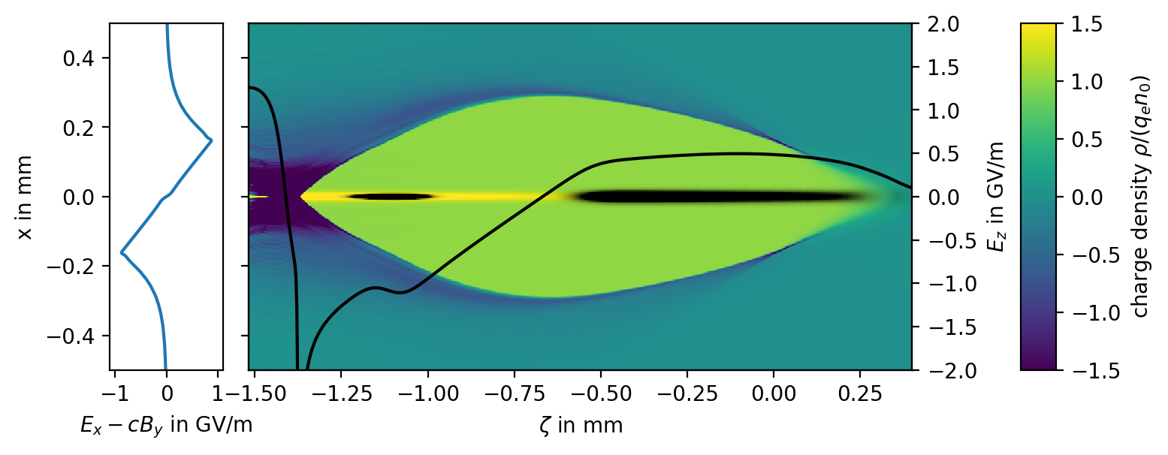
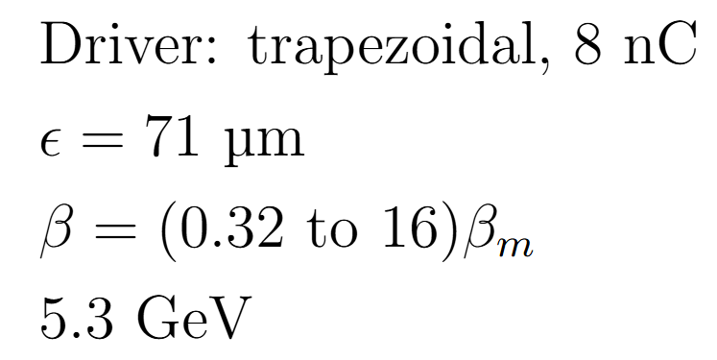
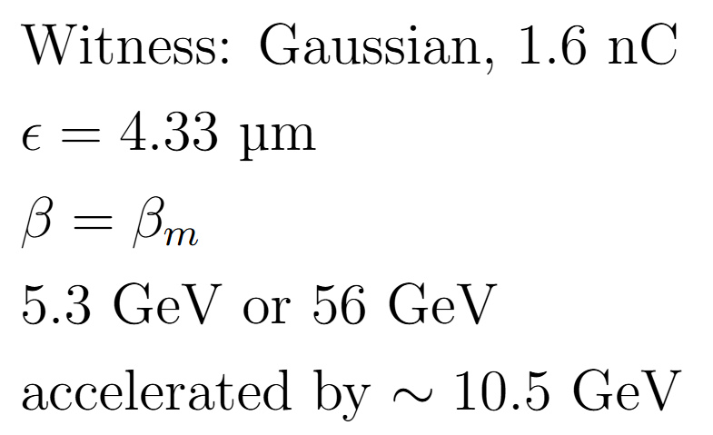
HALHF Plasma stage Parameters
Parameters adapted from Carl Lindstrøm
Effect of dynamic ion motion in plasma accelerators | Alexander Sinn

Slide 7
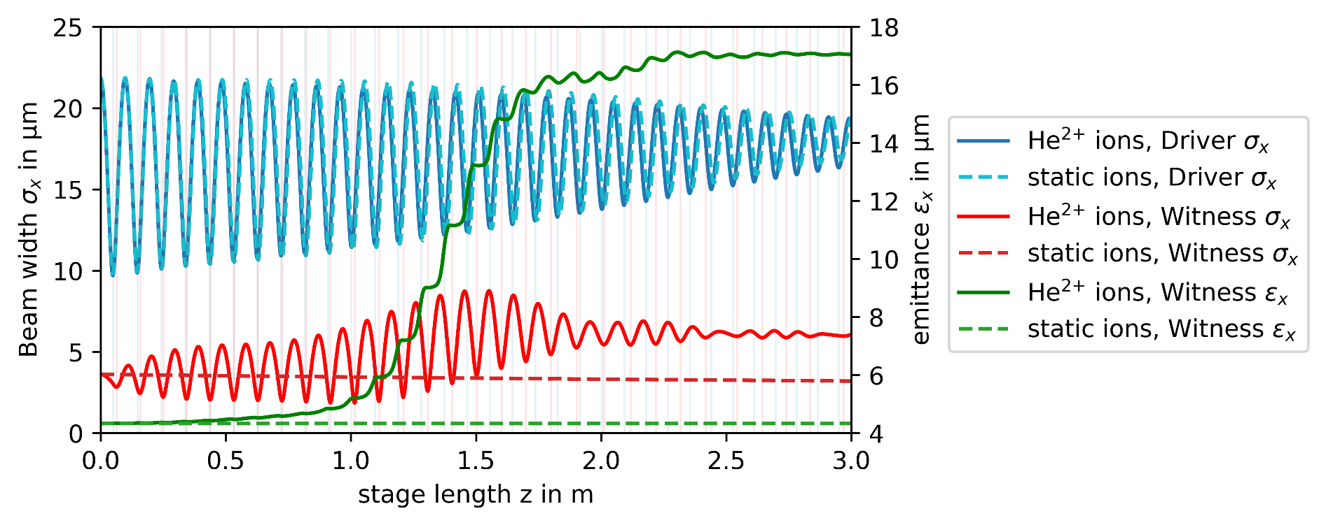
Pinching in the first stage: resonant betatron oscillations
What happens to the Witness beam:
Witness and Driver have similar betatron oscillation frequencies
Frequency shift due to acceleration
Very large Witness emittance increases
Effect of dynamic ion motion in plasma accelerators | Alexander Sinn

Slide 8
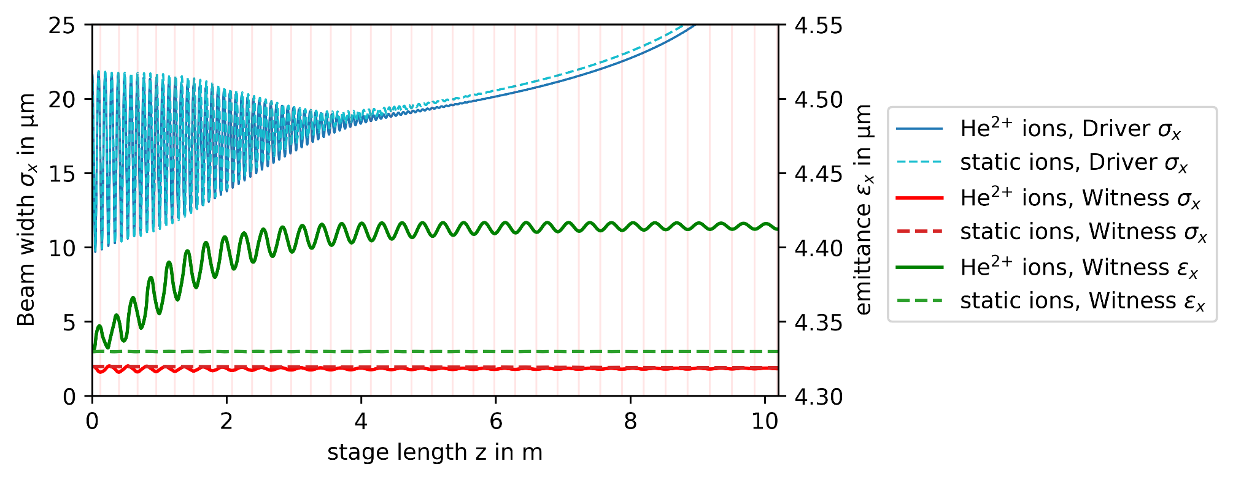
Pinching in the fifth stage: moderate emittance growth
5th Plasma stage: oscillations not resonant
Only a 2% increase in Witness emittance
Effect of dynamic ion motion in plasma accelerators | Alexander Sinn

Slide 9
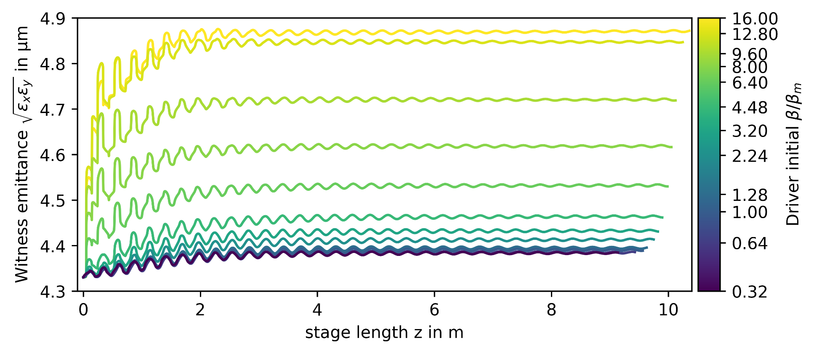
Fifth stage: scan over Driver initial beta
Small beta: head erosion, decreased energy
Large beta: strong pinching, increased emittance
Effect of dynamic ion motion in plasma accelerators | Alexander Sinn

Slide 10
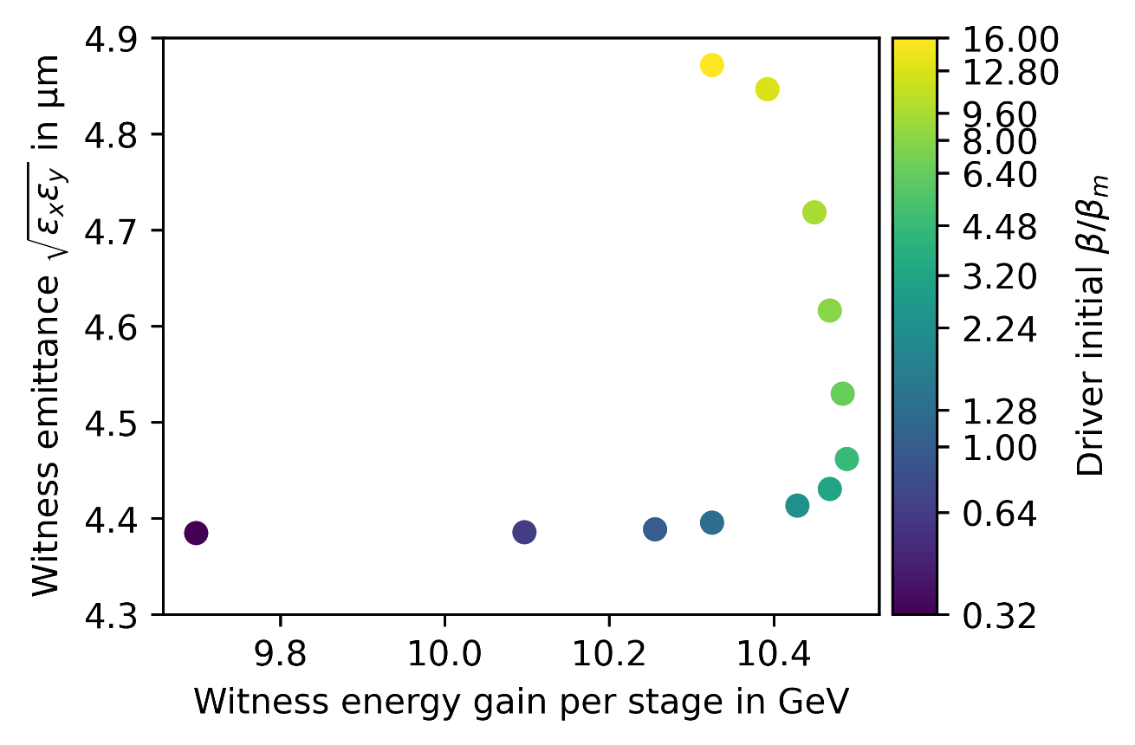
Fifth stage: scan over Driver initial beta
Small beta: head erosion, decreased energy
Large beta: strong pinching, increased emittance
Very large beta: decreased energy
Effect of dynamic ion motion in plasma accelerators | Alexander Sinn

Slide 11
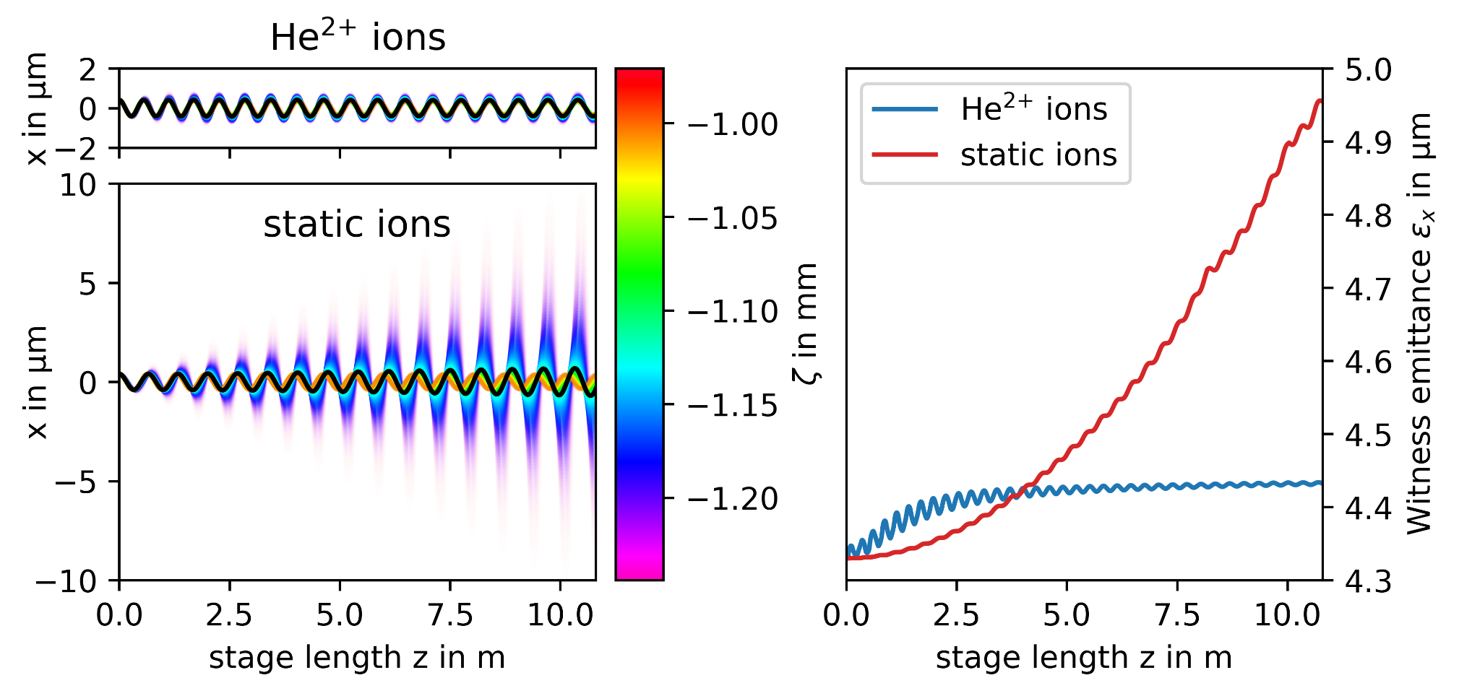
Hosing mitigation from ion-motion
Hosing causes big emittance increase with no ions
Even with periodic pinching, He²⁺ ions suppress hosing, but does not stop oscillations
T. J. Mehrling, , et al. Rev. Lett., vol. 121, p. 264 802, 26 Dec. 2018
Effect of dynamic ion motion in plasma accelerators | Alexander Sinn

Slide 12
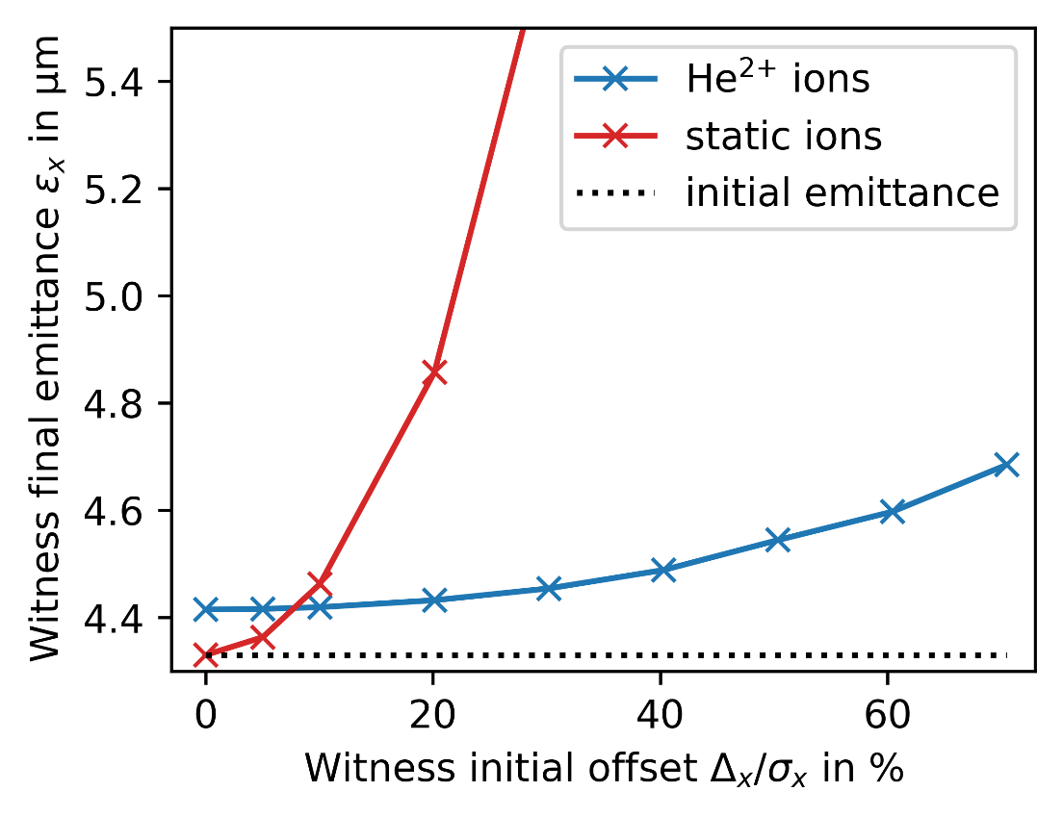
Hosing mitigation from ion-motion
Small offset: modest hosing, lowest emittance with static ions as He²⁺ ions have ion motion
Large offset: strong hosing, lowest emittance with He²⁺ ions for hosing mitigation
Best ion type depends on accuracy of initial injection
Effect of dynamic ion motion in plasma accelerators | Alexander Sinn

Slide 13
Thank you
Conclusions:
Periodic driver pinching can dramatically increase emittance if witness betatron frequency is similar
Moderate emittance increase from ion-motion if betatron frequency is different
Non-constant ion-motion does mitigate hosing
HALHF multi-stage simulations should be done with fully resolved ion-motion

Slide 14
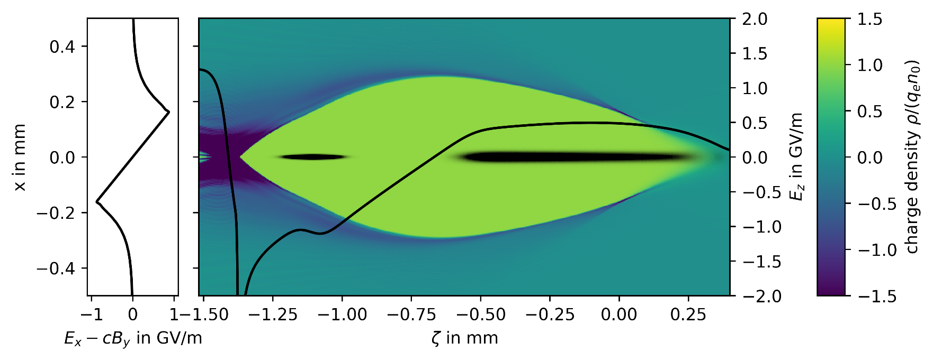
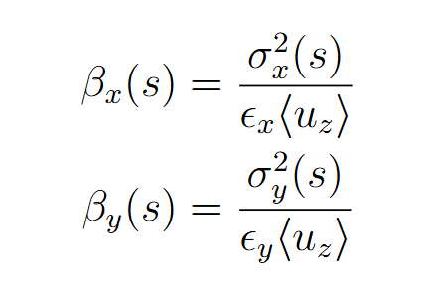
Formulas
Beta and emittance
Effect of dynamic ion motion in plasma accelerators | Alexander Sinn

Slide 15
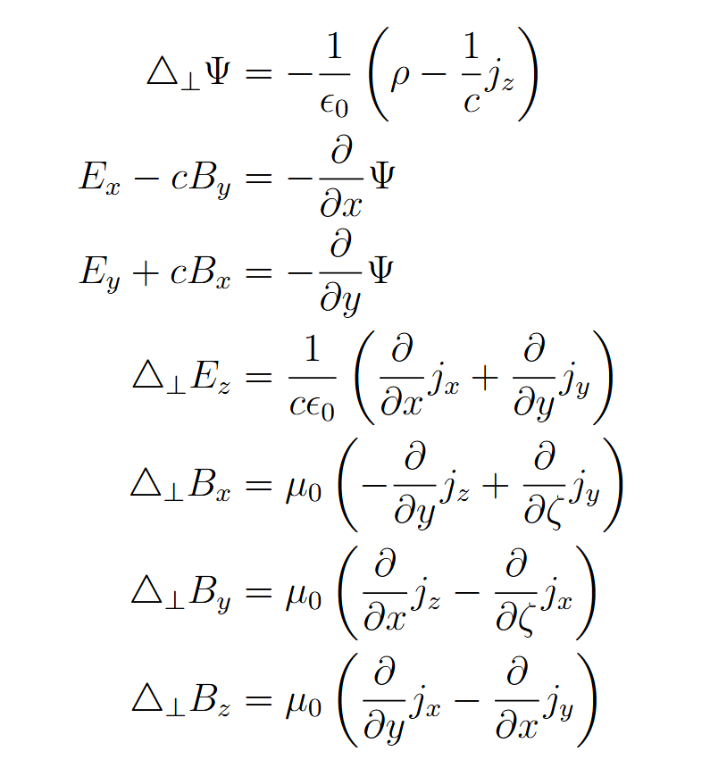
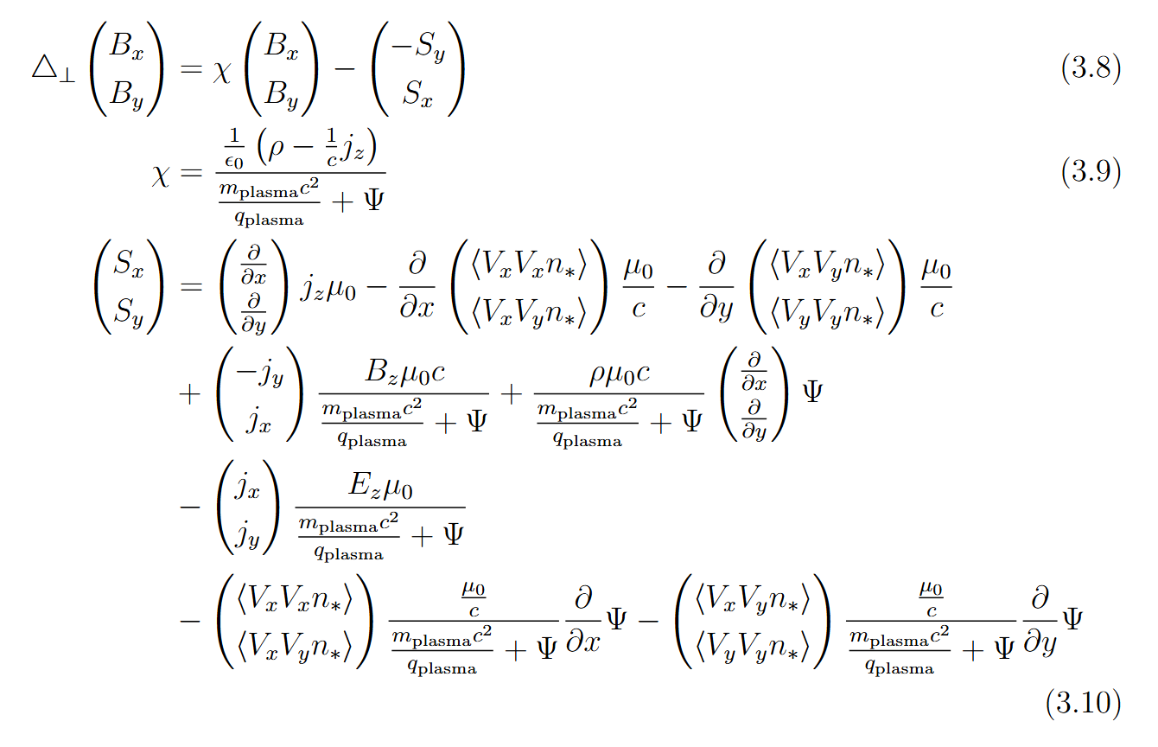
Formulas
Field equations
Effect of dynamic ion motion in plasma accelerators | Alexander Sinn

Slide 16
HALHF
Effect of dynamic ion motion in plasma accelerators | Alexander Sinn

Slide 17
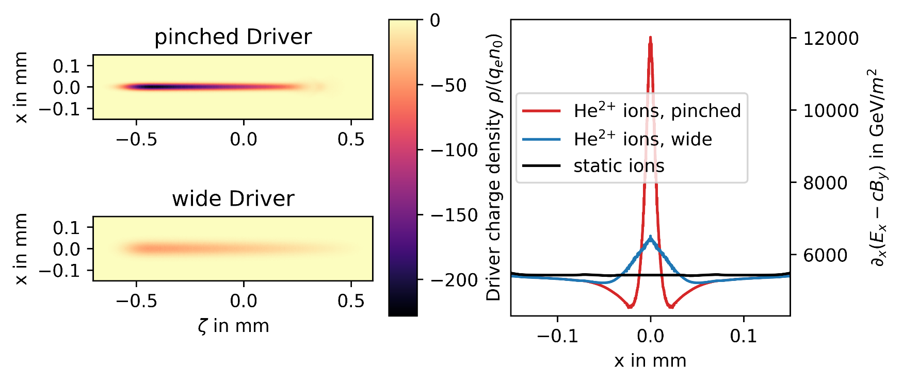
Pinching in the first stage: resonant betatron oscillations
Non-matched driver beta leads to pinching
Causes time-dependent ion motion
Stronger nonlinear transverse focusing force at Witness beam
Effect of dynamic ion motion in plasma accelerators | Alexander Sinn

Slide 18
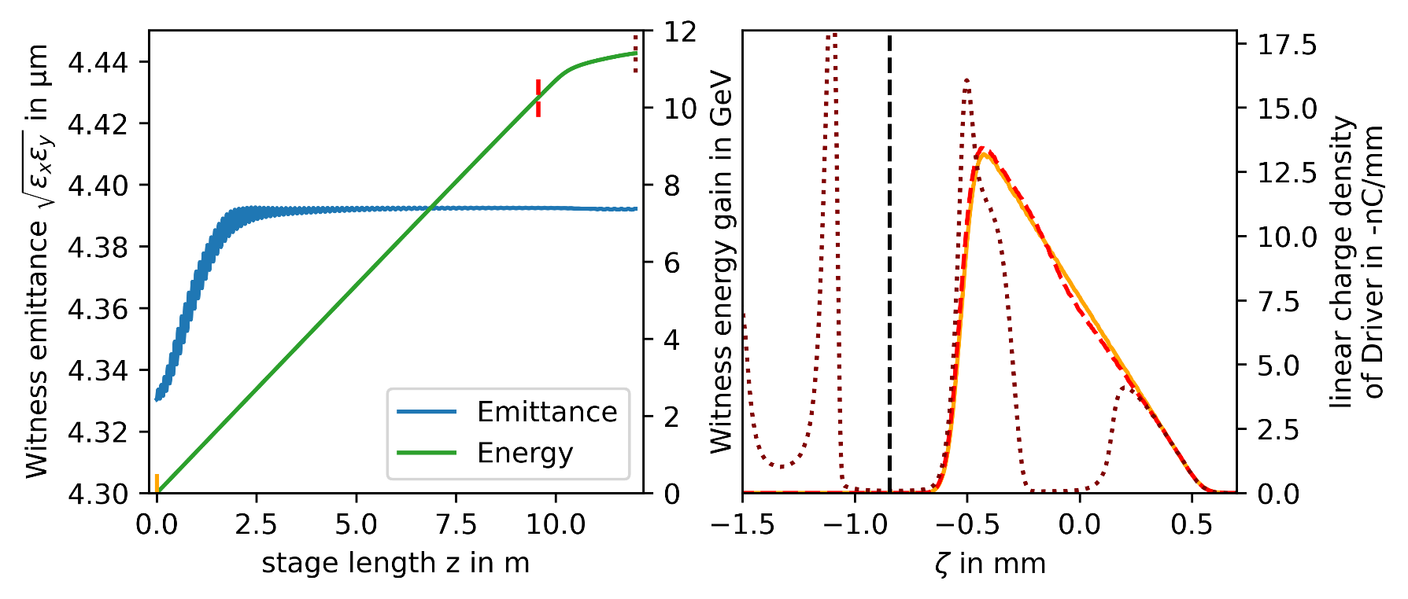
Designing a PWFA stage: determining the end of a stage
Drive beam depletes at the end of a plasma stage
Per-particle energy not collected due to large data storage need
Stage ends when driver current profile moves too far back
Effect of dynamic ion motion in plasma accelerators | Alexander Sinn

