Slide 1
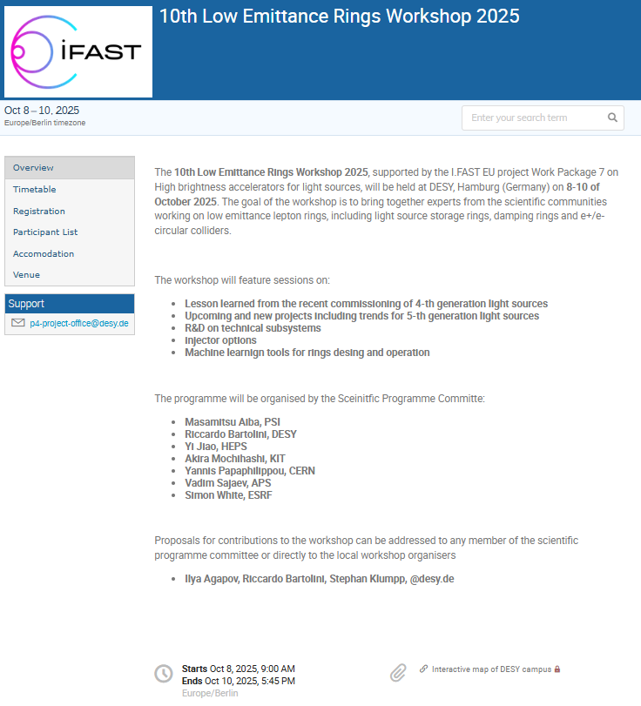


10th LER workshop at DESY 8th-10th October
92 registered delegates
EU 77
US 6
China 5
Japan 3
Talks (15 + 15 + 14 = 44)
Thanks to the I-FAST project
Thanks to the EU
https://indico.desy.de/event/49686/

Slide 2
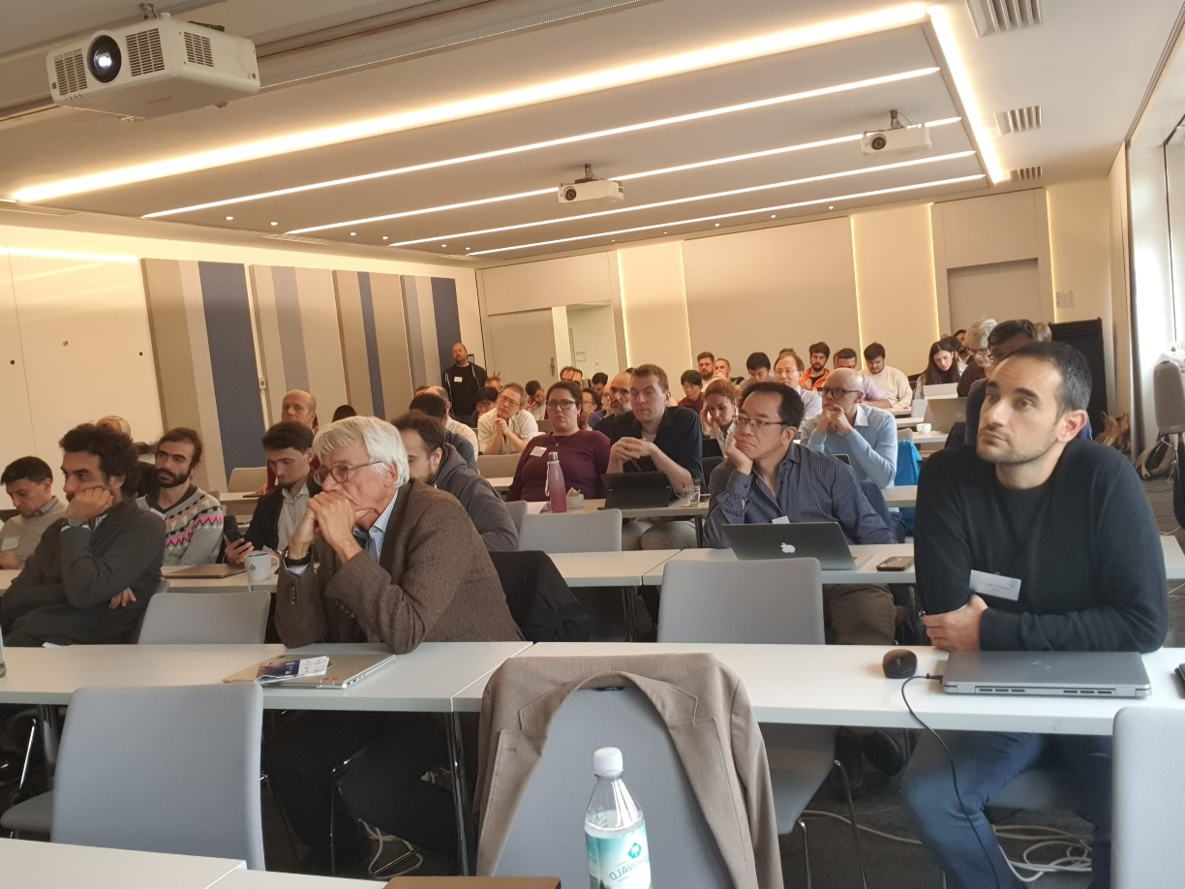
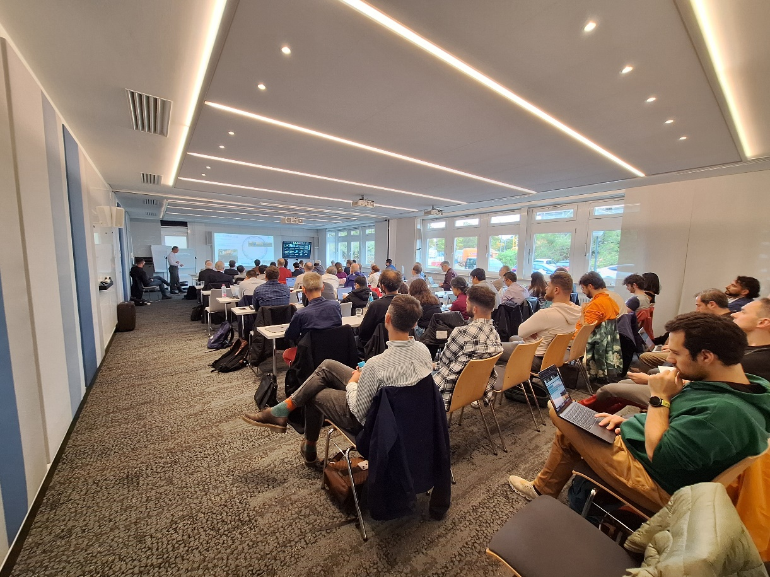
All slides will be uploaded to the indico page
Thank you very much for these 3 days of intense work
excellent presentations
lots of coffee-break discussions
large overview of activities, main issues/challenges, and new directions

Slide 3
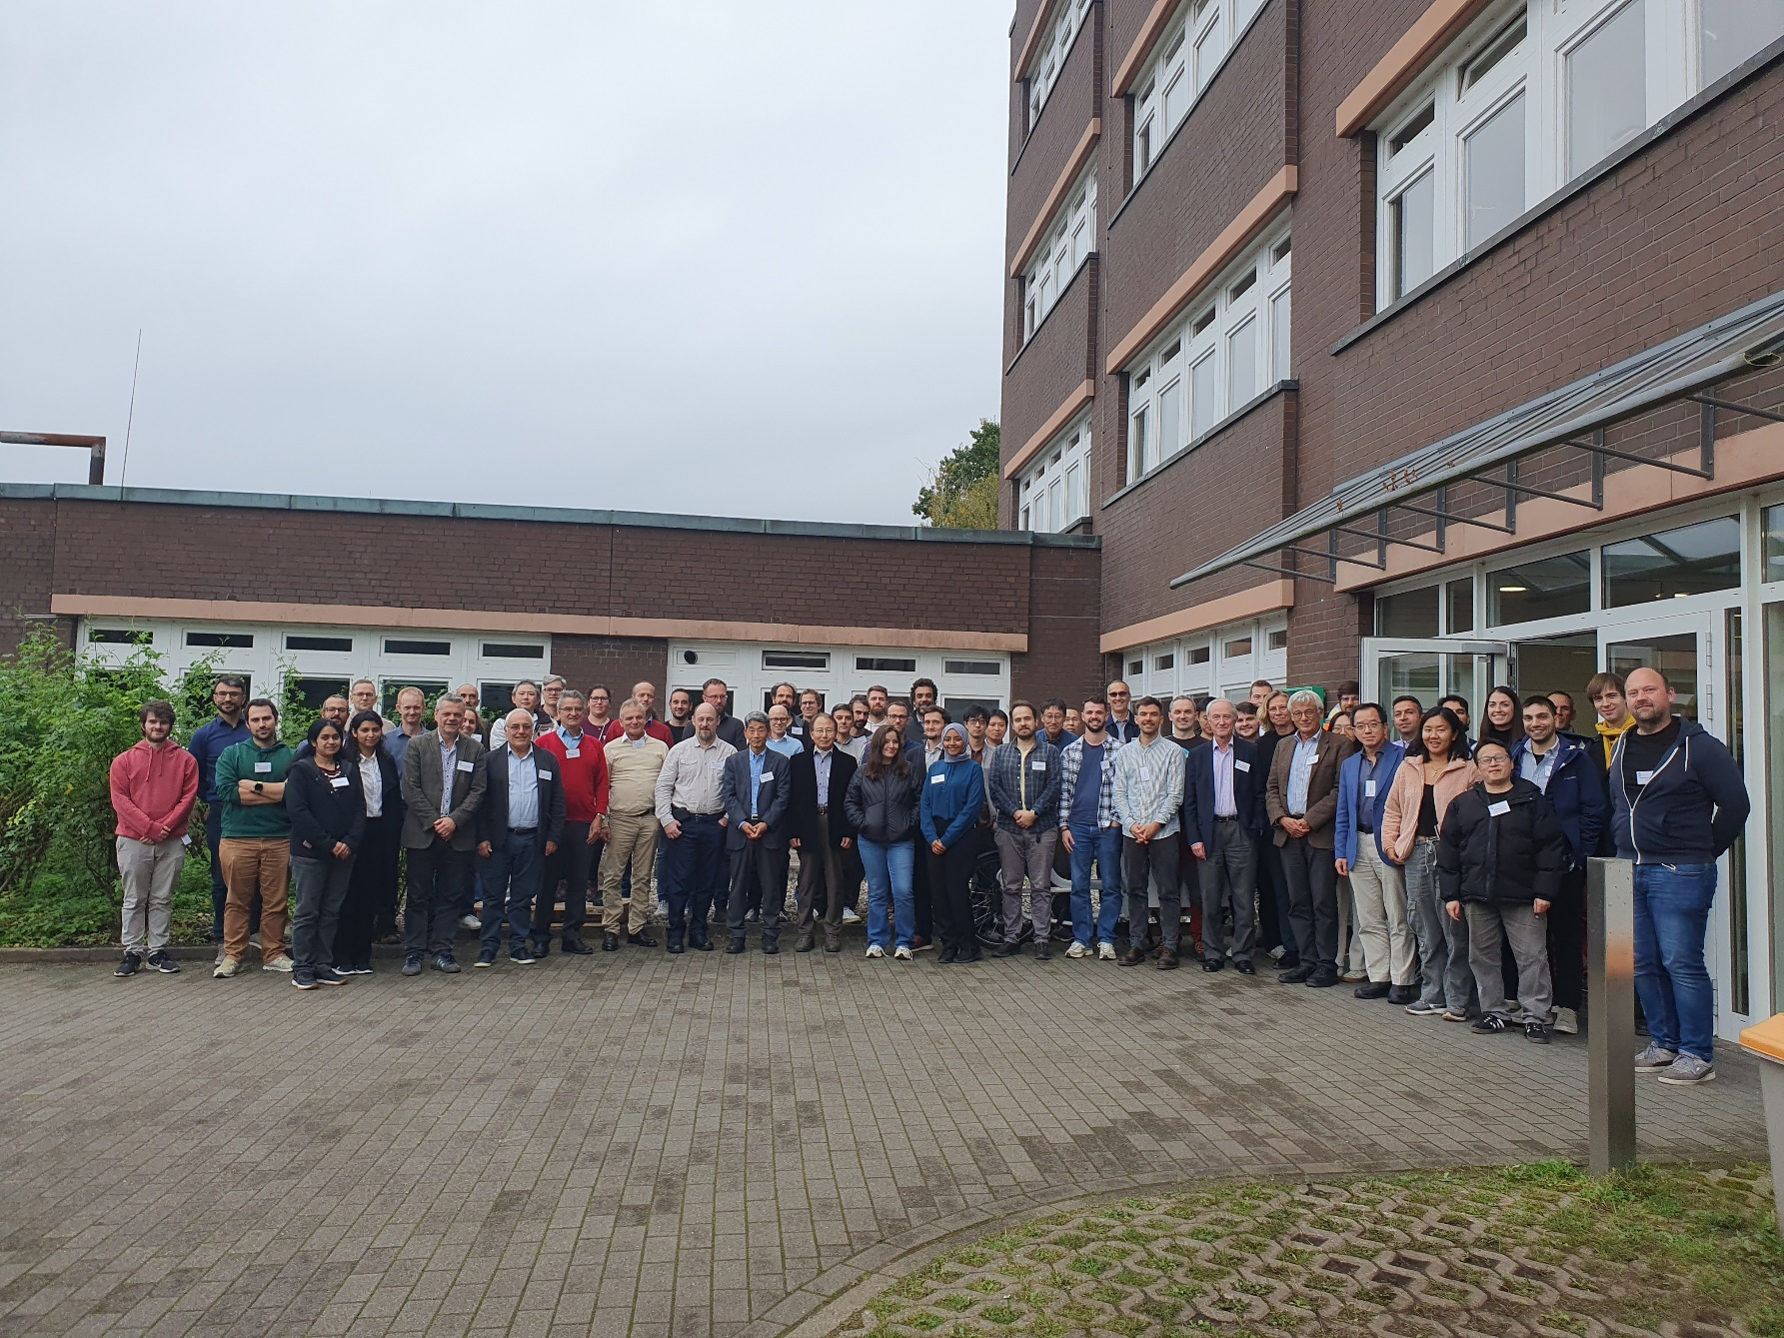
Hamburg provided its best weather
put blue here….

Slide 4
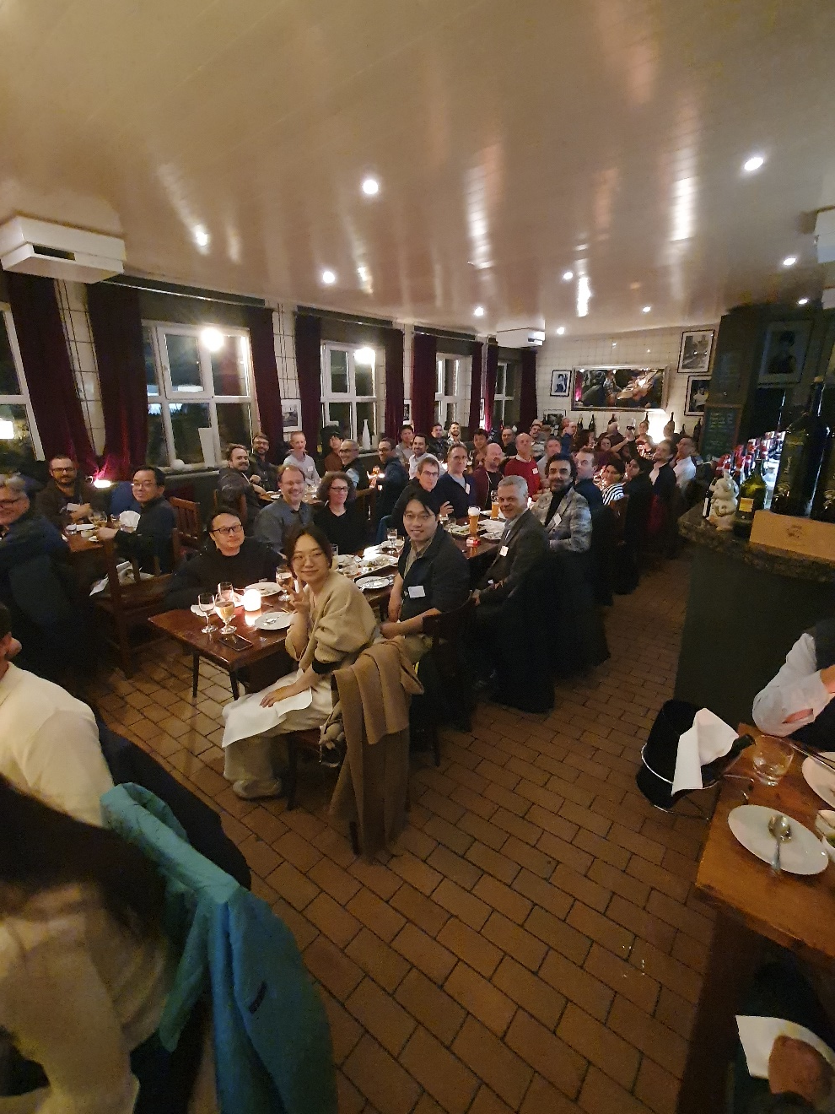
…and some Italian food

Slide 5
The Low Emittance Rings (LER) Workshops Series
1th Low Emittance Rings Workshop, 12-15 January 2010 CERN – participants 70
https://ler2010.web.cern.ch/
2th Low Emittance Rings Workshop, 3-5 October 2011 Heraklion, Crete
https://lowering2011.web.cern.ch/
3th Low Emittance Rings Workshop 8-10 July 2013 Oxford University – participants 80
https://indico.cern.ch/event/247069/overview (EuCARD-2)
4th Low Emittance Rings Workshop, 17-19 September 2014, INFN-LNF Frascati – participants 67 https://agenda.infn.it/event/7766/ (EuCARD-2)
5th Low Emittance Rings Workshop, 15-17 September 2015 ESRF, Grenoble https://indico.cern.ch/event/395487/overview (EuCARD-2)
6th Low Emittance Rings Workshop, 26-28 October 2016, Synchrotron SOLEIL
https://www.synchrotron-soleil.fr/en/events/low-emittance-rings-workshop-2016 (EuCARD-2)
7th LER Workshop, 15-17 January 2018 CERN
https://indico.cern.ch/event/671745/ (ARIES)
8th LER Workshop 26-30 October 2020 INFN-LNF Frascati (held remotely) (ARIES) – participants 160
https://agenda.infn.it/event/20813/overview
9th LER Workshop 13-16 February 2024 CERN (I-FAST) – participants 99
https://indico.cern.ch/event/1326603
10th LER Workshop 8-10 October 2025 DESY (I-FAST) – participants 93
https://indico.desy.de/event/49686/

Slide 6
How do we move forwards
We need the agreement and support from Labs.
Early discussion
(coffee break: H. Braun, M. Aiba, Y. Papaphilippou, V. Sajaev, E. Karantzoulis, R. Bartolini)
Seek support from
Labs that commissioned their ring
Labs that gets funding approval
Next Low Emittance Ring Workshops so far…
PSI (early 2027)
ELETTRA (2028)
CERN/DESY will follow

Slide 7
Special thanks
Special thanks to Y. Papahilippou CERN
(S. Guiducci, M. Biagini, R. Nagaoka, M. Böge)
Special thanks to S. Klumpp (DESY) and his team

