Slide 1
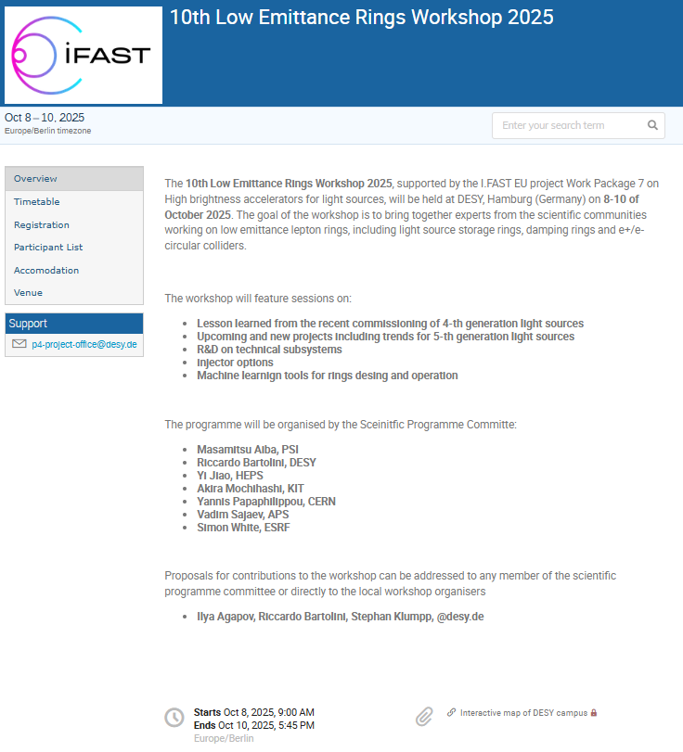


10th LER workshop at DESY 8th-10th October
92 registered delegates
EU 77
US 6
China 5
Japan 3
Talks (15 + 14 + 14 = 43)
Thanks to the I-FAST project
Thanks to the EU
https://indico.desy.de/event/49686/

Slide 2
The LER Workshops Series
1th Low Emittance Rings Workshop, 12-15 January 2010 CERN – participants 70
https://ler2010.web.cern.ch/
2th Low Emittance Rings Workshop, 3-5 October 2011 Heraklion, Crete
https://lowering2011.web.cern.ch/
3th Low Emittance Rings Workshop 8-10 July 2013 Oxford University
https://indico.cern.ch/event/247069/overview (EuCARD-2) – participants 80
4th Low Emittance Rings Workshop, 17-19 September 2014, INFN-LNF Frascati https://agenda.infn.it/event/7766/ (EuCARD-2) – participants 67
5th Low Emittance Rings Workshop, 15-17 September 2015 ESRF, Grenoble https://indico.cern.ch/event/395487/overview (EuCARD-2)
6th Low Emittance Rings Workshop, 26-28 October 2016, Synchrotron SOLEIL
https://www.synchrotron-soleil.fr/en/events/low-emittance-rings-workshop-2016 (EuCARD-2)
7th LER Workshop, 15-17 January 2018 CERN (ARIES)
https://indico.cern.ch/event/671745/
8th LER Workshop 26-30 October 2020 INFN-LNF Frascati (held remotely) (ARIES)
https://agenda.infn.it/event/20813/overview – participants 160
9th LER Workshop13-16 February 2024 CERN (I-FAST)
https://indico.cern.ch/event/1326603 – participants 99
Special thanks to Y. Papahilippou CERN
(S. Guiducci, M. Biagini, R. Nagaoka, M. Böge)

Slide 3
Social events
Coffee breaks in the building 3 atrium
Lunches at the DESY Canteen 13:00
8th October - barbecue by DESY
9th October - working dinner “La Panetteria” (walking distance from DESY)
In case of fire go out of the building entrance. Meeting point outside the entrance.

