Slide 1
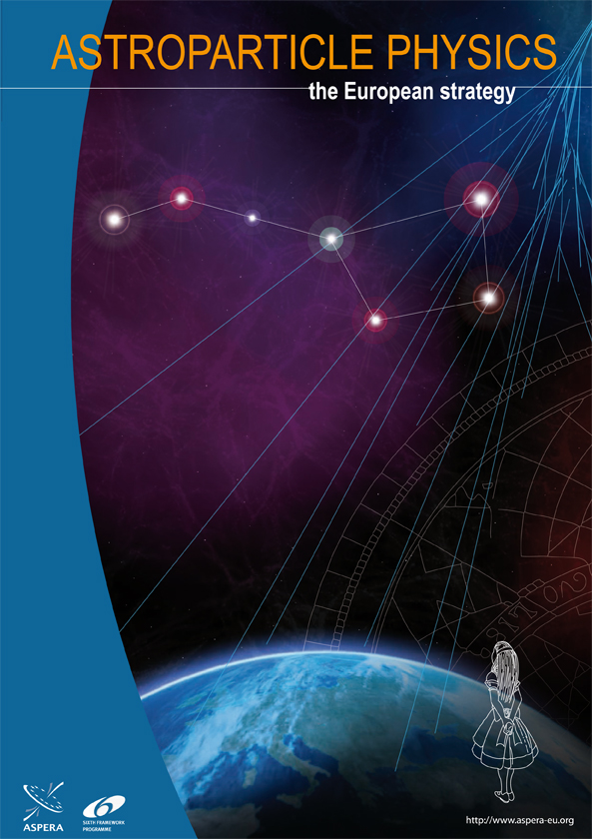
Astroparticle Physics
The 2011 ASPERA Roadmap
Christian Spiering, DESY
Dubna, Dec. 8, 2011

Slide 2
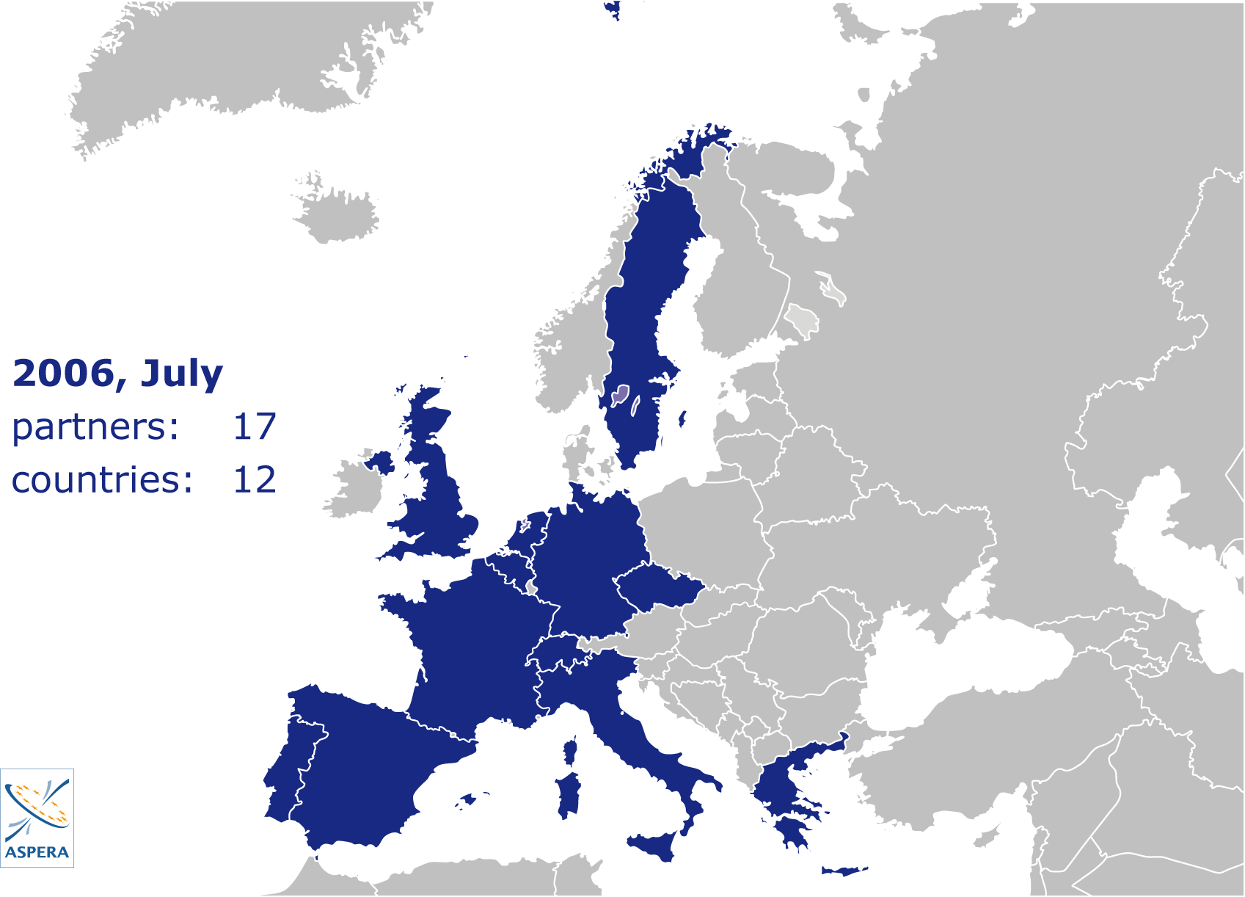
ASPERA
5

Slide 3
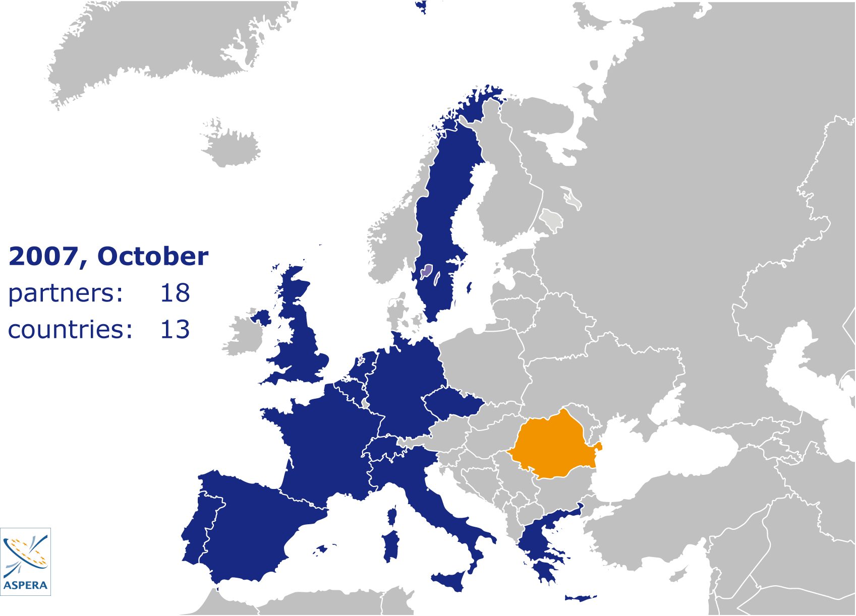

Slide 4
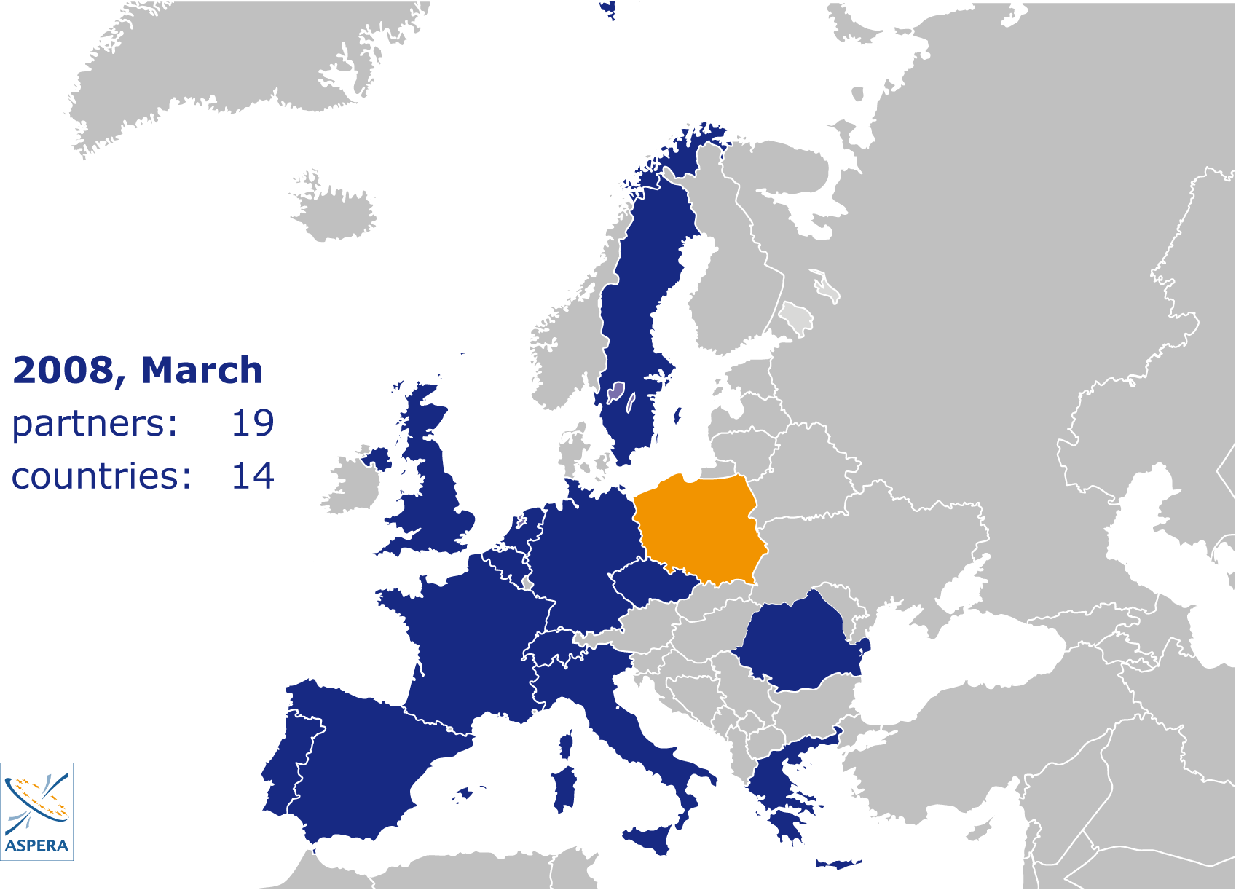

Slide 5
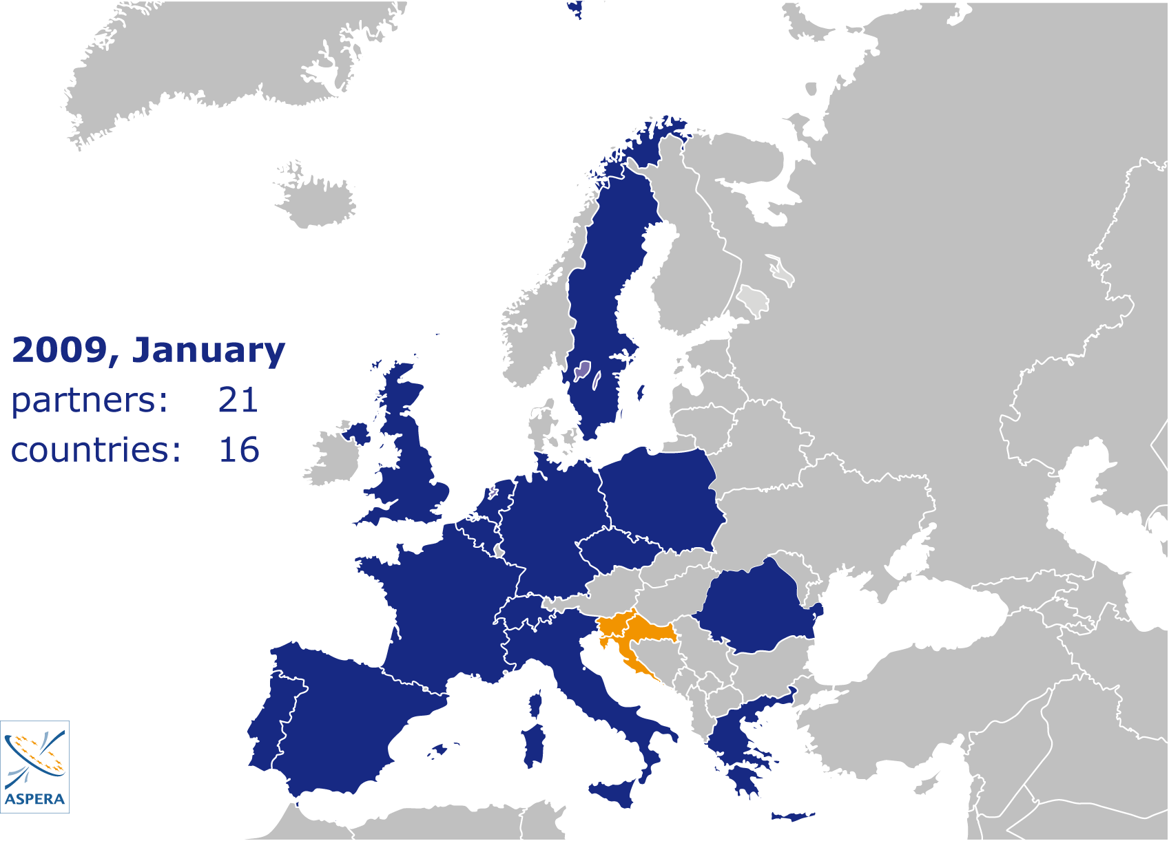

Slide 6
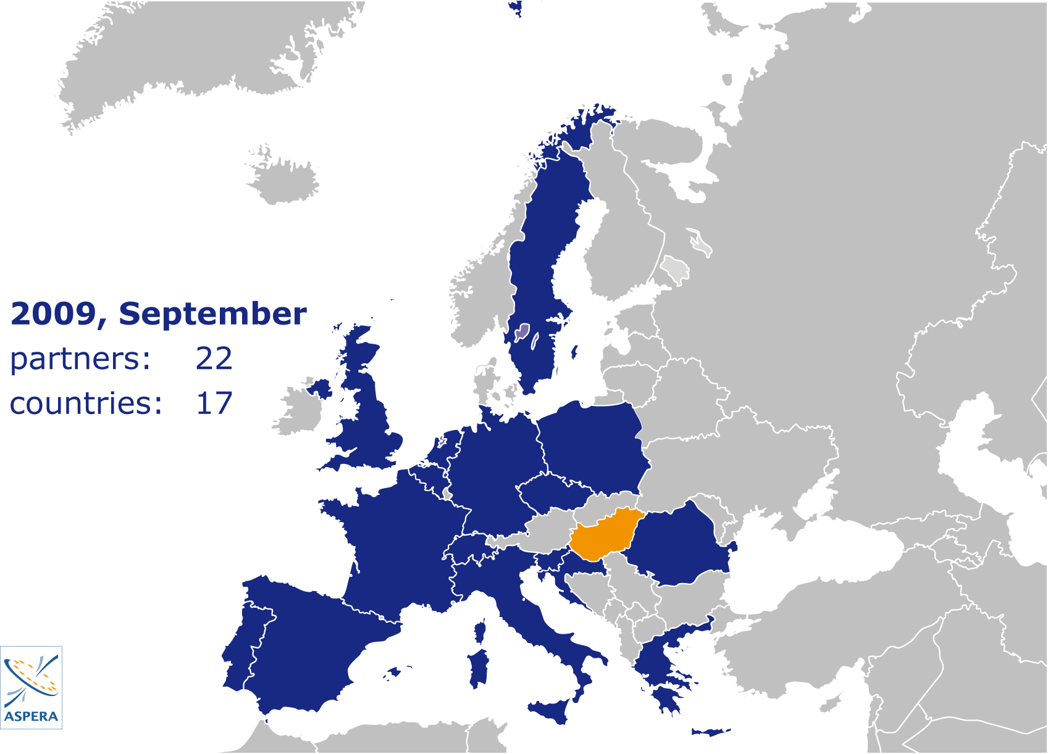

Slide 7
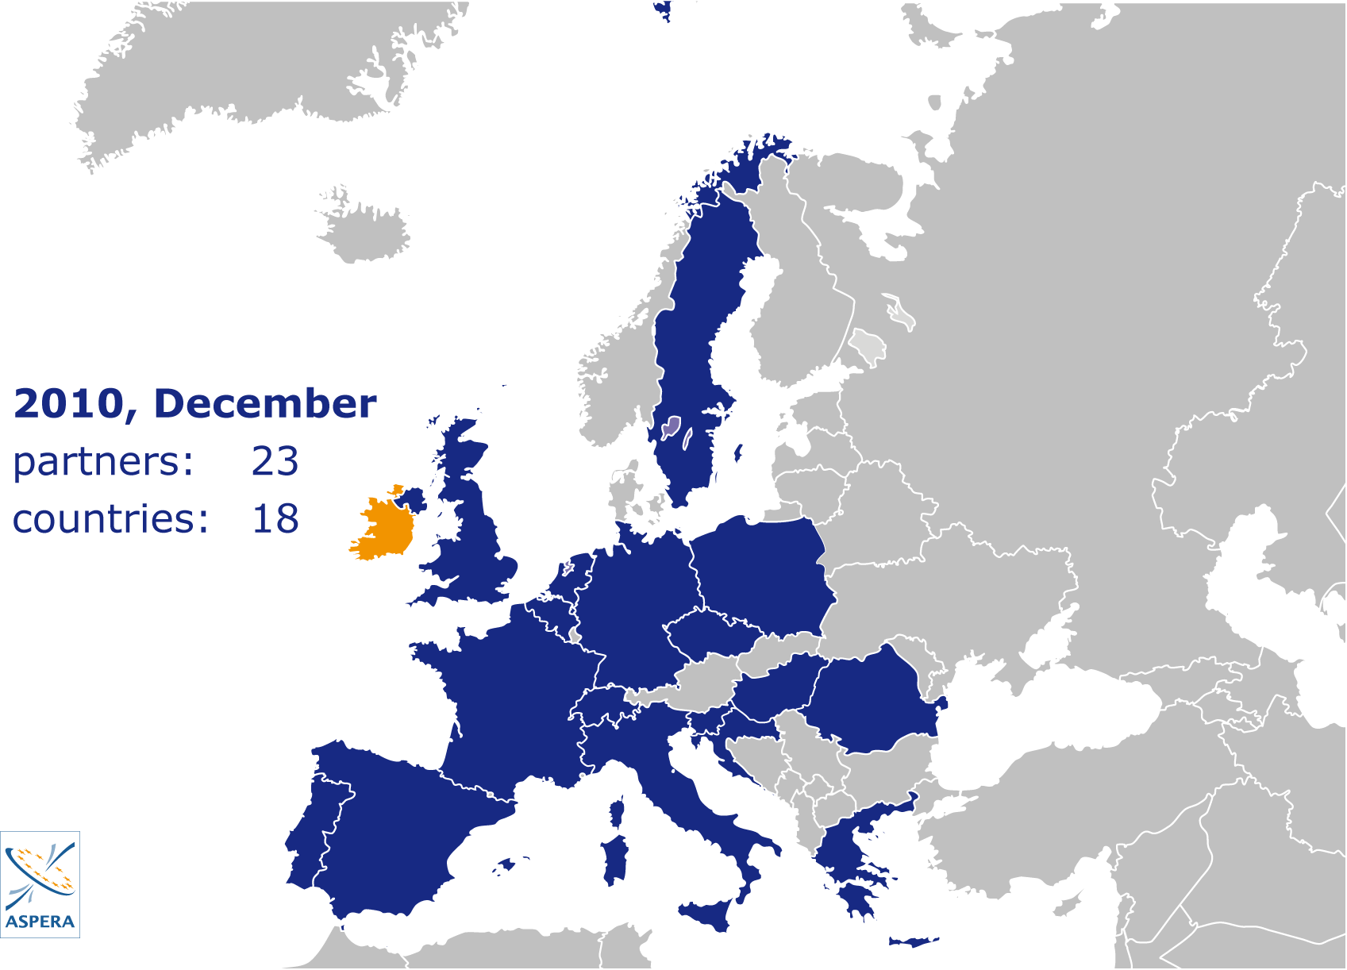

Slide 8
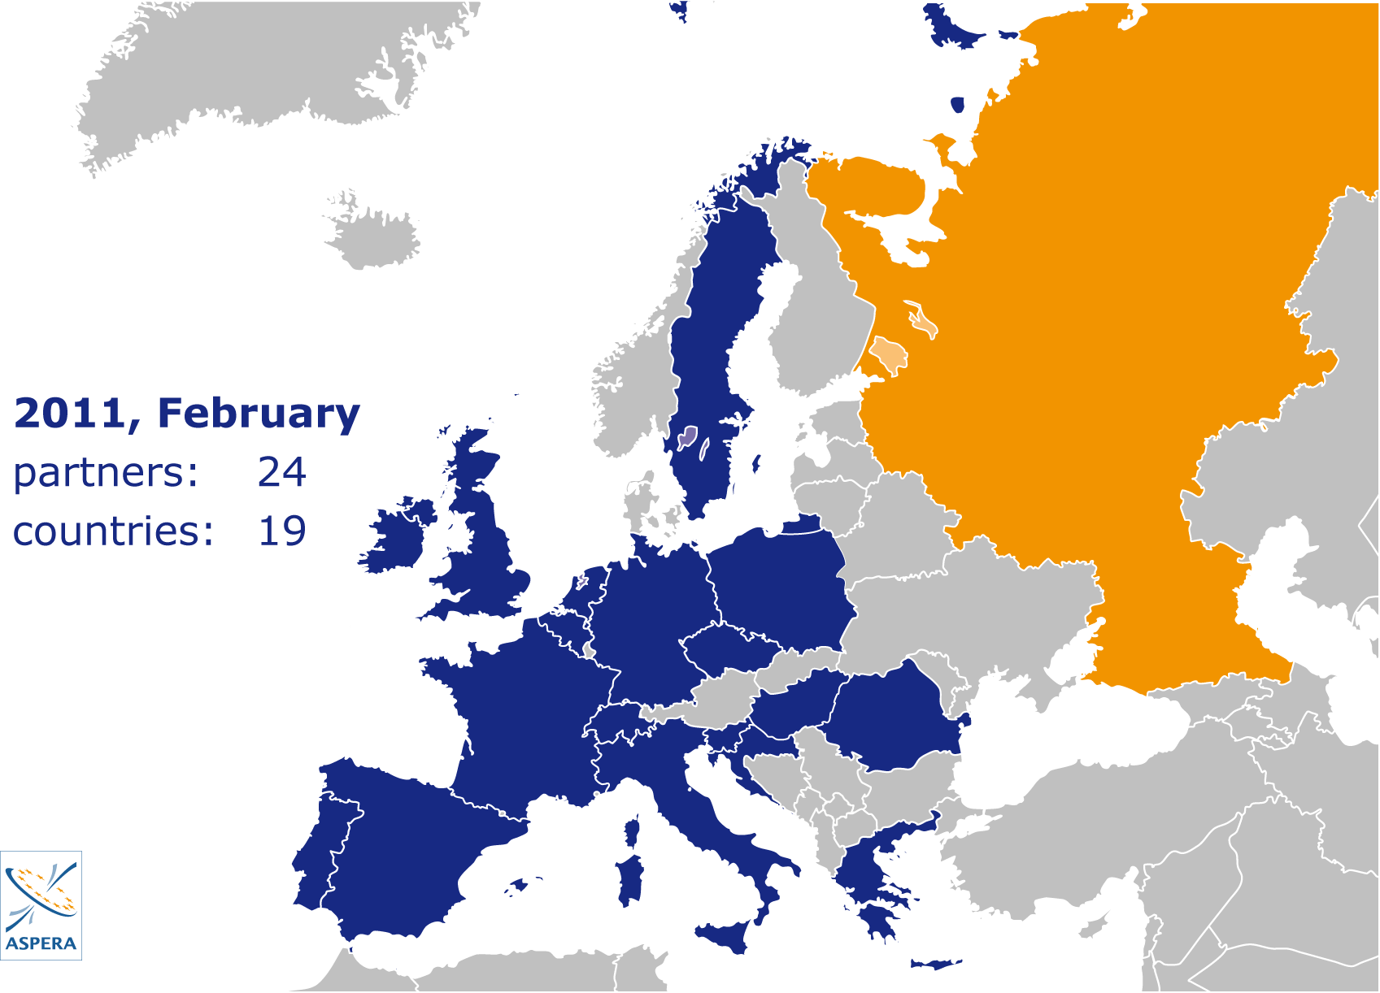

Slide 9
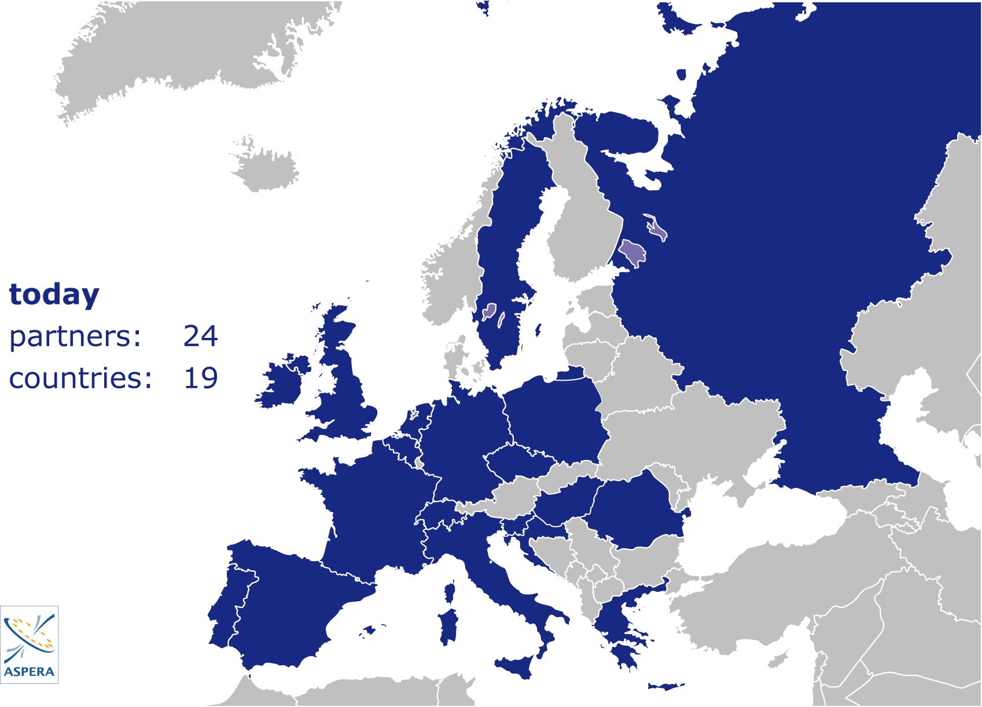

Slide 10
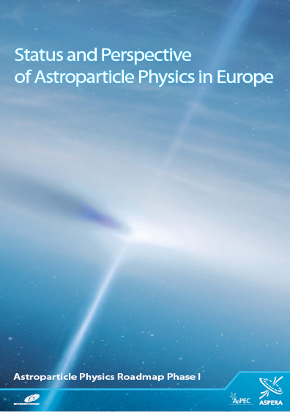
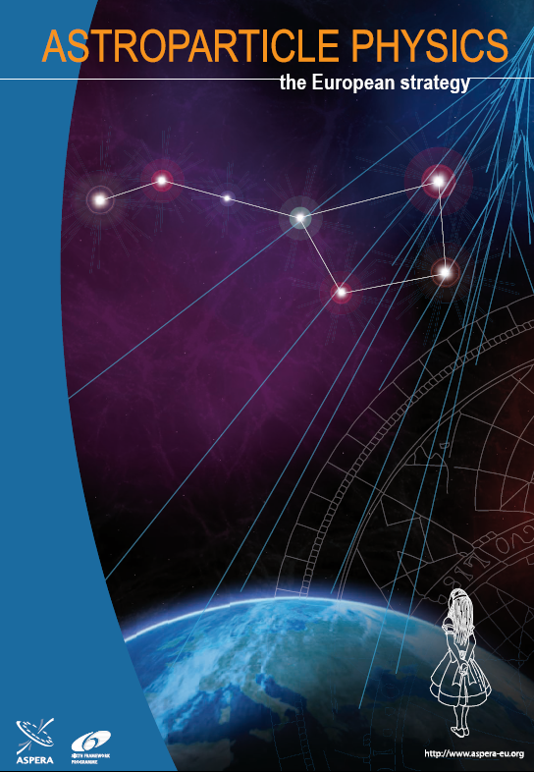
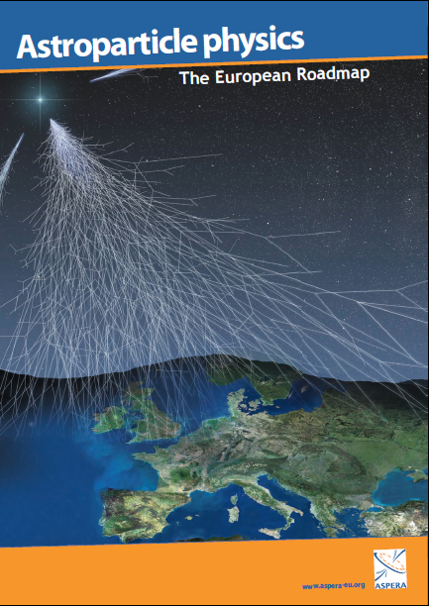
2007 2008 2011

Slide 11
Medium scale, ongoing/extension
Large scale (few hundred M€), mid of decade
Very large scale (several hundred M€ to G€), end of decade

Slide 12
Medium scale
Advanced detectors for gravitational waves
Dark Matter
Neutrino properties
Extension of the Modane Underground Laboratory (LSM)
“We prioritize these projects for immediate funding, and urge agencies to join their forces for an effective, substantial support”
impressing momentum which needs to be maintained;
enter a region with high discovery potential;
hand in hand with LHC physics;
technologically ready and worldwide community

Slide 13
Medium scale
Advanced detectors for gravitational waves
Dark Matter
Neutrino properties
Extension of the Modane Underground Laboratory (LSM)

Slide 14
Medium scale
Advanced detectors for gravitational waves
Dark Matter
Neutrino properties
Extension of the Modane Underground Laboratory (LSM)

Slide 15
10⁻⁴
2006
10⁻⁶
Cross section (pb)
10⁻⁸
10⁻¹⁰
1980 1985 1990 1995 2000 2005 2010 2015

Slide 16
10⁻⁴
2008
10⁻⁶
LHC
Cross section (pb)
10⁻⁸
10⁻¹⁰
1980 1985 1990 1995 2000 2005 2010 2015

Slide 17
10⁻⁴
2011
10⁻⁶
LHC
Cross section (pb)
10⁻⁸
10⁻¹⁰
1980 1985 1990 1995 2000 2005 2010 2015

Slide 18
10⁻⁴
2012
10⁻⁶
LHC
Cross section (pb)
10⁻⁸
10⁻¹⁰
1980 1985 1990 1995 2000 2005 2010 2015

Slide 19
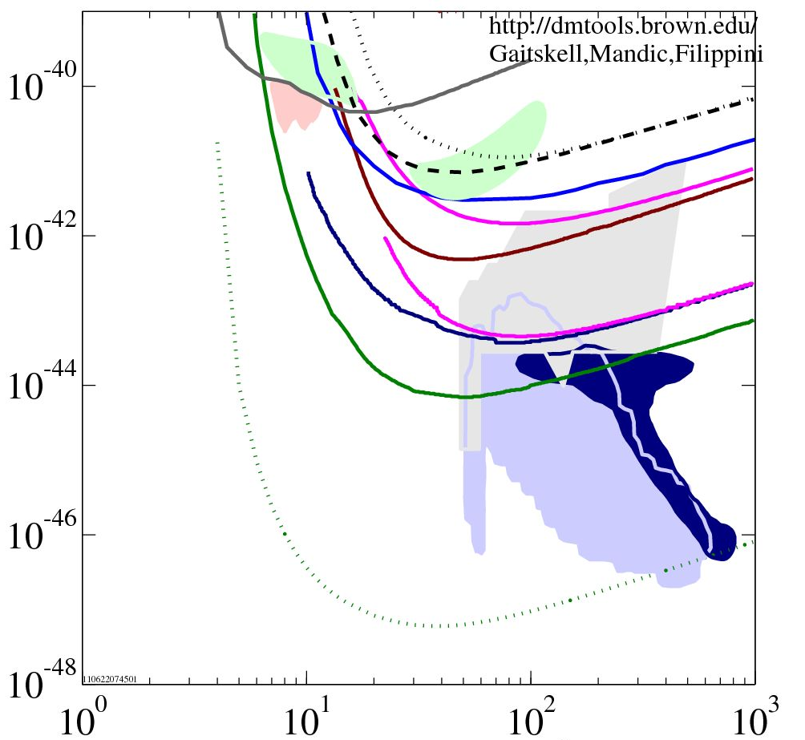
Towards the ton scale
Heidelberg Moscow 1996
IGEX 1998
http://dmtools.brown.edu
Gaitskell, Mandic, Filippini
DAMA 1998 / LIBRA 2008
CoGENT 2010
CDMS 2000
EDELWEISS 2002
CRESST 2009
WIMP – Nucleon Cross Section / cm²
EDELWEISS 2011
CDMS 2011
XENON 2011
DM searches + LHC:
The next 5-10 years will
bring the moment of
truth for SUSY WIMPs.
~ 0.002 cts / kg / d
goal 1ton projects
Baltz, Gondolo MSSM 2001
Baltz, Gondolo 2004
Trotta et al CMSSM 2008
WIMP Mass / GeV/c²

Slide 20
Recommendations Dark Matter
The highly significant annual modulation signal observed by DAMA/LIBRA, and its interpretation in terms of dark matter interactions, will be scrutinized in the next years.
The dramatic progress of the liquid-xenon technology over the past 2-3 years demonstrates a high momentum, which must be maintained. The recently approved XENON1T at Gran Sasso laboratory is expected to start operation in 2014/15.
The bolometric experiments CDMS and Edelweiss have recently provided upper limits close to those of XENON100 and move towards a closer US-Europe coordination. We recommend supporting the development of EURECA, which envisages one ton of sensitive mass, eventually in a common US-Europe framework.
Looking beyond the scale of one ton, we strongly recommend that DARWIN, a program to extend the target mass of noble liquids to several tons, is pursued and supported.

Slide 21
Medium scale
Advanced detectors for gravitational waves
Dark Matter
Neutrino properties
Extension of the Modane Underground Laboratory (LSM)

Slide 22
Recommendations Neutrino Properties
Several highly important experiments in Europe are either in the commissioning phase or in the final years of construction: GERDA, CUORE and the demonstrator for SuperNEMO will search for neutrino-less double beta decay, KATRIN for neutrino mass via single beta decay. Double CHOOZ, a nuclear reactor experiment, is studying neutrino oscillations. The mentioned experiments build on a long experience and validation with precursors. They have recently joined by NEXT, a new approach to the search for double beta decay.
We renew our strong support for these experiments and look forward to first results.
Beyond this, we recommend phased experimental approach in neutrino-less double beta decay with a sensitivity (ton scale masses) exploring fully the mass range predicted by oscillation experiments for the inverted mass hierarchy.

Slide 23
Large scale, mid of decade:
TeV gamma-ray astrophysics: CTA
High energy neutrinos: KM3NeT
High energy cosmic rays: 30,000 km² ground based array
Low energy neutrinos & p-decay: LAGUNA

Slide 24
Large scale, mid of decade:
TeV gamma-ray astrophysics
High energy neutrinos: KM3NeT
High energy cosmic rays: 30,000 km² ground based array
Low energy neutrinos & p-decay: LAGUNA

Slide 25
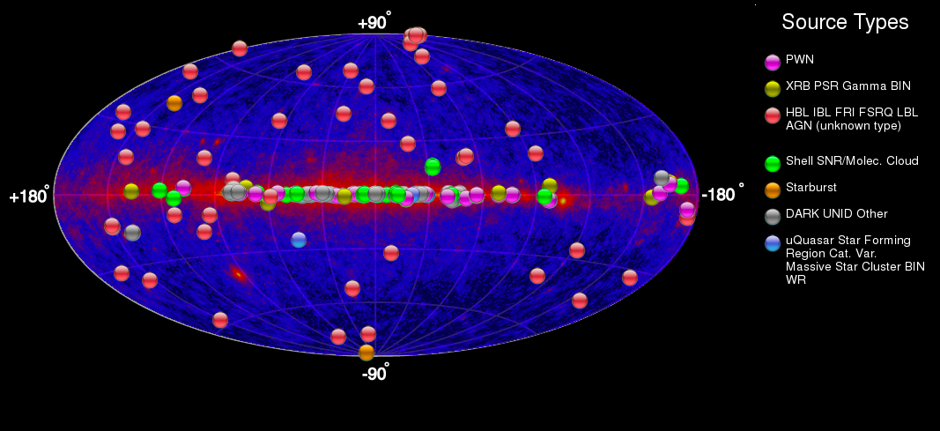
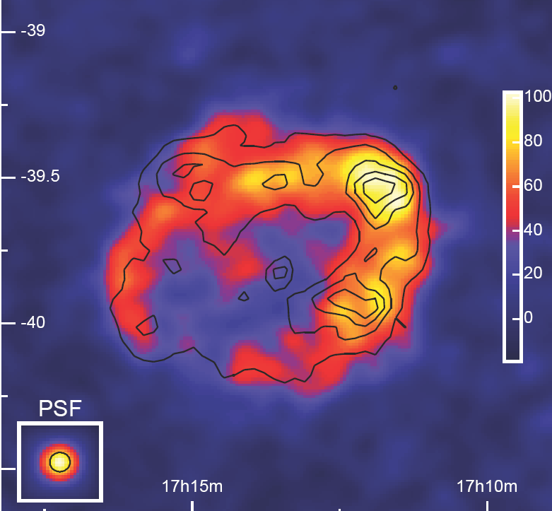
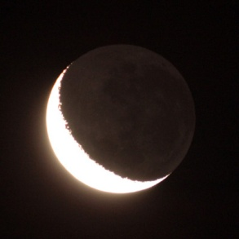
The VHE gamma ray sky
© TeVcat (14/May/2011)
0.5°
RX J1713.7-3946
143 sources
48 Extragalactic Morphology
Moon

Slide 26
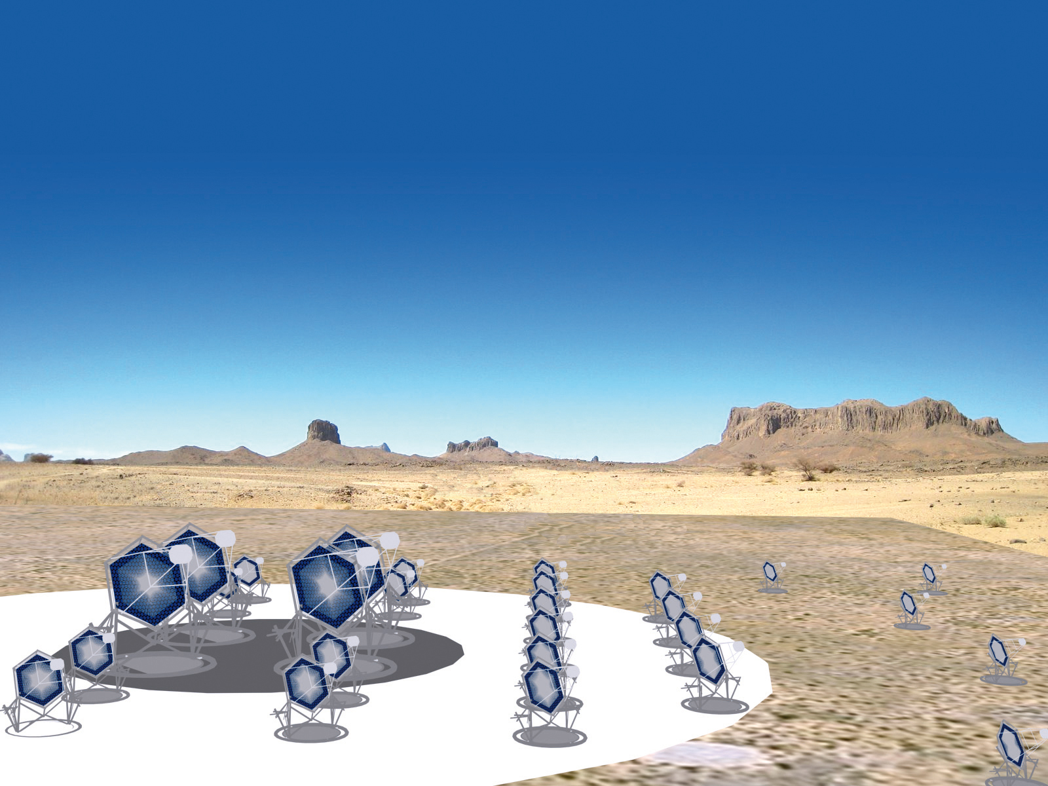
10 fold sensitivity of current instruments
10 fold energy range
improved angular resolution
~1000 sources expected
two sites (North / South)
World-wide cooperation
25 countries, 132 institutes,800 scientists
The future in
VHE gamma ray
astronomy:

Slide 27
TeV gamma-ray astrophysics:
The Cherenkov Telescope Array (CTA) is the worldwide priority project of this field. It combines proven technological feasibility with a high speed towards prototyping, with a guaranteed scientific perspective and a mode of operation and wealth of data similar to mainstream astronomy.
The cost scale of CTA is 200 M€.
We recommend to design and to prototype CTA, to select the site(s), and to proceed vigorously towards start of construction in 2014.

Slide 28
Large scale, mid of decade:
TeV gamma-ray astrophysics: CTA
High energy neutrinos
High energy cosmic rays: 30,000 km² ground based array
Low energy neutrinos & p-decay: LAGUNA

Slide 29
Last 12 years: a factor of 1000 !
Amanda
2000
IceCube
2012

Slide 30
Last 12 years: a factor of 1000 !
Amanda
2000
Km3- Projects in the North:
- KM3NeT
- GVD
IceCube
2012

Slide 31
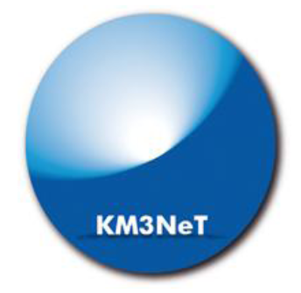
KM3NeT
2011: Technical Design Report
Late 2012: Technical proposal
Physics: Focus to galactic sources !
Fresh funding for engineering arrays in France and Italy, also Romania. Netherlands since years
Greece 50M€ promised

Slide 32
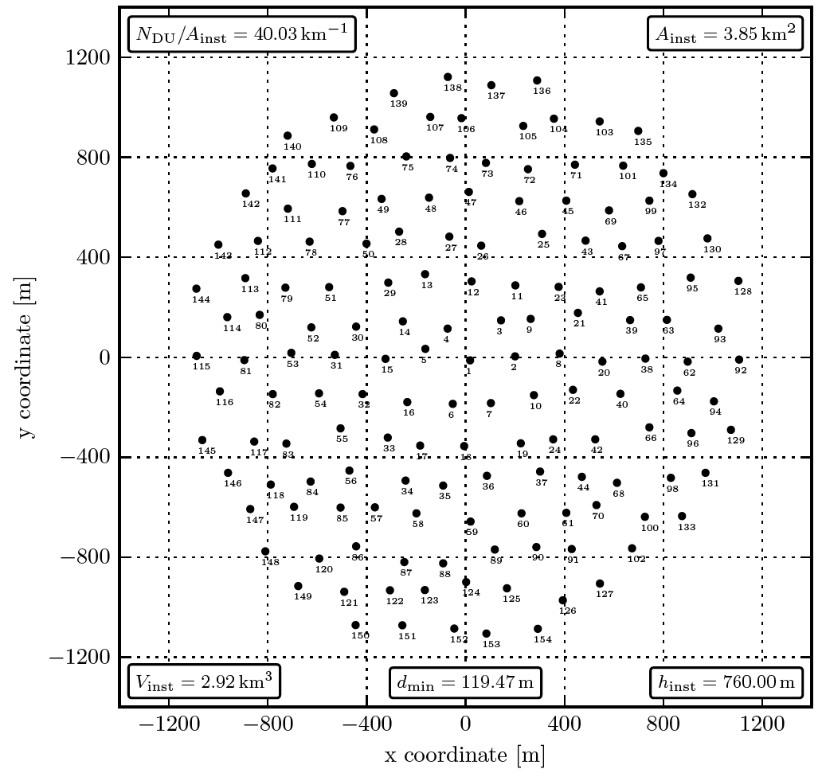
KM3NeT
Haven taken the basic technology decisions
Site question still open. 1, 2 or even 3 sites?
Here: 2 blocks each with 3 km³
Cost ~ 250 M€

Slide 33
High-energy neutrinos
IceCube is now providing data with unprecedented quality and statistics. The European partners should be supported in order to ensure the appropriate scientific return.
There is a strong scientific case for a neutrino detector in the Northern hemisphere, with a substantially larger sensitivity than IceCube. Resources for a Mediterranean detector should be pooled in a single optimized design for a large research infrastructure. The KM3NeT collaboration is encouraged to present a technical proposal matching these requirements and in particular take final site and design decisions that would enable start of construction in 2014.
The IceCube, ANTARES and KM3NeT collaborations are encouraged to strengthen cooperation, with the vision to form a future Global Neutrino Observatory, including also other projects like GVD-Baikal.

Slide 34
Large scale, mid of decade:
TeV gamma-ray astrophysics: CTA
High energy neutrinos: KM3NeT
Cosmic rays
Low energy neutrinos & p-decay: LAGUNA

Slide 35
Galactic cosmic rays
Low energies: AMS – successful launch 2011
Need an overlap between present direct and air-shower detection methods for a better understanding on the mass composition and spectral features of cosmic rays.
large-aperture, long duration flight missions above the atmosphere (balloons/satellites) and/or
ground-based detectors with adequate particle identification placed at the highest altitudes.
The existing experiments IceCube, TUNKA-133 and the low-energy extensions of the Pierre Auger Observatory (AMIGA/HEAT) should be exploited. We encourage the further development of MHz radio wave detection of air showers, e.g. at the large facilities Auger (AERA) and LOFAR, as well as at the South Pole and the Tunka site.
An array at the highest possible altitude is desirable to determine the chemical composition in the energy range overlapping with balloon experiments (10 TeV – PeV). At present, the planned LHAASO experiment in China seems to come closest to this requirement.

Slide 36
Perspective for cosmic rays at highest Energies
Exposure
(km² sr year)
10⁷
JEM-EUSO
(space)
30,000 km²
10⁶
Early 2012 – TUS (Russia)
10⁵
Auger-South
10⁴
HiRes
AGASa
Fly‘s eye
Telescope Array
10³
10²
1985 1990 1995 2000 2005 2010 2015 2020 2025 2030
year

Slide 37
High energy cosmic rays
We reiterate the definition of a substantially enlarged ground-based cosmic-ray observatory as the priority project of high energy cosmic-ray physics – wherever it will be deployed.
Cost scale 100-150 M€
We encourage the community to work towards a global common path for such a substantially enlarged observatory including the development of new detection technologies. We recommend that European groups play a significant role in preparing a proposal for the next generation experiment, and, after its approval, make a significant contribution to construction and operation.
We also support European participation in JEM-EUSO with its novel technology. We encourage cross coordination between these two approaches.

Slide 38
Large scale, mid of decade:
TeV gamma-ray astrophysics: CTA
High energy neutrinos: KM3NeT
High energy cosmic rays: 30,000 km² ground based array
Low energy neutrinos & p-decay

Slide 39
Science on the Megaton scale
Proton decay: improve sensitivity by > factor 10 and test a new class of Supersymmetry models
Galactic Supernova: 10⁴- 10⁵ events Incredibly detailed information on the early SN phase
Diffuse flux from past SN: probe cosmological star formation rate
Solar neutrinos: details of the Standard Solar Model determined with percent accuracy
Atmospheric neutrinos: high statistics would improve knowledge neutrino mixing and provide unique information on the neutrino mass hierarchy
Geo-neutrinos: improve understanding of the Earth interior
Indirect WIMP search
Neutrinos from accelerators over a long baseline (also with dedicated smaller detectors): neutrino properties !

Slide 40
Projects on the Megaton scale
Europe: LAGUNA
Japan: Hyper-K
USA: LBNE

Slide 41
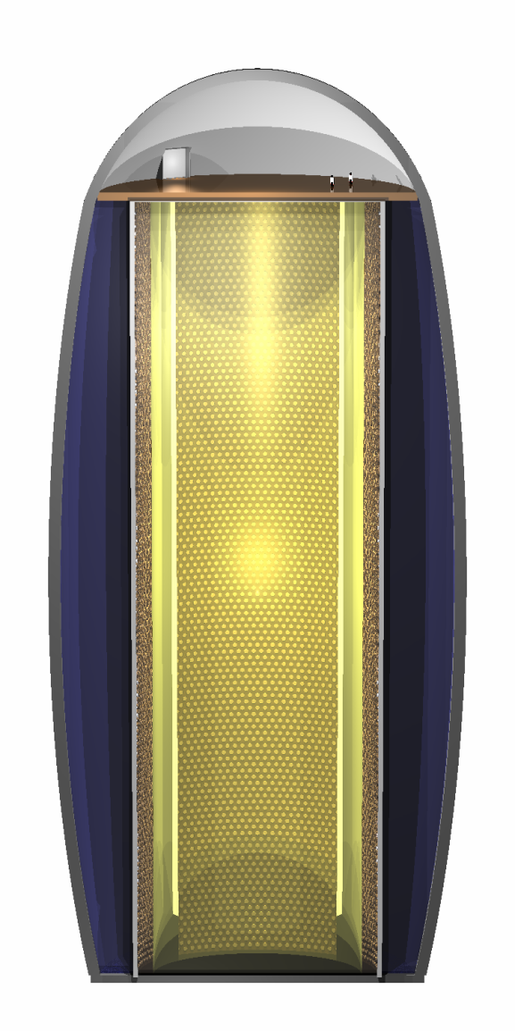
LAGUNA
MEMPHYS
600 kton water
LENA
50 kt scintillator
50 m
GLACIER
100 kton liquid argon

Slide 42
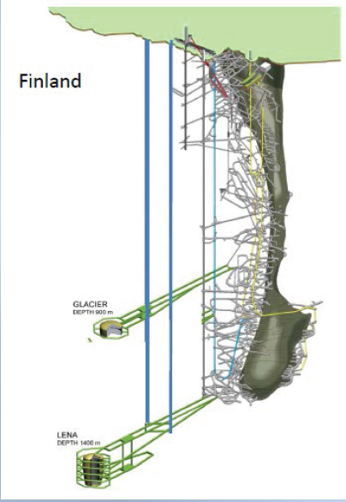
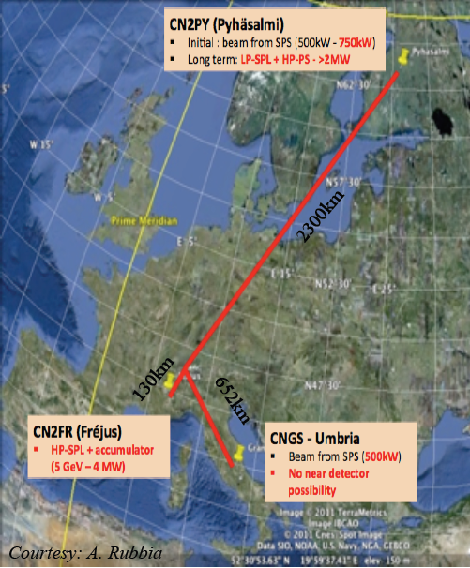
LAGUNA Case Study
Case study for European
Strategy Process:
- CERN-Pyhäsalmi
- LSc + LAr
(Studies also incremental approach)
Update European Strategy
of Particle Physics

Slide 43
LAGUNA Design study
The scientific goals combine high-risk research addressing several fundamental questions of physics (proton decay, CP violation) with exciting neutrino astrophysics (e.g. supernova, solar, geo- and atmospheric neutrinos).
We recommend the LAGUNA-LBNO program, including options with and without a new neutrino beam.
Due to the high cost (350-700 M€, depending on site and type of detector) and the long development time, we recommends that this program is pursued in a global context.
If the current indications for a large mixing angle θ₁₃ were to be confirmed within one or two years, attractive scenarios for the medium-term CERN strategy open up.
As such the LAGUNA project constitutes a high astroparticle physics priority to be discussed within the CERN strategy update process.

Slide 44
Large scale, mid of decade: All Four ?
The presently conceived start of construction of KM3NeT, “AugerNEXT” and LAGUNA is between 2014 and 2016.
It seems likely that this does not fit into a realistic funding scheme!
We would support a strategy to search for funding opportunities for these projects – both in Europe and worldwide – and promote any one of these projects as soon as a corresponding window appears.

Slide 45
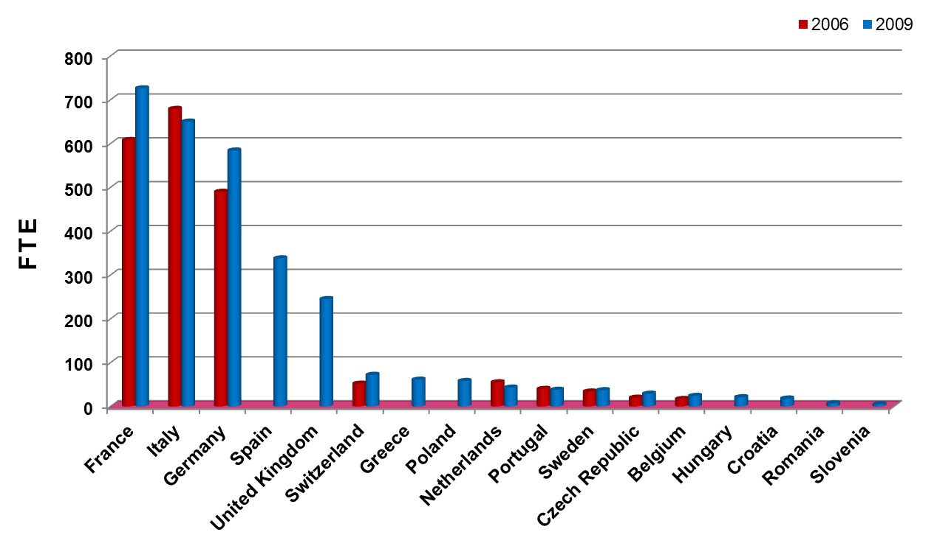
Total ApP manpower (FTE) in ASPERA countries
Year 2009: Total ≈ 3 000 FTE:
Researchers ≈ 1 250, Post-docs ≈ 550, Graduate students ≈ 750, engineers ≈ 450
≈ 200 universities, research institutes & national labs
Germany ~600

Slide 46
Total ApP budget in ASPERA countries
≈ 220 M€ (Personnel, Investment, running costs)
Germany ~50 M€

Slide 47
Summary
Astroparticle physics is a rapidly growing, dynamical field
In full blossom: gamma-ray astrophysics → CTA
Many fundamental topics have progressed to levels of sensitivity with high discovery potential (gravitational waves, dark matter, ...) → maintain momentum !
Close relation to CERN strategy → LAGUNA
Relations to other sciences (particle, astro, environmental) → broaden community!
Europe is a leading player in astroparticle physics
Embedded in a worldwide landscape: think global !

Slide 49
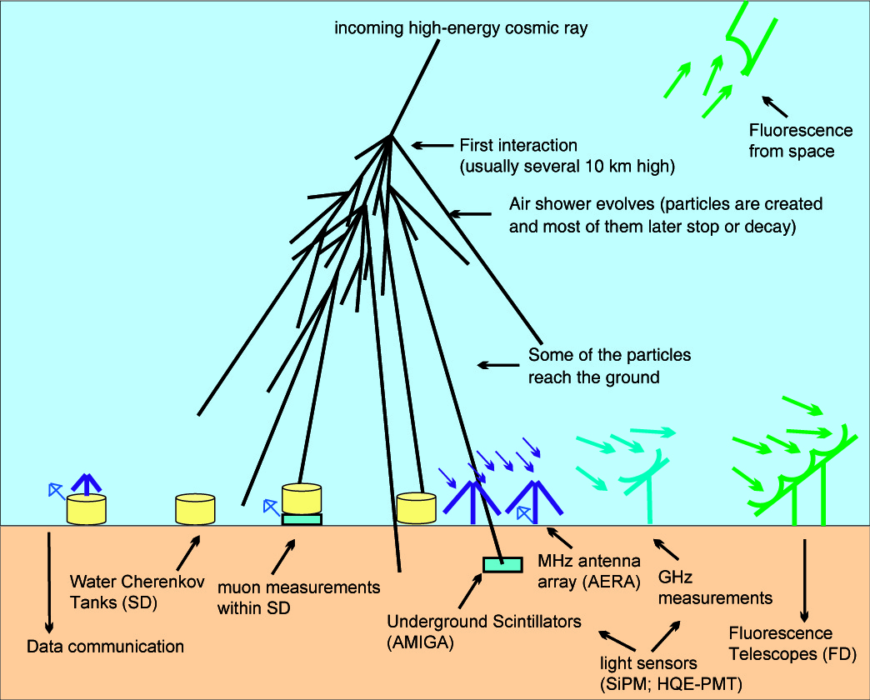
The next 3-4 years
Improve existing technologies
Develop new technologies (radio MHz, GHz)
Hybrid !

Slide 50
Recommendations Gravitational Waves Advanced Detectors
With advanced VIRGO, advanced LIGO and GEO-HF, a discovery in the next five years becomes highly probable. This would open an entirely new window to the Universe.
We urge the agencies to continue substantially supporting the on-going and planned upgrades to advanced detectors.

Slide 51
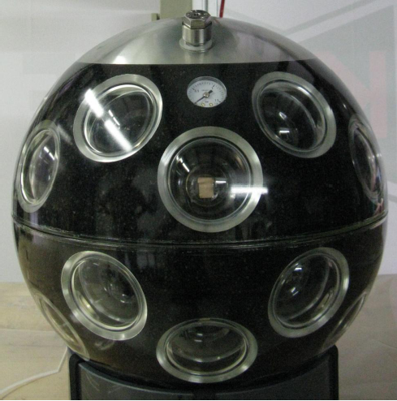
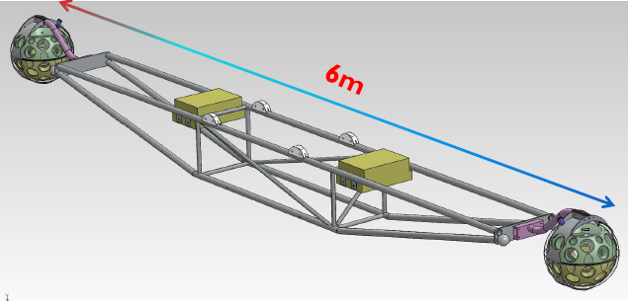
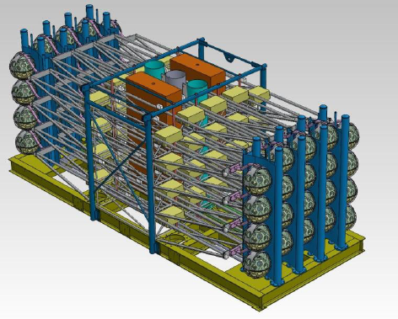
Technology Convergence
2) Towers with 2-DOM floors
, Backup single string
DOM with 31 PMT
Still needs long-term in-situ test!
Backup 13´´ PMT
3) „All data to shore“ concept
cutting-edge fibre technology

