Slide 1
HELMHOLTZ ASSOCIATION
Dr. Martin Sandhop
Notes:
Dear Mr Matveev,
Dear Christian Spiering and Mr Domogatsky,
ladies and gentlemen,
my name is Martin Sandhop. I am representing the Helmholtz Association of German Research Centres here in Moscow.
It is a pleasure for me to be again in Dubna in the Joint Institute of Nuclear Research. The JINR is without doubt one of the key partners of the Helmholtz Association in Russia.
Let me very briefly introduce to you the Helmholtz Association and our co-operation with Russia.

Slide 2
HELMHOLTZ MISSION Strategic Research for National Needs
Solving major challenges with cutting-edge research
Think big, act big: Developing and operating complex infrastructure and large-scale facilities for the national and international scientific community
Creating wealth for society and industry through knowledge transformation and innovation
Notes:
The Helmholtz Association is a community of 17 scientific-technical and biological research centres.
With an annual budget of 3.3 billion euros the Helmholtz Association is Germany´s largest research organisation.
Our mission is to find solutions to the great challenges facing society, science and industry.

Slide 3
HELMHOLTZ CENTRES
Alfred Wegener Institute for Polar and Marine Research (AWI)
Deutsches Elektronen-Synchrotron DESY
German Cancer Research Center (DKFZ)
German Centre for Neurodegenerative Diseases (DZNE)
German Aerospace Center (DLR)
Forschungszentrum Jülich (FZJ)
Karlsruhe Institute of Technology (KIT)
GSI Helmholtz Centre for Heavy Ion Research
Helmholtz-Zentrum Berlin für Materialien und Energie (HZB)
Helmholtz-Zentrum Dresden-Rossendorf (HZDR)
Helmholtz Centre for Environmental Research - UFZ
Helmholtz Centre for Infection Research (HZI)
Helmholtz-Zentrum Geesthacht - Centre for Materials and Coastal Research (HZG)
Helmholtz Zentrum München - German Research Center for Environmental Health (HMGU)
Helmholtz Centre Potsdam GFZ, German Research Centre for Geosciences
Max Delbrueck Center for Molecular Medicine (MDC) Berlin-Buch
Max Planck Institute for Plasma Physics (associated) (IPP)
1.1.2012: Helmholtz Centre for Ocean Research – GEOMAR
Notes:
Those Helmholtz research centres that are co-operating with the JINR are marked,for instance:

Slide 4
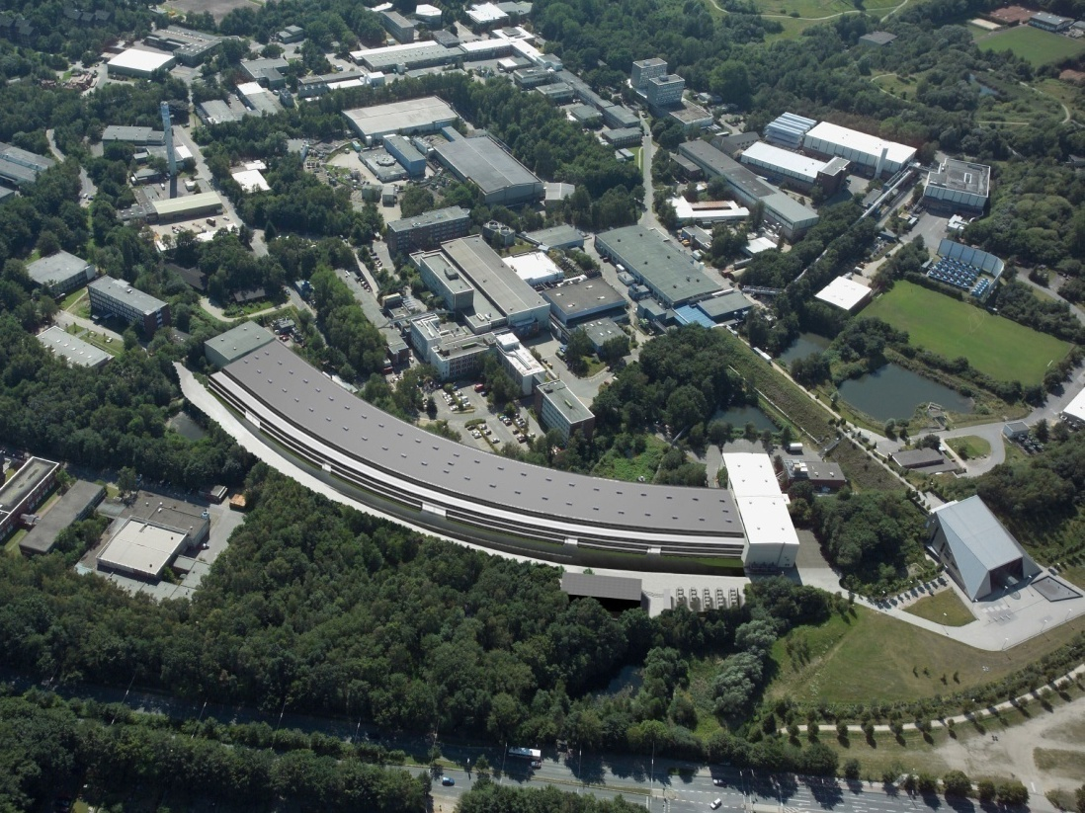
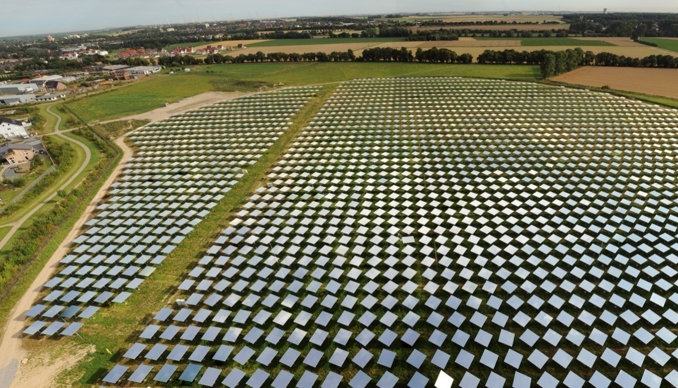
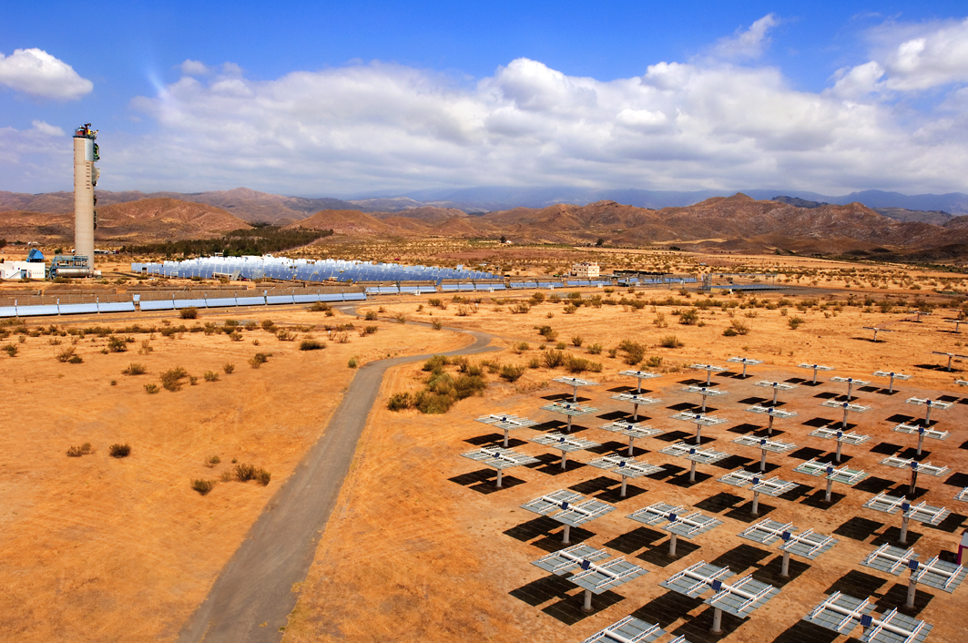
Notes:
Our special area of expertise is the planning, construction and operation of large, complex research infrastructures in collaboration with national and international partners.
On this slide you can see 4 examples of Helmholtz research infrastructure:
Picture top left:
PETRA III, which took up operation in 2009, is the most brilliant storage-ring-based X-ray radiation source in the world. As the most powerful light source of its kind, it offers scientists outstanding experimental opportunities with X-rays of an exceptionally high brilliance.
Picture top right:
View from the solar tower in Jülich. You can see 2150 movable mirrors, so called „heliostates“, of a demonstration pilot plant for solar energy. The plant is run by the German Aerospace Centre (DLR).
Picture bottom left:
The Solar thermal power station, in Almeria/ Spain, operated by DLR
Picture bottom right:
The BESSY II synchrotron. In June 2011 the Helmholtz Zentrum Berlin für Materialien und Energie was celebrating the 10th anniversary of the Russian-German beamline at the Bessy synchrotron

Slide 5
CUTTING-EDGE SCIENCE IN NETWORKS The Six Research Fields
Energy
Earth & Environment
Health
Key Technologies
Structure of Matter
Aeronautics, Space
and Transport
Notes:
Helmholtz operates in six fields of research: Energy, Earth and Environment, Health, Key Technologies, Structure of Matter, and Aeronautics, Space and Transport.
From the many examples of co-operations with Russian partners I will pick out only a very few – out of the research fields Energy; Earth and Environment; Health, and Structure of Matter.

Slide 6
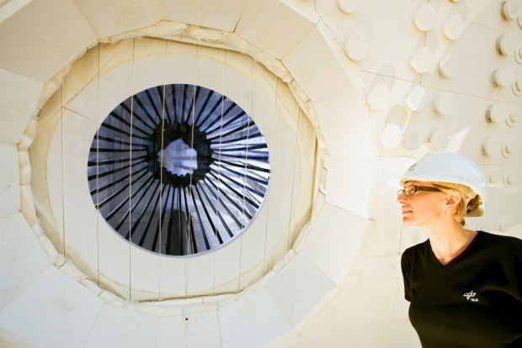
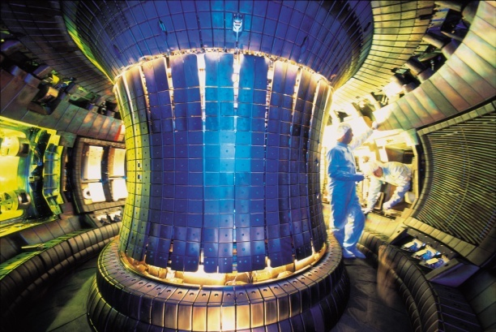
RESEARCH FIELD ENERGY For Example: Reducing CO₂ Emissions
Solar-thermal power stations
Bioliq pilot plant
Geothermal pilot plant
CO₂ separation with membranes and CO₂ sequestration
Nuclear fusion (ITER)
SOLHYCO/DLR
ASDEX UPGRADE/IPP
Notes:
Nuclear safety
The tragic events in Fukushima have clearly underlined the urgent need for this kind of research. Russian and German scientists can, without a doubt, make an important contribution to making our world a safer place.
Helmholtz is therefore very closely co-operating with ROSATOM and their research institutes in nuclear safety and nuclear waste management. – for instance through developing the technology of partitioning and transmutation.

Slide 7
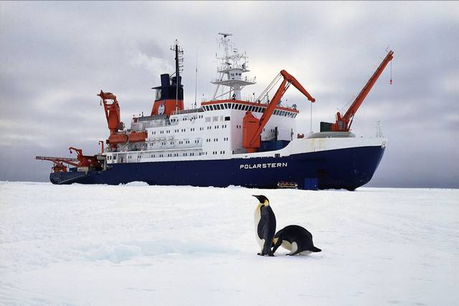
RESEARCH FIELD EARTH & ENVIRONMENT For Example: Understanding Climate Change
Polar research with the ice-breaker Polarstern and the Neumayer Station
Earth observation with satellites
Understanding atmospheric changes with the HALO aircraft
The climate initiative REKLIM and Regional Climate Offices
Polarstern/AWI
HALO/DLR
Notes:
Picture Top: The Research Icebreaker Polarstern of the Alfred Wegener Institute for Polar and Marine Research, Bremerhaven. In October 2011 the Polarstern came back from an 16 week Arctic expedition TransArc 2011 to the North Pole - with German, Russian and international researchers. They carried out measurings of the Arctic sea ice thickness – by using a special instrument with the helicopter: an torpedo shaped probe that is flown over the ice. Measurings are carried out by electromagnetic induction. In many areas the Arctic sea ice is melting dramatically.
Picture at the bottom:
Climate researchers from Forschungszentrum Jülich, from Karlsruhe Institute of Technology (KIT) and from the German Aerospace Centre (DLR) together with Russian partners from the Central Aerological Observatory (CAO) use the Russian research aircraft GEOPHYSIKA M55 to carry out atmospheric research. The Russian aircraft can reach a height of 20,000 m, up to the stratosphere. Higher than the German DLR-aircraft HALO (High Altitude Longe Range research aircraft; bottom picture) which is designed for atmospheric research in heights up to 15,000 m. This is a good example of the mutual benefit in sharing ressources, infrastructure and expertise!
Latest news: the day before yesterday, December 6, Jülich-KIT- and Russian researchers conducted for the first time a worldwide unique experiment: they carry a novel infrared camera (GLORIA) on board of Geophysika in order to test this climate-observation-instrument for a measurement campaign over the Arctic!

Slide 8
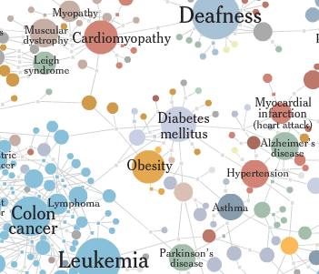
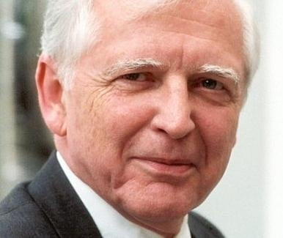
RESEARCH FIELD HEALTH For Example: Combating Major Common Diseases
Disease prevention and personal risk assessment
Translational research
Nationales Zentrum für Tumorerkrankungen (NCT) Heidelberg
Experimental and Clinical Research Centre (ECRC), Berlin
TWINCORE, Braunschweig
German Centres of Health Research
Helmholtz Cohort
Nobel Laureat Prof. Harald zur Hausen/DKFZ
Notes:
Health Research
In health research, there are two topics where Helmholtz researchers and Russian experts are carrying out joint research projects: cancer research, and in the field of infectious diseases: tuberculosis. Tuberculosis is of high relevance, since this infectious disease is again on the way of becoming a growing threat – not only in Russia.

Slide 9
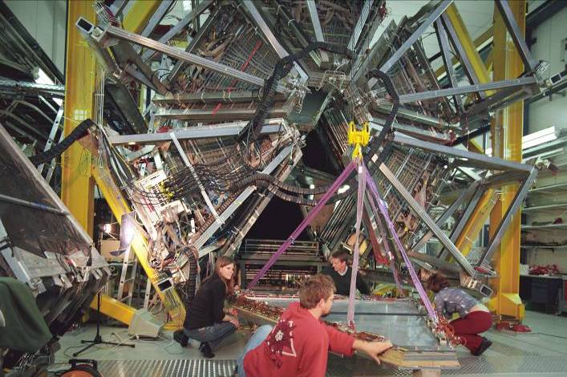
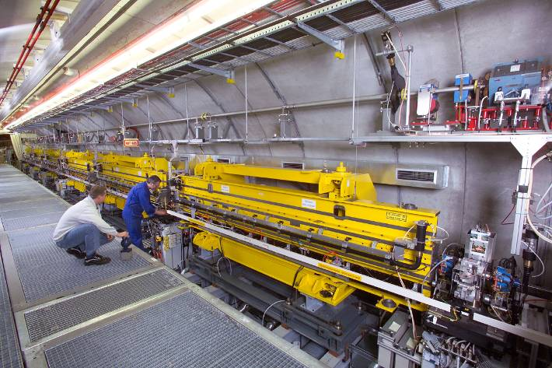
RESEARCH FIELD STRUCTURE OF MATTER For Example: Operating Large-scale Facilities
European XFEL: Films from the nanocosmos
Pilot plant FLASH
FAIR: Understanding the secrets of matter
Large Hadron Collider (LHC) at CERN
New Element 112 Copernicium
Magnetic monopoles
HADES-Detektor/GSI
DESY
Notes:
Russia is our most important and reliable partner in the two German-Russian flagship-projects – European XFEL and FAIR.
FAIR stands for Facility for Antiproton and Ion Research. It will be established at the GSI Helmholtz Centre in Darmstadt. FAIR is an accelerator complex of the next generation. It is one of the world’s largest research projects seeking to gain new insights into the structure of matter and the evolution of the universe from the Big Bang to the present. Helmholtz and Rosatom jointly established a FAIR Russia Research Centre that is coordinating Russia´s contribution to FAIR. More than 500 scientists and engineers in Russia have expressed their intention to participate in FAIR.
The second large research infrastructure being set up in Germany with the help of Russia is the European XFEL. This research facility, which is currently under construction near Hamburg, will generate extremely intense X-ray flashes to map the atomic details of viruses, to film chemical reactions and to study the processes that occur inside planets.
Astroparticle Physics is one of the four Helmholtz research programmes within the research field “structure of matter”. The Karlsruhe Institute of Technology (KIT) and the Deutsches Elektronen Synchrotron (DESY) are both participating in this programme. The focus of the programme is the continuation of involvement at the Pierre Auger Observatory and at the ICECUBE Collaboration. In Karlsruhe, accompanying research as regards radio detection of air showers takes place. The neutron telescope ICECUBE will be completed and guarantees a wealth of results in the next programme period. In connection with this, DESY plans to contribute to the preparatory work on the Cherenkov Telescope Array. The search for dark matter is becoming ever more important as a result of new astronomical studies and is to be expanded through the KIT taking a leading role in the European project EURECA. Comprehensively, the so-called Multimessenger Analysis is being advanced, in which information from several celestial sources are to be combined. The KATRIN experiment at KIT will conduct its measurements in this programme period and enable the worldwide most sensitive measurement of neutrino mass.

Slide 10
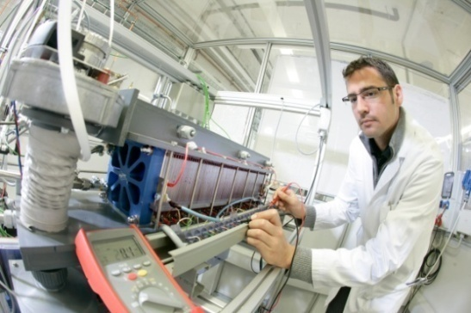
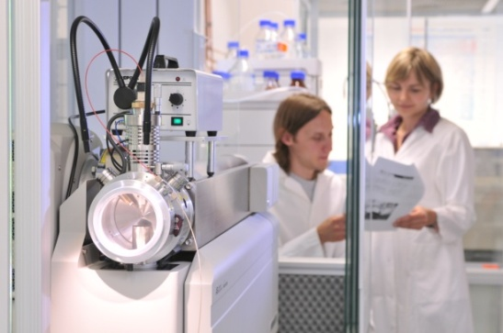
BROAD VARIETY OF STRATEGIC PARTNERSHIPS WITH UNIVERSITIES AND OTHERS
Participation in the excellence initiative
Close cooperation within JARA
Competence networks in translational research
First merger of university and non-university research centres creates the KIT
Promoting joint initiatives through:
10 Helmholtz Alliances
5 Helmholtz Institutes
99 Virtual Institutes
151 Helmholtz Young Investigators Groups
230 Joint Professorships
Karlsruhe Institute of Technology
Helmholtz Zentrum München
Notes:
Helmholtz Research Alliances
Helmholtz Alliance Astroparticle Physics
In addition to the Helmholtz centres KIT and DESY, the Helmholtz Alliance for Astroparticle Physics, headed by the KIT in a leading role, combines a total of 15 German universities and three Max Planck Institutes as well as two more external partners to form a syndicate with visibility on an international level. The subject matter includes the "non-thermal universe", the "dark universe" and "astroparticle theory". The Alliance follows in the footsteps of the successful networking concept of the Helmholtz Alliance "Physics at the Tera Scale" and bundles all significant astroparticle physics activities scattered across German universities. Helmholtz will fund the Alliance with up to 9.990 million euros over a period of 5 years.

Slide 11
Helmholtz Russia Joint Research Groups (HRJRG)
September 2006: Russian Foundation for Basic Research and Helmholtz Association signed the first agreement over the joint funding of Helmholtz-Russia Joint Research Groups
Funding scheme: three years; up to 130,000 euros (Helmholtz Association) and 1 million roubles (RFBR) per year
Notes:
Finally,
in all our work, the key to the future is the promotion of young scientists. For this purpose, we have set up a programme to fund the Helmholtz Russia Joint Research Groups in collaboration with the Russian Foundation for Basic Research. 20 joint research groups were and are being funded, 6 new research groups take up their work in 2012. With this programme, Helmholtz and RFFI make an effort to also strengthen the academic career perspectives of German and Russian early stage researchers.

Slide 12
Examples of HRJRGs (total 20 + 6)
HRJRG-016
“Structural Aspects of Biocompatible Ferrofluids by Scattering Methods: Stabilization, Properties Control and Applications” (Helmholtz-Zentrum Geesthacht Centre for Material and Coastal Research; Joint Institute for Nuclear Research (Dubna); National Research Centre “Kurchatov Institute” (Moscow)
HRJRG-106
Development of a High Energy Electron Cooler for Hadron Physics Experiments at COSY and HESR by (Forschungszentrum Jülich; Budker Institute of Nuclear Physics (BINP), Siberian Branch of Russian Academy of Sciences (Novosibirsk); Joint Institute for Nuclear Research (JINR) (Dubna, Moscow Region)
Notes:
I pick out only three examples of HRJRGs – tweo of them with the JINR involved, namely the HRJRG-016 with a topic out of Key technologies; and the HRJRG-106 with a topic out of Structure of Matter.

Slide 13
Examples of HRJRGs (total 20 + 6)
HRJRG-303:
Measurements of Gamma Rays and Charged Cosmic Rays in the Tunka-Valley in Siberia by Innovative New Technologies
German partner: Deutsches Elektronen Synchrotron (DESY), Dr. Ralf Wischnewski
Russian partner: Institute for Nuclear Research of the Russian Academy of Sciences (Moscow), Dr. Grigory Rubtsov; Irkurtsk State University (Applied Physics Institute)
Notes:
And – we only a few days ago sogned the contract for funding the HRJRG-303 on „Measuremensts of Gamma Raysand Charged Cosmic Rays in the Tunka Valley in Siberia by Innovative Technologies“ to start by April 1st, 2012.
My warmest congratulationsto Ralf Wischnewski from DESY Zeuthen as the Proincipal Investigator on behalf of Helmholtz and to Grigoriy Rubtsov from the Institute for Nuclear Research of the RAS as the Principal Investigator on behalf of the Russian Side.
Good luck for your Joint Research Group,
And many fruitful exchanges for this joint workshop on Astroparticle Physics!
Thank you very much.

Slide 14
HELMHOLTZ ASSOCIATION
Dr. Martin Sandhop

