Slide 1
Front-end for BAMs
Samer Bou Habib
Notes:
How to edit the title slide
Upper area: Title of your talk, max. 2 rows of the defined size (55 pt)
Lower area (subtitle): Conference/meeting/workshop, location, date, your name and affiliation, max. 4 rows of the defined size (32 pt)
Change the partner logos or add others in the last row.

Slide 2
Agenda
Introduction/Concept
Frontend
ADC Test
FMC Design
Plans
2011.12.15 Warsaw University of technology, Warsaw
Samer Bou Habib, Phd, student, ISE-WUT

Slide 3
Hardware concept
Opt to RF analog Frontend
ADC
216 Mhz pulses
ADC
FPGA (Digital processing)
216 Mhz pulses
Opt to RF analog Frontend
Clock distribution
Opt to RF analog Frontend
ADC
216 Mhz pulses
ADC
Notes:
the concept of the board is rather staight forward:
High freq. Analog sygnals are matched to the input of the adcs and digital data is aquisited by a large fpga where algoryths are implemented to obtain information about the phase and ampl. Of the modulating signals.
The sampling frequency has to be synchronized with the input sygnals so an external reference is used to synthesize and distrubute the clocks.
Additional memory block are use for analisys of the sampled data.
Diagontic circuits are implemented to monitor the board operation and tempreture
Moreover external interfaces are put to connect to the ATCA system and/or the user.
triggering of the system is supplied from the outside.
And an additional slot for a daughter board containing a proecessor for additional configuration and computation of the system is used.

Slide 4
Hardware concept
Opt to RF analog Frontend
ADC
216 Mhz pulses
ADC
FPGA (Digital processing)
216 Mhz pulses
Opt to RF analog Frontend
Clock distribution
Opt to RF analog Frontend
ADC
216 Mhz pulses
ADC
Notes:
the concept of the board is rather staight forward:
High freq. Analog sygnals are matched to the input of the adcs and digital data is aquisited by a large fpga where algoryths are implemented to obtain information about the phase and ampl. Of the modulating signals.
The sampling frequency has to be synchronized with the input sygnals so an external reference is used to synthesize and distrubute the clocks.
Additional memory block are use for analisys of the sampled data.
Diagontic circuits are implemented to monitor the board operation and tempreture
Moreover external interfaces are put to connect to the ATCA system and/or the user.
triggering of the system is supplied from the outside.
And an additional slot for a daughter board containing a proecessor for additional configuration and computation of the system is used.

Slide 5
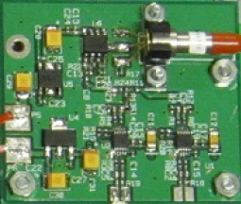
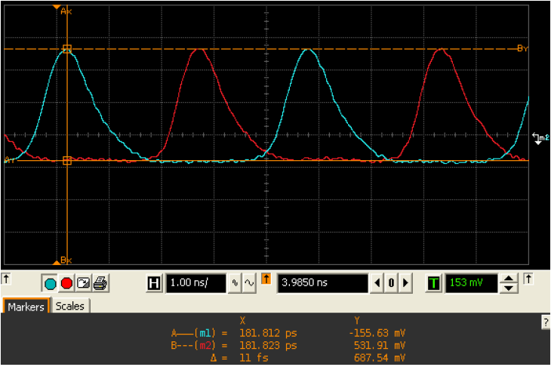
Analog Frontend*
Photodiode with signal conditioning and splitting
Differential pulses
170-190 fs of jitter (10Hz -> 1 MHz)
*Courtesy of Dominik Sikora
2011.12.15 Warsaw University of technology, Warsaw
Samer Bou Habib, Phd, student, ISE-WUT

Slide 6
Hardware concept
Opt to RF analog Frontend
ADC
216 Mhz pulses
ADC
FPGA (Digital processing)
216 Mhz pulses
Opt to RF analog Frontend
Clock distribution
Opt to RF analog Frontend
ADC
216 Mhz pulses
ADC
Notes:
the concept of the board is rather staight forward:
High freq. Analog sygnals are matched to the input of the adcs and digital data is aquisited by a large fpga where algoryths are implemented to obtain information about the phase and ampl. Of the modulating signals.
The sampling frequency has to be synchronized with the input sygnals so an external reference is used to synthesize and distrubute the clocks.
Additional memory block are use for analisys of the sampled data.
Diagontic circuits are implemented to monitor the board operation and tempreture
Moreover external interfaces are put to connect to the ATCA system and/or the user.
triggering of the system is supplied from the outside.
And an additional slot for a daughter board containing a proecessor for additional configuration and computation of the system is used.

Slide 7
Main Problems
Splitting of signals in frontend
Not identical channels
Possible signal degradation
Current Hardware samples every other pulse @108MSPS
2011.12.15 Warsaw University of technology, Warsaw
Samer Bou Habib, Phd, student, ISE-WUT

Slide 8
Solutions
Very Fast ADCs (Fs>432 MSPS)
Not enough accuracy
Fast ADCs (Fs>216 MSPS)
Analog devices: 16-bit, 250 MSPS
2011.12.15 Warsaw University of technology, Warsaw
Samer Bou Habib, Phd, student, ISE-WUT

Slide 9
ADC test
„Poor” matching
Error < 0.19%
2011.12.15 Warsaw University of technology, Warsaw
Samer Bou Habib, Phd, student, ISE-WUT

Slide 10
First Step - FMC
FMC board for FAST ADC EVM
Keep design for changeable frontend?
Opt to RF analog Frontend
ADC
ADC
Opt to RF analog Frontend
Clock dist.
Opt to RF analog Frontend
ADC
ADC
2011.12.15 Warsaw University of technology, Warsaw
Samer Bou Habib, Phd, student, ISE-WUT

Slide 11
Future Plans
Finish FMC design
Testing on live signals
Possibly integrate FMC and carrier board into one pcb
Test final system in accelerator(s)
Celebrate success…
2011.12.15 Warsaw University of technology, Warsaw
Samer Bou Habib, Phd, student, ISE-WUT

Slide 12
Thank you for your attention
S.BouHabib@stud.elka.pw.edu.pl
2011.12.15 Warsaw University of technology, Warsaw
Samer Bou Habib, Phd, student, ISE-WUT

