Slide 1
Hardware production and Quality Control
Maciek Kudla,
LLRF Collaboration Workshop,
Warsaw
December 14, 2011
Notes:
How to edit the title slide
Upper area: Title of your talk, max. 2 rows of the defined size (55 pt)
Lower area (subtitle): Conference/meeting/workshop, location, date, your name and affiliation, max. 4 rows of the defined size (32 pt)
Change the partner logos or add others in the last row.

Slide 2
Outline
Hardware production
XFEL
Installations
Quality Issues
Device tracking
Documentation
Conclusions, remarks
Notes:
Before you start editing the slides of your talk change to the Master Slide view: Menu button “View”, Master, Slide Master:
Edit the following 2 items in the 1st slide: 1) 1st row in the violet header: Delete the existent text and write the title of your talk into this text field 2) The 2 rows in the footer area: Delete the text and write the information regarding your talk (same as on the Title Slide) into this text field.
If you want to use more partner logos position them left beside the DESY logo in the footer area Close Master View

Slide 3
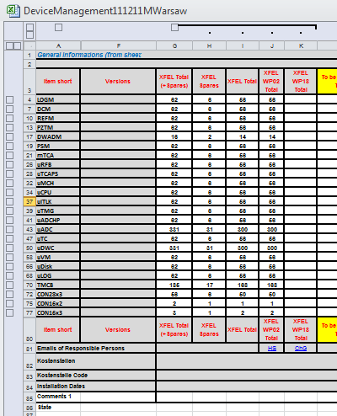
WP02 devices in XFEL
24 Devices:
3 types of Rack Containers
6 19” modules
1 mTCA.4 crate
8 AMC Boards
2 RTM Boards
4 special Boards (TMCB, uLOG,
RFbackplane, mTCA PS)
But no one in version ready for production
19”
Modules
AMCs,RTMs
Industry products:
Rack containers, uADC, uTCAPS, uCPU, uDISK, uMCH, mTCA (9)
Industrilized:
uDWC, uVM, uTC, uADC, uLOG, TMCB (6)
To be decided (to industry, collaboration, DESY):
9 devices (19” modules, etc)
Racks
Cost driving
WP18 Devices not yet counted
MSK (N) disk: \4all\public\_xTCA_Units\Managment\DeviceManagementDate.xlsm
Notes:
Before you start editing the slides of your talk change to the Master Slide view: Menu button “View”, Master, Slide Master:
Edit the following 2 items in the 1st slide: 1) 1st row in the violet header: Delete the existent text and write the title of your talk into this text field 2) The 2 rows in the footer area: Delete the text and write the information regarding your talk (same as on the Title Slide) into this text field.
If you want to use more partner logos position them left beside the DESY logo in the footer area Close Master View

Slide 4
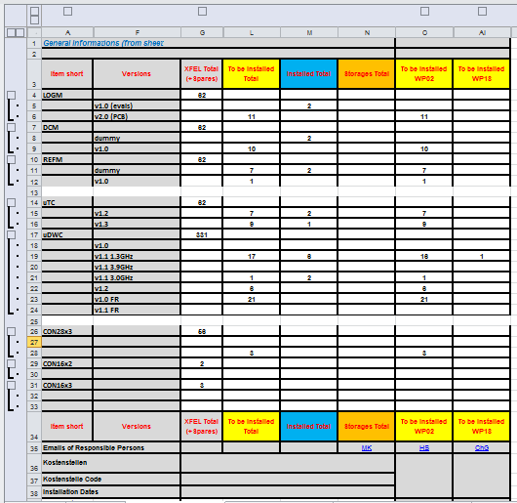
WP02 devices in Installations
24 Devices:
66 versions now
but no one in final version, ready to production
18 LLRF installations:
Flash, AMTF, CMTB, Dlab, etc
12 ~Special Diagnostics
installations:
Lasers, TDS, Regae, etc
Devices for Installations:
Installed or reserved – ~100
To be installed (produced, purchased) - ~300
MSK (N) disk: \4all\public\_xTCA_Units\Managment\DeviceManagementDate.xlsm
Notes:
Before you start editing the slides of your talk change to the Master Slide view: Menu button “View”, Master, Slide Master:
Edit the following 2 items in the 1st slide: 1) 1st row in the violet header: Delete the existent text and write the title of your talk into this text field 2) The 2 rows in the footer area: Delete the text and write the information regarding your talk (same as on the Title Slide) into this text field.
If you want to use more partner logos position them left beside the DESY logo in the footer area Close Master View

Slide 5
Preassumptions for device tests
proposal to divide the Production contracts into two parts:
preproduction (~5%)
full production (~95%)
all device functions (inputs, outputs, links, memories, download schemes, interfaces, etc) has to be tested
production test procedures strategy to be defined
test stands (hardware, software) for Factory and DESY device tests needed
Notes:
Before you start editing the slides of your talk change to the Master Slide view: Menu button “View”, Master, Slide Master:
Edit the following 2 items in the 1st slide: 1) 1st row in the violet header: Delete the existent text and write the title of your talk into this text field 2) The 2 rows in the footer area: Delete the text and write the information regarding your talk (same as on the Title Slide) into this text field.
If you want to use more partner logos position them left beside the DESY logo in the footer area Close Master View

Slide 6
Device Production and Tests – Strategy
When final device version established ->
DEVICES
Preproduction (~5% of XFEL devices)
Factory device tests (using the test stand built in DESY or in collaboration) -> Factory Test Report
All produced device - DESY device tests
Repetition of Factory device tests -> DESY Test Report
System tests (CMTB, ACC1, etc) -> check for integral tests
If everything OK ->
Production (95% of device) the same technology as preproduction!!!
Device Factory tests as before -> Factory Test Report
Selective DESY device tests (~5%)
Repetition of Device Factory tests -> DESY Test Report
System tests (CMTB, ACC1, etc) -> check for integral tests
Notes:
Before you start editing the slides of your talk change to the Master Slide view: Menu button “View”, Master, Slide Master:
Edit the following 2 items in the 1st slide: 1) 1st row in the violet header: Delete the existent text and write the title of your talk into this text field 2) The 2 rows in the footer area: Delete the text and write the information regarding your talk (same as on the Title Slide) into this text field.
If you want to use more partner logos position them left beside the DESY logo in the footer area Close Master View

Slide 7
Integration tests – Strategy
When all device accepted ->
CRATE
Crate assembly (all modules, all internal connections)
DESY mTCA Crate tests (the purpose: check in fully occupied crate, all links to, downloading, performance check, etc ) -> DESY Crate Test Report
When all crate tests passed ->
RACK CONTINER
Assembly the LLRF rack container (all 19” modules, mTCA crate, all in rack interconnections, clocks)
DESY Rack tests (the purpose: interconnection test, long time operation, etc) -> DESY Rack container Test Report
When rack tested ->
Move fully assembled to Rack Storage
Install rack in XFEL, etc
Notes:
Before you start editing the slides of your talk change to the Master Slide view: Menu button “View”, Master, Slide Master:
Edit the following 2 items in the 1st slide: 1) 1st row in the violet header: Delete the existent text and write the title of your talk into this text field 2) The 2 rows in the footer area: Delete the text and write the information regarding your talk (same as on the Title Slide) into this text field.
If you want to use more partner logos position them left beside the DESY logo in the footer area Close Master View

Slide 8
WP02 Testing Structure
WP02 Process Map (1/2)
Factory
Tests
DesyRack Tests
DESY
Device
Tests
Courtesy F.Eints
Notes:
Before you start editing the slides of your talk change to the Master Slide view: Menu button “View”, Master, Slide Master:
Edit the following 2 items in the 1st slide: 1) 1st row in the violet header: Delete the existent text and write the title of your talk into this text field 2) The 2 rows in the footer area: Delete the text and write the information regarding your talk (same as on the Title Slide) into this text field.
If you want to use more partner logos position them left beside the DESY logo in the footer area Close Master View

Slide 9
QC/QA issues – Device tracking
LLRF Labelling (all delivered devices must be labelled – Contact me)
Proposed form:
Labelling in Factory (labels delivered from DESY) or in DESY
Inventory (Contact Bibiane Wendland or me)
KDS
now partially – not all devices have full models available, it is not reasonable to follow all versions changes
But, is possible to make logical models for versions
introduced devices: history events (locations, remarks)
Excel
all LLRF registered devices are there
Device Interconnections, Cable connections
KDS – now limited usage of Installations
not all devices have full models available
no cable naming established
not all Installations have their locations
MSK (N) disk: \4all\public\_xTCA_Units\Management\WP02Devices.xls
Notes:
Before you start editing the slides of your talk change to the Master Slide view: Menu button “View”, Master, Slide Master:
Edit the following 2 items in the 1st slide: 1) 1st row in the violet header: Delete the existent text and write the title of your talk into this text field 2) The 2 rows in the footer area: Delete the text and write the information regarding your talk (same as on the Title Slide) into this text field.
If you want to use more partner logos position them left beside the DESY logo in the footer area Close Master View

Slide 10
QC/QA issues – Documentation
Hardware
Now
N disk
Subversion
Final
EDMS (also Test Reports)
Software
Now
Subversion
Final ?
Firmware
Now
Subversion
Final
How to relate the firmware to the XFEL Stations (Hardware) and Software ???
MSK (N) disk: \4all\public\_xTCA_Units
https://svnsrv.desy.de/k5websvn/wsvn/General.MSK_Doc
https://svnsrv.desy.de/k5websvn/wsvn/General.MSK
Notes:
Before you start editing the slides of your talk change to the Master Slide view: Menu button “View”, Master, Slide Master:
Edit the following 2 items in the 1st slide: 1) 1st row in the violet header: Delete the existent text and write the title of your talk into this text field 2) The 2 rows in the footer area: Delete the text and write the information regarding your talk (same as on the Title Slide) into this text field.
If you want to use more partner logos position them left beside the DESY logo in the footer area Close Master View

Slide 11
Closing remarks
no one of 24 LLRF devices is in final version
30 of WP02 and WP18 installations to built and support during 2012
test strategy proposed
test procedures established for 3 devices (uDWC, iTC, uVM)
Notes:
Before you start editing the slides of your talk change to the Master Slide view: Menu button “View”, Master, Slide Master:
Edit the following 2 items in the 1st slide: 1) 1st row in the violet header: Delete the existent text and write the title of your talk into this text field 2) The 2 rows in the footer area: Delete the text and write the information regarding your talk (same as on the Title Slide) into this text field.
If you want to use more partner logos position them left beside the DESY logo in the footer area Close Master View

