Slide 1
Exploring Bluesky Data with PyMca and Tiled
Abigail Giles, Joshua Lohmolder, and Padraic Shafer
NSLS-II Data Analysis & Workflow Integration (DAWI)
2025-11-06

Slide 2

Bluesky needs an interactive data viewer
PyMca is familiar to many synchrotron users for visualizing data.
As a file-based tool, needed adaption for API-based data,
Tiled.

Slide 3

Tiled – Bluesky’s data access service
REST API access to Bluesky runs, metadata, tables, images.
Enables search and structured, chunk-wise access to data.
Serves a variety of formats, providing data in a consistent structure regardless of the original format.
Slicing and sub-selection – transfer only the data of interest.
Fully featured, embeddable python client.
https://blueskyproject.io/tiled/

Slide 4
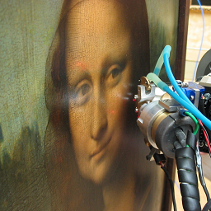
PyMca – Data analysis app
Support for multiple data formats.
1D, 2D, 3D and 4D imaging capabilities.
Extensible application via plugins.
Domain aware (XRF, Powder diffraction, XAS, FT-IR, Raman, …).
Multivariate analysis.
Common data reduction operations (normalization, fitting, …).
https://www.silx.org/doc/PyMca

Slide 5
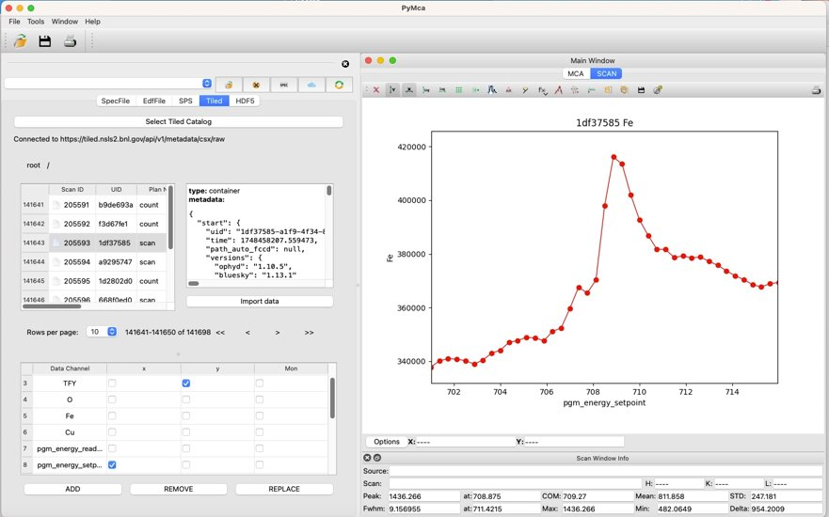
PyMca + Tiled integration
Leverage out-of-the box capabilities of PyMca
plotting, inspection,
data reduction
w/ data powered by Tiled
remote access,
search, filtering,
on demand,
any NSLS-II beamline.

Slide 6
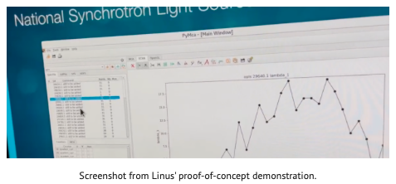
Confluence of community interest
Bluesky community call – brainstorming with Will Smith (BESSY II), Dan Allan (NSLS-II), et al.
Visit to NSLS-II by Linus Pithan (DESY), proof-of-concept demo for beamtime at OPLS.
NSLS-II Complex Scattering beamlines have expressed interest to incorporate it into user operations.

Slide 7
Project goals (Visible to users)
PyMca opens a Tiled browser that provides paginated access to the BlueskyRuns in a CatalogOfBlueskyRuns.
Optionally filter the BlueskyRun datasets presented.
Present data from 'primary' and 'baseline' streams.
Optionally plot live streaming data.
Minimize the impact of I/O on GUI responsiveness.

Slide 8
Tiled catalog select + search
BlueskyRun selector
Data channel selector
Paginated data loaded in separate thread

Slide 9
Project goals (Invisible to users)
Unit tests for new features
Separate the logic of widget interactions in a dialog / panel from the UI interactions + display details
Model – View – View Model (MVVM) approach
tiled.client
QTiledWidget
QTiledSearch
QTiledCatalogSelectorDialog
QTiledDataChannelTable
TiledCatalogSelector
TiledRunSelector

Slide 10
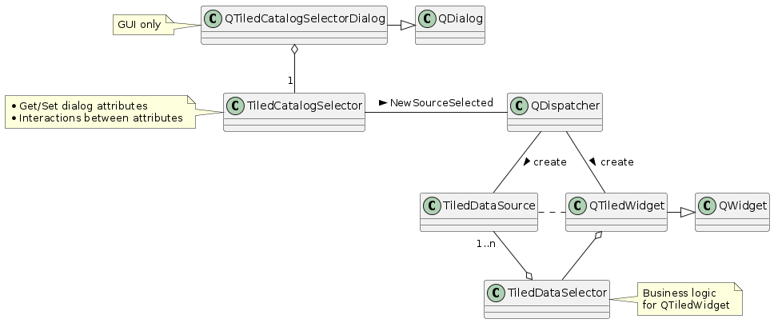
View Models isolate functionality, testing
The majority of testing is performed against these objects / methods
Run

Slide 11
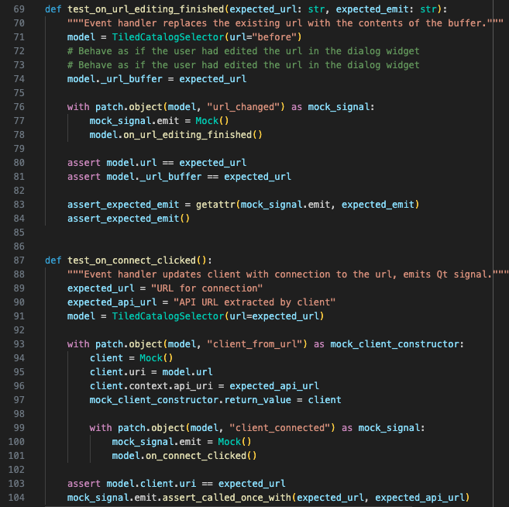
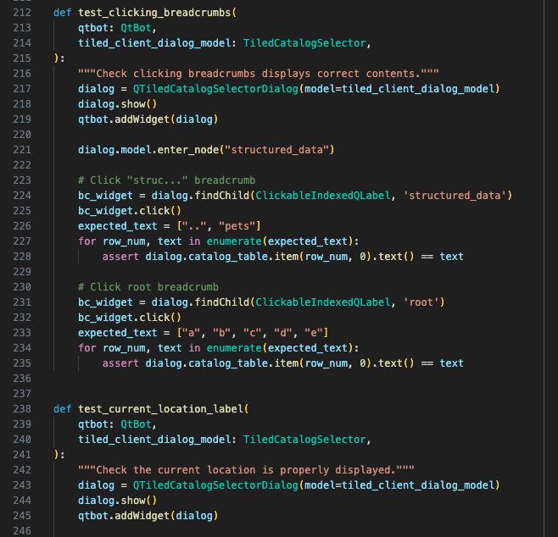
Unit tests – pytest + pytestqt (QtBot)
View Model
logic
View
display

Slide 12
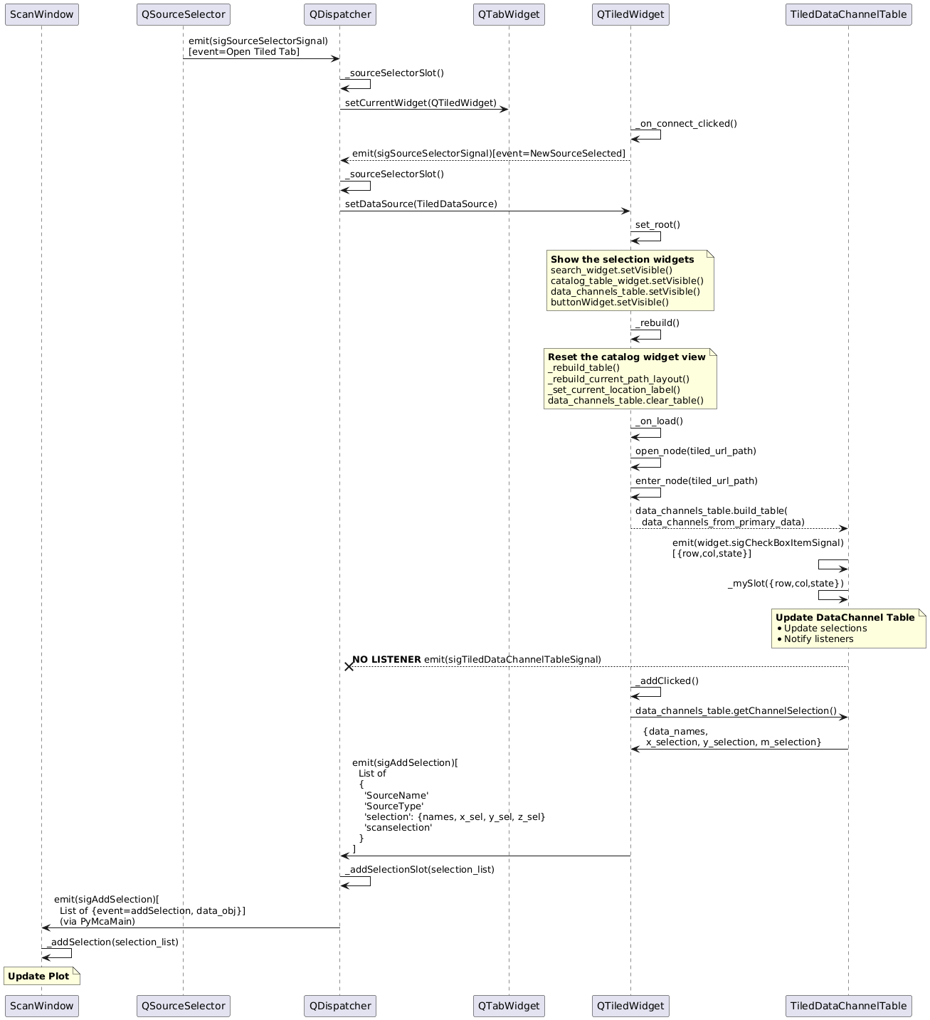
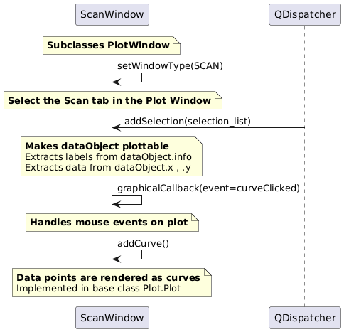
Building a mental model

Slide 13
Deployment and user conveniences
PyMca + Tiled on virtual desktop
Modules to load beamline ENV
PyMca launches connected to beamline’s data catalog
TILED_PROFILE
TILED_DEFAULT_URL
Prompts login to Tiled at launch

Slide 14
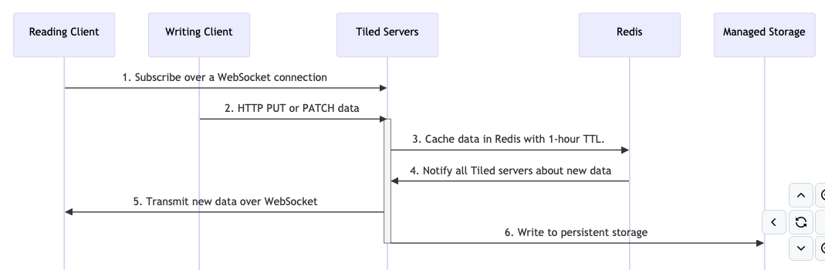
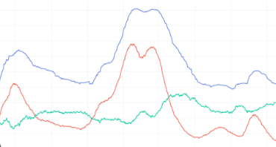
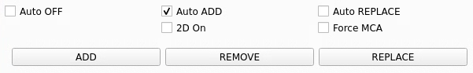
Ongoing developments
Live streaming data, using Tiled websockets.
Auto-Add and Auto-Replace options to build multi-trace plots (or latest plot only).
Multi-run plot loading to simplify batch comparisons.

Slide 15
Questions?
DAWI team
https://github.com/NSLS2/pymca/issues

