Slide 1

Running an ultra-high throughput MX beamline entirely through Bluesky
Ollie Silvester

Slide 2
Introduction to Hyperion
K04, one of Diamond-II's flagship beamlines, aims to collect from 10,000 protein crystal samples per day via unattended data collection (UDC)
This throughput requires a major upgrade in both the software and hardware
Hyperion is the Bluesky-based data acquisition software to orchestrate UDC in a way which maximises throughput
Ongoing project for the last 4 years, with an average of 3 developers

Slide 3
Why move to Bluesky?
Predecessor acquisition software GDA is now impossible to maintain to a high quality.
To maximise throughput, we need to make heavy use of asynchronous device operations and flyscanning – easy with ophyd-async.
Can easily be integrated with other acquisition services.
There's now a very active international community of Bluesky developers.

Slide 4
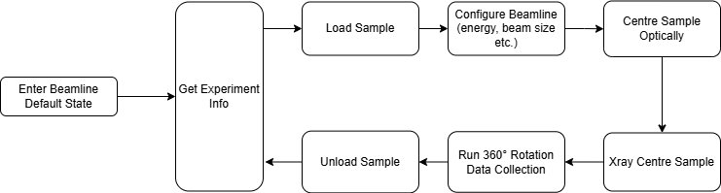
The UDC loop

Slide 5
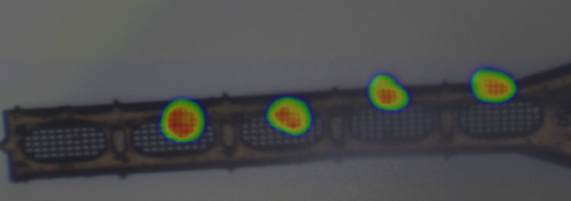
XRC results from a pin with with 4 samples

Slide 6
Hyperion: Current state

Slide 7
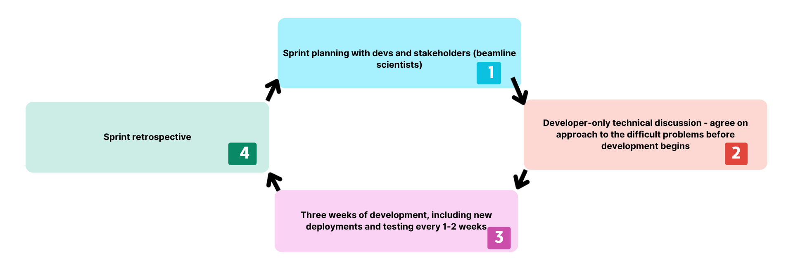
Development approach

Slide 8
Using Bluesky for Hyperion
Modern Python ecosystem >> old DAQ software with Jython
Emerging Bluesky standards at DLS
Need lots of asynchronous code - easy with ophyd-async
Heavy use of generators confusing to non-developers
Wide adoption of Bluesky across facilities - joint effort
No users -> no live interaction with RunEngine
No GUI required!

Slide 9
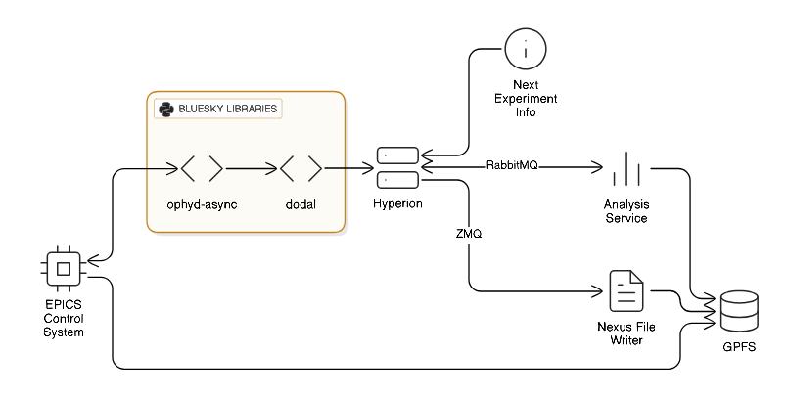

Slide 10
What made Hyperion successful?
A decision was made to prioritise Hyperion at the expense of other beamlines
01
A focussed team working closely together with minimal context-switching is very efficient
02
Workload simplified by the nature of the UDC loop: Same experiment every time, no users, no GUIs, no manual interaction with experiments to consider.
03

Slide 11
Takeaway advice for Bluesky projects
Sacrifice short-term development speed for long term benefits!
What to do | Cost | Benefit
Regular deployments, high unit test coverage, strictly typed Python | Development is slowed down in the short term | Higher quality software, more maintainable and readable. Significantly fewer beamtime-costing bugs. Faster development long term.
Have an agile project team whose members spend most of their time on the sprint | Work on other projects is halted outside existing support | Higher quality software, no overreliance on a single person, overall more efficient software long term.
Make your code useable by other beamlines/facilities where appropriate. | Takes time to generalise and standardise bits of code with no immediate benefit | Communal benefit for all Bluesky projects

Slide 12
Acknowledgements
Dominic Oram
Robert Tuck
David Perl
Neil Paterson
All Bluesky contributors!

Slide 13
Aside: Bluesky/Python standards at DLS
Typed Python
High unit test coverage
System tests
Aim for frequent deployments

Slide 14
Bluesky standards at DLS: Device standardisation
More DLS beamlines adopting Bluesky -> more effort to avoid code duplication in both devices and plans
Standardized EPICS interface for that device
Base level ophyd device including only its fundamental features
Device usable for all beamlines. Make variations using base device + beamline-specific components

Slide 15
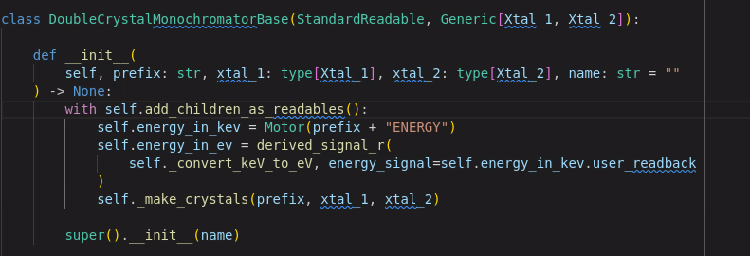
Simplified example: DCM
A DCM rarely looks exactly the same on multiple beamlines, but they do all have a settable energy and two crystals.
Most Bluesky plans only use the DCM to set energy, so can use the simple base class

Slide 16
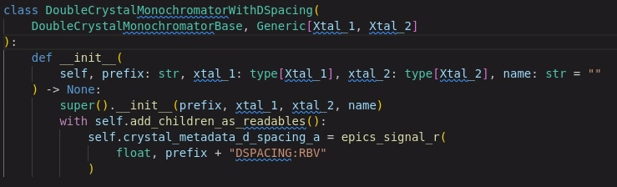
Simplified example: DCM
Plans which require more logic can build another DCM using this base
Wide inheritance >> flat inheritance

Slide 17
Bluesky standards at DLS: Plan composition
We have also made an effort to share plans across beamlines using composition
Steps to sharing a plan across beamlines:
Identify the fundamentals of the overall plan
Identify possible plan differences between beamlines
Where devices differ, use protocols for required types

Slide 18
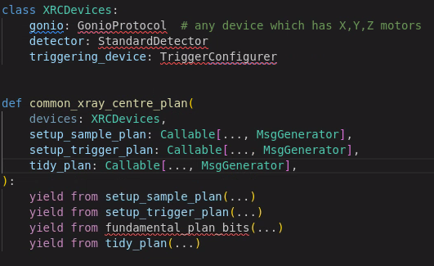
(Very) Simplified example: Xray centring plan
Plan fundamentals: Setup sample environment, setup triggering, arm detector + trigger motion script, wait for results
Plan differences: Implementations of some of the above, as well as optional features, experiment parameters, and lots more...

Slide 19
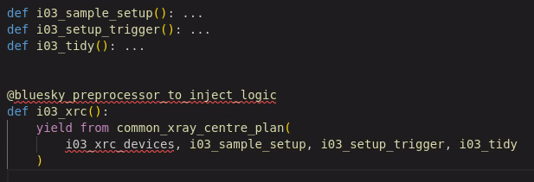
(Very) Simplified example: Xray centring plan
To get a beamline specific implementation we now just need to construct the beamline-specific bits.
One preprocessor example is to verify the undulator gap just before a run begins, in-case it has been affected by a beam dump.

