Slide 1
Expanding the BlueSKY Queue-Server use case to further experiment Control & Orchestration Systems
Linus Pithan and Udai Singh
DESY FS-EC

Slide 2



Slide 3
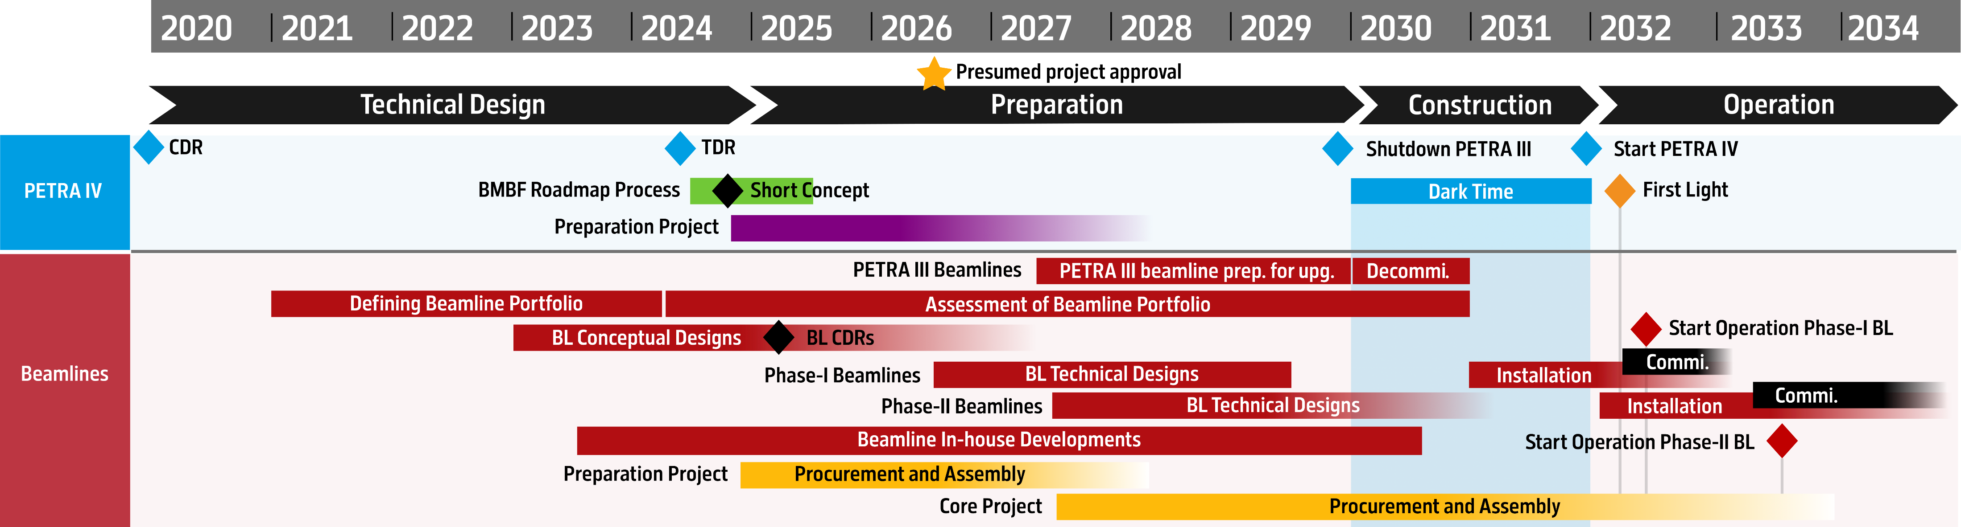



Slide 4

Mix & Match
Our motivation to look at the outside of the box:
We will run the Petra III beamlines with the exiting software stack for the next five years but want to start moving forward already today
For software developments that are yet to come we aim to define future-looking interfaces that for now will not narrow down our choices regarding the control software before the Petra IV project actually started
Traditionally using Tango BlueSky and it’s collaboration partners are “new” to us, so we aimed to explore possible bridges into the BlueSky eco-system. We consider this important, even if the facility might not be adopting BlueSky

Slide 5
In a Nutshell: What is the BlueSky QueueServer?
The BlueSky QueueServer automates the execution of BlueSky plans
Manages a queue of what is to be measured next
It provides and API-controlled environment for experiment control incl. access control and role management
Dual communication layer (ZeroMQ Messaging and HTTP RESTful)
Wraps around a “kernel” (think about ipython kernels that run on the server when you use Jupyter through the browser) … The BlueSky Run Engine runs in this kernel
https://blueskyproject.io/bluesky-queueserver/
Intended usage

Slide 6
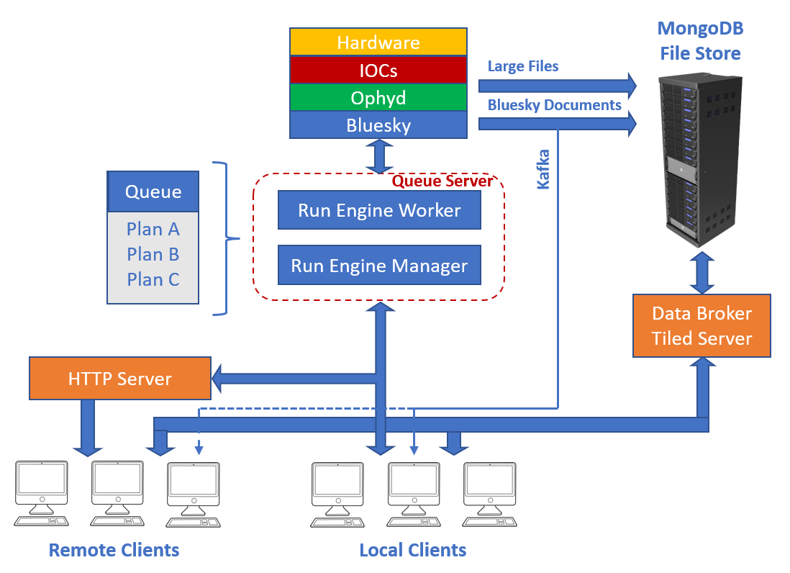
In a Nutshell: What is the BlueSky QueueServer?
Intended usage
Figure from https://blueskyproject.io/bluesky-queueserver/introduction_for_users.html

Slide 7


In a Nutshell: What is the BlueSky QueueServer?
QueueServer Process that exposes API
Worker Environment
HTTPS
ZeroMQ
user
Intended usage
Run Engine

Slide 8

In a Nutshell: What did we investigate?
We asked ourself: Why should the embedding API to communicate to the orchestrating engine be specific to one orchestration engine?
Want to evaluate: Is the QueueServer API generic enough to also wrap around other control systems?
QueueServer API
QueueServer API
QueueServer API
Worker Environment
Worker Environment
Worker Environment
…
Run Engine

Slide 9

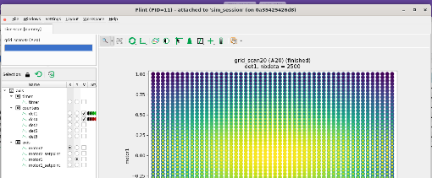


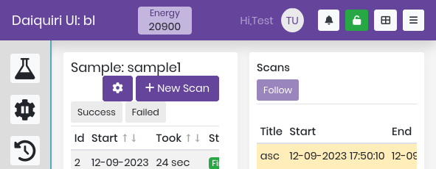
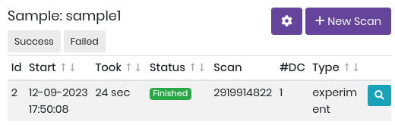
In a Nutshell: What did we investigate? … The RockIT setup at DESY
QueueServer
Data
Flint (Qt)
Daquiri (Web)
QueueServer API

Slide 10
In a Nutshell: What did we investigate? … How to port the RockIT interfaces to existing Petra III beamlines
QueueServer
Data
Flint (Qt)
Daquiri (Web)
QueueServer API

Slide 11
In a Nutshell: What did we investigate? … How to port the RockIT interfaces to existing Petra III beamlines
QueueServer
Maxwell / ASAP::O / processing workflows
or
Data
Qt GUIs (e.g. Flint)
or
Web-GUI and API for beamline control
QueueServer API

Slide 12

This is how far we got
Prototype QueueServer encapsulating Sardana (via Sarana-Door to MacroServer)
Successful usage for an demonstration experiment for Autonomous AI-based decision making (at P08 together with user group from Uni Tübingen)
https://gitlab.desy.de/fs-ec/queueserver/-/tree/sardana

