Slide 1
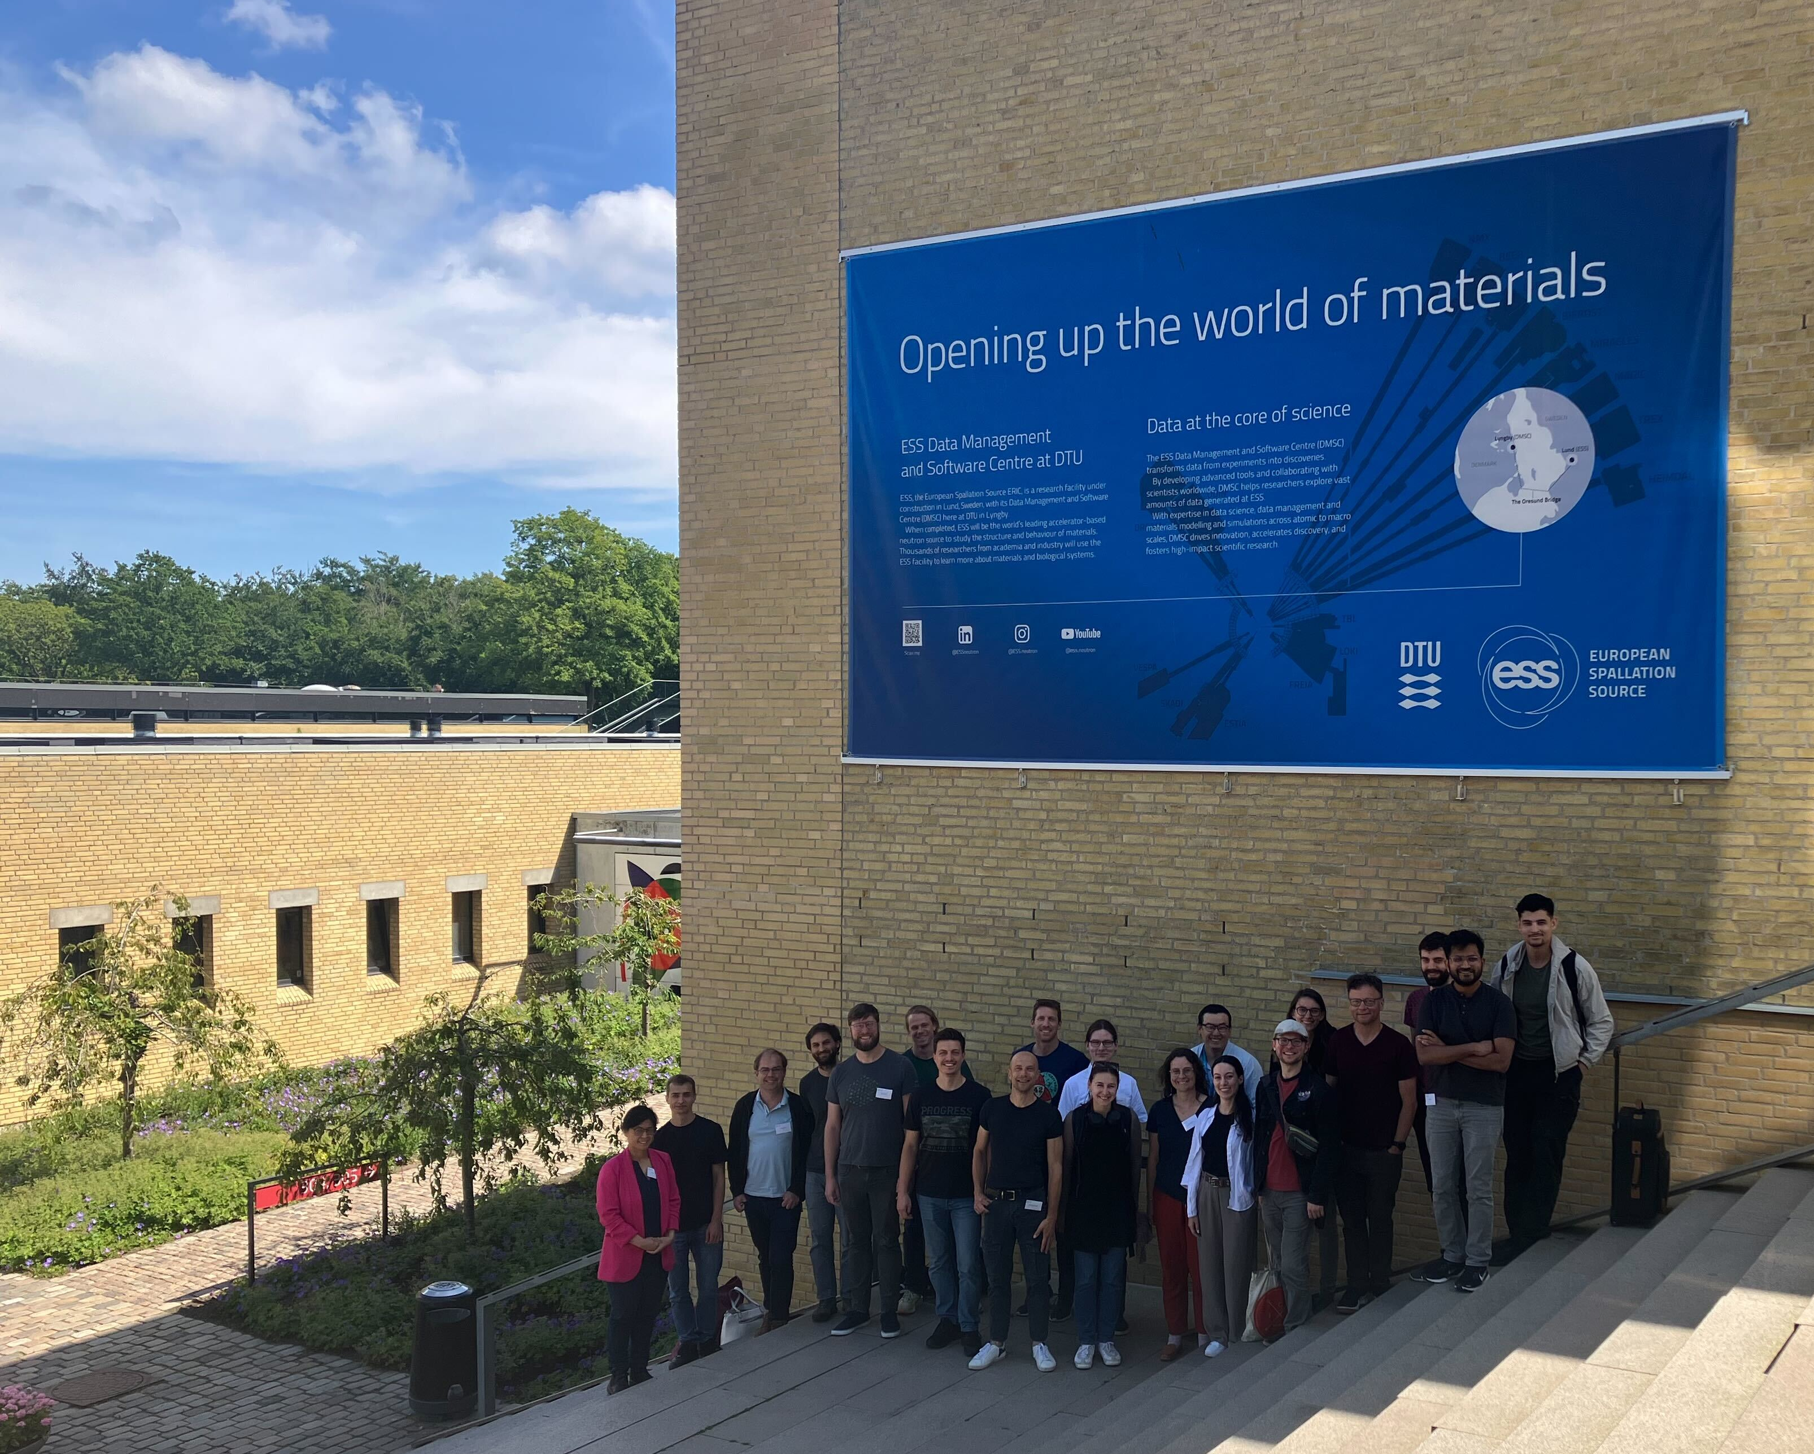
Highlights from SciCatCON2025
DTU, Lyngby, Denmark 24.06. – 26.06.2025
Thank You, Max and ESS, for hosting SciCatCON2025!
Regina Hinzmann
SCT 2025-07-07

Slide 2
SciCatCON2025 – Annual face2face meeting of SciCat collaboration
DTU, north of Copenhagen hosted by ESS
Programme: https://indico.ess.eu/event/3731/overview
Overview of latest developments
11 facility updates (3 by DAPHNE LSFs)
2 hands on sessions with goal: definition of next years roadmap.
Keynote and user feedback talks
Main results :
DAPHNE contribution to SciCat lead to many beneficial code improvments on project level.
Governance of SciCat: Collaboration has grown, need organisational structure to manage development and ensure continuity.
hands-on/brainstorming sessions covered several topics, notes on Google Doc:
0. Project governance
Mono repo
Dataset lifecycle
UI/IX efforts
data ingestion
API v3 vs API v4
Documentation
Published data workflow
Customized dataset detailed view
9. Permissions management
10. Selection (former: cart)
11. Actions
12. History sub system (PR)
13. Performance
14. Security

Slide 3
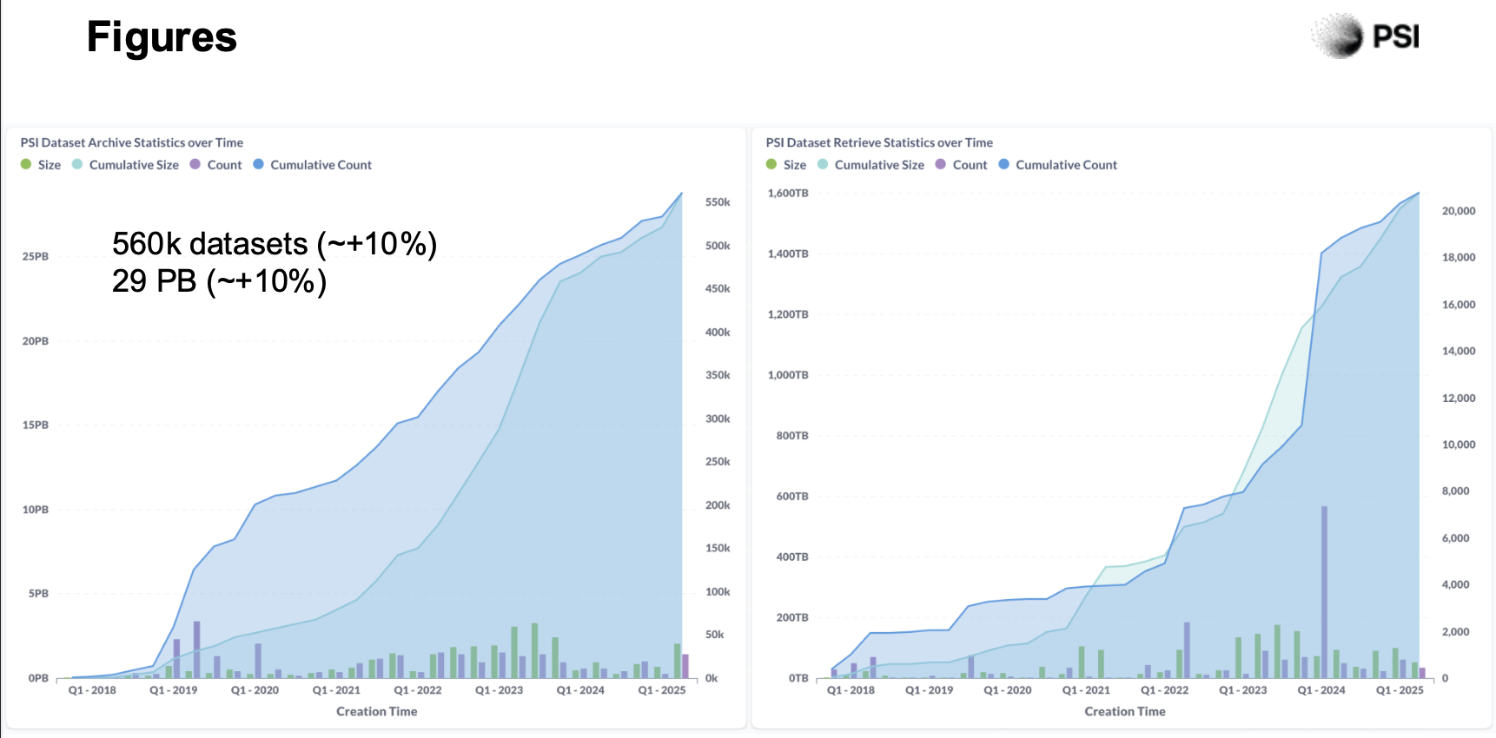
SciCatCON2025 – Annual face2face meeting of SciCat collaboration
The PSI case
SciCat@PSI (from Carlos and Spencer’s talk/conversations)
They produce 29 PB of data and use a single SciCat instance for management.
You login when you want to work with embargoed data.
After embargo period is over a job launches an automated switch to “isPublic=true”.
User can mint DOIs through dataset selection.
Ingestion happens differently for beamlines, in some cases live in some after data-taking so users make sure to have some curative steps discovery.psi.ch and doi.psi.ch
SOLEIL
They have a data policy but their challenge is to make the user at the beamline use SciCat.
Their interest is in the data to be taken, are currently in preparation/upgrade phase.
MaxIV
Use SciCat for each beamline in production
Get many user complaints
ALS
Plan 1 PB/day…

