Slide 1

Thermodynamically modified theories of Newtonian gravity
Máté Pszota

Slide 2
Overview
A generalised derivation of a gradient modification of Newtonian gravity within a thermodynamic framework
Modified gravities and their possible applications
Notes:
An extension of standard nonequilibrium thermodynamics is presented, where the gravitational potential is a thermodynamic state variable,
Standard and rigorous methods of Rational Mechanics and nonequilibrium thermodynamic framework allow a set of evolution equations to be derived for the gravitational field and the derivation of thermodynamic forces and fluxes.
The method effectively substitutes variational principles for ideal systems without dissipation, and provides the evolution equations for dissipative continua at the same time.
An important aspect of this framework is the application of $β$-, or thermometer flow-frame, i.e. tying the flow of the continuum, the flow-frame, to the temperature four-vector, compared to the usual Landau-Lifshitz (or energy) or Eckart (conserved particle) flow-frames, which have been proved unstable.
With certain straightforward assumptions for the gravitating system, a nondissipative gravitational field equation can be derived in the form of a modified Poisson equation
Analytical solutions show a double crossover, allowing for different gravitational behaviour on different size scales (S. Abe & P. Ván, Symmetry 2022, 14, 1048(7)).
This property presents a possible approach to explain Dark Matter-related phenomena on galactic scales, and different dynamics on extragalactic scales.
A direct connection to quantum mechanics is presented, as well, (P. Ván, Physics of Fluids, (2023) 35(5).).

Slide 3
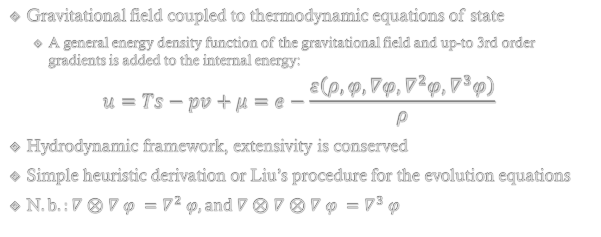
Gravitation and thermodynamics
Gravitational field coupled to thermodynamic equations of state
A general energy density function of the gravitational field and up-to 3rd order gradients is added to the internal energy:
$$u=Ts−pv+μ=e−\frac{ε\left(ρ,φ,∇φ,∇^{2}φ, ∇^{3}φ\right)}{ρ}$$
Hydrodynamic framework, extensivity is conserved
Simple heuristic derivation or Liu’s procedure for the evolution equations
N$.b.:∇⊗∇ φ =∇^{2} φ, and ∇⊗∇⊗∇ φ =∇^{3} φ$
VÁN and ABE, Physica A: Statistical Mechanics and its Applications, 588:126505
VÁN, Physics of Fluids 35, 057105 (2023)
Notes:
Nemrelativisztikus kapcsolat a grav + thermo közt új dolog (relativisztikusan nehéz, mint látni fogjuk)
Dissipative field equation is obtained
Stationary solution can be derived with given density distribution

Slide 4
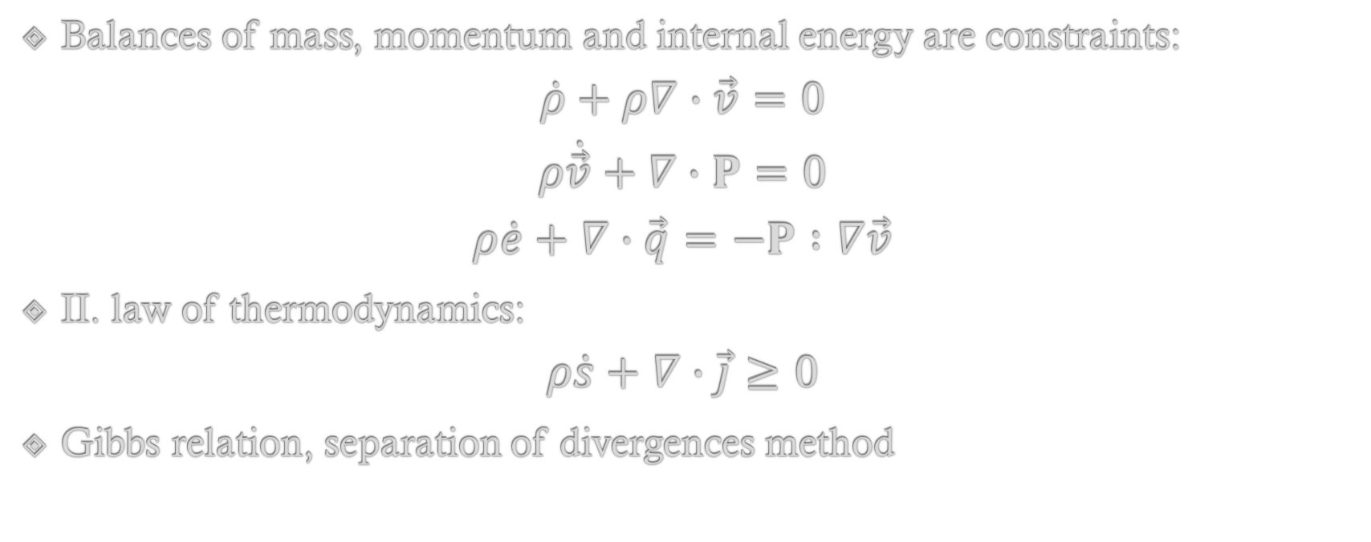
Gravitation and thermodynamics
Balances of mass, momentum and internal energy are constraints:
$$\dot{ρ}+ρ∇∙\vec{v}=0$$
$$ρ\dot{\vec{v}}+∇∙P=0$$
$$ρ\dot{e}+∇∙\vec{q}=−P∶∇\vec{v}$$
II. law of thermodynamics:
$$ρ\dot{s}+∇∙\vec{j}≥0$$
Gibbs relation, separation of divergences method
Notes:
j – conductive entropy current (entropy flux)
(s pont) – specific entropy rate
Egyenlőtlenség bal oldala – entropy production density rate

Slide 5
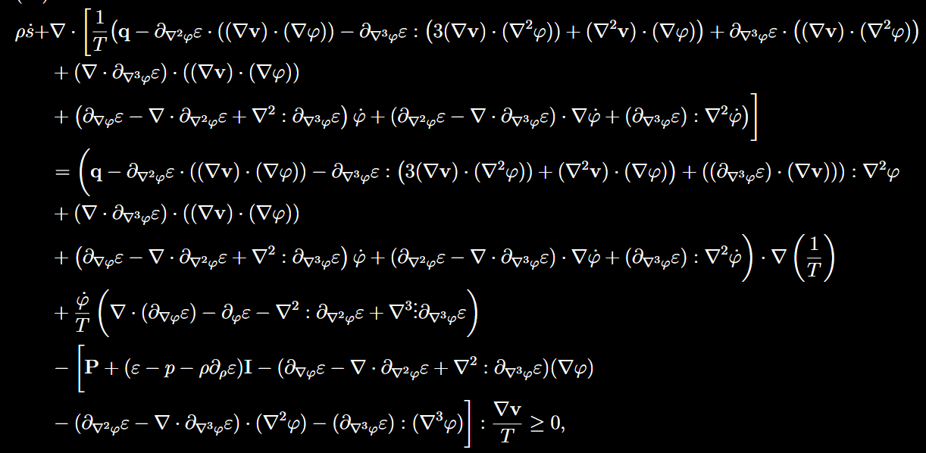
Full entropy balance
Poisson’s equation!

Slide 6
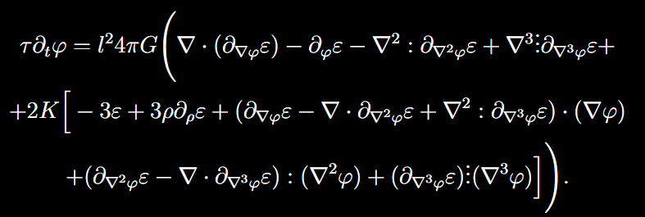



Gravitation and thermodynamics
Cross-effect can arise between 2 of the resulting constitutive equations, and a dissipative field equation for gravity can be derived assuming negligible pressure terms:
$$\dot{φ}=l_{1}\left(\frac{∆φ}{4πG}−ρ\right)+l_{12}∇∙\vec{v}$$
$\frac{∂φ}{∂t}=\frac{l^{2}}{τ}\left(∆φ−4πGρ+\frac{l_{12}}{6det\left(L\right)}{\left(∇φ\right)}^{2}\right)$,
where $K∶=\frac{l_{12}}{6det\left(L\right)}$, and classical holography holds:
Notes:
Jó modellezési tulajdonságok (meglepő eredmény asztrofizikusan)
(Hidrodinamikai keret)
Chandrashekar – dynamic viscosity

Slide 7
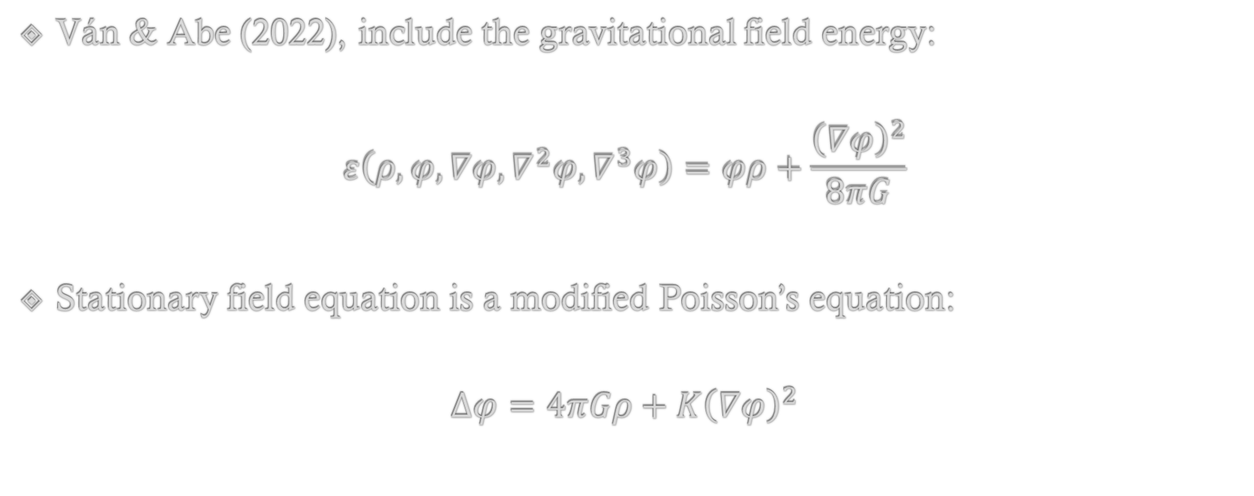
Standard thermodynamic gravity
Ván & Abe (2022), include the gravitational field energy:
$$ε\left(ρ,φ,∇φ,∇^{2}φ, ∇^{3}φ\right)=φρ+\frac{{\left(∇φ\right)}^{2}}{8πG}$$
Stationary field equation is a modified Poisson’s equation:
$$∆φ=4πGρ+K{\left(∇φ\right)}^{2}$$

Slide 8
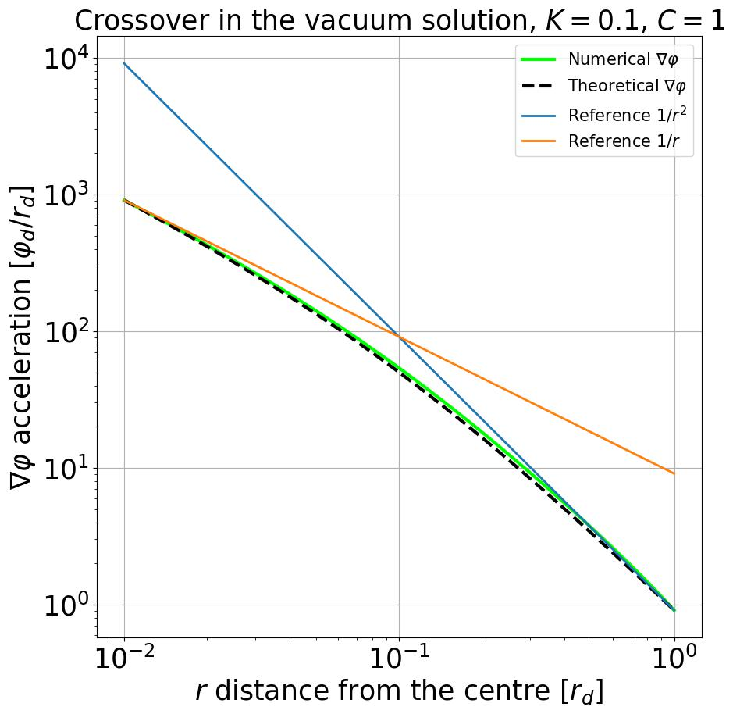
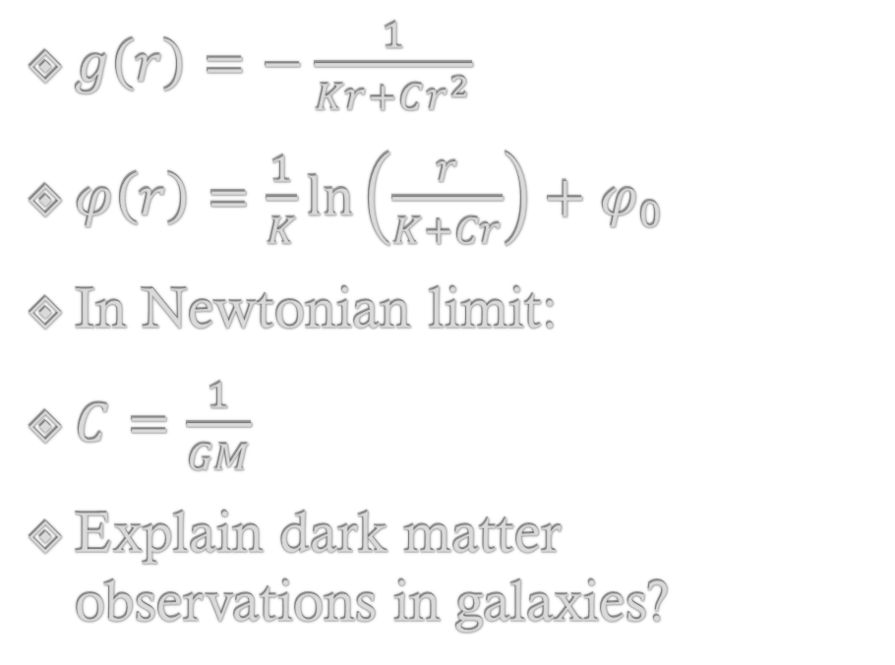
Vacuum solution
$g\left(r\right)=−\frac{1}{Kr+Cr^{2}}$
$φ\left(r\right)=\frac{1}{K}\ln\left(\frac{r}{K+Cr}\right)+φ_{0}$
In Newtonian limit:
$C=\frac{1}{GM}$
Explain dark matter observations in galaxies?
ABE and VÁN, Symmetry 2022, 14(5), 1048

Slide 9
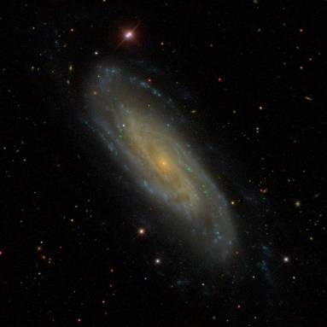
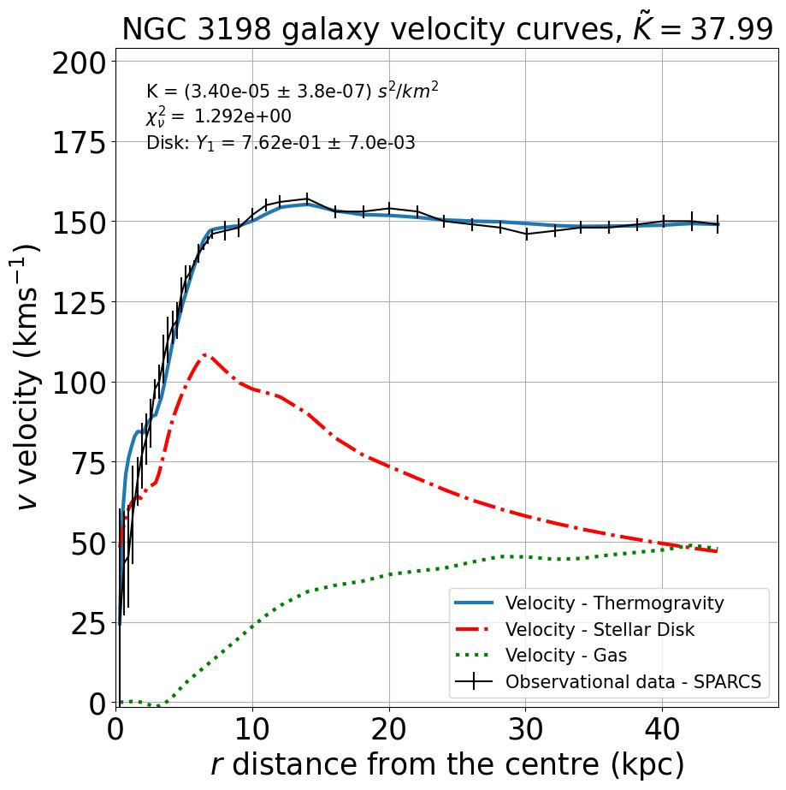
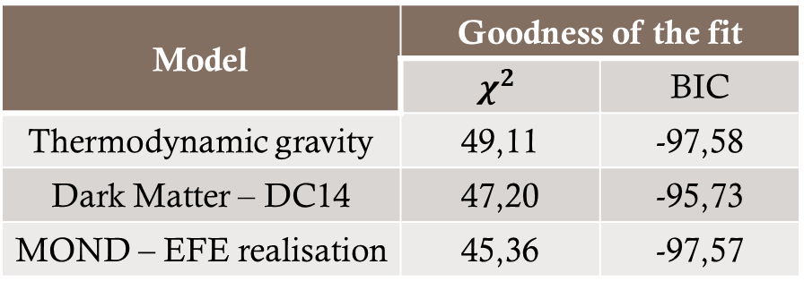
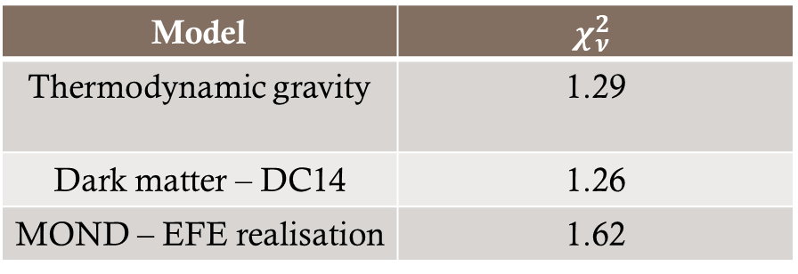
Galactic rotation curves
NGC 3198
Source: Sloan Digital Sky Survey
Thermodynamic gravity applied to observed density distributions
Comparable results to Dark Matter or MOND approaches (DOI 10.1016/j.dark.2024.101660):
Fewer parameters, but
Model | $$χ_{ν}^{2}$$
Thermodynamic gravity | 1.29
Dark matter – DC14 | 1.26
MOND – EFE realisation | 1.62
Model | Goodness of the fit
 | $$χ^{2}$$ | BIC
Thermodynamic gravity | 49,11 | -97,58
Dark Matter – DC14 | 47,20 | -95,73
MOND – EFE realisation | 45,36 | -97,57

Slide 10
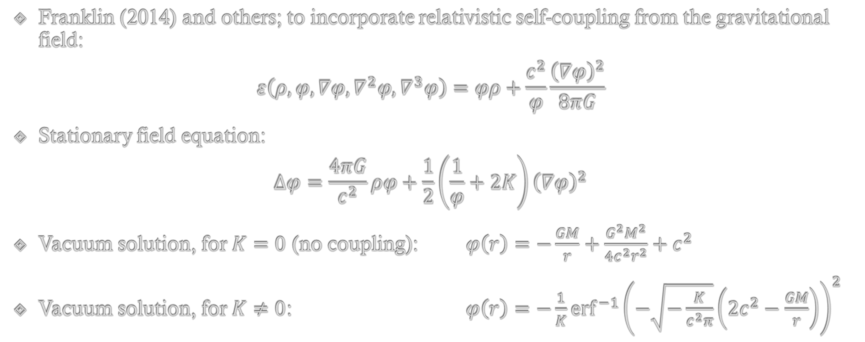
Self-consistent, self-coupled scalar gravity
Franklin (2014) and others; to incorporate relativistic self-coupling from the gravitational field:
$$ε\left(ρ,φ,∇φ,∇^{2}φ, ∇^{3}φ\right)=φρ+\frac{c^{2}}{φ}\frac{{\left(∇φ\right)}^{2}}{8πG}$$
Stationary field equation:
$$∆φ=\frac{4πG}{c^{2}}ρφ+\frac{1}{2}\left.\left(\frac{1}{φ}+2K\right.\right){\left(∇φ\right)}^{2}$$
Vacuum solution, for $K=0$ (no coupling): $φ\left(r\right)=−\frac{GM}{r}+\frac{G^{2}M^{2}}{4c^{2}r^{2}}+c^{2}$
Vacuum solution, for $K≠0$: $φ\left(r\right)=−\frac{1}{K}{erf}^{−1}{{\left.\left(−\sqrt{−\frac{K}{c^{2}π}}\left.\left(2c^{2}−\frac{GM}{r}\right.\right)\right.\right)}^{2}}$

Slide 11
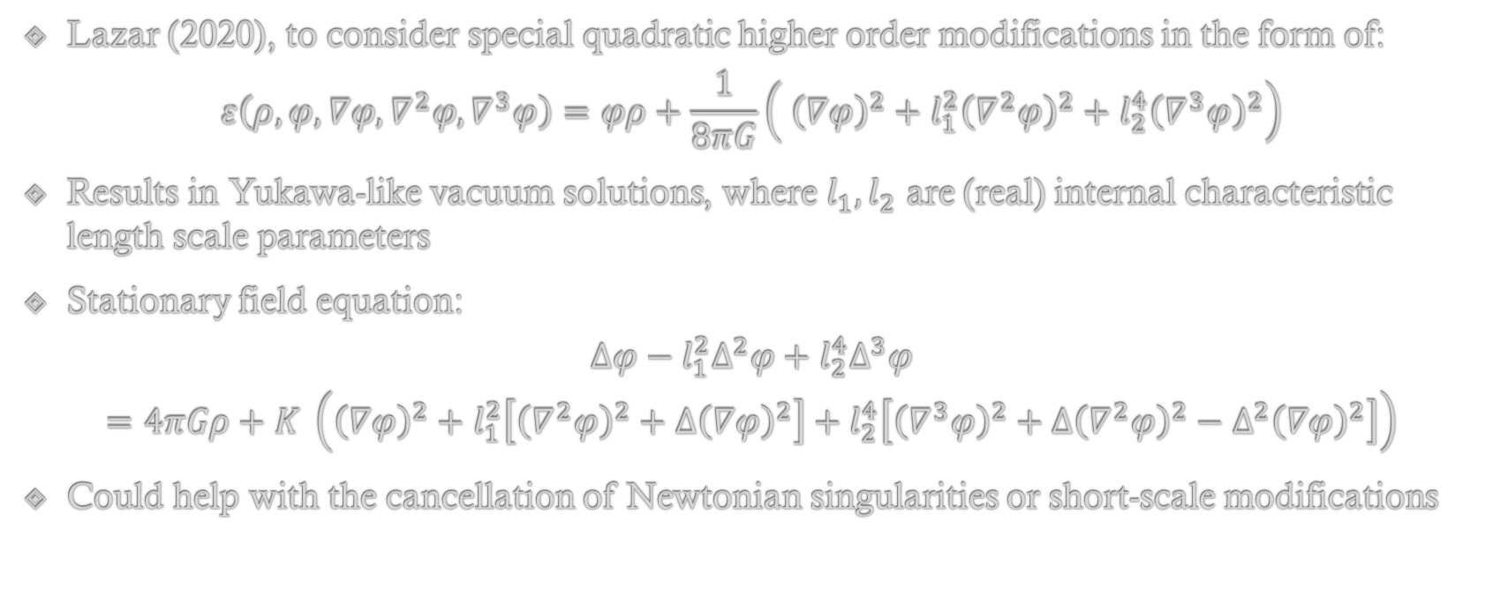
Gradient modified gravity
Lazar (2020), to consider special quadratic higher order modifications in the form of:
$$ε\left(ρ,φ,∇φ,∇^{2}φ, ∇^{3}φ\right)=φρ+\frac{1}{8πG}\left.\left( {\left(∇φ\right)}^{2}+l_{1}^{2}{\left(∇^{2}φ\right)}^{2}+l_{2}^{4}{\left(∇^{3}φ\right)}^{2}\right.\right)$$
Results in Yukawa-like vacuum solutions, where $l_{1},l_{2}$ are (real) internal characteristic length scale parameters
Stationary field equation:
$$Δφ−l_{1}^{2}Δ^{2}φ+l_{2}^{4}Δ^{3}φ$$
$$=4πGρ+K \left.\left({\left(∇φ\right)}^{2}+l_{1}^{2}\left.\left[{\left(∇^{2}φ\right)}^{2}+Δ{\left(∇φ\right)}^{2}\right.\right]+l_{2}^{4}\left.\left[{\left(∇^{3}φ\right)}^{2}+Δ{\left(∇^{2}φ\right)}^{2}−Δ^{2}{\left(∇φ\right)}^{2}\right.\right]\right.\right)$$
Could help with the cancellation of Newtonian singularities or short-scale modifications

Slide 12
Summary
Non-equilibrium thermodynamics provides a solid foundation for studying modifications to Newtonian gravity
The theories can represent theoretically justified alternative weak-field limits of any generalized General Relativity theories
Thermodynamic gravity and other similar modifications offer a possibility of describing dynamics on galactic scales
Hydrodynamic description can be a thermodynamic link between QM and gravity
Notes:
Új gravitációs modell – új predikciókat ad
ÉS kapcsolódási pont a QM-el – egységes leírásban vannak

Slide 13
Thank you for your attention!
Main references:
Peter Ván and Sumiyoshi Abe. Emergence of extended Newtonian gravity from thermodynamics. Physica A: Statistical Mechanics and its Applications, 588:126505, 2022
Joel Franklin. Self-consistent, self-coupled scalar gravity. American Journal of Physics, 83:332–337, 2014.
Lazar, M. Gradient modification of Newtonian gravity. Phys. Rev. D. 102, 096002 (2020,11)
S. Abe and P. Ván. Crossover in Extended Newtonian Gravity Emerging from Thermodynamics. Symmetry, 14(5), 2022
M. Pszota and P. Ván. Field equation of thermodynamic gravity and galactic rotational curves. DOI 10.1016/j.dark.2024.101660, Physics of the Dark Universe, (arXiv:2306.01825v3)

Slide 14
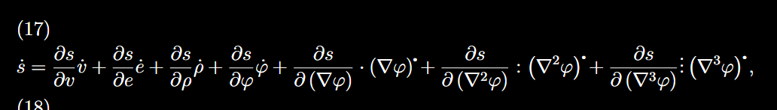

Thermodynamic derivation in depth
Derive from the Gibbs-relation the full differential of the entropy:
Use it to rewrite the time derivative of the entropy:

Slide 15
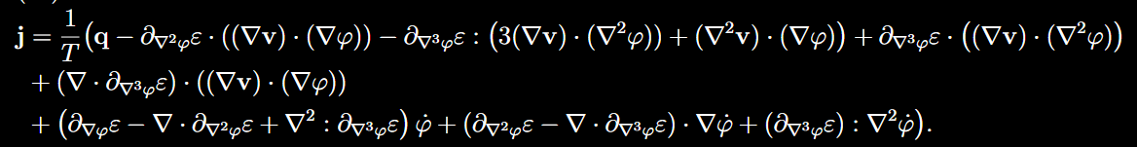
Thermodynamic derivation in depth
This allows us to rewrite the entropy balance with the separation of divergences
The entropy flux will be:

Slide 16
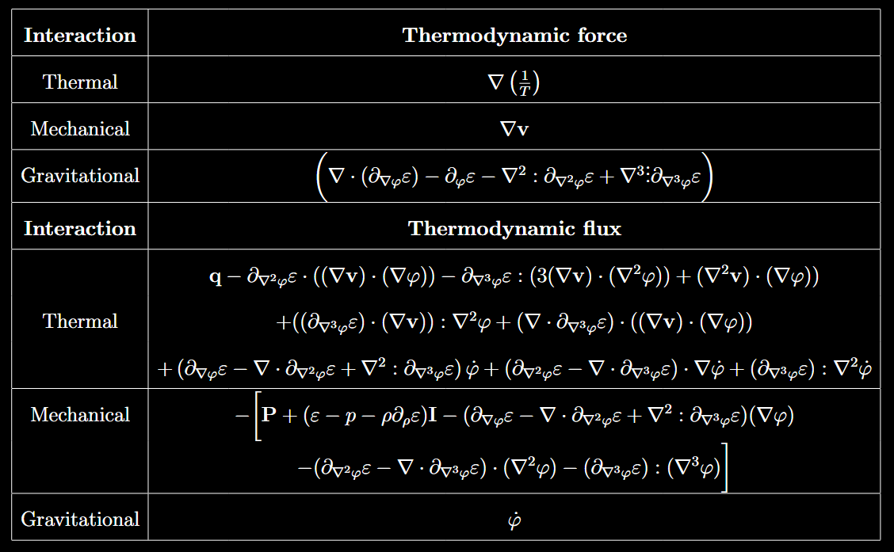
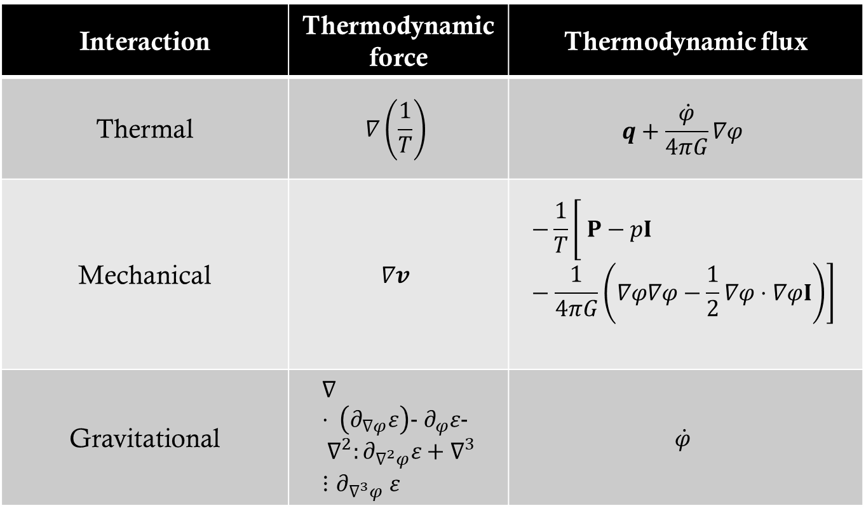
Thermodynamic forces and fluxes
Interaction | Thermodynamic force | Thermodynamic flux
Thermal | $$∇\left.\left(\frac{1}{T}\right.\right)$$ | $$q+\frac{\dot{φ}}{4πG}∇φ$$
Mechanical | $$∇v$$ | $$−\frac{1}{T}\left.\left[ P−pI−\frac{1}{4πG}\left.\left(∇φ∇φ−\frac{1}{2}∇φ⋅∇φI\right.\right)\right.\right]$$
Gravitational | $$∇⋅ \left(∂_{∇φ}ε\right)− ∂_{φ}ε− ∇^{2}:∂_{∇^{2}φ}ε+∇^{3}⋮∂_{∇^{3}φ} ε$$ | $$\dot{φ}$$
Notes:
Lineáris és izotróp kapcsolat a mechanikai és gravitációs tagok közt

Slide 17
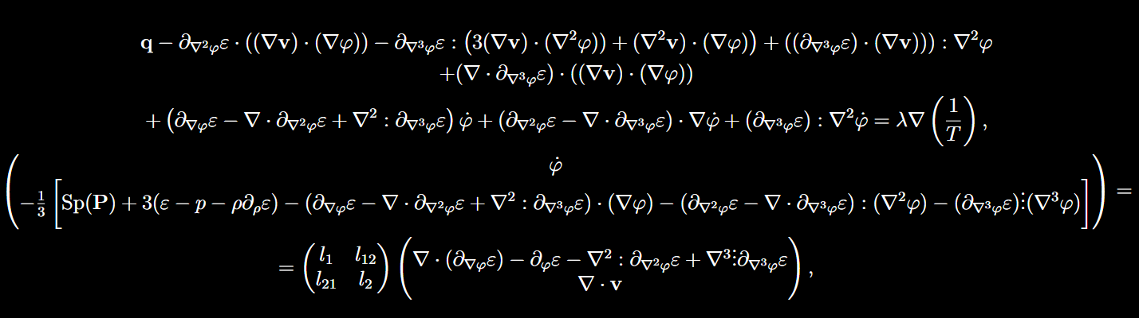



Onsagerian constitutive relations
$$q+\frac{\dot{φ}}{4πG}∇φ=λ∇\left(\frac{1}{T}\right)=−λ_{F}∇T$$
$$\dot{φ}=l_{1}\left(\frac{Δφ}{4πG}−ρ\right)+l_{12}∇⋅v$$
$$\frac{1}{3}\text{Sp}\left(P\right)−p+\frac{∇φ⋅∇φ}{24πG}=l_{21}\left(\frac{Δφ}{4πG}−ρ\right)+l_{2}∇⋅v$$
$$P−\text{Sp}\left(P\right)\frac{I}{3}−\frac{1}{4πG}\left(∇φ∇φ−\frac{1}{3}{\left(∇φ\right)}^{2}I\right)=−η\left(∇v+{\left(∇v\right)}^{T}−\frac{2}{3}∇⋅vI\right)$$
Notes:
Nemdisszipatív esetre is információt adnak a formulák
Fejlődési egyenletet tud adni a themo. a gravitációra
Eta – sheer viscosity
3. + 4. egyenlet a gravitáció nélkül a Navier-Stokes egyenlethez vezet
Nagy P – Newtoinian pressure tensor

Slide 18
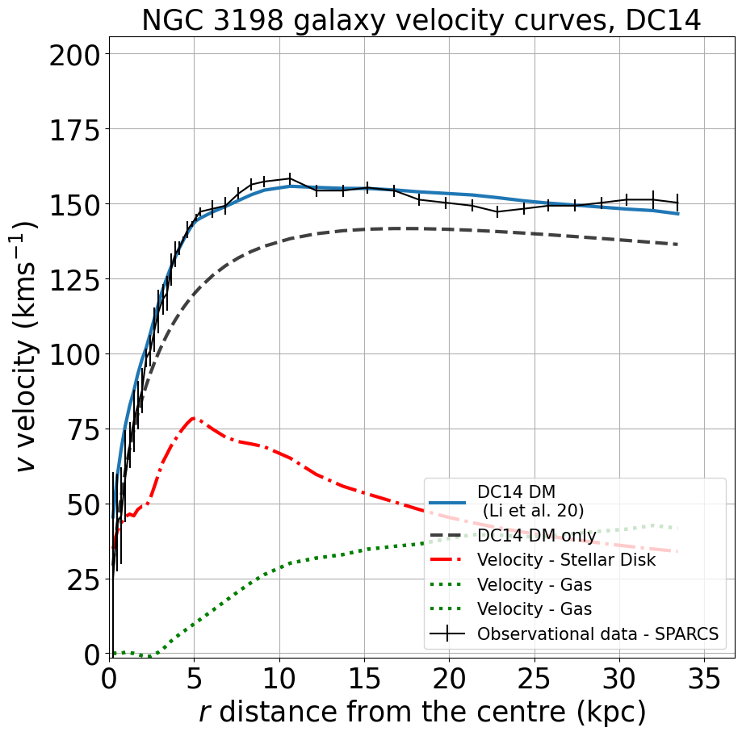
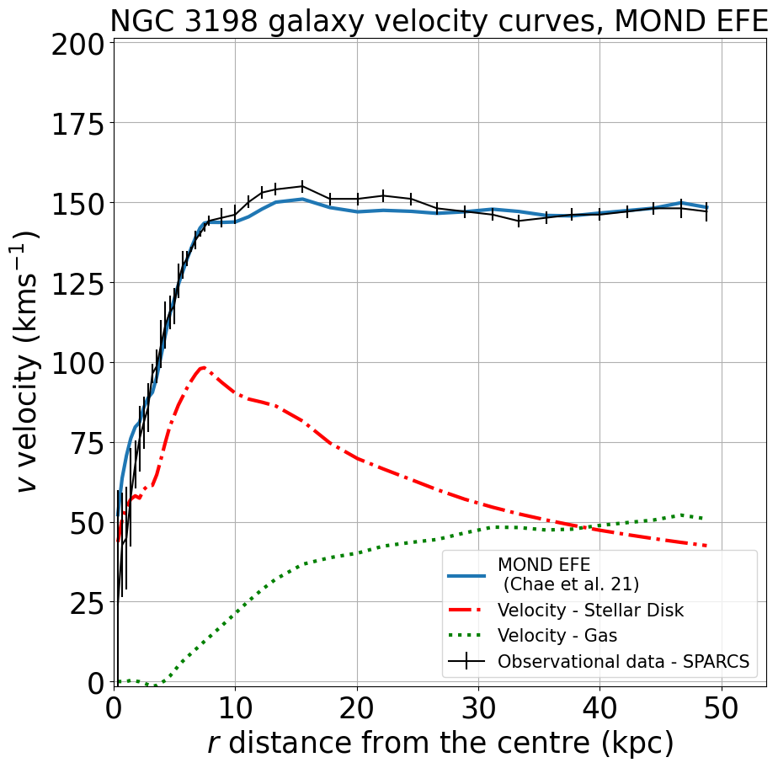
NGC 3198
Source: Sloan Digital Sky Survey
NGC 3198 velocity curves

