Slide 1


Electron Beam Dump Simulation
Report on: Dose rate at Q = 1 nC, Nuclei Charts
Sergii Vasiukov
ELBEX meeting
16.07.2025
https://indico.desy.de/event/50043/

Slide 2
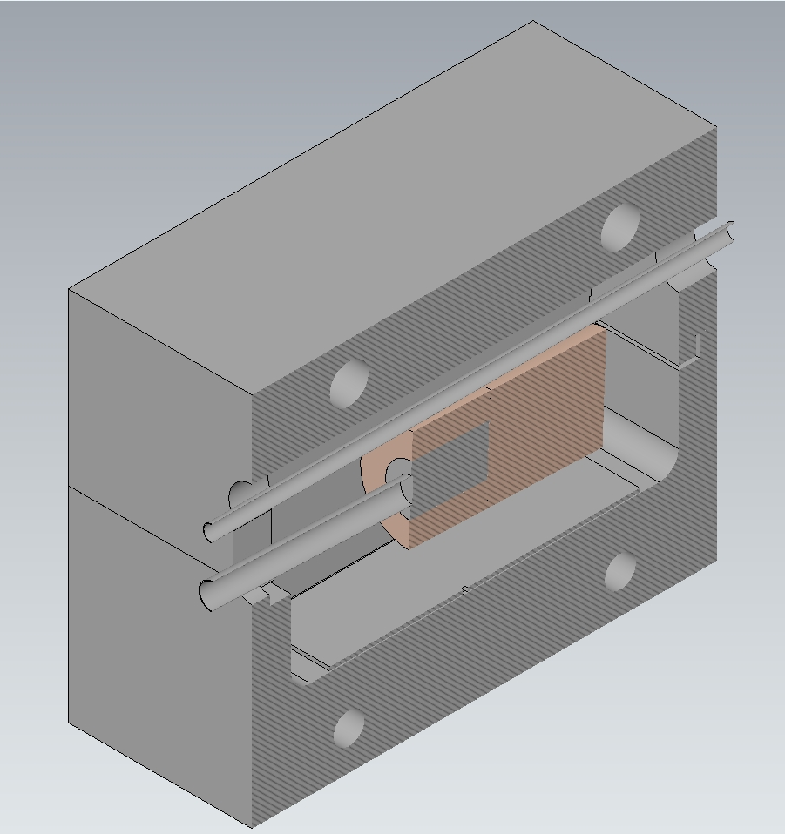
BEAM DUMP: Geometry and Model Components
Reg_3
Element | Dimensions, mm | Material | Model region
Top Concrete Shield (TCS) | 950 x 1200 x h530 | Concrete Portland | Reg_3
Bottom Concrete Shield (BCS) |  | Concrete Portland | Reg_5
Copper back | D260 x L300 | Copper | Reg_1
Copper shield | D260, d130, L200 | Copper | Reg_4
Beam Transport Pipe (BTP) | Di40, De43 | Steel | Reg_2
Metal plate | W400, L800, t10 | Steel | Reg_8
Beam Dump Core (BDC) | D130, L200 | Aluminum | Reg_7
Beam Exit Pipe (BEP) | Di63, De67 | Aluminum | Reg_6
Reg_4
Reg_1
Reg_2
Reg_7
Reg_8
Reg_6
Reg_5

Slide 3
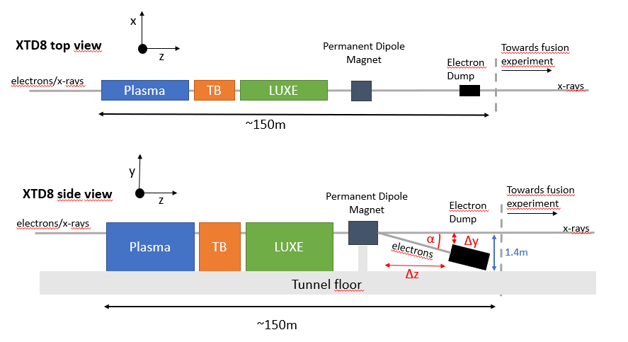
Requirements for ELBEX main electron beam dump (14.05.2025)
The main electron dump is placed at the end of the ELBEX user beamline located in XTD8. The electron beam is bent downwards towards the dump with a permanent dipole magnet (see sketch). The dump is placed at an angle α and at a distance Δz from the permanent magnet such that sufficient space Δy remains between the dump and the X-ray beam pipe going at a height of 1.4m above the tunnel floor straight towards the fusion area and the Schenefeld hall.
Parameter | Value
Maximum Beam Energy | 40 GeV
Maximum number of bunches extracted per train to XTD8 | 50
Repetition rate | 10 Hz
Maximum bunch charge | 1 nC
Intra-train bunch spacing | 220 ns
Beam intensity = 6.24 x 10¹⁸ x 10⁻⁹ x 10 x 50 = 3.12 x 10¹² e⁻ per sec → 6.24 x 10¹⁰ e⁻ per sec

Slide 4
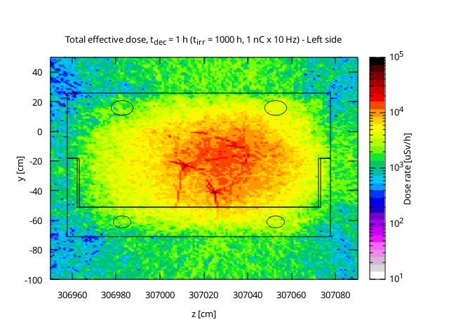
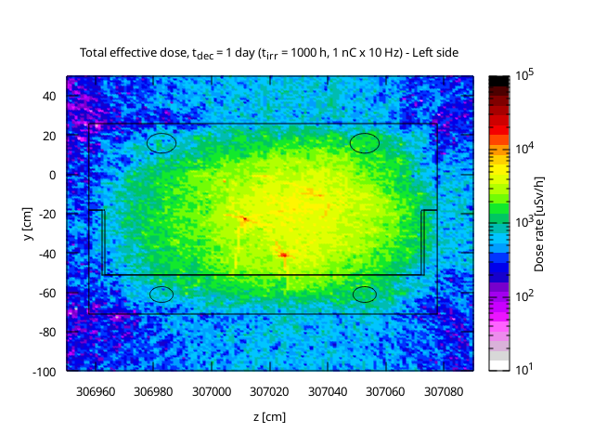
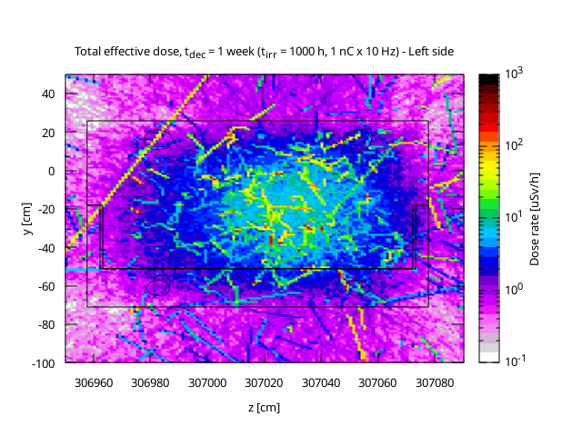
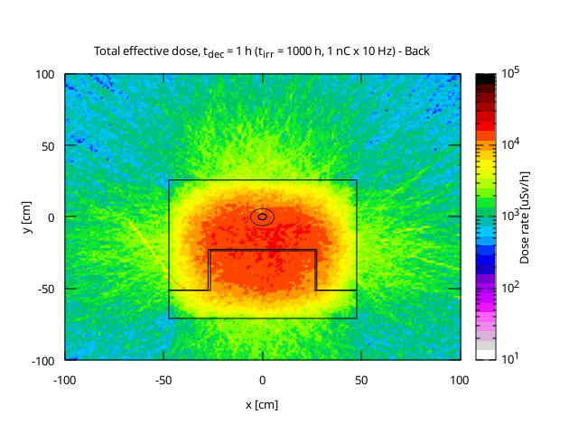
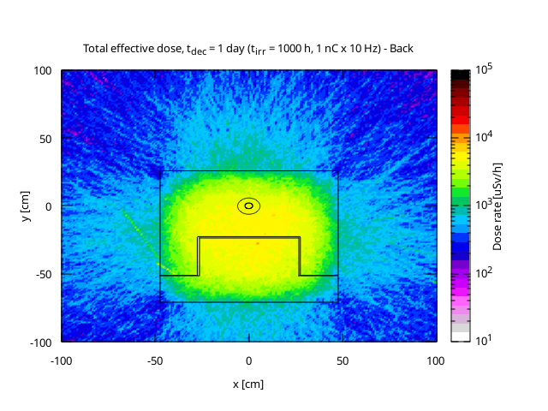
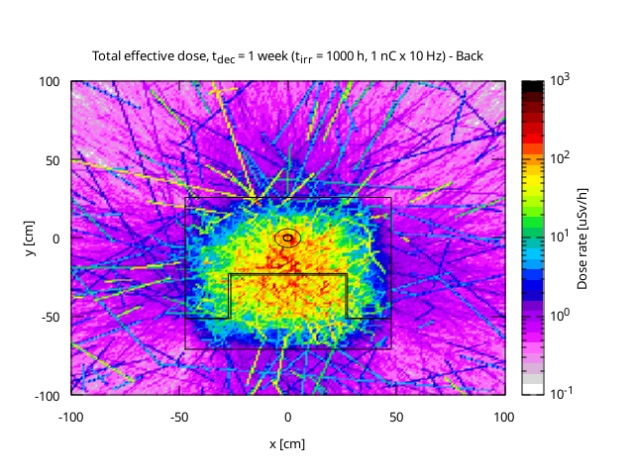
Residual Decay
1 hour
1 day
1 week

Slide 5
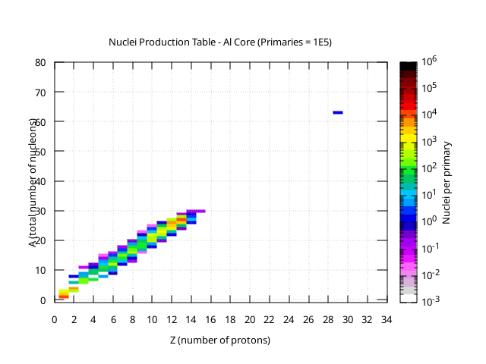
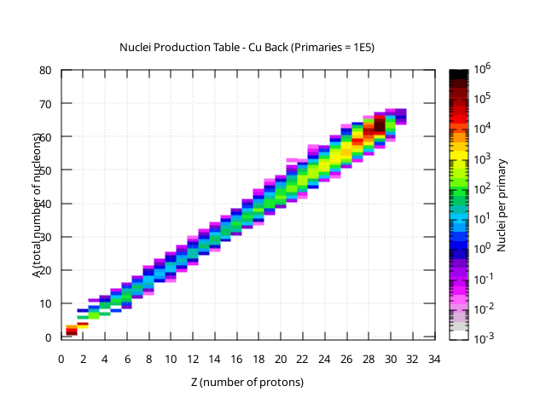
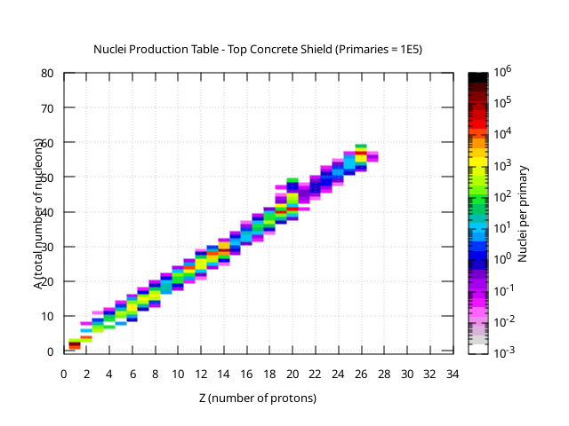
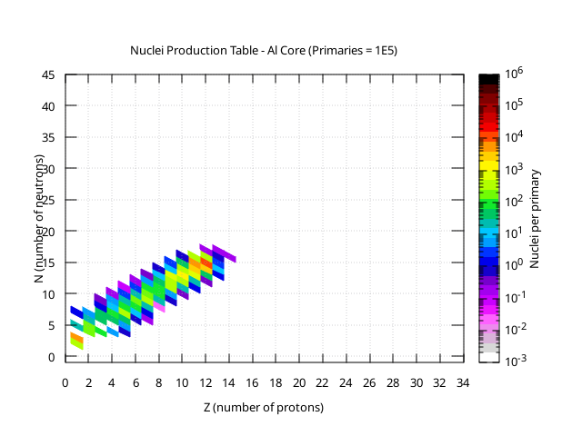
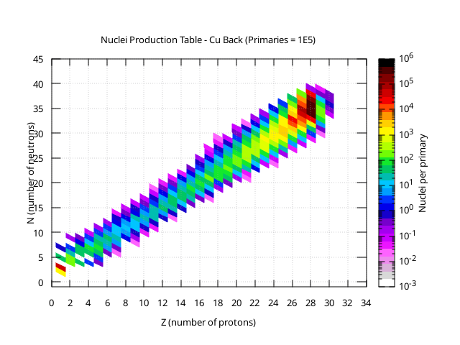
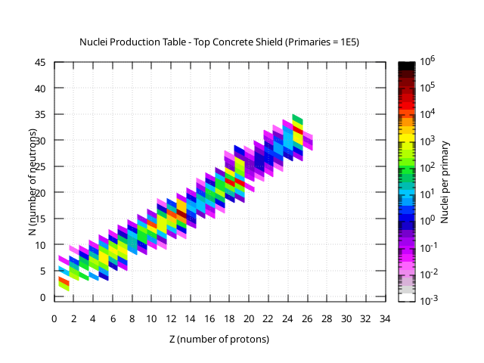
Nuclei Production: Nuclide Charts
Al core
Cu back
Concrete shield

Slide 6
Hazardous Isotopes: Z = 1–30
Z | A | N | Element | Isotope | Notes
1 | 3 | 2 | Hydrogen | H-3 | Tritium, β-emitter, long-lived (12.3 y)
3 | 6 | 3 | Lithium | Li-6 | Used in fusion, neutron absorber
4 | 10 | 6 | Beryllium | Be-10 | Long-lived, α-emitter
11 | 22 | 11 | Sodium | Na-22 | γ-emitter, T₁/₂ = 2.6 y
13 | 28 | 15 | Aluminium | Al-28 | Short-lived β⁻ emitter
17 | 36 | 19 | Chlorine | Cl-36 | Very long-lived, β⁻ emitter
18 | 41 | 23 | Argon | Ar-41 | γ-emitter, short-lived (1.8 h)
19 | 40 | 21 | Potassium | K-40 | β and γ-emitter
23 | 48 | 25 | Vanadium | V-48 | β⁺ and γ-emitter, T₁/₂ = 16 days
24 | 51 | 27 | Chromium | Cr-51 | γ-emitter
25 | 54 | 29 | Manganese | Mn-54 | Strong γ-emitter, T₁/₂ = 312 days
26 | 55 | 29 | Iron | Fe-55 | X-ray emitter, long-lived
27 | 60 | 33 | Cobalt | Co-60 | High γ emitter
28 | 63 | 35 | Nickel | Ni-63 | β-emitter
30 | 65 | 35 | Zinc | Zn-65 | High γ emitter

Slide 7
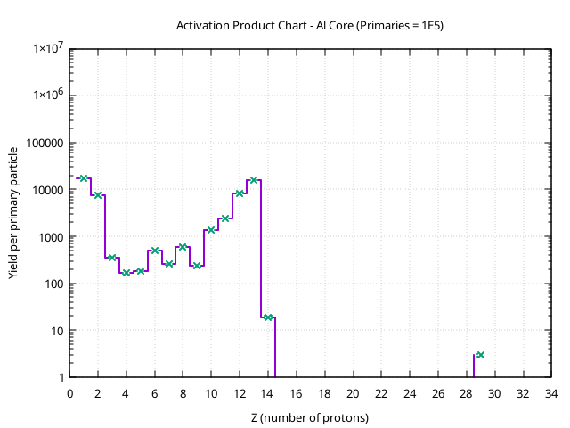
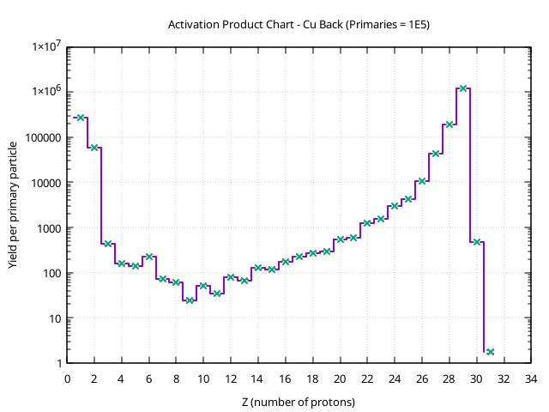
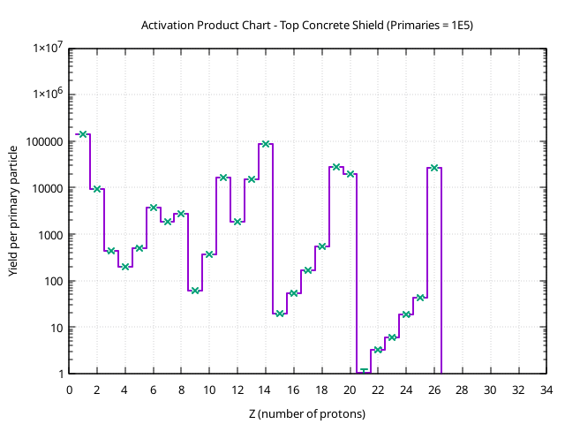
Nuclei Production
Cu Back (Region 7) shows higher residual nuclei production, including Zn-65 and Co-60, which are long-lived gamma emitters with significant radiological impact.
Top Concrete Shield (Region 3) shows a consistent reduction (~55–65%) in yield for all relevant isotopes.
Co-60 and Zn-65 are the most concerning due to their half-lives and gamma emission — more shielding is needed. Stainless steel is one of the options.

Slide 8
Energy Deposited for ANSYS simulation
IN PROGRESS…
https://gitlab.cern.ch/SY_STI_TCD/Fluka-to-ansys-tables
Fluka To Ansys Tables
Script to convert Fluka energy deposition files to a loadable power table by Ansys Mechanical, CFX and Fluent tools of Ansys. The script allows scaling based on beam intensity and pulse length, coordinate transformation and total power calculation.

Slide 9
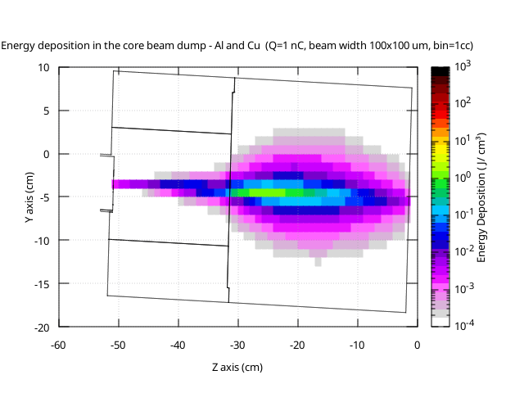
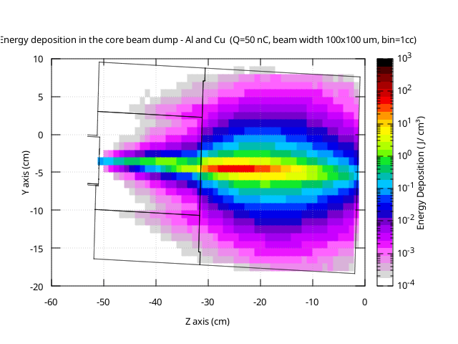
Energy Deposited for ANSYS simulation
1 GeV = 1.602e-10 J
1 C = 6.24 x 1e18 e-
IN PROGRESS…
Norm factor = 1.602 x 1e-10 x 6.24 x 1e9
Norm factor = 1.602 x 1e-10 x 6.2 x 1e9 x 50

Slide 10
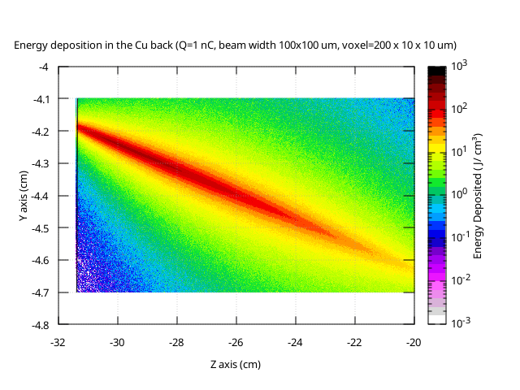
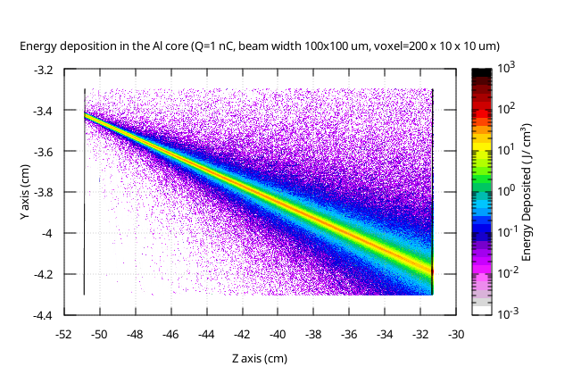
Radiation Resistance of materials
IN PROGRESS…
Al core
Cu back

Slide 11
Thank you for attention
INFN Padova
Sergii Vasiukov
16.07.2025

Slide 12
BACK UP

Slide 13
BEAM DUMP: Geometry and Model Components
Reg_3
Element | Dimensions, mm | Material | Model region
Top Concrete Shield (TCS) | 950 x 1200 x h530 | Concrete Portland | Reg_3
Bottom Concrete Shield (BCS) |  | Concrete Portland | Reg_5
Copper back | D260 x L300 | Copper | Reg_1
Copper shield | D260, d130, L200 | Copper | Reg_4
Beam Transport Pipe (BTP) | Di40, De43 | Steel | Reg_2
Metal plate | W400, L800, t10 | Steel | Reg_8
Beam Dump Core (BDC) | D130, L200 | Aluminum | Reg_7
Beam Exit Pipe (BEP) | Di63, De67 | Aluminum | Reg_6
Reg_4
Reg_1
Reg_2
Reg_7
Reg_8
Reg_6
Reg_5

Slide 14
Requirements for ELBEX main electron beam dump (14.05.2025)
The main electron dump is placed at the end of the ELBEX user beamline located in XTD8. The electron beam is bent downwards towards the dump with a permanent dipole magnet (see sketch). The dump is placed at an angle α and at a distance Δz from the permanent magnet such that sufficient space Δy remains between the dump and the X-ray beam pipe going at a height of 1.4m above the tunnel floor straight towards the fusion area and the Schenefeld hall.
Parameter | Value
Maximum Beam Energy | 40 GeV
Maximum number of bunches extracted per train to XTD8 | 50
Repetition rate | 10 Hz
Maximum bunch charge | 1 nC
Intra-train bunch spacing | 220 ns
Beam intensity = 6.24 x 10¹⁸ x 10⁻⁹ x 10 x 50 = 3.12 x 10¹² e⁻ per sec

Slide 15
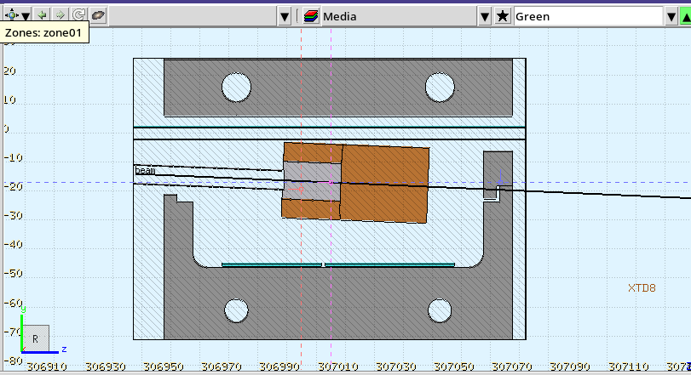
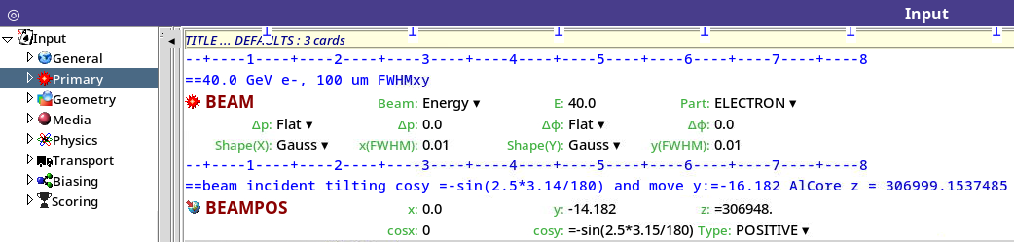
Beam Parameters
Parameter | Value
Particle | Electron
Energy | 40.0 GeV
Type | Gauss
FWHM | 0.1 mm (0.01 cm)
Initial position | X = 0 cm Y = -141.82 mm Z = 3069480.0 mm
beam incident tilting | Cos Y ~ 2.235 degrees

Slide 16

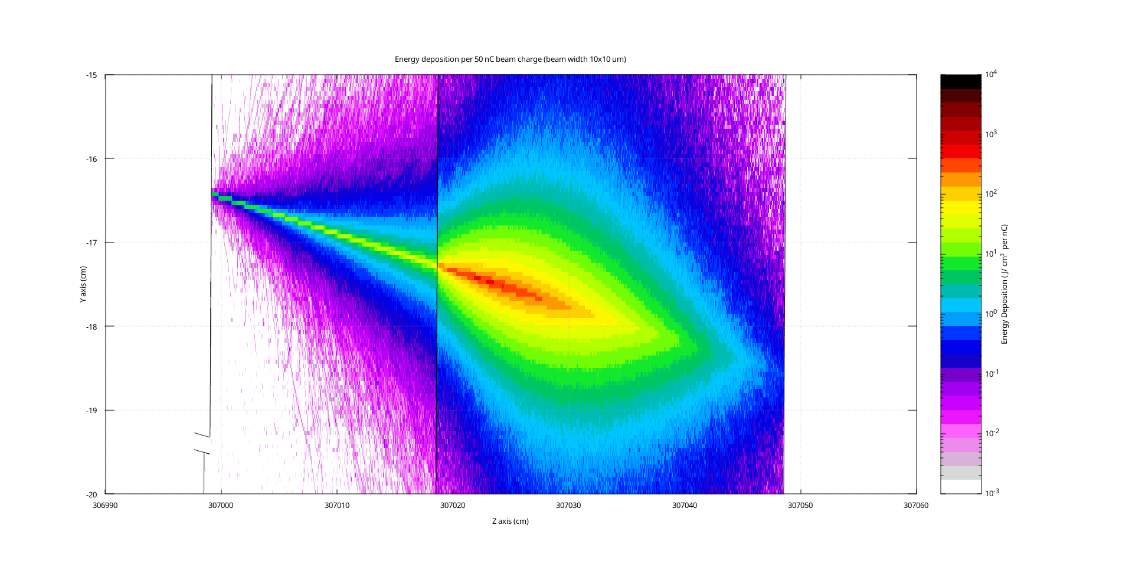
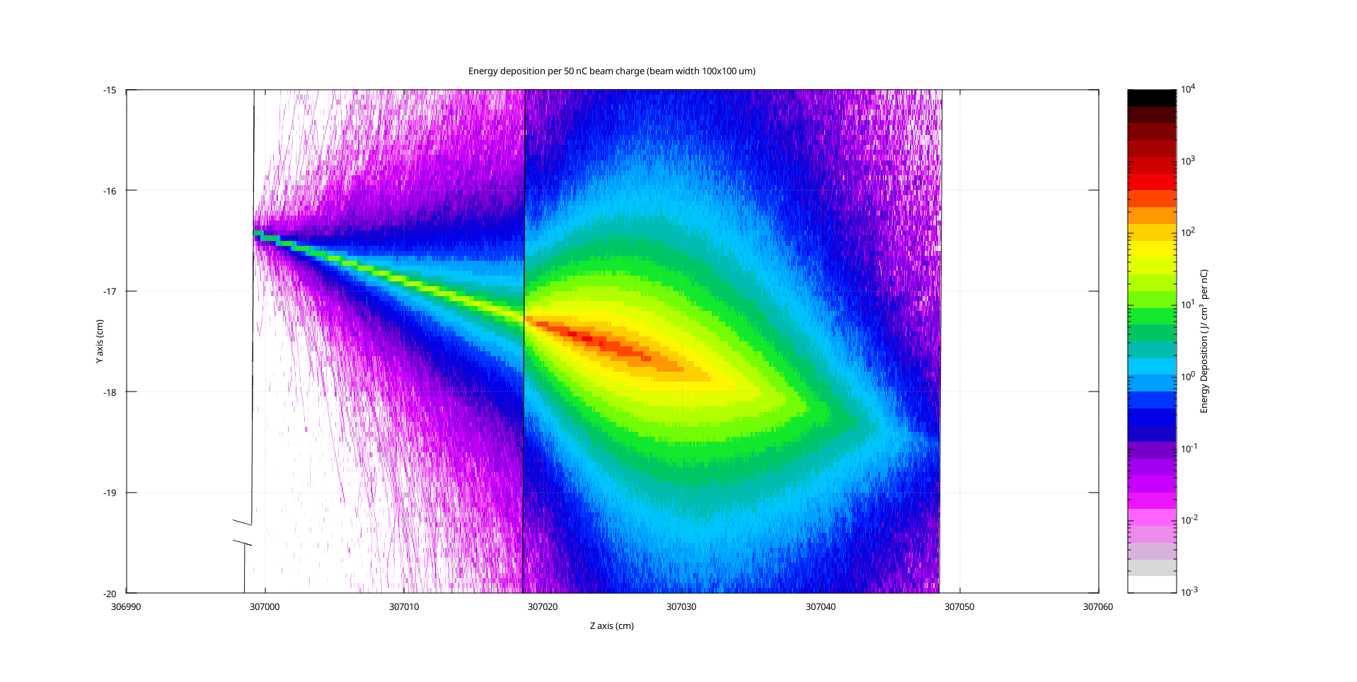
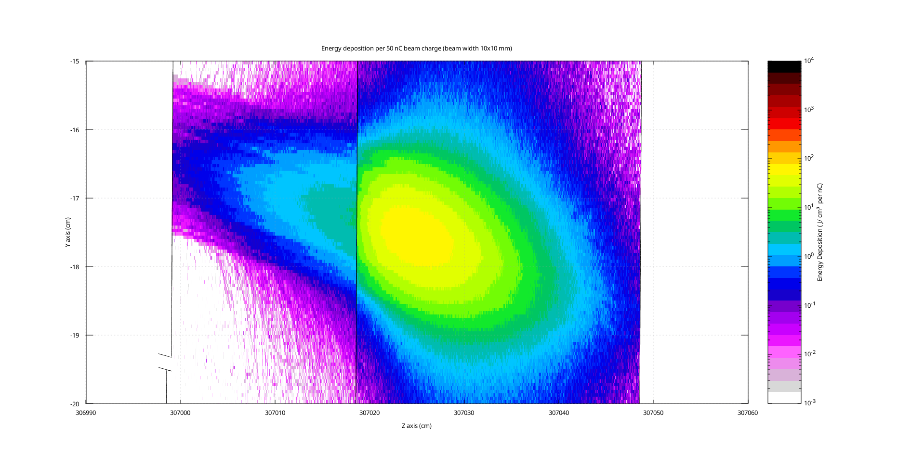

Radiation Resistance of materials
Material | Energy deposition limit (theor.) | Energy deposition (sim.)
Al (ρ=2.7 g/cm³) | 100 – 200 J/g | 17 J/g
Cu (ρ=8.96 g/cm³) | 500 – 1000 J/g | 36 J/g
cm
cm
10 um
100 um
15 J/g limit
Al
Cu
Al
Cu
1 mm
10 mm
Al
Cu
Al
Cu

Slide 17
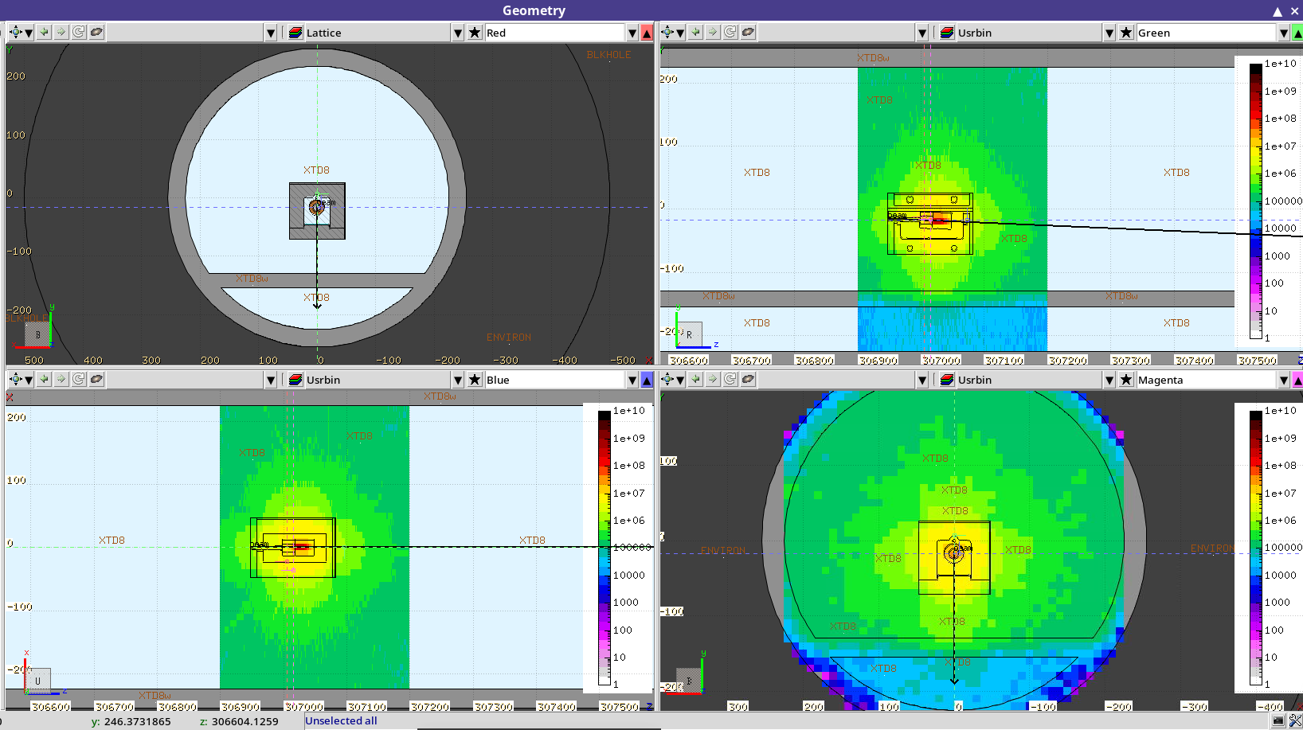
Simulation results: heat maps dose rate in the tunnel
Thanks to Ted Liang for his help with the model and advice.

Slide 18
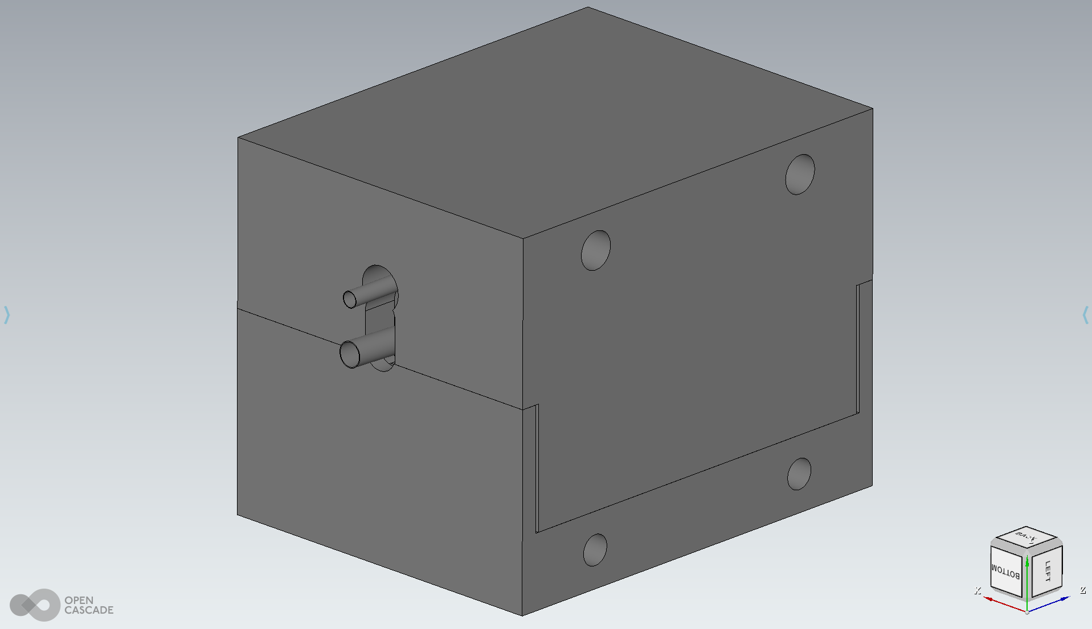
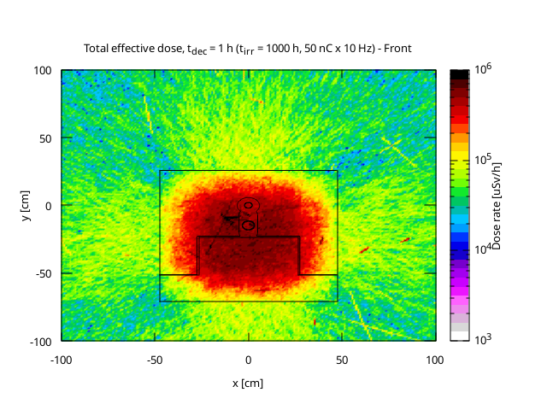
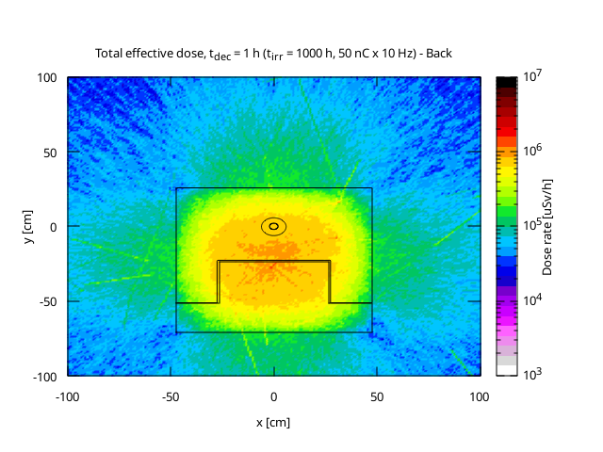
Residual Decay: 1 hour
Front side
Back side

Slide 19
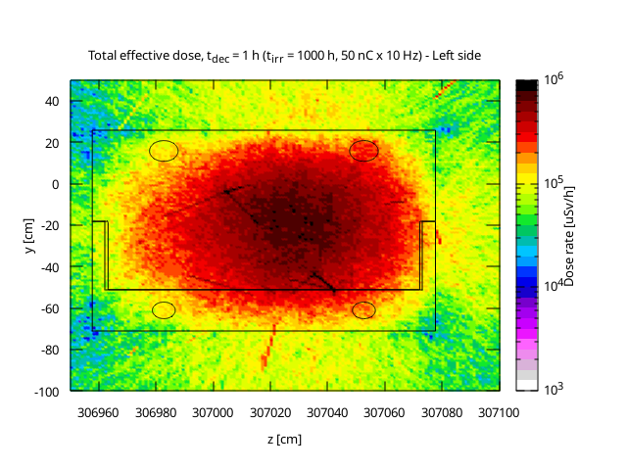
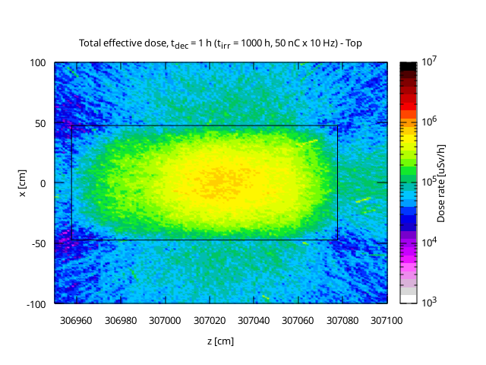
Residual Decay: 1 hour
Left side
Top side

Slide 20
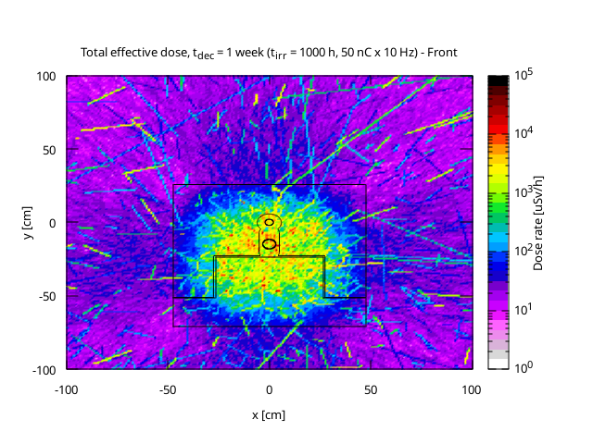
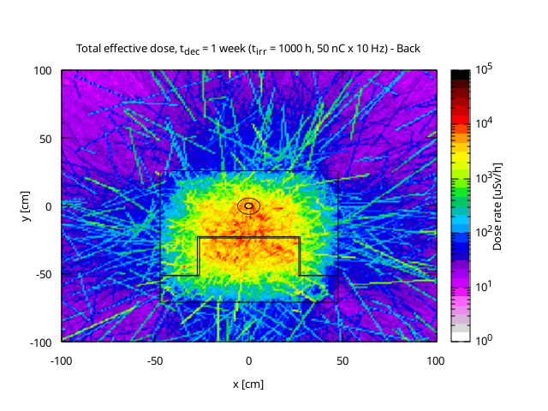
Residual Decay: 1 week
Front side
Back side

Slide 21
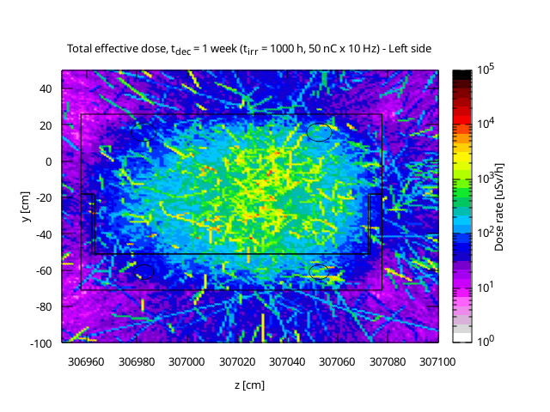
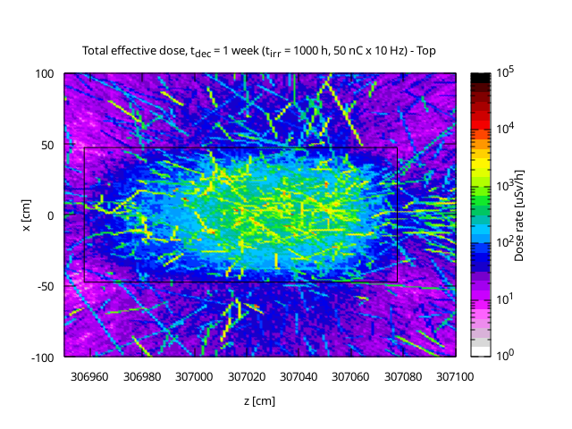
Residual Decay: 1 week
Left side
Top side

Slide 22
What the Model Allows You to Observe
The model makes it possible to
Dose rate heat map and profiles;
Assess dose outside shielding (important for personnel and electronics);
Evaluate shielding efficiency.
Arguments demonstrating the model’s suitability for an electron beam dump
The 40 GeV electron beam energy corresponds to new realistic accelerator conditions.
Main physical processes relevant to a high‑energy beam dump are activated and explicitly treated.
The complex beam dump geometry is imported from detailed CAD (ABAQUS) data, ensuring geometric fidelity.
Energy‑loss and fluence scorers quantify heating and material damage inside the dump.
Dose‑equivalent scoring in surrounding regions addresses radiation‑protection requirements.
Residual‑dose calculations provide cooldown estimates for safe human access and maintenance.

Slide 23
Supplementary Materials

Slide 24
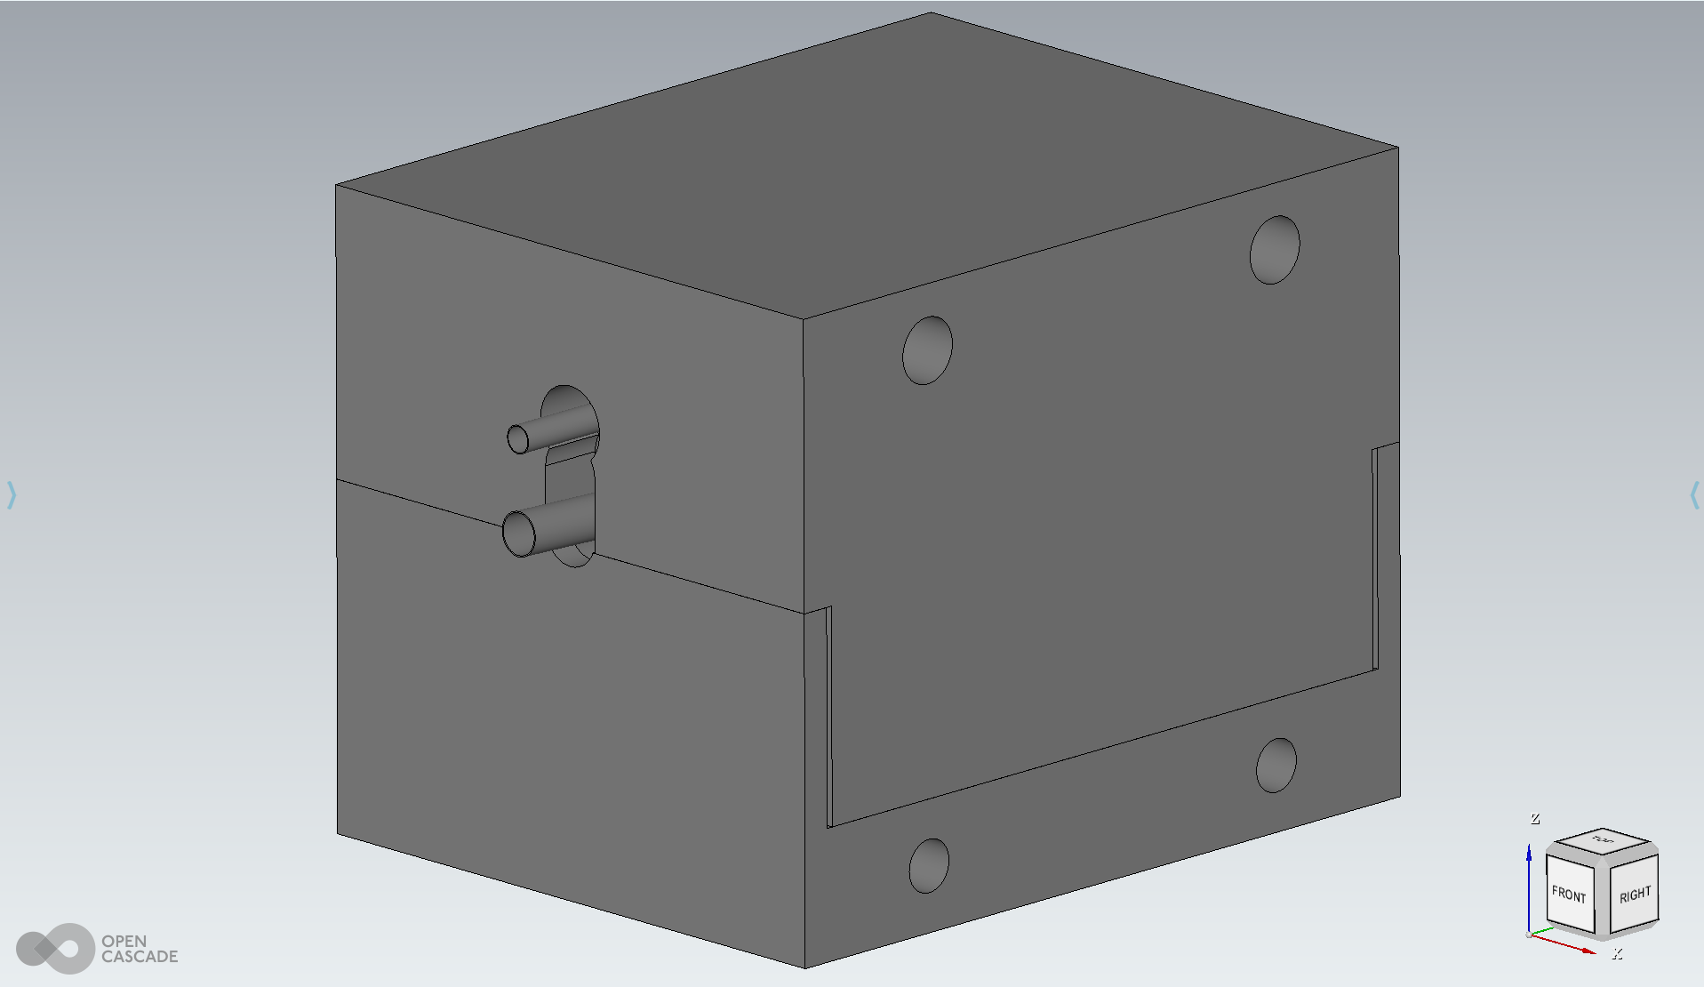

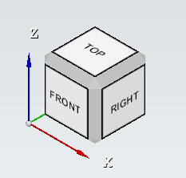
BEAM DUMP: Model Orientation
Initial Model XYZ (CAD)
Rotated Model XZY (FLUKA)
Step 1: rotate on 90 degrees around X axis
Step 2: rotate on 180 degrees around Z axis
The correct orientation of the model must be done before importing it into FLUKA. Minimizing rotation and positioning operations ensures fewer bugs during simulation and data post-processing.
Advice: perform all work with the model in a CAD file, convert and import the finished model into FLUKA!

Slide 25
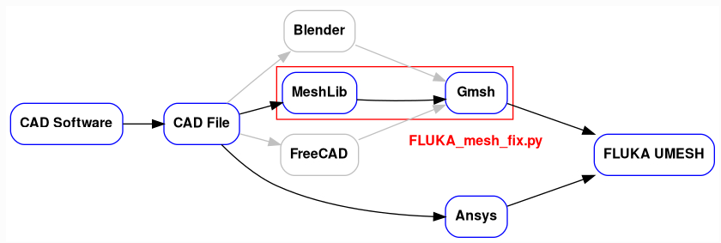

Complex Model Import to FLUKA
Unstructured meshes mini guide has been used to convert CAD file of the complex model to FLUKA UNMESH card (ABAQUS file)
Starting with FLUKA version 4-5.0, the support of multiple types of the first order polyhedral meshes, the Unstructured Meshes (UM), has been included in the code. This document has the scope to guide in the use of UM as geometry of FLUKA simulations.
CAD file → STEP file → ABAQUS file
A specific tool, FLUKA_mesh_fix.py has been developed for this purpose. It is a Python script, located in the geom_mesh_utils package, which utilizes Voxel remeshing, similar to the one in Blender. The script employs a comparable functionality from the Meshlib library, which is more flexible in terms of supported systems and Python versions (more details and guide for the meshing script).

Slide 26
Radiation Hardness: beam width 10 x 10 um
Al
Cu

Slide 27
Radiation Hardness: beam width 100 x 100 um
Al
Cu

Slide 28
Radiation Hardness: beam width 1 x 1 mm
Al
Cu

Slide 29
Radiation Hardness: beam width 10 x 10 mm
Al
Cu

Slide 30
Radiation Resistance: limits check

Slide 31
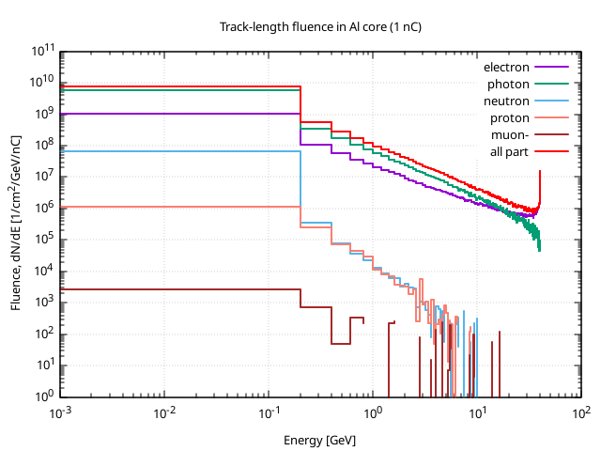
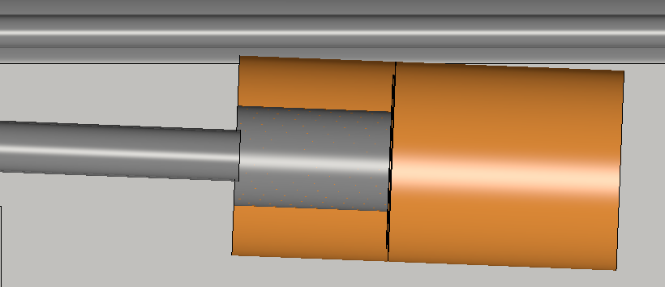
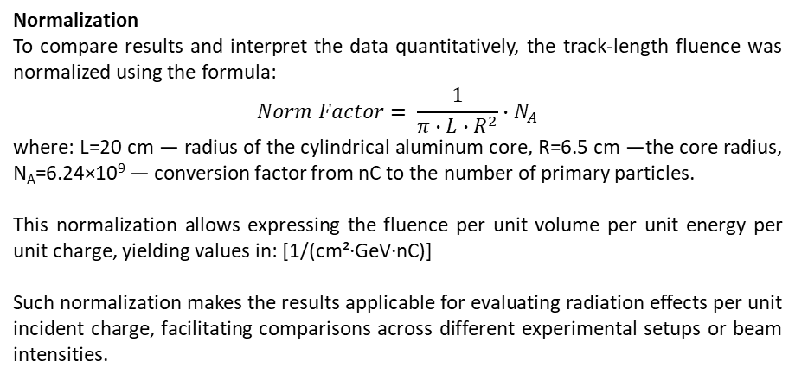
Simulation results: Track-length fluence
Normalization
To compare results and interpret the data quantitatively, the track-length fluence was normalized using the formula:
$$Norm Factor= \frac{1}{π∙L∙R^{2}}∙N_{A}$$
​where: L=20 cm — radius of the cylindrical aluminum core, R=6.5 cm —the core radius, N_{A}=6.24×10⁹ — conversion factor from nC to the number of primary particles.
This normalization allows expressing the fluence per unit volume per unit energy per unit charge, yielding values in: [1/(cm²·GeV·nC)]
Such normalization makes the results applicable for evaluating radiation effects per unit incident charge, facilitating comparisons across different experimental setups or beam intensities.
The aluminum cylindrical core is exposed to a significant flux of secondary particles, especially electrons and photons at low energies, and protons and neutrons at higher energies.
The maximum track-length fluence reaches approximately 10¹⁰–10¹¹ [1/(cm²·GeV·nC)] around 1–10 MeV, which is critical for assessing radiation hardness.
The spectrum is characteristic of hadronic and electromagnetic cascades generated by primary particle interactions with the target.
The fluence distribution highlights the dominant particle types and energy ranges that contribute most to radiation dose and particle flux, which is essential for shielding design, material selection, and electronic damage evaluation.

Slide 32
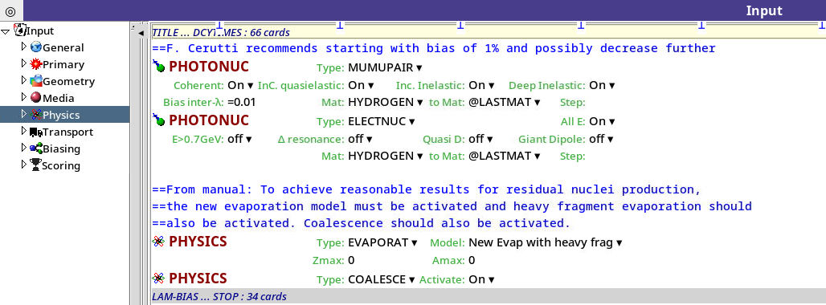
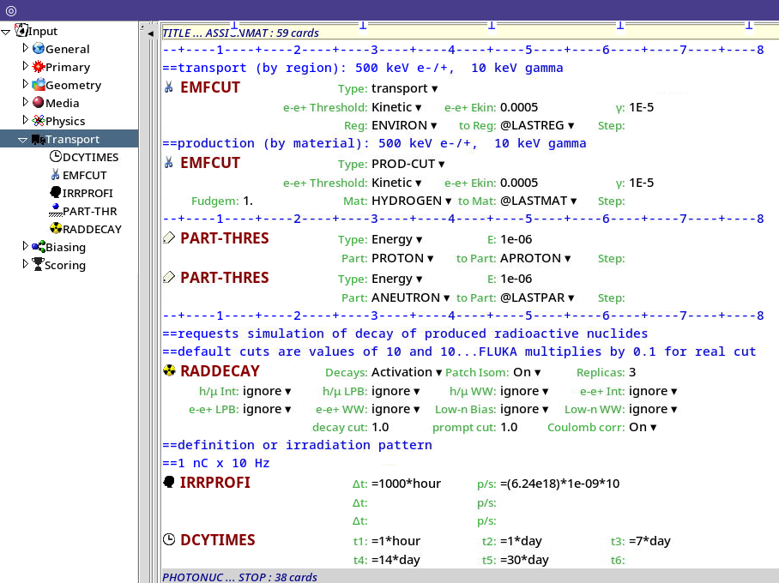
Physics and Transport Cards
Physics included in the calculation
Electromagnetic transport of electrons and photons — included; lower transport thresholds set to 500 keV for e⁻ and 10 keV for γ.
Residual‑nuclei production — included via the RADDECAY and DCYSCORE cards.
Nuclear evaporation — enabled through PHYSICS EVAPORAT, allowing the de‑excitation of highly excited nuclei.
Coalescence of light fragments — enabled through PHYSICS COALESCE.
Photo‑nuclear reactions — included and accelerated with a mean‑free‑path bias (LAM‑BIAS).
Muon, photon and neutron interactions — fully enabled by the corresponding PHYSICS, PHOTONUC and scoring cards.
Secondary (bremsstrahlung) radiation — handled by FLUKA’s built‑in electromagnetic model.

Slide 33
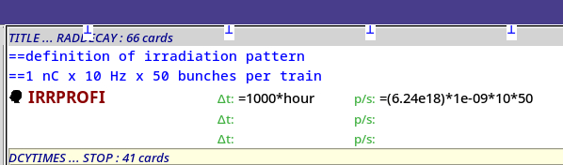

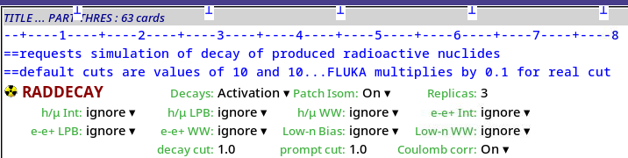
Residual Decay Settings
Defines how long and with what intensity the system is irradiated (e.g. 10 sec, 10 h).
Irradiation profile (IRRPROFI): 1 nC per pulse at 10 Hz with 50 bunches per train, giving 3.12 × 10¹² primary particles per hour.
Beam intensity
electrons per second
Irradiation Exposure Time
Specifies moments after shutdown for dose evaluation. Decay times (DCYTIMES): residual‑dose evaluations scheduled at 1 h, 1 d, 7 d, 14 d and 30 d after beam shutdown.
With RADDECAY, FLUKA simulates the entire chain of residual radiation, including β-decay, γ-emission, and neutron emission from unstable nuclei.

