Slide 1
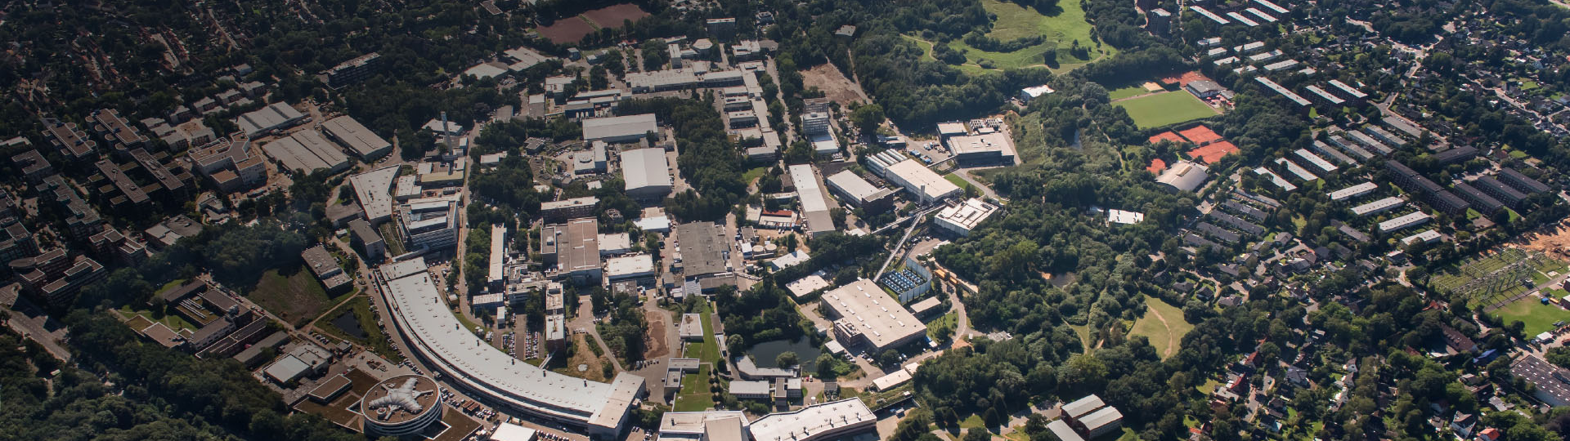

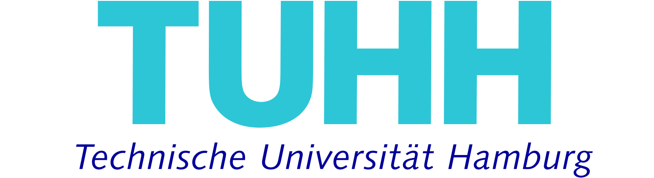
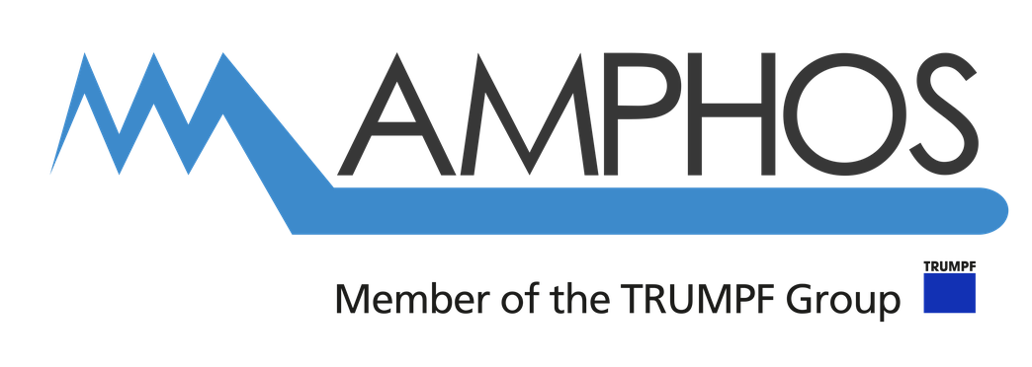
OPAL-FEL Welcome and Roundtable 1:
Work Package Realization & Beyond
Henrik Tünnermann
Deutsches Elektronen-Synchrotron DESY, Notkestraße 85, 22607 Hamburg, Germany
Notes:
HIRX slac
erwähnen
Push for ai

Slide 2
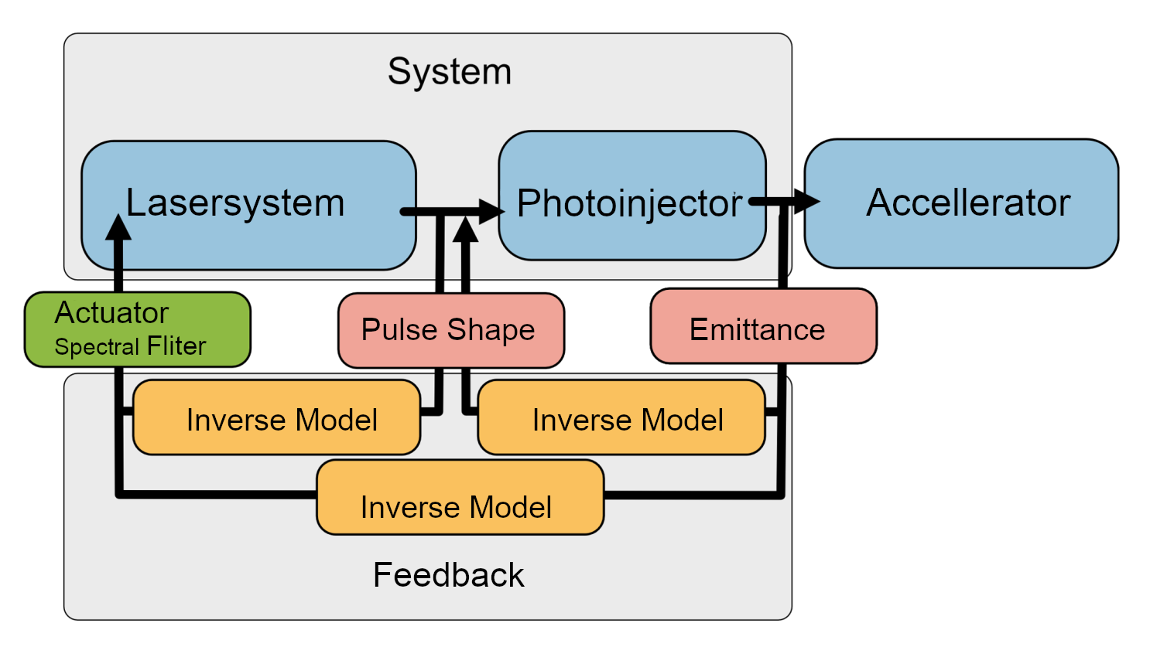
OPAL-FEL Concept

Slide 3

OPAL-FEL Concept
Flat Top used in user run at euXFEL for one week

Slide 4
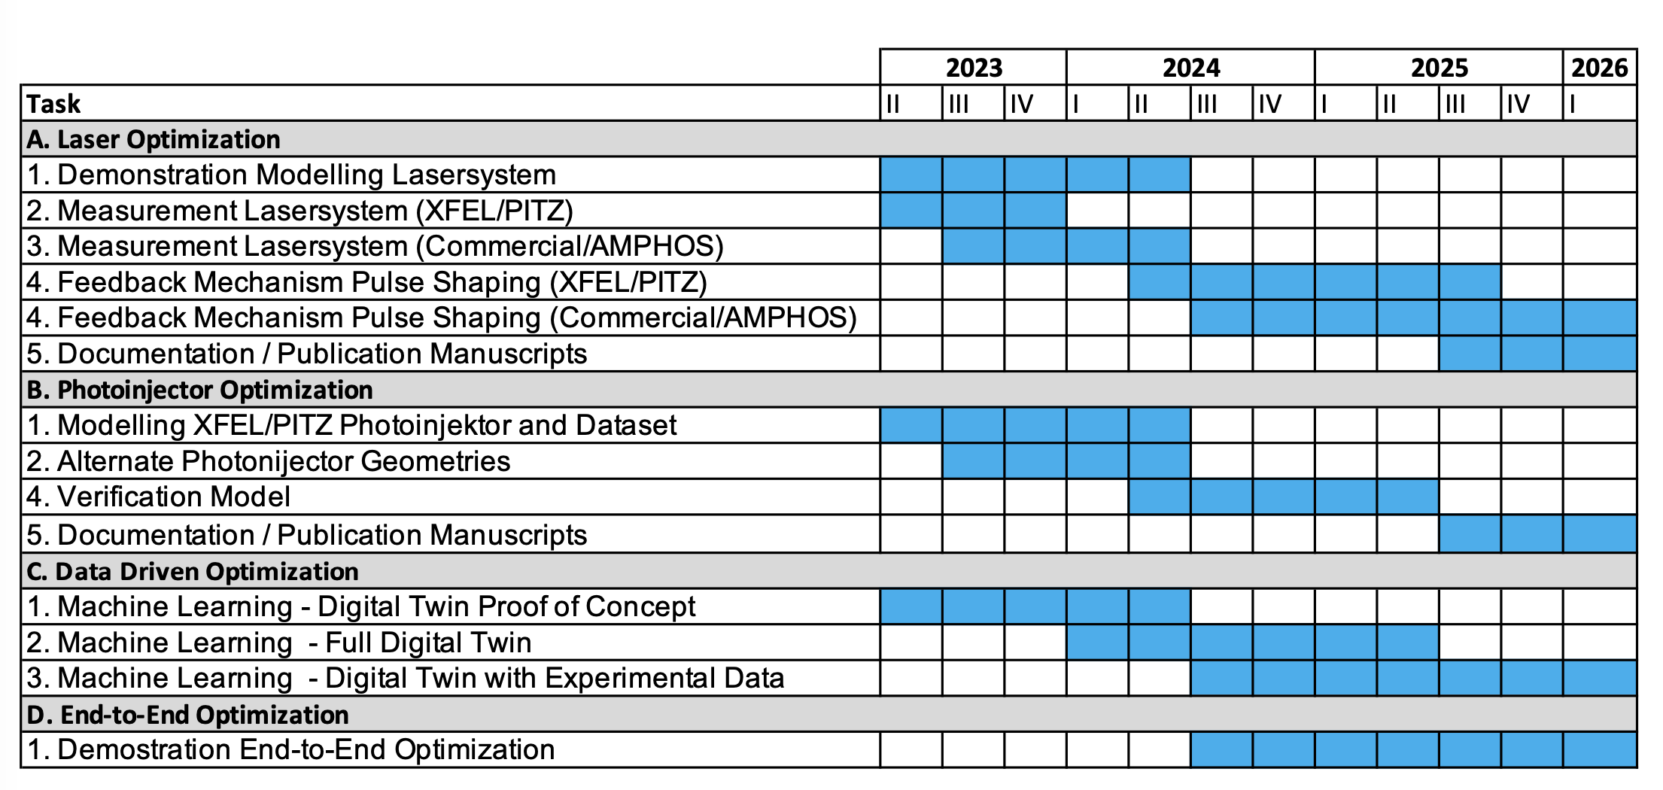
Timeline
We are here

Slide 5
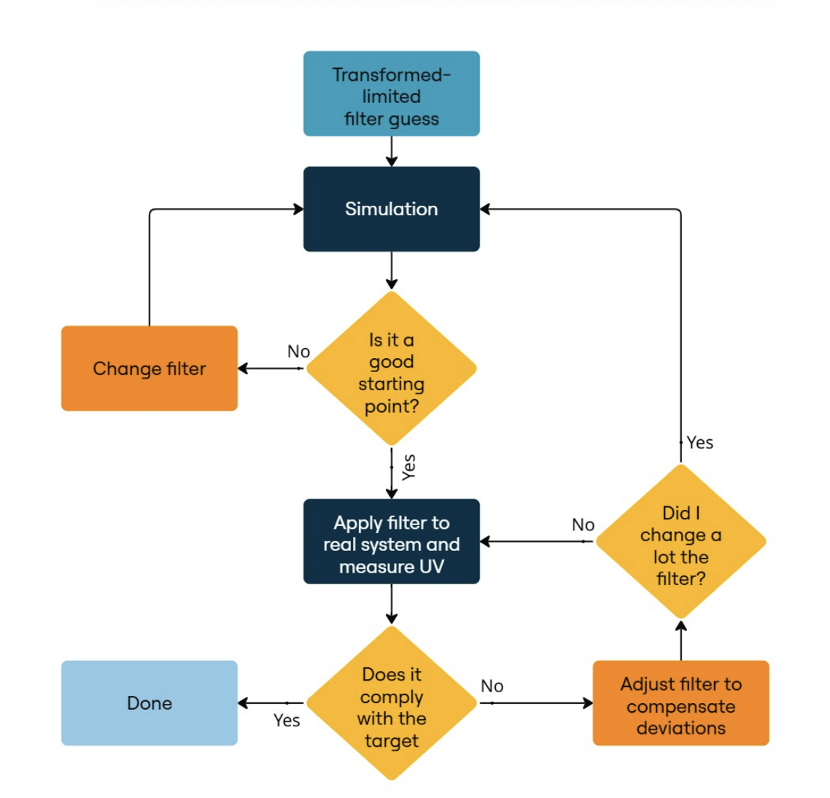
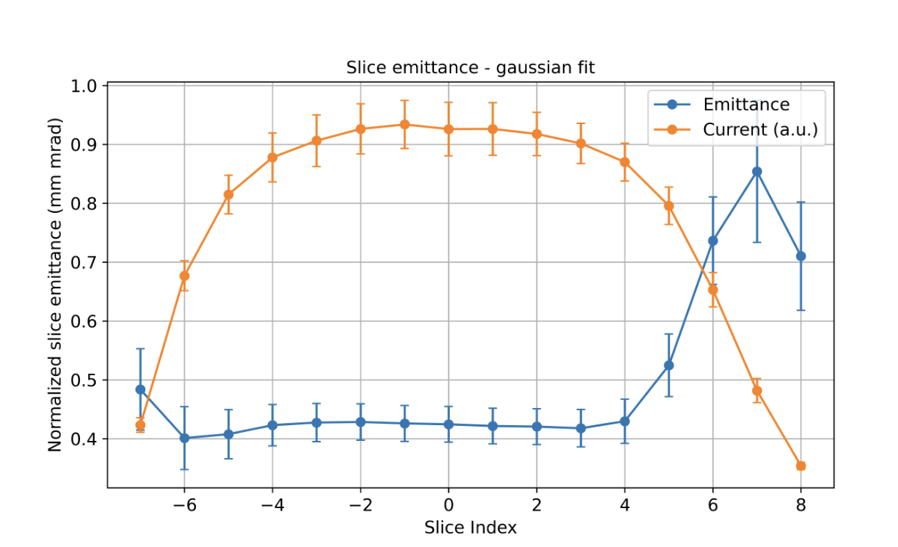
Laser Shaping and Sliced Emittance with Flat Top

Slide 6
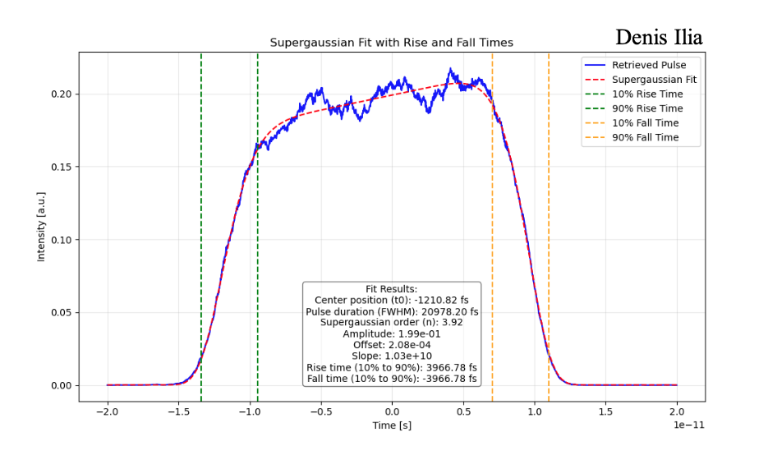
Why?

Slide 7
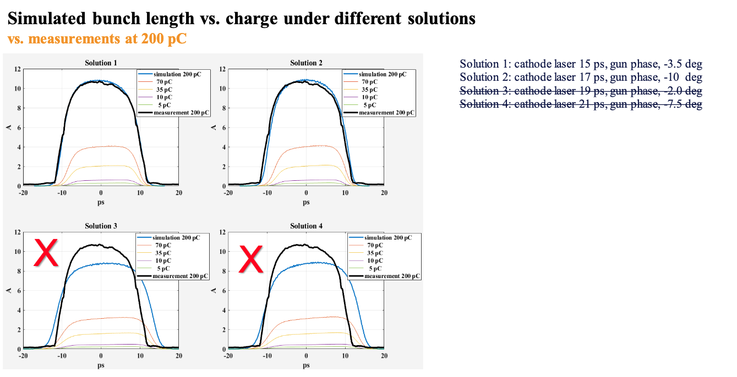

Slide 8
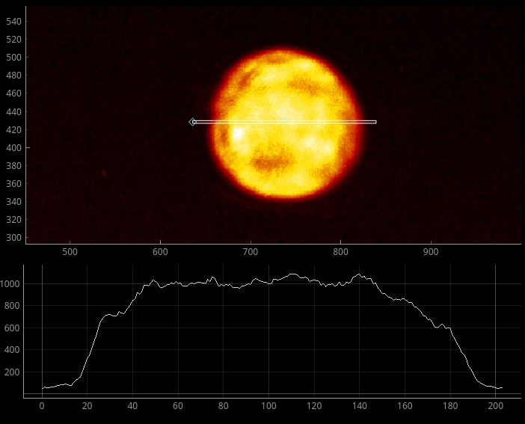
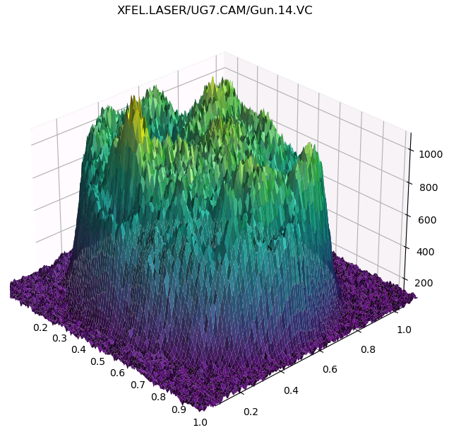
Spatial

Slide 9
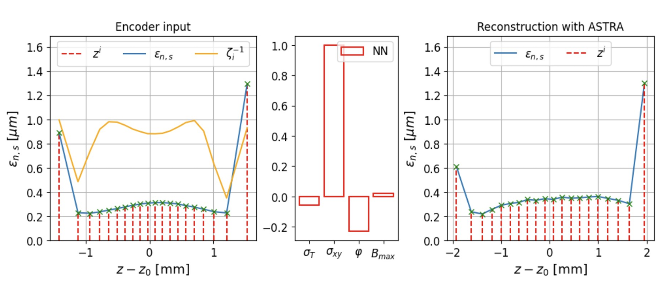
Machine Learning

Slide 10
Roadamap
Laser Shaping with commercial Laser system
Add Acc Modules for realistic comparison with Experiment
  You can’t compare what you can’t measure
  Let alone control
Train surrogate Injector Model
Optimize like in a Control Problem

Slide 11
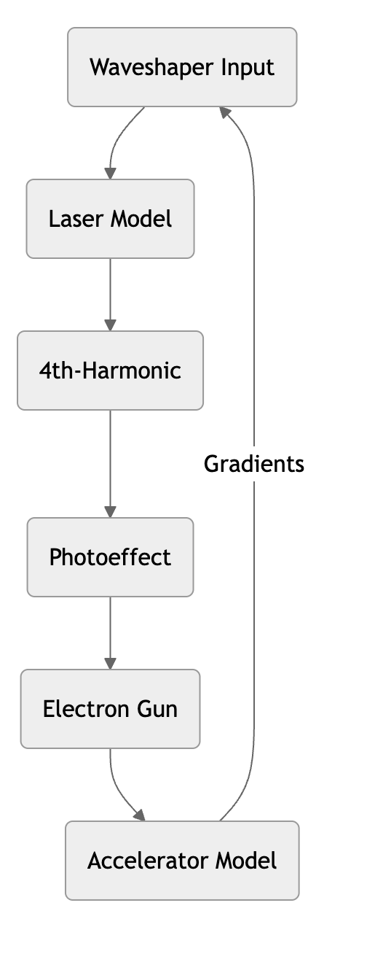
Custom Python Implementation / RP Fiber Power
Chi23D / Custom Python Implementation / Update Denis
ASTRA / distgen https://github.com/ColwynGulliford/distgen / Update Alex
ASTRA / Krack3 / Custom Python Implementation of K3 / Update Meng and Alex
OCELOT / Cheetah

Slide 12
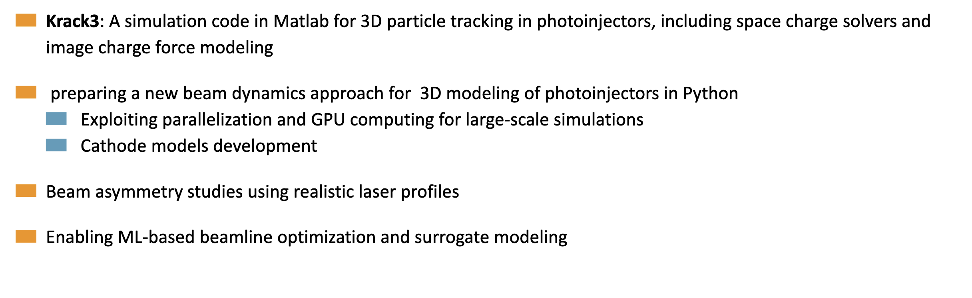

Slide 13
Timeline
We are here

Slide 14
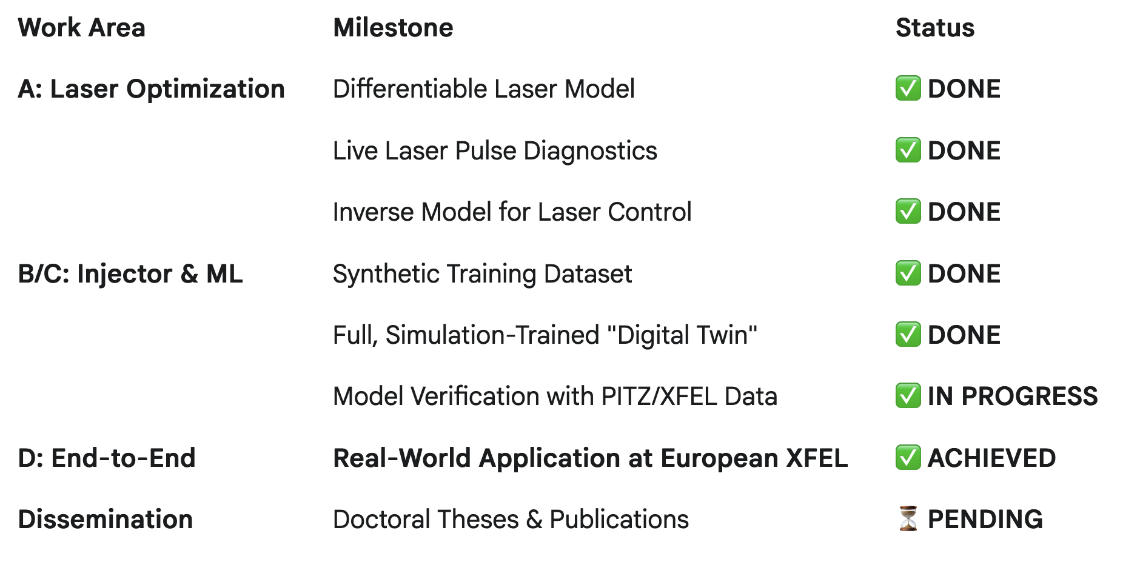
Milestone Scorecard
What We've Achieved

Slide 15
Opportunities for Future Improvement
Building on our success, we have identified key directions for advancing the core technology.
From "Digital Twin" to "Adaptive Model"
  Challenge: Simulations are a great starting point, but real-world conditions drift.
  Next Step: Develop algorithms that can infer and adapt to the real machine's state using existing, passively collected data. This moves beyond static models to a live, adaptive framework.
2. Holistic, Multi-Node Optimization
  Challenge: We learned that optimizing the laser in isolation has its limits.
  Next Step: Evolve the ML architecture to model the interplay between the laser and other key accelerator components. This allows us to find superior solutions by optimizing multiple settings in concert, purely within the software model.
3. Autonomous Control Algorithms
  Challenge: The best "co-pilot" can eventually learn to fly on its own.
  Next Step: Explore advanced control algorithms (e.g., Reinforcement Learning) within our validated simulation environment to develop fully autonomous optimization routines. This high-level AI can then provide operators with more powerful, ready-to-implement solutions.

