Slide 1
OPAL-FEL
Laser pulse shaping
Denis Ilia
21/07/2025

Slide 2
The laser system
NEPAL
Front-end
Power amplifier
FH generation
Oscillator
Waveshaper
Fiber amplifier
Solid state amplifier
SHG
Solid state amplifier
Reference IR
150 fs pulses
SHG
DFG Cross-correlator
Camera
Streak
Camera
UV pulse
Beam to BSA and Photocathode
Flip-mirror
Flip-mirror

Slide 3



A differentiable model of (our) laser
A new approach for pulse shaping
Implementation of a differentiable laser model:
  Requires implementation of laser physics by differentiable programming.
  Allows for optimization of any user-defined target function
  Can be expanded and adapted for more simulations
Example of Pulse shaping:
Differentiable model
Filter settings
$$F\left(ω\right)$$
Output pulse
$$I\left(t\right)$$
$ℒ={\left\|I{\left(t\right)}_{target}−I\left(t\right)\right\|}_{2}^{2}$
$$δ\left(F\right)=∇_{F}\left(ℒ\right)∗step$$

Slide 4








The simulation toolkit
A differentiable-programmed pulse propagation package
Learnable parameter
    Current physics implemented:
    NLSE for pulse propagation (1D)
    Rate equations for steady-state fiber amplifier
    Coupled equations for SHG process (2D)
Simulation block
Trainable module
Laser system Module
New !
Fiber Module
Fiber Amplifier Module
Loss block
SHG Module
$l$, $r_{core}$, $β_{2}$, $n_{2}$,$α$
$l$, $r_{core}$, $β_{2}$, $n_{2}$,$α$, $N$, $P_{pump}$
$$loss_{db}$$
$$l, d_{eff}$$
Passive fiber
Fiber amplifier
Filter module
$l$, $r_{core}$, $β_{2}$, $n_{2}$,$α$
SHG process
$l$, $r_{core}$, $β_{2}$, $n_{2}$,$α$, $N$, $P_{pump}$
$$l, d_{eff}$$
$$A(f)$$

Slide 5
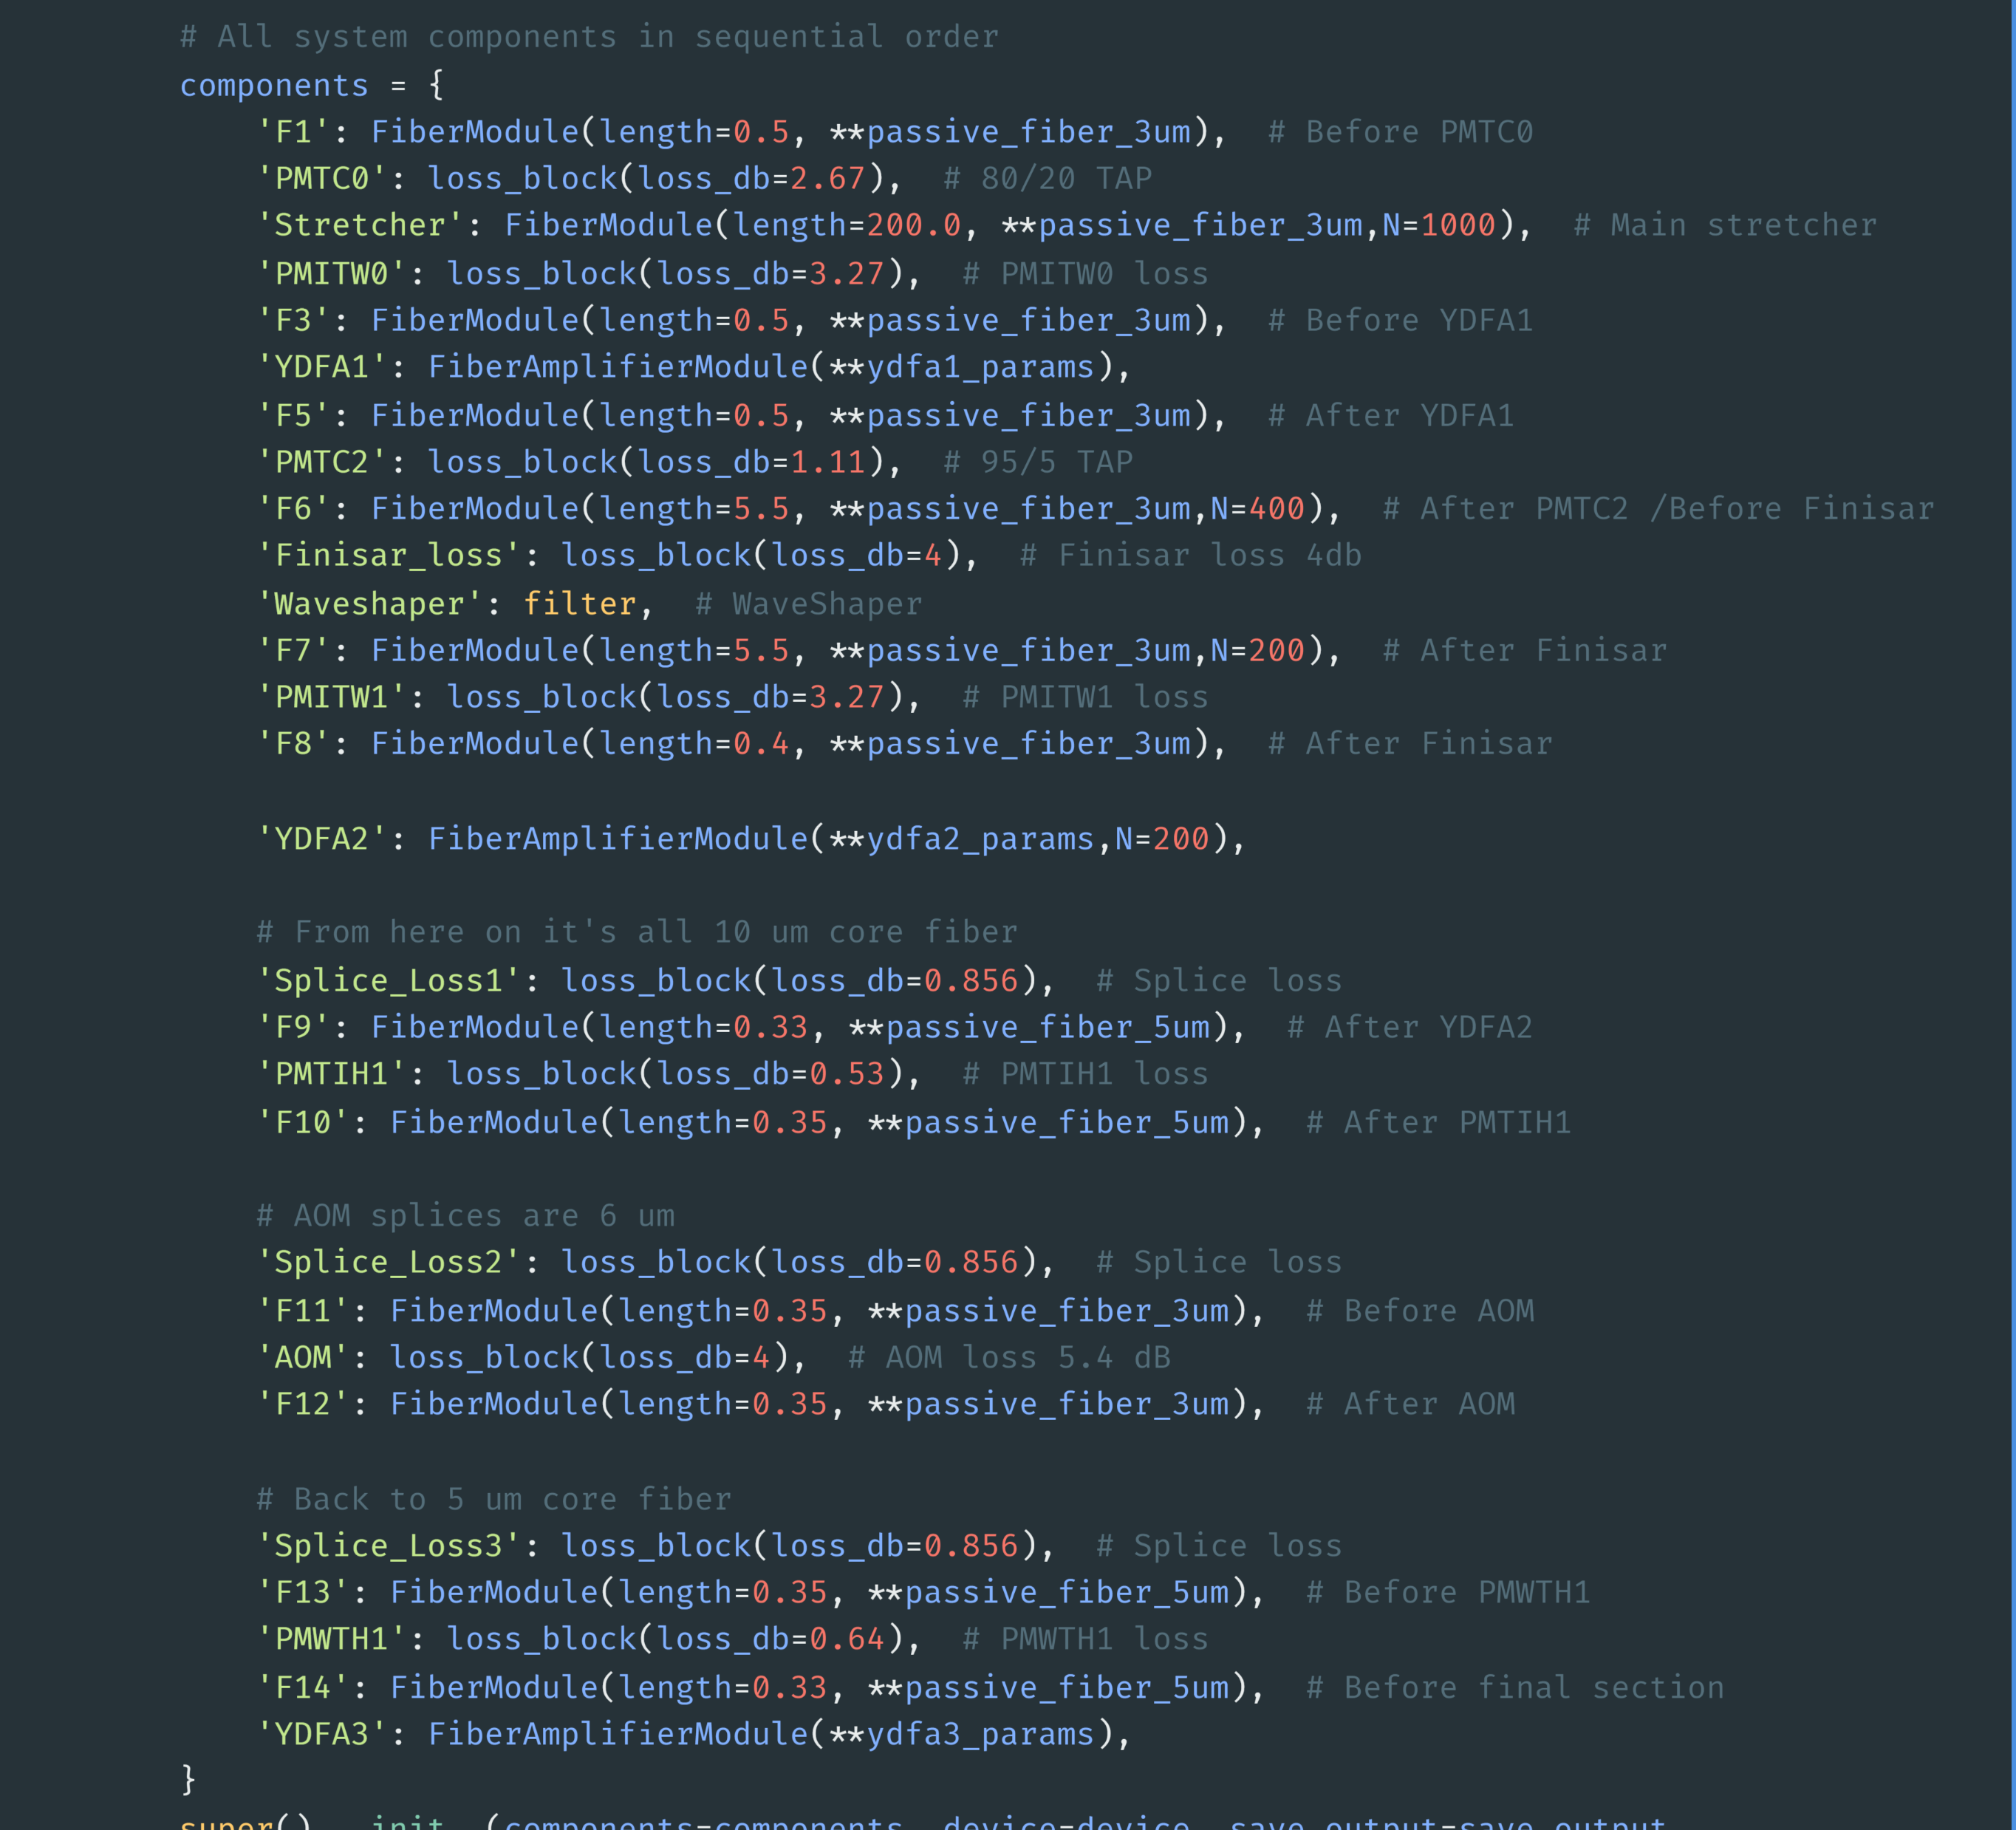
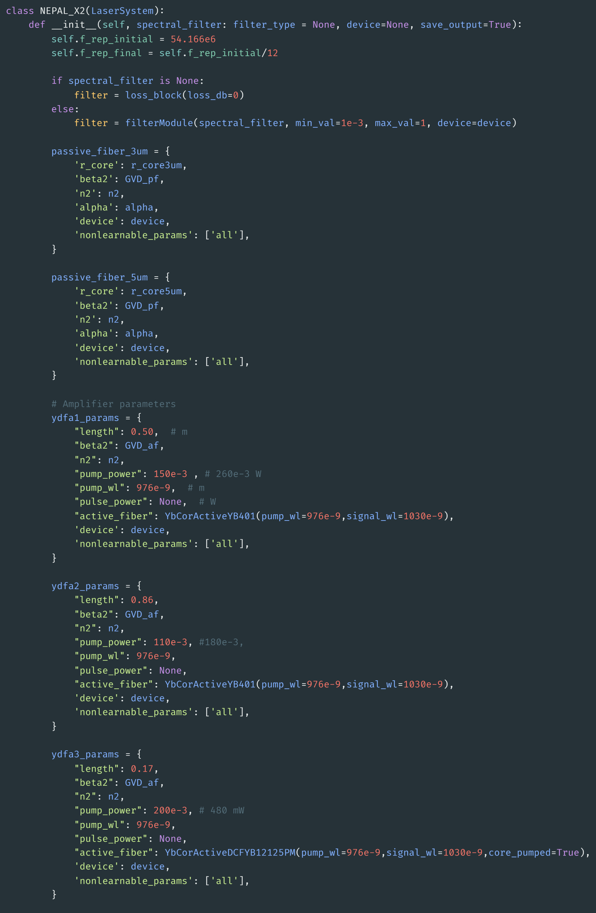
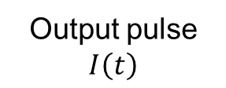
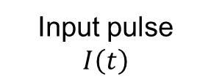
A differentiable model of NEPAL laser
NEPAL Front-end composed by modules
Laser system Module
Input pulse
$$I\left(t\right)$$
Output pulse
$$I\left(t\right)$$
Module 1
Module 2
Module …
Module N-1
Module N

Slide 6
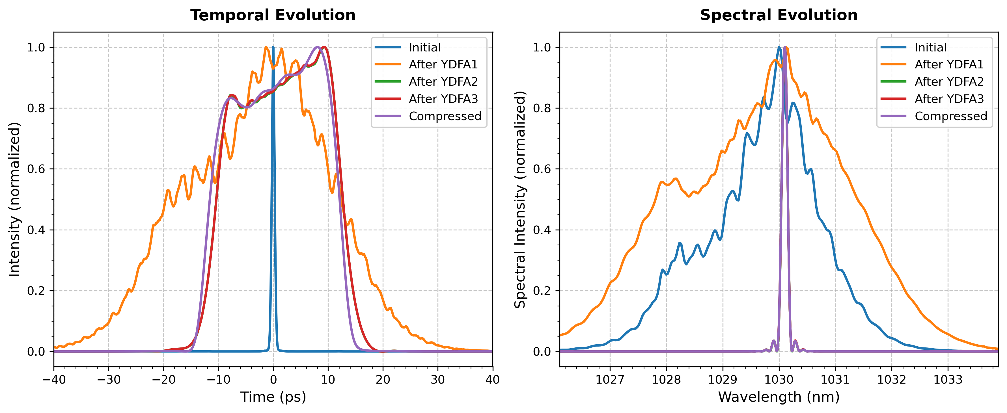
A differentiable model of NEPAL laser
Forward pass

Slide 7
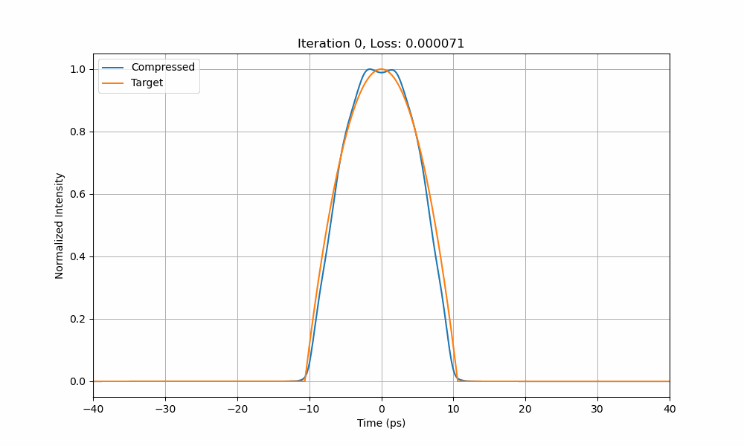
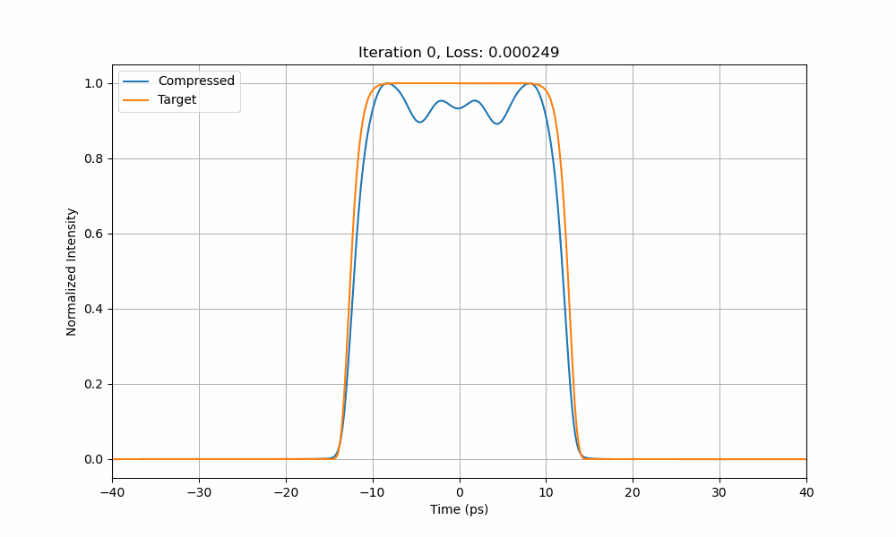
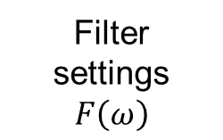


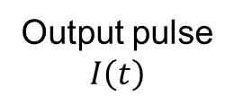
A differentiable model of NEPAL laser
Backward pass
Filter settings
$$F\left(ω\right)$$
Differentiable model
$ℒ={\left\|I{\left(t\right)}_{target}−I\left(t\right)\right\|}_{2}^{2}$
Output pulse
$$I\left(t\right)$$
$$δ\left(F\right)=∇_{F}\left(ℒ\right)∗step$$

Slide 8

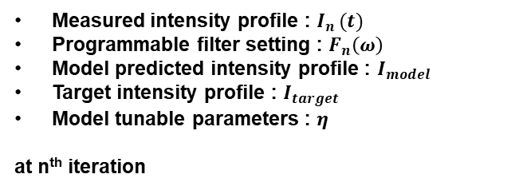




Adapting to real systems
Gradient-based feedback
Measured intensity profile : $I_{n }(t)$
Programmable filter setting : $F_{n}\left(ω\right)$
Model predicted intensity profile : $I_{model}$
Target intensity profile : $I_{target}$
Model tunable parameters : $η$
at n^{th} iteration
Training data pairs for local model tuning
$$δ\left(F\right)=∇_{F}\left({\left|I_{model}−I_{target}\right|}^{2}\right)∗step$$
Differentiable laser model
Laser system
$$I_{n }(t)$$
$$\left(\begin{aligned}{F_{n−4} \atop F_{n−3}} \\ F_{n−2} \\ F_{n−1} \\ F_{n}\end{aligned} \begin{matrix}\begin{aligned}I_{n−4} \\ I_{n−3} \\ I_{n−2}\end{aligned} \\ I_{n−1} \\ I_{n}\end{matrix}\right)$$
Model tuning
Filter tuning
$$F_{n}\left(ω\right)$$
$$δ\left(η\right)=∇_{η}\left({\left|I_{meas}−I_{model}\right|}^{2}\right)∗step$$

Slide 9
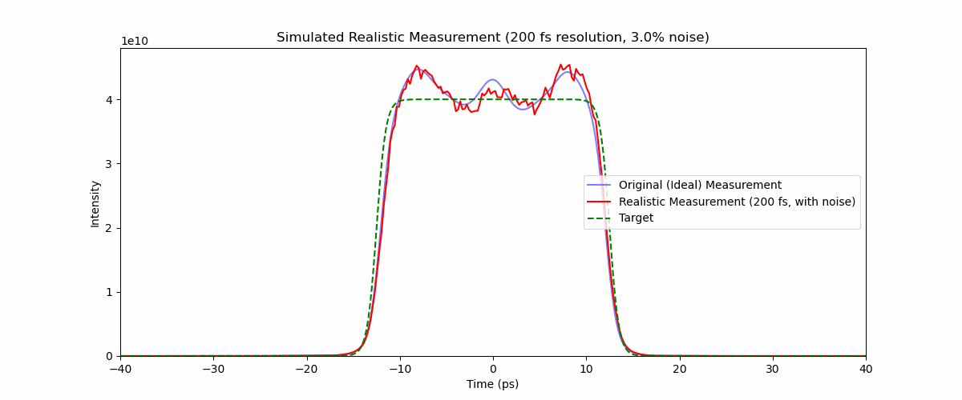
A simple experiment
Gradient-based feedback run on a “sandbox” laser

Slide 10
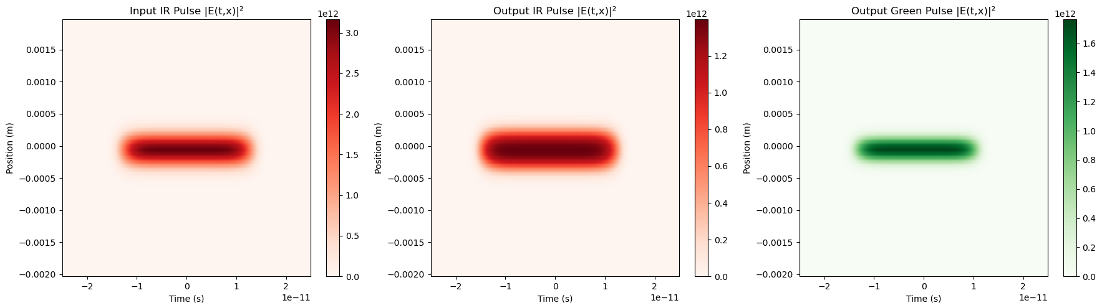
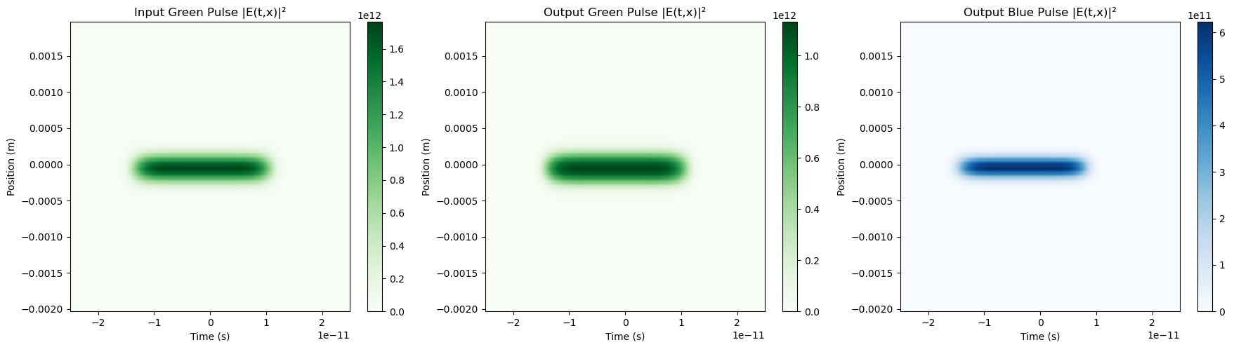

Including SHG processes
Computational challenges
From 1D to 2D:
  $N_{t} ×N_{x}$ points
Memory footprint ↑
Computation time ↑
Optimization landscape more complicated

Slide 11
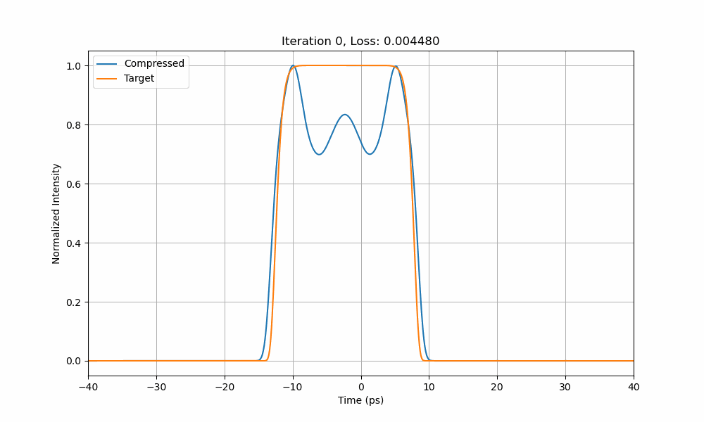
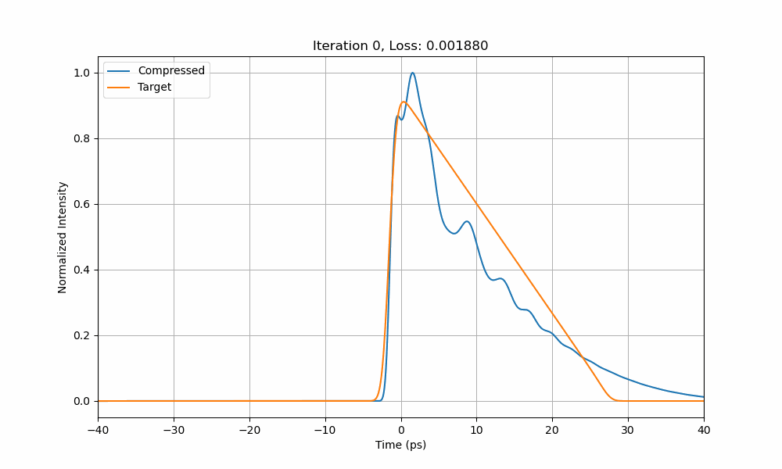
A differentiable model of NEPAL laser with FHG
Backward pass
Filter settings
$$F\left(ω\right)$$
Differentiable model
$ℒ={\left\|I{\left(t\right)}_{target}−I\left(t\right)\right\|}_{2}^{2}$
Output pulse
$$I\left(t\right)$$
$$δ\left(F\right)=∇_{F}\left(ℒ\right)∗step$$

Slide 12
Conclusion
So far…
Developed a toolkit for differentiable fiber simulations + SHG processes.
Implemented a differentiable model of NEPAL (partially).
Tested gradient-based feedback on a sandbox NEPAL system.
Next steps
Complete implementation and validation of modules.
Improve performances of algorithm on sandbox system.
Use the gradient-based feedback algorithm on NEPAL systems.

Slide 13
Thank you

Slide 14
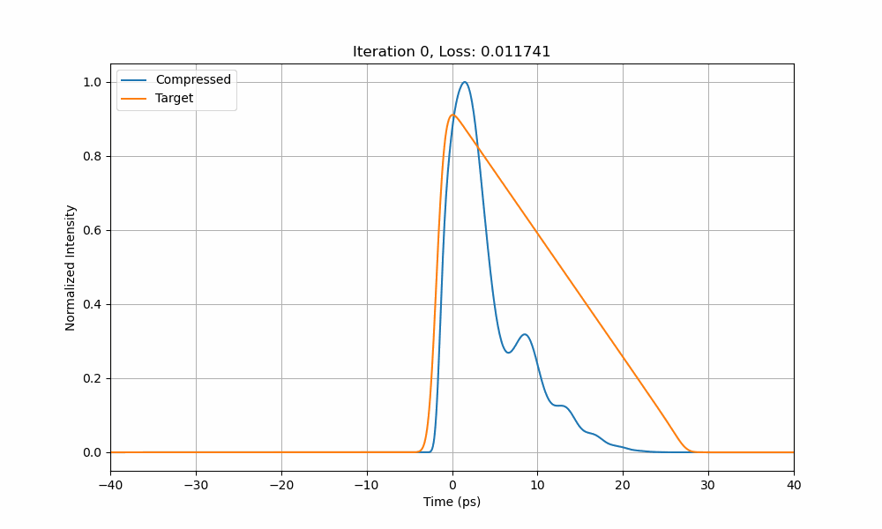
Extra
Feedback with fhg

