Slide 1
OPAL-FEL meeting:
Progress Updates on Photoinjector Optimization
Meng Cai
21.07.2025

Slide 2
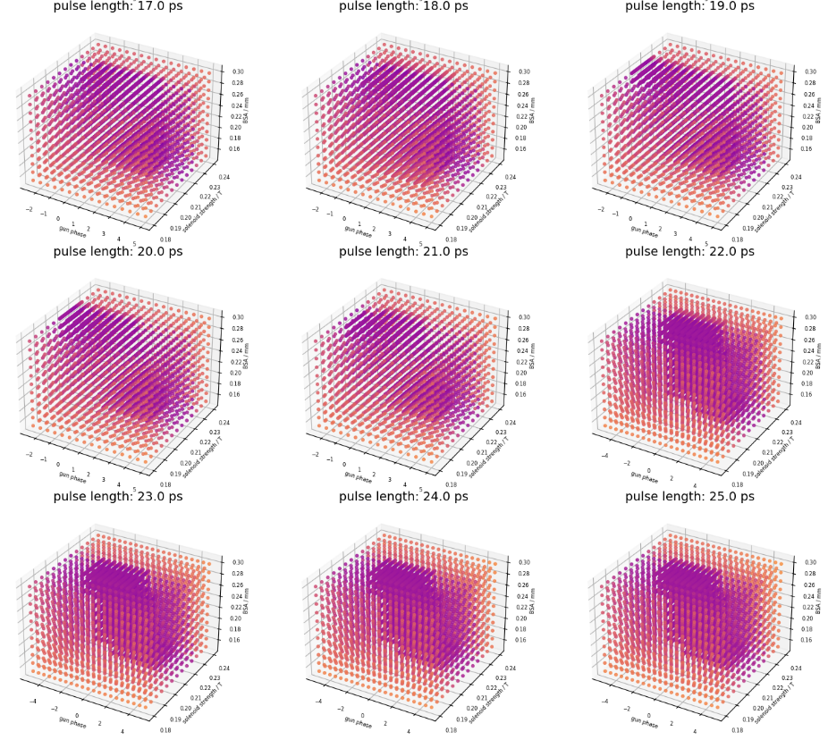
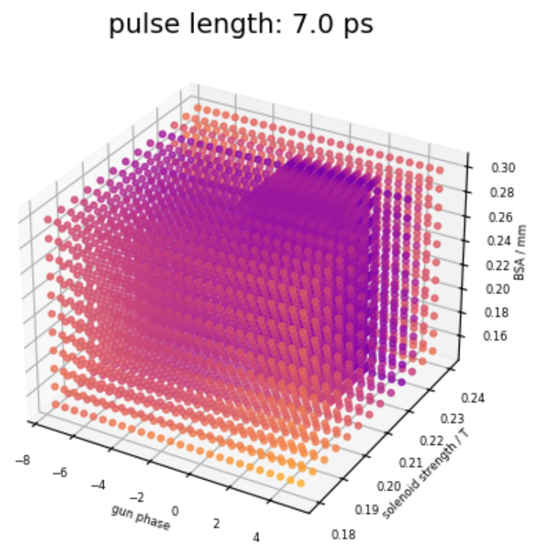
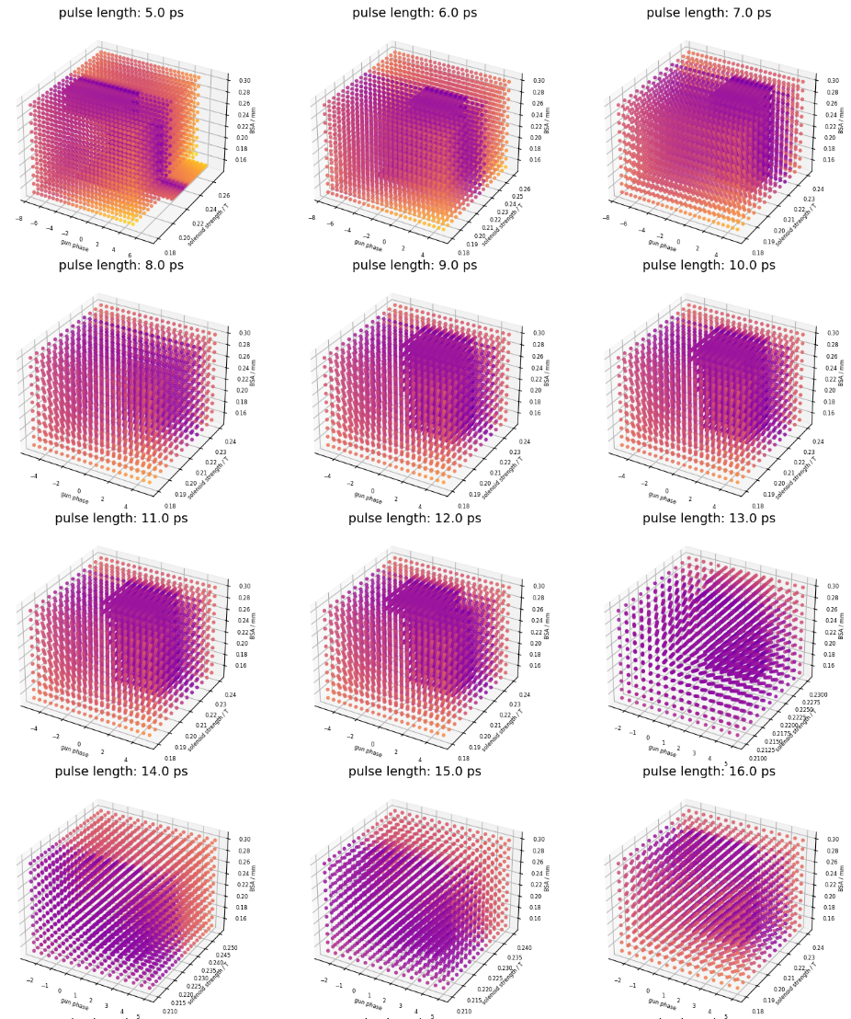
Simulation datasets of EuXFEL and PITZ for machine learning (Alex’ model)
Variables | Range | Step
Laser temporal length | Flattop 5-25 ps | 1 ps
Transverse spot size | 0.15 - 0.3 mm | 0.015 mm
Gun phase | -12.5 – 12.5 deg | 2.5deg, 0.5deg
Solenoid | ± 0.15 T – 0.3 T | 0.05 T, 0.001 T
Electric field | 59.5268 MV/m | /
Bunch charge | 250 pC | /
Resolution | EuXFEL | PITZ
Particle numbers | 20k | /
Nmin | 200 | /
Nrad | 35 | 50
Nlong_in | 70 | 100
Total simulations: 199057 runs *2 facility
Average simulation time on Maxwell: 3 min 30 s
Only 24 stable nodes
Overall time ≈ 58,058 min ≈ 40.3 days

Slide 3
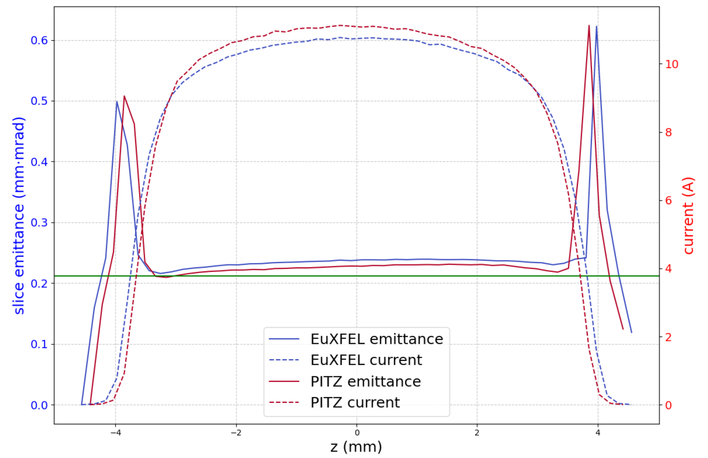
Selected best emittance cases from the database
rerun using 200k macroparticles
XFEL beam: downstream the first accelerating module A1
PITZ beam: downstream the CDS booster
BSA=1.0mm for 25 ps flattop, 250 pC
(varied ф_{gun} & B_{z_solenoid})
very similar best slice emittance
close to the thermal emittance level
thermal emittance

Slide 4
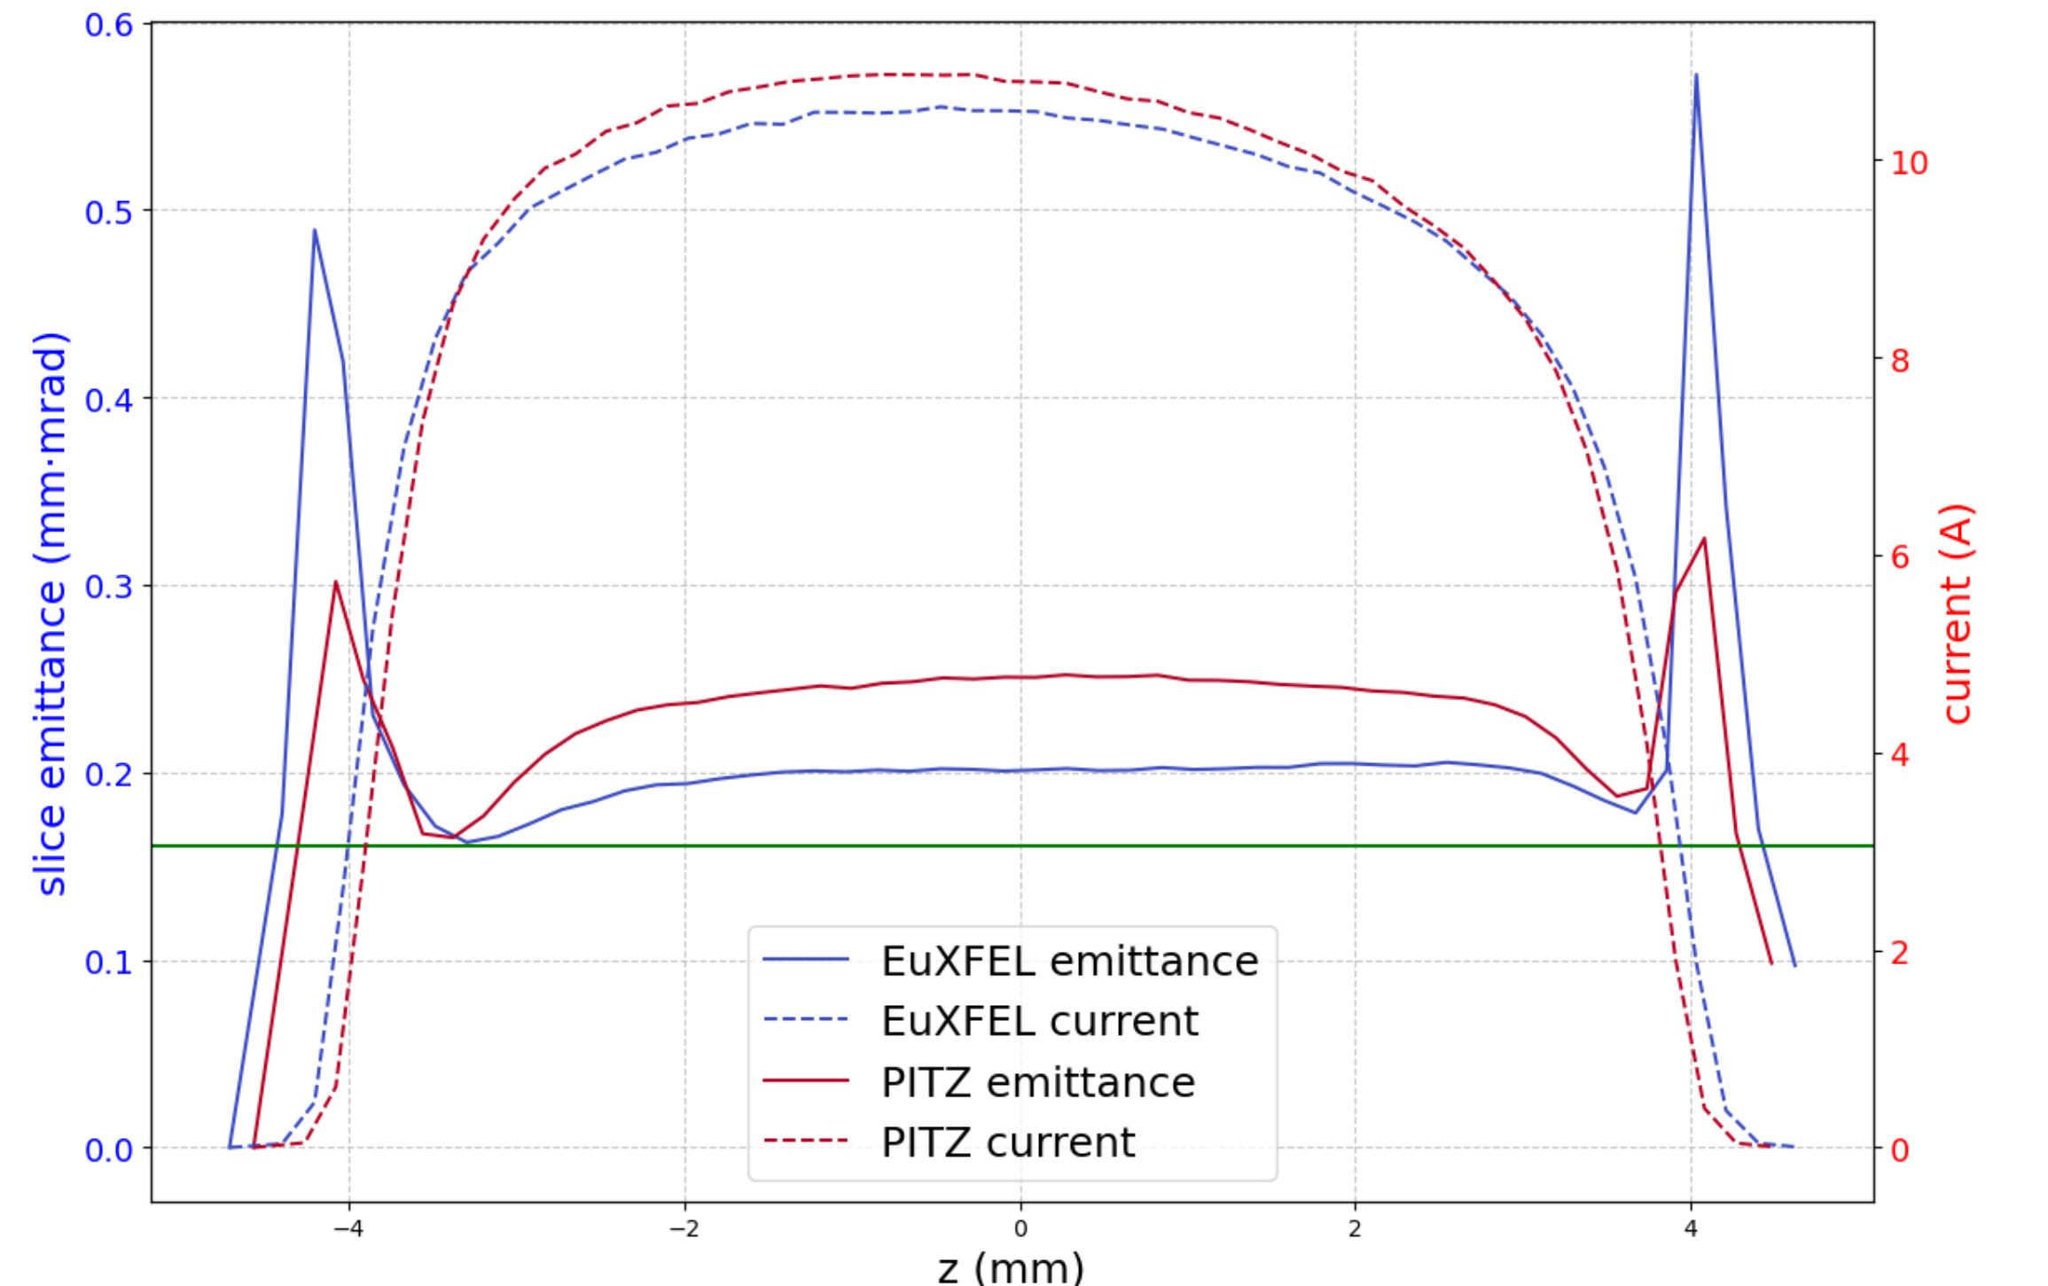
Selected other cases from the database
rerun using 200k macroparticles
XFEL beam: downstream the first accelerating module A1
PITZ beam: downstream the CDS booster
BSA=0.76mm for 25 ps flattop, 250 pC
(varied ф_{gun} & B_{z_solenoid})
Lower best slice emittance
for the XFEL case than BSA1.0

Slide 5
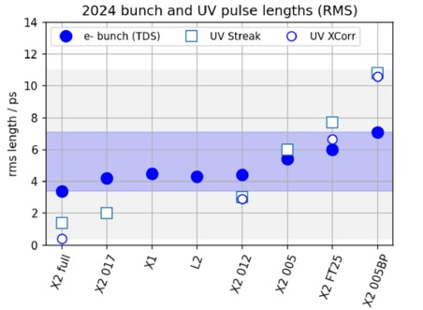
Electron Bunch Length (BL) Characterization
Motivation: quantify how electron bunch length at injector exit depends on initial laser conditions and injector settings, considering strong collective beam effects.
Electron BL depends on
initial photon bunch length
bunch charge
gun phase
laser spot size
measurement uncerntainty…

Slide 6
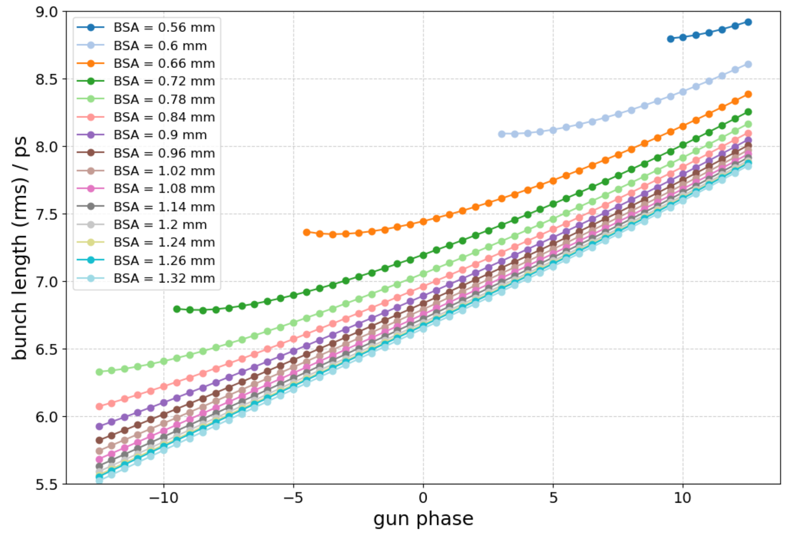
Systematical studies on impacts of gun phase and laser spot size on BL at 2 bunch charges and 3 laser pulse lengths
Laser temporal length: 25 ps （rms=7.2736 ps）
Bunch charge: 250 pC
Varibles | Range
Laser temporal length | Flattop 5, 9, 25 ps
Bunch charge | 10, 250 pC
Transverse spot size | 0.04 - 0.45 mm
Gun phase | -12.5 – 12.5 deg
Solenoid | 0.225 T
Electric field | 56 MV/m
Larger
BSA
/deg
compression phase

Slide 7
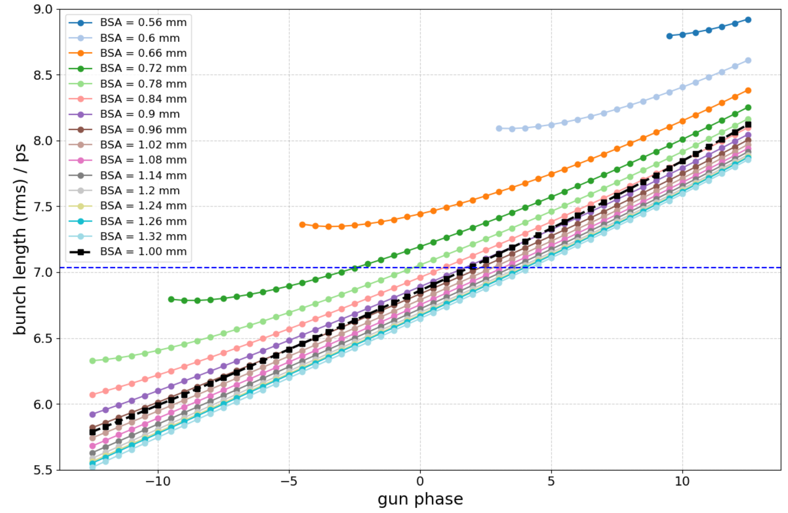
Identify simulation points consistent with measurements
Simulations data points:
25 ps （rms=7.2736 ps）
250 pC
Measurements data points:
25 ps 250 pC BSA=1.0 mm
Bunch length = 7.0341 ps in experiments
Larger
BSA
In simulations
At 25 ps 250 pC BSA=1.0 mm
gun phase ≈ 1.88, BL = 7.0341 ps
Rerun with 200k marcoparticles
At 25 ps 250 pC BSA=1.0 mm
gun phase ≈ 1.88, BL = 6.93 ps
/deg
compression phase

Slide 8
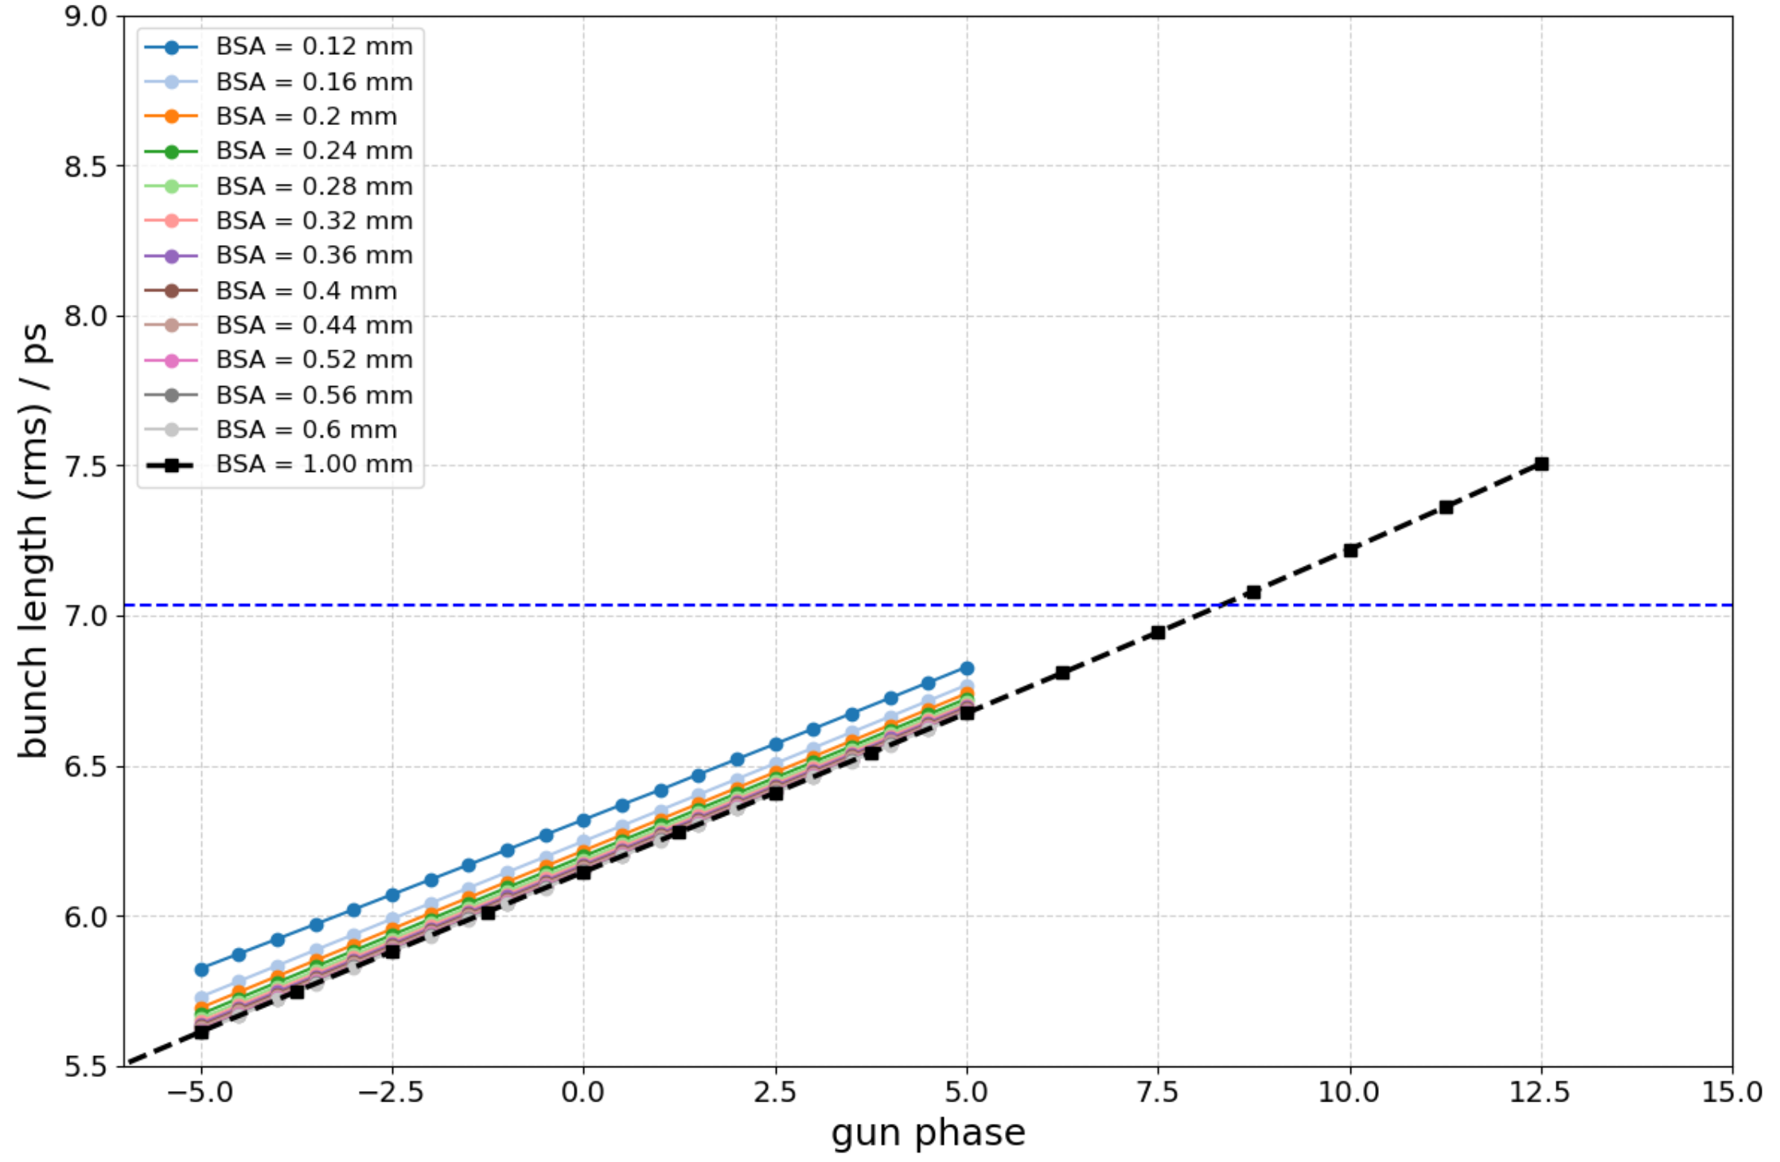
Lowering charge to 10 pC: finding simulation settings consistent with measured bunch length under reduced space charge
Simulations data points:
25 ps （rms=7.2736 ps）
10 pC
Measurements data points:
25 ps 250 pC BSA=1.0 mm
Bunch length = 7.0341 ps in experiments
Larger
BSA
In simulations
At 25 ps 10 pC BSA=1.0 mm
gun phase ≈ 8.33, BL = 7.0341 ps
Rerun with 200k marcoparticles
At 25 ps 10 pC BSA=1.0 mm
gun phase ≈ 8.33, BL = 7.0315 ps
/deg
compression phase

Slide 9
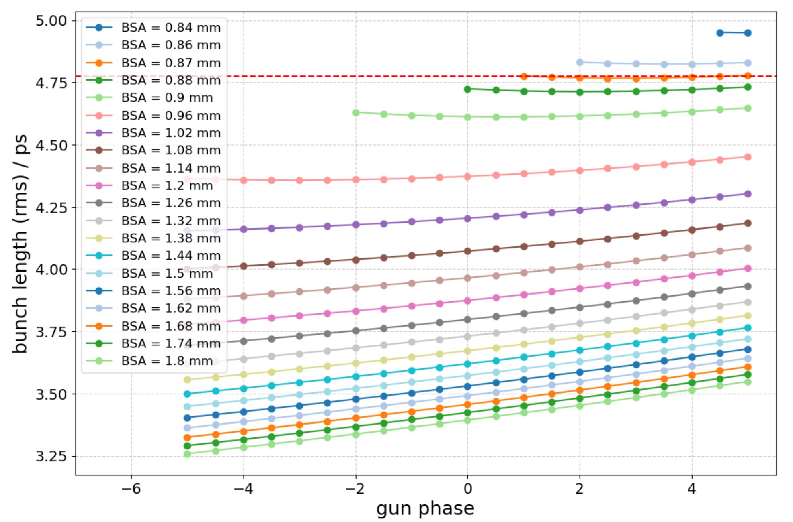
Identify simulation points consistent with measurements
Simulations data points:
9 ps （rms=2.752 ps）
250 pC
Measurements data points:
9 ps 250 pC BSA=1.0 mm
Bunch length = 4.7754 ps in experiments
In simulations
At 25 ps 10 pC BSA=0.87 mm
gun phase ≈ 1-5
BL = 4.7754 ps
/deg

Slide 10
Summary
Simulation Database of EuXFEL and PITZ Established for Machine Learning Applications
Emittance Optimization and Performance Analysis for EuXFEL and PITZ
Characterization and Validation of Bunch Length Dynamics

Slide 11
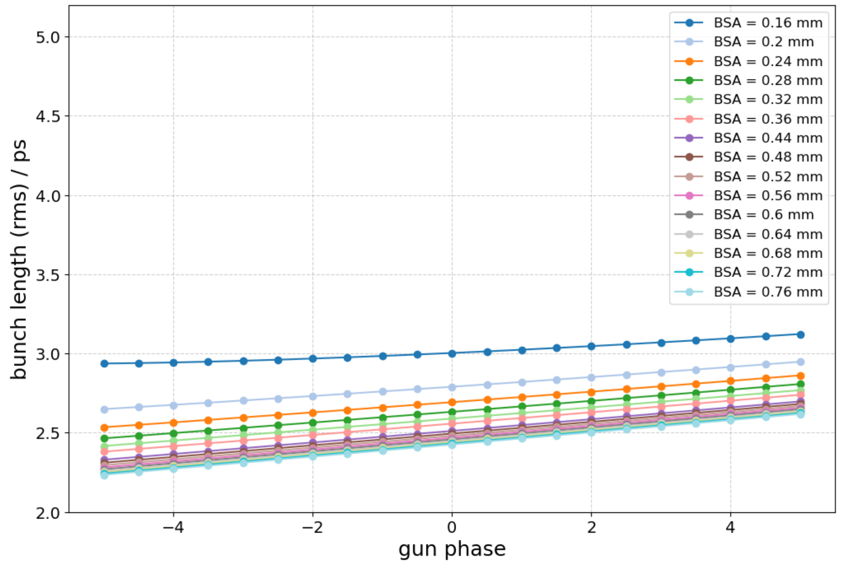
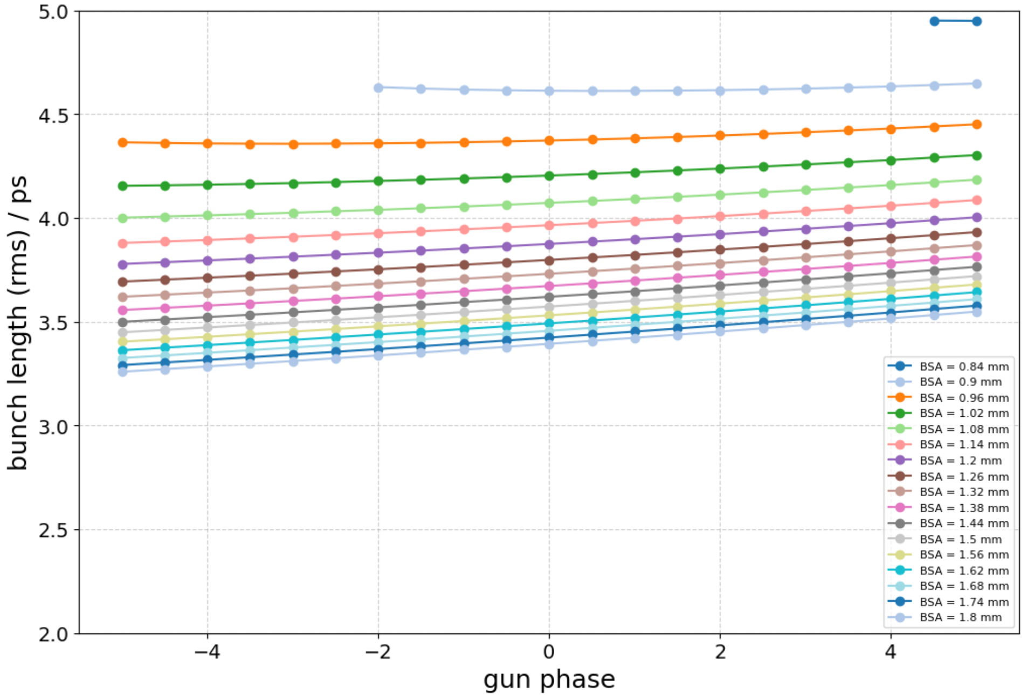
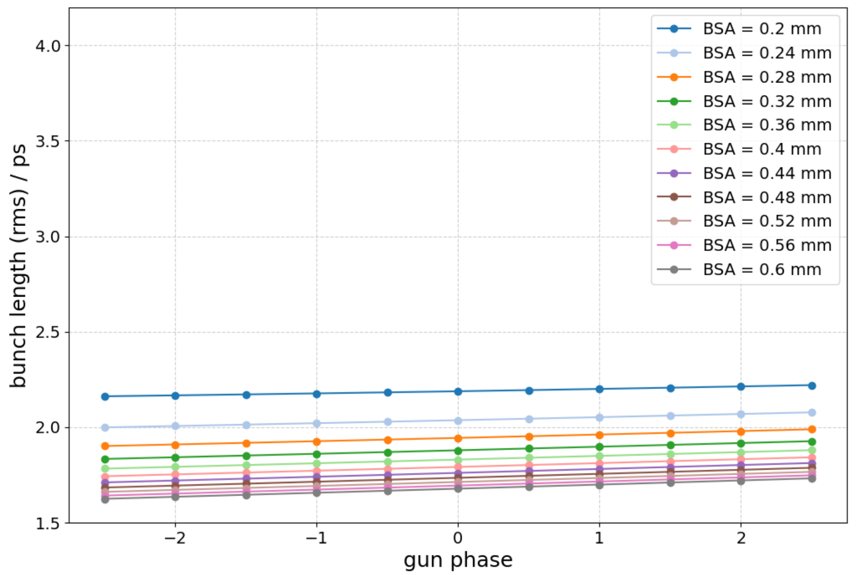
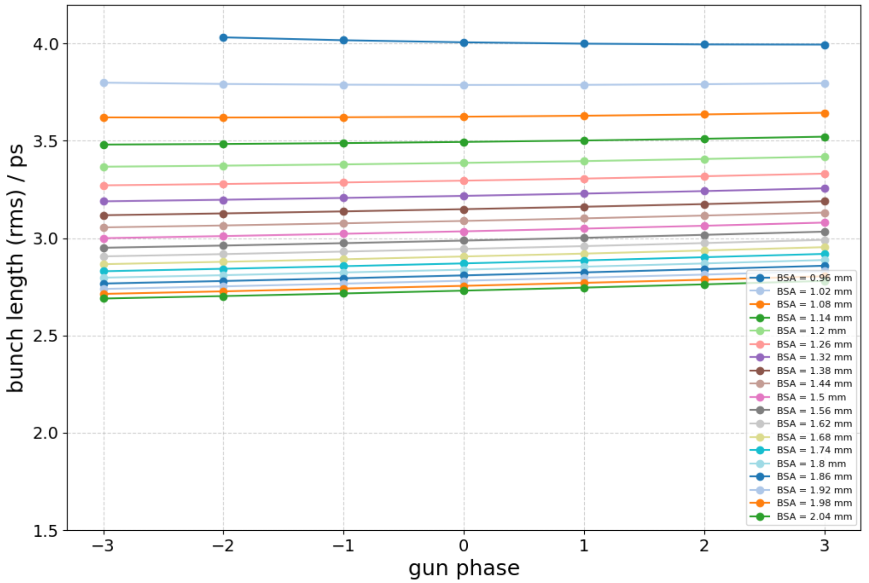
Backup slides
10 pC
250 pC
9 ps (rms=2.752 ps)
250 pC
10 pC
5 ps (rms=1.705 ps)

Slide 12
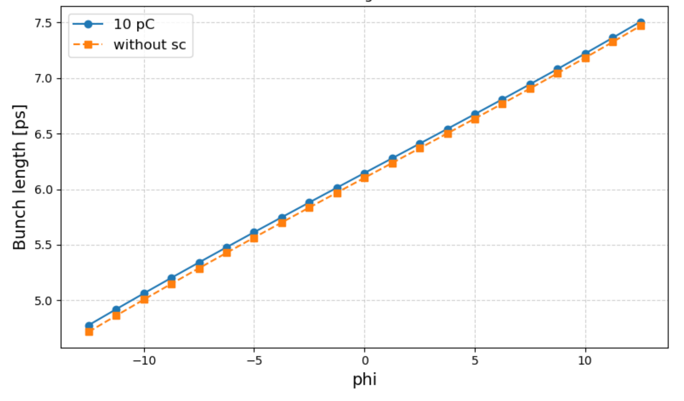
25 ps, bunch charge 10 pC vs. without space charge

