Slide 1
New Workflow for SciCat Data Publication
DCS Round 2 Update, July 21st 2025
Nicolas Hayen, Regina Hinzmann, DAPHNE4NFDI

Slide 2




DCS Round 2
Second round of DAPHNE Contributions to SciCat
Work by Martin Trajanovski since March 2025
Two major subprojects for this round
Improvement to Frontend UI and
search capabilities
Rework of data publication and
DOI minting workflow

Slide 3
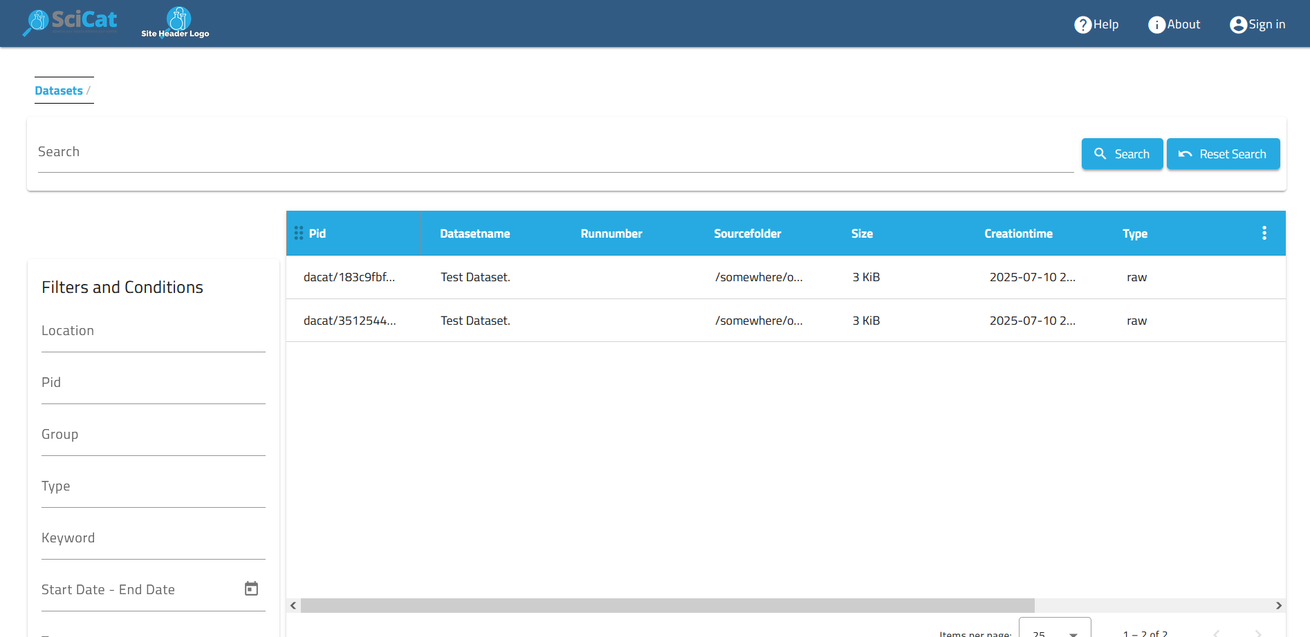
UI Improvements

Slide 4
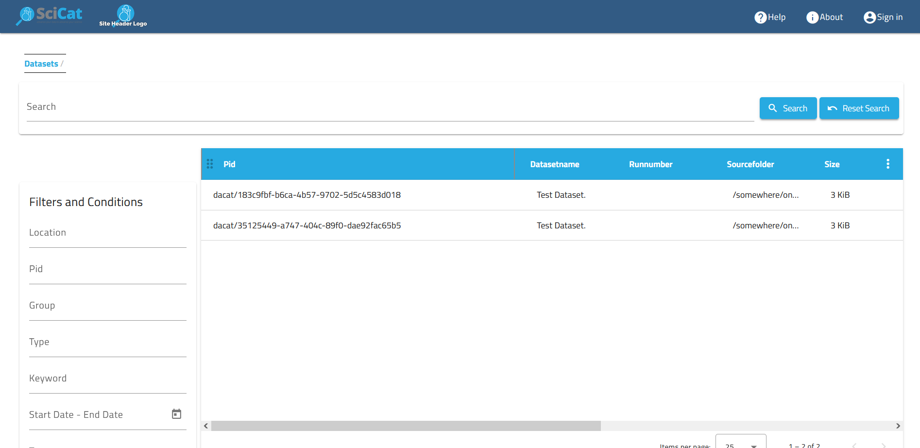
UI Improvements

Slide 5

UI Improvements

Slide 6
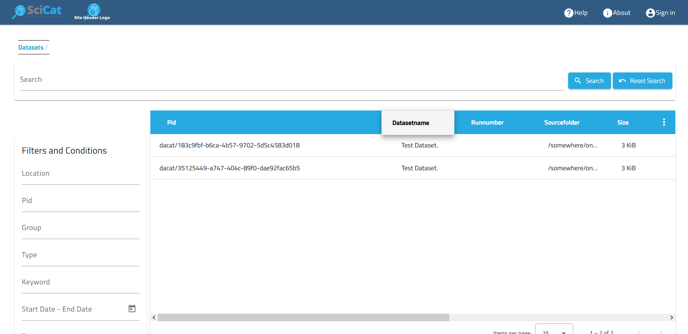
UI Improvements

Slide 7
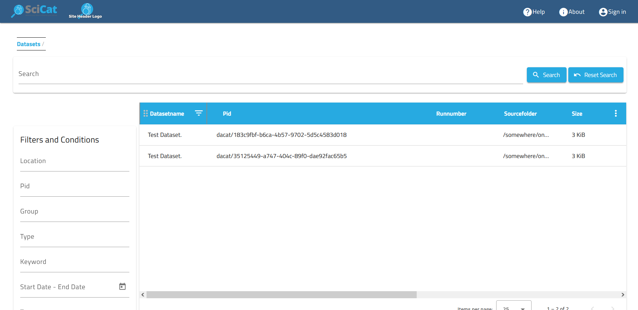
UI Improvements

Slide 8
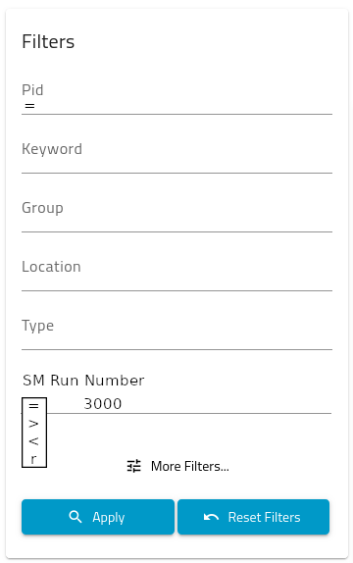
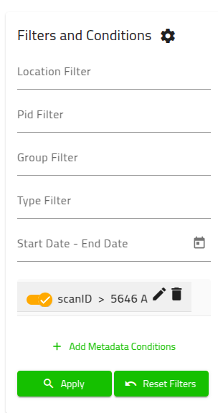
UI Improvements
Improvements to Frontend search filters
https://github.com/SciCatProject/frontend/issues/1806
Streamline adding SM filters
Add new operators
Higher responsiveness
Use Dataset API v4 queries

Slide 9

SciCat DOI
Reworking the data publication / DOI feature in SciCat
Replacing the existing system with
extended new workflow
Focus on general applicability and
user freindliness

Slide 10
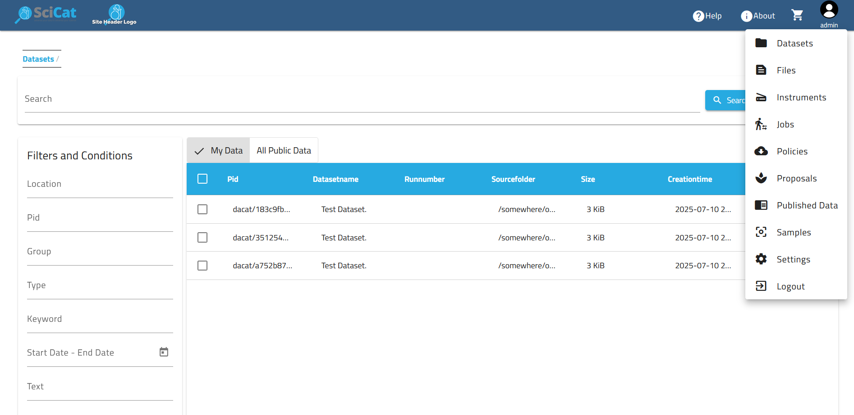
SciCat DOI

Slide 11
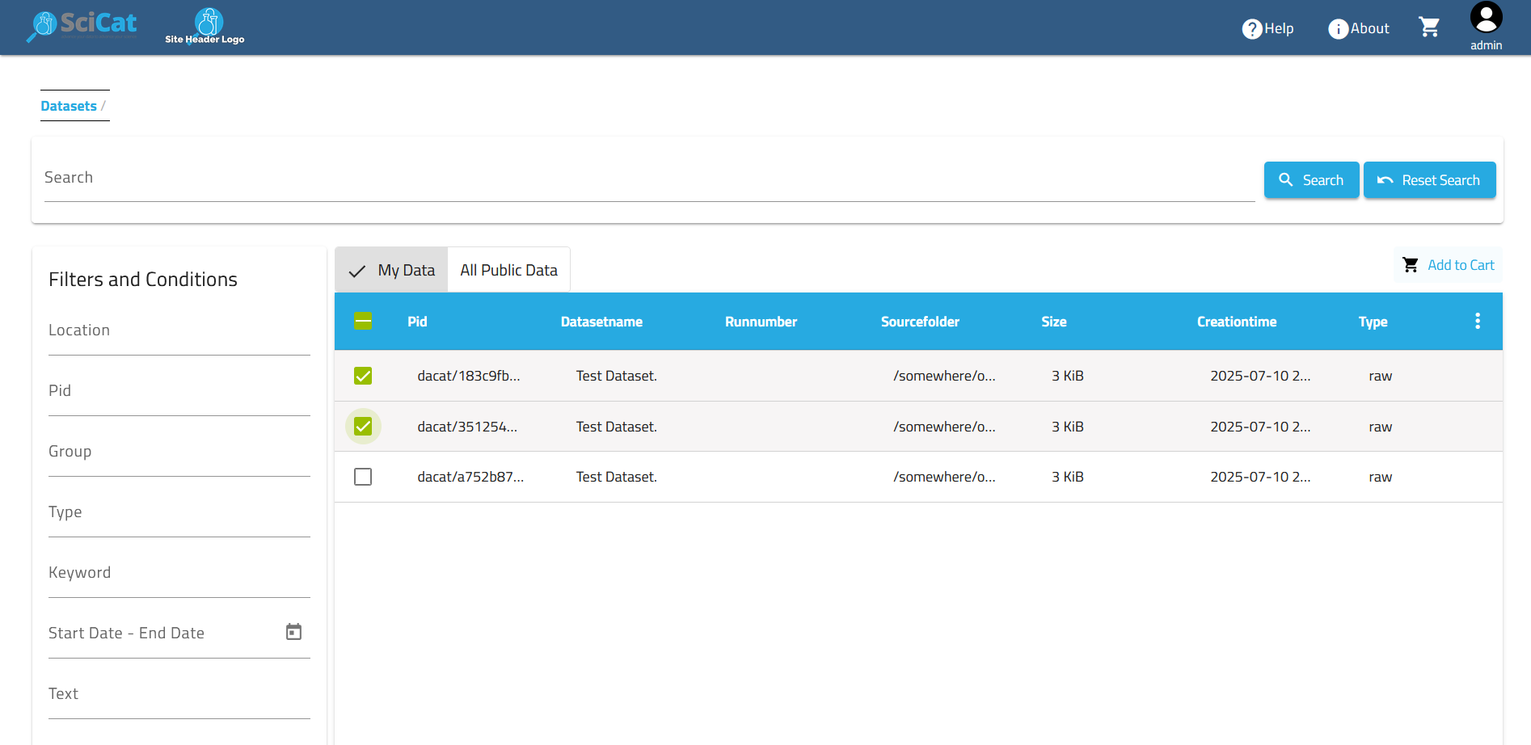
SciCat DOI

Slide 12

SciCat DOI

Slide 13
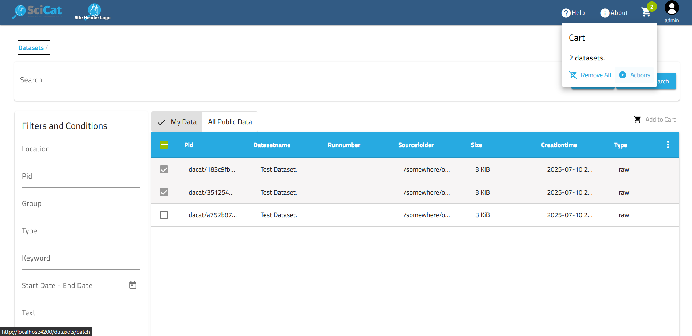
SciCat DOI

Slide 14
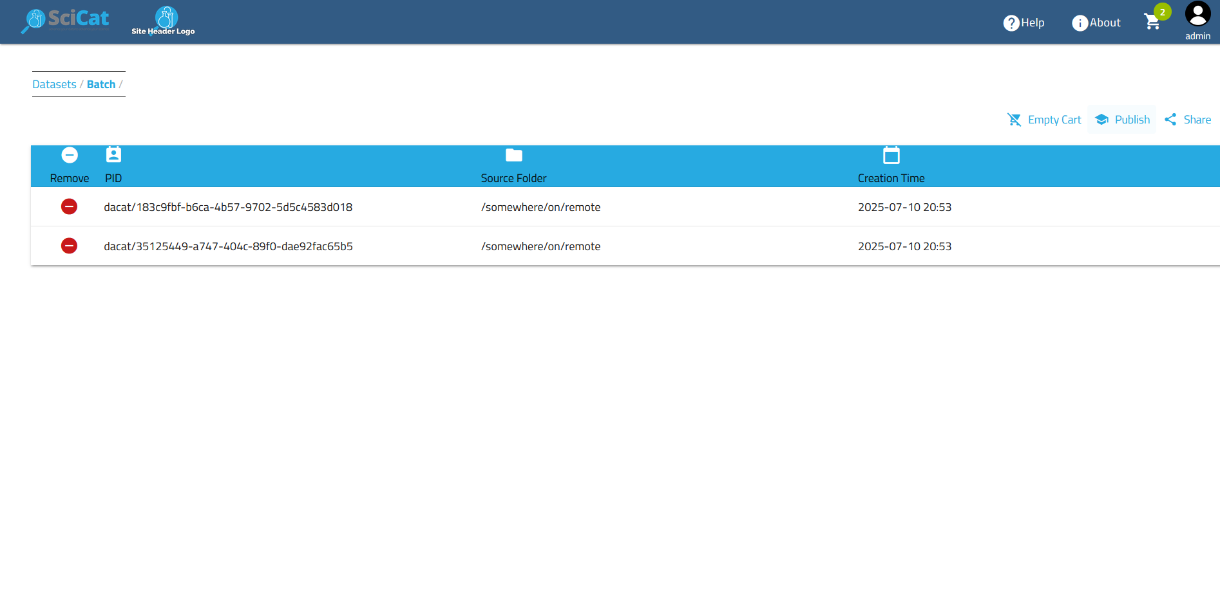
SciCat DOI

Slide 15
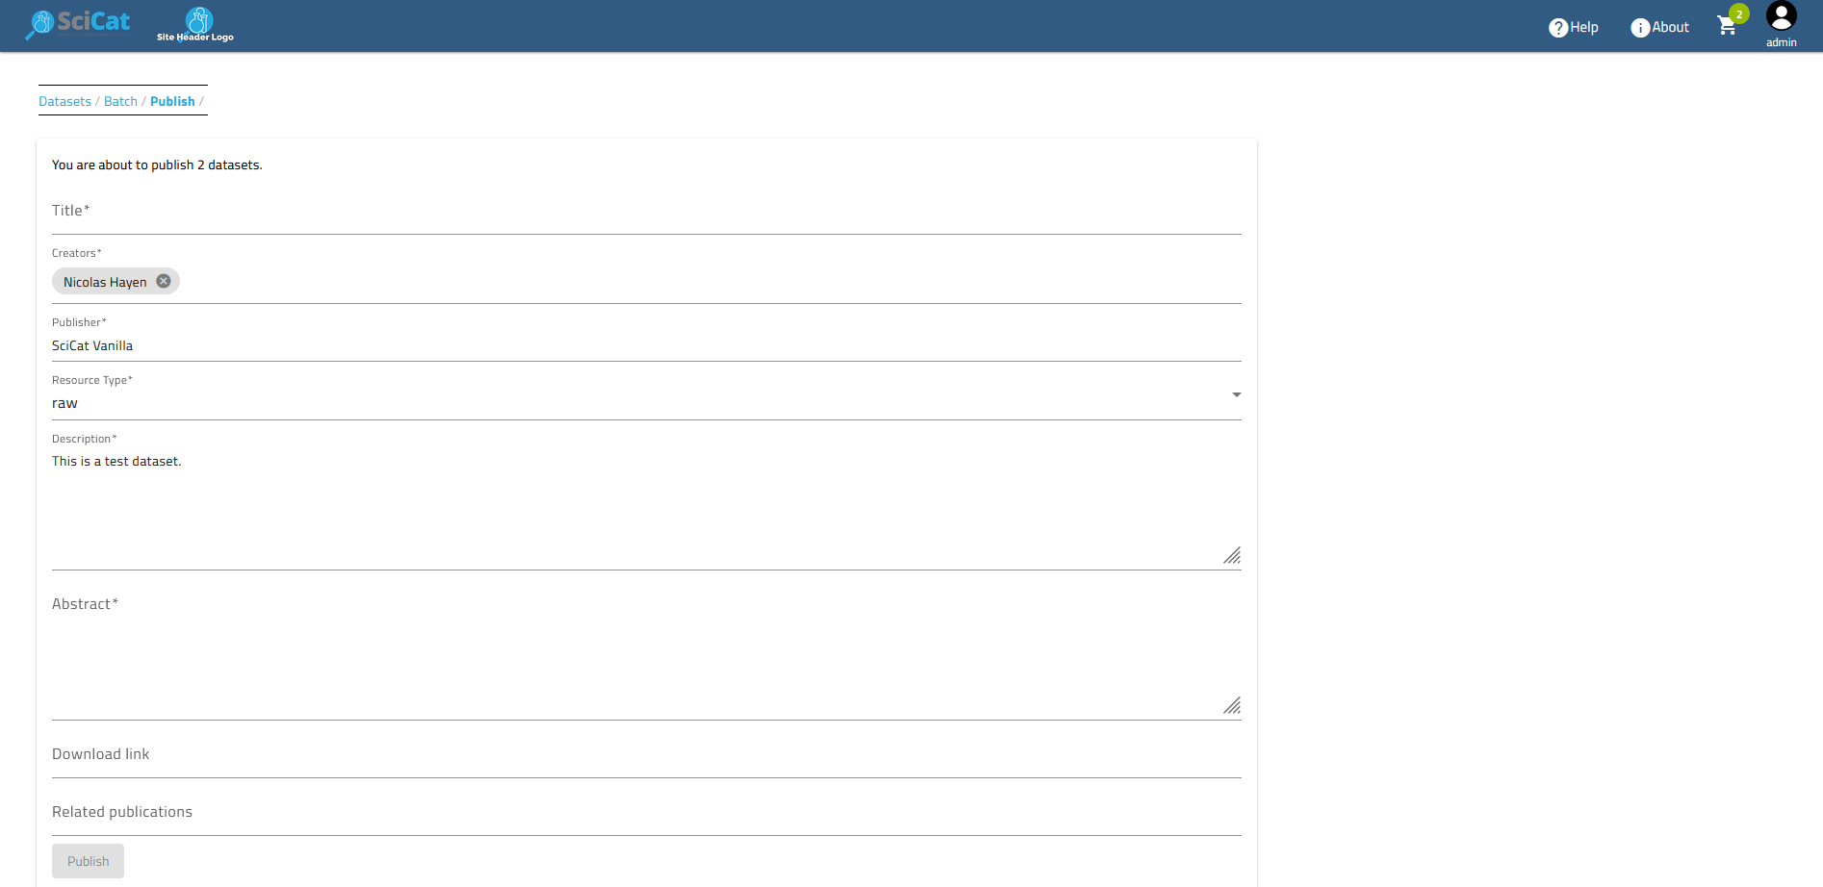
SciCat DOI

Slide 16
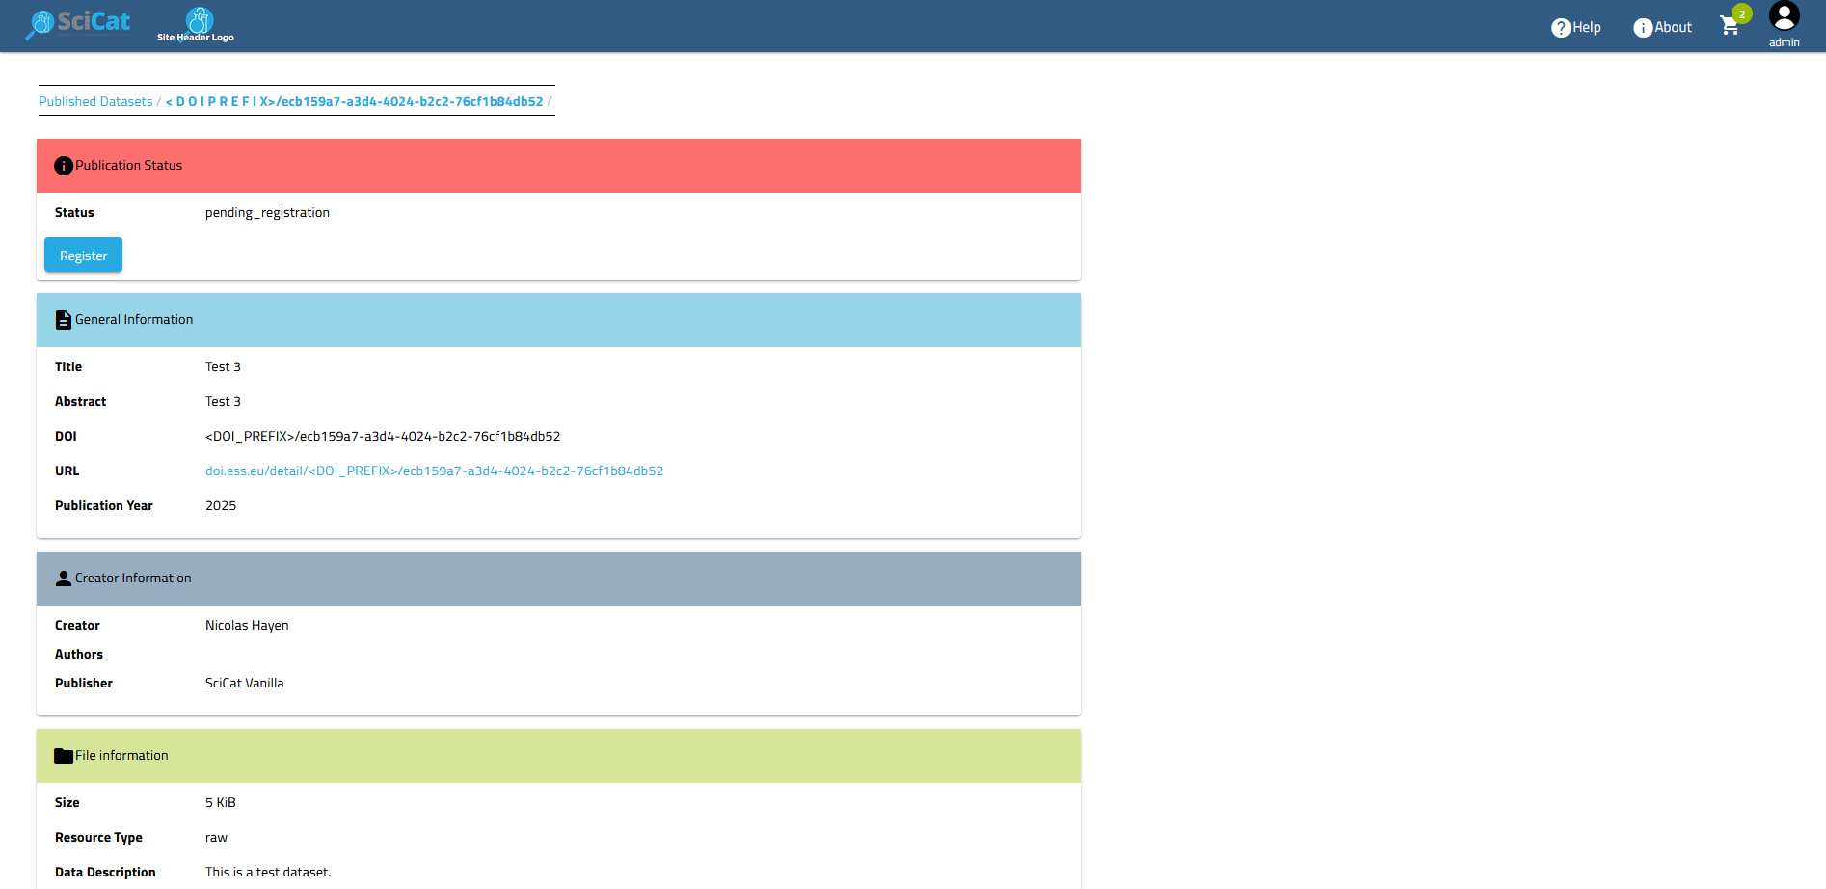
SciCat DOI

Slide 17
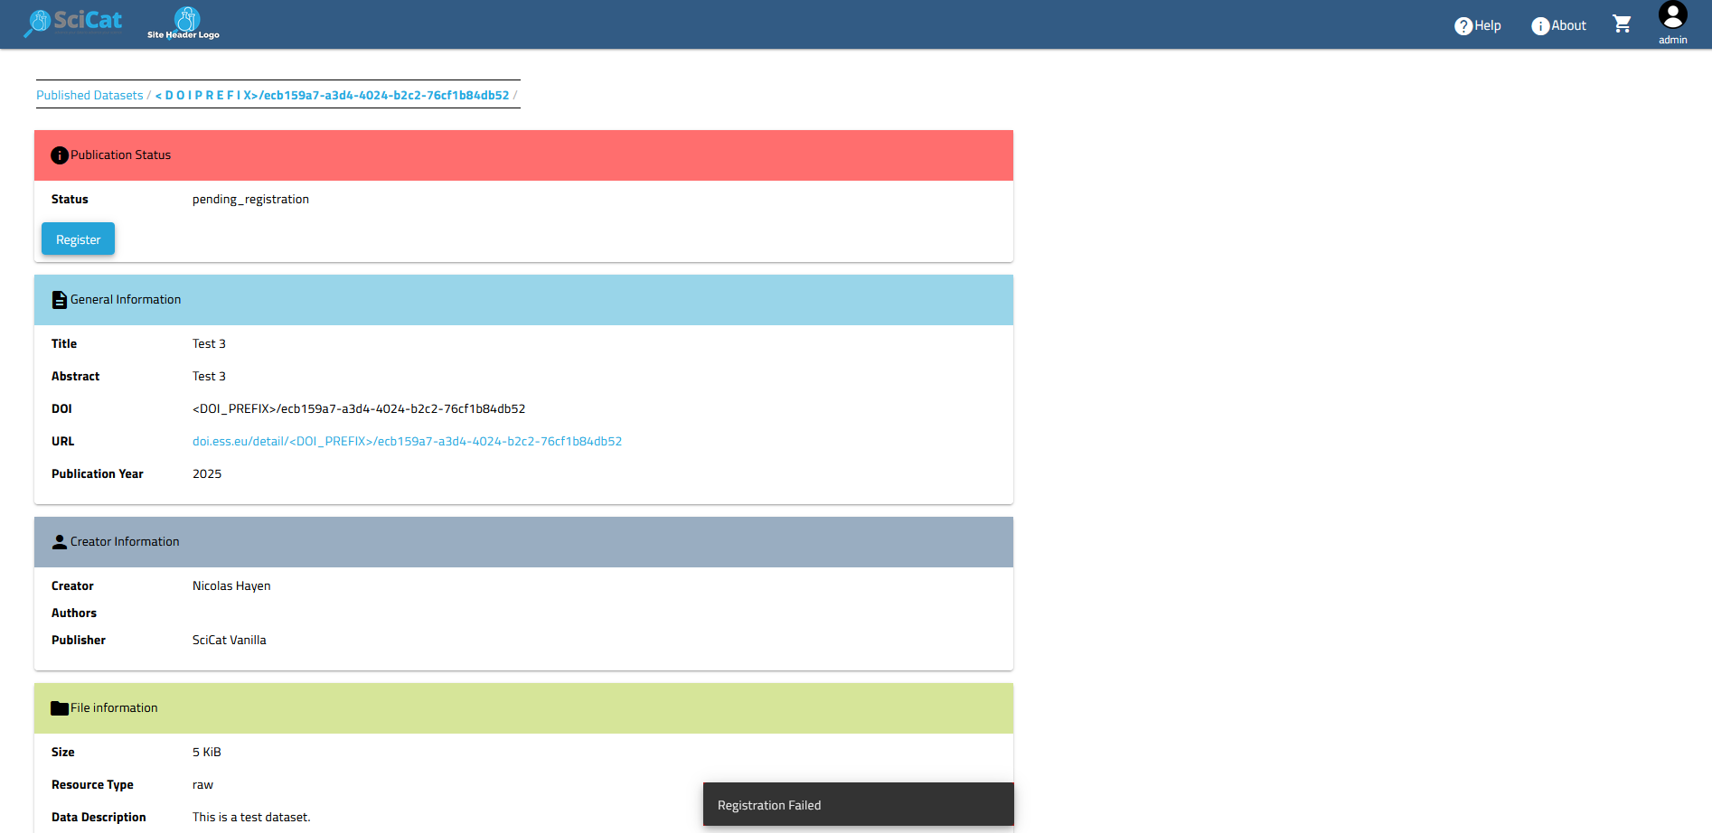
SciCat DOI

Slide 18
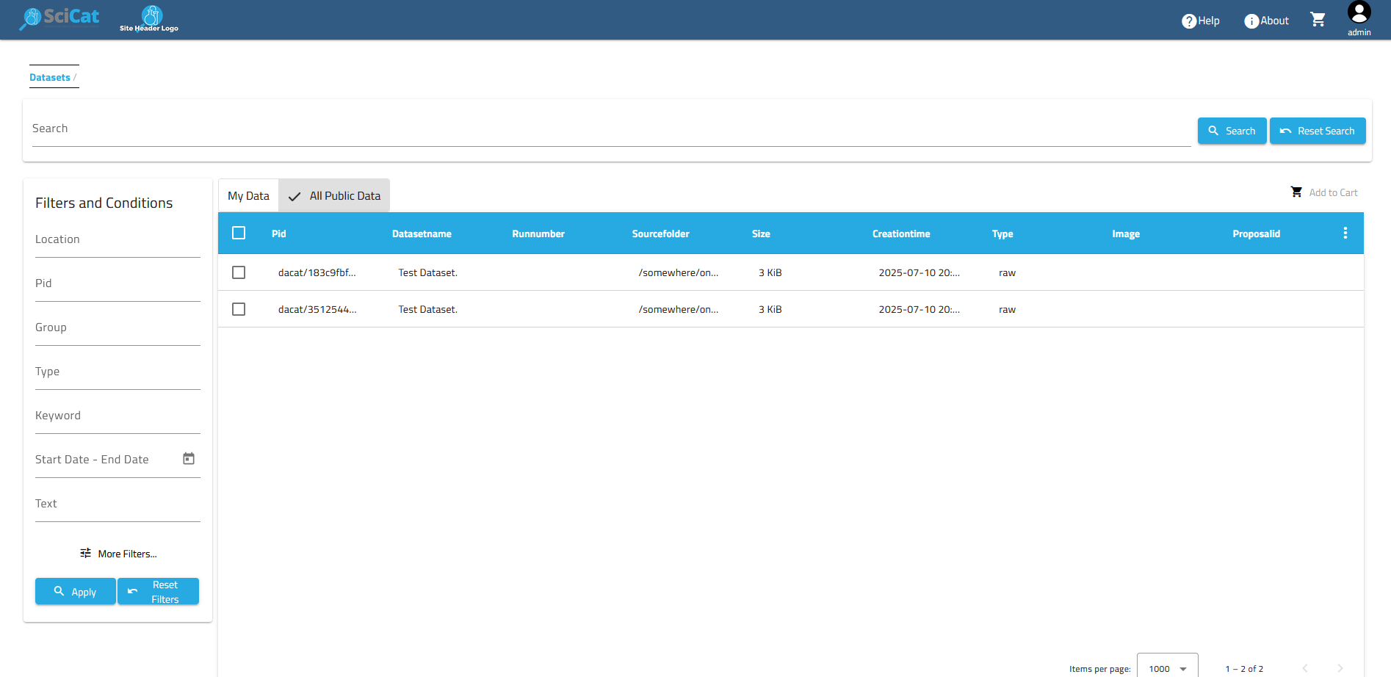
SciCat DOI

Slide 19
Problems
Unintuitive UI path to get to data publication
Metadata form covers only absolute minimum for DOIs
No possibility to edit PublishedData once created
All data is made public upon registration, but can be hidden again
No possibilty for integration with other services / databases

Slide 20




New workflow
Editable
Locked
public
Create
Publish
Register
Review
Review
Dataset List
PublishedData
Status: private
Status: public
Status: registered

Slide 21
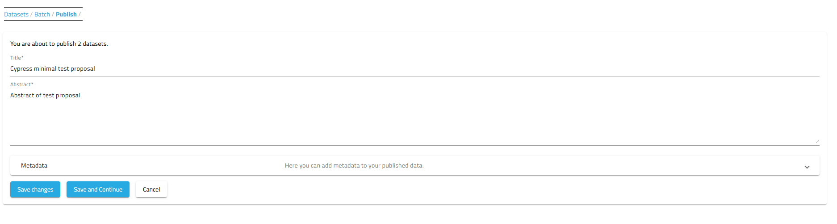
Metadata Form

Slide 22
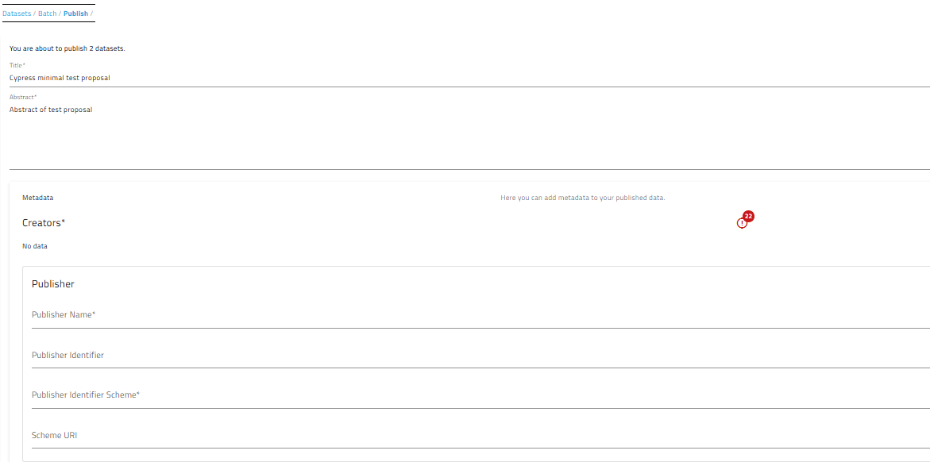
Metadata Form

Slide 23
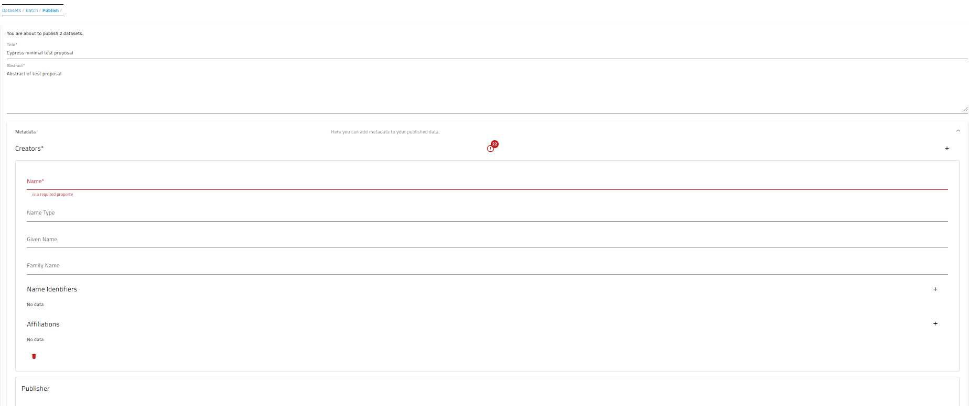
Metadata Form

Slide 24
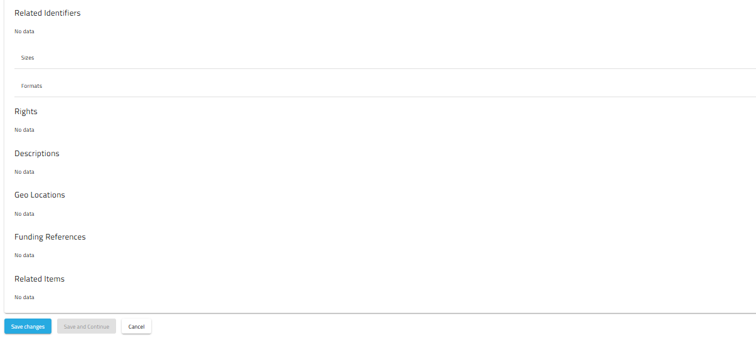
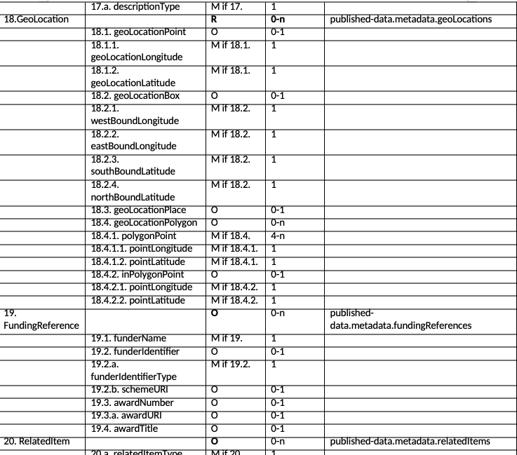
Metadata Form

Slide 25
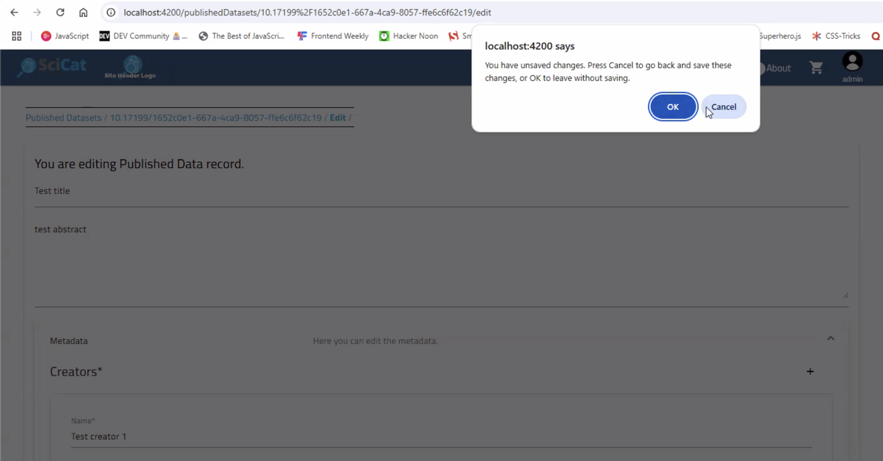
Metadata Form

Slide 26
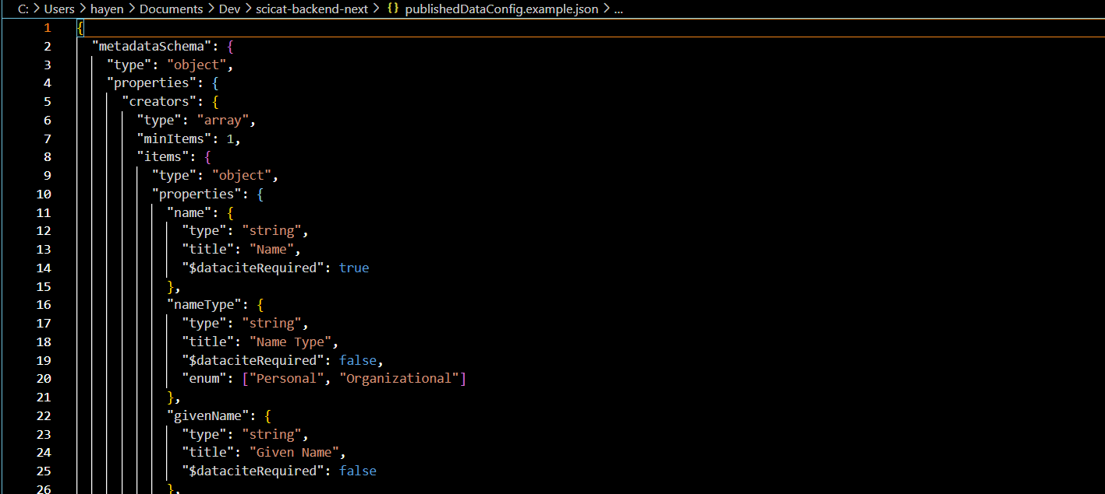
Configuration

Slide 27
Summary & Timeline
When will the features be available?
Adjustable columns: already available (FE v5)
Reworked published workflow: by end of contract
Fix in search w/ scientific metadata: not trivial
Focus now in SciCat Collaboration: follow up of topics from SciCatCON2025
Mono repo, UI/UX (DAPHNE contribution)
Details for Governance model: September

