Slide 1
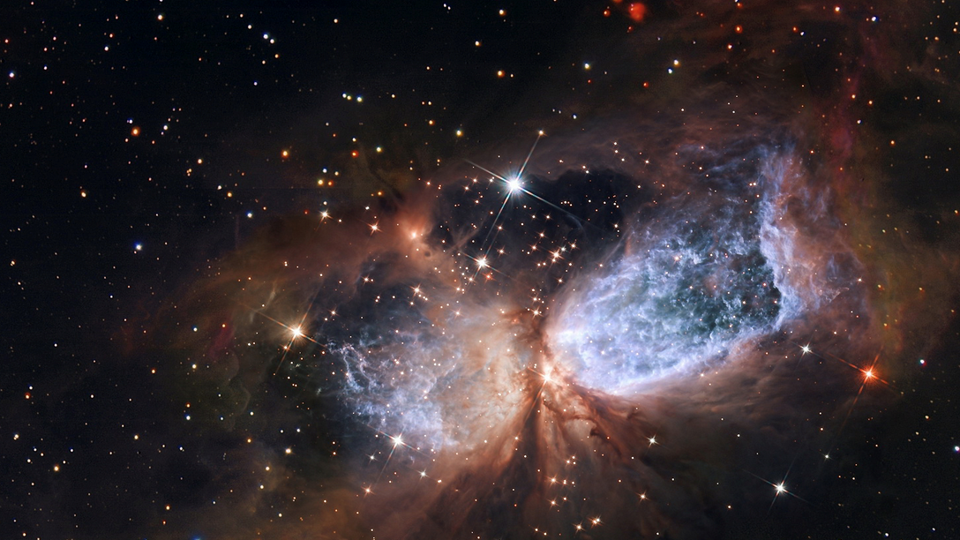
Development of FH Infrastructures
Detector Assembly Facility, Building 2, Wolfgang Pauli Centre, Data Centre,
Test Beam Facility
Thomas Schörner
PRC 100, 11 November 2025

Slide 2
The Detector Assembly Facility (DAF)

Slide 3
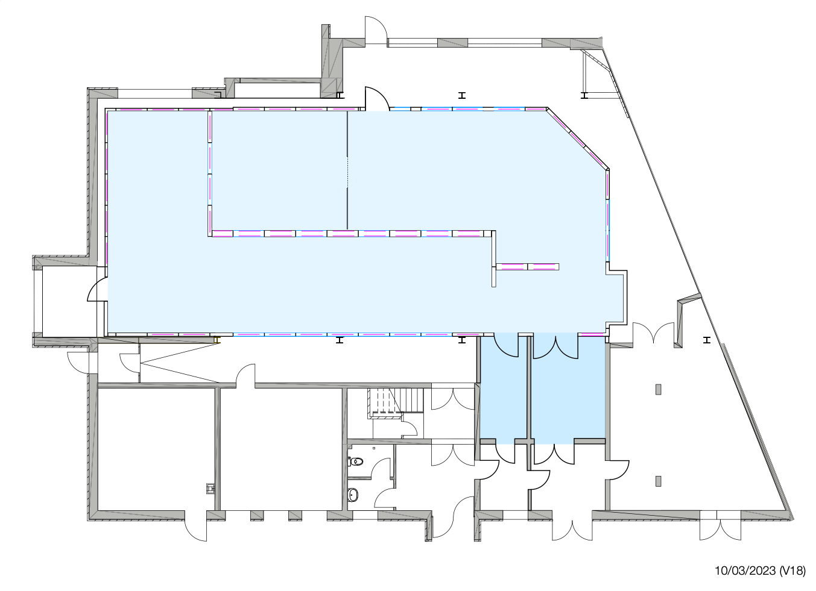
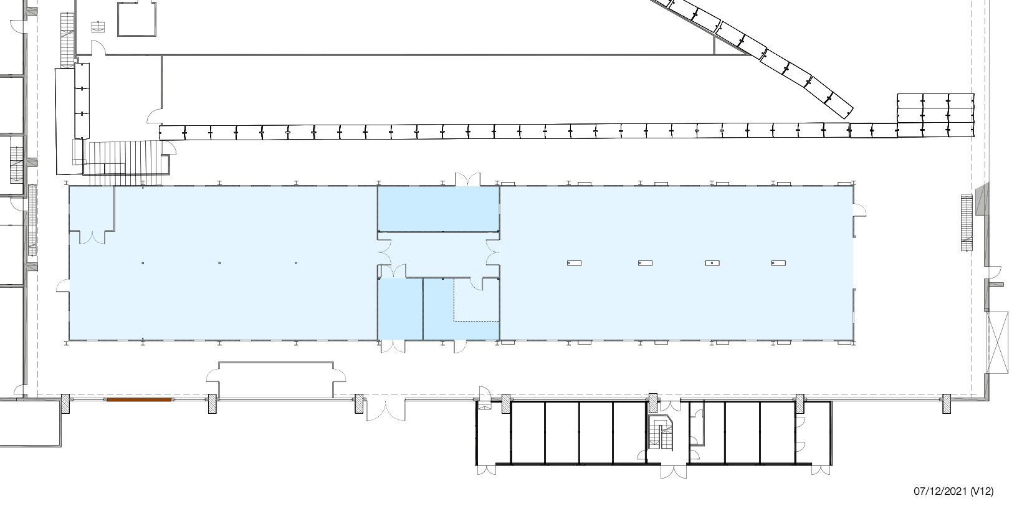
Detector Assembly Facility
Thinking about usage after HL-LHC tracker end-cap production
Two clean rooms with 255 m² (ISO6) and 620 m² (ISO7); facility with specialized equipment for detector development and construction
Essential for the HL-LHC upgrades of the ATLAS and CMS tracker, excellent asset for future detector projects
Ideas for the future:
“small” DAF: lab space for detector development (FE); compensation for labs in building 2?
“large” DAF: Plan to use as infrastructure for detector development (FH, FS / PETRA IV, potentially external / industry)
Contribution to High-Tech Agenda of Federal Government

Slide 4
Building 2, the New Data Centre and the Wolfgang Pauli Centre

Slide 5
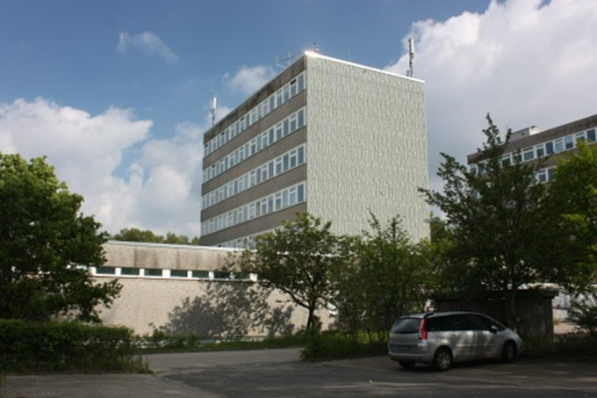
B2: Status and Options
Theory and Computing Centre
            Building 2 (a and b)
            Built in 1972
            home to (parts of) DESY and UHH theory, to computer centre / IT and electronics development FE
            Status of building
            In strong need of repair (and extension) ..
            … but current renovation estimate at ~28 Mio EUR
            Decision: no full renovation, but investments into electricity / cabling and fire safety measures to keep building alive for ~10 more years.
            Consequences for theory and Computing Centre / IT!

Slide 6
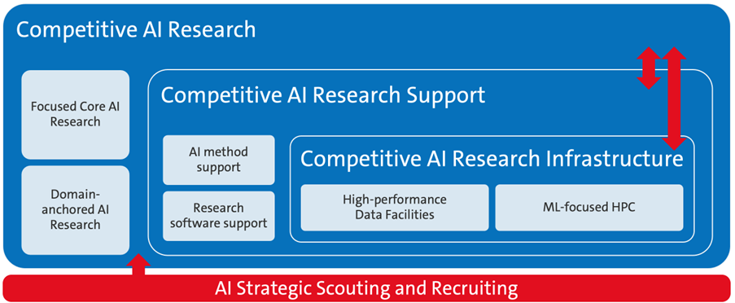
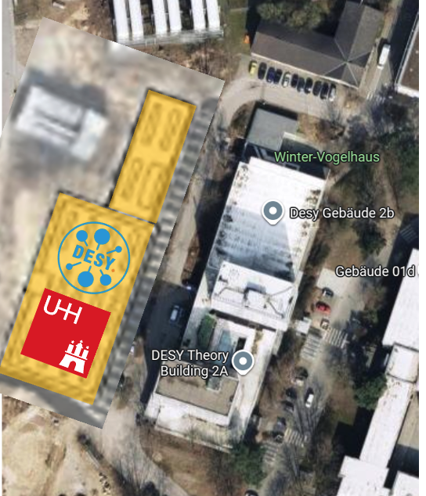
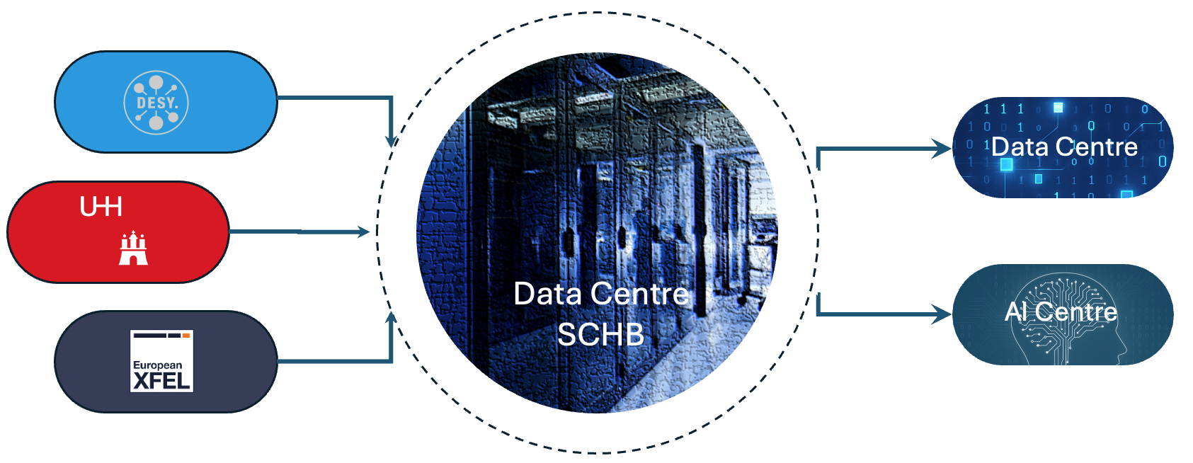
The New Data Centre
Taking SCHB computing into the next decades
            DESY operates modern compute centre
            Focus on data-intense computing: LHC, DESY data sources, European XFEL, soon PETRA IV, …
            Science City Hamburg Bahrenfeld: new requirements
            … in terms of data volumes / rates, AI etc.
            Existing computing centre building 2b (built 1972!)
Extension / renovation not reasonable
➔ Feasibiliity study new compute centre SCHB on campus
            Current plan and status:
Planning for joint DESY-UHH compute centre
Focus on data intense science for Bahrenfeld location
Aspiration: AI centre for northern Germany
Cost frame phase 1 (next slide): 96 Mio EUR
Notes:
There is a document proposing such a regional AI centre in Hamburg, which has already quite detailed ideas on the structural and scientific implementation.

Slide 7
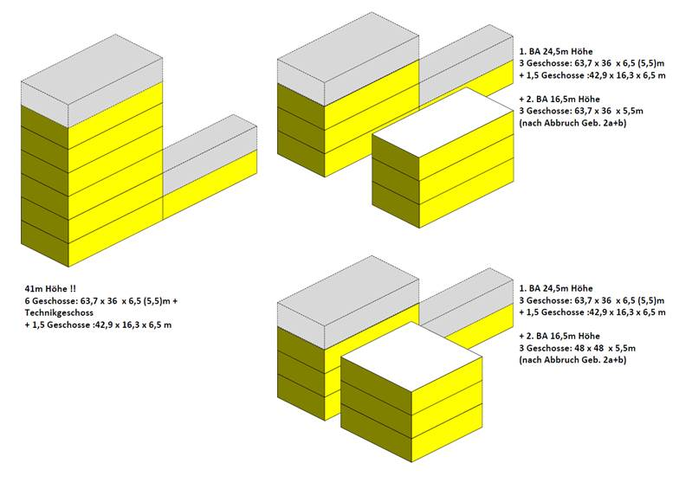
A Staged Approach
… allowing continued use of building 2
Area
Old: 2000 m²
New phase 1: ~10.000 m²
New phase 2: ~15.000 m²
Energy consumption
Old: 1.5 MW
New phase 1: 4.0 MW
New phase 2: 16.0 MW
New PUE = 1.158!
Invest:
Phase 1: 96.49 Mio EUR 19200 EUR/kWh
Phase 2: 138.8 Mio EUR 8697 EUR/kWh
Operation costs / year (100% IT
usage, phase 2, 2025 cost base)
0.3 EUR/kWh: 52 Mio EUR
0.15 EUR/kWh: 28 Mio EUR
(DESY price)
Original one-building plan
Phased Ansatz with two buildings
adjust to the development of the needs from the main users
Separate into more manageable chunks

Slide 8
A Staged Approach
… allowing continued use of building 2
Original one-building plan
Phased Ansatz with two buildings
Area
Old: 2000 m²
New phase 1: ~10.000 m²
New phase 2: ~15.000 m²
Energy consumption
Old: 1.5 MW
New phase 1: 4.0 MW
New phase 2: 16.0 MW
Invest:
Roughly 100 Mio EUR for phase 1
Operation costs / year
Depending on electricity prices
28-52 Mio
adjust to the development of the needs from the main users
Separate into more manageable chunks
Notes:
New building very efficient PUE 1.1598 oder so!
2025 cost base)
0.3 EUR/kWh: 52 Mio EUR
0.15 EUR/kWh: 28 Mio EUR
(DESY price)

Slide 9

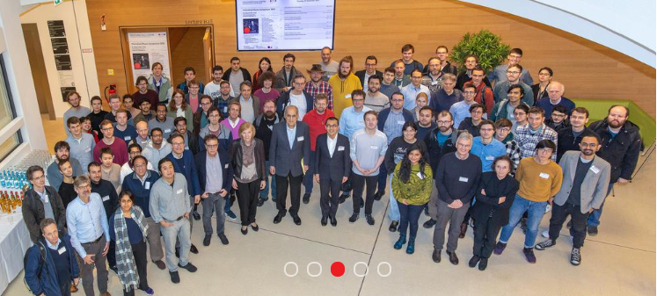
The Wolfgang Pauli Centre (WPC)
An interdisciplinary centre for theoretical physics in Hamburg
            Centre in existence since long
            Centre established as centre of excellence and meeting point of DESY + UHH theorists and guests with strong scientific programme
            Goal: building = surroundings that foster scientific exchange
Planning since about 10 years, numerous ideas for
(initially) a new building on campus.
Goal: scientific home for theory, room for discussions and seminars, room for guest. / visitor programme
            Current status:
Rental and renovation of „Doppel-H“ close to campus Planning DESY-UHH concluded
Discussions with City of Hamburg
about rental conditions ongoing
Expectation: Moving to Doppel-H in 2 years
WPC building requirements in numbers
DESY 116 persons
UHH 81 persons
WPC: 46 persons (guests, admin, etc.)

Slide 10
The Test Beam Facility

Slide 11
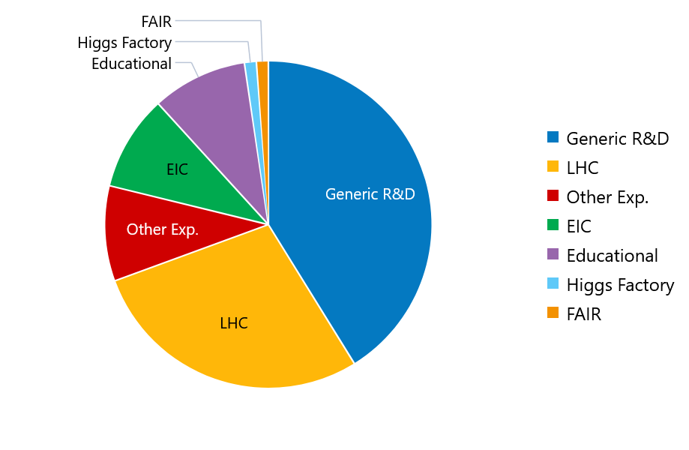
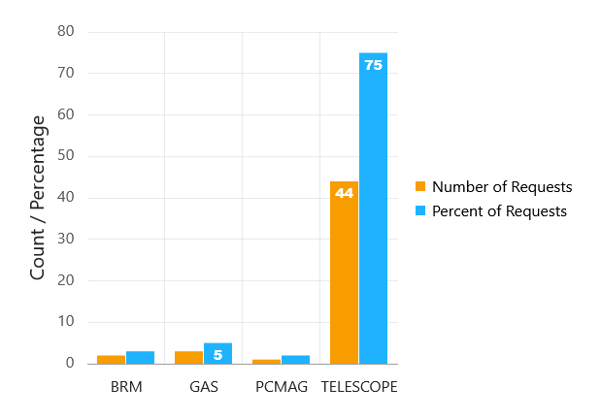
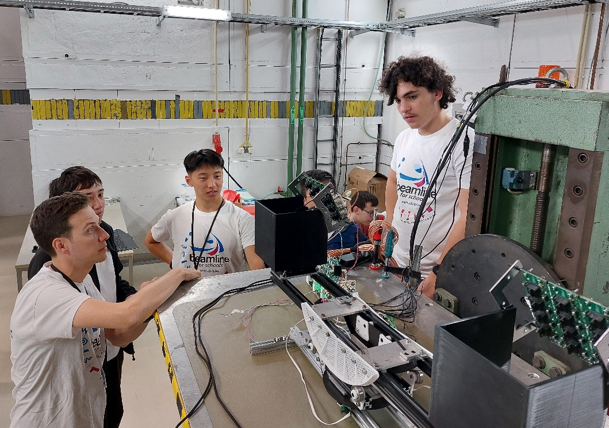
Test Beam Facility Status
Going very strong – many users, upgrade of infrastructure, Beamline4Schools !
            2025 Statistics (status 3 Nov)
376 users - 167 from German institutes
105 slots (weeks) – 81% used
~Half of the users are students → essential training facility!
            Telescope upgrade – ALPIDE!
New ALPIDE-based telescopes – first benevolent users!; some features identified and fixed
Next steps: Final board – 2nd generation submitted.
Inquiries from FNAL and SLAC
            Beamline4Schools 2025: 2 teams!
Two projects: testing self-designed muon detector and testing organic scintillators
A. Athanassidis and A. Laudrain essential as support scientists (and S. Krause!)
Continuous support with dedicated staff is essential!
Notes:
Teams from Canada and Mexico
BIG RED MAGNET 1.4
pCMAG 1 T

Slide 12
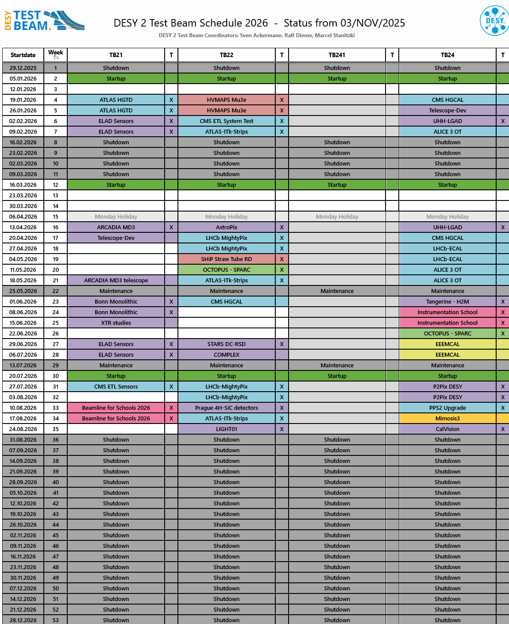
Test Beam Facility Future
Continued user interest / need → need to think about the „PETRA IV“ future
Schedule 2026 finalized – again well booked
Shutdown Sep ‘26 – Feb ‘27 (new LINAC II interlock, PIA renovation)
Test beam in PETRA IV era: Discussions ongoing!
Test beam should become integral
part of PETRA IV project
Keep in mind: Test beam is an internationally used (and highly esteemed) infrastructure!
After 2027:
CERN LS3 (2027-29+)
Shift of PETRA IV (2030): “dark time” in Europe avoided
Coping with >700 users during LS3 a challenge (in particular given current person power)
Additional FNAL test beam facility down time starting 2027
→ additional beam time requests from US users expected

Slide 13
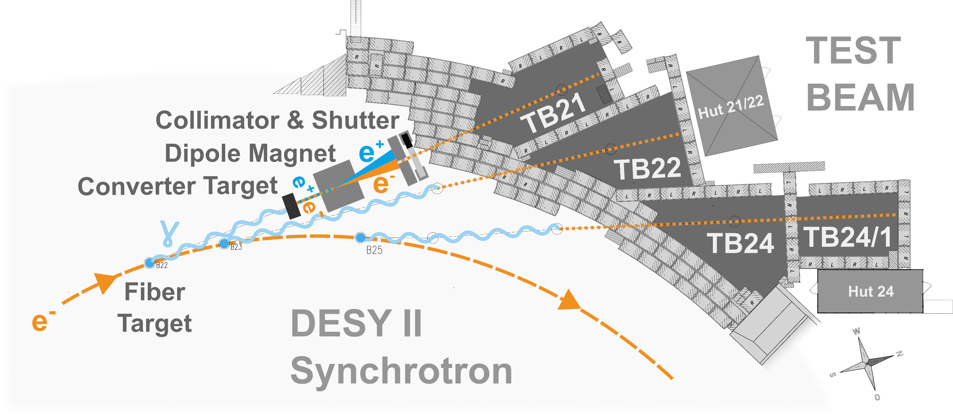
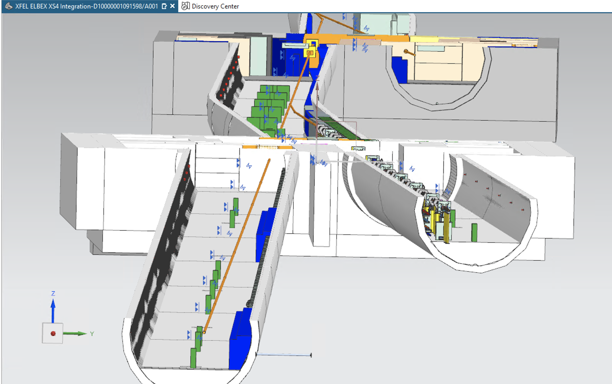
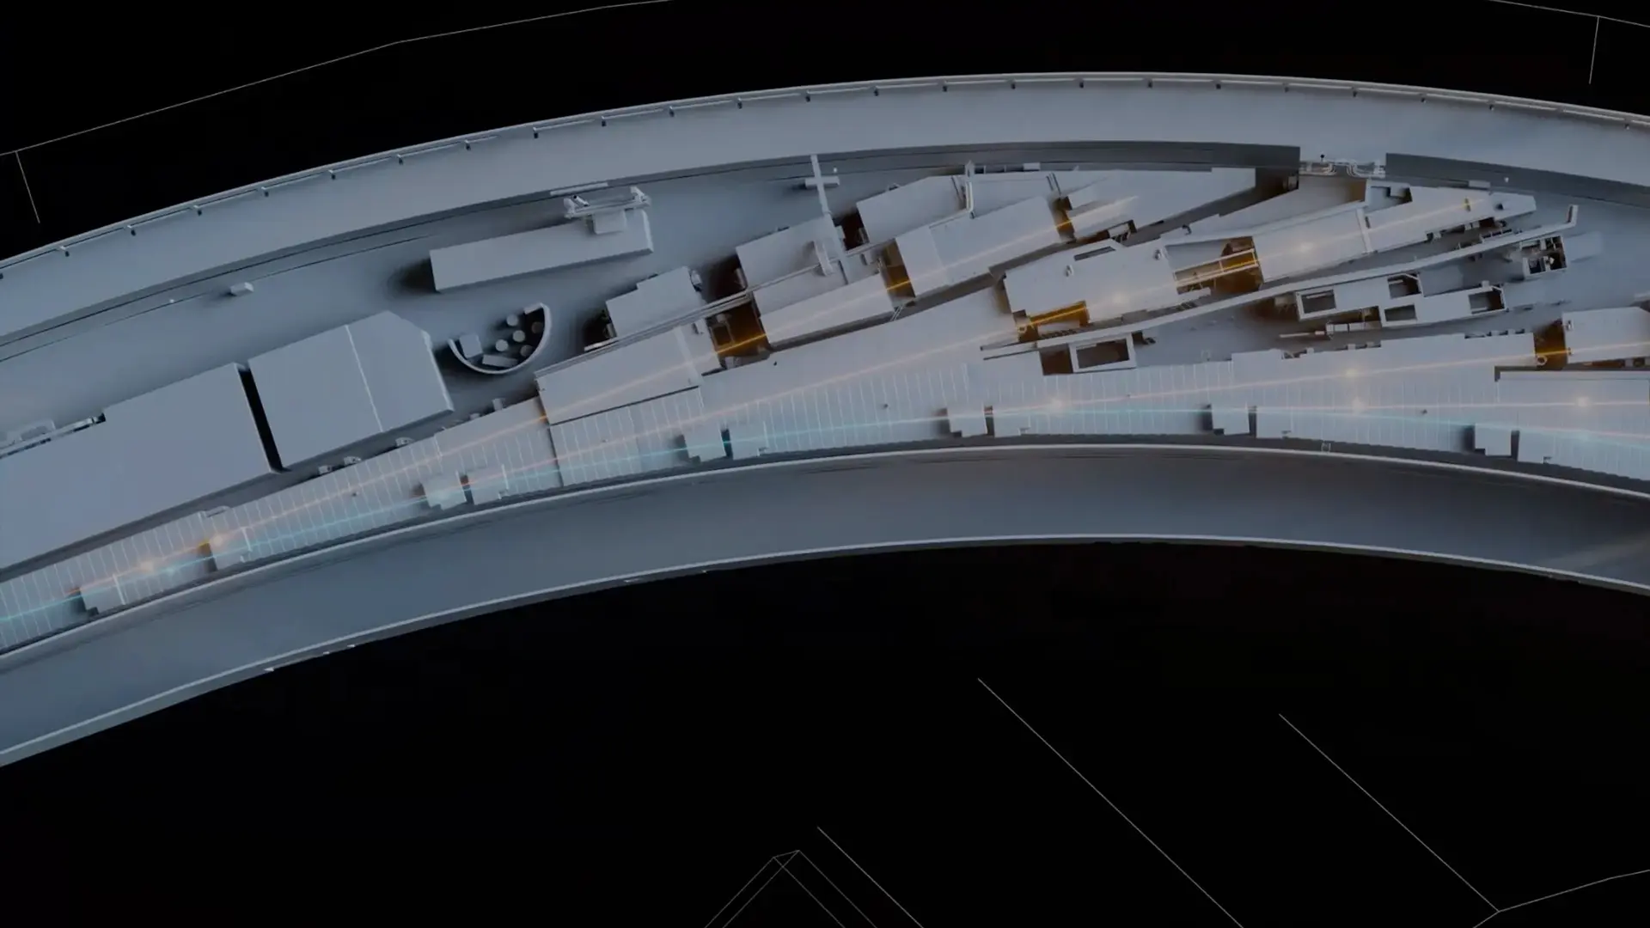
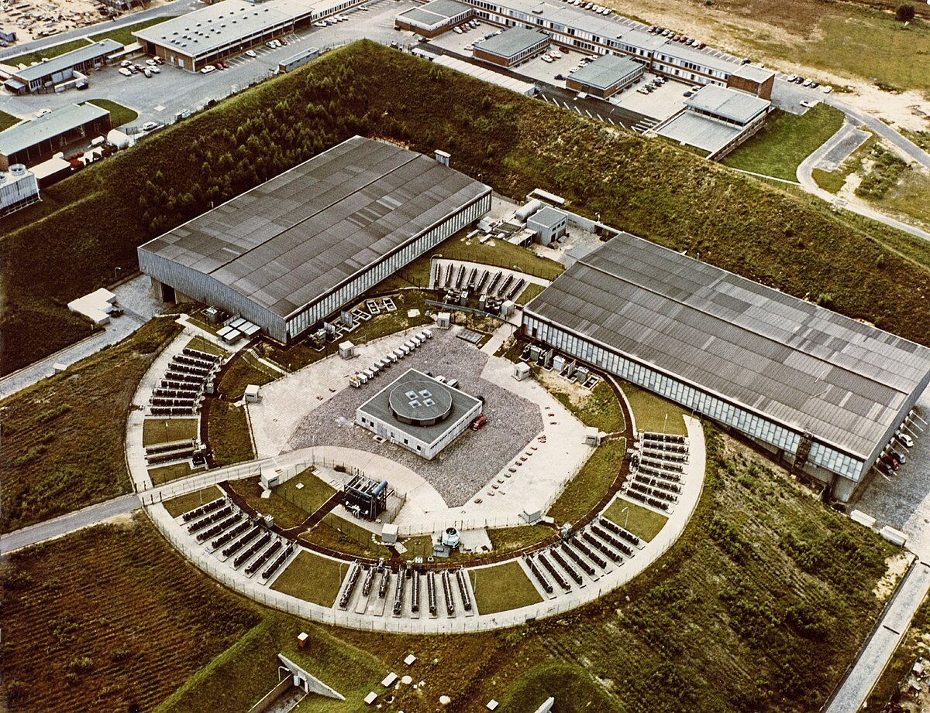
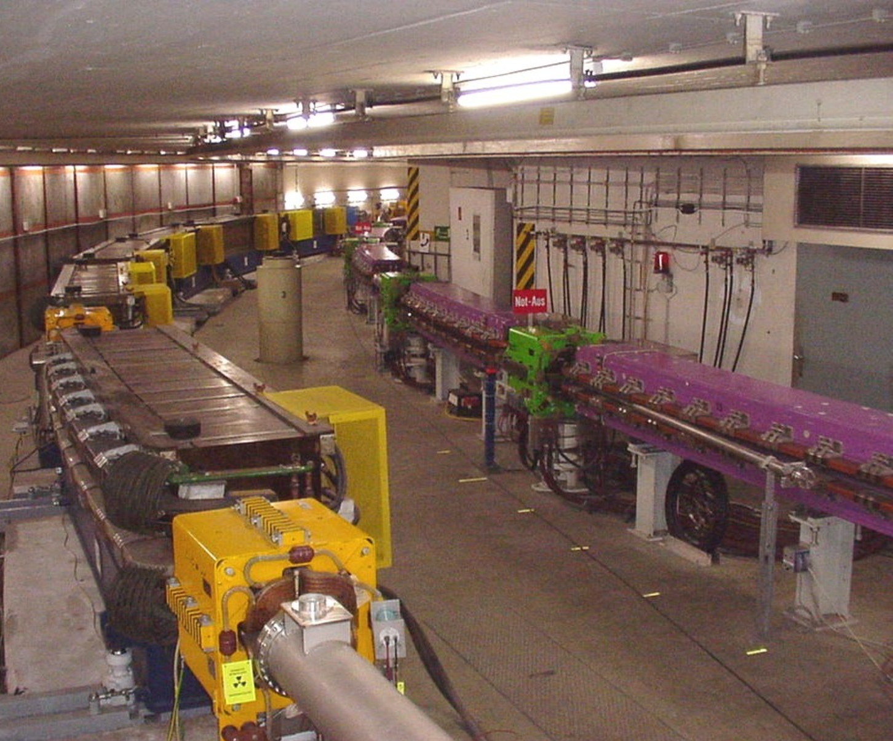
Test Beam Facility Future: Options
Timely decision needed
(PIV: review 2026, decision 2027)
Refurbish DESY II or build DESY IV
(traditional injector)
Test beam in PETRA IV era: Discussions ongoing!
DESY DIR needs to decide that test beam becomes part of PETRA IV project
Central: Question of PETRA IV injector:
  Traditional injector: integrate test beam!
  Plasma injector: integration difficult!
Test beam at EU.XFEL?
(bunch structure, rates, …)
Test beam line at PETRA IV?
(Politics? Cost? Space?)
Notes:
DESY II ? IV and laser injection – geht zusammen oder nicht?
For XFEL: in principle wrong bunch structure and too high rate. Maybe Crystall extraction in halo of full bunches or using empty bunches?
DESY IV 100 M
DESY 2 refurb 20 M
XFEL rep rate too low – 5 Hz trains, Cw waere ein anderer Schnack
Note that ELBEx profits from new XTD8 location discussions and the possible synergies with laser fusion …

Slide 14
Thank you!
            Thomas Schörner
DESY-FH/CMS
Notkestr. 85, D-22607 Hamburg
Tel: +49 40 (9) 8998 3429
thomas.schoerner@desy.de

