Slide 1

XFEL Accelerator R&D Status Report Understanding and Controlling Beam Losses in High-Power XFELs
Shan Liu (DESY), Nick Walker (DESY), Andy Wolski (University of Liverpool), Jiacheng Wu (DESY and University of Liverpool)
12.09.2025

Slide 2
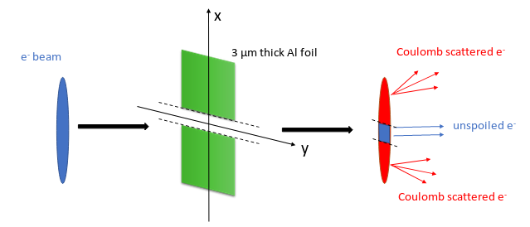
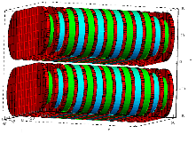
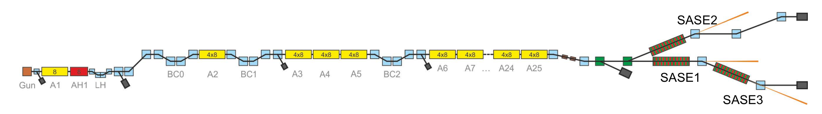
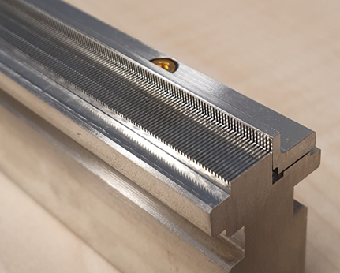
Scope of the R&D Activity
Shorter pulses, Phase-locked pulses
Higher photon energy
Slotted foil (180 um gap)
Superconducting undulator (5 mm aperture)
A. Potter et al., WEP15 and WEP16, FEL2022
Fresh slice application
Advanced operation modes may require devices inserted into the beam like slotted foil, electron beam kicked very close to the corrugated wakefield structure and devices with very narrow vacuum chambers such as for the superconducting undulator -> beam loss studies are crucial!
Corrugated wakefield structure
(0.5 mm to beam core)
JunjieGuo et al., NIMA 1034 (2022): 166780
Notes:
this matches your summary in the written report
depending on the amount of presentation time assigned to your report, you can use up to 3 slides on this topic
if this is your final report, give the achievements of the entire R&D project

Slide 3
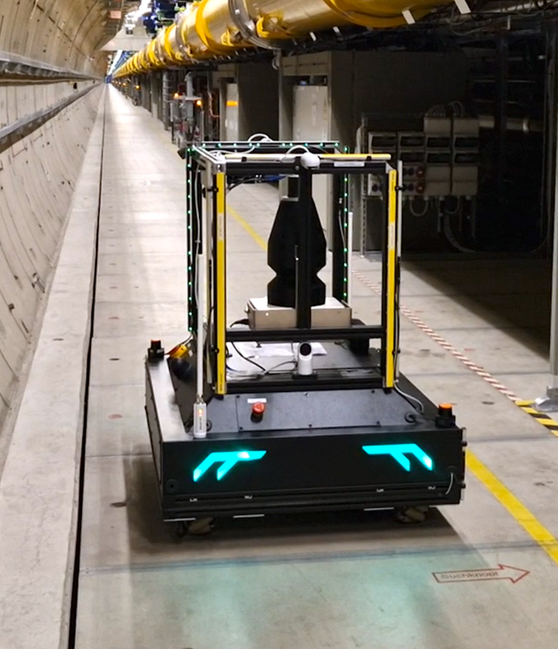
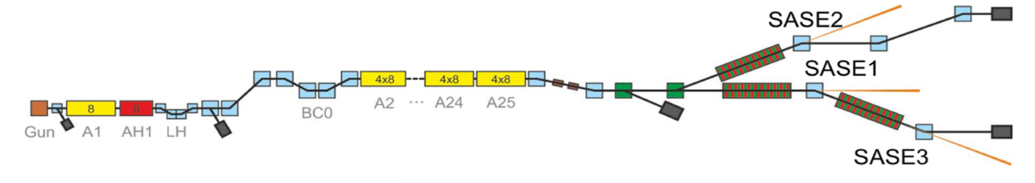
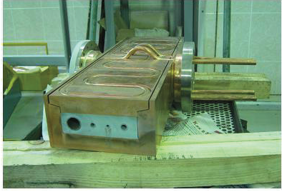
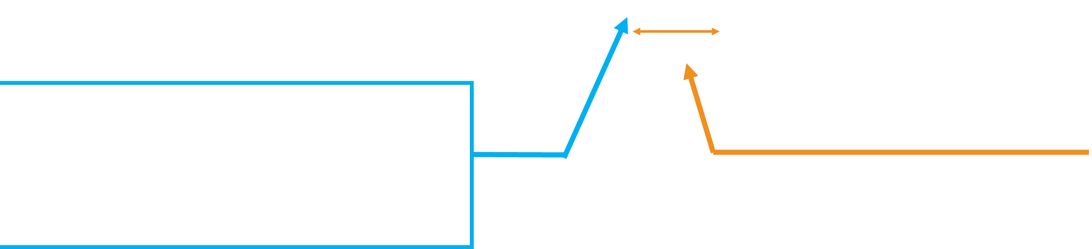
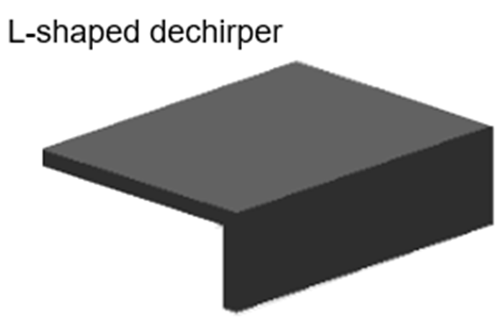
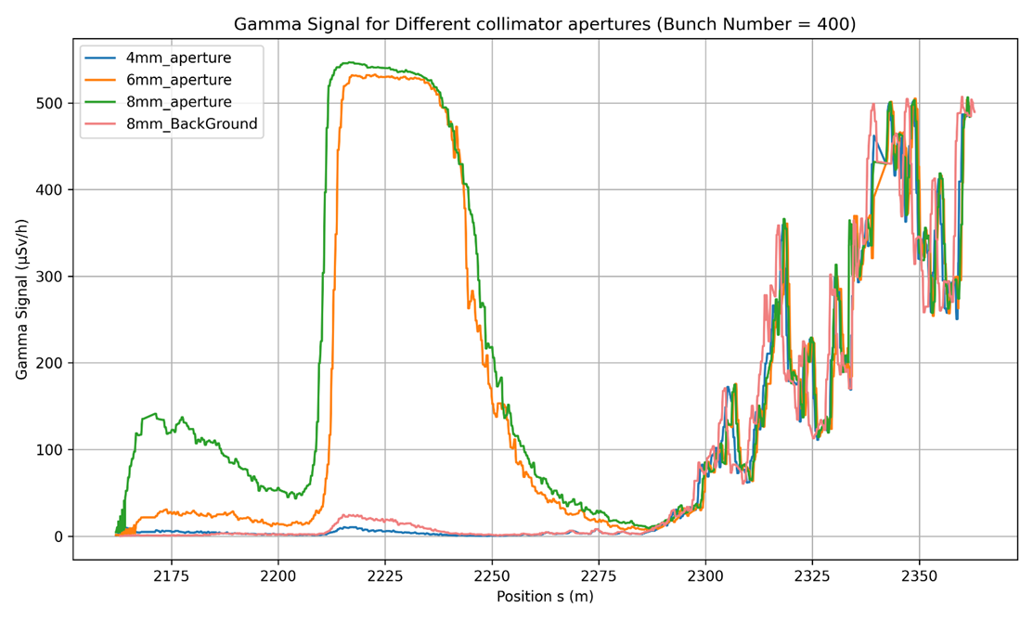
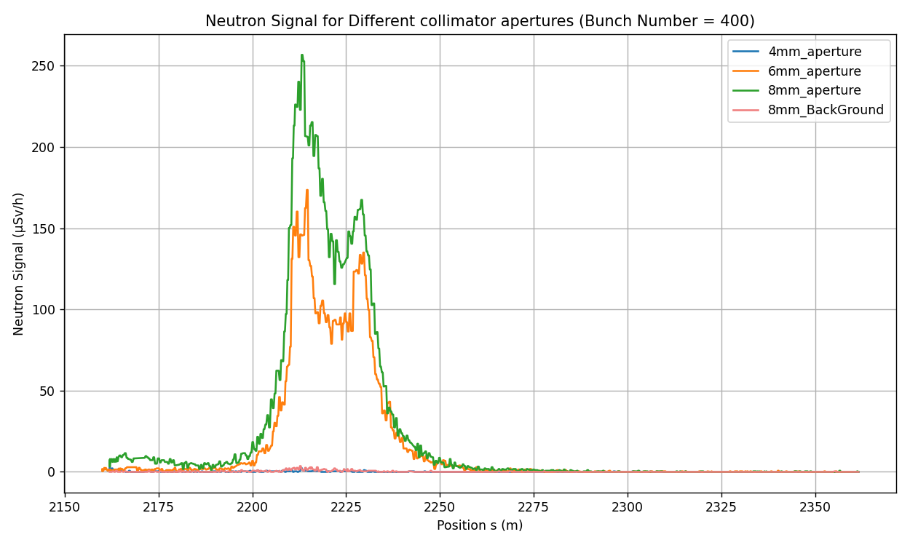

Achievements in the past year: corrugated structure
Collimation section
200 m scanning range
MARWIN: Movable robot for gamma and neutron radiation monitoring in the XFEL tunnel
Gamma dose
Neutron dose
Synchrotron
radiation
Notes:
Experiment 1: Bump the beam to different positions inside the dechirper and observe downstream losses
with single bunch.
Experiment 2: Fix the beam–dechirper alignment and adjust the collimation section to reduce beam losses
with 400 bunches.
MARWIN Signal Gamma: Electromagnetic radiation from beam losses, mainly from electron–material interactions and synchrotron radiation.
MARWIN Signal Neutron: Neutrons produced via hadronic interactions with surrounding materials. These are more harmful and dominate at high bunch charge.

Slide 4
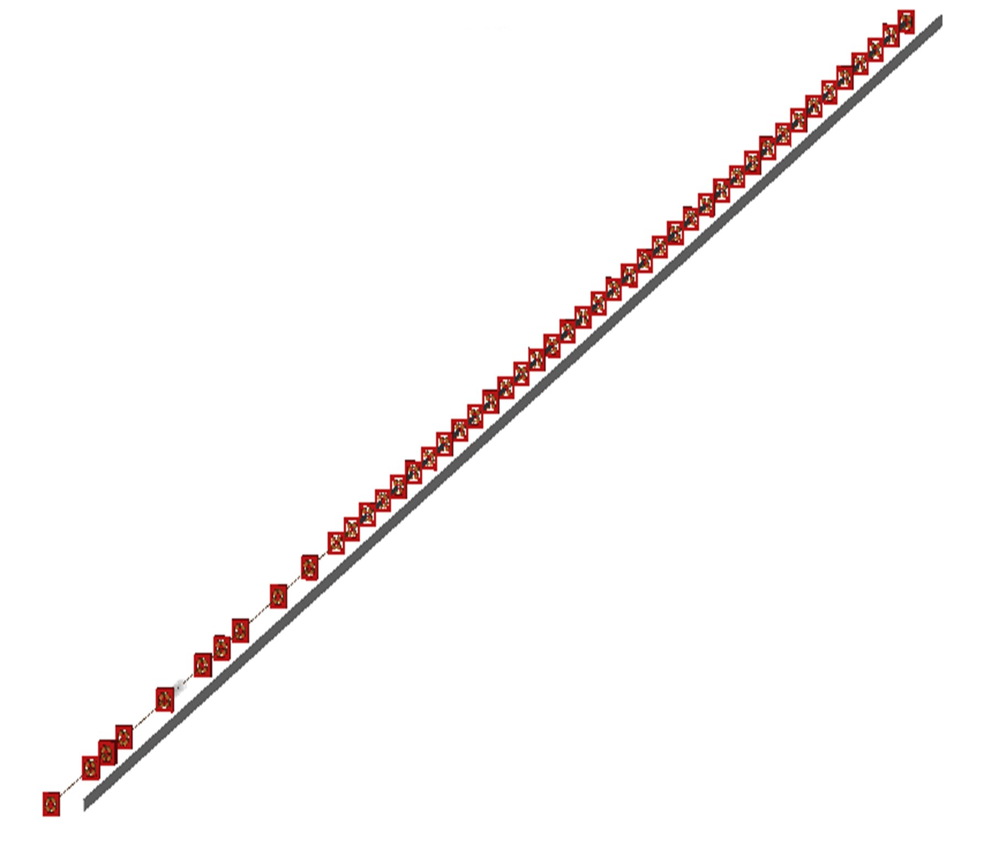
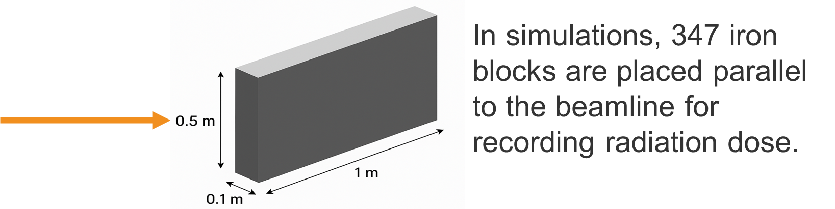
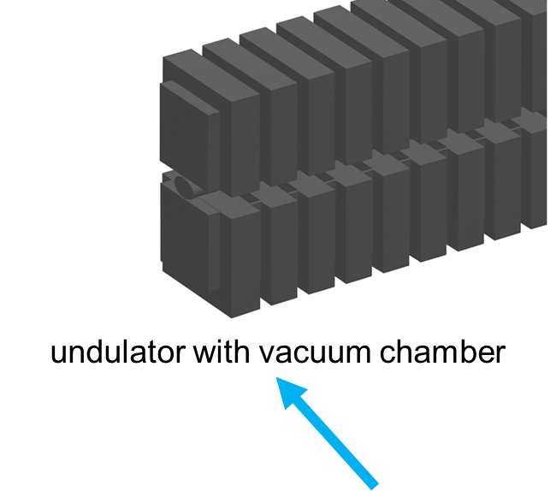
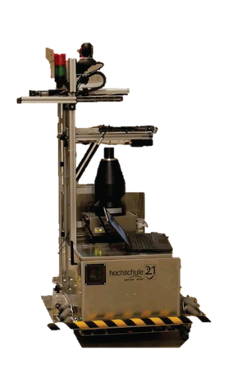

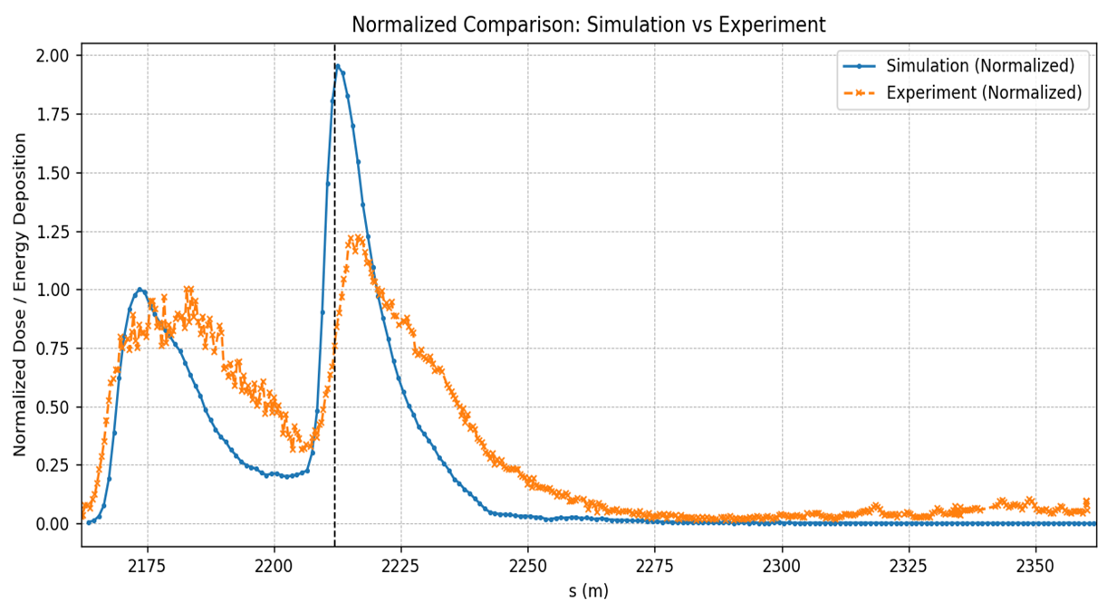
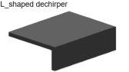
Achievements in the past year: corrugated structure
Iron blocks were placed 2 meters off the beamline, matching the position
of the MARWIN detector.
collimator
dechirper

Slide 5
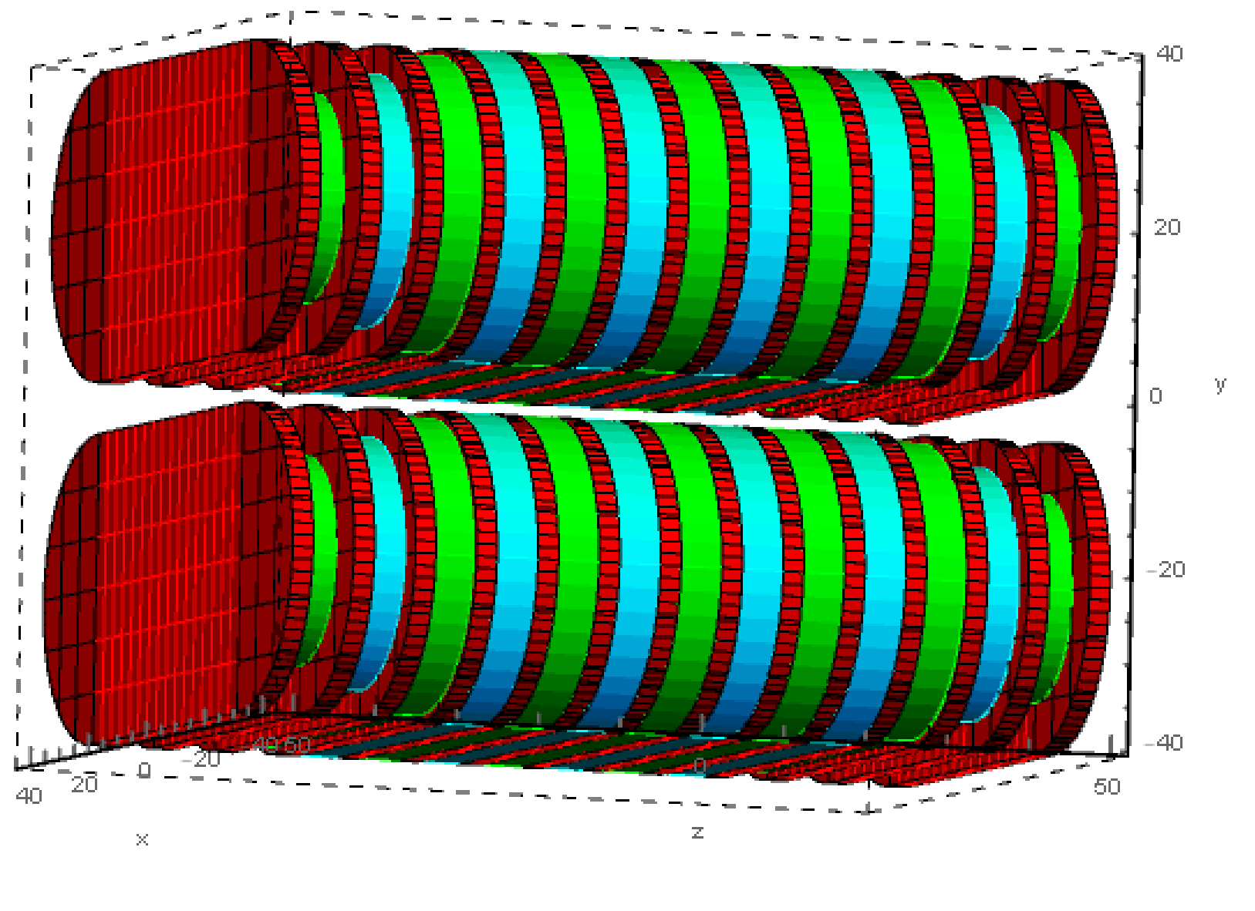
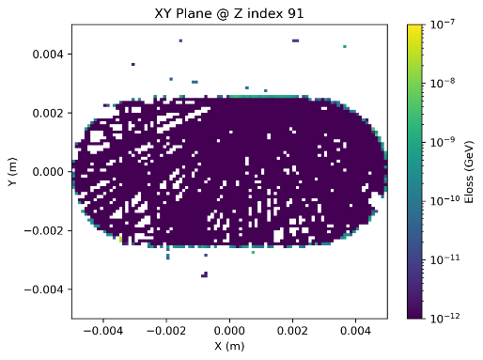
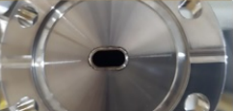
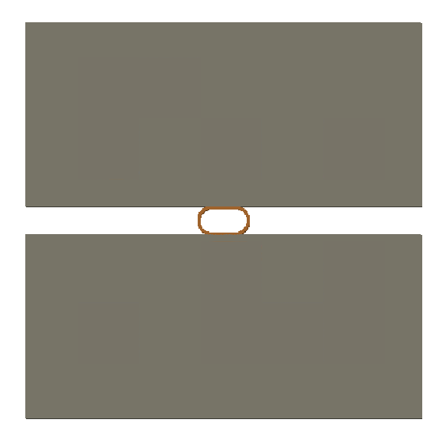
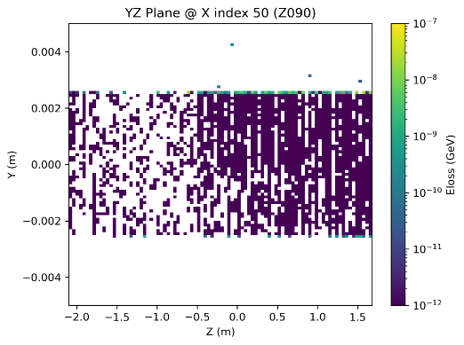
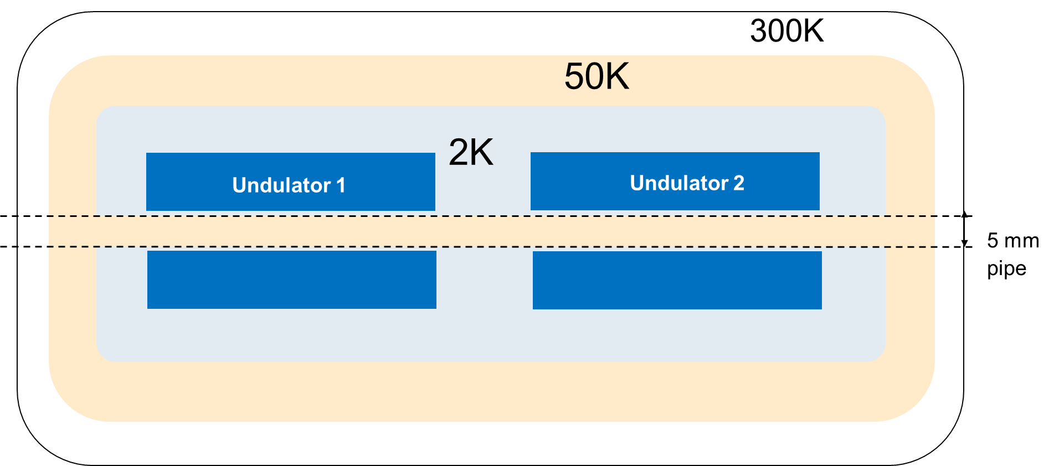

Achievements in the past year: superconducting undulator
BDSIM model
10mm
race track 10 mm × 5 mm
vacuum chamber cross section
cross section
0.25m
0.5m
0.25m
2m
2m
2m
Magnetic gap = 6 mm
Vacuum gap (beam stay clear) = 5 mm
Notes:
this matches your summary in the written report
depending on the amount of presentation time assigned to your report, you can use up to 3 slides on this topic
if this is your final report, give the achievements of the entire R&D project

Slide 6
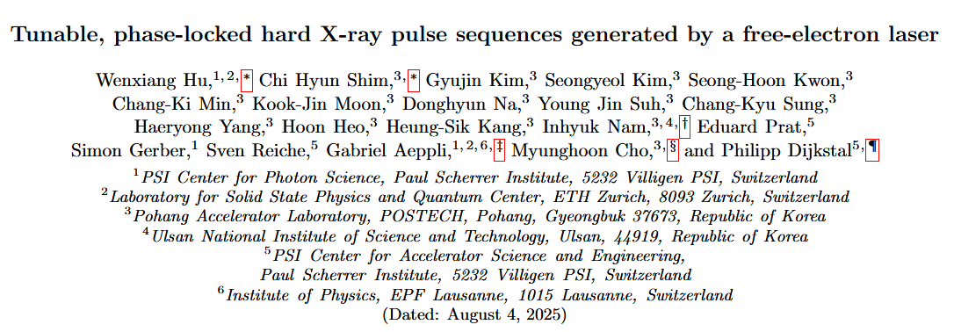
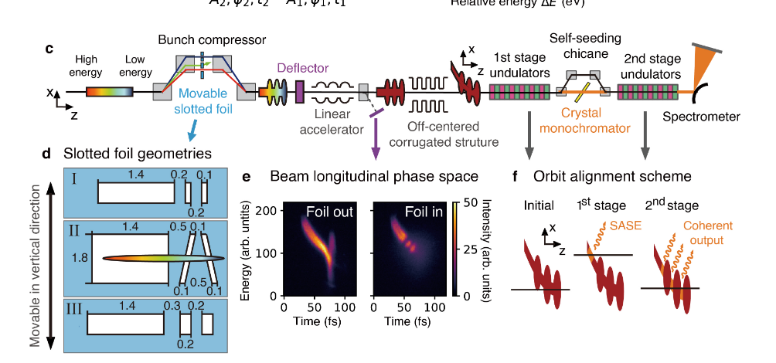
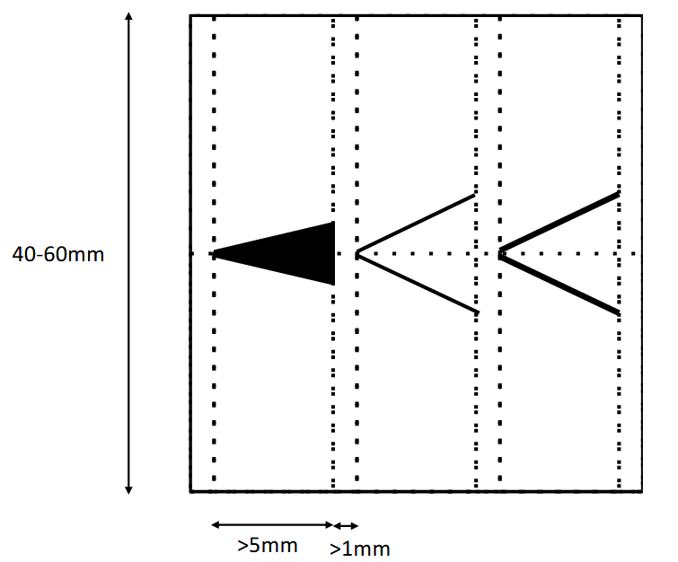
Deviations from plan
New design of the slotted foil needed for the phase-locked applications
Shorter pulses, Phase-locked pulses
Slotted foil (180 um gap)
A. Potter et al., WEP15 and WEP16, FEL2022
https://arxiv.org/abs/2508.00455v1
Notes:
which of your orginally planned achievements for the past year could not be reached
explain reasons for deviations
outline consequences for the remainder of the activity

Slide 7
Timeline of this R&D activity
Date / Period | Milestone Description | New Date/ Period
Month 8 | Simulations of beam losses and radiation levels in detailed, up-to-date model of existing machine. Comparison between different simulation codes (e.g. BDSIM, Bmad…) -> Compared with previous BDSIM simulation results. | Done
Month 12 | Beam loss measurements with the dechirper. Detailed comparison between simulation and experimental results. | Done
Month 18 | Measurements of beam halo using adjustable apertures with associated downstream radiation detectors. -> No detailed study on beam halo distribution yet. | Partially done
Month 24 | Extension of BDSIM (in collaboration with the BDSIM developers) to include synchrotron radiation. -> Establish OCELOT-BDSIM interface.
Month 30 | Collection and analysis of signals from a variety of diagnostics, to develop a quantitative understanding of radiation levels along the machine.
Month 36 | Implementation of the slotted foil for ultra-short photon pulse generation and phase-locked self-seeding. Measurements of beam losses with the slotted foil, and comparison with simulations. | Possible installation in summer 2026
Month 42 | Exploration and evaluation of potential techniques for control and mitigation of beam losses, in simulation and (where possible) in experimental tests in European XFEL.
Notes:
this is essentially Table 1 of your report
add the milestones with the originally proposed date and the current estimate of achievement
for the sake of space, omit milestones that have been completed before 2022
in case of deviation, explain those
issues discussed on the previous slide don‘t need to be repeated here
only needed for the milestones in the past period (2022) and the future

Slide 8
Risks to R&D Project
Compatibility of slotted foil with multi-beamline operation -> possible solution with separated beam region in BC1
Electron beam losses for SCU project -> already measured relatively high losses with one absorber installed?
Beam time for measurements-> night shifts possible
Notes:
what are the risks associated with your R&D project that may prevent or limit you
to achieve the planned goal of your activity
provide the deliverables
jeopardize the time line of your project

Slide 9
Outlook / Summary
Corrugated wakefield structure project
updated the simulation model and compared loss with single plate model
explored methods to mitigate beam halo induced losses
conducted multiple beam loss measurement campaigns using the MARWIN robot
SCU project
analyzed the impact of absorber misalignment on the SR induced dose and thermal load
Plan for next year:
Further studies to enable routine operation of corrugated wakefield structure in front of SASE1
Design and fabricate new slotted foil for phase locked application
Establish OCELOT-BDSIM interface
Notes:
describe the planned activities for the this year
are there any risk that may challenge this plans
list of publications / conference proceedings

Slide 10
Outlook / Summary
list of publications / conference proceedings
Jiacheng Wu et al., “Understanding and Controlling Beam Losses in High-Power XFELs”,Poster in Students’ and Science Days of European XFEL 2025, Fintel, Germany.
Bingyang yan, Jiacheng Wu et al., “Orbit alignment study in the collimation section at the European XFEL”, MOPB037, IPAC’2025 proceedings, Taipei, Taiwan.
Weilun Qin, Marc Guetg, Jiacheng Wu et al., “Experimental demonstration of an L-shaped corrugated wakefield structure for beam shaping at a high repetition rate free-electron laser”, submitted to PRL.
Notes:
describe the planned activities for the this year
are there any risk that may challenge this plans
list of publications / conference proceedings

