Slide 1
XFEL Accelerator R&D Status / Final Report XFEL Oscillator Demonstrator
Patrick Rauer/Winfried Decking
12.09.2025

Slide 2
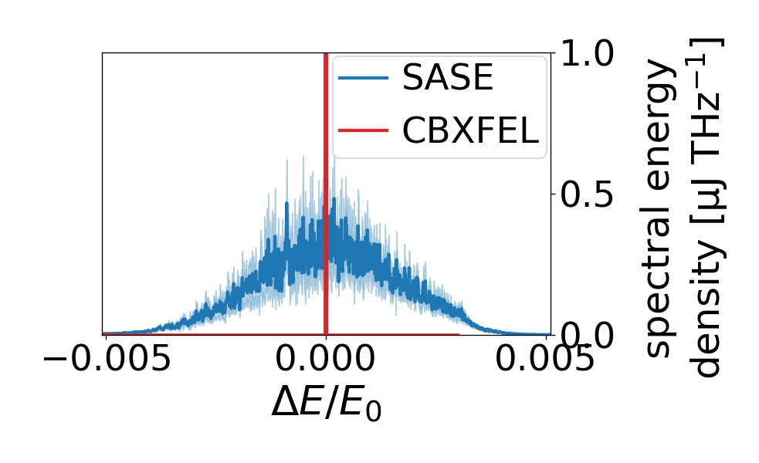
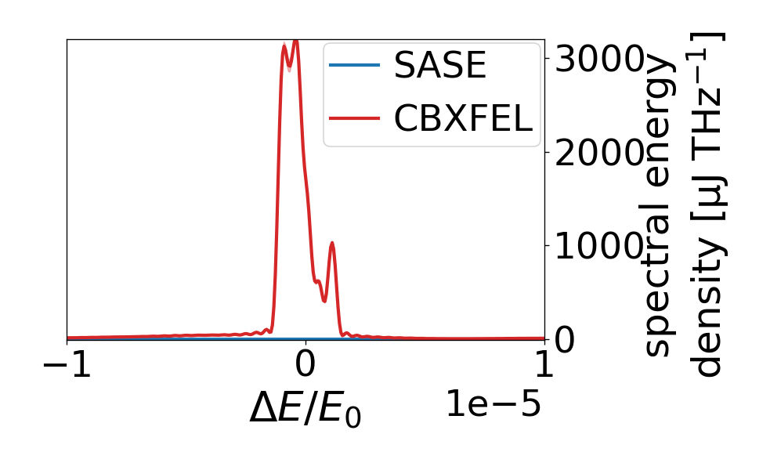
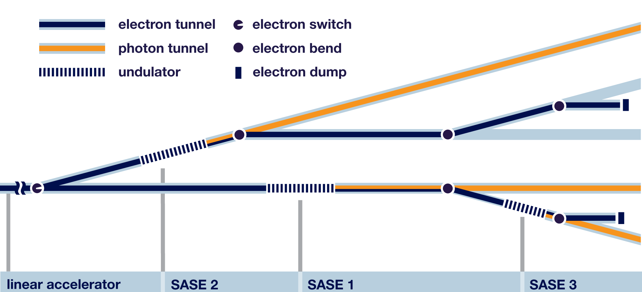
Scope of the R&D activity
CBXFEL
R&D project to realize a proof-of-concept Cavity Based X-ray FEL demonstrator at the EuXFEL.
Located at the end of the SASE1 tunnel
Using last four (typically not used) undulators
Based on 2.25 MHz repetition rate ↔ 132 m roundtrip length
Interface: XFELO Oscillator Project on photon side (XRO)
Deliverable: A as “simple” as possible demonstrator to realize working principle = seeding!

Slide 3
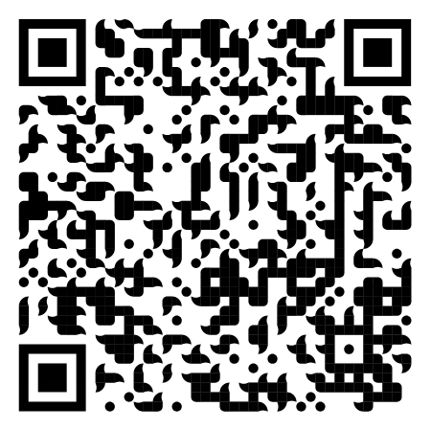
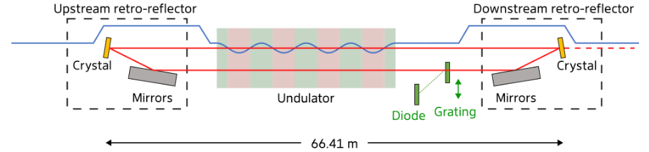
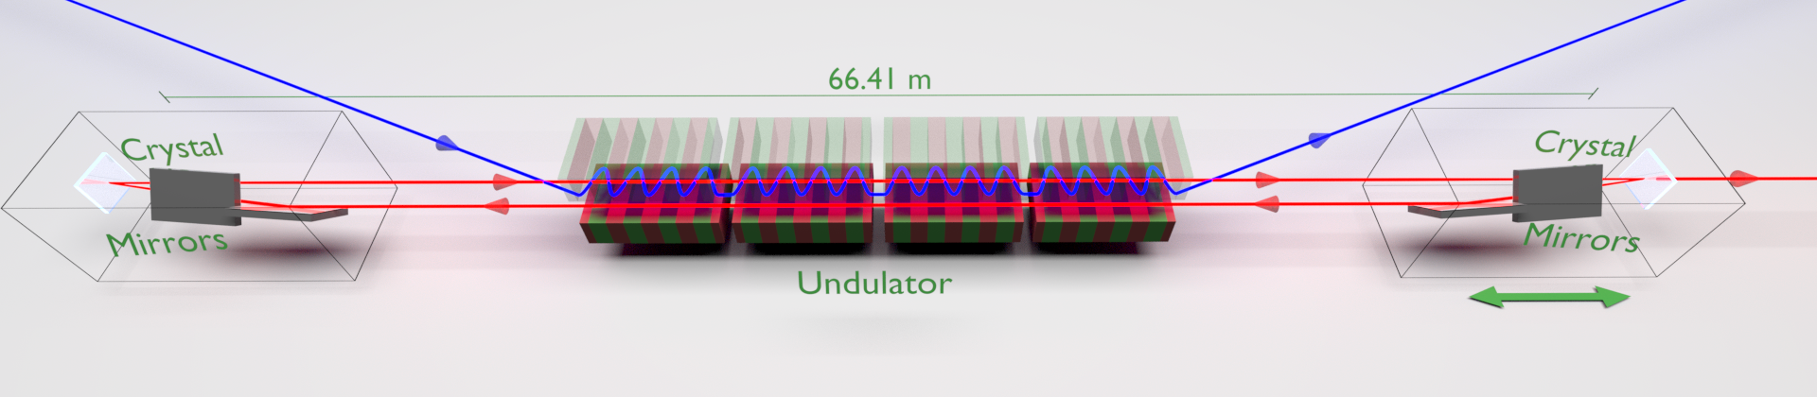
Project Achievements: Construction of High Accuracy X-ray Cavity
Lasing of a Cavity Based X-ray Source
Patrick Rauer, Immo Bahns, …, Harald Sinn (submitted)
Accelerator
High repetition rate (2.2 MHz)
High energy (14 GeV)
Long. and trans. ultra stable (6 fs, 1 µm)
Radiators
Last 4 SASE Undulators
Aligned to 10 µm
Diagnostics
Spectrometer
Gas Monitor
Diode
Imagers
X-Ray Cavity
For demo experiment as simple as possible
Crystal in backscattering geometry
Mirrors for guidance and focusing
Retro-reflector to reduce sensitivity to angular errors (nrad tolerance)
Length matched to 2.2 MHz and adjustable with sub-µm precision – while keeping nrad angular reproducibility!

Slide 4
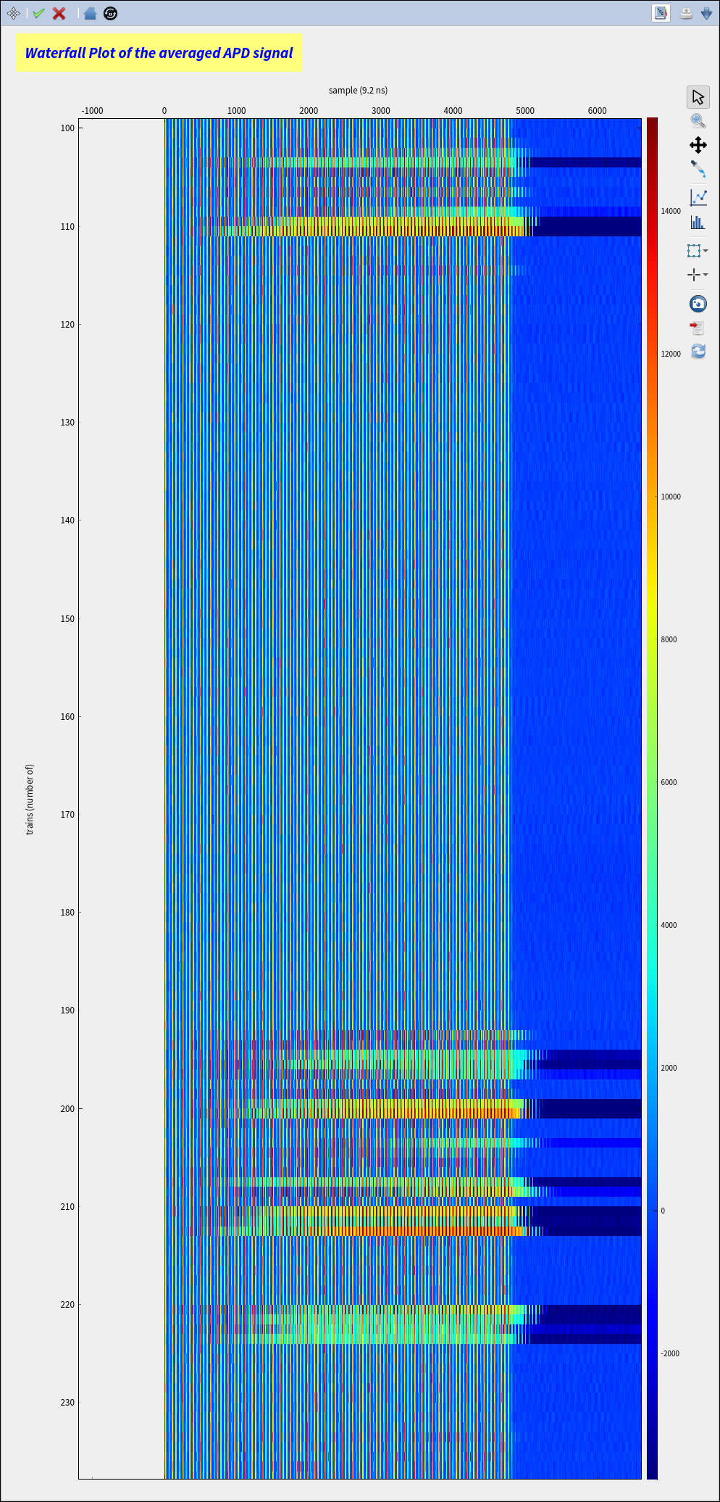
Project Achievements: Alignment
100 bunches going through cavity |→ ring down (6 cycles after opt.)
time consecutive bursts

Slide 5
Project Achievements: Lasing
100 bunches going through cavity |→ ring down (6 cycles)
time consecutive bursts tuning of cavity length
Saturation of Diode

Slide 6
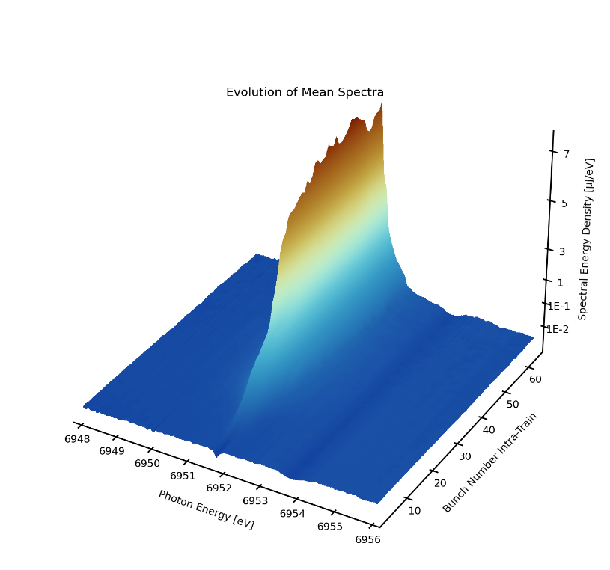
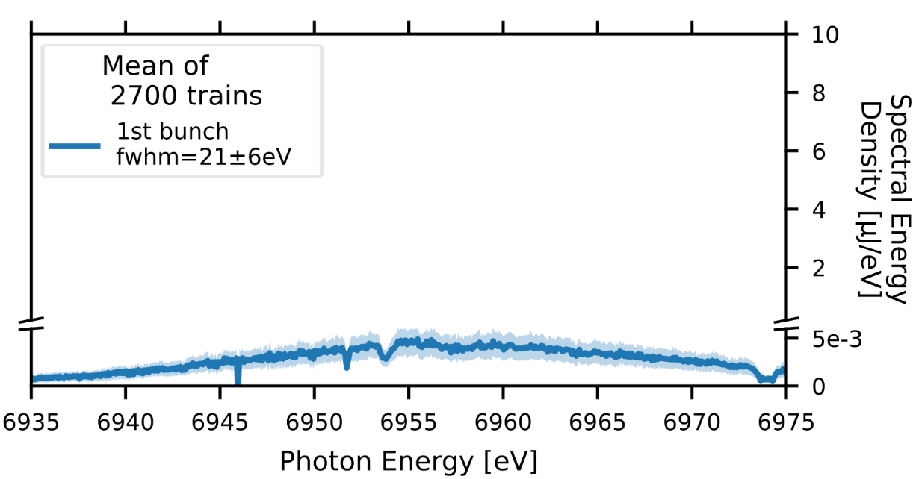
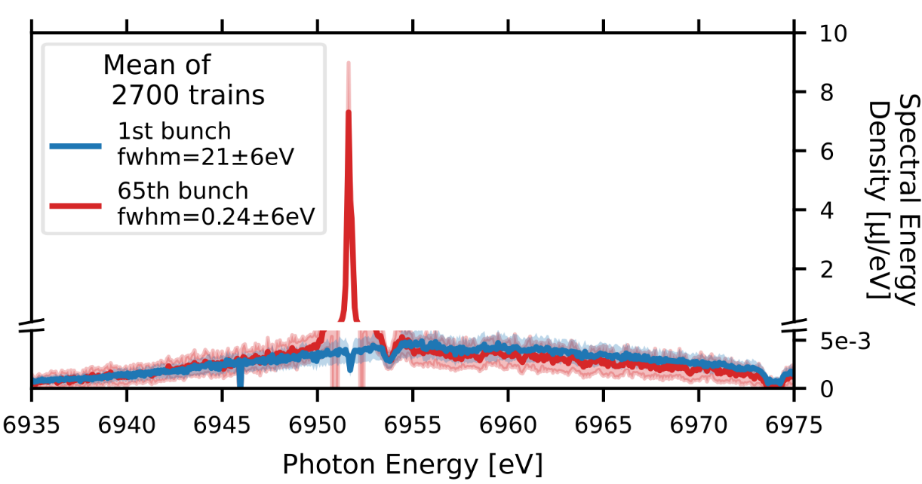
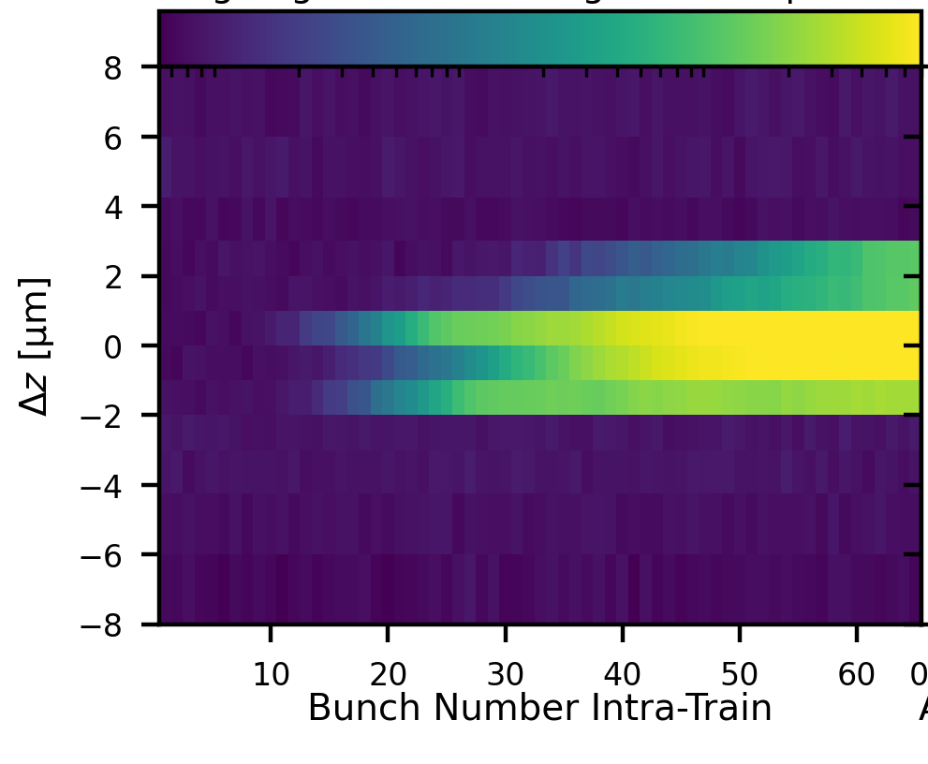
Project Achievements: Lasing
Spectrometer
Peak Spectral Density

Slide 7
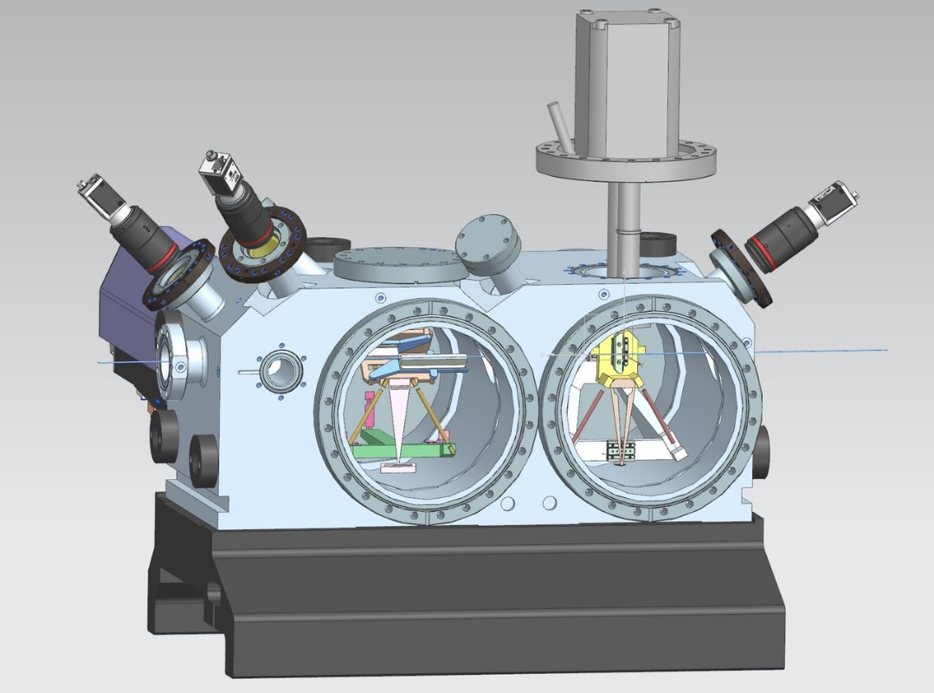
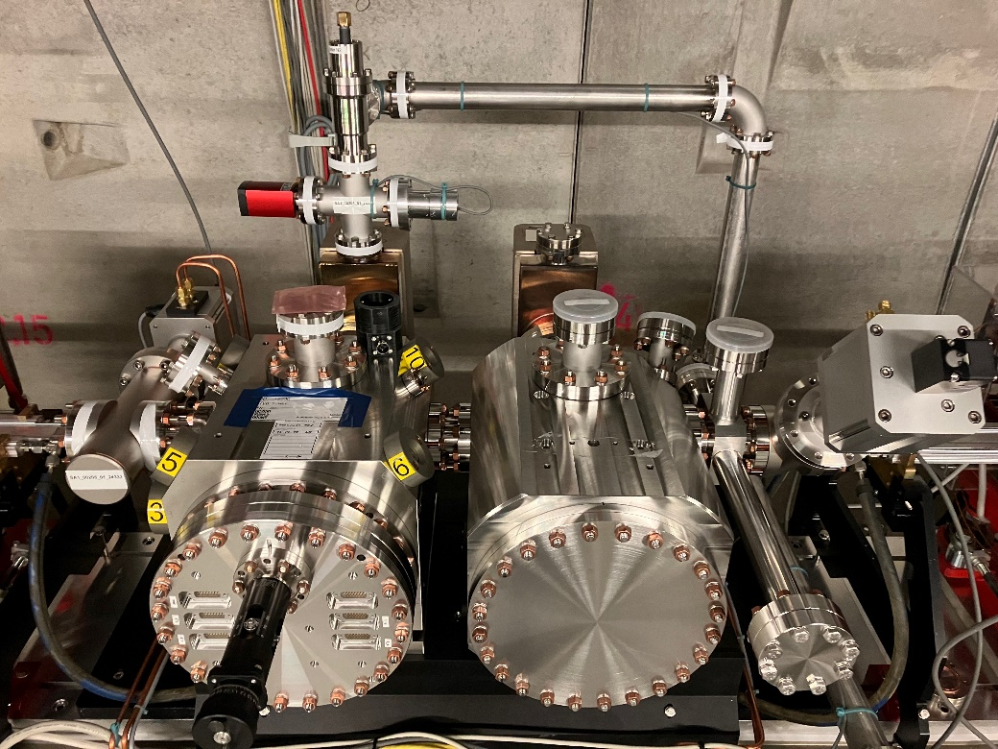
Deviations from plan
Crystal + Mirror chamber by external manufacturer were not fulfilling (any) of the specified tolerances
MVS produced a replacement and brought us back on track. Thank you!

Slide 8
Timeline of this R&D activity
Proposal Timeline | Milestone Description | Actual Timeline
Q3/2021 | PostDoc Hired
Q4/2021 | Support of installation plans | Q4/2022
Q2/2022 | Refined simulations and transfer of software into open domain
Q4/2022 | Definition of experiment plan
Q1/2024 | Execution of beam experiments | Q1/2024-Q2/2025
Q3/2024 | Analysis of results | Q2/2025-Q3/2025
Q4/2024 | Documentation and publication of results | Q3/2025-Q4/2025

Slide 9
Outlook / Summary
Together with European XFEL, we demonstrated the concept of a Cavity Based X-ray FEL, ~20 years after it‘s original proposal (which is also the first lasing of any cavity based X-ray source).
do you plan a follow-up proposal
We will get the experiment going together with European XFEL and do some small upgrades (components already procured). There is discussion about a more extensive upgrade of the setup.
list of publications / conference proceedings connected to this activity
P. Rauer, et al. „Lasing of a Cavity Based X-ray Source“, under review at Nature. Preprint available.
P. Rauer, et al. "Cavity based x-ray free electron laser demonstrator at the European X-ray Free Electron Laser facility." Physical Review Accelerators and Beams 26.2 (2023): 020701.
P. Rauer. A Proof-Of-Principle Cavity-Based X-Ray Free-Electron-Laser Demonstrator at the European XFEL. Diss. Deutsches Elektronen-Synchrotron DESY, 2022

