Slide 1
Final Report
RP 318 Fresh Slice
Marc Guetg
12.09.2025

Slide 2
Scope of the R&D activity
Study of L-shaped wakefield structures
  Maximize dipole field gradient along the electron pulse
  Reduce higher-order wakefields
  Mitigate potential beam losses (Collaboration with RP 324)
Use the structure to generate short pulses in SASE1 (few-fs scale)
  Enable photon pulse production at full repetition rate
  Allow parallel operation of SASE3 (non-interleaved)
  Combine the short pulses with other methods
    Two colors
    High power pulses (Multi-stage amplification)

Slide 3
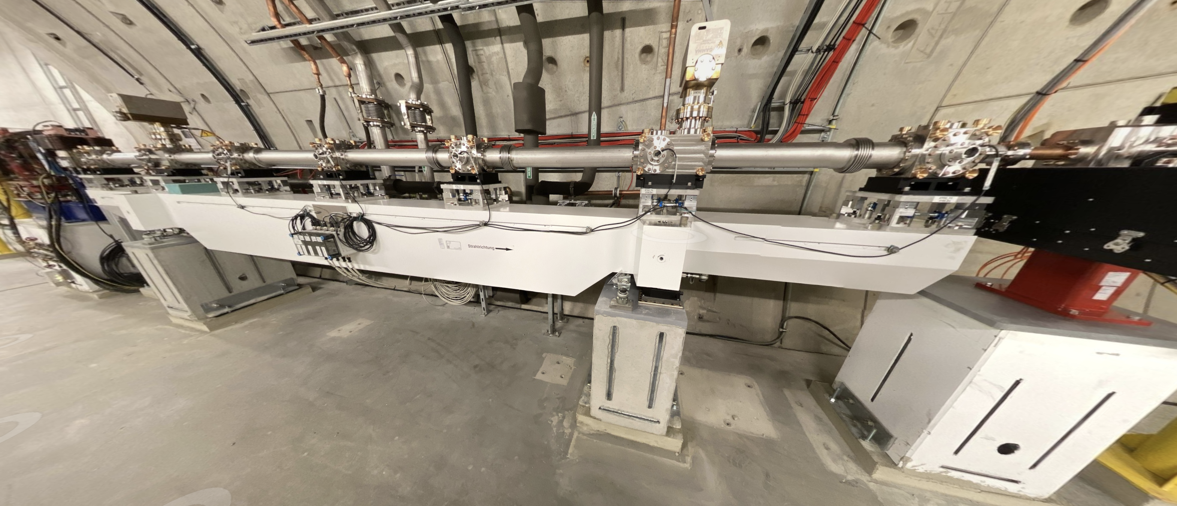
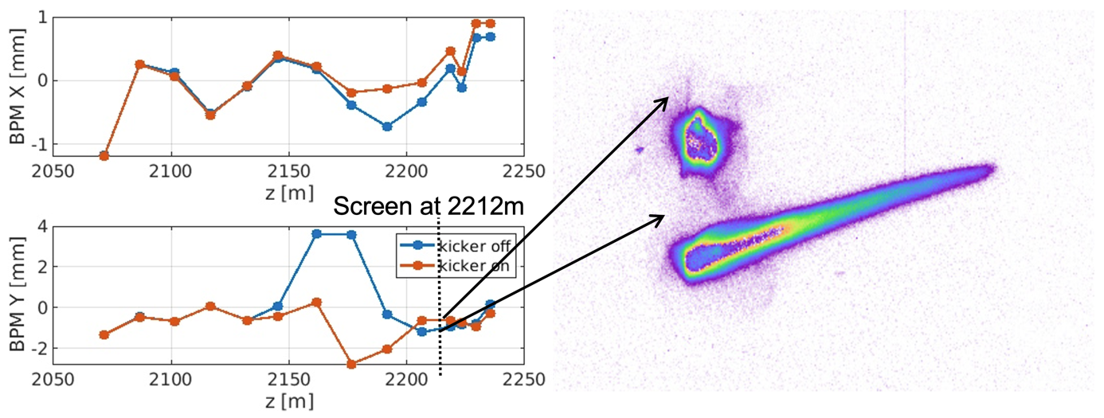
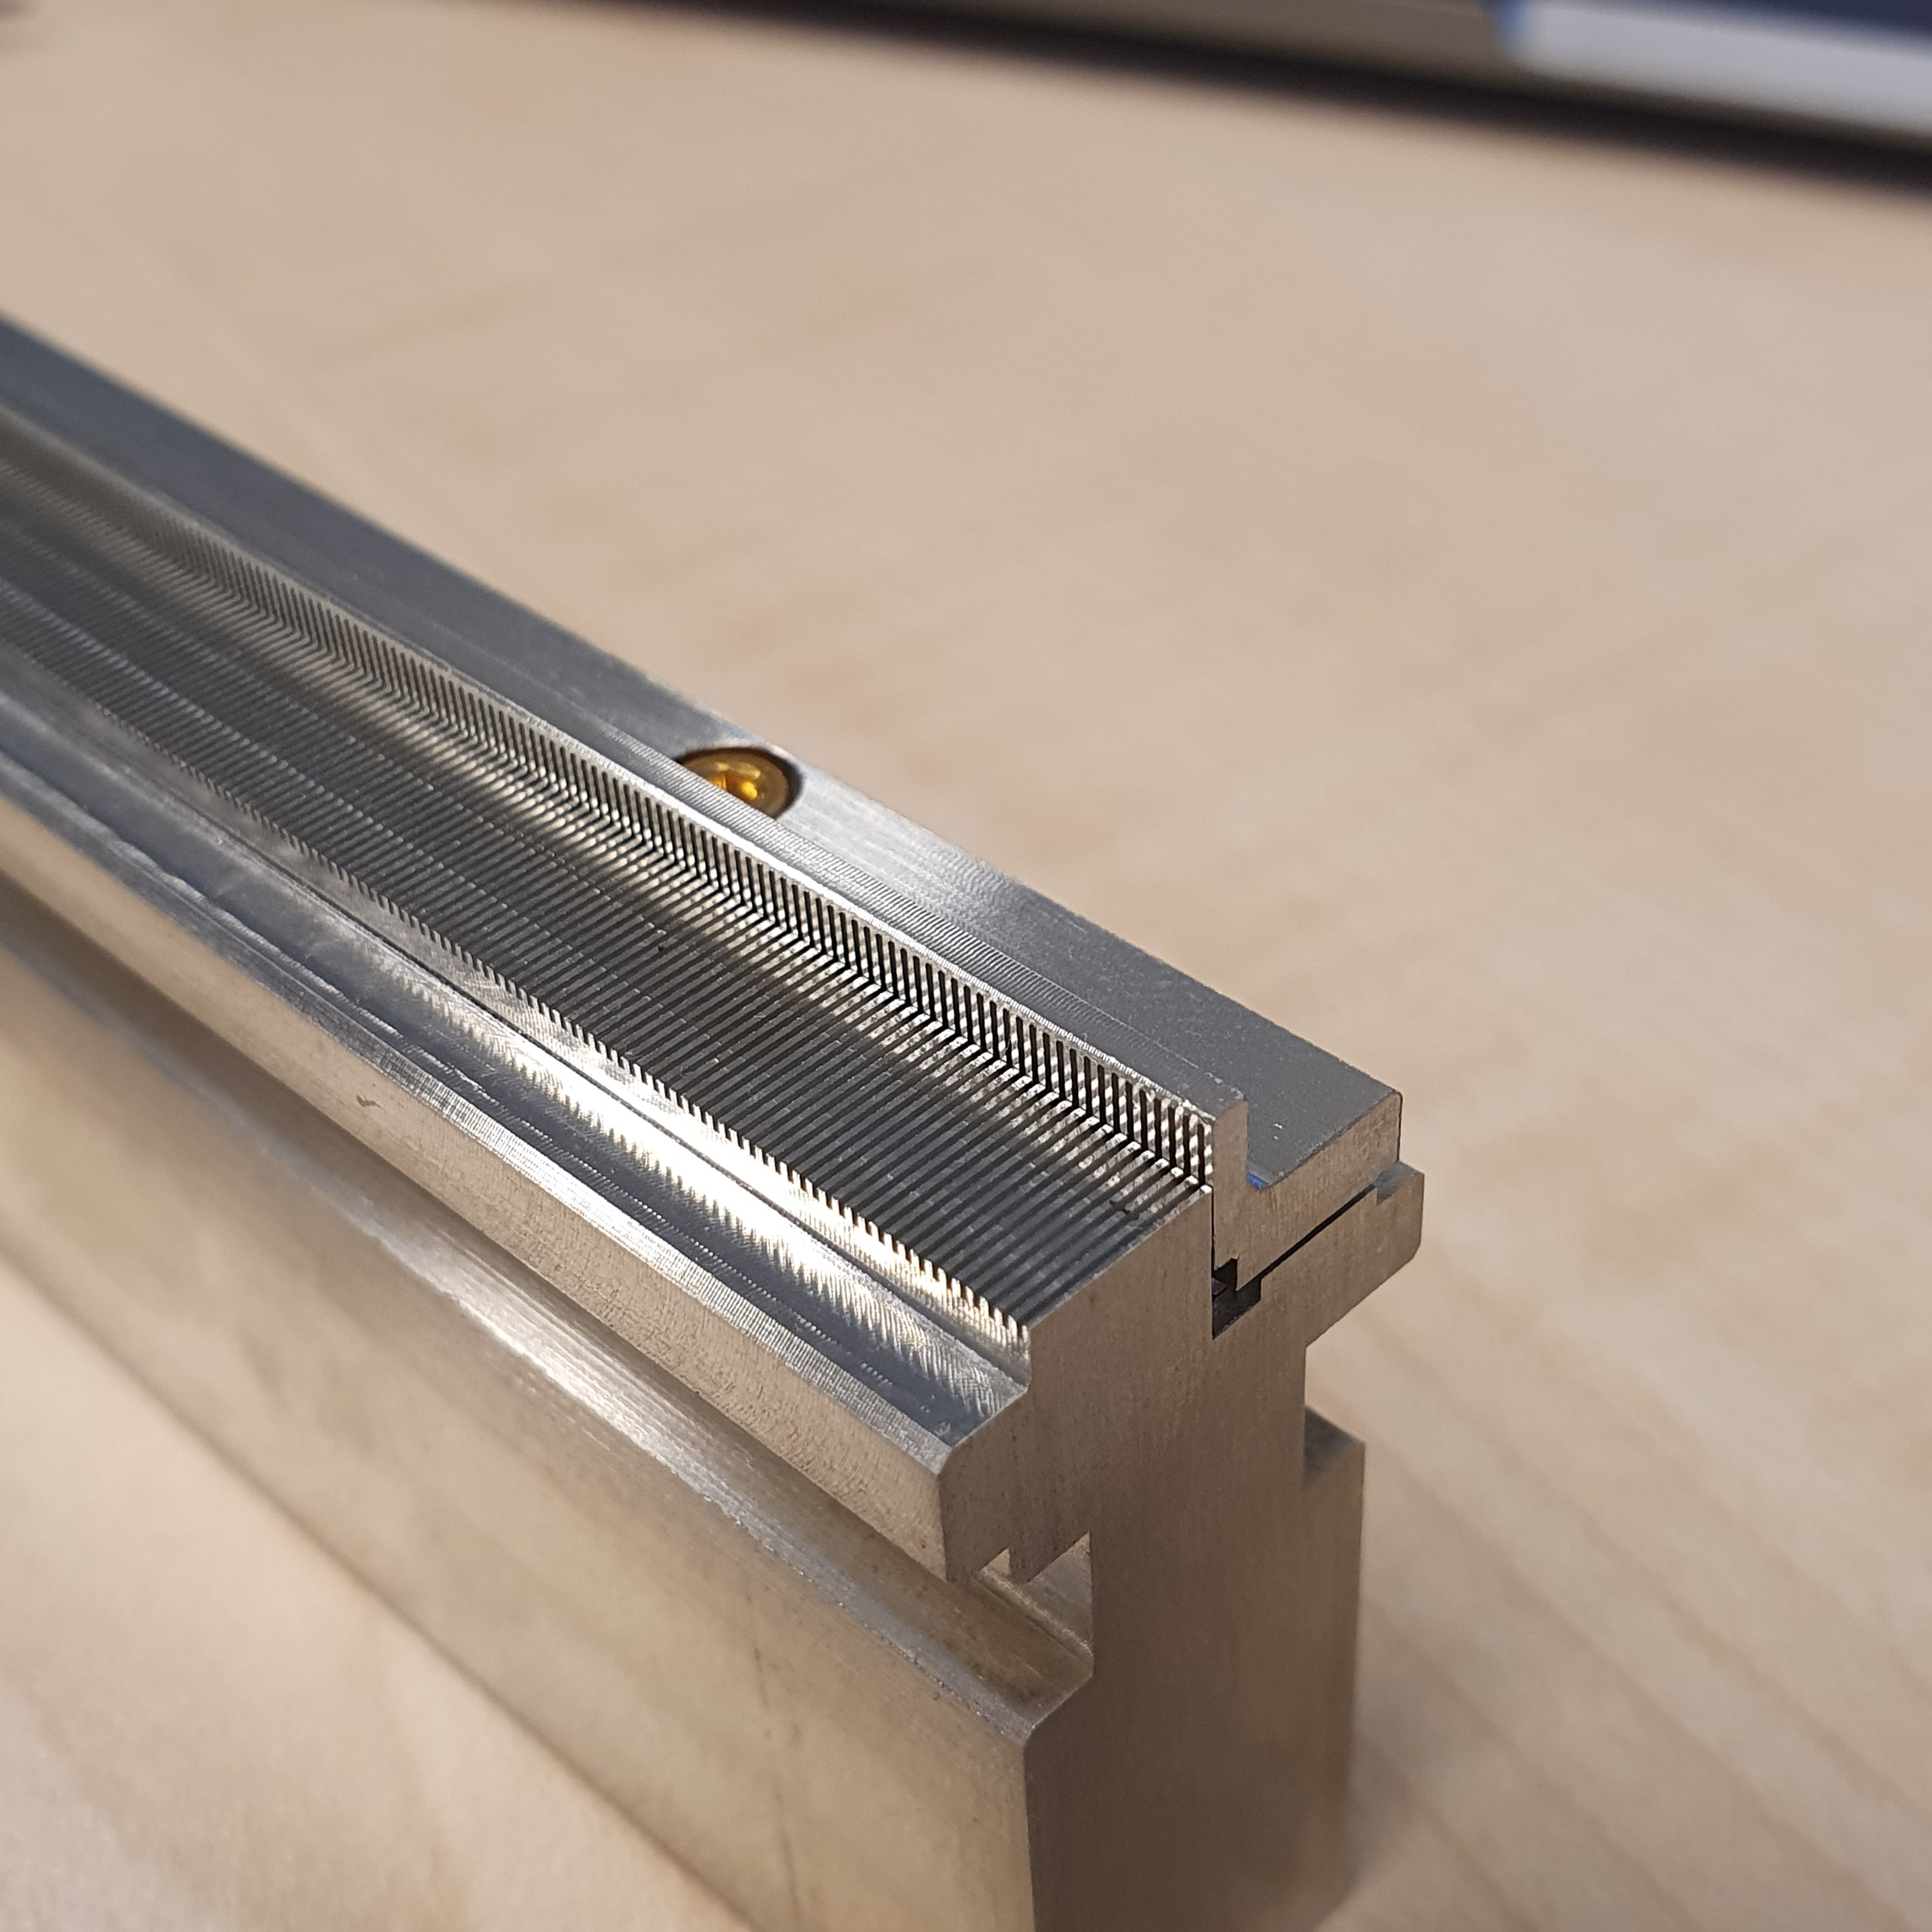
Beam Shaping Wakefield Structure (Installed WS 22)
Corrugated structure (6 m)
  Completely passive
Two additional Quadrupoles
  For better optics and orbit control
Three additional KL Kickers for orbit control
  Allow different orbits over the bunch train
Fixed gap collimator
  Collimate streaked beam halo

Slide 4
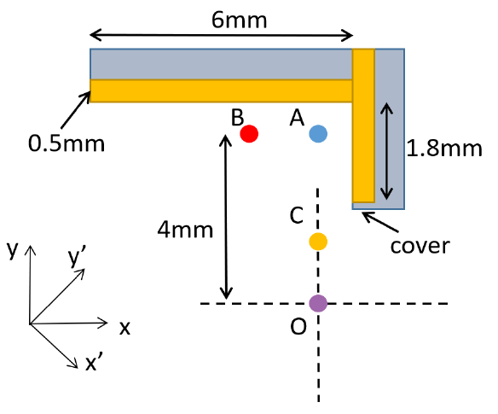
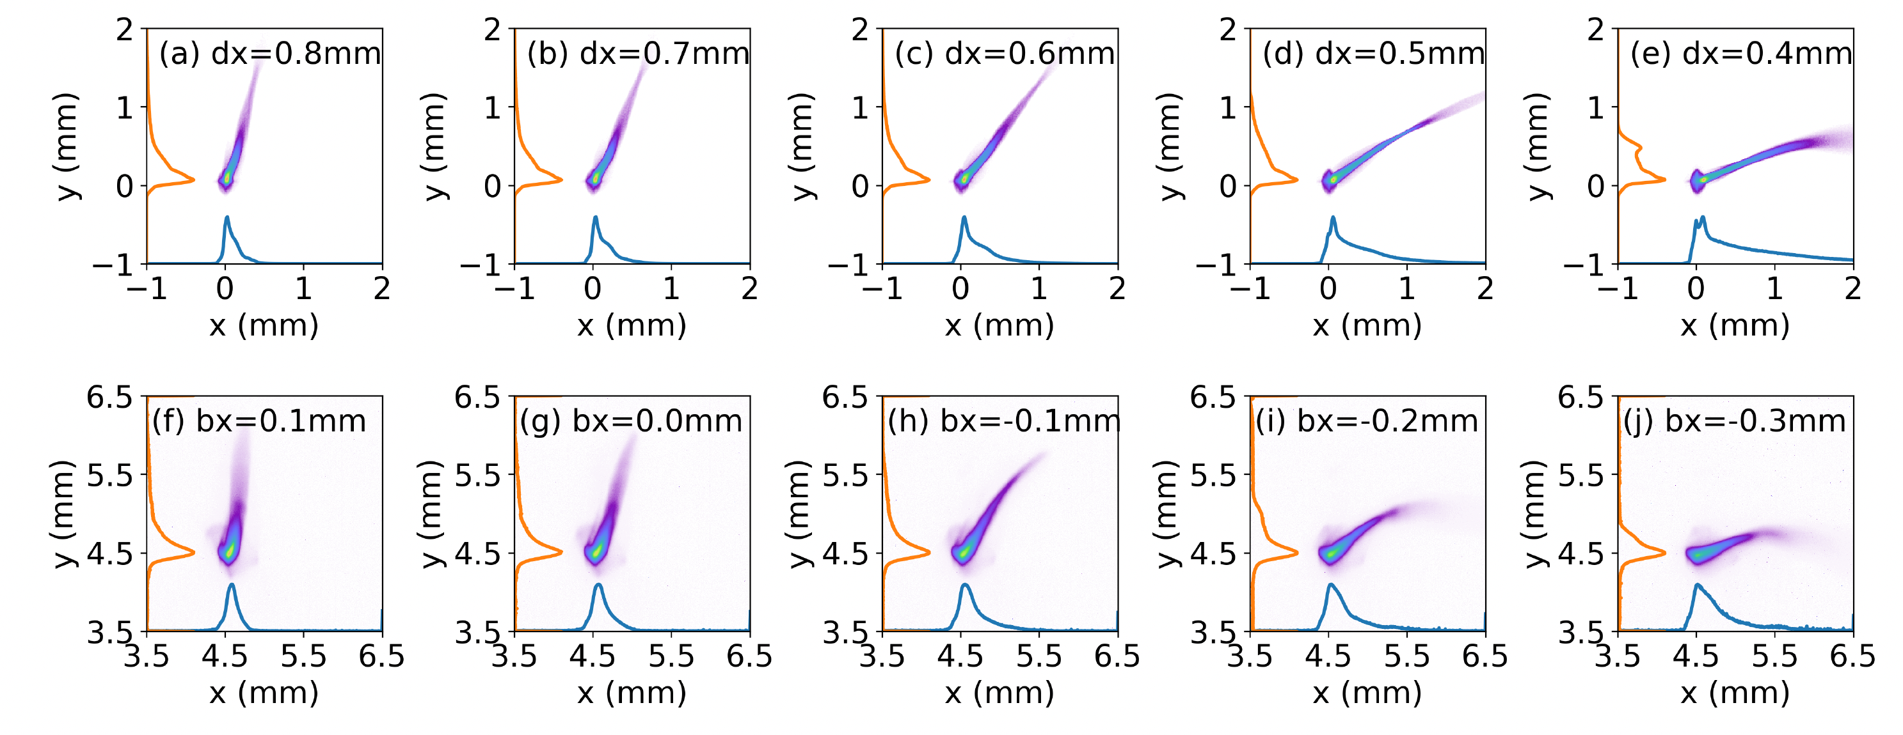
Study of the L-Shape Wakefield Structure
Theoretical Work
  Development of analytical model
  Extensive Numerical Study (in-house and with TU Darmstadt)
Experimental Verification
  Measurements show good agreement with simulations
Simulations
Measurements

Slide 5
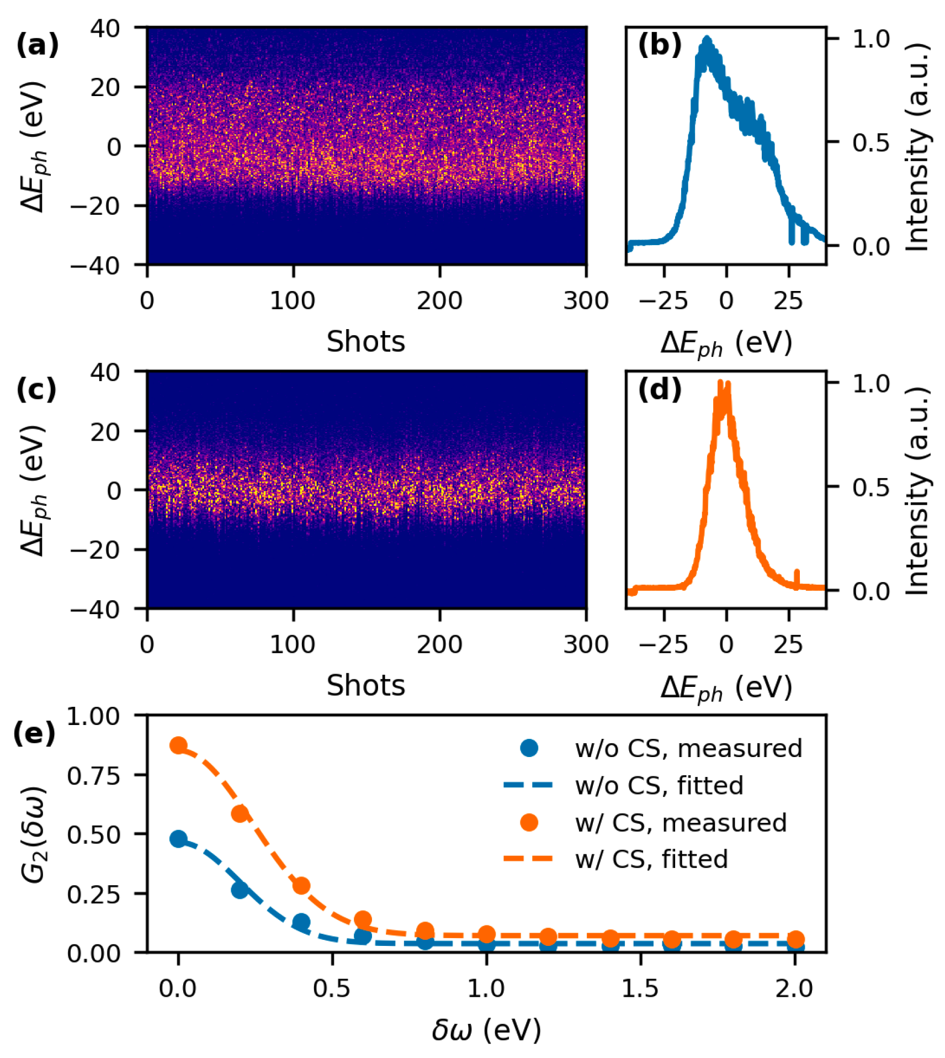
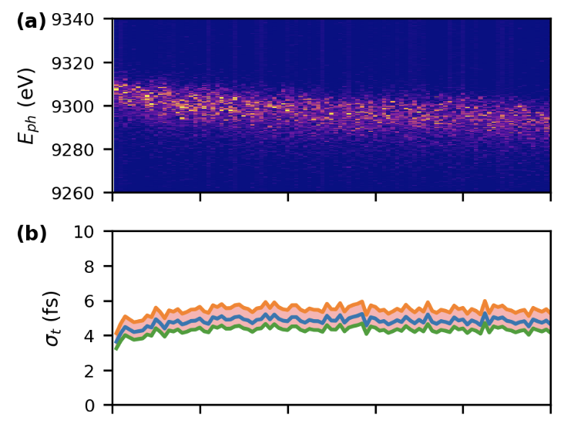
Effective Pulse Shortening
Nominal
Spectral analysis indicates pulse duration reduction by a factor of 4
Enables pulse trains with hundreds of pulses
  Works across large parts of the hard X-ray regime
Streaked
Spectra along Pulse train

Slide 6
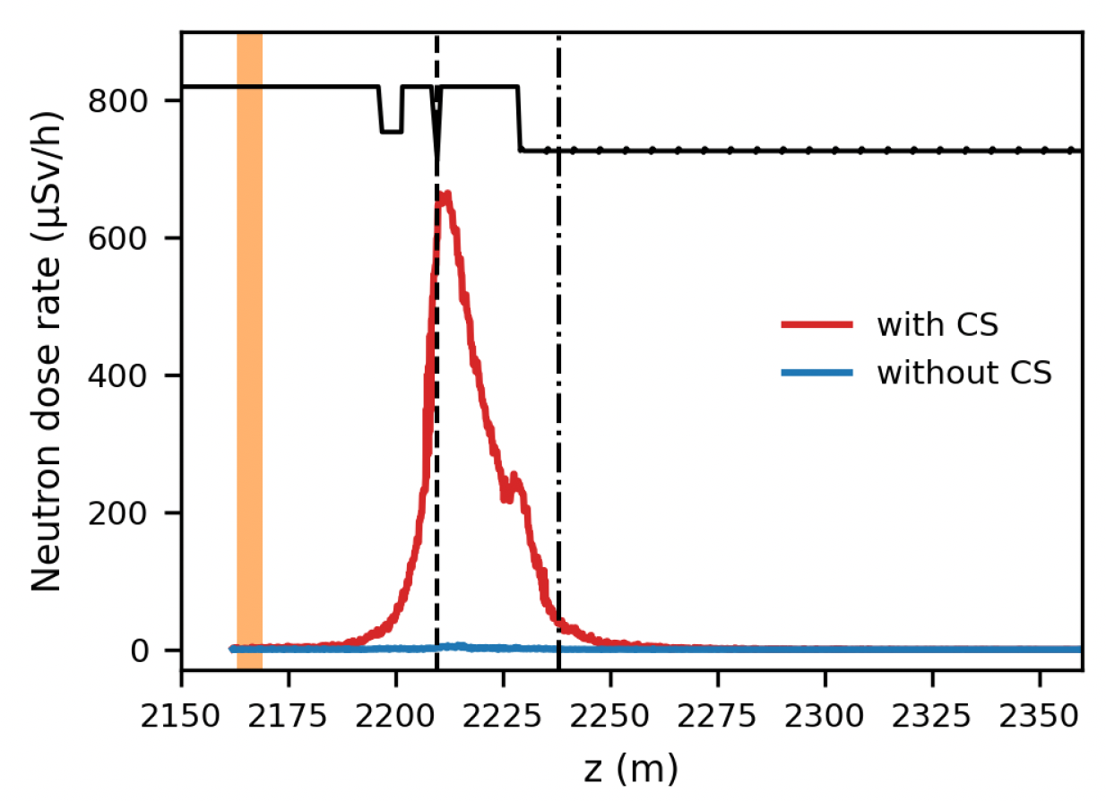
Deviations from Plan
Limitation: Streaking power reduced by radiation losses
  Not predicted from initial beam halo studies
  More information in 30 minutes: RP-324 Beam Losses
Mitigation: Fixed-gap collimator provided partial improvement
  Additional strategies under investigation

Slide 7
Timeline of this R&D activity
The project concluded without any substantial delays
User delivery and demonstration of multistage lasing were descoped
Further studies on beam loss reduction continue outside project scope
Date / Period | Milestone Description | Actual Timeline
Q3/19 | PostDoc hired | Done
Q3/20 | PostDoc started | Done
Q1/21 | Simulation framework to study machine parameters | Done
Q2/22 | Generation of two-color lasing with individual delay and color control | Done
Q4/24 | Demonstration of wakefield structure based fresh-slice | Done

Slide 8
Summary
Comprehensive study of the L-shaped wakefield structure
  Analytical Model
  Numerical simulations (Internally and in collaboration)
  Successful experimental verification of both the model and the simulations
Achieved pulse shortening by a factor of 4
  Experiments indicate ~5fs
  Further shortening limited by beam losses
    Simulations suggest an achievable pulse duration of 1-2fs
    Mitigation efforts ongoing outside of this project
Results published in peer-reviewed journals
  3 Journal articles (+1 submitted)
  Multiple conference talks and proceedings

Slide 9
Publications
Short-range wakefields in an L-shaped corrugated structure, W Qin et al, Physical Review Accelerators and Beams 26 (6), 064402 (2023)
Longitudinal phase space diagnostics with a nonmovable corrugated passive wakefield streaker, P Dijkstal et al, Physical Review Accelerators and Beams 27 (5), 050702 (2024)
Beam loss study for the implementation of corrugated structure at the European XFEL, J Guo et al, NIMA Volume 1034, 166780 (2022)
Experimental demonstration of corrugated wakefield structure for beam shaping at a high repetion rate free-electron laser, W. Qin et al, submitted to PRL
First experience of using corrugated structures at high repetition-rate x-ray free-electron lasers, W Qin et al, Proc. of 42st Free Electron Laser Conf. FEL2024, (2024)
General method of short-range wakefield calculation for corrugated structures of arbitrary shape, W Qin et al, 14th International Particle Accelerator Conference (2023)
Corrugated structure system for fresh-slice applications at the European XFEL, W Qin et al, Proc. of 41st Free Electron Laser Conf. FEL2022, (2022)

