Slide 1
Final Report
RP 321 S2E Simulations
Marc Guetg
12.09.2025

Slide 2
Scope of the R&D activity
Photon beam pointing jitter is decremental for photon experiments
  Leads to intensity jitter at the strongly focused interaction point
  Potential destruction of beam line elements
  Existing diagnostic options are limited
    Single pulse → destructive
    Multi pulse → restricted to high photon energy (12+ keV)
Provide an easy-to-use diagnostic tool to support daily operation
  Parasitic in nature
  Works for both single and multi pulse across the full energy range
Initial collaboration with SPB/SFX to characterize the beam pointing and wavefront
  Investigate the photon beam at the end of the undulator
  Investigate the photon beam at the experiment station

Slide 3
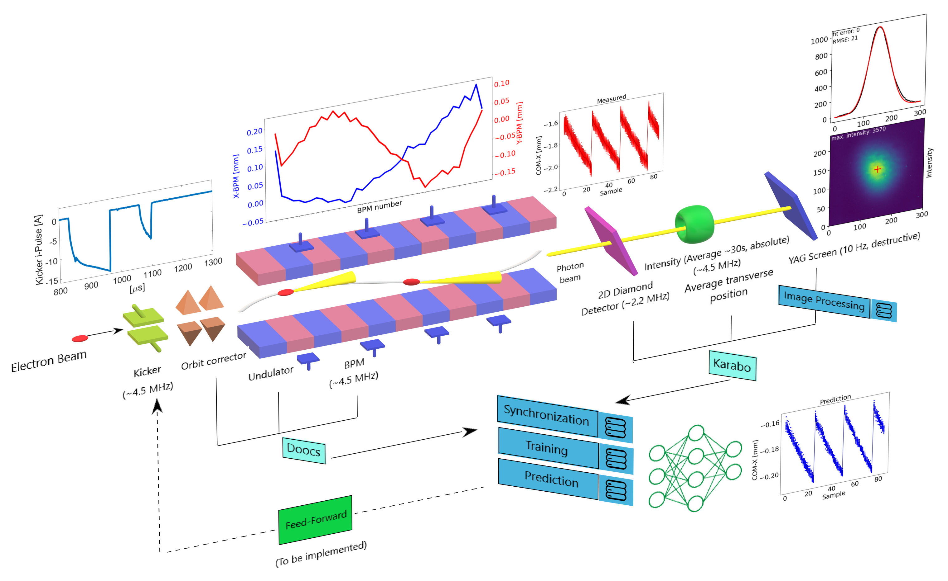
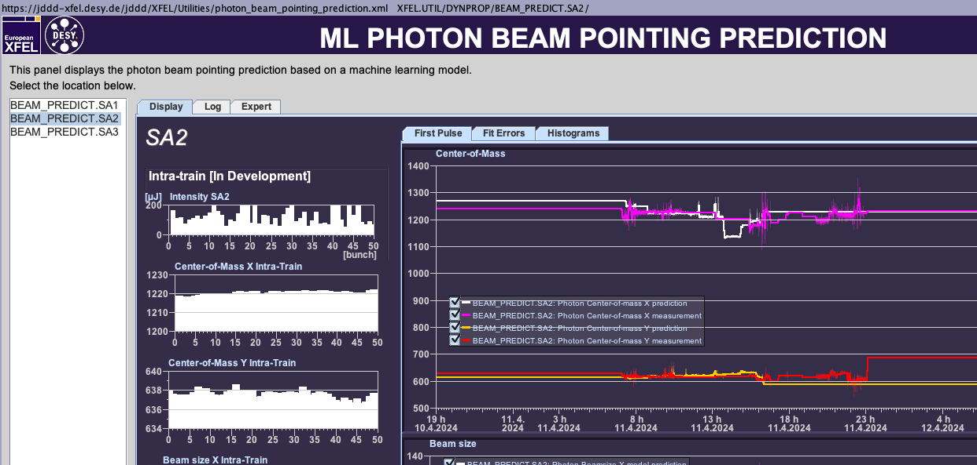
Diagnostic Tool
Machine-learning-driven virtual diagnostics of photon beam pointing
  Based on BPM and XGM data as input
  Based on several models
    Feedforward neural network (FNN)
    XGBoost
Features
  Real-time parasitic online diagnostics
  Server-based
  Built on standard MCS frameworks

Slide 4
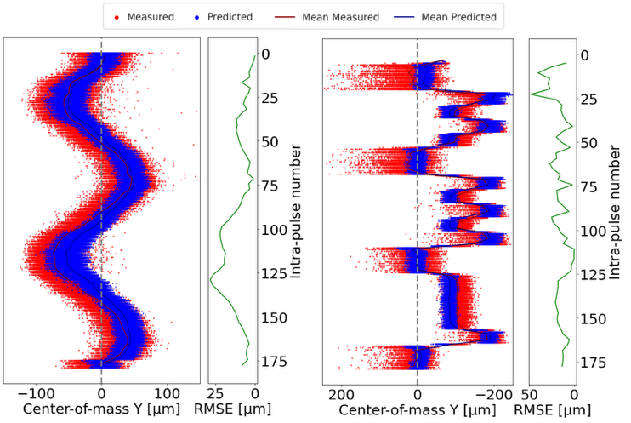
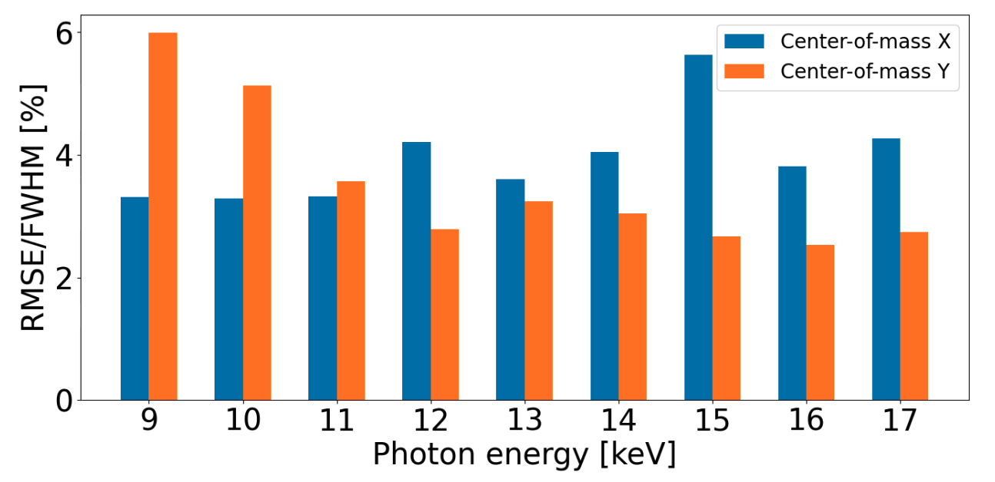
Model Performance of Beam Pointing Prediction
Model performance along the pulse train
  Model trained on single pulse measurements
  Prediction within measured range for all pulses within the pulse train
Model performance across a wide photon energy range
  Model trained on all but the test energy
  All prediction errors <6% FWHM of the beam size
Very stable beam at the end of the undulator required artificial “jitter” for training and testing

Slide 5
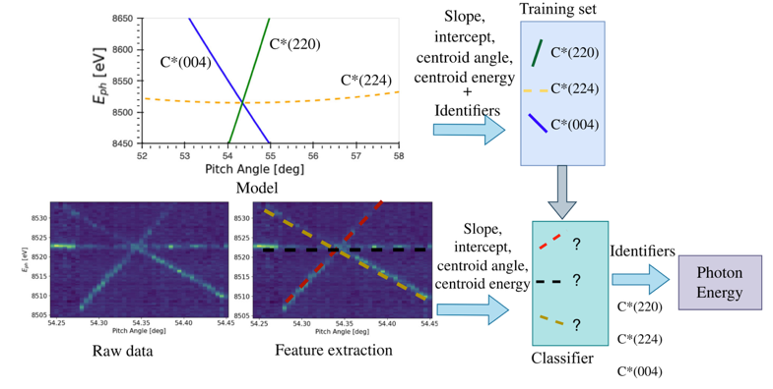
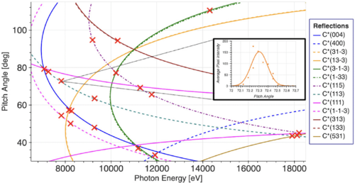
Absolute Energy Calibration of the Photon Beam
Absolute photon energy calibration only possible at specific
locations
Development of a virtual diagnostic for photon energy calibration of the full spectral range of SASE2
  ML model to predict the photon energy based on crystal reflections of the HXRSS mono
  Validated by Cu absorption scan at 8.98 keV
Enables photon energy scanning of seeded beams
  Successfully applied in multiple experiments
    Eg. Resonant X-ray excitation of the nuclear clock isomer 45Sc, Yuri Shvyd’ko, et al, Nature

Slide 6
Deviations from plan
Reduced collaboration with SPB/SFX
Focus intensified to photon pulse characterization after the undulator
Freed resources enabled additional extensions
  Absolute energy calibration
Beam pointing prediction tool still requires expert support

Slide 7
Timeline of this R&D activity
The project concluded without any substantial delays
Proposal Timeline | Milestone Description | Actual Timeline
Q2/2021 | Both postdocs: hired and onboarded. Experience shows that the ML might require more time to be hired. Phys: learning simulation tools in MXL/s2e/FPH/SPB/SFX ML: learning their way around Doocs/Karaboo/IPC | Done
Q4/2021 | Phys: First ensembles of pulses generated. Initial statistical characteristics concluded. First large-scale simulations underway. ML: Automate a way to retrieve machine information from both Karabo and Doocs for storage and further processing. | Done
Q3/2022 | Successful passing of data between all phases of the Start-to-End simulation, First paper draft(s). First prototypes of virtual diagnostics tools. Start categorizing and training surrogate models, take further input from Phys to improve upon this. | Done
Q1/2023 | Fully automatize the data collection required for ML | Done
Q3/2023 | Create a prediction model which of the photon beam pointing which does not require a retraining each week for a standard operation setting | Done
Q3/2025 | Have a fully working virtual diagnostic tool which can be utilized in daily operation. | Partially done
Q3/2025 | Further explore alternative virtual diagnostic possibilities | Done

Slide 8
Outlook / Summary
Beam pointing prediction
  Pipeline established
  Performs well across multiple photon energies without retraining
  Performs well along the pulse train
  Demonstrates control of the photon beam pointing at the end of the undulator
    Of interest for the beam sharing activities which is part of EuxFEL Strategy Program 04
Absolute energy calibration
  Implemented and used in several user deliveries
  Extension beyond seeded beams is part of EuXFEL Strategy Program 04
Results published in peer-reviewed journals

Slide 9
Publications
Crystal-based absolute photon energy calibration methods for hard x-ray free-electron lasers, C. Grech, MW Guetg, GA Geloni, U. Boesenberg, N. Kujala, M. Makita, S. Serkez, Phys. Rev. Accel. Beams 27, 050701 – Published 16 May, 2024
Computer vision approaches for the absolute energy calibration of Bragg crystal setups, C. Grech, GA. Geloni, MW. Guetg, Proceedings Volume 12581, X-Ray Free-Electron Lasers: Advances in Source Development and Instrumentation VI; 125810G (2023)
Virtual Photon Pulse Characterisation using Machine Learning methods, C. Grech, GA Geloni, T. Guest, F. Jafarinia, M. Guetg, 14th International Particle Accelerator Conference (2023)
Simulation Study on a Virtual Diagnostics Concept for X-Ray Pulse Characterisation, F. Jafarinia, GA Geloni, C. Grech, MW Guetg, 14th International Particle Accelerator Conference (2023)
Machine Learning Applied for the Calibration of the Hard X-Ray Single-Shot Spectrometer at the European XFEL, C. Grech, MW Guetg, GA Geloni, 13th International Particle Accelerator Conference, IPAC'22, Bangkok, Thailand, 12 Jun 2022 - 17 Jun 2022
Machine-Learning-Driven Virtual Diagnostics of Photon Beam Pointing in MHz Free-Electron Lasers, F. Jafarinia, C. Grech, R. Kammering, SP Schnake, T. Yildiz, W. Freund, J. Grünert, J. Liu, GA Geloni, MW Guetg – submitted to PRAB

