Slide 1
XFEL Accelerator R&D Status CW Accelerator Modules
Serena Barbanotti and Julia Goedecke
12.09.2025

Slide 2
Scope of the R&D activity
Summary
development of concept and prototype for an HDC-ready accelerator module built of high performance superconducting radio frequency (SRF) cavities
Interface
CW LLRF development: usage of pre-prototype cryomodules for R&D measurement
TS4i: cavity development and production
SRF R&D activities strongly benefit from the OP220 resources
Milestones
recipe for cavity heat treatment developed using single-cell cavities
production of test pieces verifying the pressure equipment directive (PED) aspects of nine cell cavity production done
single cavity – horizontal test-stand almost finalized, cold test before end of 2025
CW capable modules: first modified cryomodule under test at XATB2, further modifications after LIMP25
cryogenic calculations ongoing, need of JT valve confirmed, final design after test campaign in AMTF

Slide 3
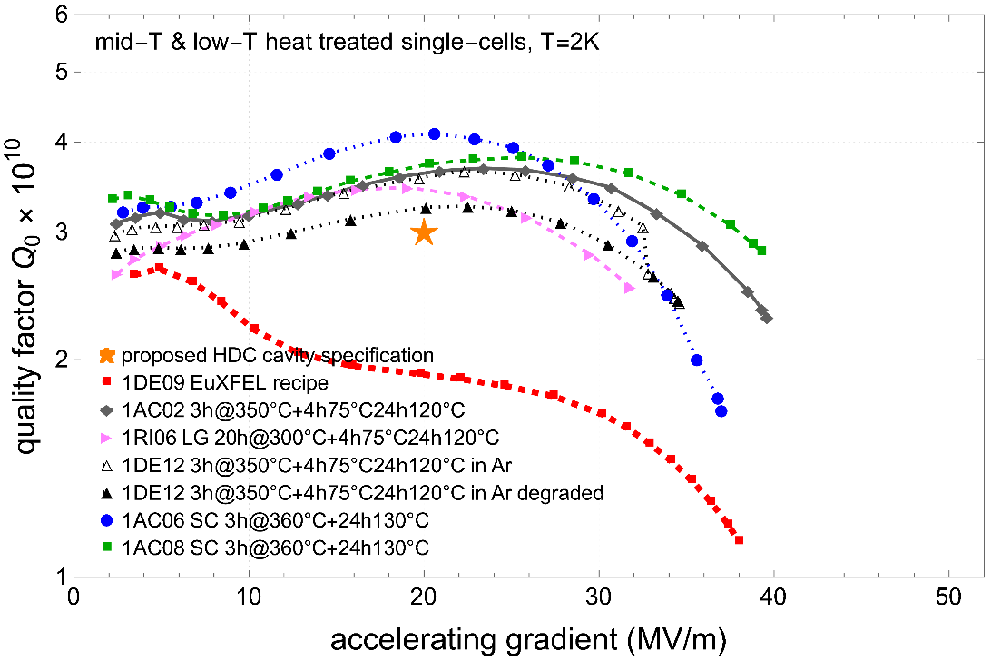
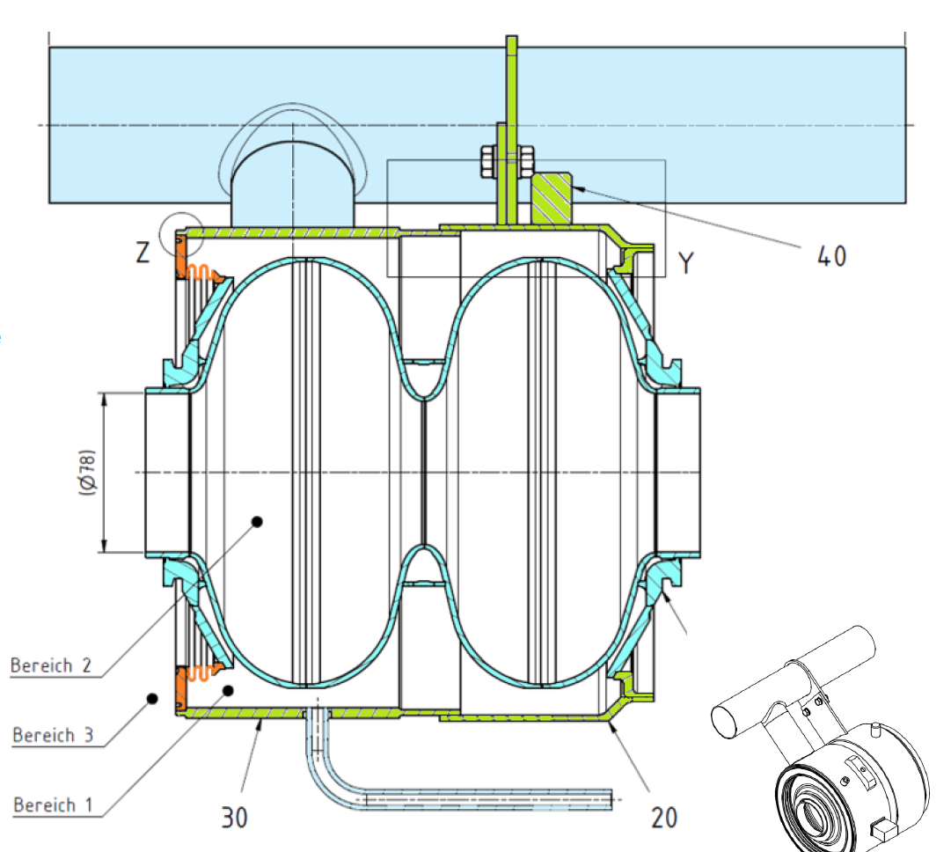
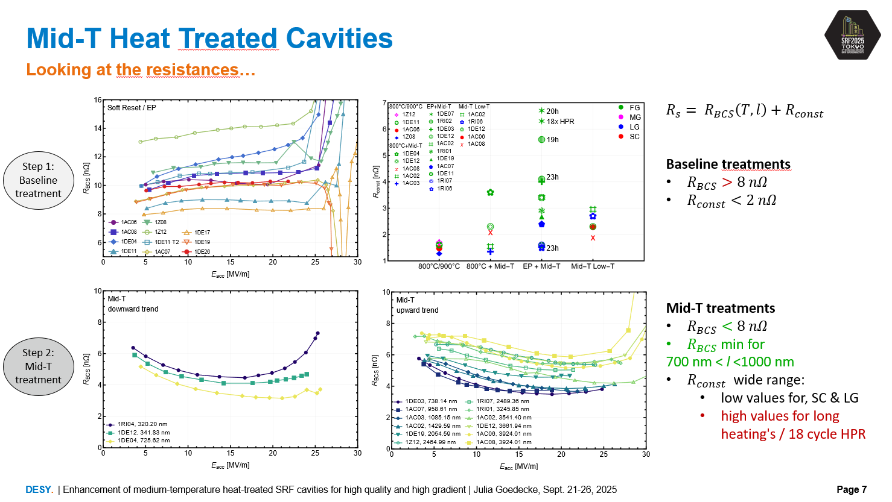
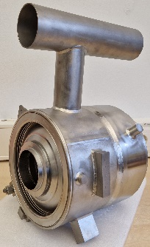
Achievements in the past year: cavities
Successful development of heat treatment recipe
unprecedented gradient reach with excellent Q₀
different Niobium grain sizes: fine, large, medium and single crystal
extensive studies of Oxygen diffusion length in Nb and surface resistance → deep understanding of underlying physics
Transfer to nine-cell cavities ongoing
revision of the SRF cavity specification (part of OP220) in final stages
test pieces as production samples of two vendors finalized, TÜV-test ongoing
Nb sheets and tube material qualified and ready for cavity production
to be presented @ SRF 2025

Slide 4
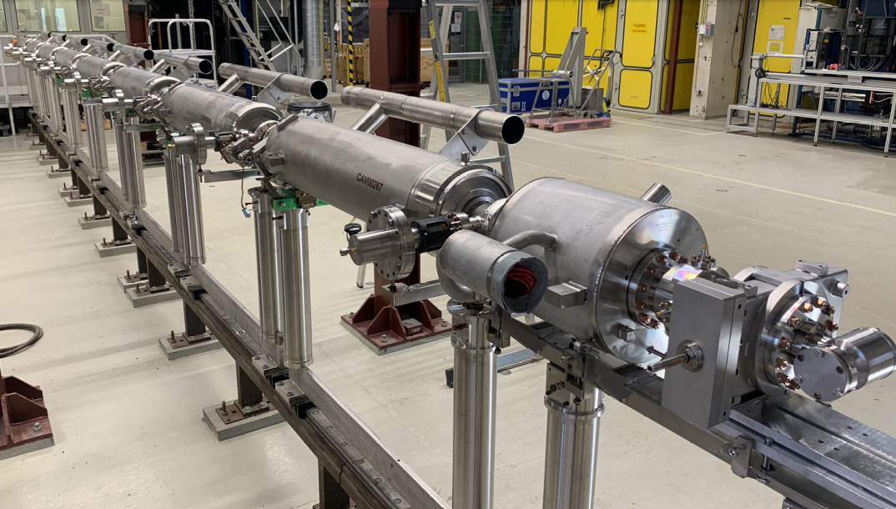
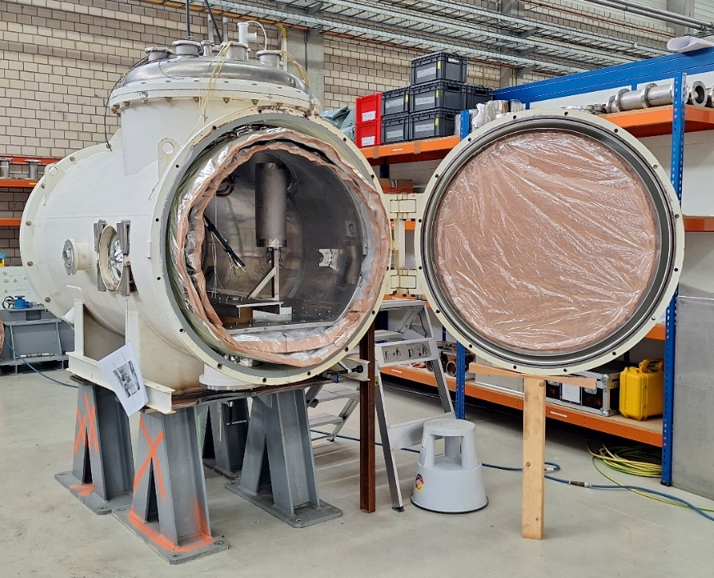
Achievements in the past year: cryomodules
Module assembly while maintaining vacuum in cavity string
technical solutions for assembly of warm RF power coupler part & frequency tuner developed
modified tooling and parts produced and tested
Power coupler studies: we need the tested thicker Copper plating
Comparison XM50.1 & VT results until the end of the year
tests are still ongoing
Horizontal test stand XATBH almost ready for cold test before end 2025
First modified cryomodule under test at XATB2, two more modules in the pipeline after end of LIMP25

Slide 5
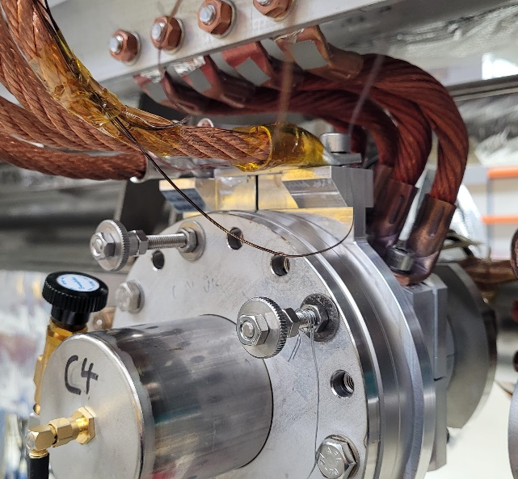
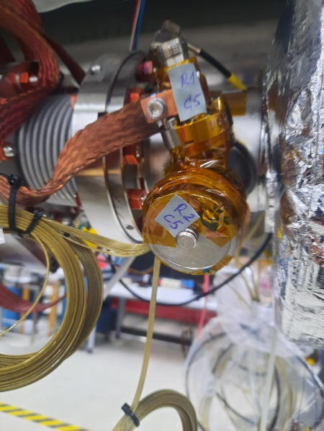
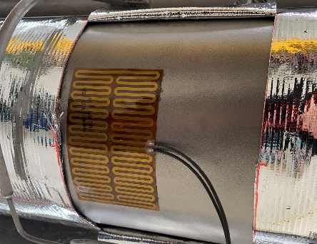
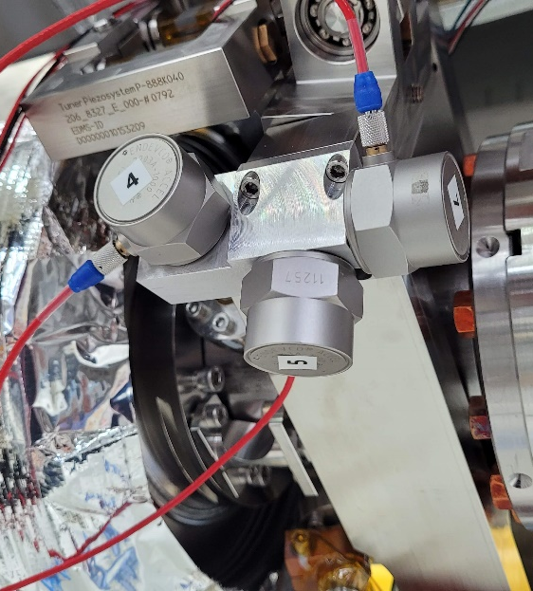
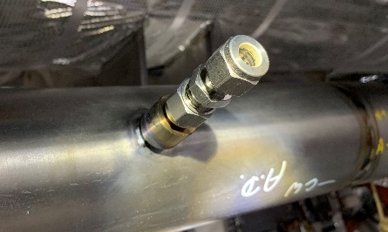
Achievements in the past year: cryomodules
First modifications on a XFEL spare cryomodule (XM99)
To improve coupler cooling
First modification tested , further changes ongoing
Deeper study of HOM heating started
Additional instrumentation installed
In situ analysis of vibration (microphonics) during RF operation ongoing (comparison of different measurement systems now possible)
5-8 K thermal shield removed
Status: cryomodule under test
1
2
1
2
3
4
3
4

Slide 6
Deviations from plan
Revision of the SRF cavity specification not yet ready
more than 12 colleagues involved: work load was underestimated, too many other high priority tasks within OP220, and also RP212 (accelerator operation, infrastructure issues)
ordering of cavities and further R&D with these cavities are being delayed
Module assembly slightly delayed
XM50.1 disassembled; new string assembly in 2026

Slide 7
Timeline of this R&D activity
Proposed Date | Milestone Description | Updated Date
Q1/2024 | Finish and implement update of the SRF cavity specification (part of OP220) | Q1/2026
Q2/2024 | Order ten state-of-the-art cavities based on new specification (OP220) | Q4/2025
Q3/2025 | Finish initial RF testing of the new cavities | Q1/2027
Q4/2025 | Define module assembly procedure with string under vacuum | Q1/2026
12/2025 | Full understanding of gas flow dynamics in the parallel 2-phase and gas return pipe system | Q4/2025
12/2025 | Clarify need of JT valve and small helium pot at each cryomodule | Q2/2026

Slide 8
Risks to R&D Project
Applicability of cavity recipe to accelerator environment
successful transfer to nine cell cavities
sensitivity to magnetic flux trapping of mid-T treated cavities to be clarified → PhD project
sensitivity to cool down speed to be clarified
Staff shortage
even after some staff increase (OP220, RP211, RP212) we see some shortage (mostly mechanical work design and all-rounders)
risk of losing expertise in assembling and testing cryomodules if colleagues retiring are not replaced in time

Slide 9
Outlook / Summary
Summary
promising new heat treatment developed, many insights gained
test pieces as production samples are finalized (TÜV-test)
Nb material for ten new nine-cells production available
feasibility studies for module assembly under vacuum available
first modified cryomodule under test, more modifications after LIMP25
horizontal test stand XATBH almost finished, first tests in 2026
Outlook
finalization of the cavity specification and call for tender for ten new cavities
transfer of new heat treatments to new nine-cells
understanding of sensitivity to magnetic flux trapping and influence of cool down speed
usage of 8 new cavities for prototype cryomodule
assembly of cryomodule with cryogenic modifications (bigger 2-phase pipe, extra valve)
commissioning of XATBH

Slide 10
Outlook / Summary
Publications
C. Bate et al., “Correlation of SRF performance to oxygen diffusion length of medium temperature heat treated cavities”, Supercond. Sci. Technol. 12/2024, https://doi.org/10.1088/1361-6668/ad9fe8
L. Steder et al., “Further improvement of medium temperature heat treated SRF cavities for high gradients”, arXiv2024, https://doi.org/10.48550/arXiv.2407.12570
J. Goedecke et al., “Enhancement of medium-temperature heat-treated SRF cavities for high quality and high gradient”, to be published in proceedings of SRF 2025, (TUA05)
D. Reschke et al., “Activities on medium grain niobium at DESY”, to be published in proceedings of SRF 2025, (THP32)
S. Barbanotti et al., „The path to high duty cycle at European XFEL: cryomodule developments”, to be published in proceedings of SRF 2025, (TUA02)

