Slide 1
Few-femtosecond
IR pump-UV probe spectroscopy in liquid phase
İdil Şimşek
Koç University, Turkey
DESY group: FS-ATTO
DESY Summer Programme, Hamburg

Slide 2
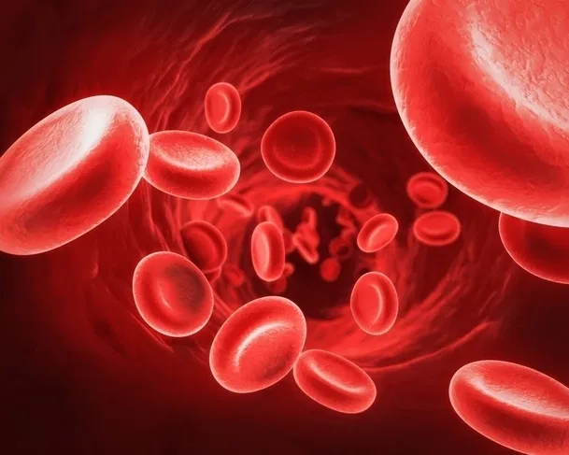
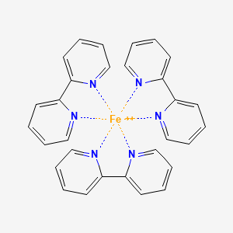
Ultrafast dynamics in liquid
Aim: Studying the effects of the liquid environment on chemical reactions in biological systems
Hemoglobin & iron tris bipyridine
Pump-probe spectroscopy
Few-fs time resolution
NCBI PubChem, CID 6857601. Retrieved Sept 8, 2025.
| Few-femtosecond IR pump-UV probe spectroscopy in liquid phase | İdil Şimşek, 10.09.2025

Slide 3
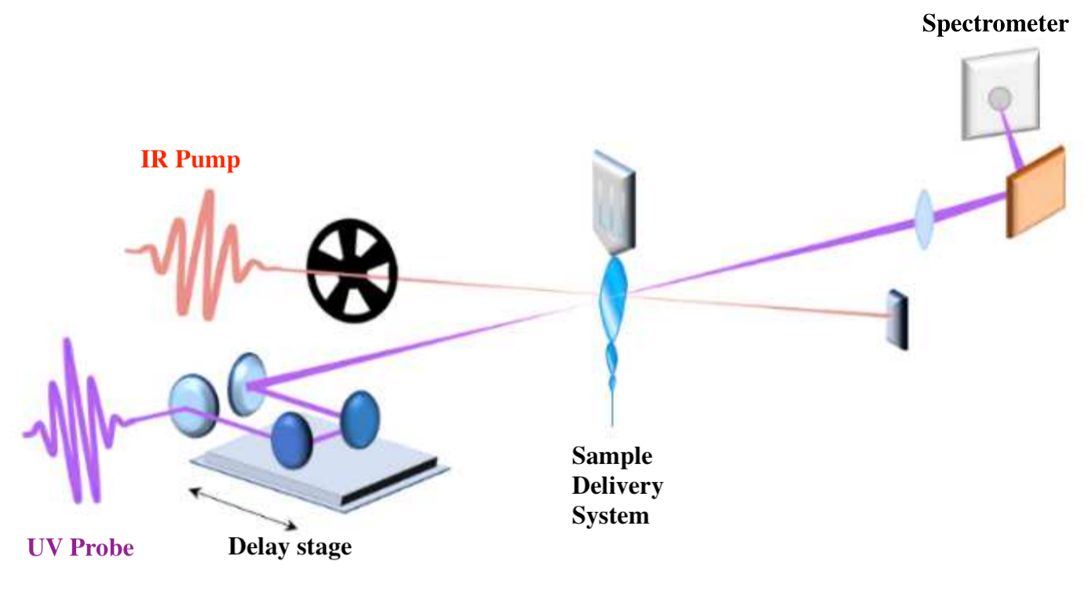
Pump-probe spectroscopy
Aim: seeing how the absorption feature of the sample changes when it’s excited.
Pump pulse (IR) excites the sample
Probe pulse (UV) captures the optical response
The delay between the pump and the probe is adjusted with each measurement
Adapted from Giovannetti et al., Research Square Preprint (2025), DOI: 10.21203/rs.3.rs-6745336/v1
| Few-femtosecond IR pump-UV probe spectroscopy in liquid phase | İdil Şimşek, 10.09.2025

Slide 4
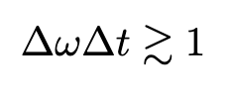
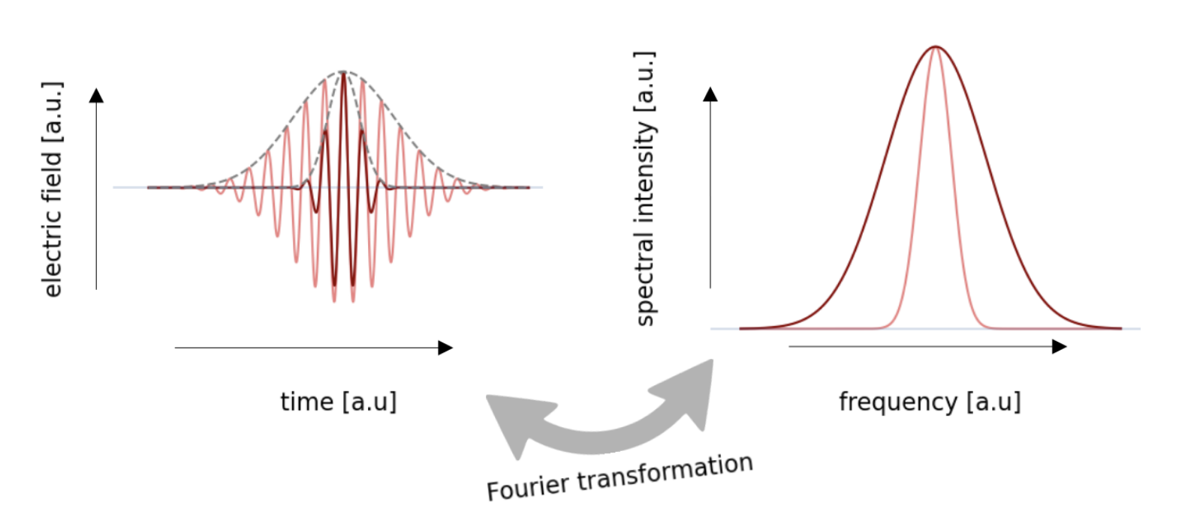
Generation of short pulses
Time-bandwidth product:
Broader spectrum = shorter pulse
Things to discuss:
  Pump
  Probe
  Delivery system
Rockenstein et al., Univ. Hamburg Lab Manual (May 2024).
| Few-femtosecond IR pump-UV probe spectroscopy in liquid phase | İdil Şimşek, 10.09.2025

Slide 5

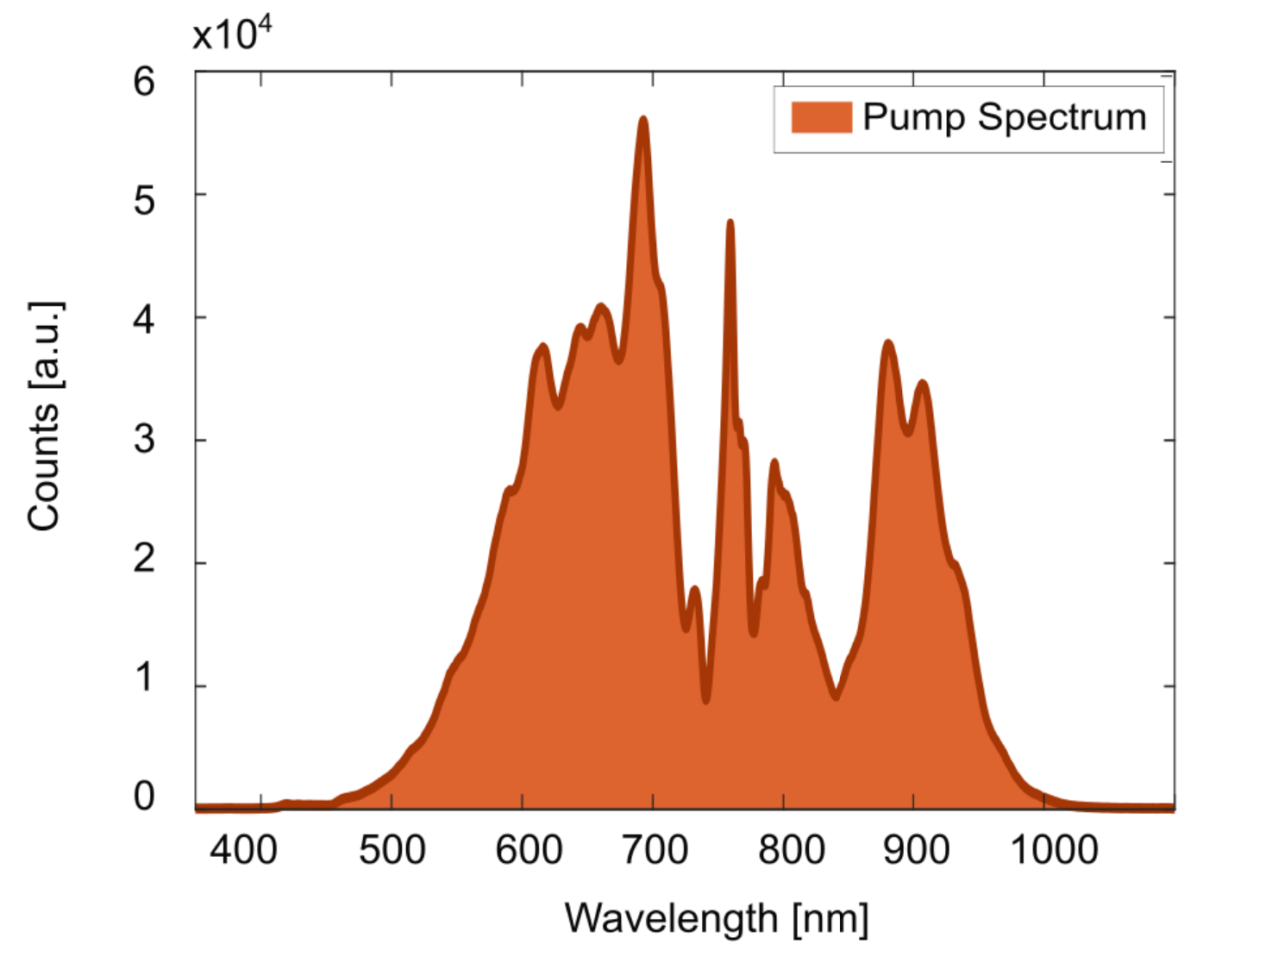
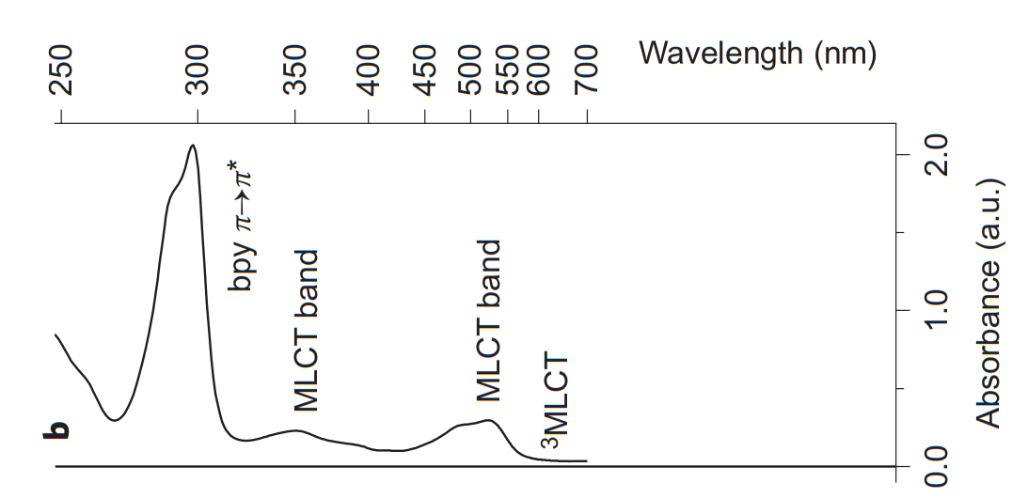
Pump: Photoexcitation of Fe complex
Giovannetti et al., Research Square (2025), Supplementary Info.
NIR Pump Spectrum
Auböck & Chergui, Nature Chem 7, 629–633 (2015).
Iron Tris Bipyridine Absorption Spectrum
| Few-femtosecond IR pump-UV probe spectroscopy in liquid phase | İdil Şimşek, 10.09.2025

Slide 6
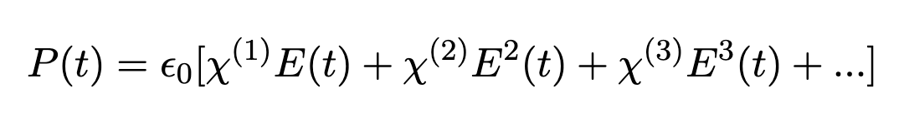
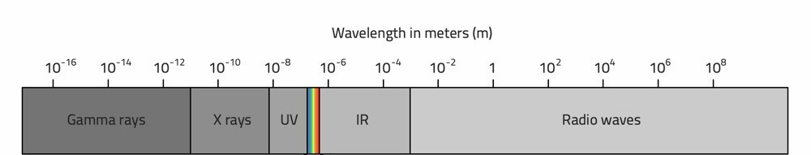



Probe: Generation of UV light
Nonlinear Optics
response of a medium towards an EM field:
“Components of electromagnetic spectrum,” PrimaLuceLab (2025).
.
Third harmonic
(~233-267 nm)
Fundamental beam
(700-800 nm)
ω
ω
3ω
| Few-femtosecond IR pump-UV probe spectroscopy in liquid phase | İdil Şimşek, 10.09.2025

Slide 7
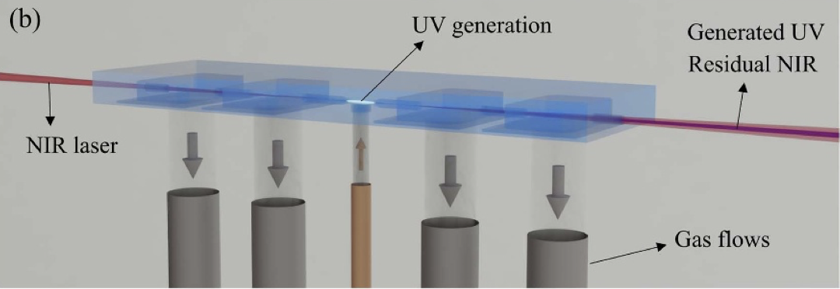
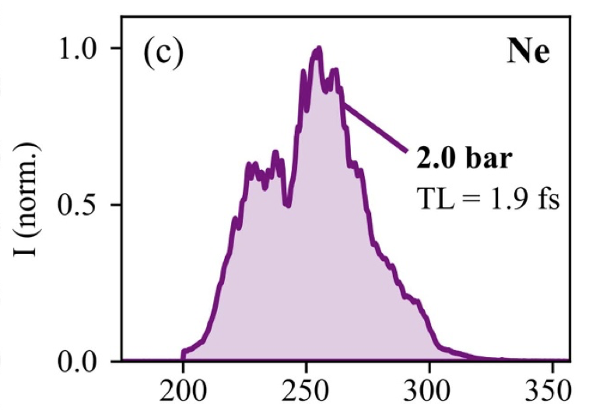

Probe: Generation of UV light
Wanie et al 2024 J. Phys. Photonics 6 025005
Wanie et al 2024 J. Phys. Photonics 6 025005
| Few-femtosecond IR pump-UV probe spectroscopy in liquid phase | İdil Şimşek, 10.09.2025

Slide 8
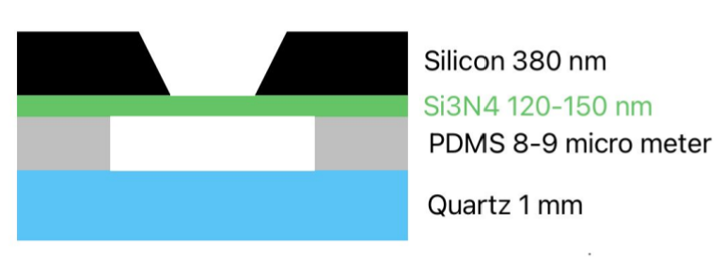
Delivery system: Flow cell
Aim: liquid sample delivery in vacuum
No dispersion
Advantages:
Isolated system from vacuum
Easy liquid control
Disadvantages:
Needs a window, requires UV-transparent materials
Small aperture, losing counts
Nasri et al., Poster, Universität Hamburg & DESY (2025).
| Few-femtosecond IR pump-UV probe spectroscopy in liquid phase | İdil Şimşek, 10.09.2025

Slide 9
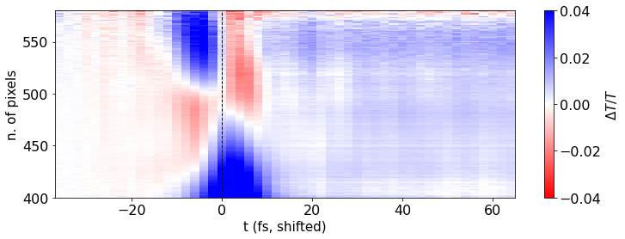
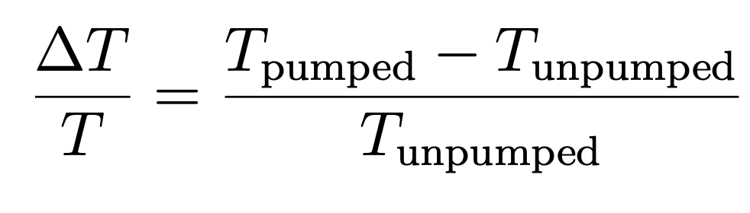
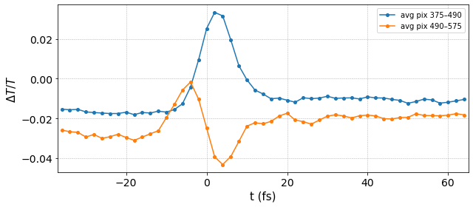
Delivery system: Flow cell
Results: [Fe(bpy)₃]²⁺
Plotted data is courtesy of FS-ATTO group.
| Few-femtosecond IR pump-UV probe spectroscopy in liquid phase | İdil Şimşek, 10.09.2025

Slide 10
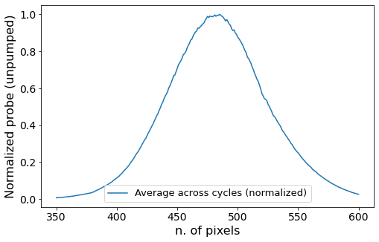
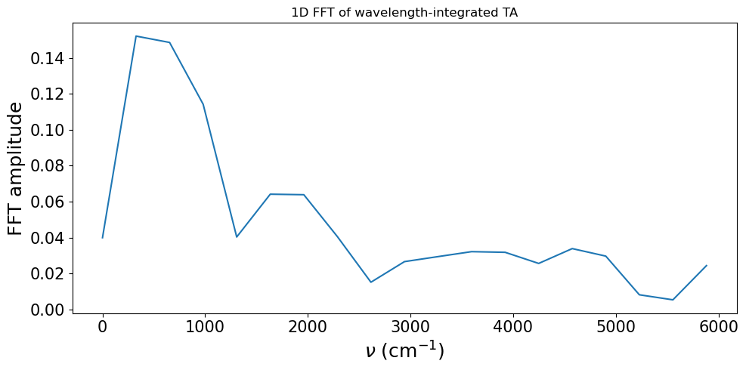
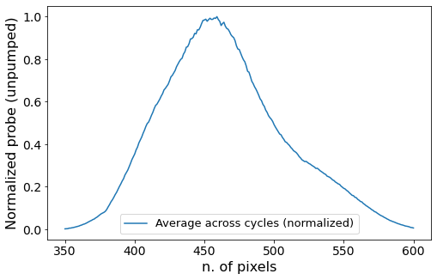
Delivery system: Flow cell
Results: [Fe(bpy)₃]²⁺
Water
Iron complex in water
Plotted data is courtesy of FS-ATTO group.
| Few-femtosecond IR pump-UV probe spectroscopy in liquid phase | İdil Şimşek, 10.09.2025

Slide 11
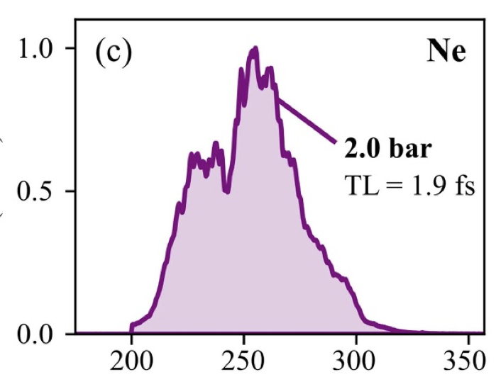
Conclusion
Few-femtosecond UV pulses: allow investigation of molecular dynamics on their native time-scale
A way of generating UV light: Third harmonic generation
Proof of concept for studies of iron complexes
| Few-femtosecond IR pump-UV probe spectroscopy in liquid phase | İdil Şimşek, 10.09.2025

Slide 12
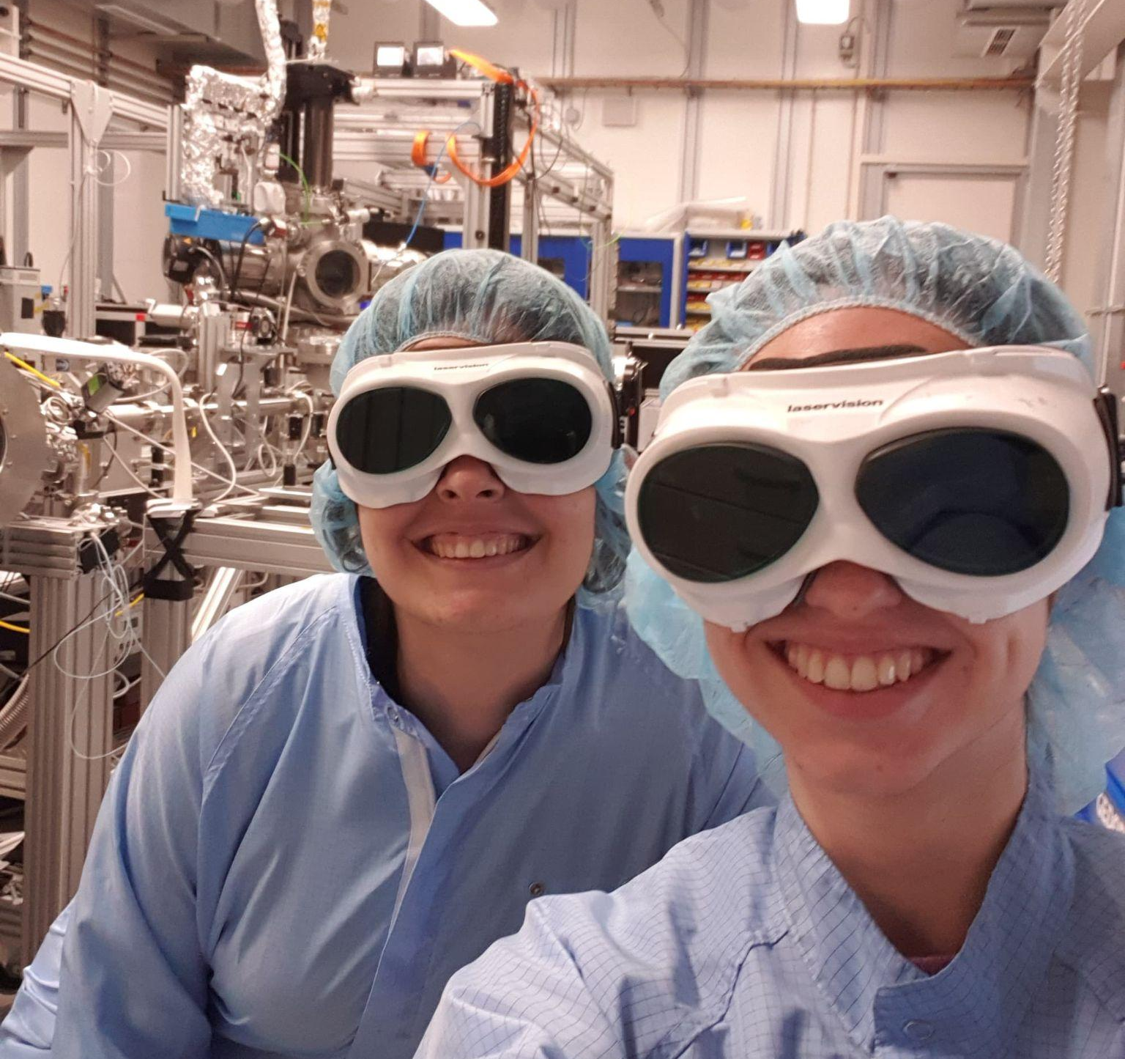








Acknowledgements
CFEL-ATTO, Germany
Ana Lambert-Bernal
Sabine Rockenstein
Kai-Fu Wong
Linda Oberti
Lorenzo Pratolli
Keerthana Ravi
Fatemehsadat Ghaffari
Ana Oliveira e Silva
Oliviero Cannelli
Terry Mullins
Aurelien Sanchez
Kate Robertson
Felix Ritzkowsky
Katinka Horn
Ammar Bin Wahid
Agata Azzolin
Marc Seitz
Sergey Ryabchuk
Vincent Wanie
Andrea Trabattoni
Erik Månsson
Francesca Calegari
Special thanks to our supervisors!
THANK YOU!
| Few-femtosecond IR pump-UV probe spectroscopy in liquid phase | İdil Şimşek, 10.09.2025

Slide 13
SUPPLEMENTARY SLIDES

Slide 14
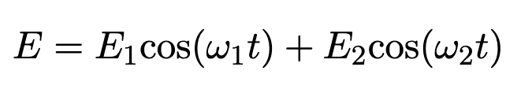
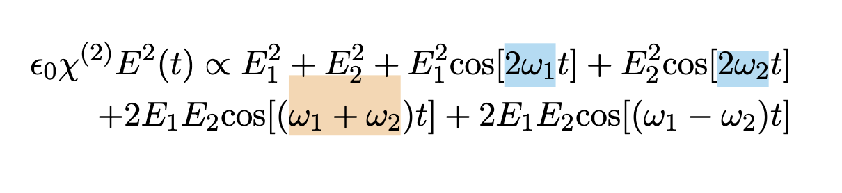
Generation of UV Light
Harmonic Generation as a Route to UV - Theory
response of a medium towards an EM field:
second harmonic generation (SHG)
the second-order polarisation contribution when we have two fields:
sum-frequency generation (SFG)

Slide 15
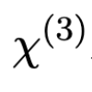



Generation of UV Light
Harmonic Generation as a Route to UV - Theory
SHG
Third harmonic generation:
1) high and high fundamental beam intensity
2) SHG (ω → 2ω) + SFG ( ω + 2ω → 3ω)
SFG
We select the frequencies to survive via phase matching.
The SFG field needs to be in phase with the fundamental field, i.e.,
so that
This condition boils down to
and can be fulfilled by adjusting the angle of the crystals used for generation.

Slide 16
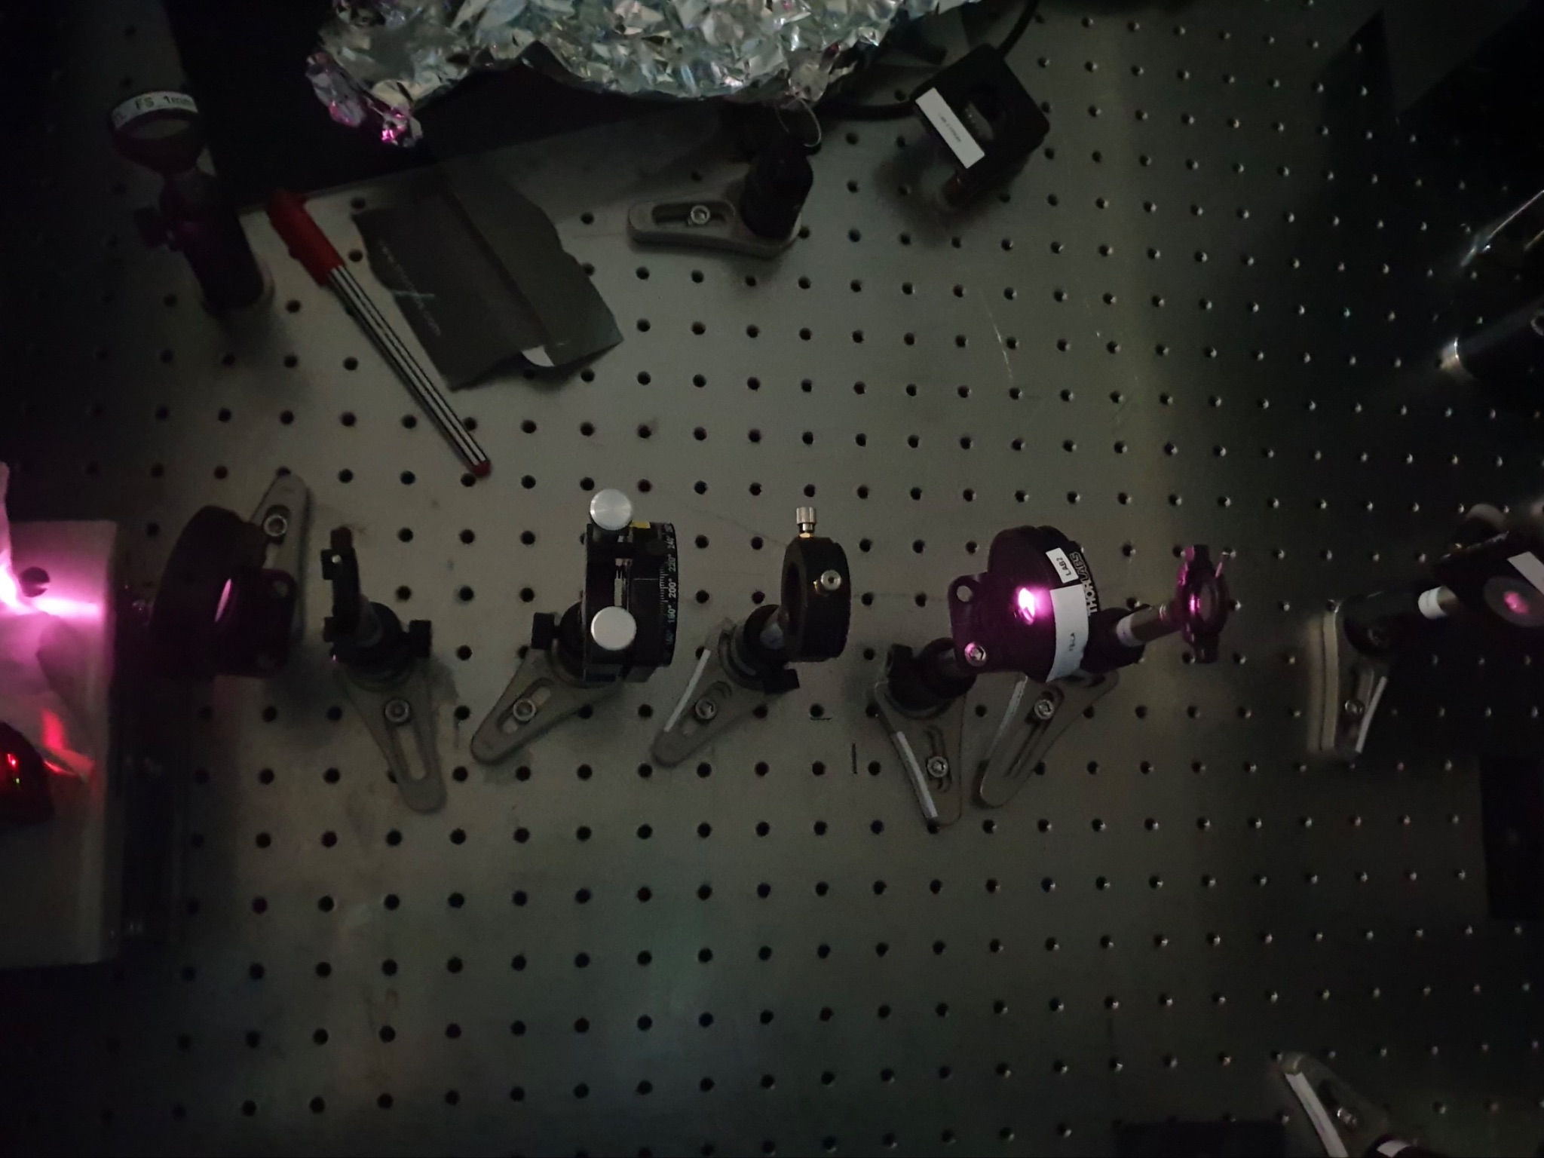
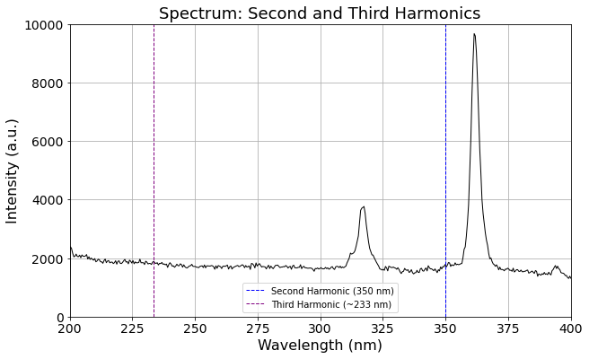
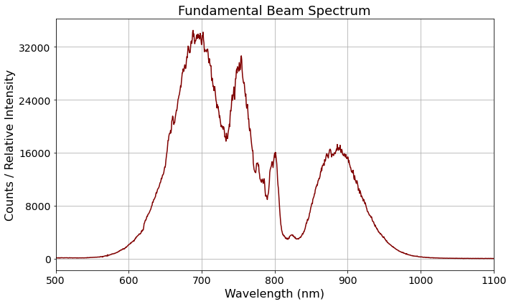
Generation of UV Light
Harmonic Generation as a Route to UV - Cascaded Approach Experimental Setup and Results
fundamental beam (700 nm)
second harmonic (350 nm)
third harmonic (~233 nm)
calcite plate
second BBO*
first BBO*
HWP
*BBO ≡ Beta-Barium Borate
first BBO
second BBO

Slide 17
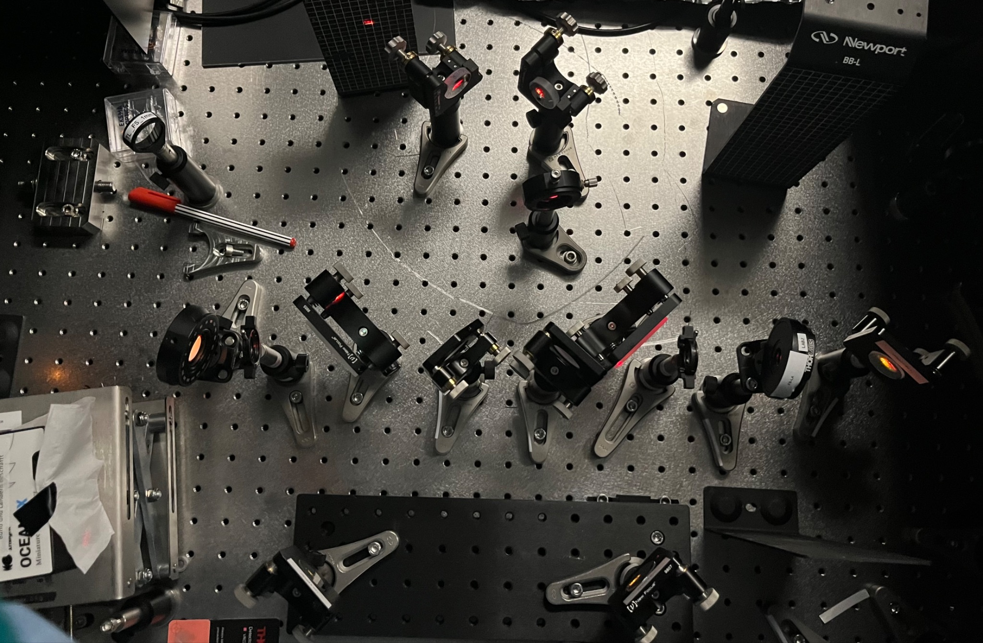
Generation of UV Light
Harmonic Generation as a Route to UV - Experimental Setup with Delay Stage
HWP
fundamental beam (800 nm)
second harmonic (400 nm)
third harmonic (~267 nm)
dichroic mirrors
spectrometer
delay stage
second BBO
first BBO

Slide 18
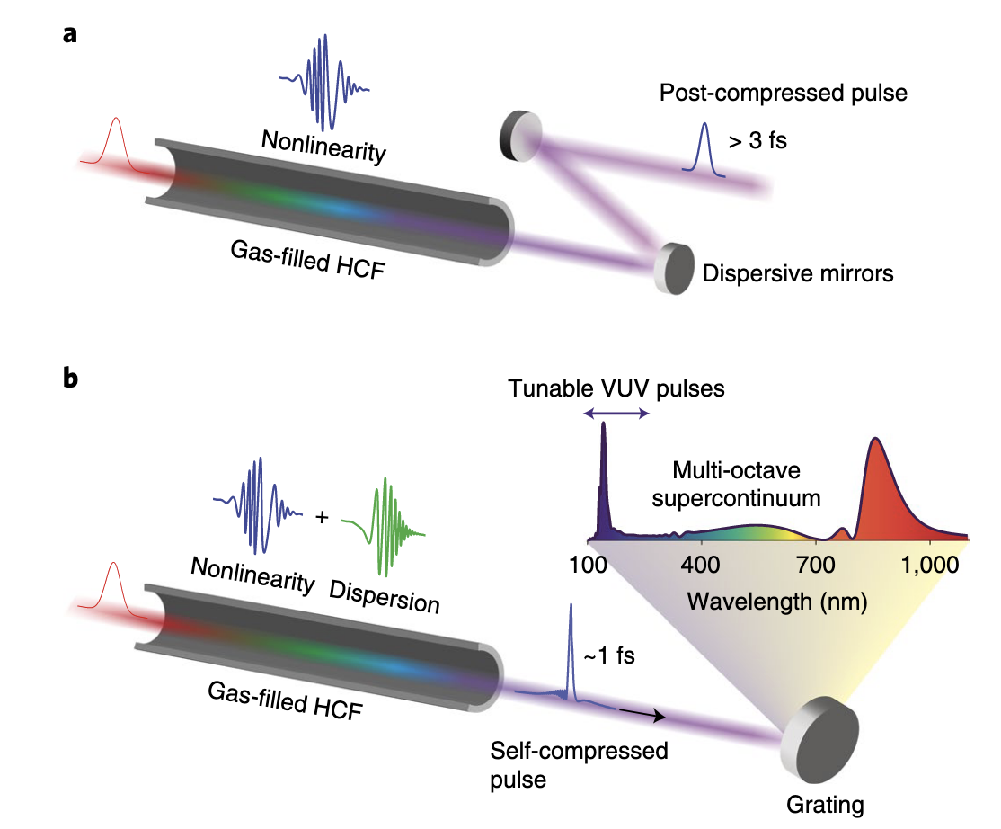
Generation of UV Light
Resonant Dispersive Wave (RDW) Emission: Towards Tunable UV - Theory
Because of nonlinear effects, the spectrum broadens and there is dispersion which are compensated by the chirped mirrors outside.
In RDW, rather than using chirped mirrors to compensate for the dispersion, we configure the system so that the compensation happens inside the waveguide.
Travers et al. 2019, Nat. Phot. 13 547 (2019)

Slide 19
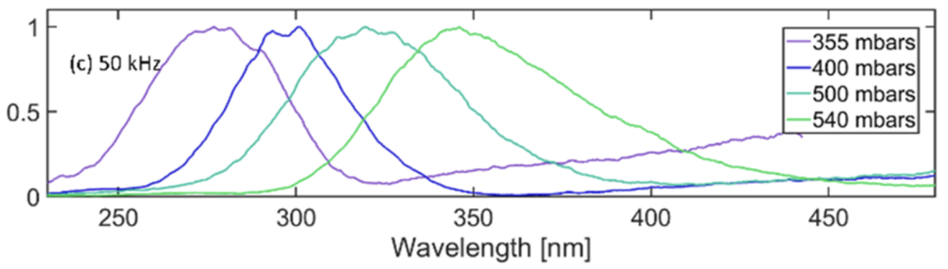
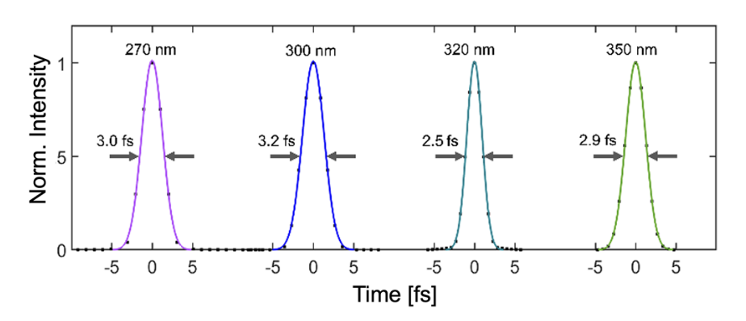
Generation of UV Light
Resonant Dispersive Wave (RDW) Emission: Towards Tunable UV - Experimental Results
Results:
very short pulse
easily tuneable across UV unlike the direct or cascaded third harmonic generations!
Silletti et al. 2025, APL Photon. 10, 026818 (2025)

Slide 20
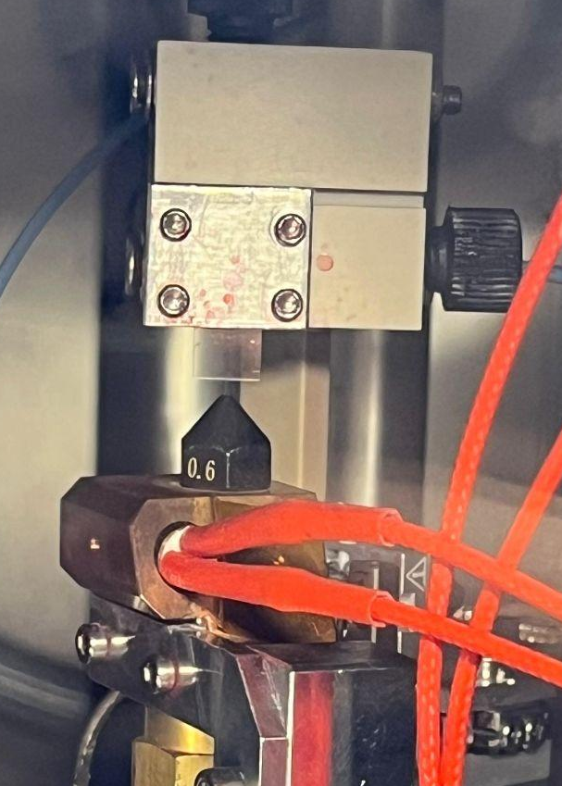
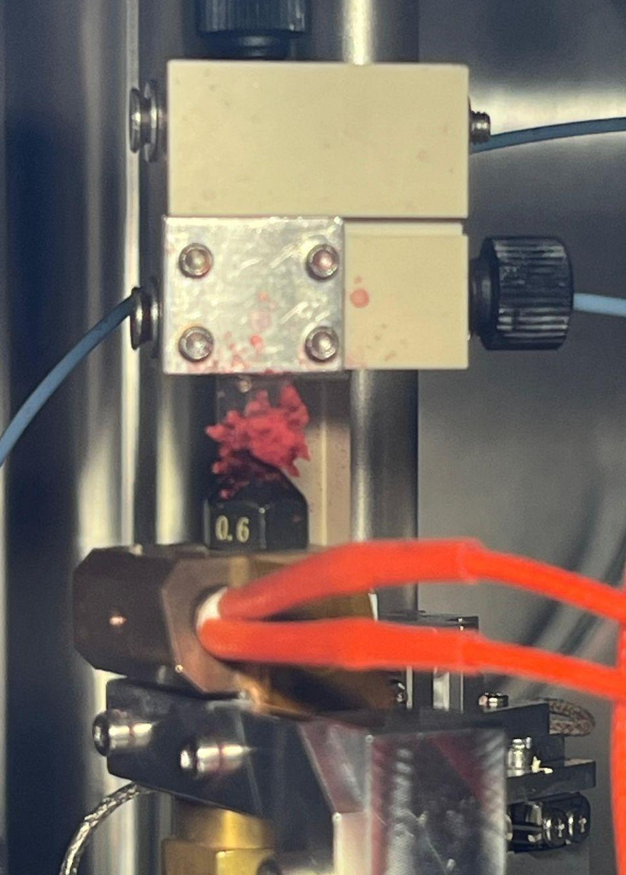
Liquid Jet
Advantages & Challenges
Advantages:
Reduced sample damaging
Controlled thickness and size
Long stability
Challenges:
Clogging
Pressure and temperature conditions

Slide 21
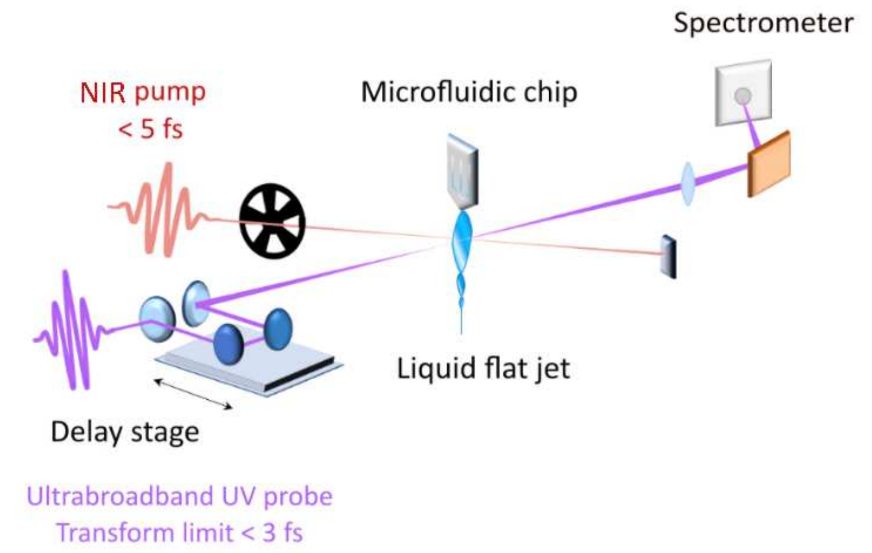
Liquid Jet
Introduction
Aim: understand the properties of aqueous solutions
Sample: Water & [Fe(bpy)₃]²⁺
Requirements:
In vacuum
Ultrathin
Giovannetti et al., Research Square Preprint (2025), DOI: 10.21203/rs.3.rs-6745336/v1

Slide 22
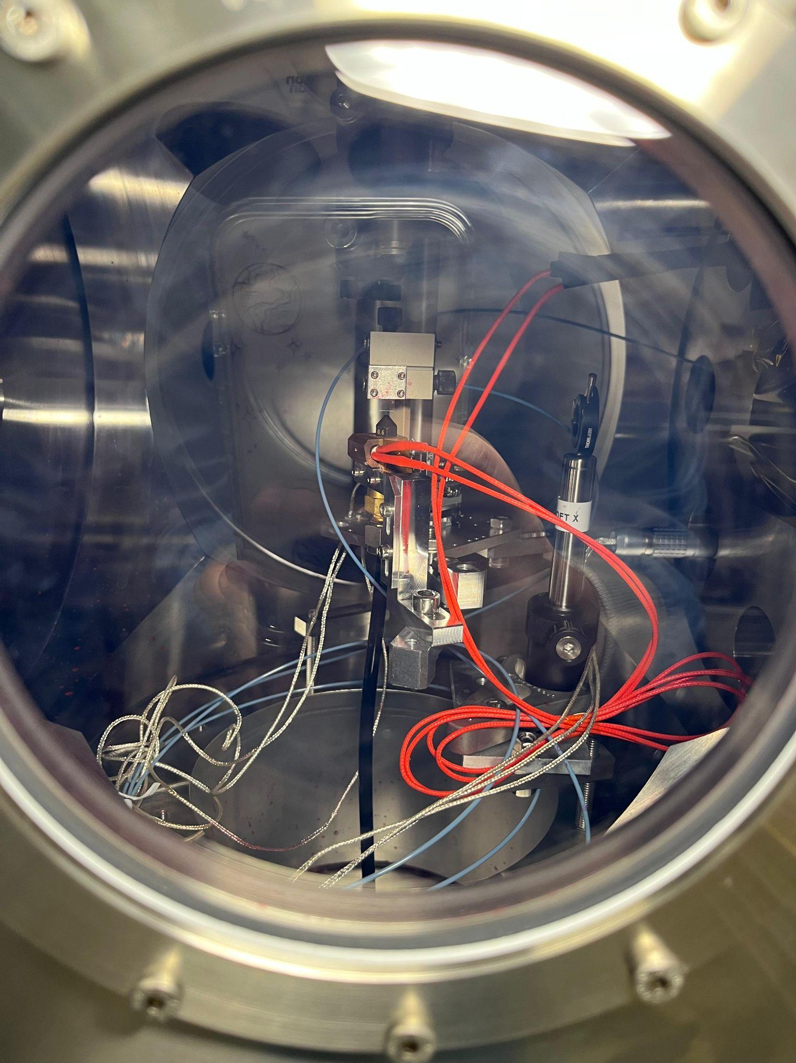
Liquid Jet
Liquid Jet Stage Setup
Micronit Chip
Flat sheet jet
Conical catcher
3D stage manipulator
Heater

Slide 23


Liquid Jet
Setup of the Vacuum Chambers
Vacuum Pump
Experimental Chamber
Glass Door
Extension Chamber
Light Source
HPLC
Gate valve
Sample
Catcher Bottle
Membrane Pump
Turbomolecular Pumps
Reservoir

Slide 24
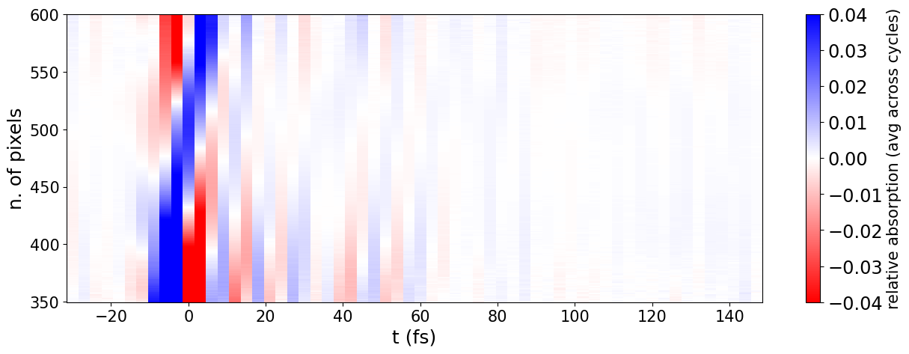
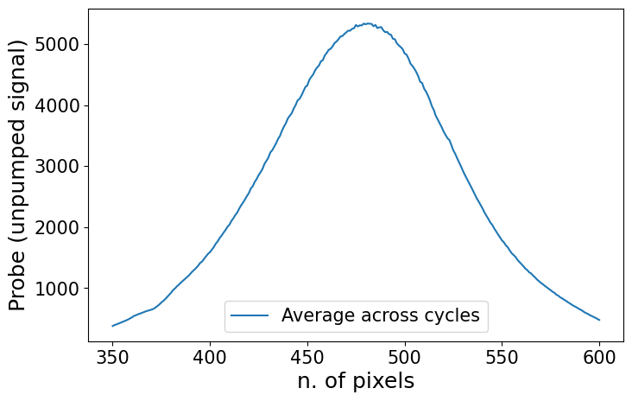
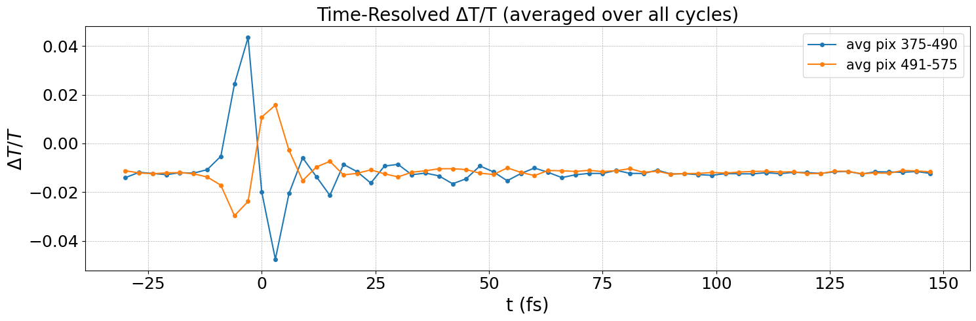
Liquid Jet
Results: Water
All data that we plotted is courtesy of FS-ATTO group.

Slide 25
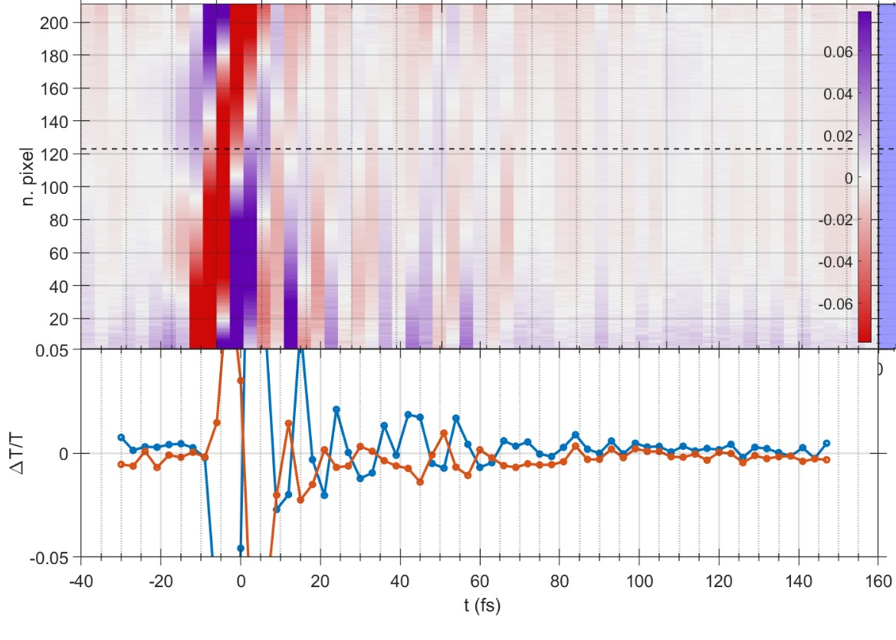
Liquid Jet
Matlab Script
Python Script

Slide 26
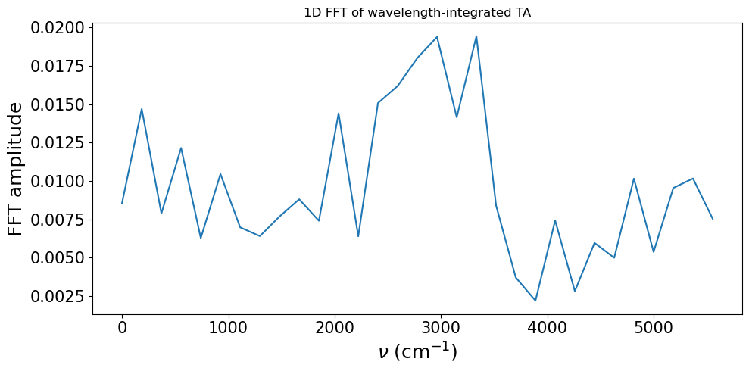
Liquid Jet
Results: Water FFT
All data that we plotted is courtesy of FS-ATTO group.

Slide 27
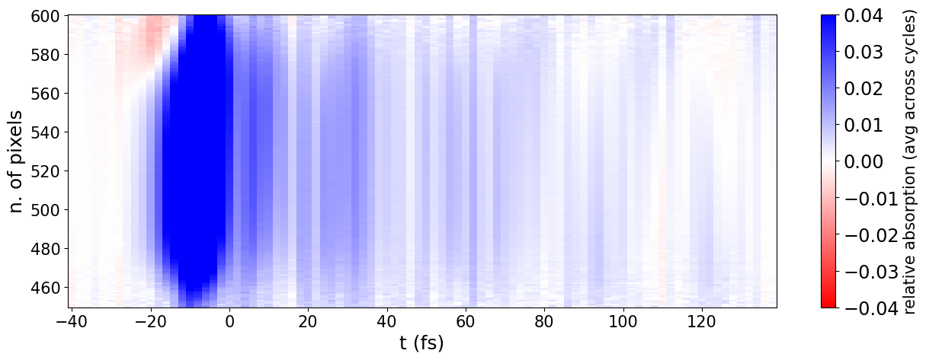
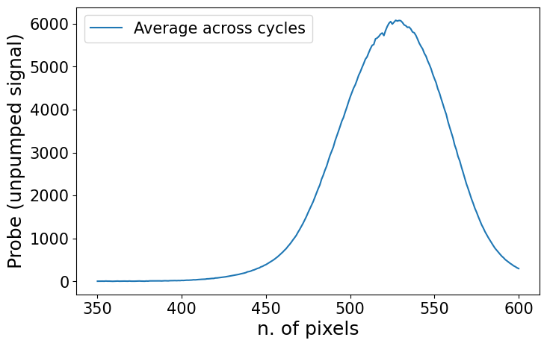
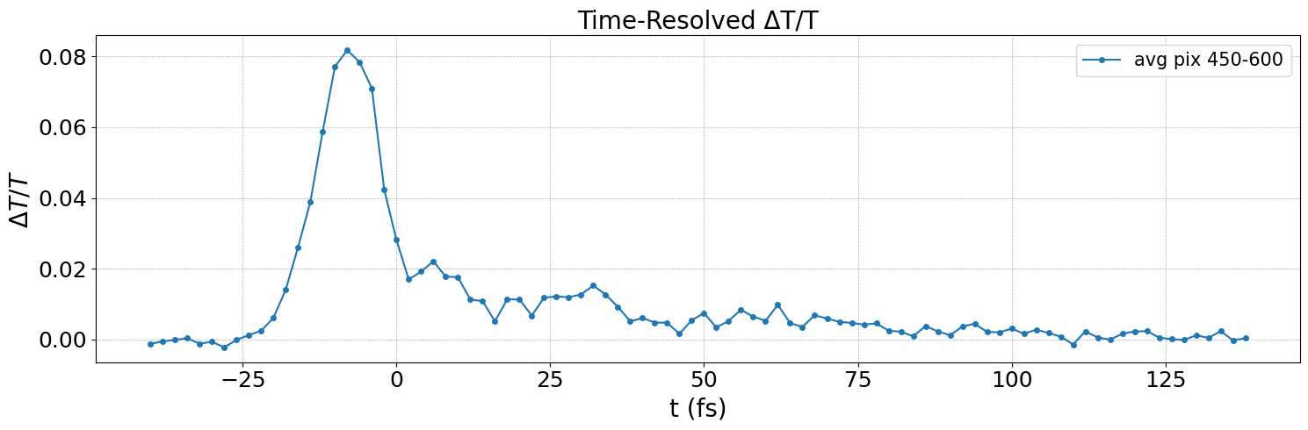
Liquid Jet
Results: [Fe(bpy)₃]²⁺
All data that we plotted is courtesy of FS-ATTO group.

Slide 28
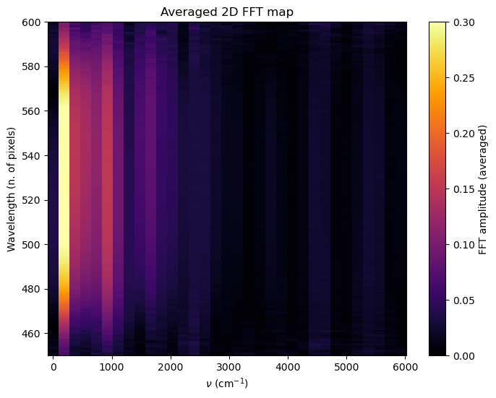
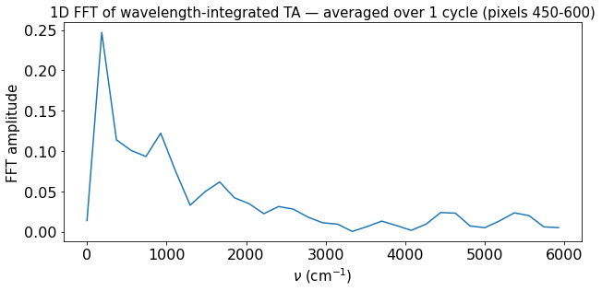
Liquid Jet
Results: [Fe(bpy)₃]²⁺ FFT
All data that we plotted is courtesy of FS-ATTO group.

Slide 29
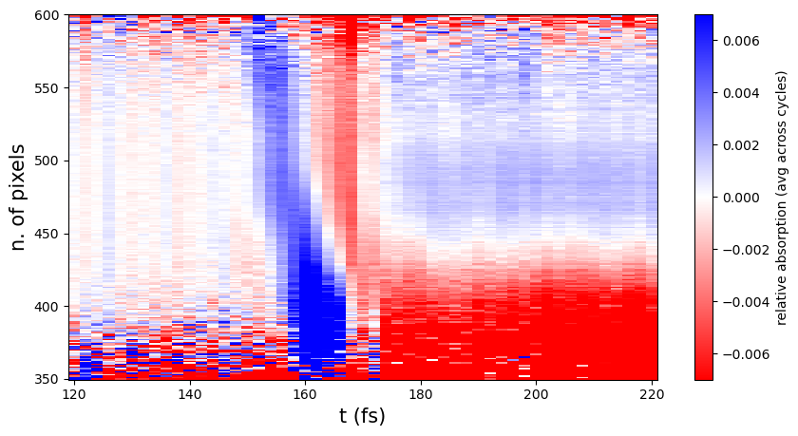
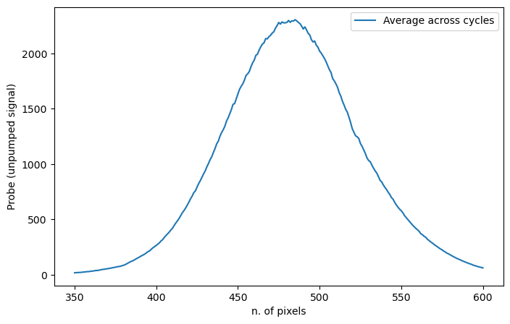
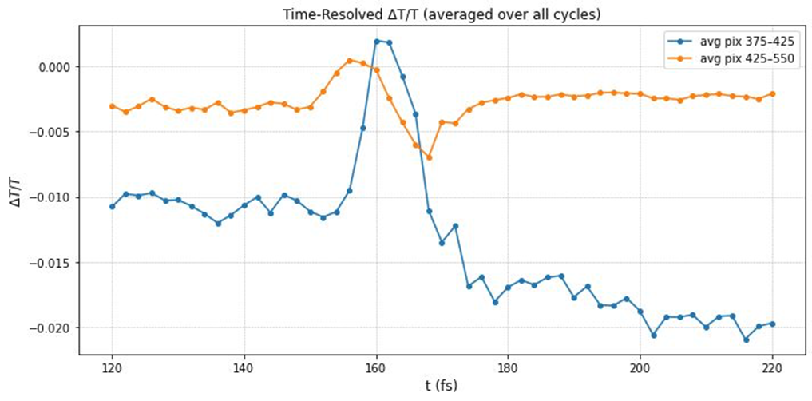
Flow Cell
Results: Water
All data that we plotted is courtesy of FS-ATTO group.

Slide 30
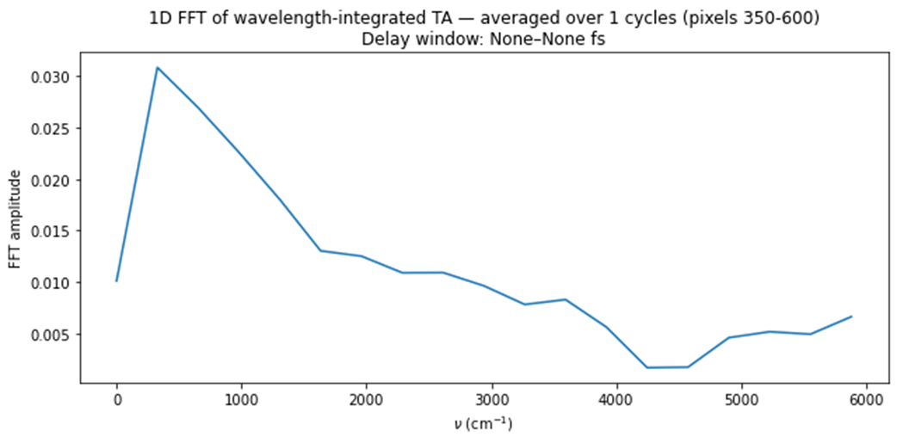
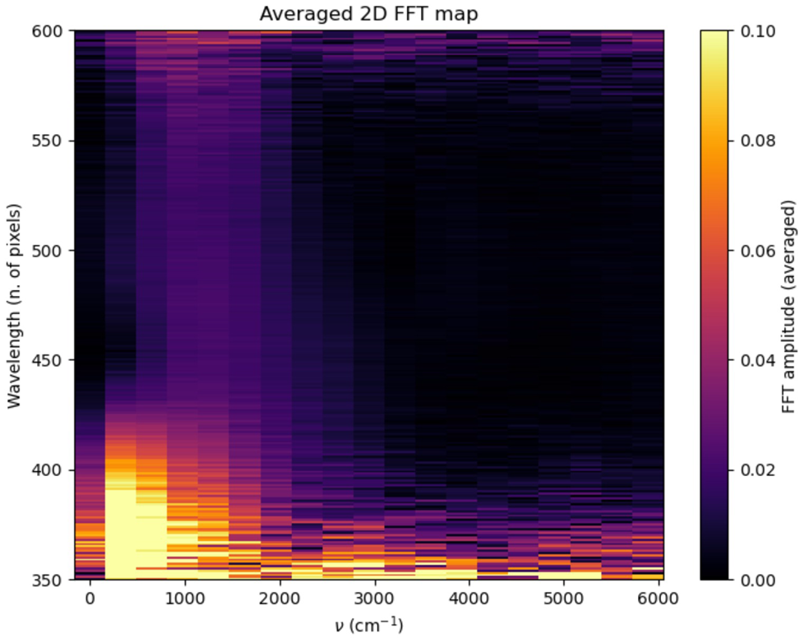
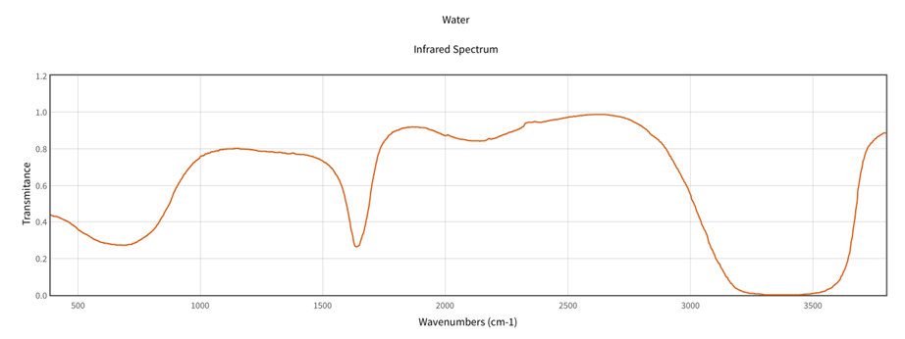
Flow Cell
Results: Water FFT
Reference Spectrum for Water
All data that we plotted is courtesy of FS-ATTO group.

Slide 31

Comparison
Water
[Fe(bpy)₃]²⁺
Flow Cell

Slide 32


Comparison
Water
Iron Bipyridine
Liquid Jet
Flow Cell

Slide 33



Comparison
Water
Iron Bipyridine
Liquid Jet
Flow Cell

Slide 34

Liquid Jet
Results: Water FFT

