Slide 1
Polarisation control of seeded stimulated emission
Student: Haoran Ye (Department of Physics, University of Cambridge)
Supervisor: Andrei Benediktovitch (FS-TUXS, DESY)
DESY Hamburg, 09/11/2025
Notes:
thank

Slide 2
Overview
Background and motivation
Polarisation modelling
  XPR response and seed polarisation
  Polarisation of seeded stimulated emission (SSE)
  Fluctuations in single-pulse polarisation
Conclusion and future work

Slide 3
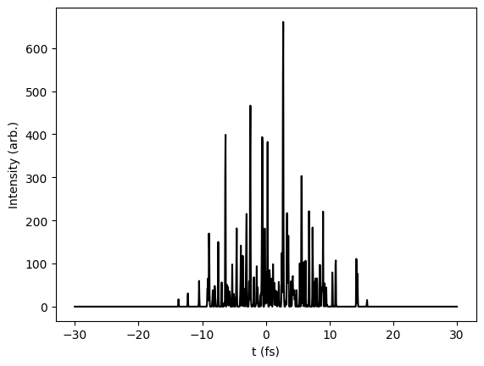
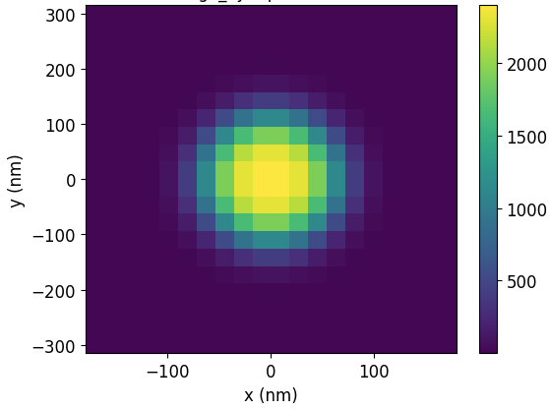
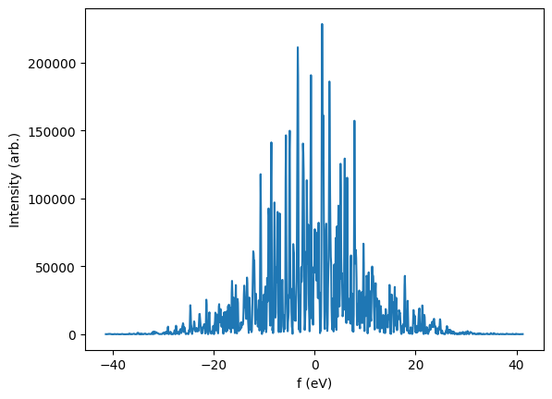
Self-amplified spontaneous emission (SASE)
XFEL pulses generated by the SASE mechanism
Modelled as a complex field Ω(t, x, y, z) with z being the propagation axis (considered to be separable)
Random spikes in amplitude and phase across time and frequency domains
Roughly Gaussian in the transverse directions
Fig 1: SASE profile (simulated with XLO_sim)

Slide 4
Background and motivation

Slide 5
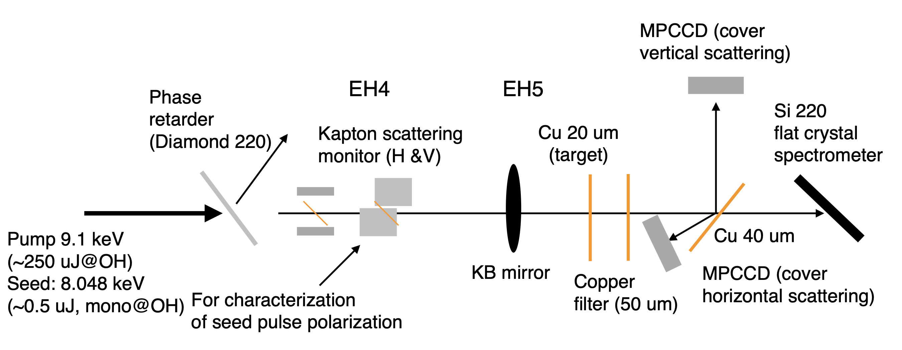
Seeded stimulated emission (SSE) and polarisation
It is of interest to amplify SASE with controlled polarisation for studying structure of matter
Pump → generates population inversion in Cu sample; seed → amplified (stochastically)
Fig 2: Polarisation measurement setup at SACLA (Ichiro et al)

Slide 6
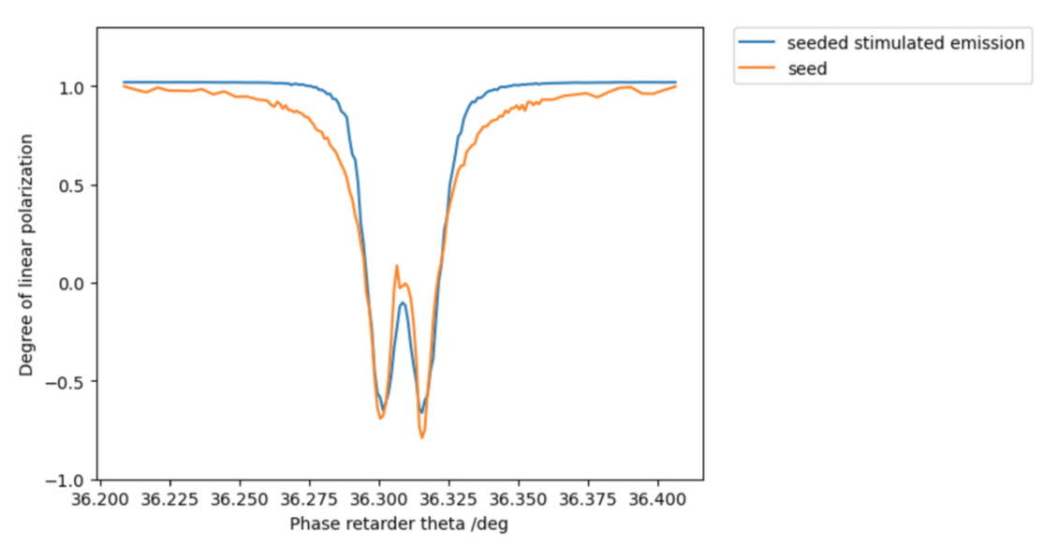
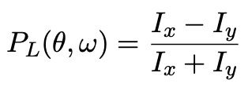
Experimental polarisation measurements
Degree of linear polarisation (x-pol: +1, y-pol: -1, circular-pol: 0):
Experiment: SSE polarisation controllable on average by tuning phase retarder angle θ
Project goals:
  Derive and reproduce the measured DoLP of seed and SSE
  Assessing the pulse-by-pulse fluctuations in circular polarisation
Fig 3: Polarisation of seed and SSE at pump energy of 30 μJ (Ichiro et al), averaged over pulses

Slide 7
Modelling approach for SSE
Propagation in Cu:
stochastic Maxwell-Bloch (MB) equations
Pump pulse
SASE generator
Emitted field
(Polarised and monochromated) seed pulse
(Polarised) seed pulse
Propagation in XPR
Fig 4: Schematics of SSE modelling

Slide 8
XPR response and seed polarisation

Slide 9
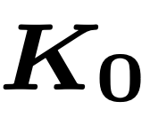





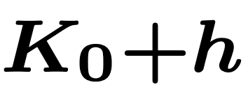

XPR (diamond crystal) transmissivity
Incident wave
Reflection region:
(220) planes
Dynamical theory (2-wave approximation):
Diffracted wave
Transmitted wave
Maxwell equations:
Fig 5: Laue geometry diffraction for (220) planes in XPR
Maxwell equations:

Slide 10
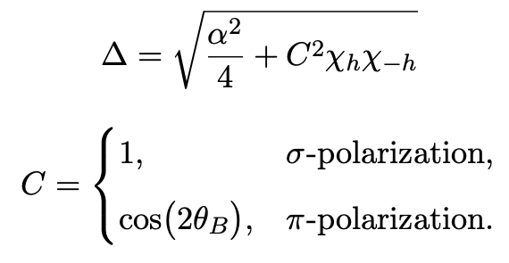
XPR (diamond crystal) transmissivity
Incident wave
Transmissivity for both polarisations:
(220) planes
Diffracted wave
Transmitted wave
Fig 5: Laue geometry diffraction for (220) planes in XPR
Birefringence is caused by phase difference between σ and π components

Slide 11
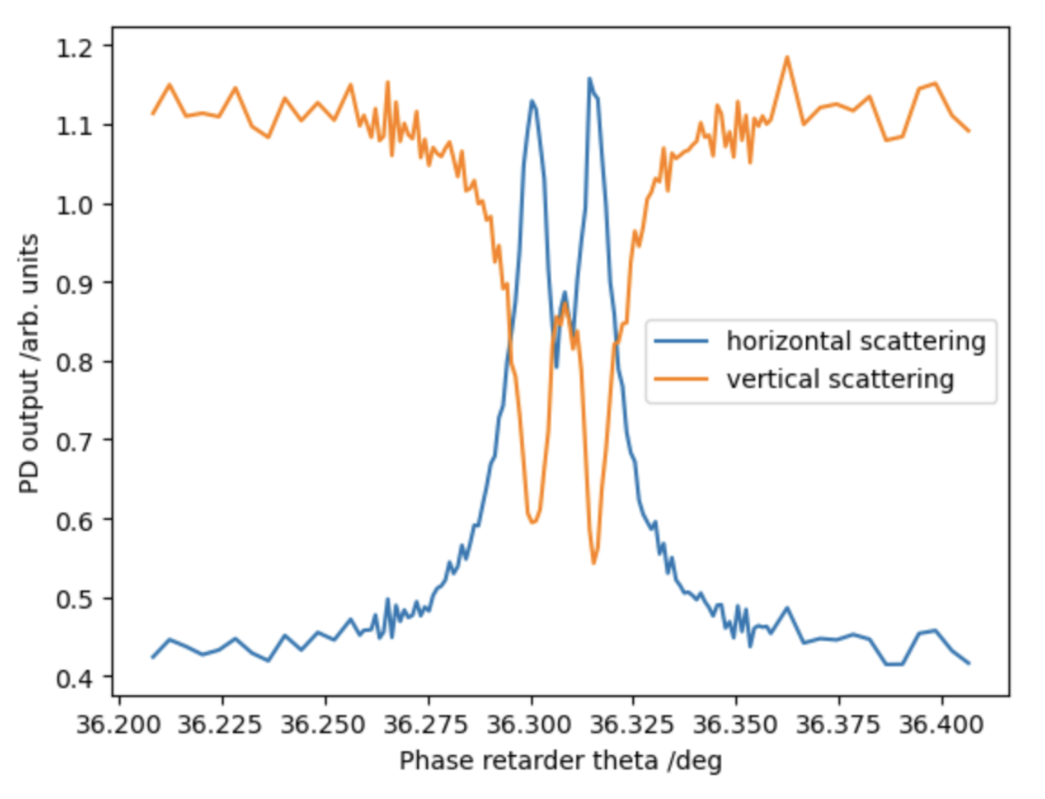
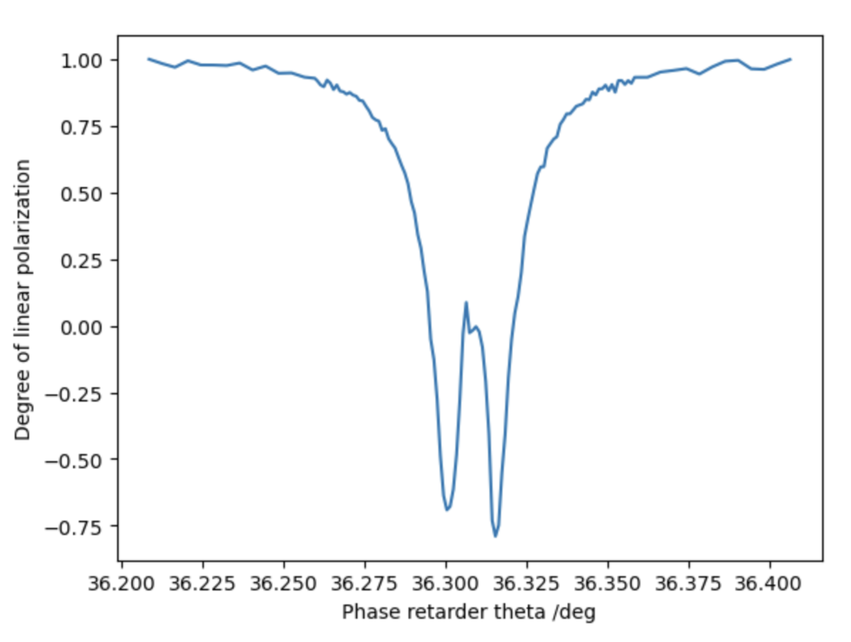
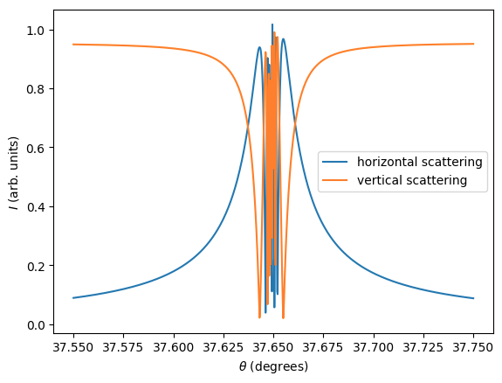
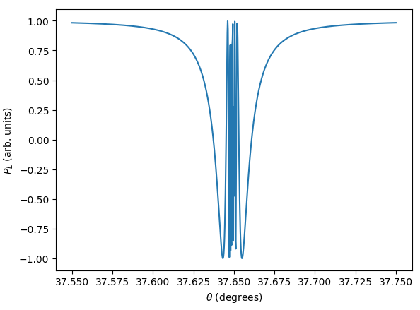
Seed polarisation as a function of θ
SACLA experiment
Monochromatic
Fig 6.1: Experiment vs simulations seed DoLP

Slide 12
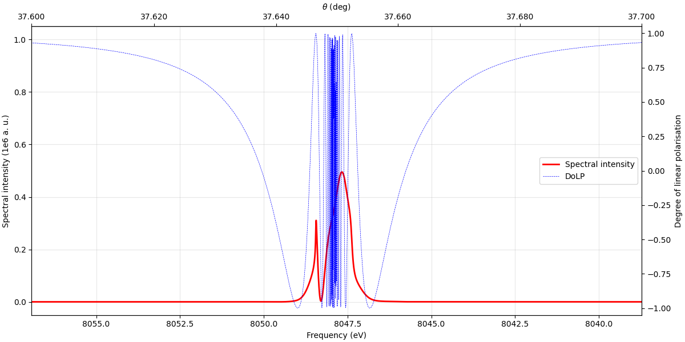
Seed polarisation and spectrum agasint deviation from Bragg
Expect unstable behaviour near Bragg
Fig 7: Typical seed spectrum and rocking curve against deviation from Bragg condition (frequency or angle)

Slide 13
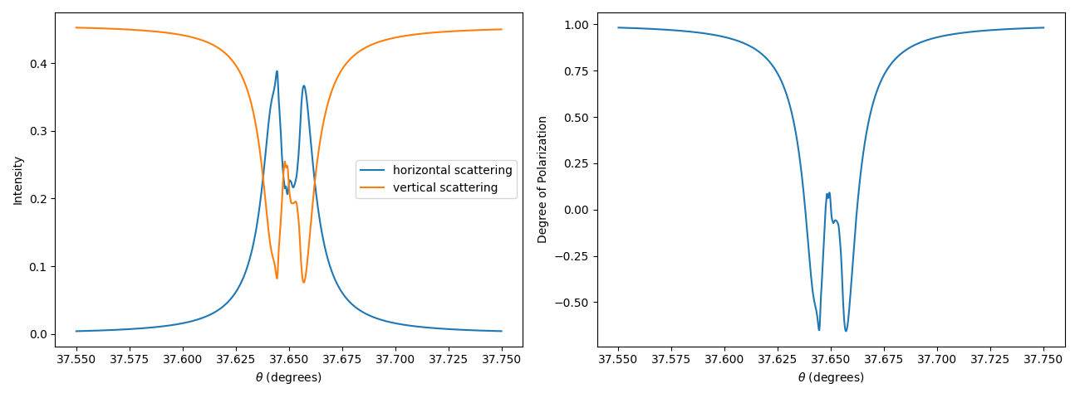
Seed polarisation as a function of θ
SACLA experiment
Overall good agreement in seed polarisation
Simulations
(single pulse)
Fig 6.2: Experiment vs simulations seed DoLP

Slide 14
Polarisation of seeded emission

Slide 15
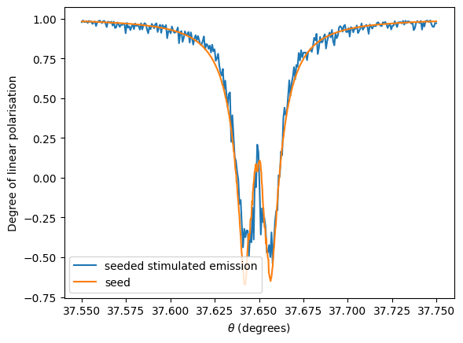
SSE polarisation – comparison with experiments
Experiment
(average over pulses)
Simulations
(average over 5 pulses)
Fig 8: Polarisation of seed and SSE
Change in polarisation is not prominent. Why?

Slide 16
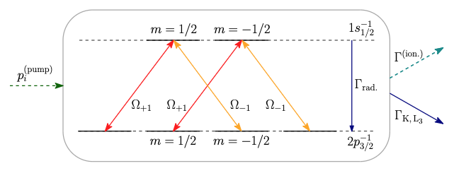
Key equations of SSE (details in appendix)
Fig 9: Cu atomic levels involved in ASE (Chuchurka et al, 2024)
Atomic equations: evolution of the density matrix ρ_{ij} (population and coherences) in x, y, z and t
Emitted field equations: evolution of the emitted field

Slide 17
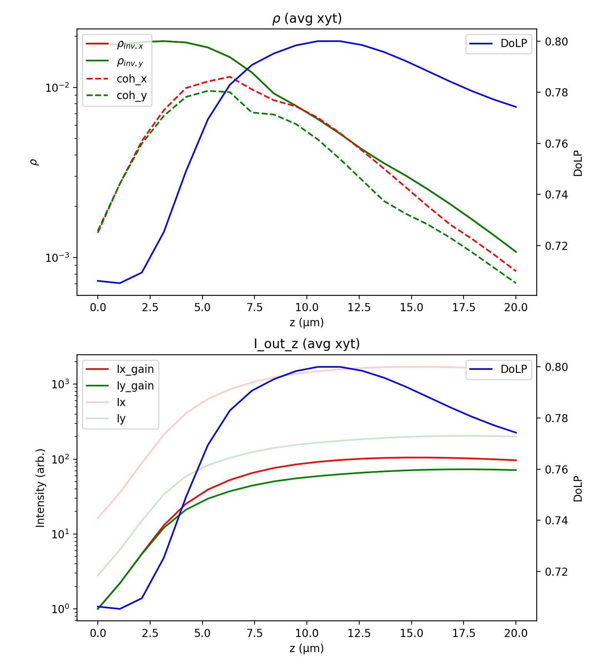
Different regimes in the medium (e.g. θ = 37.675°)
Saturation regime
  Coherences comparable to populations
  Field saturates
  Non-linear effects kick in, changing polarisation
Linear regime
  Small coherences
  Exponential amplification
  No favoured polarisation axis
Fig 10: Evolution of field intensities, population and coherences and polarisation in medium

Slide 18
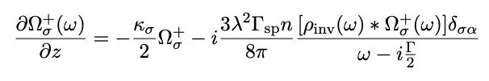
Examining the linear regime
Linear amplification regime
  Population ρ_{ii} as given functions of time, constant in z (coherences are small)
  Seeded emission dominates over spontaneous emission (stochastic terms are small)
  Incoherent pumping, magnetic levels populated equally
Evolution of SSE in the linear regime
No birefringence in this regime (+1 and -1 polarisations evolve independently)
Birefringence (change in polarisation) due to non-linear effects in the saturation regime

Slide 19
Fluctuations of single-pulse polarisation

Slide 20
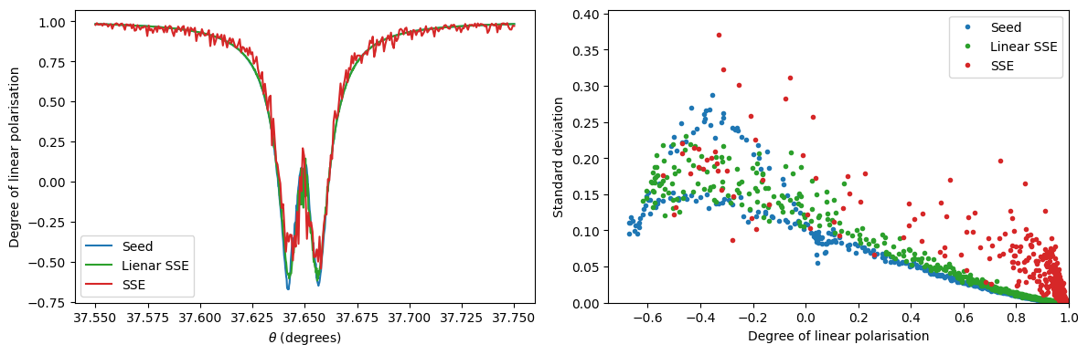
Different regimes in the medium (e.g. θ = 37.675°)
Fig 11: Comparison of fluctuations in polarisation
Polarisation of SSE indeed follows seed in the linear regime
Greater fluctuation in the polarisation in SSE compared to seed due to stochastic processes
x-pol is stable, circular-pol is less stable (How good do we need for experiment?)

Slide 21
Conclusions

Slide 22
Future work
Correctly reproduced seed polarisation
Implemented polarisation into existing simulations of SSE
Demonstrated from first principles the control of polarisation of SSE
Non-linear behaviour causes change in polarisation state through the medium

Slide 23
Future work

Slide 24
Future work
Investigate non-linear effects analytically and numerically (e.g. by solving for populations and coherences iteratively)
Investigating the effect of noise compared to seeded emission
Explore more parameters in the simulation (e.g. finer grids)

Slide 25
References
Authier, A. Dynamical Theory of X-ray Diffraction. IUCr Monographs on Crystallography, Vol. 11. Oxford University Press, 2004. ISBN 0198528922.
Hirano, K.; Ishikawa, T.; Kikuta, S. “Perfect crystal X-ray phase retarders.” Nuclear Instruments and Methods in Physics Research Section A 336 (1993): 343–353.
Suzuki, M.; Inubushi, Y.; Yabashi, M.; Ishikawa, T. “Polarization control of an X-ray free-electron laser with a diamond phase retarder.” Journal of Synchrotron Radiation 21 (2014): 466–472.
Kubota, Y.; Suzuki, M.; Katayama, T.; Yamamoto, K.; Tono, K.; Inubushi, Y.; Seki, T.; Takanashi, K.; Wadati, H.; Yabashi, M. “Polarization control with an X-ray phase retarder for high-time-resolution pump–probe experiments at SACLA.” Journal of Synchrotron Radiation 26 (2019): 1139–1143.
Chuchurka, S.; Benediktovitch, A.; Krušič, Š.; Halavanau, A.; Rohringer, N. “Stochastic modeling of x-ray superfluorescence.” Physical Review A 109 (2024): 033725.

Slide 26
Supplementary information

Slide 27
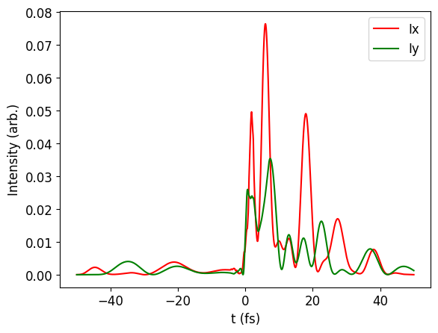
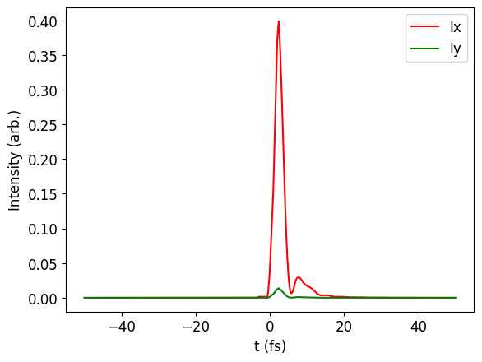
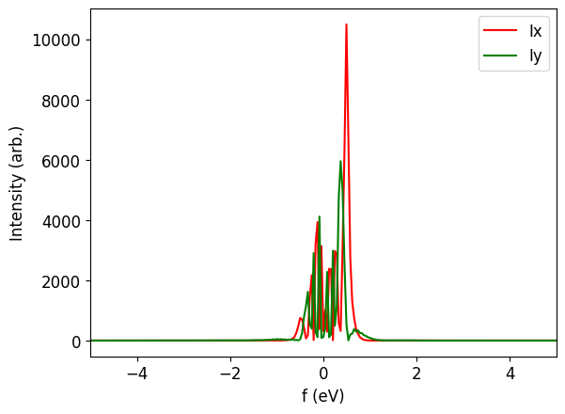
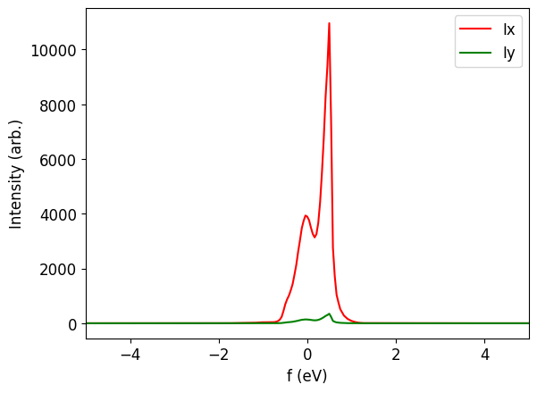
Typical seed pulse profiles with different θ angles
Transmitted at Bragg angle
Transmitted far from Bragg angle
SASE
Fig X1: typical pulses

Slide 28
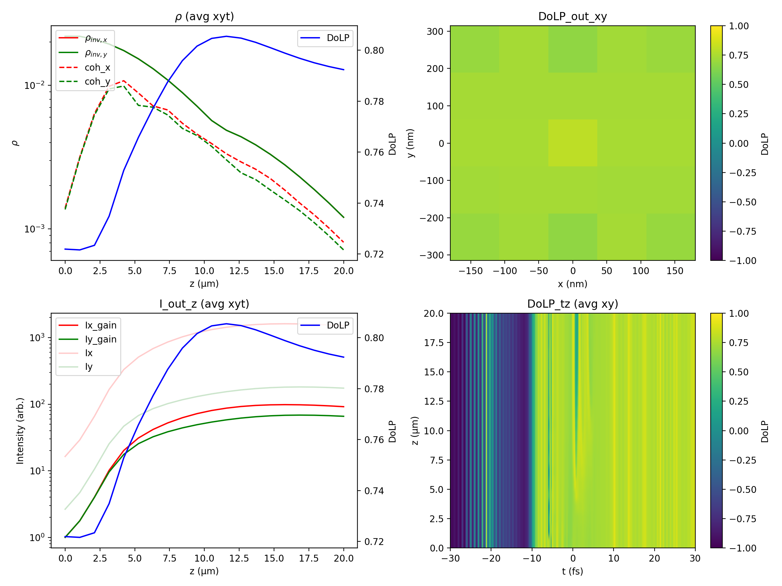
SSE profile far from Bragg (θ = 37.675°)
Fig X2: SSE plots far from Bragg

Slide 29
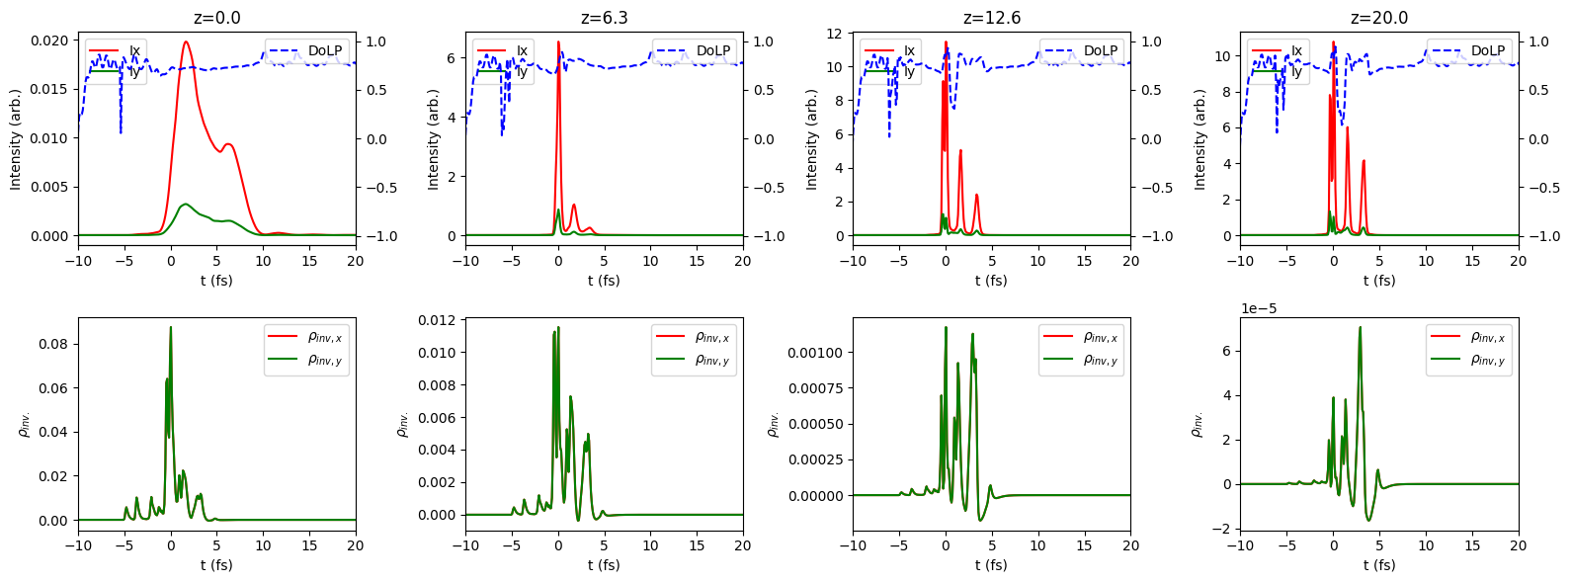
SSE profile far from Bragg (θ = 37.675°)
Fig X3: SSE plots at different z slices far from Bragg

Slide 30
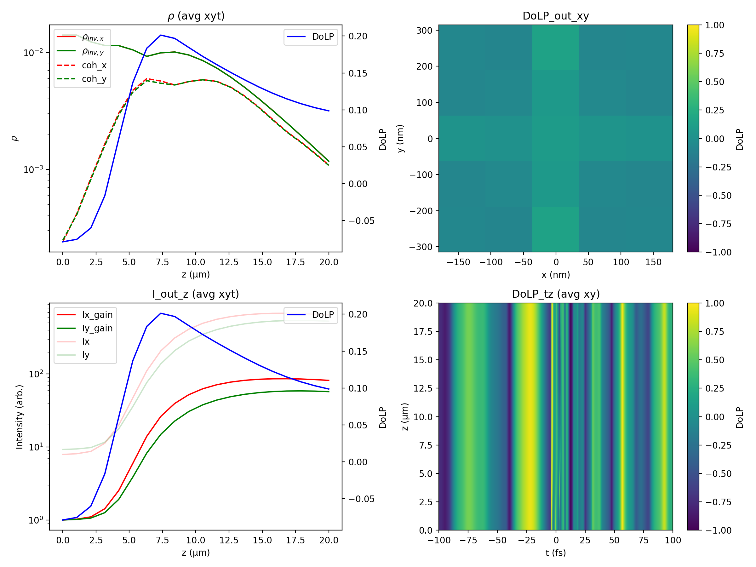
SSE profile near Bragg (θ = 37.649°)
Fig X4: SSE plots near Bragg

Slide 31
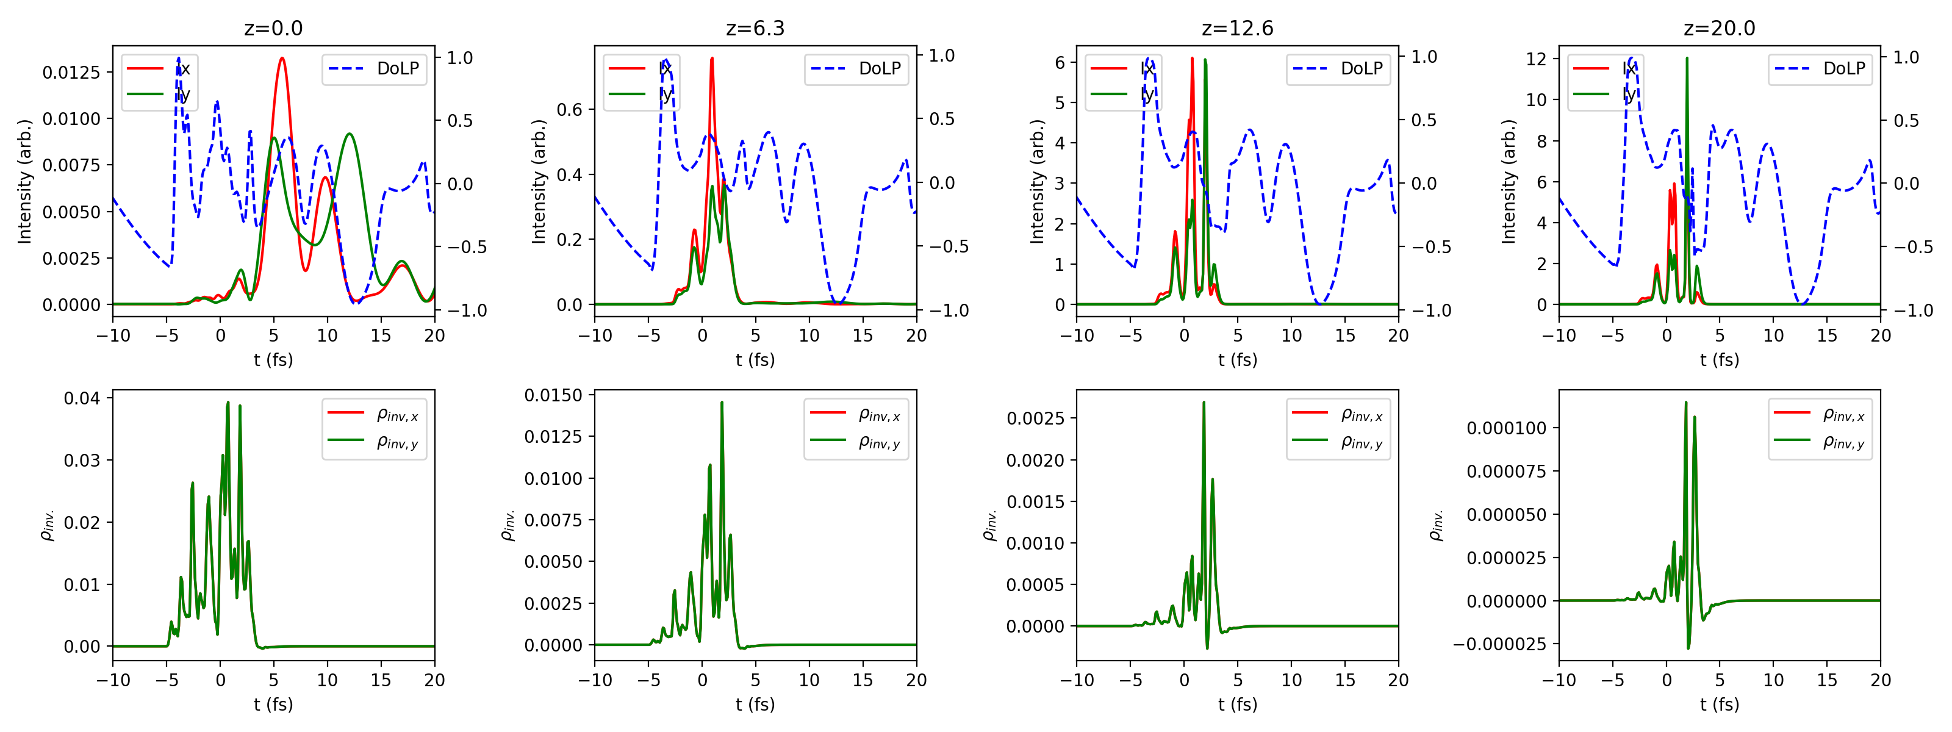
SSE profile near Bragg (θ = 37.649°)
Fig X5: SSE plots at different z slices near Bragg

Slide 32
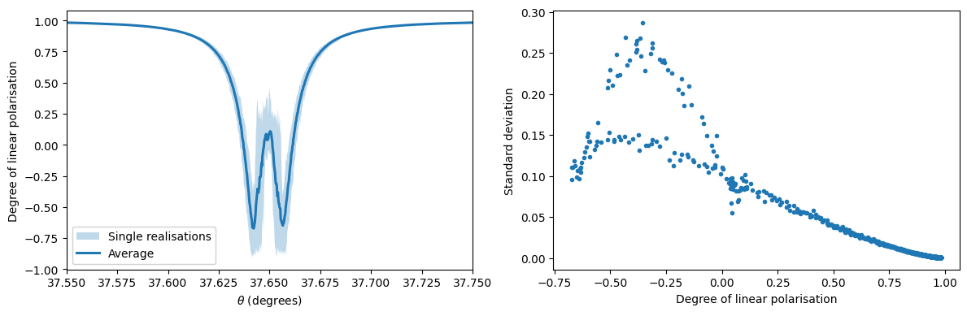
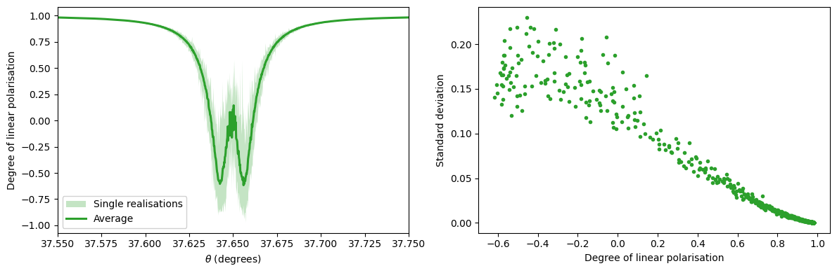
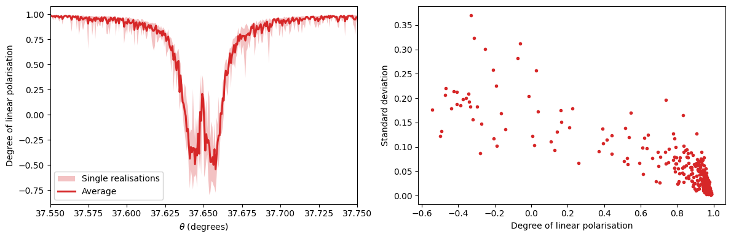
DoLP distributions
Seed
SSE in linear regime
SSE
Fig X6: Comparison of stability of seed, linear SSE and SSE

Slide 33
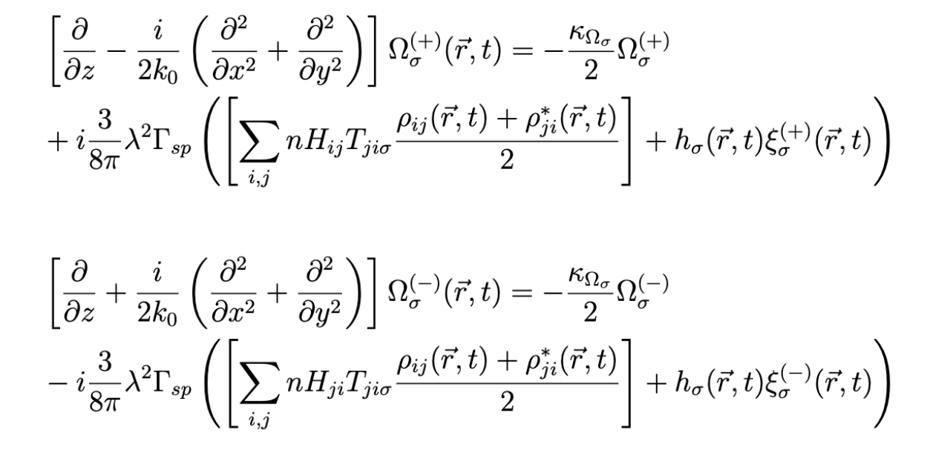
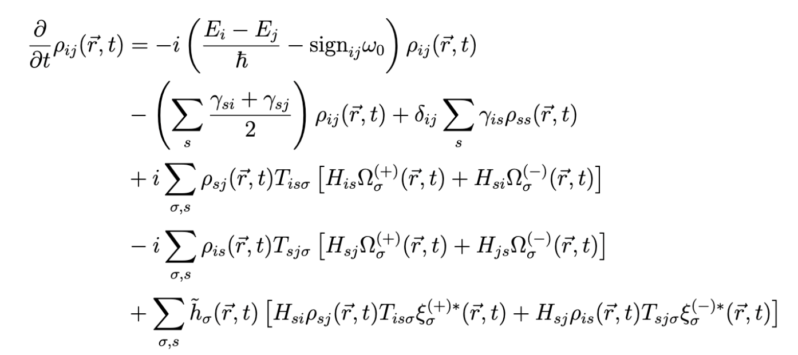

Equations for the SSE
Emitted field equations (initial: seed)
Atomic equations
Pump field equation
Source: XLO_sim documentation

Slide 34
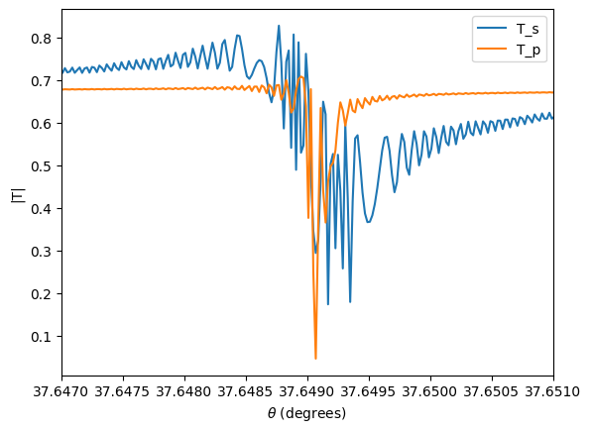
XPR response
Fig X7: XPR response

Slide 35
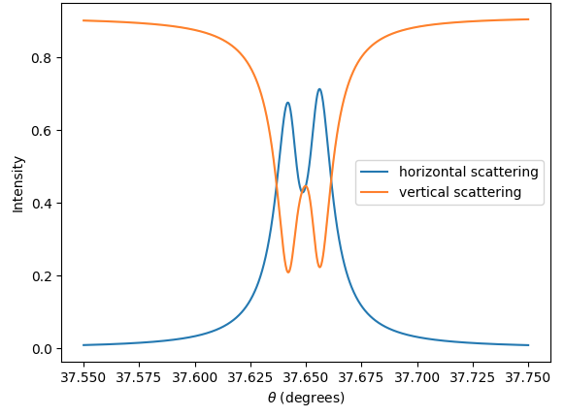
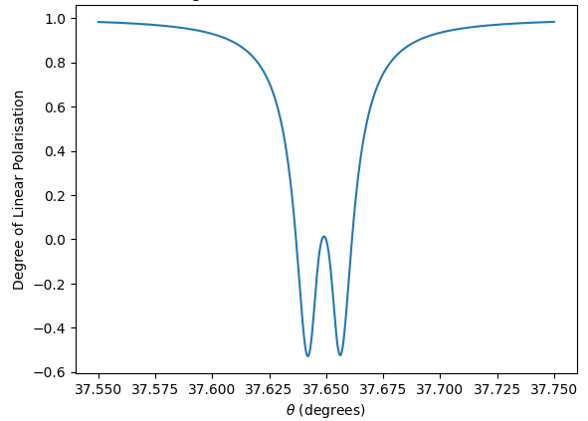
Seed polarisation as a function of θ
Monochromatic
Gaussian
SACLA data
Fig X8: Experiment vs simulations seed DoLP

